Slide 1



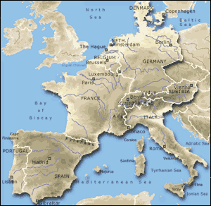
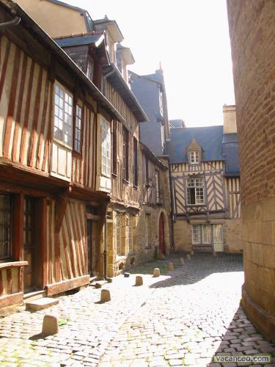
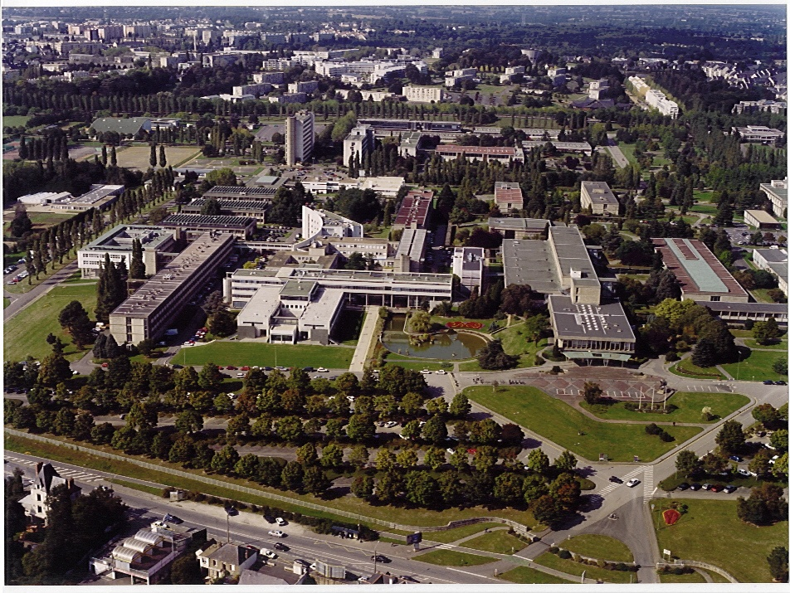
▪ Photonics / 2016 - Berlin ▪
Institute of Physics - Rennes / IPR CNRS 6251 - France
Orator : Bruno BÊCHE, Pr.
Rennes
400 000 inhabitants
60 000 students in formation
Institute of
Physics - Rennes
Notes:
Mr Chairman, Ladies and Gentlemen,
On behalf of my colleagues and myself, I would like to thank you for your kind invitation.
It's my purpose in this brief talk to illustrate the various aspects of an integrated optical on SU-8 (fluorinated or not) polymer for designing of waveguides, S-bends, Y-junctions, and MZI.

Slide 2
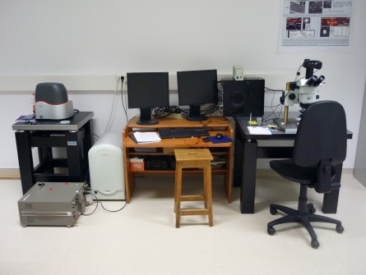
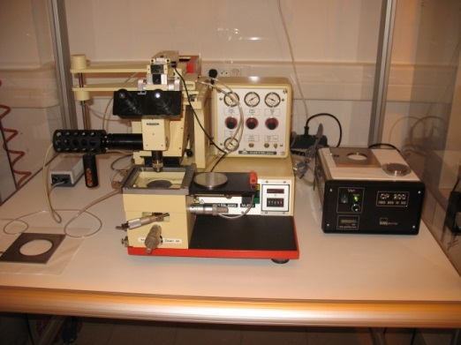
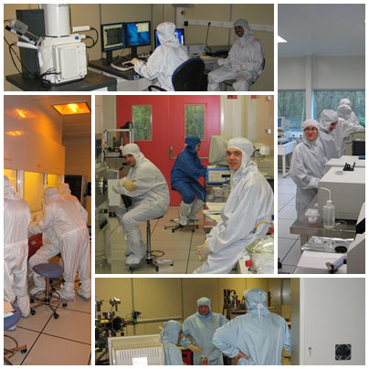
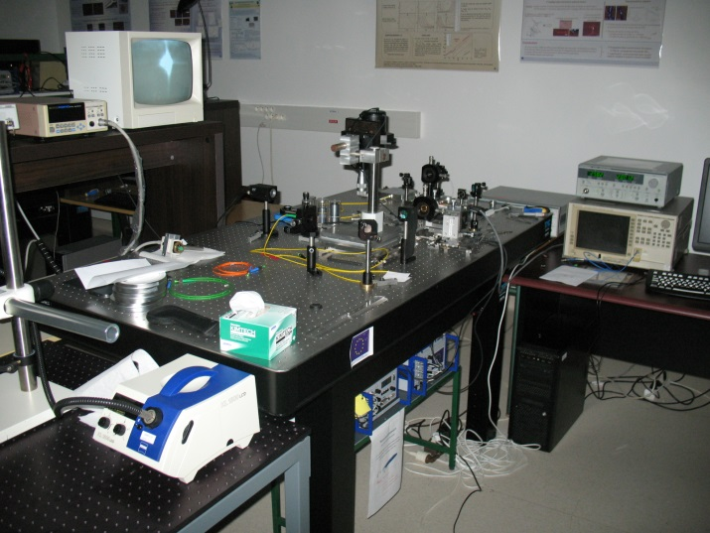
Soft Matter for Integrated Photonics and Resonances: various hybrid approaches and adaptive technologies
➔ Collaboration IPR CNRS, IETR CNRS, STLO INRA
NanoRennes - clean room IETR-CNRS
Optical characterizations

Slide 3
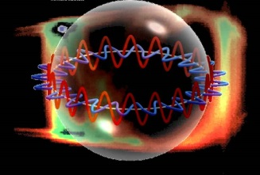
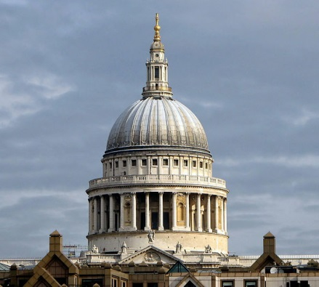
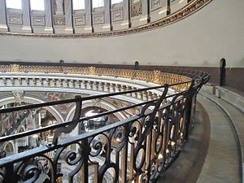
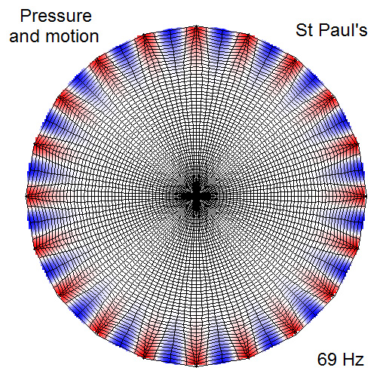

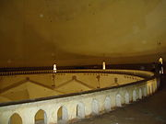
The resonant waves or Whispering Gallery Modes (WGM)
Artist’s view of the phenomenon
▪ At the origin, discover in acoustic (Lord Rayleigh ➔theory in 1910-1914)
▪ Type of waves which can propagate along the concave surface (grazing reflection) + ‘tuning’ if cycle ! Notion of resonance.
St Paul Cathedral - London – United Kingdom
Compression of the air - acoustic
Gol Gumbaz – Bijapur - India

Slide 4
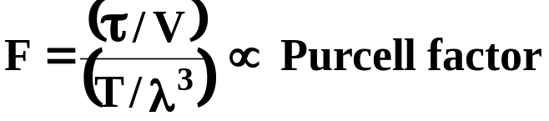
➔ One century later, in nano-sciences and nano-technologies, such concepts are totally transposed to electromagnetic waves in integrated photonics.
▪ Optical micro-resonators (MRs) = seductive objects
- Control of electromagnetic fields in term of spatial localization (or strong confinement of the light into a restrict V-space volume)
- Quantification of the optical modes (called WGM) and increase of their own life time τ into such cavities (Q=ω.τ)
Factor of merit of an optical mode
▪ Applications in QED (discrete modes coupling electromagnetic modes and atomic) ➔ Rabi oscillation and intricated states ; on physical cavities and Laser (spontaneous recombination / stimulate), in optical telecommunications ((de)-multiplexing in wavelength or filters), in sensors (optical probe strongly localized and interactive➔ measurements with shift of the resonance), and so on.
OpticalPerimeter_{MR} = m. λ_{Maxwell}
➔ Notion of photonic’s orbital

Slide 5
Part I
« I. Organic commercial Chemistry for polymer MRs : an example with Deep UV»
▪ I.1] Organic chemistry for sub-λ photonics
▪ Choices and study of organic materials, many products and liquid photoresist exist for the realizations of integrated photonics elements [PMMA, PS233, SU8, NOA stick, Kapton, and DUV210…]
Various integrated structures and functions-principles, wave-guiding, interference, resonant…

Slide 6
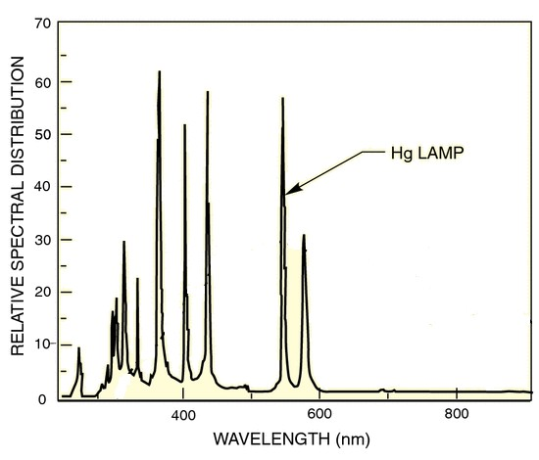
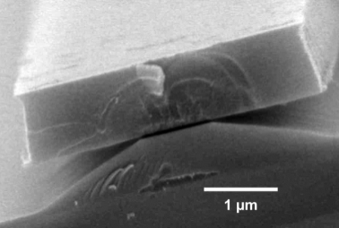
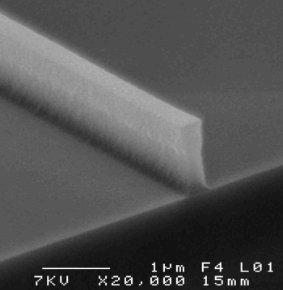
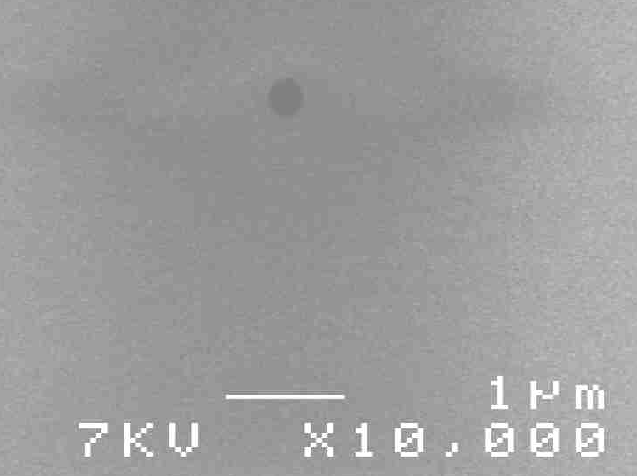
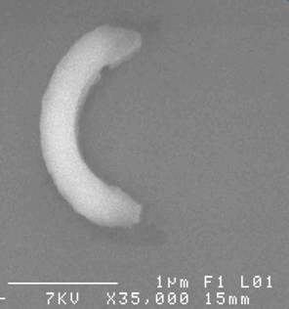
▪ Photolithography: limited by diffraction
365 nm
DUV
248nm
▪ Usual lithography: insolation
at λ = 365 nm
▪ Limit of resolution < 1 µm
Lampe Hg
▪ Deep UV lithography (DUV):
▪ Insolation at λ = 248 nm
                ➔ Organic material (ex): UV 210 (positive photoresist)
▪ High resolution: 200 nm
▪ Judicious optical properties
n=1.565 + lower optical losses (3 dB.cm⁻¹ at λ = 980nm)
➔ Possibility to develop sub-λ patterns for nanotechnology and photonics
Width of waveguide 300nm
sub-λ nano-hole

Slide 7
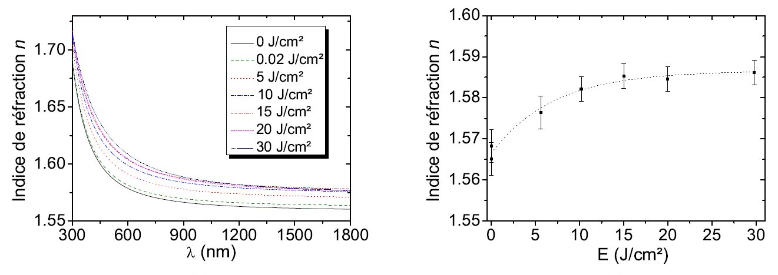
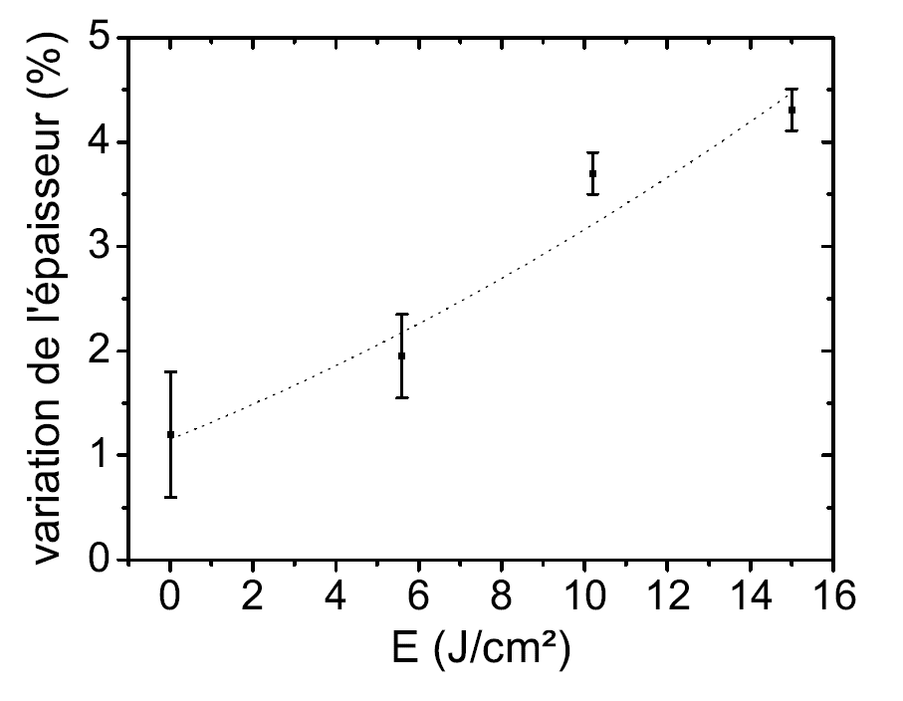
▪ The UV210 organic material
▪ Ellipsometric measurement & dispersion curves of UV210 (extinction k <10⁻³)
Refraction index n
Refraction index n
at λ=980 nm
➔ Indices enough high for core waveguide applications on lower cladding
➔ Insolation dose increases ➔ saturation of the value of index + diminution of film thickness, density increases (Gladstone empiric law)
Thickness variation (%)

Slide 8
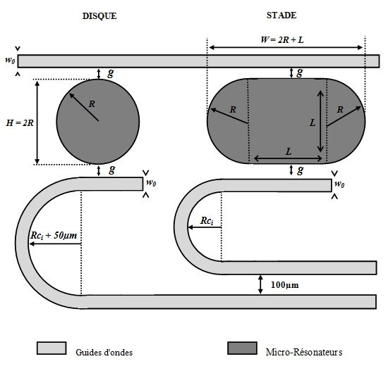
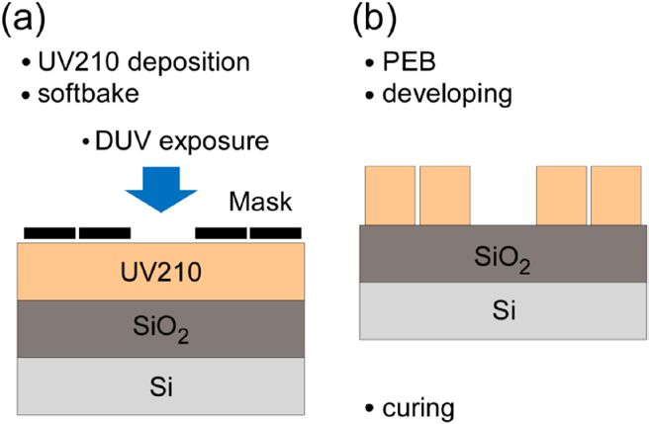
▪ Realization of optical MRs families in UV210 with sub-λ gap
▪ Conception of quartz/chrome mask
Families of resonant probes :
Stadium, disk
Dimensions of cavities:
Radius R = 25 µm et 50 µm
Gap g: 200 nm à 500 nm
Guides : width 5 µm
Injection
Détection
Détection

Slide 9
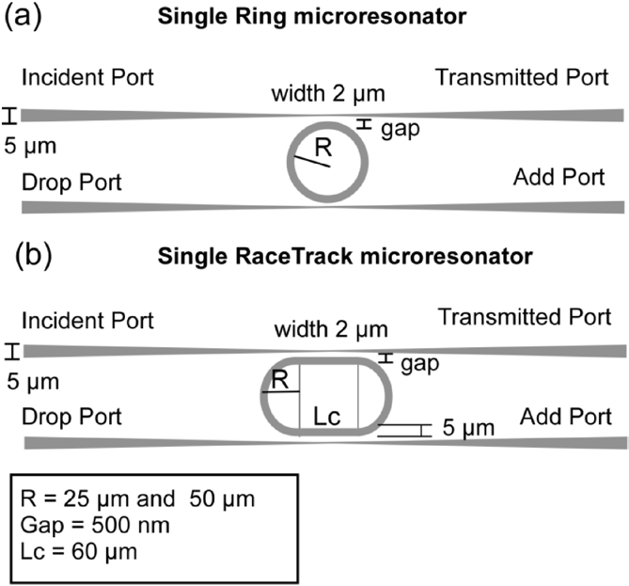
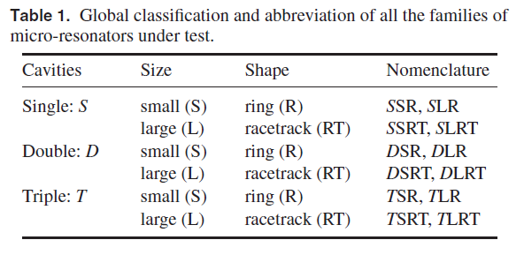

Slide 10
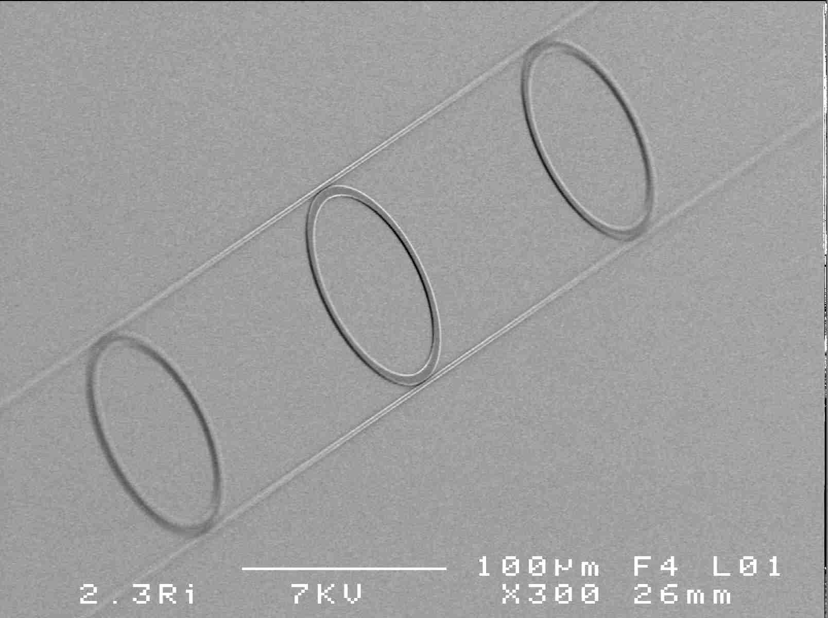
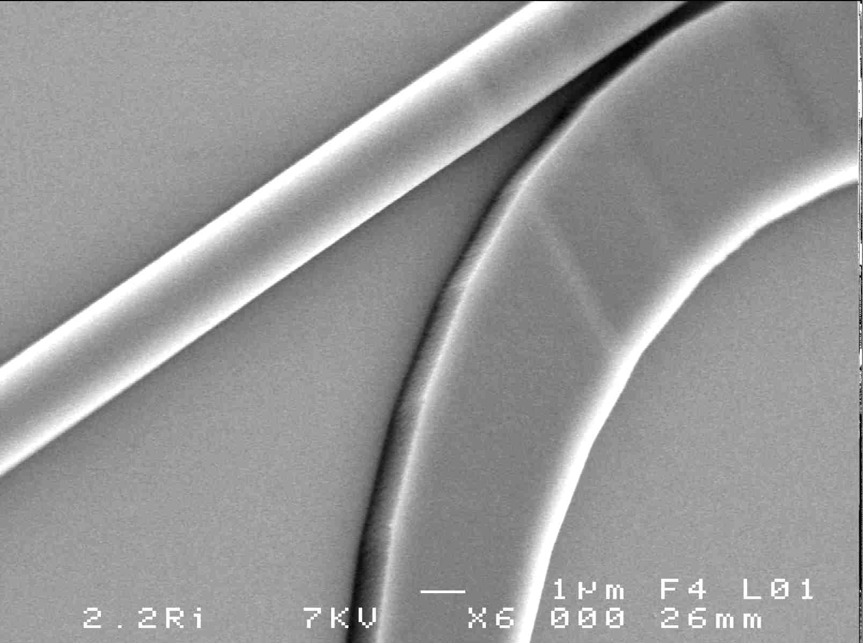
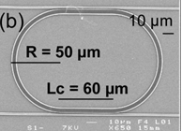
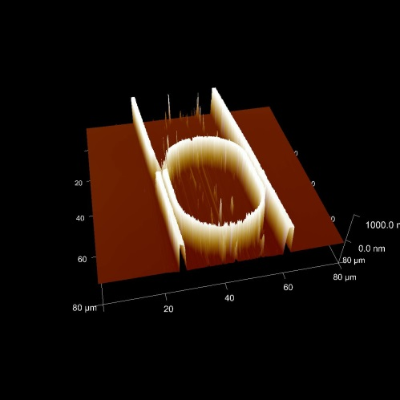
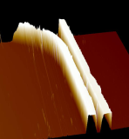
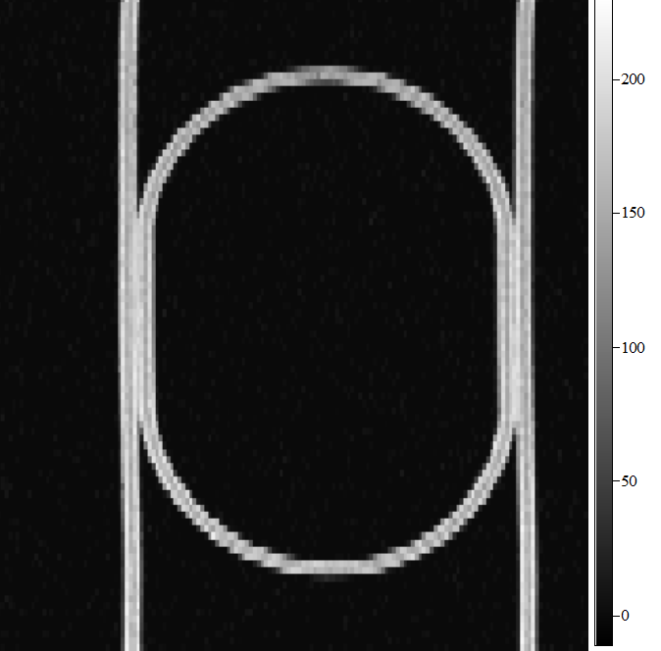
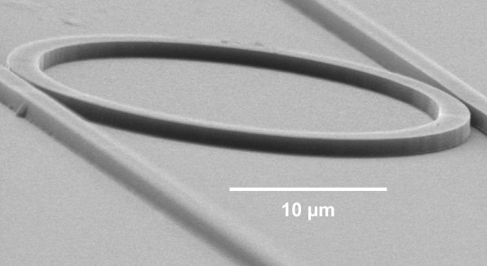
▪ SEM - AFM - Raman Analyses
Serial /cascade of MRs (gap=500 nm)
Racetrack (gap=500 nm)
Pedestal ring
(gap=500 nm)
AFM
Raman imaging
g
h
2R
@1002cm⁻¹
➔ Roughness surface : 2 nm

Slide 11
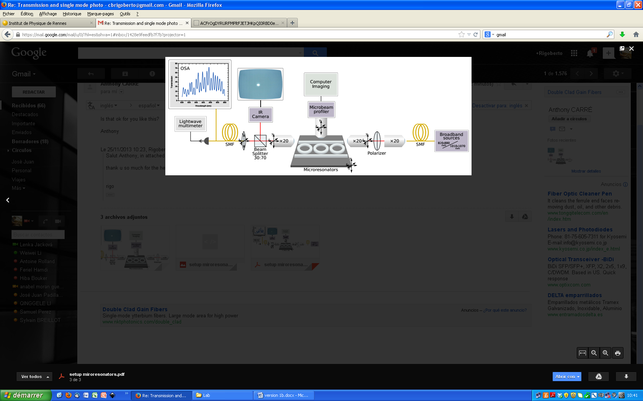
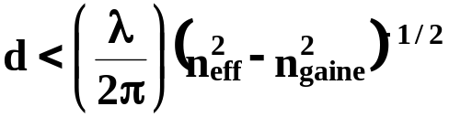
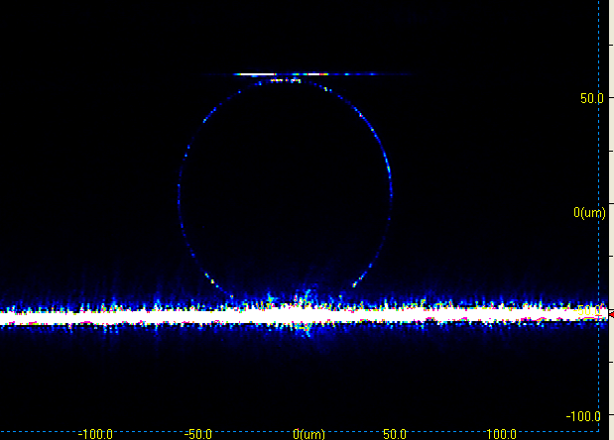
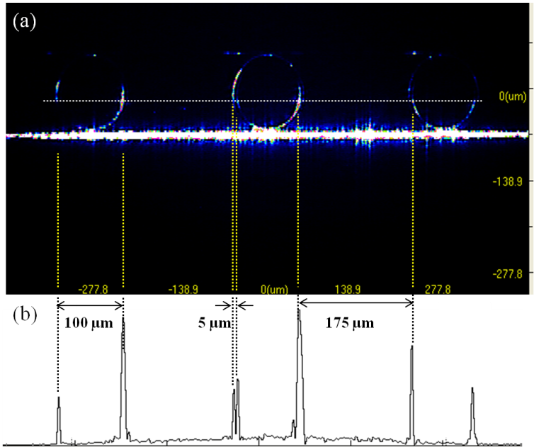
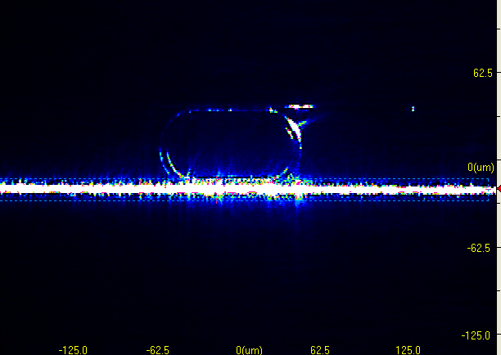
▪ Optical characterizations, experiences

Slide 12
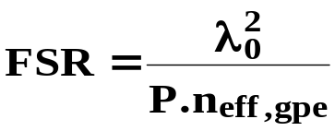
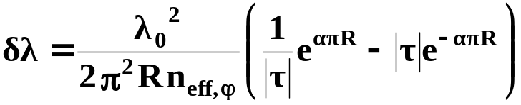
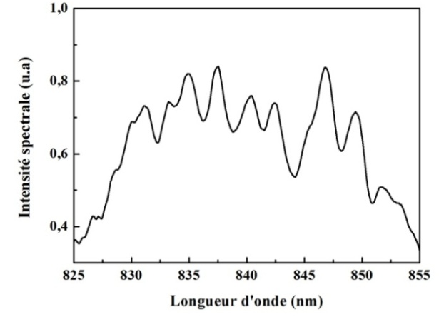
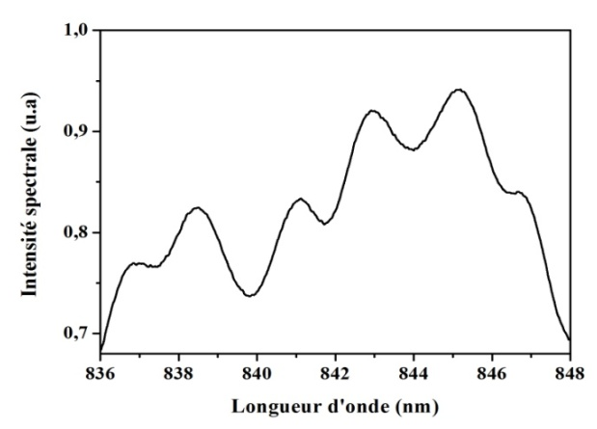
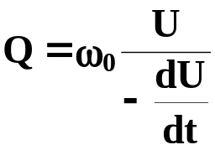
▪ Spectral transmissions - FSR (Δλ)
Disk cavity : R = 25 µm Stadium cavity
Spectral principle resonance :
Δλ, FSR
Δλ, FSR
Wavelength (nm)
Wavelength (nm)
Structures | Disk |  | Stadium
Parameter R | 25µm | 50µm | 25µm | 50µm
FSR theo. (nm) | 2.92 | 1.46 | 1.78 | 0.89
FSRexp. (nm) | 2.70 | 1.45 | 1.95 | /
Quality factorQ | 700 | 950 | 700

Slide 13
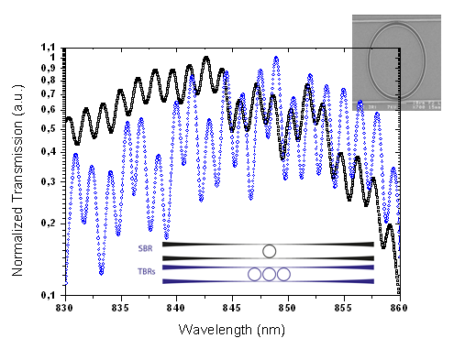
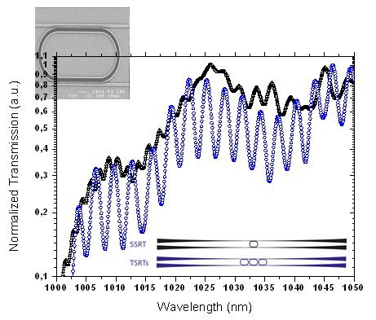
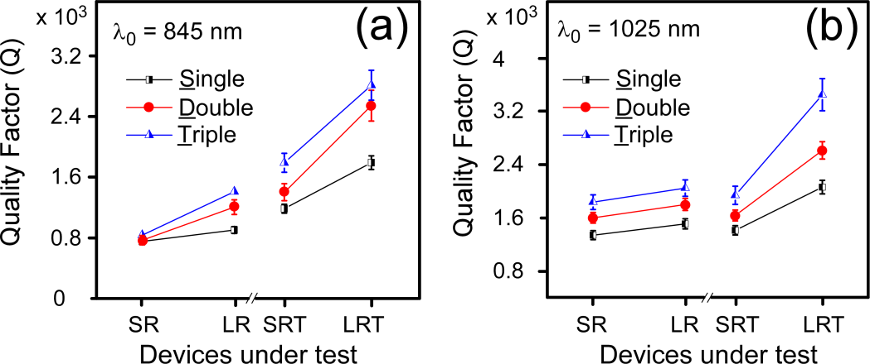
1.0
Fourier
0.8
FFT
0.6
0.4
0.2
0.5
1.0
1.5
2.0
2.5
FSR (nm)
Quality factor Q >3000 at λ_{IR}

Slide 14
Part II
« II. Plasmas processes for organic MRs »
▪ II.1] Fluorinated organic by plasma process : optical losses decrease

Slide 15
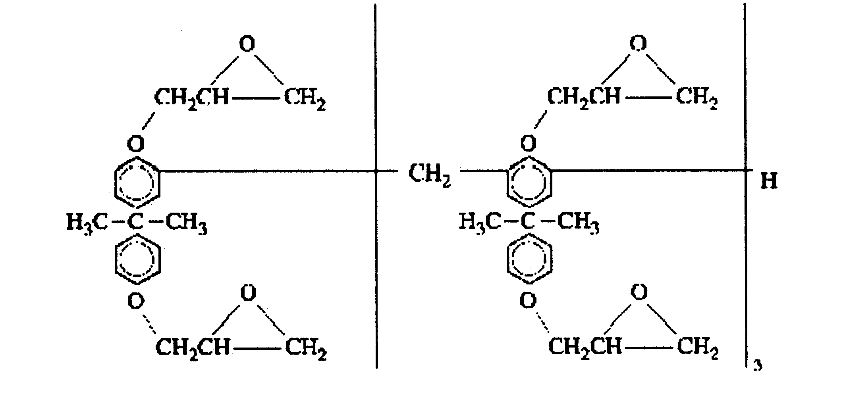
▪ Elaborations of plasmas processes - fabrication
Optical, fluidic circuits
Biphenol A ether glycidyl (SU8)
(100) Si substrate
Thermal oxidation PECVD
SiO₂
Spin-Coating, PECVD, Plasmas (O₂, Ar, CF₄)
SU-8 (or PMMA)
(100) Si substrate
SOG, NOA, PS233
(100) Si substrate
[lower pressure]
Reactor
[13.56 MHz]
Electrode
Precursors entrance
+
Mask / Lithography (D)UV / Development / Baking + Plasmas treatments : Etching and functionalization
ˉ
ion/molecules
reactions
+
ˉ
diffusion
Optical emission
recombination
+
Molecular/radicals reaction
NOA, SOG, PS233
Surface reaction
Products
exit
(100) Si substrate
Electrode

Slide 16
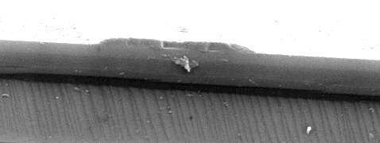
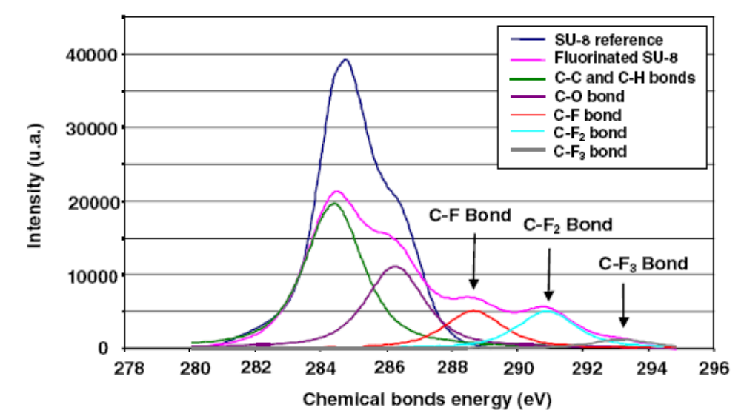
▪ Plasma treatments with CF₄ for optical losses decrease into organic waveguides
4 µm
Rib guide
SU8
Analysis of the SU-8 reference polymer and the fluorinated SU8 polymer
SiO₂
Si substrate

Slide 17
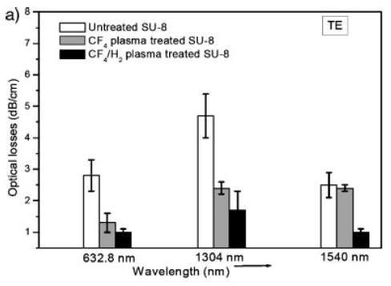
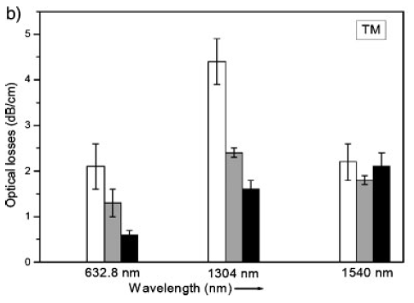
➔ Fluorinated XPS peaks = C-H substitution ; successful C-F_{X} functionalization
Plasma CF₄ :
t=30s, P_{RF}=50W, D=30sccm
Plasma CF₄ + 10% H₂ :
t=110s, P_{RF}=20W, D=30sccm
Avoid ‘RIE’ during plasma
Optical propagation losses : decrease of 50 to 70 %

Slide 18
▪ II.2] Plasmas to shape 2,5D MRs
▪ Schematic diagram of elementary 2.5D MR (disk or ring))
λ_{i}
Upper view
Cut
x₃
W_{a}
x₃
x₂
h_{a}
x₁
R
h_{r}
d
λ₁, λ₂, … λ_{i} … λ_{n}
x₂
λ₁, λ₂, ... λ_{i-1} λ_{i+1}, ... λ_{n}
W_{r}
x₁
▪ Problems and conceptions :
➔ Polymers no always compatible to shape 2,5D structures (good adherence of each layer, and ability to develop successively each pattern).
➔ Idea : Development et use of lithographic process combined to plasma [SOG/PS233/SU8, plasmas O₂ and Ar].

Slide 19


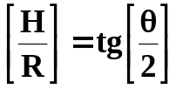

▪ Plasma treatment (O₂ and Ar) and principle of measurements (θ, γ)
▪ Surface energy measurement (superficial tensions, J.m⁻²) :
- Dispersive contribution γ^{d-(LW)} (London Van der Waals forces)
- Non-dispersive contribution (or polar) γ^{nd} (Keesom interactions, Debye forces, H / H₂O atomic attraction, Acid-Base interactions]
γ^{T-(total)}
vapor
γ_{LV} γ_{L}
2^{d} Newton law or PFD (F=γL)
➔ Young eq. at three interfaces
H
liquid
θ
Contact point (S-L-V)
measurement
R
γ_{SL}
γ_{SV} γ_{S}
SOG or PS233
Van Oss Model (or Acid-Base)
Reference liquid | γ^{T-(totale)} | γ^{d-(LW)} | γ ^{nd(+)} | γ ^{nd(-)}
Water | 72.8 | 21.8 | 25.5 | 25.5
Glycerol | 63.3 | 34.0 | 3.92 | 57.4
Diiodomethane | 50.8 | 50.8 | 0.0 | 0.0
(Unity: mJ.m⁻²)

Slide 20




▪ Results:
θ=117° (hydrophobe surface )
[θ_{water}]
30s<t_{O2}<60s
30s<t_{Ar}<180s
[γ_{S}/O₂]
maximum

Slide 21




[γ_{S}/Ar]
plateau
➔ The overall determination of the γ_{S} of each solids (materials) fixe the adhesion work at the interface between the core waveguide SU8 and the cladding PS233 or SOG
[W_{SU8/PS233}]
[W_{SU8/SOG}]

Slide 22





▪ 2,5D Micro-resonators on organic materials
TE₀₀ whispering gallery mono-mode (at λ=670 nm)

Slide 23
Part III
« III. Soft matter in complex fluid and biomolecular interface for MRs»

Slide 24






▪ III.1] Biomolecular lipid gap or Langmuir film
Hydrophobic
Hydrophilic
Tension-meter
Pinch (‘dipper’)
Collapse threshold
solid
Sample
liquid
Movable barrier
Superficial tension (nN/m)
Tank
Expended liquid
gas
Average molecular surface(Å²/molécule)
air
Lipids
water
4 nm

Slide 25


▪ III.2] Design of organic 3D MRs with micro-fluidics coupled to thin-film processes for photonics applications
Pharmacology and medicines

Slide 26



▪ Technology and concepts of micro-fluidic: realization of 3D MRs
Q_{d}
D_{d}
D_{p}
▪Micro-channels realization by thin layer processes (SU8, PDMS, glass and plasma cleaner).
▪ Generation of mono-disperses droplets ( T-flow focusing junction)
-‘T’-structure +restriction area : NOA pinching.
-NOA = dispersed phase (Q_{dp}, µL/h)
-Silicon oil = continuous phase (Q_{cp}, a few 100 µL/h)
➔ 30µm<R_{spheres}<200µm.

Slide 27


▪ Simple model in two times t, the rate Q_{p,d} fixe the sizes of droplets:
(t_{droplet-formation} = t_{blocking}+t_{pinching} , with V=Q.t, Q=v.S)
Geometry
Rates
μ_{NOA}=200mPa.s, γ_{NOA}=4.3mN/m

Slide 28



▪ A few parameters that determinate the flow regimes…
▪ The viscosity (μ) and the superficial tensions of fluids (γ) act (more the previous geometry) on the dynamic of flow : μ_{dp} high ➔ difficulty to pinch and shape the spheres & privileged jet ; μ_{dp} high ➔ easy to pinch and form the spheres, Minimization E=γ.S impose S of spheres! S_{n-spheres}/S_{jet}=3r_{jet}/2r_{sphere} with L=4n.(r_{sphere})³/3/r_{jet}².
Laplace-Young eq. (local profile)
The shape of the droplet is link to the factor of form (constituted by Bond number=c/b²=function(γ) + profile imaging)
➔ γ measurements
γ=4.3mN/m
➔ Competition between these effects give various flow regimes : capillary number =μ_{p}.v_{d}/γ 1
➔ This value of capillary number allows the existence of these two types of régimes on the ‘T’

Slide 29

▪ Film ‘The formation of 3D MRs droplets’ (500 images/second)

Slide 30




▪ Two kinds of dynamic flow regimes on the T-‘flow-focusing ’
▪ Jetting regime t_{jet-formation}<t_{pinching}, dynamic capillary instability called Rayleigh-Plateau ➔ The energy minimization leads to the formation of droplets after the jet.
▪ Dripping regime t_{pinching}<t_{jet-formation} (pinching enough fast).
▪ Resonance in 3D organic MRs
▪ Use of Raman plate-form (λ=785nm) to highlight the optical resonances (Stokes peak)
End spot ➔ Equatorial
trajectory
FSR
FSR
wire
Excitation localization
50 µm
FSR_{average} (Δλ)= 0.86 nm & 0.88 nm (here D_{sphere}= 143 µm).
Wavelength (nm)
Wavelength (nm)

Slide 31






▪ Coupling and excitation of whispering gallery modes
DIC Nomarski imaging

Slide 32




δλ=1.9nm and Q=450
Intern caustic function (n,l quantic numbers)
a
r₁

Slide 33



▪ AFM analysis and statistic de moments for the origin of the Q-quality factor
Q=λ₀/δλ
experimentaly
AFM & statistic mathematic
h_{RMS} quadric average distance of roughness
L_{C} coherence length (topology sense and surface statistics !)
Origin of the value on Q-factor
85-90% by diffusion losses

Slide 34
Part IV
« IV. The sensors on resonant probes (MRs)…towards the life science »

Slide 35




▪ IV.1] Resonant probe of light for glucose detection
(Typically concentration in sugar into cells are weak ➔ [0-5 mg/ml])
S 280 pm/(mg/ml)
Limit 0,04 mg/ml
ΔC ➔Δn= 10⁻⁵

Slide 36




▪ IV.2] Resonant probes of light to detect and follow the phase-transition in temperature : biology application, lipids (MSM)
a)
b)
Polar head
Apolar queue
Water
Gel phase
Liquid Phase
Liposome
T_{m}
T (°C)

Slide 37




Serial spectral
&
statistic
λ₃
λ₂
λ₄
λ₁
➔ phase-transition (gel=>liquid) of MSM-lipids at T_{m} [31-32]°C

Slide 38



Artist view of the phenomenon…
…towards the reality
▪ IPR-CNRS :
V. Vié, P, Panizza, F. Artzner, A. S^{t} James, and me.
▪ Our ex-PhD et post-doct:
D. Pluchon, R. Castro-Beltran, D. Duval, M. Specht, Q. Li
▪ IETR-CNRS :
H, Lhermite.
▪ STLO-INRA :
D. Dupont.
+ LAUM-CNRS : E. Gaviot
For global references:
➔ See web site IPR http://www.ipr.univ-rennes1.fr/

