Slide 1
Clinical Potential of Stem Cells in Amniotic Fluid
Bruce K. Young, MD
Silverman Professor, Obstetrics and Gynecology
Division of Maternal-Fetal Medicine
Department of Obstetrics and Gynecology
New York University Langone Medical Center

Slide 2
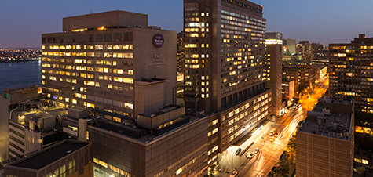
Research Team
Margaret Dziadosz MD
Jessie Chen PhD
Helen Wang PhD
Cara Dolin MD
Michael Chan AB
Maryann Perle PhD
Ross S Basch MD
Bruce K Young MD

Slide 3
What are stem cells?
They are cells:
with the ability to self renew. When they divide “stemness” is retained by a portion of the population.
with the ability to differentiate into several lineages providing a reservoir capable of replenishing specialized cell types.
whose progeny have sufficient proliferative potential to renew and maintain the tissues they populate.

Slide 4
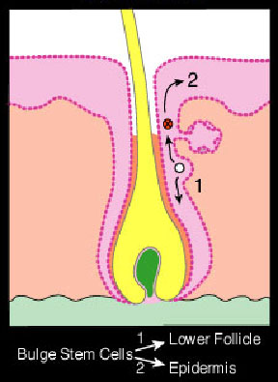
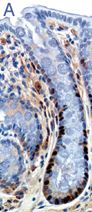
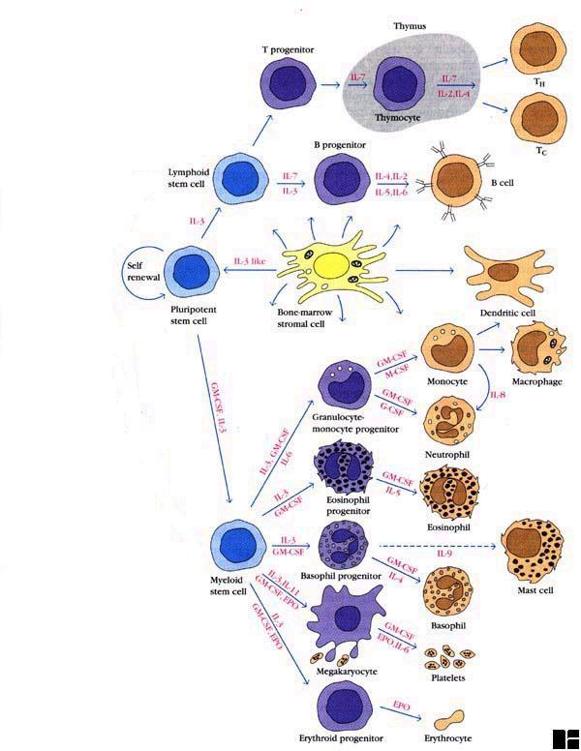
Sources of Multipotential Cells
Embryonic stem cells
Tissue stem cells
Induced pluripotential stem cells [iPSC]
Obtained by culturing morula or blastocyst cells.
In mice, these can produce a viable mouse.
In humans develop into embryoid bodies that can be differentiated to many tissue types.
Religious and ethical concerns.
Other: cord blood, marrow, umbilical cord, placenta, peripheral blood, AF
Adult cells, genetically reprogrammed to an embryonic stem cell–like state by being forced to express genes important for maintaining the key properties of embryonic stem cells.
Extent to which the entire genome has been re-stored to its embryonic state is unknown.
Low yield & some risk of tumors.

Slide 5
Since AF is plentiful and non-controversial it might be a good source of stem cells, so the goals of the study were to determine:
If Amniotic Fluid Cells [AFSC] have the characteristics of stem cells.
If they are a homogeneous population.
If all or any of them are multipotent.
If they can survive and be expanded in culture.
If they can be induced to differentiate into cells of specific lineages.

Slide 6
Study Design
We grew cell lines from:
  Freshly obtained amniotic fluid (3-6cc) AND cytogenetics cultures in the same patients.
  2. Another group of patients obtained from the cytogenetics lab ONLY.
16 patients with both fresh and cytogenetic samples.
21 patients from the cytogenetics lab, without a prior fresh sample.
We assayed 16 cell surface markers by FACS and 4 transcription factors by qPCR.

Slide 7
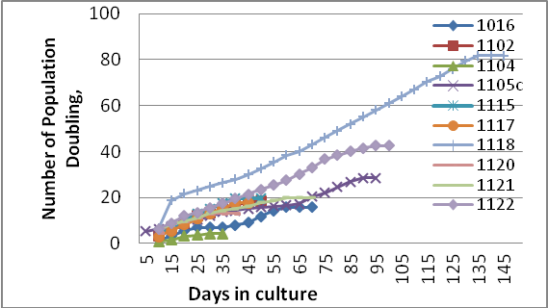
The proliferation capacity of AF-derived cells.

Slide 8
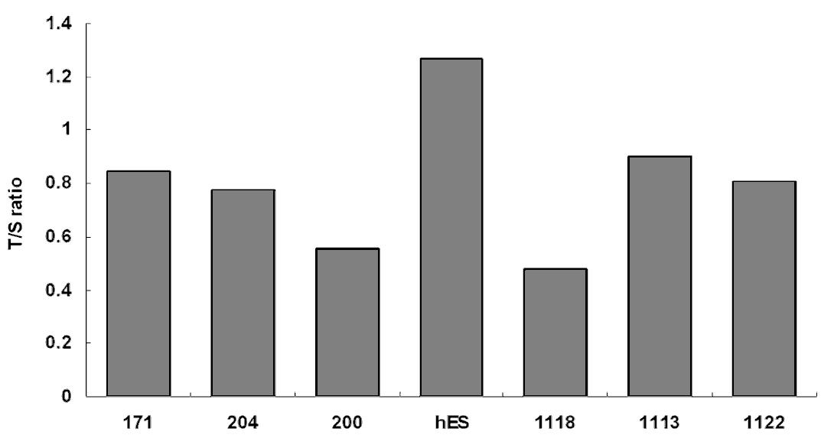
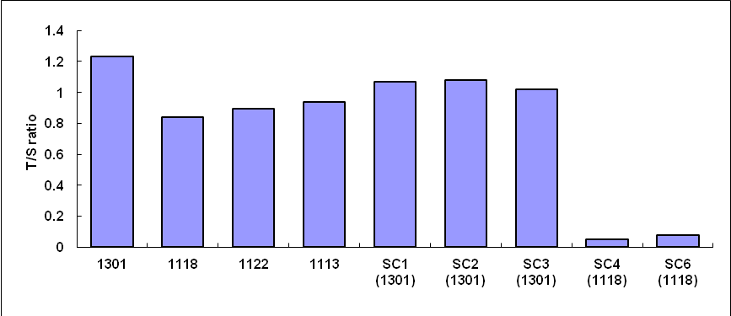
Telomere Length in AFSC
Legend: 171,204,200 are fibroblasts. HES is human embryonic stem cells.
AFC 1118, 1113, 1122 are human amniotic stem cells.
Legend: 1301 is a tumor cell line.
SC1-6 are single cell telomere lengths.

Slide 9
Marker profiles of cultured cells
 |  | CD117 | CD133 | SSEA1 | SSEA3 | SSEA4 | T-1-60 | T-1-81 | CD90 | CD29 | CD105 | CD44 | CD73
All | mean | 0.4 | 2.3 | 2.3 | 0.8 | 28.0 | 15.1 | 3.0 | 62.3 | 91.2 | 63.3 | 99.4 | 99.0
 | S.D. | 1.6 | 6.3 | 4.6 | 1.7 | 26.7 | 23.5 | 6.1 | 32.2 | 9.6 | 28.8 | 0.6 | 2.2
Early | mean | 0.1 | 3.5 | 4.5 | 1.5 | 22.5 | 14.6 | 1.8 | 58.0 | 97.2 | 51.0 | 99.7 | 99.5
P2-3 | S.D. | 0.3 | 4.8 | 10.6 | 2.6 | 18.3 | 17.4 | 2.6 | 29.4 | nd | nd | nd | nd
Late | mean | 0.3 | 2.7 | 2.1 | 0.5 | 30.8 | 14.1 | 3.6 | 63.4 | 90.7 | 69.0 | 99.4 | 98.9
>P5 | S.D. | 1.2 | 7.8 | 3.7 | 0.9 | 29.1 | 21.2 | 6.4 | 34.2 | 9.9 | 30.7 | 0.7 | 2.3
Fresh | mean | 0.6 | 1.1 | 3.5 | 0.7 | 25.9 | 19.6** | 4.1 | 62.1 | 91.7 | 70.7 | 99.5 | 99.0
 | S.D. | 2.1 | 2.5 | 8.5 | 1.4 | 30.2 | 28.3 | 7.4 | 34.7 | 9.7 | 26.6 | 0.7 | 2.4
Cyto | mean | 0.1 | 4.4 | 3.1 | 1.1 | 29.2 | 7.4** | 1.2 | 56.4 | 89.0 | 38.7 | 99.3 | 99.0
 | S.D. | 0.2 | 8.8 | 5.7 | 1.9 | 20.8 | 9.3 | 2.0 | 32.8 | 12.7 | 25.1 | 0.6 | 1.4

Slide 10
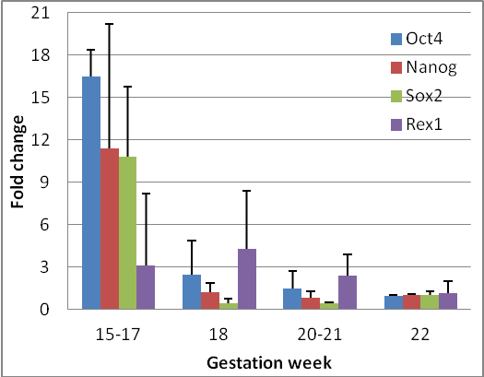
Transcription factor expression by AFC

Slide 11
AFSC Marker Expression on Early and Late Passages
%
Notes:
No differences

Slide 12
AFC Marker Expression in
Fresh vs. Cytogenetic Laboratory Cultures
%
Significance between these groups <0.05

Slide 13
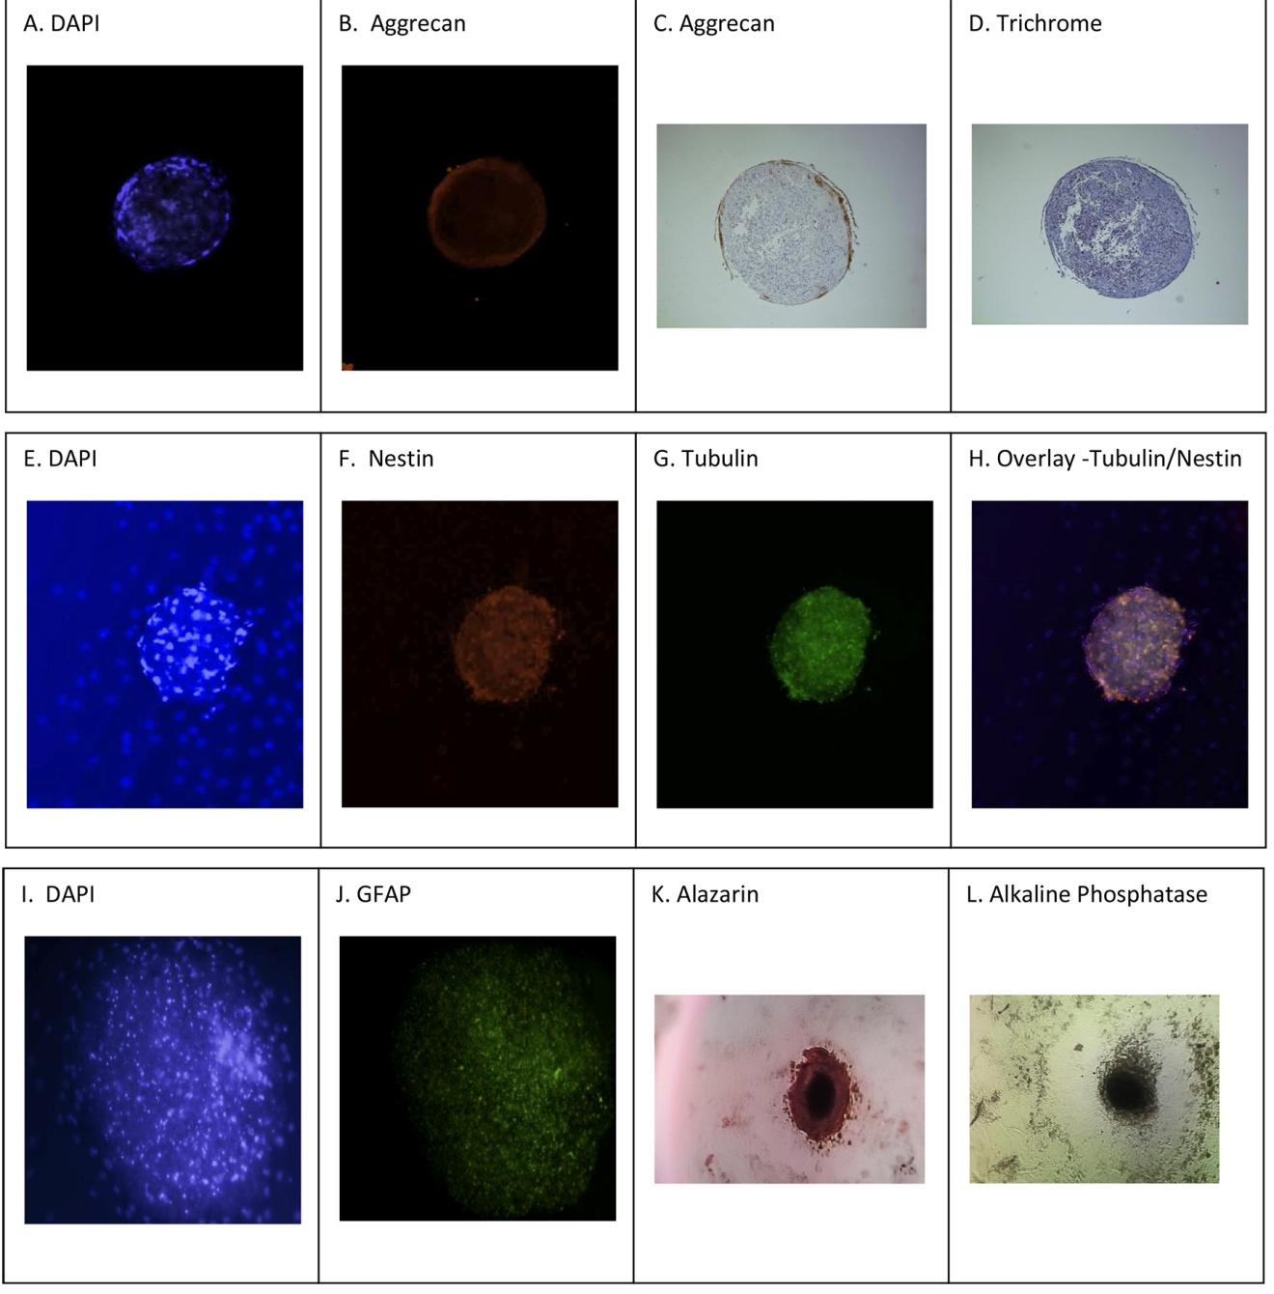
Differentiation of AFSC

Slide 14
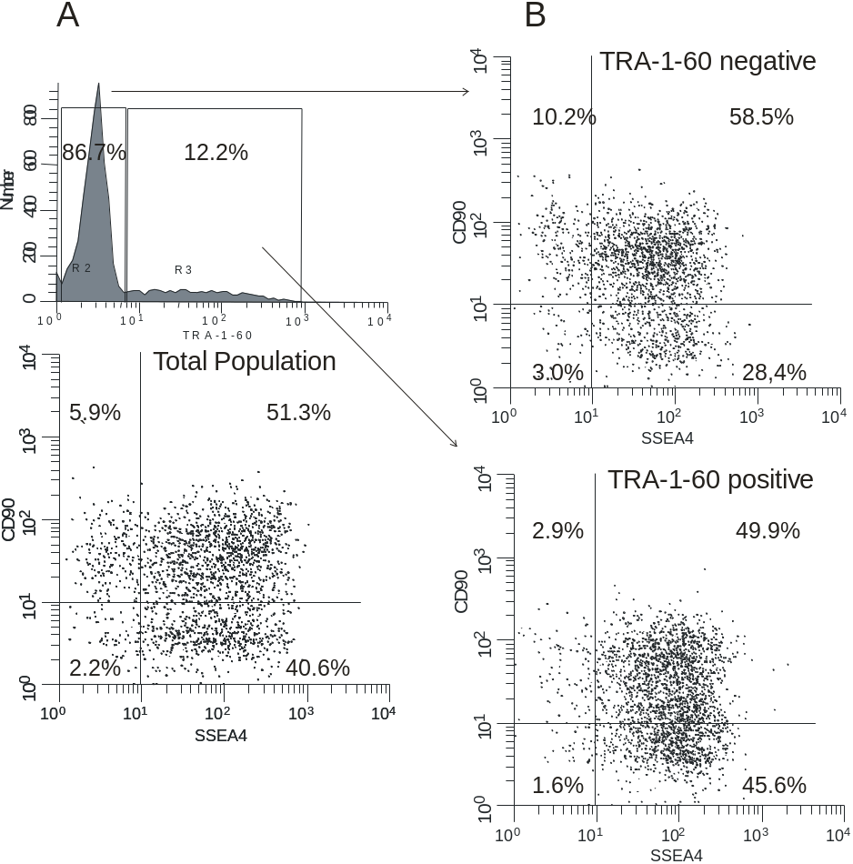
AFC surface marker expression shows heterogeneity.

Slide 15
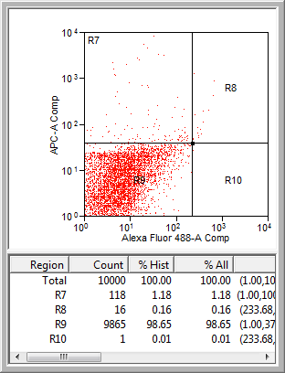
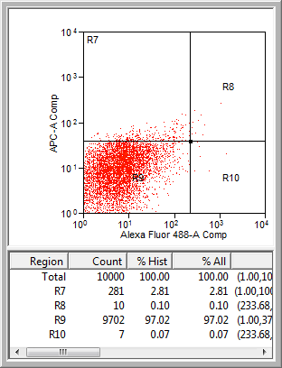
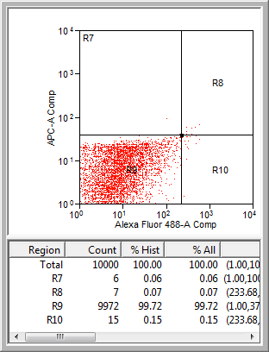
Double Staining AFSC
TRA-1-60 and SSEA4
SSEA4
SSEA4
SSEA4
TRA-1-60
TRA-1-60
TRA-1-60
ISO TRA-1-60
ISO TRA-1-60 & SSEA4
ISO SSEA4

Slide 16
Results
AF cells were propagated in tissue culture and grew to over a million cells in 5 to 10 doublings over 7 to 14 days.
They express CD90, TRA-1-60, and SSEA4 stem cell surface markers, embryonic transcription factors for pluripotency OCT4, Nanog, Sox2, Rex1 and mesenchymal progenitor cells, at high levels.
The AFC populations are heterogeneous, expressing single, double & triple markers.
CD90 expression persists over the lifespan of the cell culture, but SSEA4 and TRA-1-60 may vary.
Statistically significant differences in marker expression between fresh and samples from the cytogenetic lab were seen, but their functional properties are indistinguishable.
The phenotype does not correlate with capacity for differentiation.
Clonal isolates of AFC are capable of multilineage differentiation.
AFC grown in serum free medium might be a source for clinical use.

Slide 17
Study Design
  We grew cell lines from freshly obtained amniotic fluid (3-6cc) from 3 different patients.
  From each patient half of the fluid was grown in a Serum Free medium and half in the standard Basic medium which contains fetal calf serum.
  All the cultures were processed in the same way.
  The proliferation, expression of stem cell factors and inducibility to bone, cartilage, and neural lineage were compared for serum free and standard cultures.

Slide 18
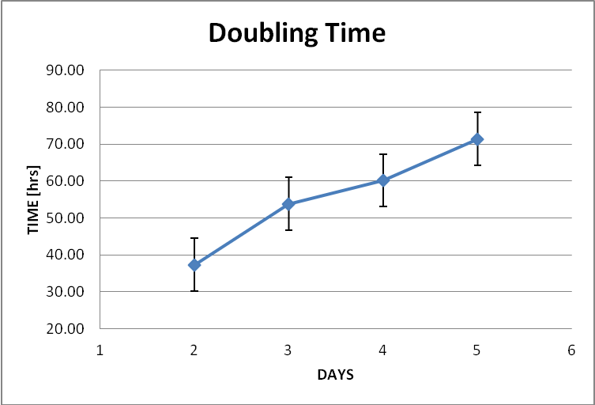
Rate of Proliferation of AFC in Culture
Doubling times varied among the samples; Basic media from 21 to 31 hours (average 26) and 22 to 71 hours (average 40) for Serum Free media

Slide 19
STEM CELL MARKER EXPRESSION IN BASIC VERSUS SERUM FREE MEDIA
          Basic (SD) Serum Free(SD) t-test p=
TRA-1-60 5.75 (7.78) 11.58(16.1) 0.27
CD90 31.58(16.3) 46.25(23.7) 0.09
SSEA4 22.83(19.0) 31.08(16.1) 0.26

Slide 20
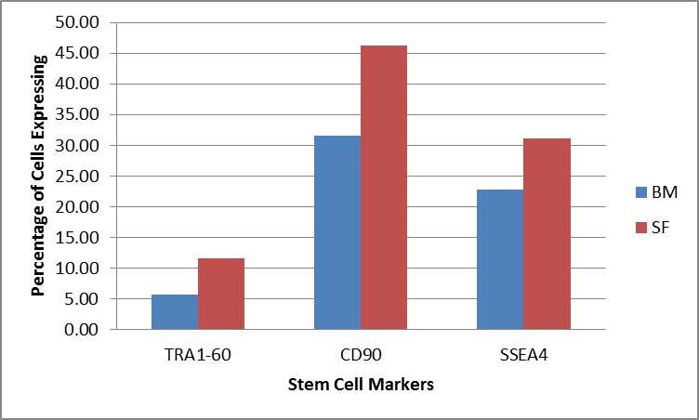
Comparison of stem cell markers

Slide 21
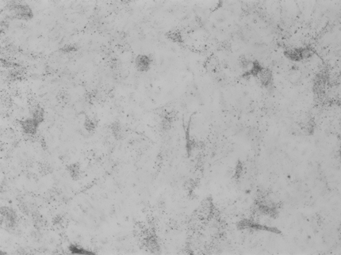
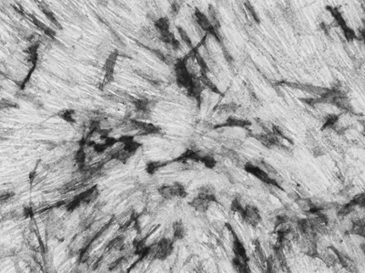
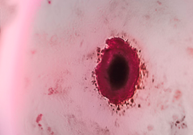
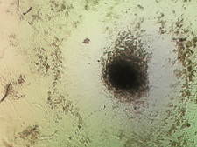
BONE
Osteogenic Differentiation of Serum Free Cells
CONTROL
ALAZARIN ALKALINE PHOSPHATASE

Slide 22
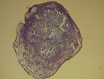
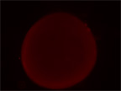
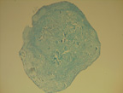
Chondrogenic Differentiation of Serum Free Cells
Trichrome
Aggrecan
Alcian Blue

Slide 23
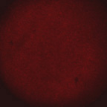
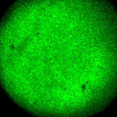
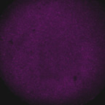
Neurogenic Differentiation of Serum Free Stem Cells
Nestin
Tubulin
G FAP

Slide 24
CONCLUSIONS
Multipotent Amniotic Fluid Cells Grown Serum Free:
Show colony formation and maintain proliferation in culture through many passages and after cryopreservation.
Express surface markers found on embryonic stem cells (SSEA4, TRA-1-60, TRA-1-81).
Express markers of mesenchymal progenitors ( CD90, CD105, CD44, CD117, CD133).
Express embryonic transcription factors characteristic of pluripotency (OCT4, Nanog, Sox2, Rex1).
Can differentiate into various cell lines, especially neuronal [ectodermal], cartilage and bone [mesodermal].
Clonal isolates are multipotent, so heterogeneity may be from different cell lineages or differences in expression.
Are a readily available source for clinical transplantation.

Slide 25
Term Amniotic Fluid
Volume: 1000-200ml
Cell Count: Varies, average about 1 million/ml
Could this be an abundant source of Stem Cells for clinical purposes?
Eight normal patients not in labor had 100-500ml of amniotic fluid obtained at scheduled C/S for study.

Slide 26
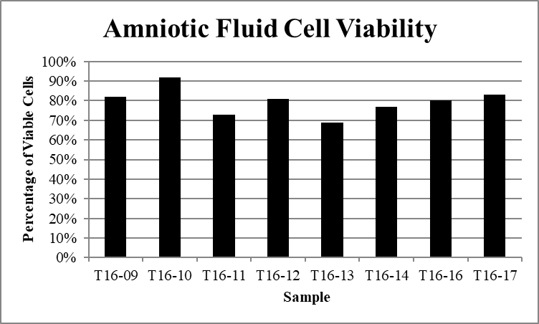
Term Amniotic Fluid Stem Cells

Slide 27
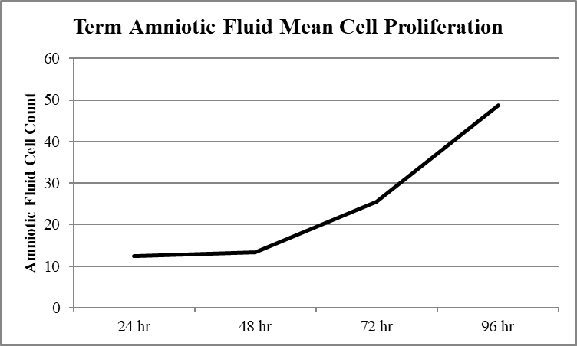
Term Amniotic Fluid Stem Cells

Slide 28
Term Amniotic Fluid Stem Cells
Stem Cell Surface Markers
Sample | CD90 | SSEA4 | TRA-1-60 | CD29 | CD44 | CD105 | CD73
T16-09 | 83% | 12% | 8% | 100% | 97% | 10% | 100%
T16-10 | 69% | 7% | 3% | 100% | 96% | 2% | 100%
T16-11 | 70% | 61% | 45% | 100% | 100% | 15% | 100%
T16-12 | 81% | 73% | 54% | 100% | 100% | 0.5% | 100%
T16-13 | 91% | 13% | 1% | 99% | 99% | 8% | 100%
T16-14 | 84% | 22% | 4% | 100% | 97% | 12% | 100%
T16-16 | 98% | 95% | 38% | 100% | 100% | 8% | 100%
T16-17 | 94% | 6% | 1% | 100% | 100% | 8% | 100%

Slide 29
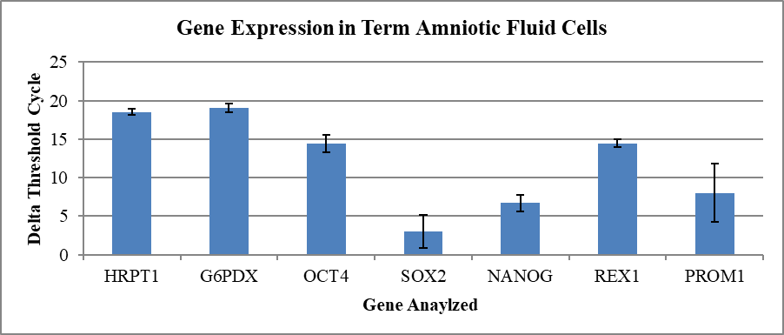
Term Amniotic Fluid Stem Cells
Transcription Factors

Slide 30
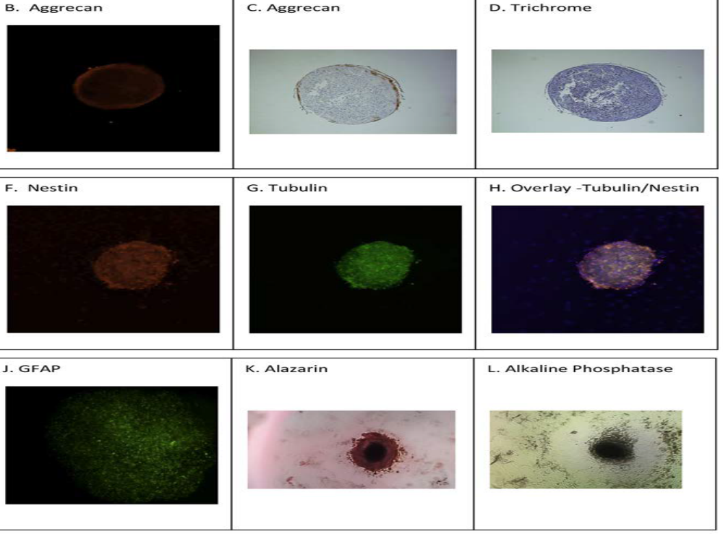
Term Amniotic Fluid Stem Cells
Differentiation

Slide 31
Conclusions
Human Amniotic Fluid Contains Stem Cells Which Can:
tolerate cryopreservation very well
proliferate rapidly in culture
survive many passages without loss of stemness
be grown in serum free media
be induced to differentiate to neural, osteoid and chondrgenic lineages
provide more than 500 million stem cells per patient sampled, enough for over 50 clinical stem cell transplants from the amniotic fluid obtained at a single cesarean delivery

Slide 32

There are some things even stem cells can’t fix!

