Slide 1


T-type calcium channel inhibition: a novel therapy in renal disease
Bruce Hendry
Emeritus Professor, King’s College London
President of the UK Renal Association

Slide 2
Outline of talk
Renal Diseases are an area of unmet therapeutic need
There are multiple new targets under study and this talk will focus on one of these
T-Type Calcium Channels (TTCC)
The key themes are the new targeting of mesangial cell proliferation and the inflammatory responses underlying glomerular sclerosis. These are relevant in Diabetic Nephropathy, IgA Nephropathy and Lupus Nephritis

Slide 3
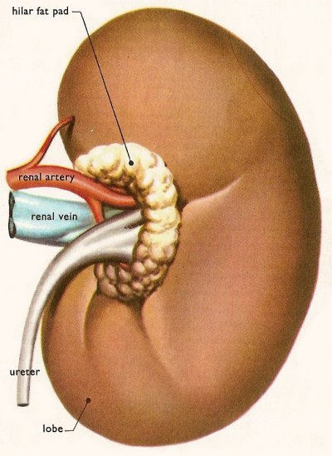
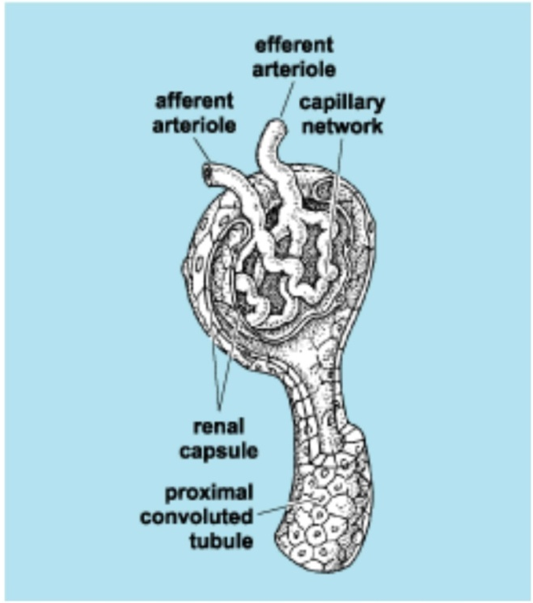
Mesangial
cells
Mesangial cells in healthy kidney;
  Structural support - ECM secretion
  Phagocytosis of macromolecules and immune complexes
  Secrete and respond to cytokines
  Contract and relax in response to vasoactive substances

Slide 4
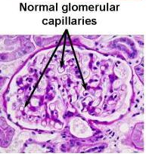
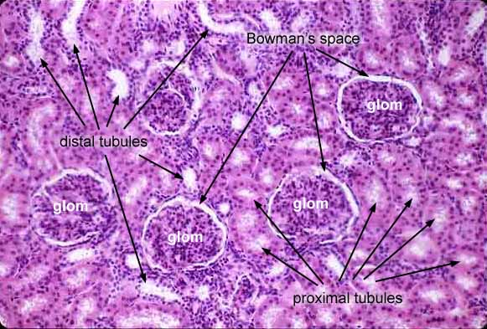
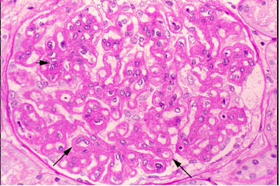
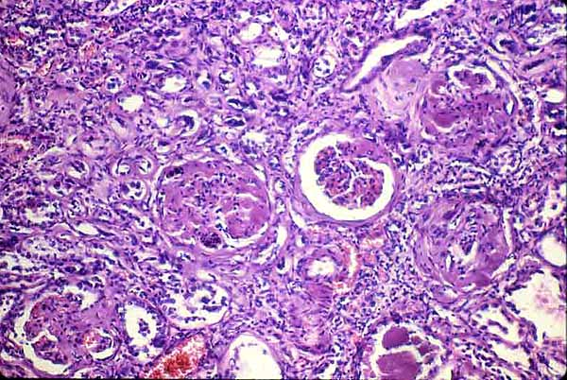
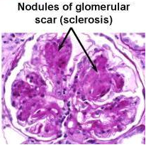
Insult eg
high glucose,
Ig deposition
Notes:
4

Slide 5
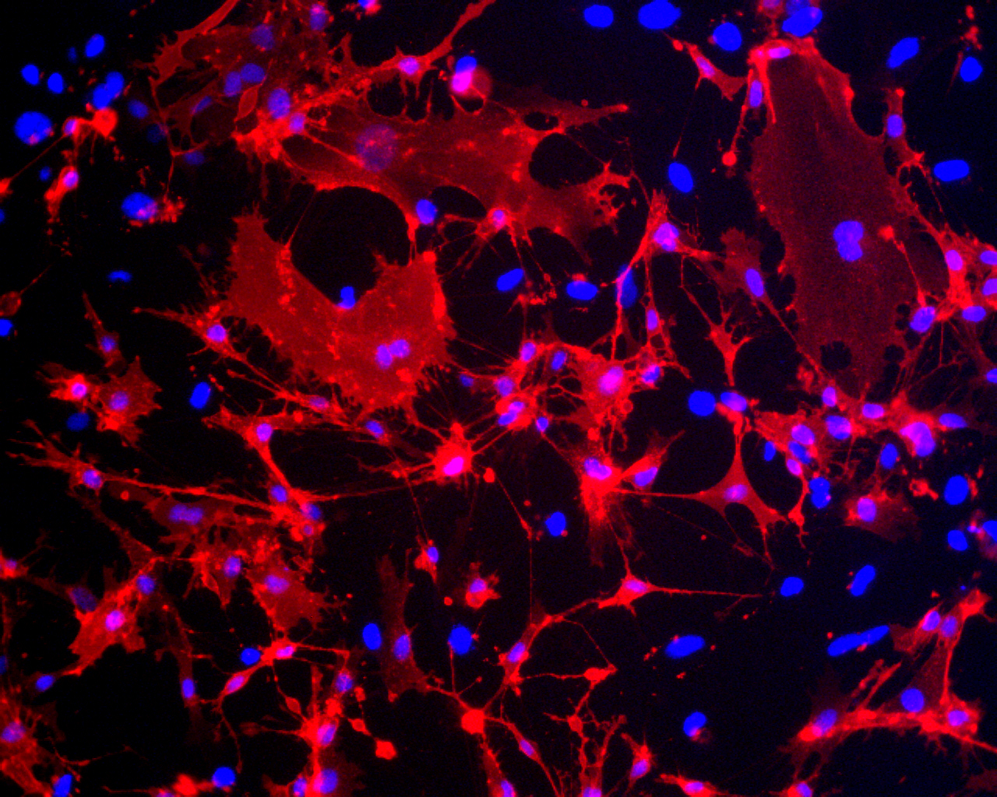
Calcium in mesangial cells
[Ca²⁺]_{i} regulates MC contraction in a mechanism akin to that in VSMC
MC proliferation is dependent on extracellular calcium
  PDGF administration causes acute rise in [Ca²⁺]_{i}
  Dantrolene has no effect on PDGF-induced proliferation
        Shultz PJ, Raij L: Inhibition of human mesangial cell proliferation by calcium channel blockers, Hypertension 1990, 15:I76-80
  CCBs inhibit MC proliferation in vitro but this action does not correlate with blockade of L-type calcium channels
        Orth SR et al.: Inhibitory effect of calcium channel blockers on human mesangial cell growth: evidence for actions independent of L-type Ca²⁺ channels. Kidney Int 49:868-879, 1996

Slide 6
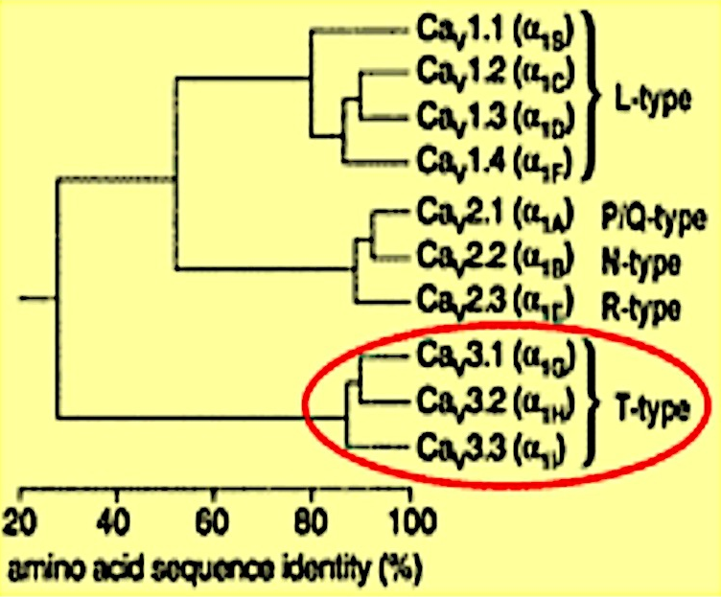
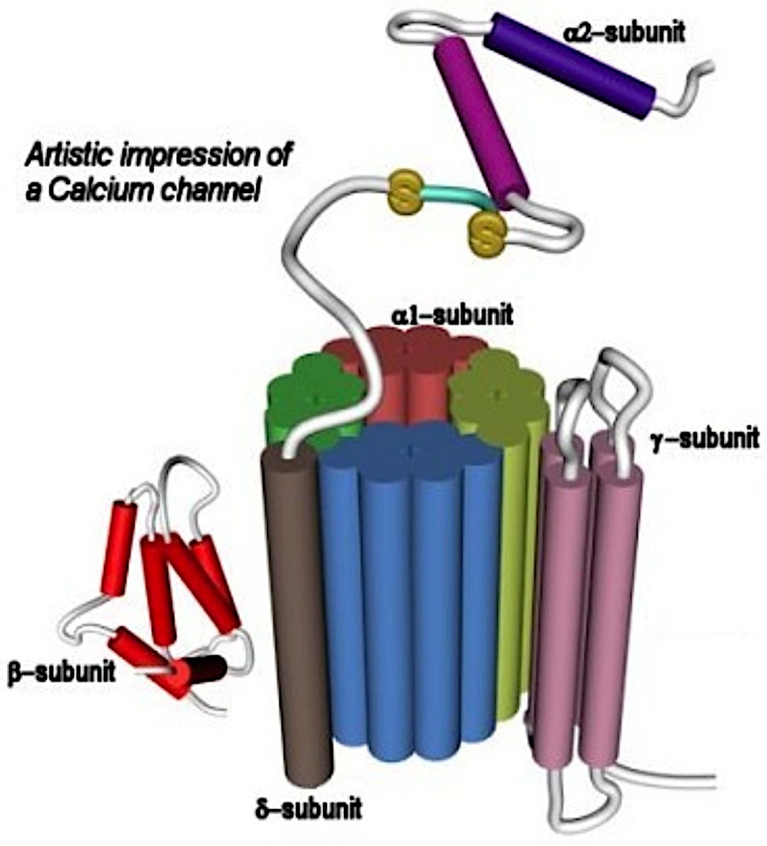
Calcium signalling
Na⁺
VOCC
ROCC
Na⁺/Ca²⁺ exchanger
Plasma membrane
SOCC
Ca²⁺
Ca²⁺
CICR
RYR
ATP
IP₃R
ER/SR
Ca²⁺

Slide 7
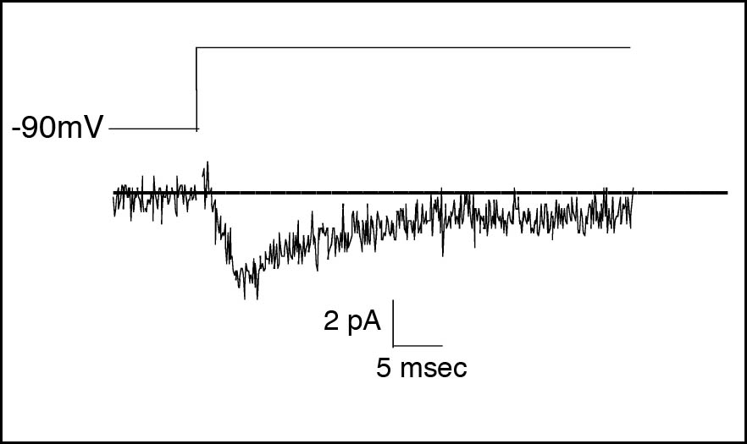
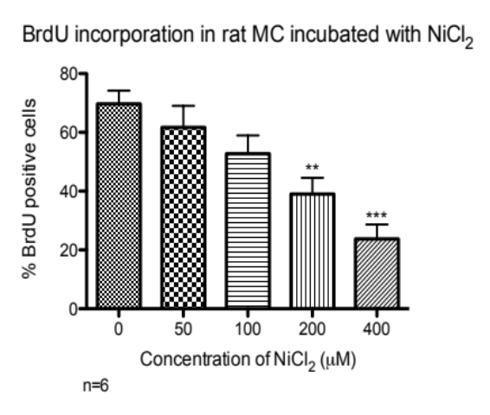
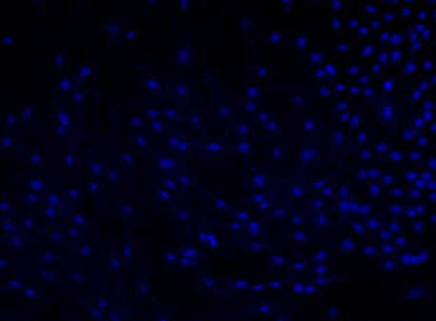
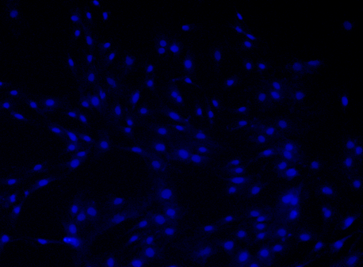




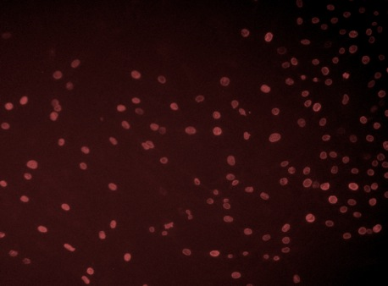

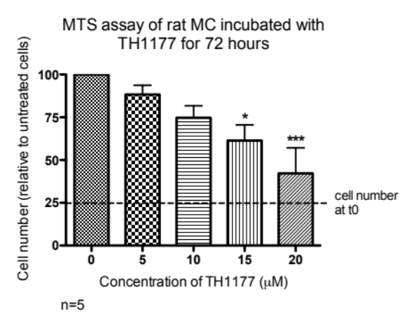
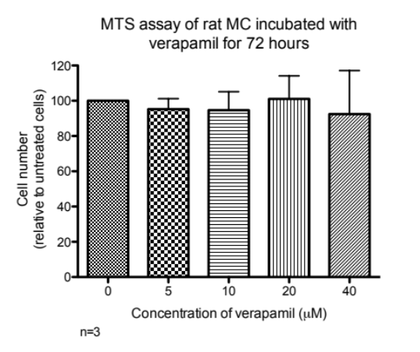
T-type calcium channels in mesangial cell proliferation in vitro
L-type channel
inhibitors
Combined T and
L-type blockers
T-type channel
inhibitors
Verapamil
Amlodipine
Nifedipine
Mibefradil
TH1177 (TTL1177)
Benidipine
Efonidipine
Nickel Chloride
R(-)-Efonidipine
New agents needed
a
Representative T-type current recorded from HMCs
a
No drug
Nickel 400µM
a
b
Ca_{v}3.1
Ca_{v}3.2
c
d
β-actin
β-actin
HMC1 HMC2 +ve control
HMC1 HMC2 +ve control
%BrdU +ve cells
*
7
5
medium alone
transfection reagent
5
0
Ca_{v}3.2 siRNA 200nM
Neg ctrl siRNA 200nM
2
5
*p<0.05
0
Mulgrew CJ., Cove-Smith A., McLatchie LM., Brooks G., Shattock MJ., Hendry BM. Inhibition of human mesangial cell proliferation by targeting T-type calcium channels. Nephron Exp Nephrol 2009, 113(2): e77-e88.

Slide 8
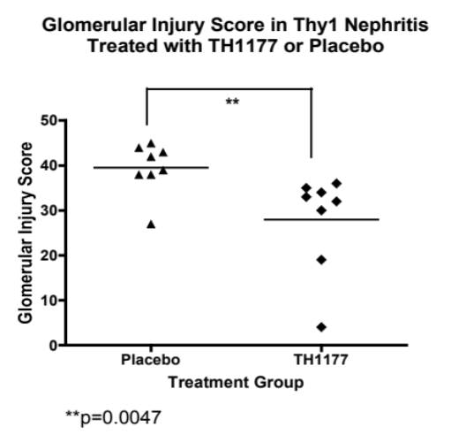
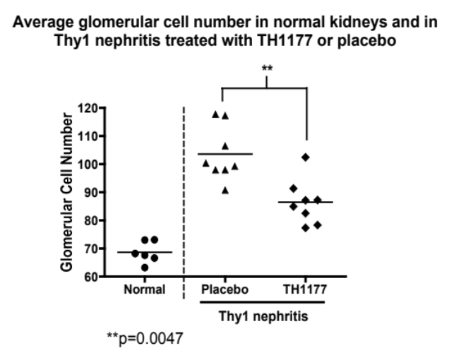
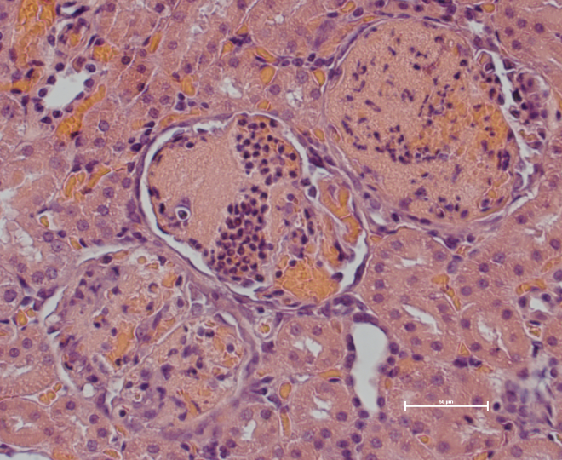
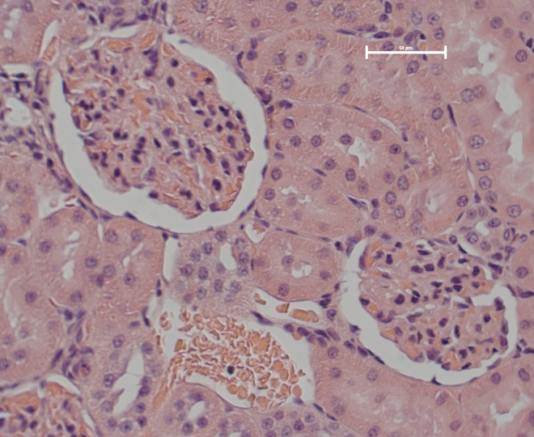
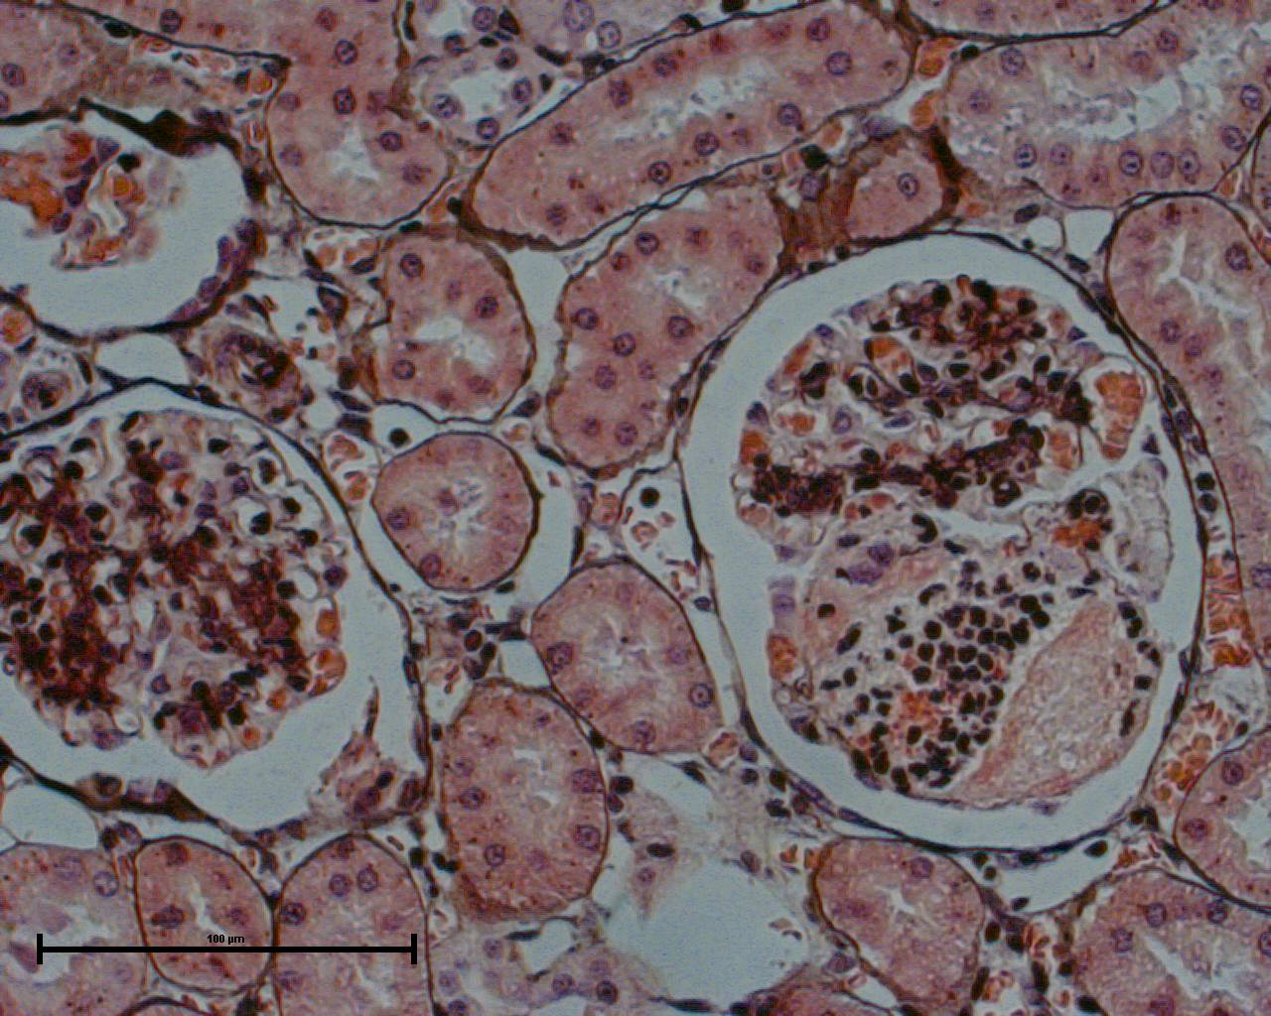
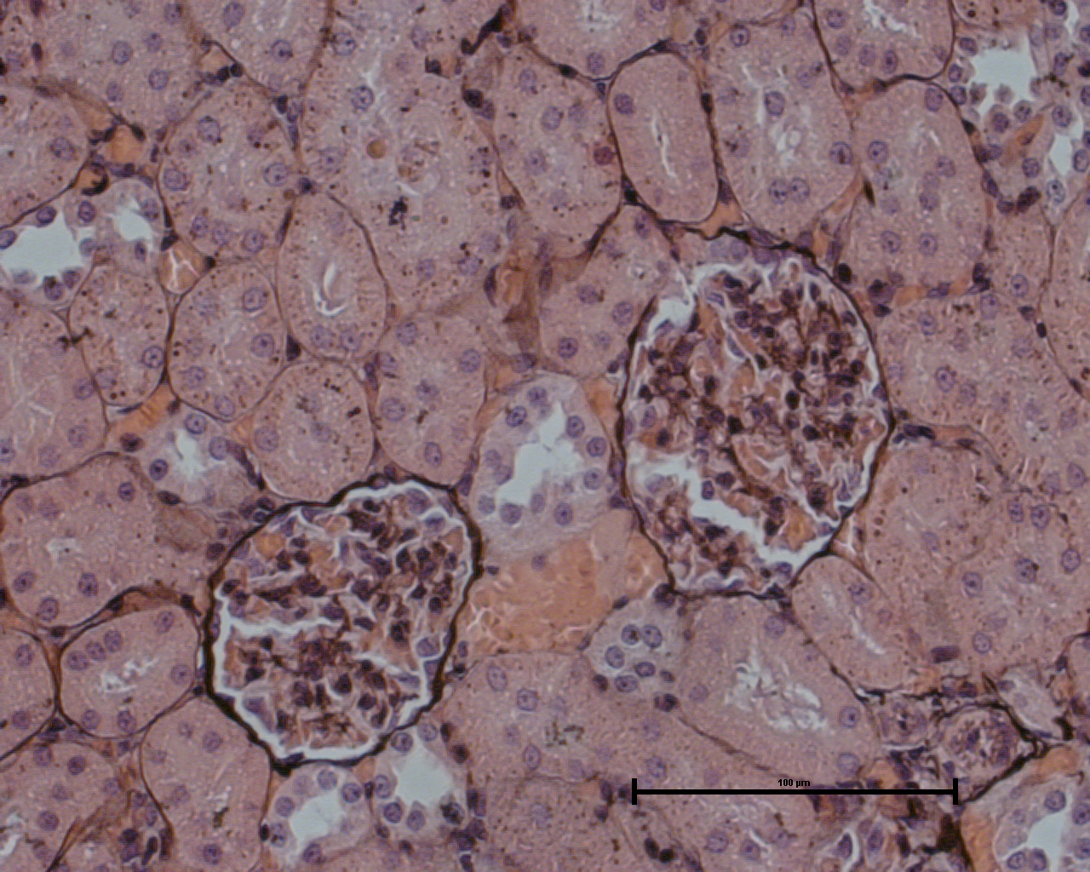
TH1177 reduces glomerular injury and glomerular cell proliferation in acute Thy1 nephritis
Intravenous injection
of 1mg/kg Ox7 Ab
Sacrifice
Sacrifice
Day 0
Day 7
Day 10
8 x TH1177
8 x placebo injection
4 x TH1177
4 x placebo
4 x TH1177
4 x placebo
Thy1 nephritis
Placebo
TH1177
a
b
c
d
Cove-Smith A et al. Anti-proliferative actions of T-type calcium channel inhibition in Thy1 nephritis. Am J Pathol 2013 Aug;183(2):391-401

Slide 9
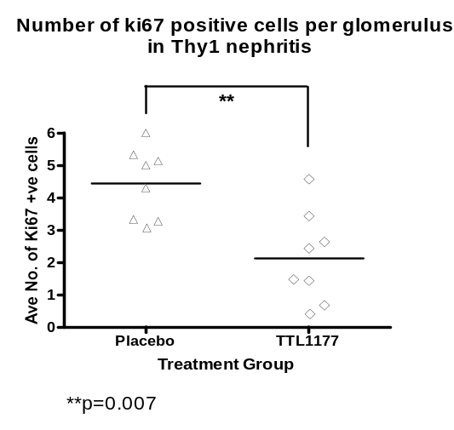
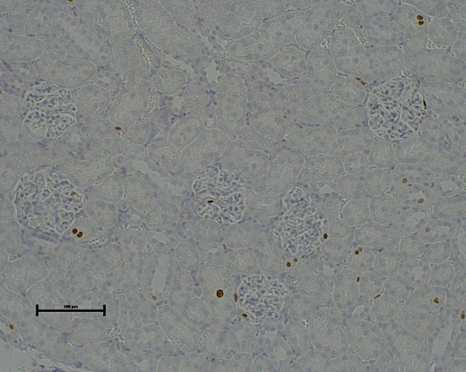
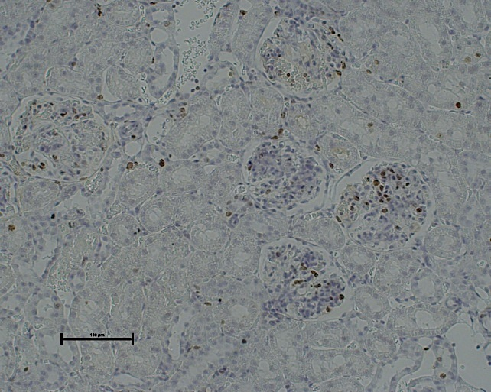
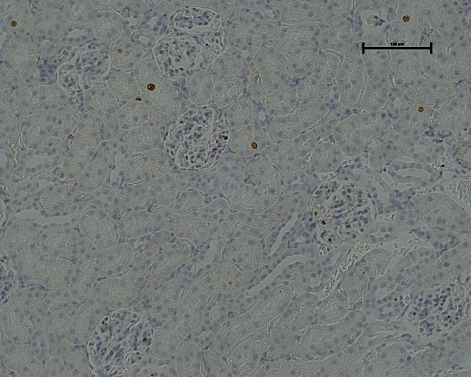
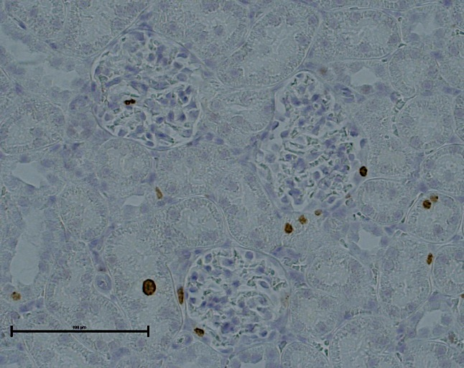
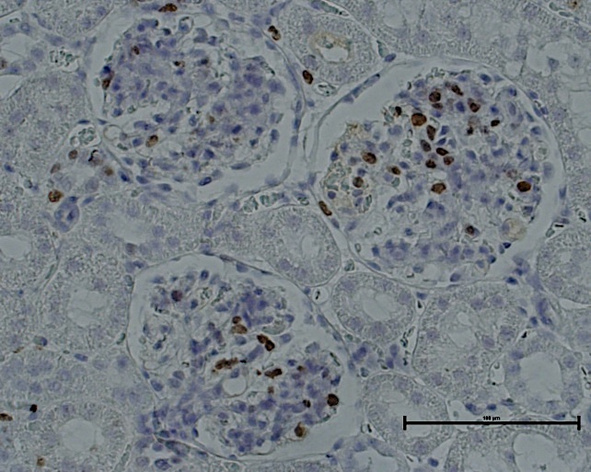
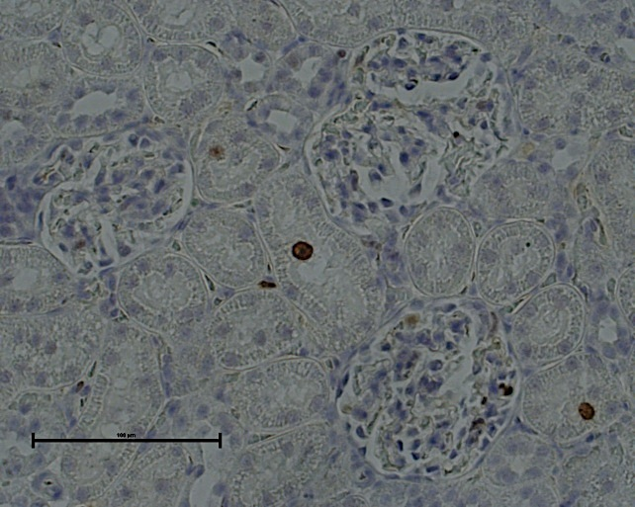
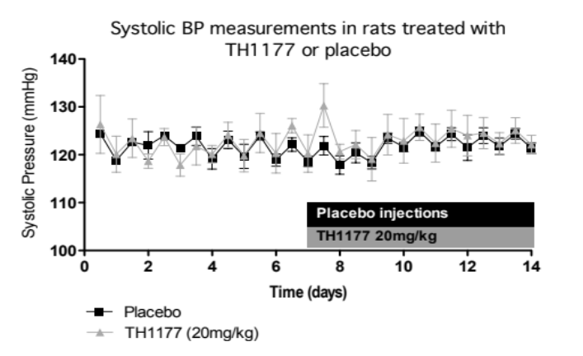
TH1177 reduces glomerular injury and glomerular cell proliferation in acute Thy1 nephritis
Intravenous injection
of 1mg/kg Ox7 Ab
Sacrifice
Sacrifice
Day 0
Day 7
Day 10
8 x TH1177
8 x placebo injection
4 x TH1177
4 x placebo
4 x TH1177
4 x placebo
Ki67 immunostaining
Thy1 nephritis
Normal kidney
Placebo
TH1177
Placebo
TH1177
Treatment Group
Cove-Smith A et al. Anti-proliferative actions of T-type calcium channel inhibition in Thy1 nephritis. Am J Pathol 2013 Aug;183(2):391-401

Slide 10
Key questions
That was Prevention. What about Treatment of established disease?
What are the mechansms involved?

Slide 11
Unilateral
Nephrectomy
(25 animals)
iv injection
2.5mg/kg Ox7 mAb
Sacrifice
Day -7
Day 0
Day 2
Day 14
Day 42
Early treatment group:
Daily IP injections of
TH1177 20mg/kg,
reduced to 10mg/kg at
day 12
Serum for creatinine and LFTs
Urine for protein:creatinine ratio
Kidney, liver, heart, brain and peritoneum for histology, RNA extraction and protein extraction
Late treatment group:
Daily IP injections of
TH1177 10mg/kg
Placebo and late
treatment groups:
Daily IP injections
vehicle only (DMSO)
Placebo group:
daily IP injections
Vehicle (DMSO)

Slide 12
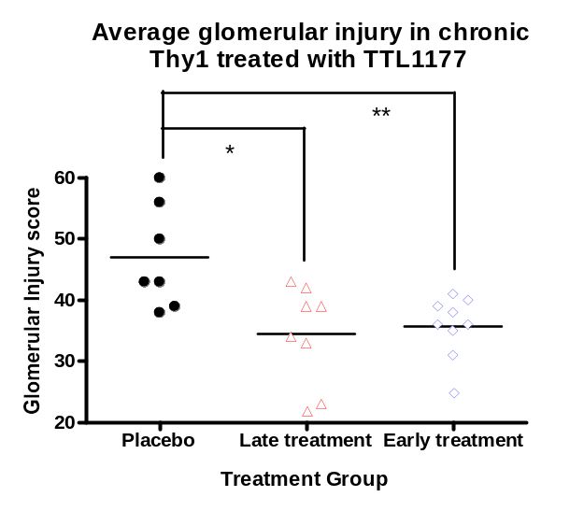
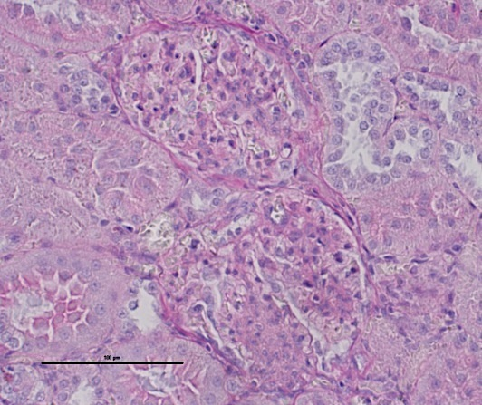
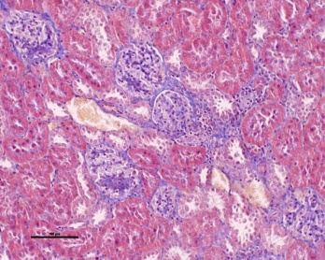
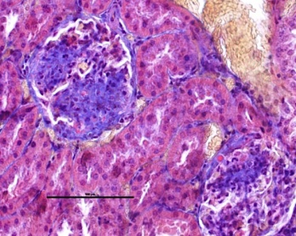
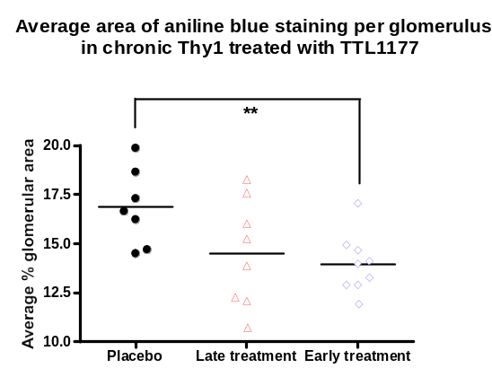
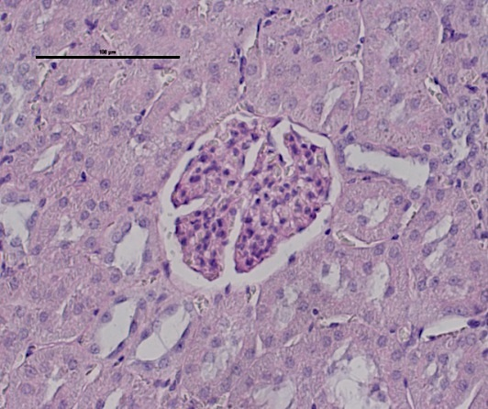
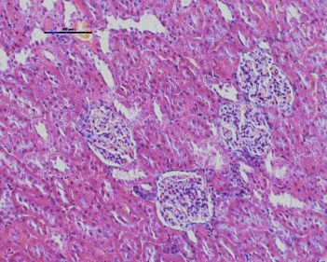
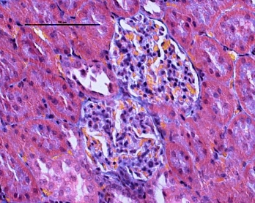
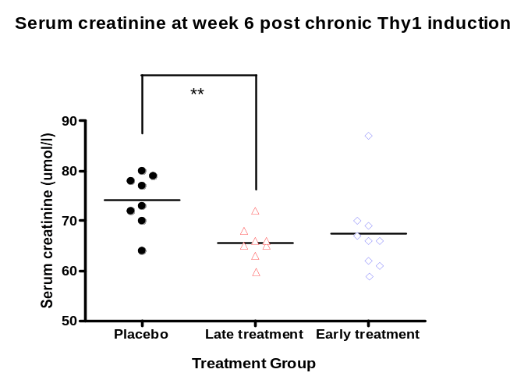
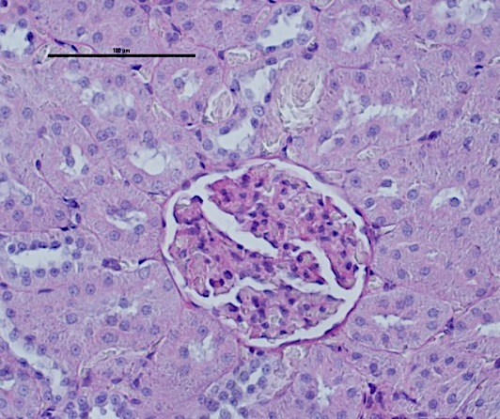
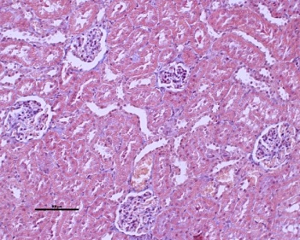
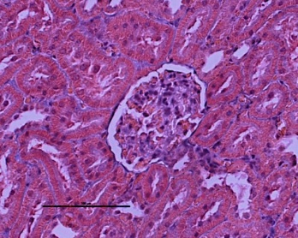
TH1177 reduces glomerular injury and serum creatinine in chronic Thy1 nephritis
Placebo
Placebo
Late Treatment
Late Treatment
Early Treatment
Early Treatment

Slide 13
DUAL BENEFITS OF TTCC INHIBITION
Inhibition of mesangial cell proliferation and reduced inflammatory cytokines
Reduced Proteinuria through lower Glomerular Capillary Pressure

Slide 14
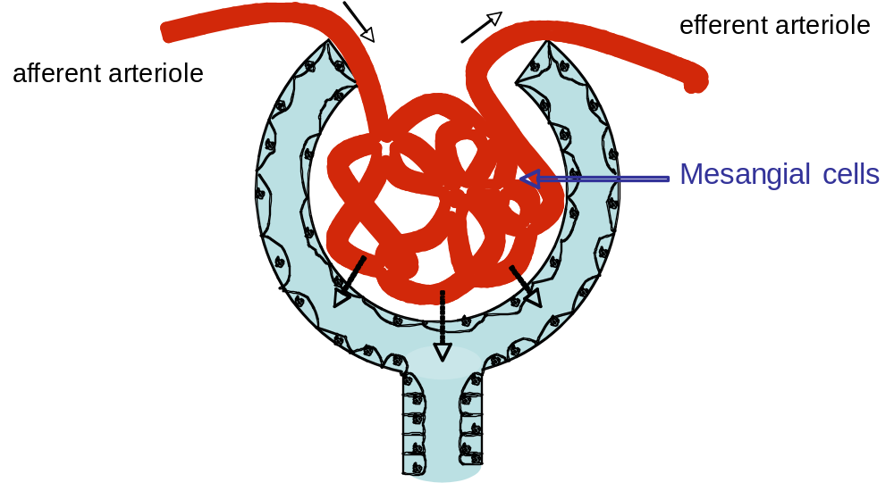
L-type blockers
T-type blockers
Honda, M., K. Hayashi, et al. (2001). Divergent renal vasodilator action of L- and T-type calcium antagonists in vivo. J Hypertens 19(11): 2031-7.
Baylis, C., C. Qiu, et al. (2001). Comparison of L-type and mixed L- and T-type calcium channel blockers on kidney injury caused by deoxycorticosterone-salt hypertension in rats. Am J Kidney Dis 38(6): 1292-7.
Ball, C. J., D. P. Wilson, et al. (2009). Heterogeneity of L- and T-channels in the vasculature: rationale for the efficacy of combined L- and T-blockade. Hypertension 53(4): 654-60.
Ge, W. and J. Ren (2009). Combined L-/T-type calcium channel blockers: ready for prime time. Hypertension 53(4): 592-4.

Slide 15
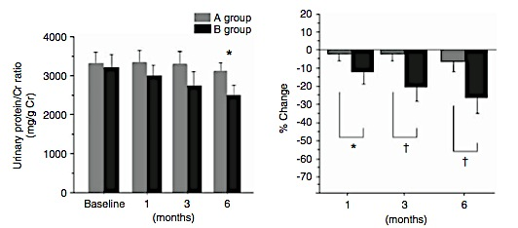
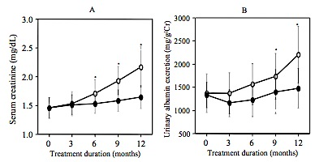
Clinical trials of T-type calcium channel blockade in renal disease
Benidipine reduces proteinuria in hypertensive patients with CKD 3-5
  47 patients, already on maximum ARB
  Randomised to benidipine or amlodipine for 6/12
  Equivalent BP-lowering effect
  No difference in eGFR
Efonidipine prevents decline in GFR and reduces arterial stiffness in patients with Type 2 DM, hypertension and nephropathy
  40 patients, all on candesartan
  Prospective, randomised to amlodipine or efonidipine
  Equivalent BP response
  Follow up 12 months
Abe, M., K. Okada, et al. (2009). Comparison of the antiproteinuric effects of the calcium channel blockers benidipine and amlodipine administered in combination with angiotensin receptor blockers to hypertensive patients with stage 3-5 chronic kidney disease. Hypertens Res 32(4): 270-5.
○ Amlodipine
● Efonidipine
Sasaki H., Saiki A,. Et al. (2009) Protective Effects of Efonidipine, a T- and L-Type Calcium Channel Blocker, on Renal Function and Arterial Stiffness in Type 2 Diabetic Patients with Hypertension and Nephropathy. J atheroscler Thromb. 2009 Sep 14. [Epub ahead of print]

Slide 16
Summary- TTCC inhibition
T-type calcium channel inhibition reduces MC proliferation in vitro and in vivo whilst L-type blockade has no effect
The reduction in proliferation is associated with reduced pERK expression in glomeruli in Thy1 nephritis
TH1177 reduces glomerular injury in chronic Thy1 nephritis even when treatment is initiated after disease induction
Small clinical trials support the hypothesis that TTCC blockade is superior to LTCC blockade in proteinuric renal disease
Further, larger study isneeded to confirm these findings

Slide 17
Current Work
Study of T-type Calcium Channel Inhibitors as potential renal therapeutics
Highly Selective T-type calcium Channel Inhibitors
In vitro and in vivo work
Use of mouse genetic models to prove mechanisms
Further use of the chronic Thy-1 model

Slide 18


Thanks to:
Andrea Cove-Smith
Mike Shattock
Chris Mulgrew
Claire Sharpe
Qihe Xu
Joe Wang
Alexandra Rankin
Fei Wong
Lucy Newbury
Ayesha Irtiza-Ali
Maz Noor
Adam Rumjon

