Slide 1
Hepatitis B in focus: new biology, new targets and real hope for finite therapy
Bruce D. Given, M.D.
COO, Arrowhead Pharmaceuticals
18th World Gastroenterologists Summit
September 7, 2018

Slide 2
Disclosures
I am an employee and shareholder in Arrowhead Pharmaceuticals, Inc.
Thanks to Nid Afdal, MD from Springbank Pharmaceuticals for providing slides for this presentation.

Slide 3
Safe Harbor Statement
This presentation contains forward-looking statements within the meaning of the "safe harbor" provisions of the Private Securities Litigation Reform Act of 1995. These statements are based upon our current expectations and speak only as of the date hereof. Our actual results may differ materially and adversely from those expressed in any forward-looking statements as a result of various factors and uncertainties, including, without limitation, our developmental stage and limited operating history, our ability to successfully and timely develop products, enter into collaborations and achieve other projected milestones, rapid technological change in our markets, demand for our future products, legislative, regulatory and competitive developments and general economic conditions. Our Annual Report on Form 10-K, recent and forthcoming Quarterly Reports on Form 10-Q, recent Current Reports on Forms 8-K, and other SEC filings discuss some of the important risk factors that may affect our ability to achieve the anticipated results, as well as our business, results of operations and financial condition. Readers are cautioned not to place undue reliance on these forward-looking statements. Additionally, Arrowhead disclaims any intent to update these forward-looking statements to reflect subsequent developments.

Slide 4
Agenda
Brief Introduction and the basis for new therapeutic approaches
Three examples of novel drug classes
Conclusions

Slide 5
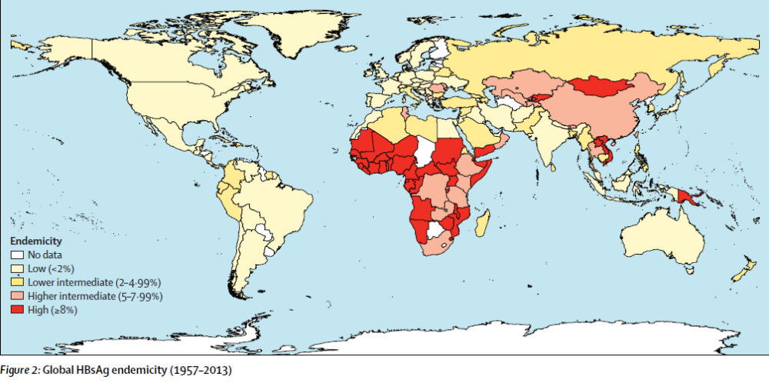
Worldwide prevalence of chronic HBV infection
Schweitzer et al. (2015), Lancet 386:1546-55
Globally an estimated 250-400 million people are chronically HBV infected

Slide 6
HBV – The Good and the Bad
Vaccination and peri-natal intervention have been widely exploited and have reduced the incidence of new chronically infected patients. Eradicating new infections is a feasible public health goal
Spontaneous or drug-induced HBsAg sero-clearance (functional cure) is associated with low risk of hepatic failure or HCC
Lifelong effective NUC therapy is also associated with reduced risk of hepatic failure or HCC
However – functional cure is rare today (spontaneously ~0.5%/yr) and must occur before age 50 to reduce risk
NUC treatment rates are low ---- adherence is a major issue
Close to 1 million annually are dying due to hepatic failure or HCC

Slide 7
HBV Has Been Stuck in a Therapeutic Rut
Interferon alpha cure rates highly dependent on genotype
  Genotype A in early trials had “respectable” HBsAg clearance rates (~25%) in early trials
  With those patients rare today, interferon in large Western trials yields single digit HBsAg clearance rates – with unacceptable tolerability
  Various trials attempting combination therapy with nucleos(t)ide inhibitors (NUCs) unimpressive
Early generation NUCs were prone to resistance and are not recommended
Entecavir, tenofovir and now TAF are well tolerated and not prone to resistance
  Persistent viremia after several years of therapy most likely non-adherence
  Controlled trials of discontinuation after years of therapy show some potential, although some fatalities and many relapses have been noted
With the recent success in HCV, there has been a flurry of activity in HBV and drugs against a diverse set of HBV targets have entered development

Slide 8
HBV is Now Exploding with Innovation
The Goal is Finite Therapy
US FDA, EMA, AASLD and EASL have agreed the general target for approving new agents
  SVR24 which will be DNA negativity and HBsAg negativity 24 weeks after cessation of all anti-virals agreed as the primary approval endpoint
They also agree that combination therapy is likely required as with HIV and HCV
Some believe that the combinations will include DAAs and immune boosting agents in at least some patients
There will be a high safety hurdle because of the efficacy and safety/tolerability of long-term NUCs

Slide 9
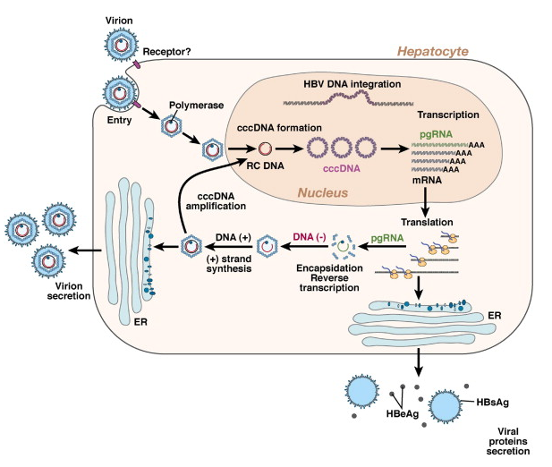
A Very Simplified View of the HBV Lifecycle
NTCP receptor
X
X & core
HBeAg
HBsAg
Hypothesis: revive host adaptive immune response by reducing HBV proteinemia

Slide 10
Three Interesting New Classes

Slide 11
RNAi: Target the Gene Silence the Disease
(siRNA)
Therapeutic gene silencing with RNA interference is highly precise and efficient

Slide 12
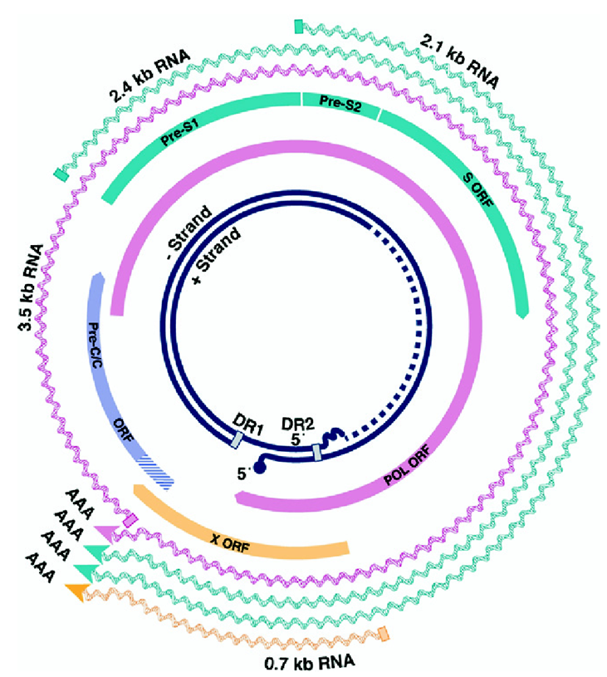
Organization of the HBV genome makes it ideal for RNAi
5 viral mRNAs
  3.5 kb pre-genomic RNA
  3.5 kb pre-core mRNA
  2.4 kb pre-S1 mRNA
  2.1 kb pre-S2/S mRNA
  0.7 kb X mRNA
7 major proteins
  Polymerase (with reverse transcriptase function)
  Core (HBcAg), forms capsid
  e antigen (HBeAg), also called pre-core, a secreted protein
  Large, medium and small surface proteins (HBsAg), form envelope
  X protein (Transactivator)
3.2 kb
Same polyadenylation signal for all mRNAs
Ghany & Liang (2007), Gastroenterology 132: 1574-1585

Slide 13
RNAi therapeutics to reduce HBV viral RNAs
Differentiation from nucleos(t)ide reverse transcriptase inhibitors
NTCP receptor
X
siRNA
↓
↓
Core
↓
Nucs
HBeAg
HBsAg
↓

Slide 14
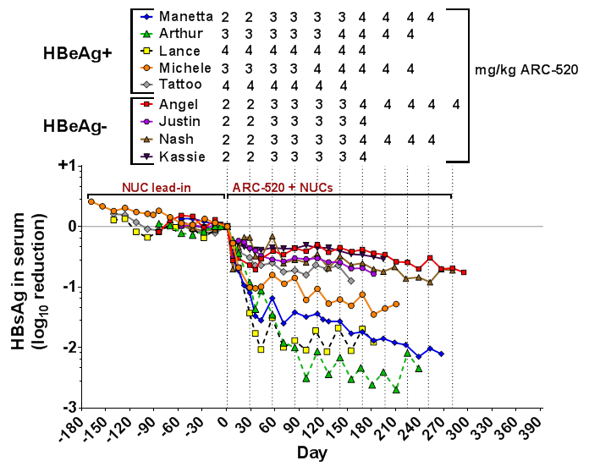
Differences in degree of HBsAg reduction correlated with HBeAg status in chimpanzees
HBeAg-negative
0.5 - 0.9 log₁₀ reduction at nadir
HBeAg-positive
1.5 - 2.7 log₁₀ reduction at nadir

Slide 15
HBV Integration Into the Host Genome Becomes Crucial
precore, core
promoters
S promoter
X promoter
DR1
HBV dslDNA
DR2
DR1
host chromosome
integration
host chromosome
integrated HBV DNA
transcription and translation
S mRNA
HBsAg
ARC-520 siRNAs
1. HBV DNA integrates into host chromosome, during which regions between DR2 and DR1 can be randomly deleted (not new!)
2. Significant HBsAg mRNA can be produced from integrated HBV DNA
  These S transcripts contain complete HBsAg CDS
  Expected loss of ARC-520 target sites in many

Slide 16
Addressing integration-derived HBV RNA requires a new target
3.2 kb
Same polyadenylation signal for all mRNAs
Ghany & Liang (2007), Gastroenterology 132: 1574-1585

Slide 17
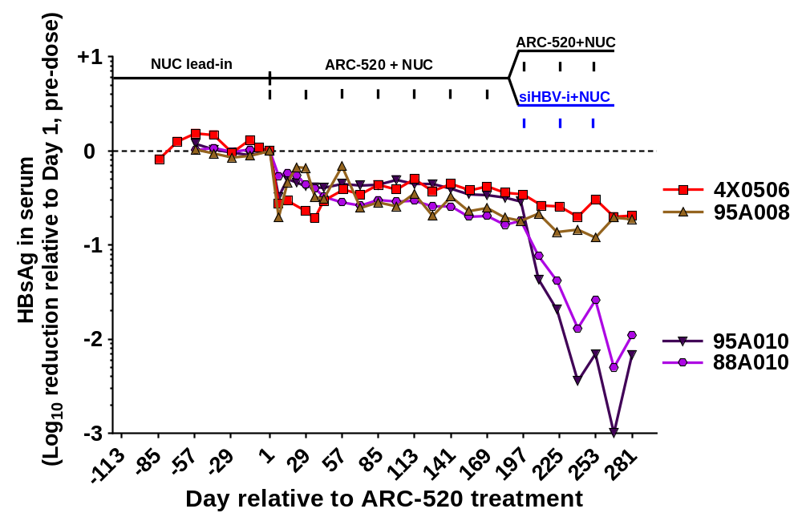
siRNA designed to target RNA derived from HBV integration products in HBeAg- chimps increases HBsAg reduction
ARC-520
siHBV-i (+ARC-EX1)
siHBV-i targets HBV RNA even if expressed from integrated HBV DNA
siHBV-i gave deep reductions in HBsAg in HBeAg- chimps, similar to those observed using ARC-520 in HBeAg+ chimps
Notes:
siHBV-i also delivered with ARC-EX1

Slide 18
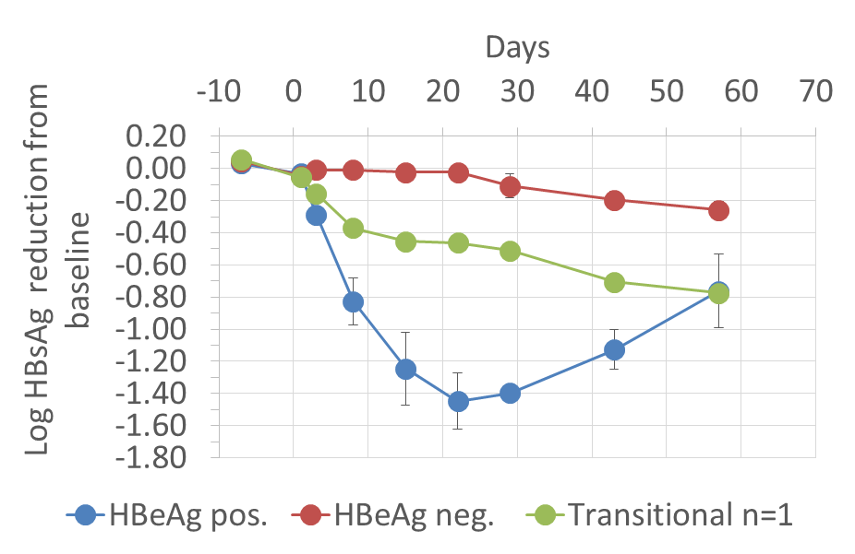
ARC-520 in NUC-naïve chronic HBV patients:
Human HBsAg data reflects chimp data
High level knockdown of HBsAg in HBeAg positive patients
HBeAg negative patients respond less well
HBeAg transitional patient is intermediate
4 mg/kg ARC-520: NUC-naïve chronic HBV patients
As in chimps, HBeAg negative patients likely produce significant amounts of HBsAg from integrated DNA not targeted by ARC-520.

Slide 19
ARO-HBV: Key Design Elements
Subcutaneous dosing, monthly or less frequent
No need for active endosomal escape agent
Addresses full HBV transcriptome
  Works for cccDNA and integrated-derived transcripts
Multiple triggers to avoid resistance development
Powerful HBsAg reduction
Wide therapeutic index
Efficacy and safety in HBV patients

Slide 20
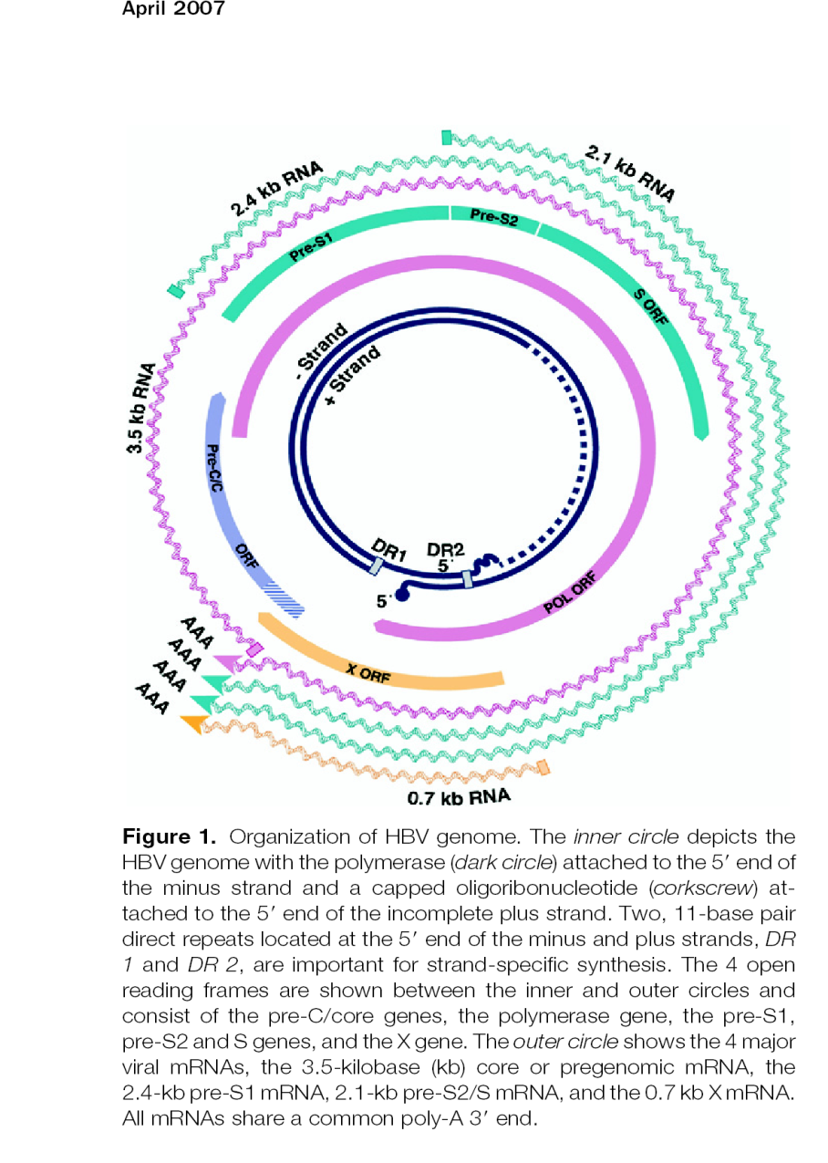
Importance of integrated HBV DNA as S mRNA source has changed RNAi strategy
Single siRNA can reduce all mRNA from cccDNA but can miss integrated HBV-derived mRNA
Combination of X and S triggers → ARO-HBV
  Greater genome coverage (99.6% full match of 17mer in ~7000 HBV genomes)
  Reduce chance of resistance
New S Trigger
HBV Transcript Map
Validated X Trigger

Slide 21
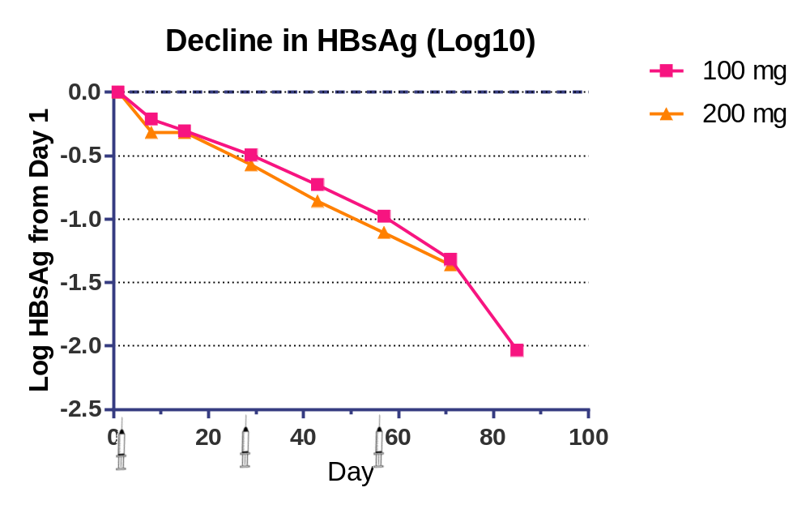
HBsAg Reduction with ARO-HBV After 3 monthly Doses
Includes cohorts with complete data through 14 days after 3rd dose
N=4
N=4
Max reduction 4 logs

Slide 22
CHB patient AE Table
AEs in >1 subject (data cut 8/24/2018)
AROHBV1001 HBV Patients | Cohort 2b, 100mg X3 Q28 days | Cohort 3b, 200mg X3 Q28 days | Cohort 4b, 300mg X3 Q28 days | Cohort 5b, 400mg X3 Q28 days | Cohort 6, 100mg X3, Q2 wk | Cohort 7, 100mg X3 weekly | Cohort 8, e+ 300mg X3 Q28 day | Cohort 9, e+ 300mg X3 Q28 day | Cohort 10, 200mg X3 Q28 day | Cohort 11, 300mg X3 Q28 day | Total AEs
AE Reported Terms | Open Label n = 4 | Open Label n = 4 | Open Label n = 4 | Open Label n = 4 | Open Label n = 4 | Open Label n = 4 | Open Label n = 4 | Open Label n = 4 | Open Label n = 4 | Open Label n = 4
Insect bites ankles, Flea bites on neck | 1 |  | 1 |  |  |  |  |  |  |  | 2
Upper respiratory tract infection, Sore throat, Laryngitis, Dry cough | 1 |  | 1 |  | 3 | 1 |  |  | 1 |  | 7
Erythema around injection sites, Injection site redness, Haematoma at injection site, Injection Site Bruise |  |  | 1 | 2 |  | 2 | 1 |  |  | 1 | 7
Facial acne, acne |  |  |  |  |  |  | 2 |  |  |  | 2
Headache, headache – intermittent |  |  | 1 |  |  | 2 |  |  |  |  | 3
Raised Creatine kinase |  |  | 1 |  |  |  | 1 |  |  |  | 2
TOTALS | 2 | 0 | 5 | 2 | 3 | 5 | 4 | 0 | 1 | 1 | 23

Slide 23
Interim AROHBV1001 Findings
Mean reduction of HBsAg was 2.0 log10 on day 85 in cohort 2b (100 mg) and 1.4 log10 on day 71 in cohort 3b (200 mg)
  This may not be the nadir
Maximum reduction of HBsAg was 4.0 log10
Activity demonstrated in all patient types (HBeAg pos/neg, NUC naïve/treated)
Response appeared to be independent of starting HBsAg levels
ARO-HBV appeared to be generally well-tolerated as of the data cutoff (August 24, 2018)
  Injection site reactions were observed in approximately 10% of injections

Slide 24
Second Example: Inarigivir

Slide 25

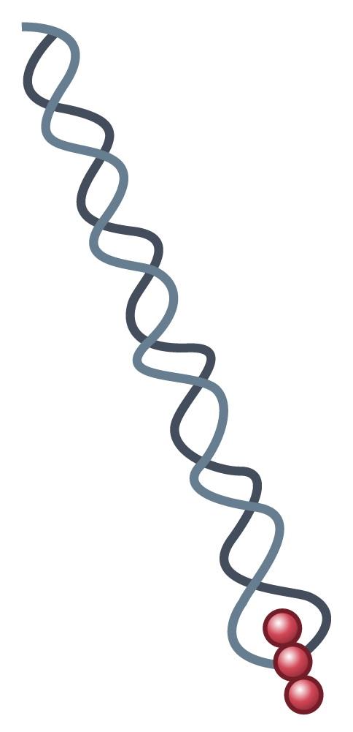
INARIGIVIR: A NOVEL, ORAL SELECTIVE IMMUNOMODULATOR WITH A DUAL MECHANISM OF ACTION
INARIGIVIR
OATP1
RIG-I ACTIVATION
AND BINDING TO
HBV PGRNA
RIG-I
DAA EFFECT TARGETING REPLICATION COMPLEX
INARIGIVIR is a RIG–I AGONIST which is designed to:
Restore hepatic selective innate and adaptive immune response stimulating the production of type I and III IFNs
Inhibit the HBV replication complex via a direct acting anti-viral effect
Result in significant anti-HBV activity with reduction in HBV DNA, HBV RNA, HBsAg
and cccDNA
RIG-I
HBV polymerase
ε
ε
5’
3’
5’
3’
HBV pgRNA
HBV pgRNA
Reverse transcription
Viral replication
TYPE III
IFNs
Dual antiviral effect against HBV
  HBV, hepatitis B virus; IFN, interferon; pgRNA, pregenomic RNA; RIG-I, retinoic acid-inducible gene-I.
  Sato et al. Immunity. 2015;42:123-132.
Hepatocyte
SPRING BANK PHARMACEUTICALS, INC. © 2018

Slide 26
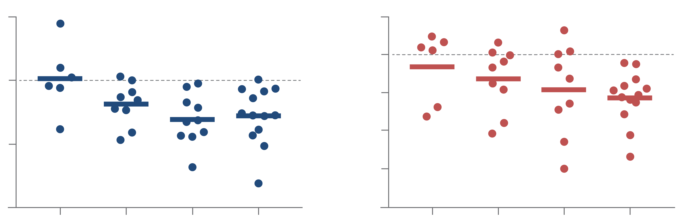
INARIGIVIR DEMONSTRATES A CONTINUING POSITIVE DOSE RESPONSE IN HBeAg +VE PATIENTS AT WEEK 12
HBV DNA
HBV RNA
1
Inarigivir vs PL
*p<0.03
#p<0.02
0.5
Inarigivir 100 mg vs PL
*p<0.05
0.0
0
-0.5
Log₁₀ Decline HBV DNA
Log₁₀ Decline HBV RNA
*
#
-1.0
-1
-1.5
-2
-2.0
Placebo
25 mg
50 mg
100 mg
Placebo
25 mg
50 mg
100 mg
Inarigivir Dose
Inarigivir Dose
Inarigivir
Inarigivir
SPRING BANK PHARMACEUTICALS, INC. © 2018

Slide 27
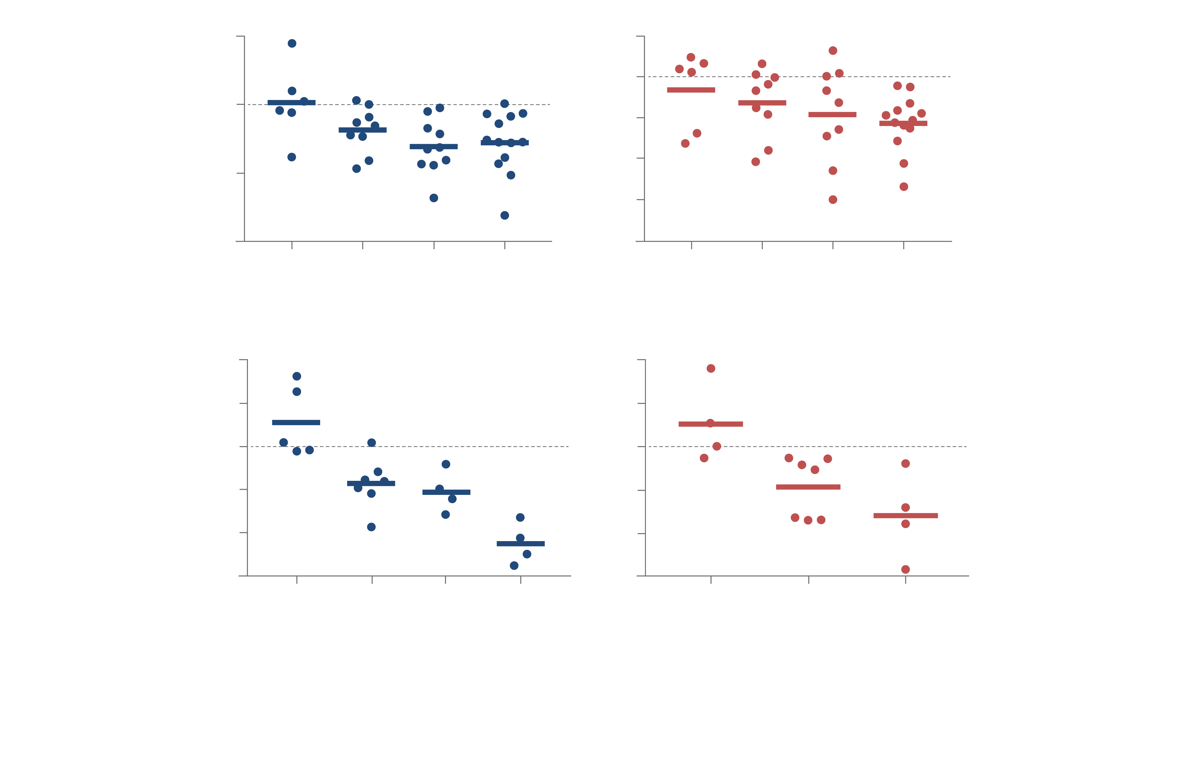
INARIGIVIR DEMONSTRATES A CONTINUING POSITIVE DOSE RESPONSE IN HBeAg -VE PATIENTS AT WEEK 12
HBV DNA
HBV RNA
2
All groups
p<0.01
4
All groups p<0.01
5 patients undetectable HBV RNA at baseline
1
2
0
0
Log₁₀ Decline HBV DNA
Log₁₀ Decline HBV RNA
-1
-2
-2
-4
-3
-6
Placebo
25 mg
50 mg
100 mg
Placebo
25 mg
50 mg and 100 mg
Inarigivir Dose
Inarigivir Dose
SPRING BANK PHARMACEUTICALS, INC. © 2018

Slide 28
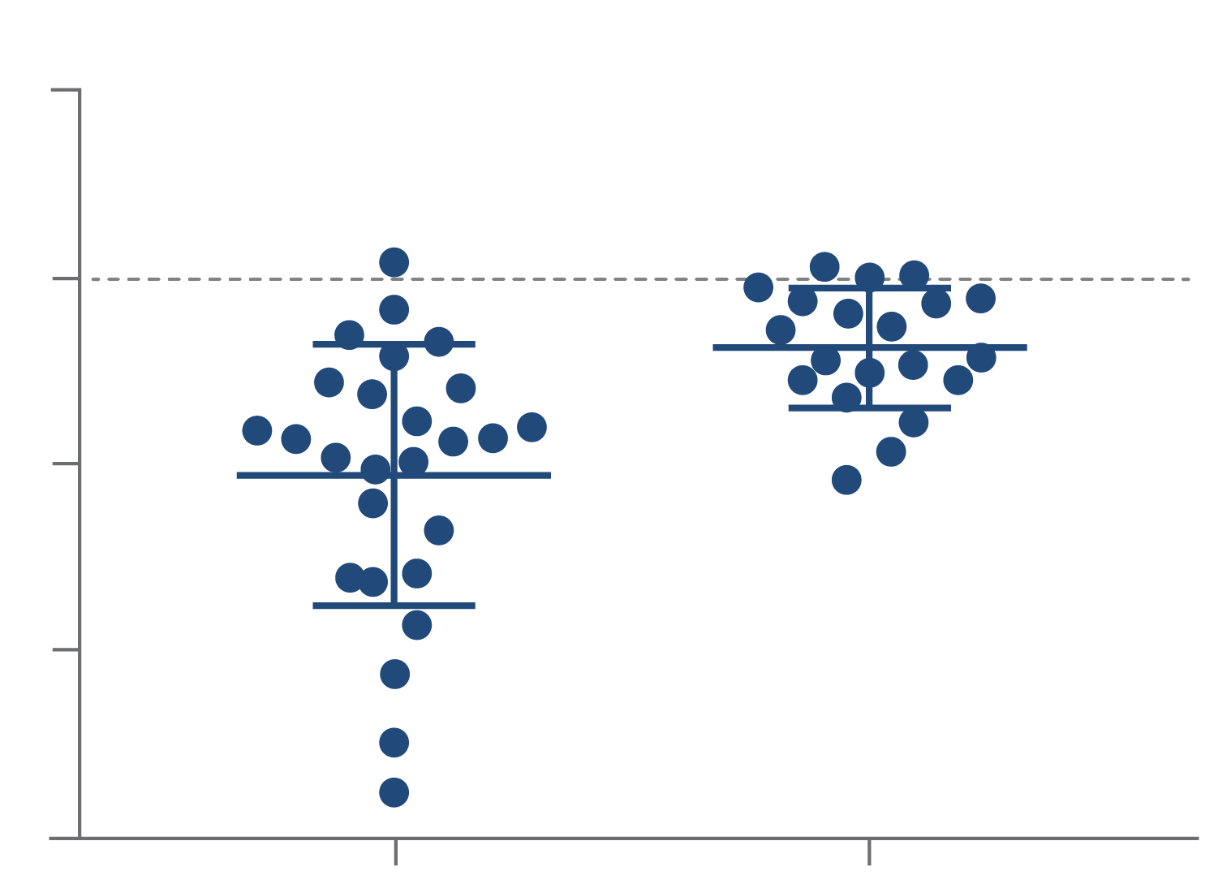
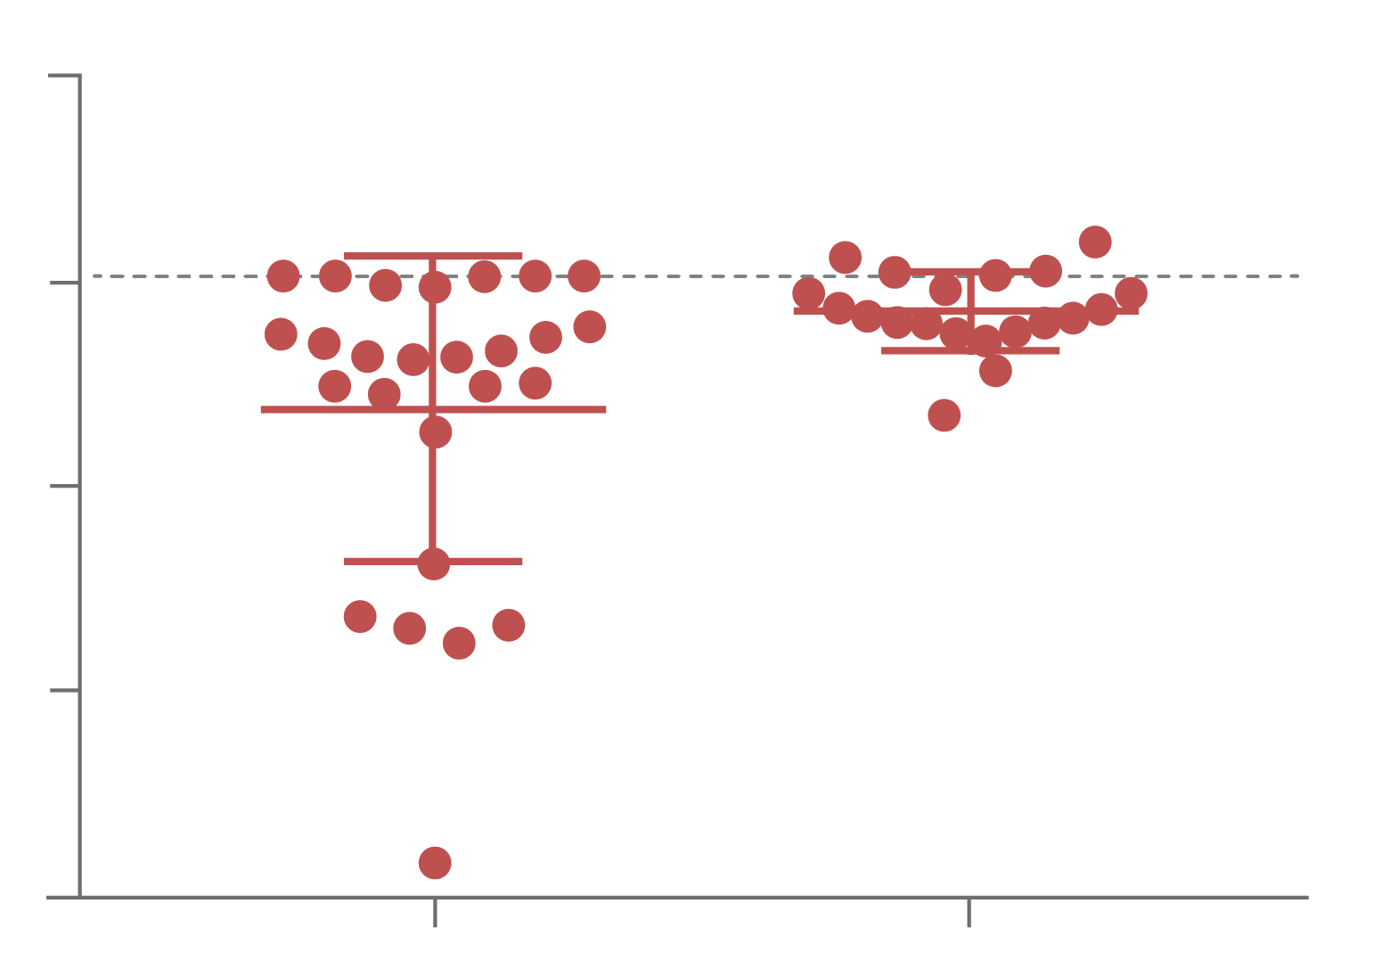
IN ALL COHORTS: BASELINE HBsAg PREDICTS RESPONSE OF BOTH DNA AND RNA TO INARIGIVIR
HBV DNA
HBV RNA
1
p<0.001
2
p<0.007
0
0
Log₁₀ Decline HBV DNA
Log₁₀ Decline HBV RNA
-1
-2
-2
-4
-3
-6
Subjects with Baseline HBsAg <4 log
Subjects with Baseline HBsAg >4 log
Subjects with Baseline HBsAg <4 log
Subjects with Baseline HBsAg >4 log
Patients: HBsAg <4 log: 16 HBeAg –ve, 10 HBeAg +ve
HBsAg >4 log: 1 HBeAg –ve, 19 HBeAg +ve
SPRING BANK PHARMACEUTICALS, INC. © 2018

Slide 29
Third Example: JNJ-6379

Slide 30
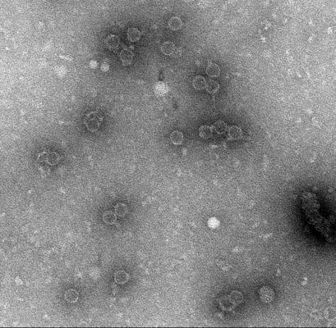
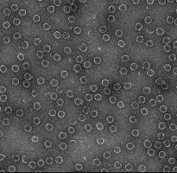
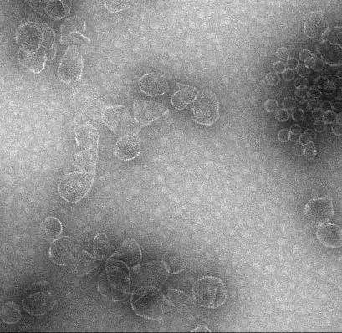
Capsid Assembly Modulator (CAM)
Also known as core protein allosteric modulator (CpAM), core (protein) inhibitor or capsid assembly effector/inhibitor
Influence assembly kinetics
Induce two types of empty capsids in vitro
Class I - Normal geometry & size
Class II - Abnormal geometry & size
DMSO
Class I - AT130
Class II - BAY41-4109
200 nm
200 nm
200 nm
Capsid Assembly Modulator
CAM
Nucleos(t)ide analog
NA
Dane particle
(Infectious DNA containing)
RNA containing particle
(pgRNA, spliced RNA)
Subviral particles
(HBsAg)
Berke JM, et al. AASLD 2016

Slide 31
HPB1001 Part 2: Chronic Hepatitis B patients
Objective and study design
The objective of Part 2 is to evaluate antiviral activity, safety and PK for 28-day oral treatment of JNJ-6379 in adult, treatment-naïve, chronic hepatitis B (CHB) patients meeting the
following criteria:
  HBeAg-positive or -negative
  Plasma HBV DNA >2,000 IU/mL
  Non-cirrhotics (F0–F2)
  ALT less than 2.5x ULN
Session 8
(8 drug; 4 placebo)
Session 9
(8 drug; 4 placebo)
Session 10
(9 drug; 3 placebo)
Optional Session A
(9 drug; 3 placebo)
100 mg
QD
25 mg
QD
8 week follow-up
The results from these sessions are being presented
here today
75 mg
QD
8 week follow-up
150 mg
QD
8 week follow-up
250 mg
QD
8 week follow-up
0
1
Dosing period (days)
28
Follow-up phase
84
Sessions 8 and 9 were conducted in Europe, and Session 10 was conducted in Europe and Asia
75 mg QD is currently being studied in the Asia-Pacific region (Session 11)
Zoulim F, et al. EASL 2018

Slide 32
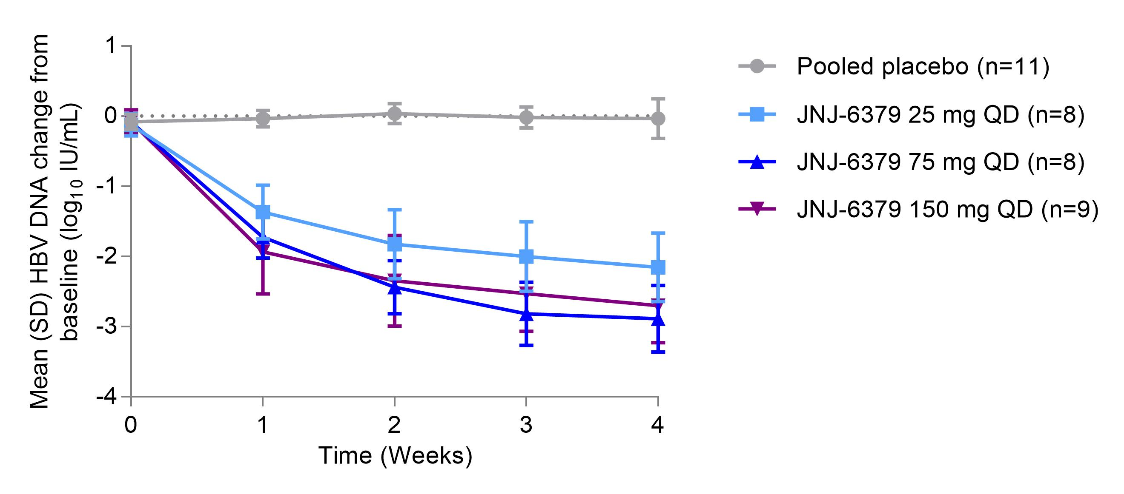

Mean HBV DNA change from baseline up to 4 weeks follow-up
Mean (SD) HBV DNA change
from baseline (log₁₀ IU/mL)
n=9
n=8
-0.04 (0.28)
Time (weeks)
n=3
**
***
-2.16 (0.49)
****
**
Each * refers to one patient with HBV DNA <lower limit of quantification of the HBV DNA assay‡
*
***
-2.70 (0.53)
*
n=5
***
***
-2.89 (0.48)
Follow-up period
6
8
Zoulim F, et al. EASL 2018
‡Roche COBAS AmpliPrep/COBAS TaqMan HBV Test, V. 2.0

Slide 33
Mean HBV DNA and HBV RNA change from baseline after 4 weeks of treatment
 | HBV DNA
 | Baseline |  |  | Day 29
Treatment arm | N | Mean (SD) log₁₀ IU/mL |  | Mean (SD) Change from Baseline log₁₀ IU/mL | <LLOQ n (%)
Session 8 (25 mg QD) | 8 | 6.90 (1.91) |  | –2.16 (0.49) | 0
Session 9 (75 mg QD) | 8 | 5.26 (1.50) |  | –2.89 (0.48) | 3 (38%)
Session 10 (150 mg QD) | 9 | 5.10 (1.56) |  | -2.70 (0.53)^{b} | 3 (38%)^{b}
Pooled placebo | 11 | 5.10 (1.64) |  | -0.04 (0.28) | 0
HBV RNA
Baselineª |  |  | Day 29
N | Mean (SD) log₁₀ cp/mL |  | Mean (SD) Change from Baseline log₁₀ cp/mL | Not detected n (%)
8 | 5.59 (2.37) |  | –2.30 (0.59) | 3 (38%)
8 | 3.39 (2.21) |  | –1.85 (1.42) | 6 (75%)
9 | 3.37 (1.66) |  | -1.67 (0.99)^{c} | 4 (80%)^{c}
11 | 3.33 (2.58) |  | 0.02 (0.86) | 3 (27%)
No relevant changes in HBsAg were observed
ª Two patients in the 75 mg JNJ-379 group, one patient in the 150 mg JNJ-6379 group and three patients in the placebo group had undetectable HBV RNA at baseline
^{b} HBV DNA at Day 29 is available for eight patients
^{c} HBV RNA at Day 29 is available for five patients
LLOQ = Lower limit of quantification
Zoulim F, et al. EASL 2018

Slide 34
Where to Next……
The next frontier is combination therapy with NUCs (usually), with Interferon (maybe to rarely) - but most importantly combining new classes
Our bias is that RNAi will be at the center of many/most/?all combos due the ability to affect the entire HBV transcriptome, including integrated DNA-sourced RNA
The bar will be very high for activity (functional cure) and safety/tolerability
Immuno-oncology agents (PD1/PDL1) monoclonals may play a role but safety concerns may dominate. In the meantime, other immune stimulation approaches are being tried

Slide 35
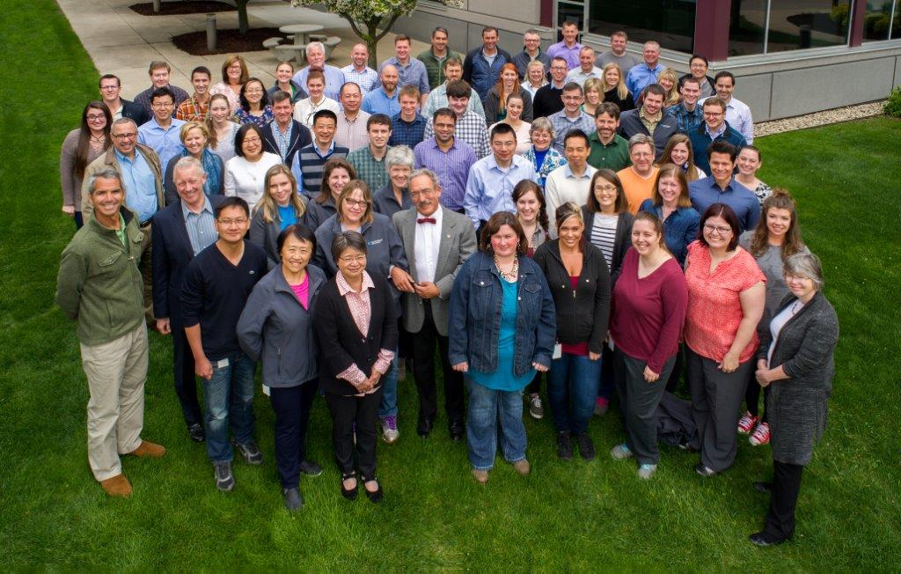
Thank you !

