Slide 1



Mindfulness-based Health Enhancement and Carbon Footprint Reduction
Bruce Barrett MD PhD
24 October 2016

Slide 2
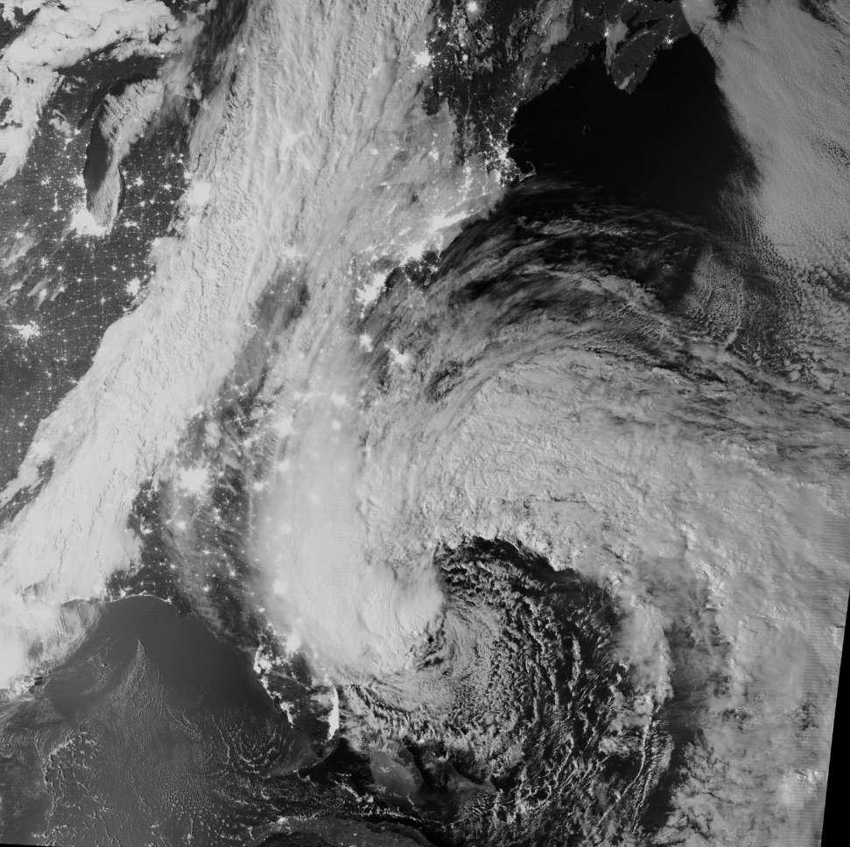
Hurricane Sandy 27 October 2013
Madison,
Wisconsin →
Atlantic
Ocean
←Lake Michigan
Chicago →
Gulf of
Mexico
Images courtesy Margaret Mooney
Mindful Climate Action Co-Investigator
Earth Science Educator, UW CIMSS
University of Wisconsin - Madison
Day Night Band Satellite Image
(reflected moonlight)
http://cimss.ssec.wisc.edu/

Slide 3

Mindful Climate Action
http://www.fammed.wisc.edu/mca/

Slide 4

Acknowledgements
Robert Wood Johnson Foundation Generalist Physician Faculty Scholars Program (2003-2007)
National Center for Complementary & Integrative Health (NCCIH) aka National Center for Complementary & Alternative Medicine (NCCAM) at the US National Institutes of Health (NIH)
K23 Patient-Oriented Career Development Grant (1999-2003)
R01 Physician Echinacea Placebo RCT (2003-2007)
R01 Meditation or Exercise to Prevent Respiratory Infection (2009- 2011)
R01 Meditation or Exercise to Prevent Respiratory Infection (2012- 2017)
K24 Mid-Career Research & Mentoring (2012- 2017)
U.W. Office of Sustainability Climate Quest planning grant (2014-2015)
Department of Family Medicine & Community Health

Slide 5

Climate Change
Threatens health
Is Time Running Out ?
What can we - as researchers and health professionals – do about it?
http://www.unep.org/climatechange/adaptation/ScienceandAssessments/

Slide 6
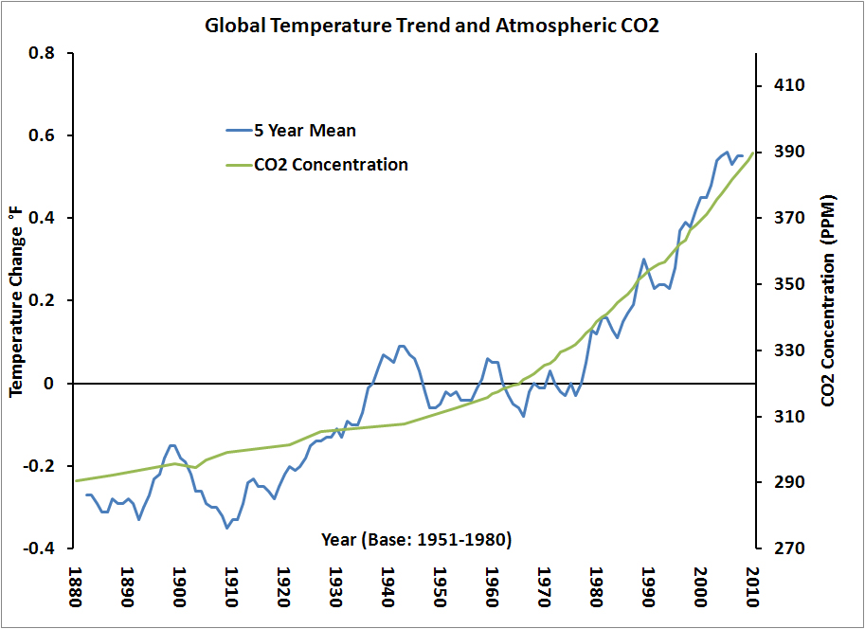
Global temperature follows C0₂ level
http://www.c2es.org/facts-figures/trends/co2-temp

Slide 7
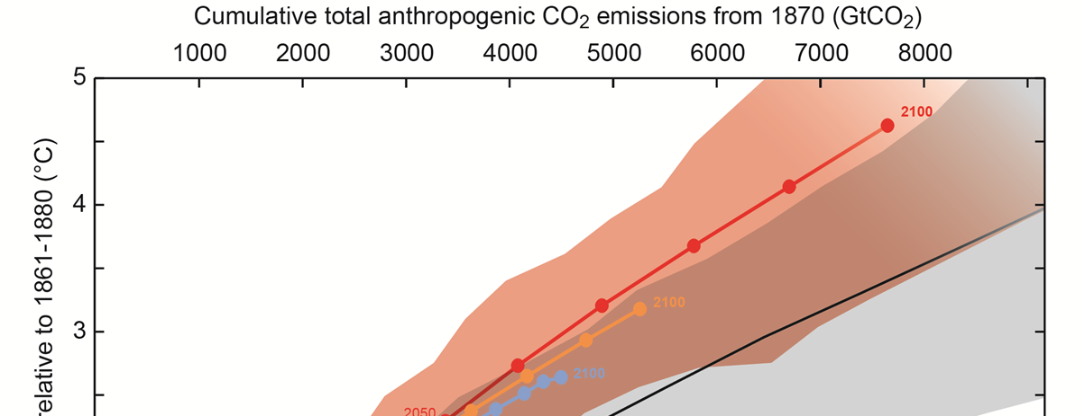
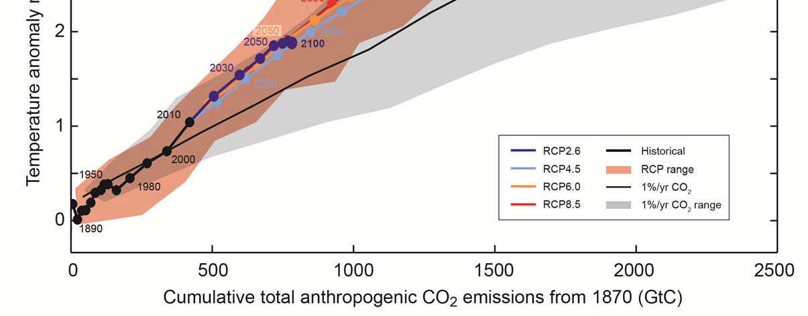
Best current predictive models from IPCC, September 27, 2013

Slide 8
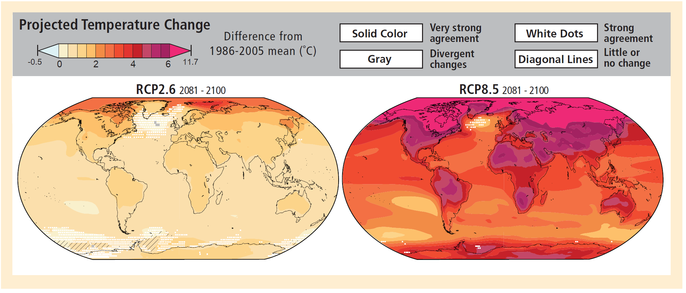
Very low emissions Business as usual = High emissions
Climate change 2014: Impacts, adaptation, and vulnerability
Intergovernmental Panel on Climate Change. IPCC Working Group 2.

Slide 9
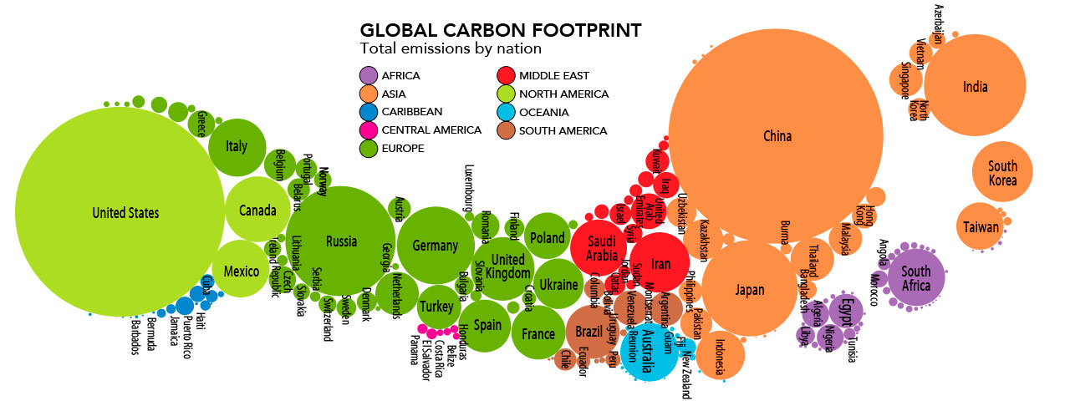
Total Carbon Footprint by Nation
http://www.stanfordkaystudio.com/information.html

Slide 10
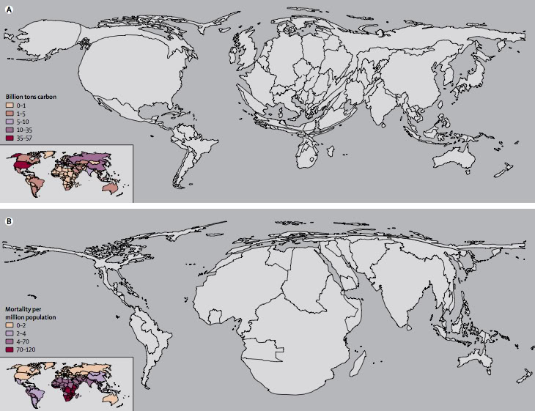
Billions of tons of carbon emitted 1950-2000
Equity, Responsibility
Least responsible,
Most vulnerable
Mortality consequences of global warming & climate change
A. Costello, et al. Managing the health effects of climate change: Lancet and University College London Institute for Global Health Commission. Lancet 373 (9676):1693-1733, 2009

Slide 11
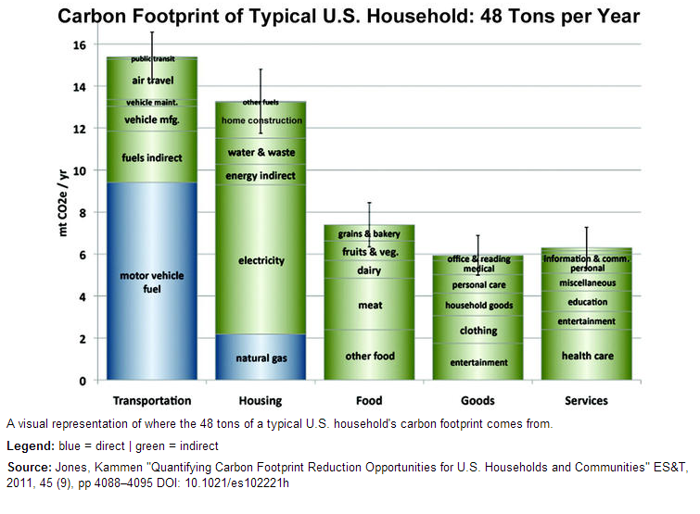

Slide 12
You can always count on Americans to do the right thing
- after they've tried everything else.
Winston Churchill
http://www.brainyquote.com/quotes/quotes/w/winstonchu135259.html

Slide 13
Mindful Climate Action - Core team
Bruce Barrett MD PhD - Team leader, Family physician, Researcher
Cathy Middlecamp PhD – Professor, Nelson Institute, Office of Sustainability
Margaret Mooney MPA – Earth science educator, Meteorologist
Mary Checovich MS – Project manager, Researcher
Maggie Grabow PhD – Post-doctoral fellow, Environmental health researcher
Alex Converse PhD – Physicist, Data analyst, Mindfulness researcher
Bob Gillespie PhD SC – Mindfulness teacher, Psychotherapist
Carmen Alonso PhD – Mindfulness teacher, Psychotherapist
Kristi Rietz OTR-L – Mindfulness teacher, Wellness program manager
Julia Yates MSSW – Clinical social worker, Psychotherapist
Elisa Torres PhD – Assistant professor, Nursing, Mind-body researcher
Roger Brown PhD – Statistician, Methodologist
Nancy Wong MBA PhD – Chair & Professor, Consumer Science & Retailing

Slide 14
Mindful Climate Action - Advisors
Jonathan Patz MD MPH- Professor, Director, Author IPCC
Richard Davidson PhD - Professor, Director, Center for Investigating Healthy Minds
Mark Johnson PhD – Director, Founder UW Climate Knowledge
Katherine Bonus MA – Founder, UW Mindfulness Program
Michele Brogunier MD – Physician, Member PSR
Steve Ackerman PhD – Director, Professor, Associate Vice Chancellor
Dick Smith JD LLB – Retired Judge, Member Citizens Climate Lobby
Dave Rakel MD - Clinician, Teacher, Director
Jon Temte MD PhD – Clinician, Researcher, Professor
MCA Consultant
Mike Berners-Lee – Director, Small World Consulting,
Lancaster University, United Kingdom

Slide 15
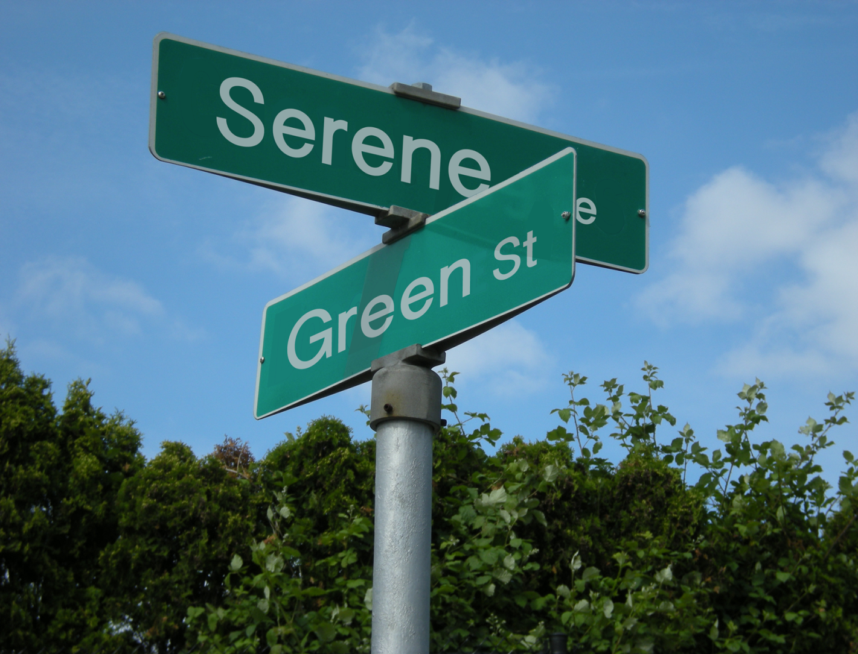
Mindful Climate Action
http://www.fammed.wisc.edu/mca/
Image courtesy of Jason Vargo 2016

Slide 16
Mindful Climate Action
Our goal:
To demonstrably influence behaviors to substantively reduce carbon footprints, and to do so in a way that enhances rather than detracts from human health and happiness.

Slide 17


IMPACT
FACTOR
1.343
IMPACT
FACTOR
1.343
Concept Paper
Mindful Climate Action: Health and Environmental
Co-Benefits from Mindfulness-Based Behavioral Training
Bruce Barrett, Maggie Grabow, Cathy Middlecamp, Margaret Mooney,
Mary Checovich, Alexander Converse, Bob Gillespie and Julia Yates
Correspondence: bruce.barrett@fammed.wisc.edu; Tel.: +1-608-263-2220
  Academic Editor: Rachel J.C. Chen
  Received: 3 August 2016; Accepted: 10 October 2016; Published: 17 October 2016

Slide 18

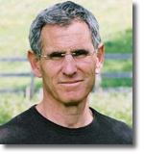

Mindfulness based stress reduction
MBSR
Pioneered by Jon Kabat-Zinn PhD
Center for Mindfulness in Medicine, Health Care
University of Massachusetts Medical School

Slide 19
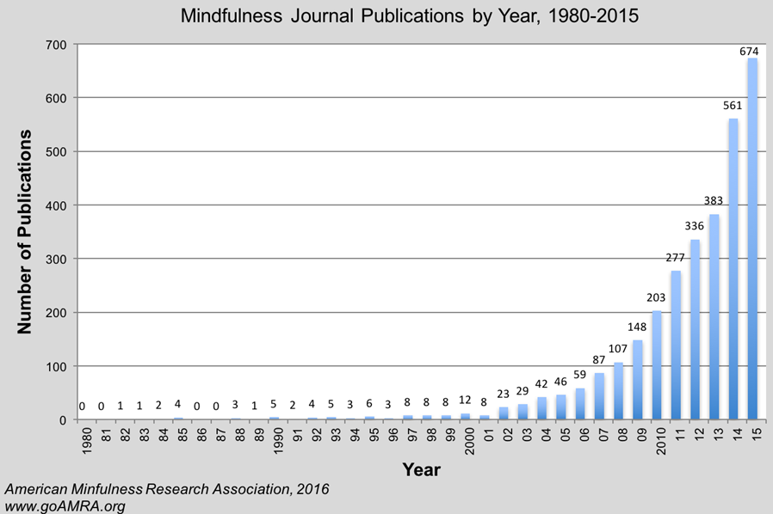
Mindfulness Research is Growing Rapidly

Slide 20
Mindfulness was defined by Jon Kabat-Zinn [¹] as:
“the awareness that emerges through paying attention on purpose,
in the present moment, and nonjudgmentally, to the unfolding of experience, moment by moment.”
Empirical research suggests that mindfulness-based behavioral training can reduce stress and anxiety, psychological distress, chronic pain, depression, and can increase quality of life [²⁻⁷].
Reference List
(1) Kabat-Zinn J. Mindfulness-based interventions in context: Past, present, future. Clin Psychol Sci Prac 2003; 10:144-156.
(2) Agency for Healthcare Research and Quality. Meditation programs for psychological stress and well-being. Comparative Effectiveness Review #124, 1-144. 2014.
(3) Black DS. Mindfulness-based interventions: an antidote to suffering in the context of substance use, misuse, and addiction. Subst Use Misuse 2014; 49(5):487-491.
(4) Black DS, Slavich GM. Mindfulness meditation and the immune system: a systematic review of randomized controlled trials. Ann N Y Acad Sci 2016.
(5) Chiesa A, Serretti A. Mindfulness-based interventions for chronic pain: a systematic review of the evidence. J Altern Complement Med 2011; 17(1):83-93.
(6) Kuyken W, Hayes R, Barrett B, Byng R, Dalgleish T, Kessler D et al. Effectiveness and cost-effectiveness of mindfulness-based cognitive therapy compared with maintenance antidepressant treatment in the prevention of depressive relapse or recurrence (PREVENT): a randomised controlled trial. Lancet 2015; 386(9988):63-73.
(7) Lauche R, Cramer H, Dobos G, Langhorst J, Schmidt S. A systematic review and meta-analysis of mindfulness-based stress reduction for the fibromyalgia syndrome. J Psychosom Res 2013; 75(6):500-510.

Slide 21
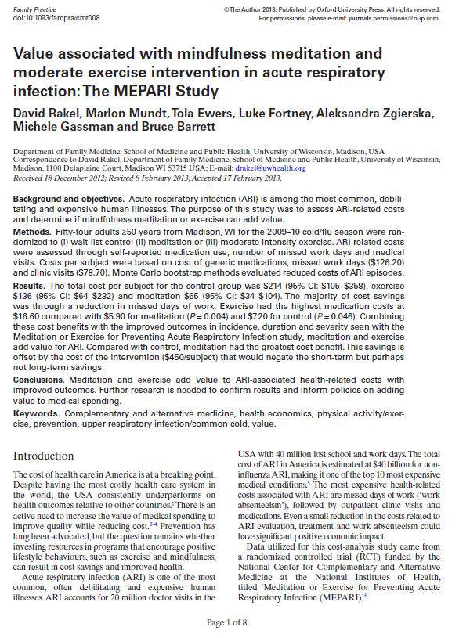
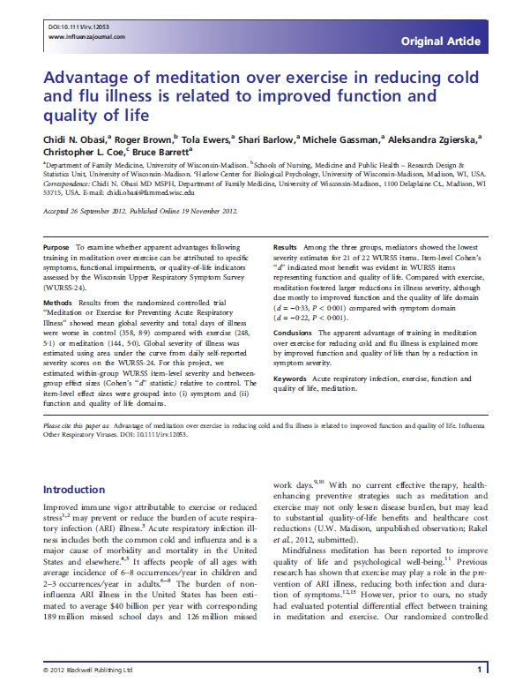
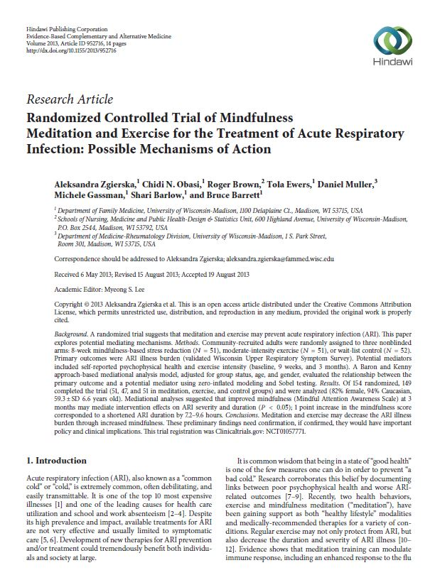
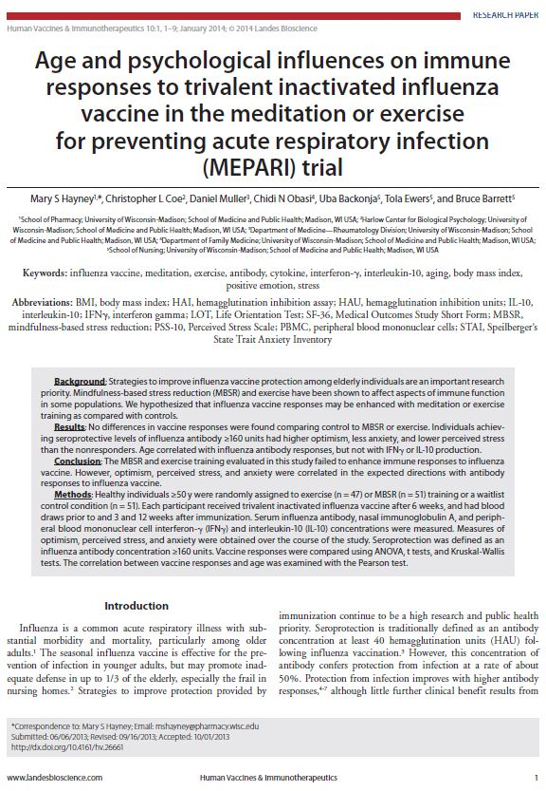
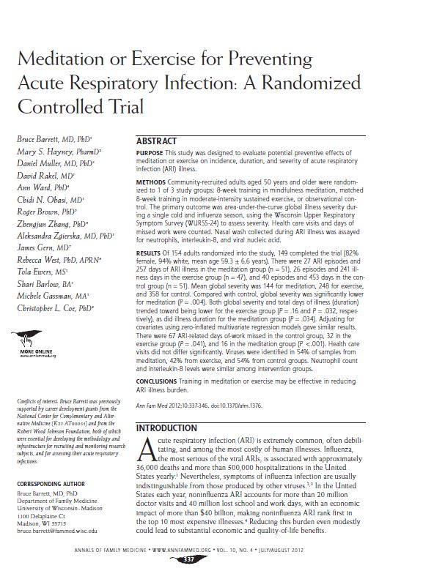
From our first Mindfulness Trial

Slide 22
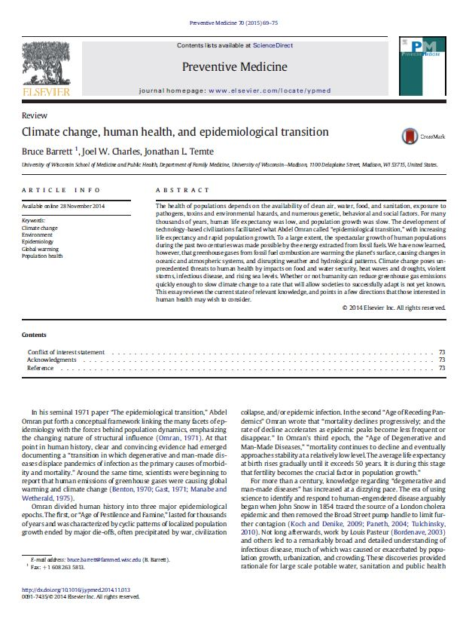
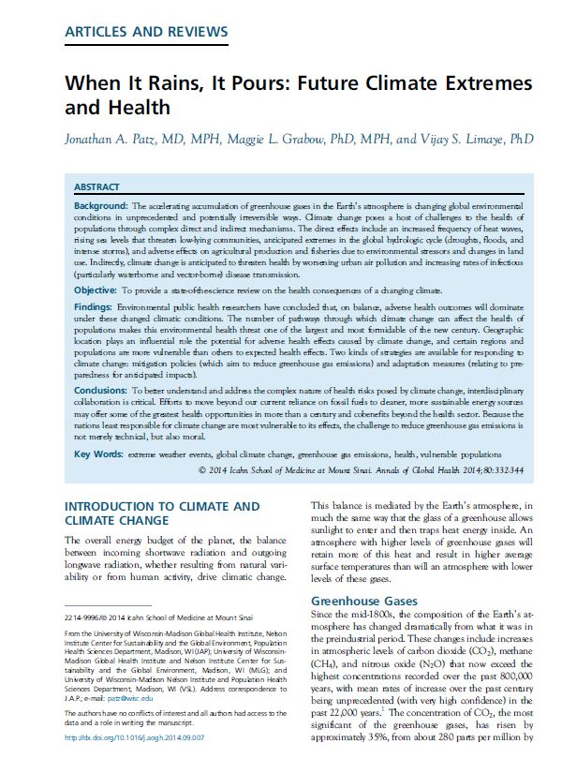
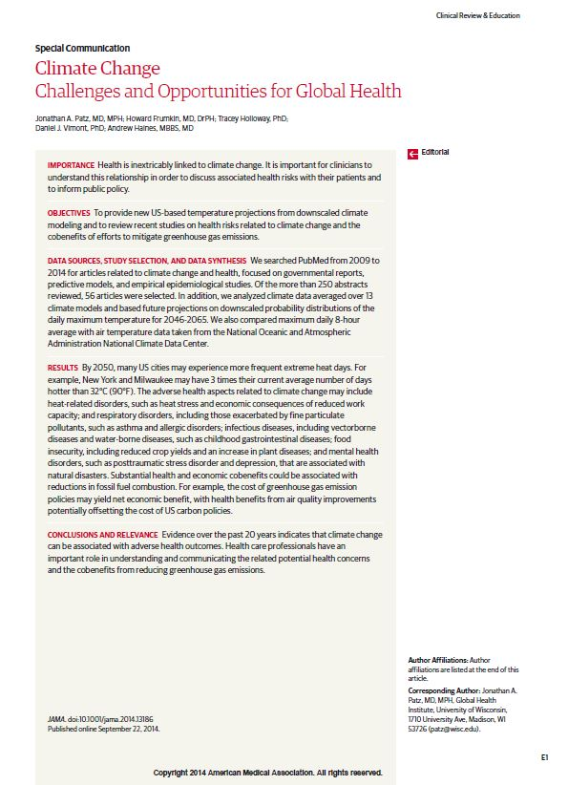

Slide 23
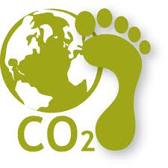
Goal / Hypothesis
Mindfulness-based behavioral trainings will:
Help people to reduce their carbon footprints
greenearthoutdoors.com

Slide 24
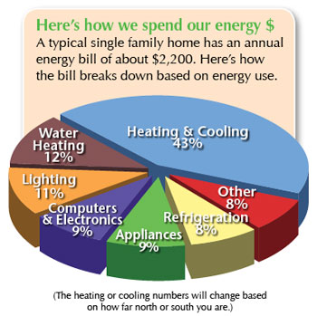
Personal & Household Energy Use
Use your
Thermostat
To save energy
Sweaters and
Long underwear
in Winter
Shortsleeves
and Shorts
in Summer
Do you really need
that air conditioner?
www.drenergysaver.com

Slide 25
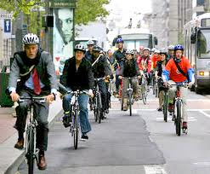
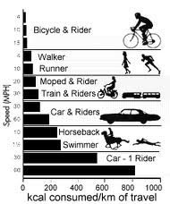
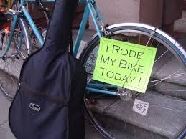
Walk, Bike to Work
www.zifflaw.com
www.theoildrum.com
www.flickr.com

Slide 26
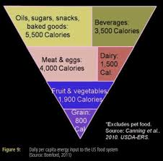
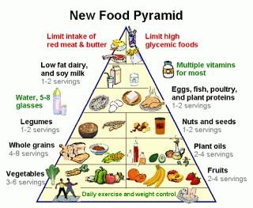
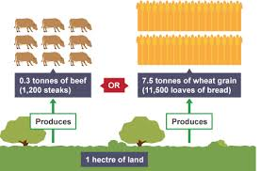
Eat lower on the food chain
www.businessinsider.com
digestiondarryltan2h.blogspot.com
www.bbc.co.uk

Slide 27

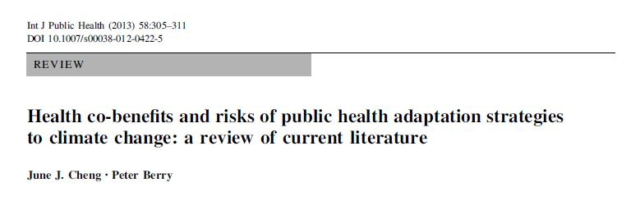
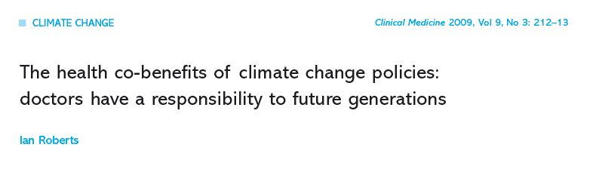
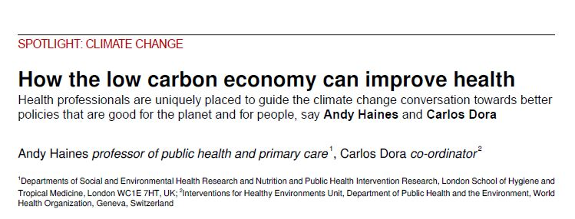
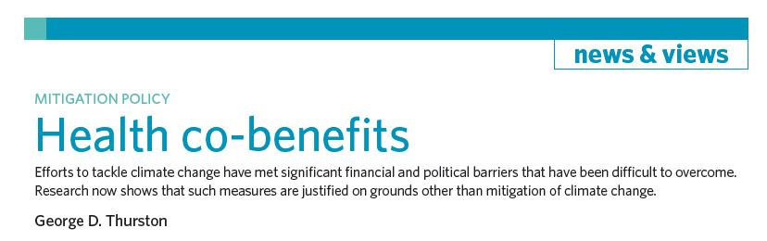
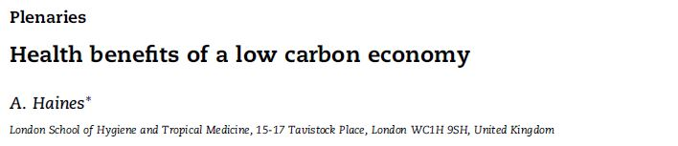
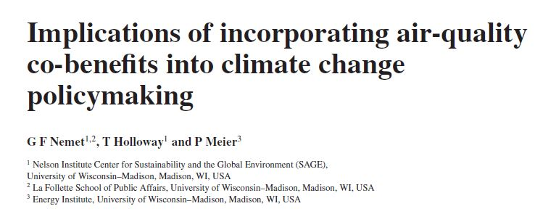
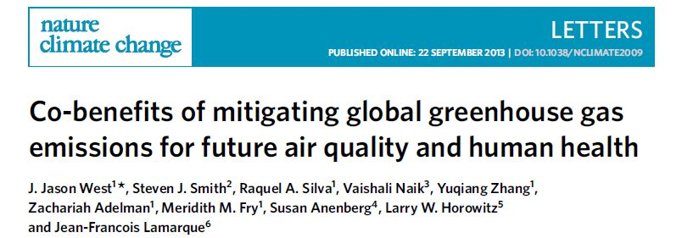
Co-Benefits = “win-win” scenario

Slide 28
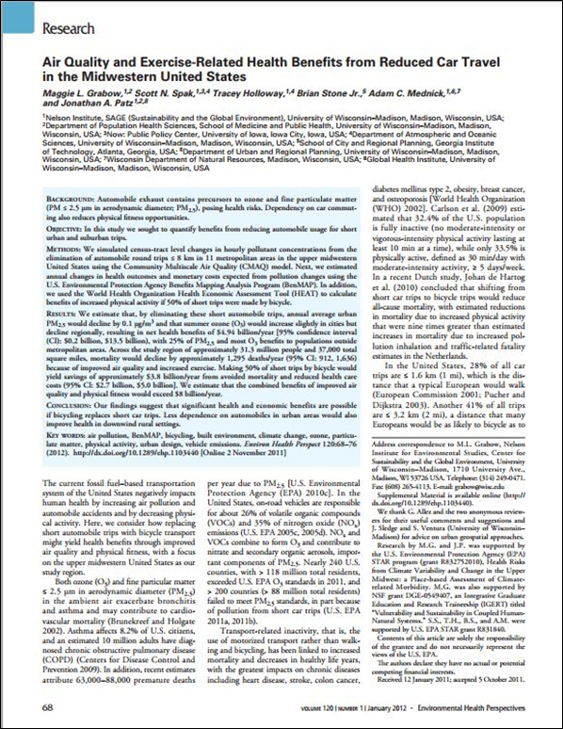
What would happen if 50% of short automobile trips
(≤ 8 kilometers) were replaced by foot or bicycle?
physical activity
air pollution
automobile accidents
petrol consumption
Modelled using data from 11 metropolitan areas in the Upper Midwestern U.S, and validated methods/algorithms

Slide 29

Air Quality and Exercise-Related Health Benefits of Reduced Car Travel in the Midwestern United States
Grabow et. al
Mortality declines regionally by 1,295 deaths per year
Combined regional benefits exceeds $8.7 billion / year
Health improvement in downwind rural areas
Reduction in climate change causing greenhouse gases
Small changes in air quality = huge health benefits

Slide 30
Stages of Change Theory –
DiClemente & Prochaska
Maintenance
Action
Preparation
Contemplation
Pre-contemplation
5
4
3
2
1

Slide 31

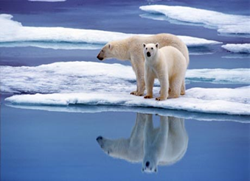
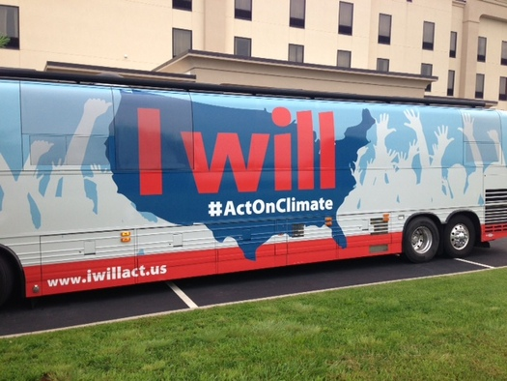
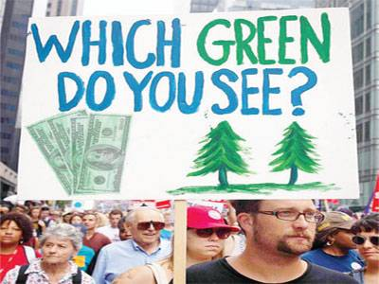
Four Climate Change “camps”
Climate Change Deniers:
Pre-contemplation
Climate Change Acceptors:
Contemplation
Climate Change Supporters:
Preparation
Climate Change Activists:
Maintenance

Slide 32
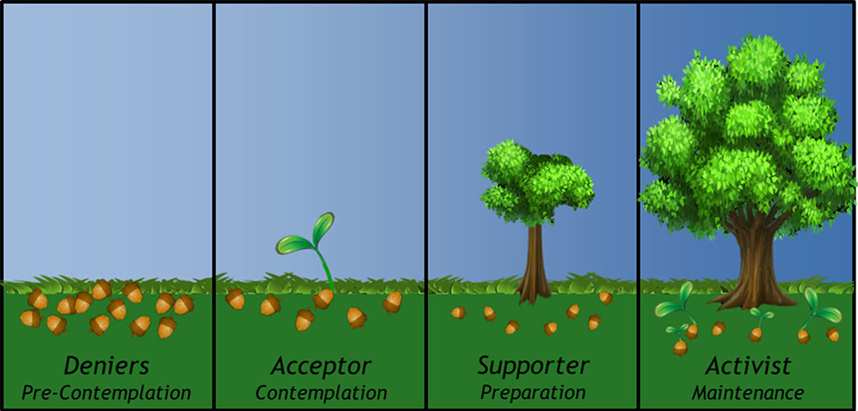
Mindful Climate Action: Health and Environmental
Co-Benefits from Mindfulness-Based Behavioral Training
Bruce Barrett, Maggie Grabow, Cathy Middlecamp, Margaret Mooney,
Mary Checovich, Alexander Converse, Bob Gillespie and Julia Yates
Published 17 October 2016

Slide 33
Week | Mindfulness Topic | Practices Learned | Climate Action Topic | Objective
1 | Cultivating Beginner’s Mind (Simple Awareness) | Mindful eating Breath Awareness Body Scan | Mindful Eating: Healthy and Sustainable Diets | Develop awareness of the varying environmental and health impacts of food
2 | Cultivating Non-striving (Attention and The Brain) | Loving Kindness Meditation | Water Considerations for Sustainable Lifestyles | Learn and understand the many implications of a changing climate on water scarcity
3 | Cultivating Acceptance (Dealing with Thoughts) | Mindfulness within movement Hatha Yoga Walking Meditation | Walking Meditation, Exercise, and Active Transport | Motivate participants to choose active modes of transport whenever possible
4 | Cultivating Patience (Stress: Responding vs. Reacting) | Sitting meditation | Energy Conservation | Make connections between daily activities and energy use and understand the benefits of reducing energy consumption;
5 | Cultivating Letting Go (Dealing with Difficult Emotions/Sensations) | Sitting meditation | Climate Connections Across Time and Space | Develop awareness of the connectedness of all living beings and ecosystems
6 | Cultivating Trust (Mindfulness and Communication) | Compassion for the conditioned mind Yoga Part 2 | Ethical considerations and observed inequities in the causes and consequences of climate change. | Develop awareness of broader impacts of climate change on those least responsible;
7 | Cultivating Forgiveness (Mindfulness and Compassion) | Sitting meditation with choiceless awareness (Metta)Loving Kindness meditation | Personal and Planetary Well-Being; Purchasing and Consumption | Understand concepts of desire and fulfillment, motivation, striving, purchasing, and the cycle of wanting and reward
8 | Sustaining Practice in Times of Transition (Conclusion) | Self-directed yoga | Mindful Climate Learnings | Discuss how to keep the momentum of mindful climate action going in every-day lives

Slide 34
Objective, Measureable Outcomes
Outcome | Research Tool (outcome measures)
Climate Change and Energy Knowledge | College intro-level test on climate change, energy & carbon footprint
Utilities | Household consumption of: 1) gas (therms); (over 12 months) 2) electricity (kilowatt hours) 3) water (gallons)
Fossil-Fuel Transport | Automobile miles driven - Odometer readings Travel by air, bus and train - Itineraries
Active Transport | Active transport vs carbon-fueled transport - Moves app Exercise - ActiGraph accelerometer
Dietary Composition | Dietary carbon footprint - Prospective food & drink intake log analyzed using Nutritional Data System for Research (NDSR)
General Mental and Physical Health | SF-36 – Highly validated, short form General Health survey PSS-10 - Perceived Stress Scale PHI - Pemberton Happiness Index CES-D -Center for Epidemiologic Studies Depressive Symptoms Scale MSES – Mindfulness-based Self-Efficacy Scale StPS - Stanford Presenteeism Scale Good Health is a Co-Benefit of Carbon Footprint Reduction!

Slide 35

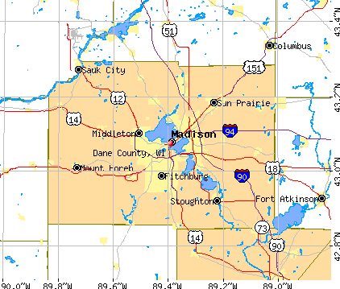
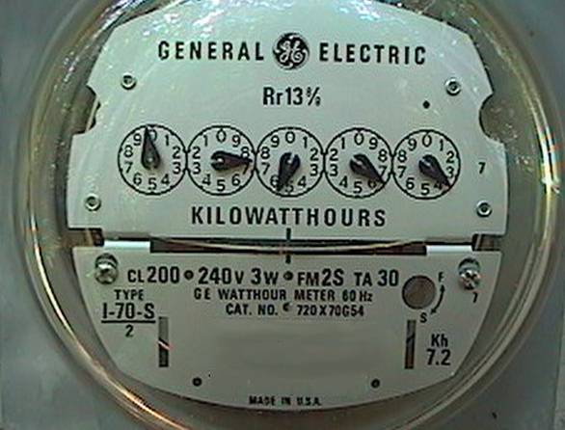
Household Gas & Electric use will be monitored monthly
using MG&E’s accessible online database

Slide 36
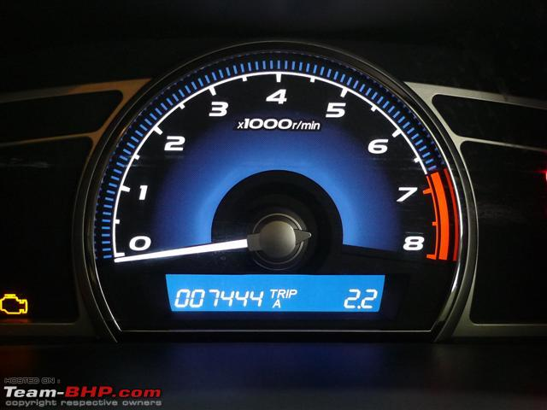
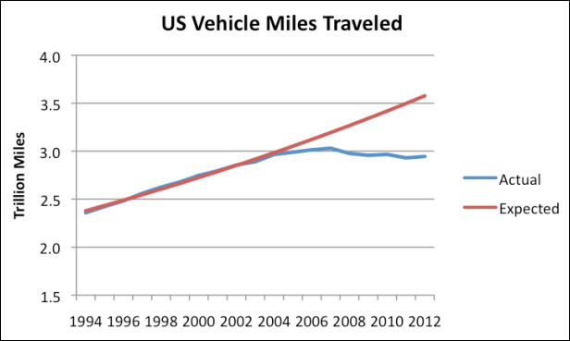
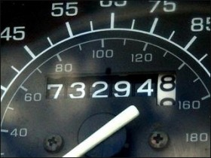
Automobile miles driven will be monitored using odometer readings photos
emailed or texted using smart phone
http://www.financialsense.com/

Slide 37
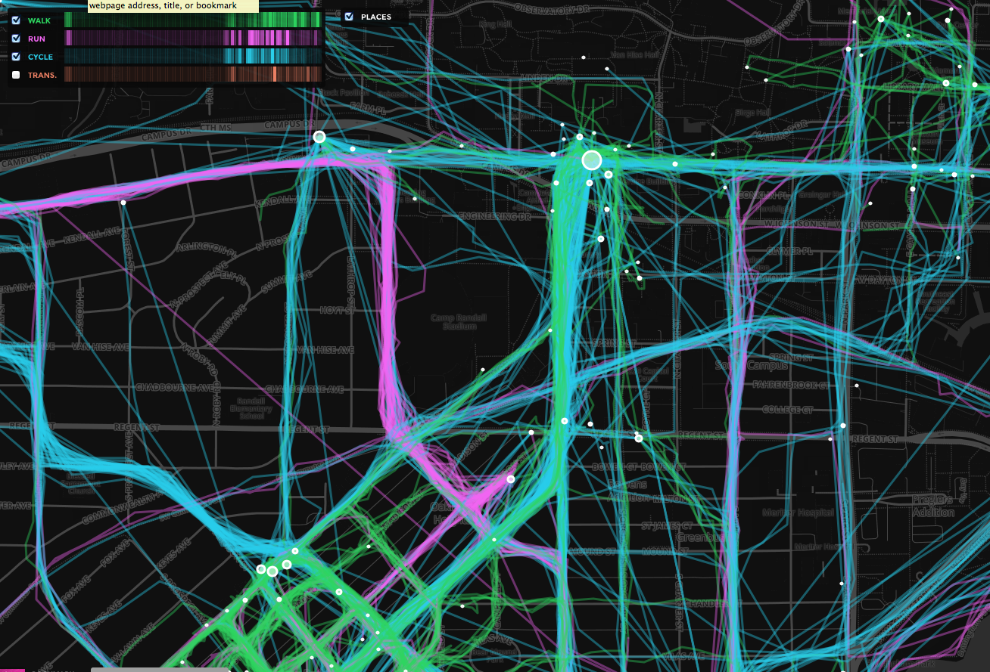
MOVES App Activity Map by Transportation Mode

Slide 38
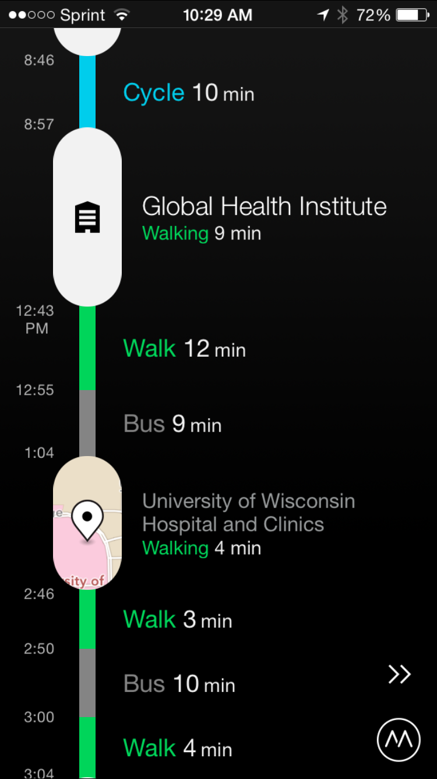
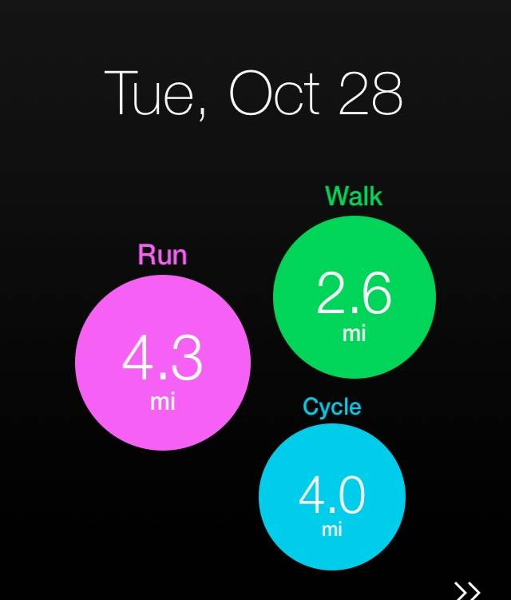
MOVES App
Activity Storyline ➔
Travel Mode Distance Summary ⬆

Slide 39

Widely used & State of the art
Comprehensive and current food database
Streamlined data entry and food coding
Calculates calories, nutrients, micronutrients
Adaptable towards carbon footprint calculation

Slide 40

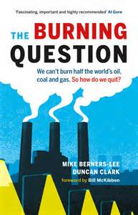
Consulting Advisor
Mike Berners-Lee and Small World Consulting at the University of Lancaster, Great Britain, will consult and assist with quantifying carbon footprints
CF = ΣCiEi
CF = individual carbon footprint
C = Consumption
E = Emission
i = Input
Inputs to be assessed include:
Gas & Electricity; Automobile transport
Air transport; Dietary consumption

Slide 41

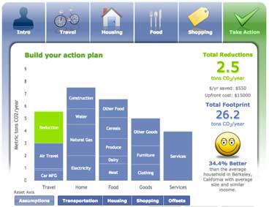

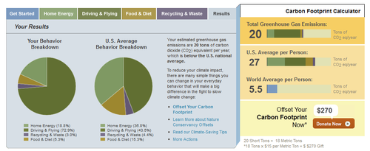
http://coolclimate.berkeley.edu/
carbon footprint calculator

Slide 42







Business & Community Partners
www.ymcadanecounty.org
www.goodmancenter.org
www.cleanlakesalliance.com
www.fusmadison.org
www.promega.com
www.cunamutual.com
www.amfam.com

Slide 43




First,
Next,

Slide 44













Potential future funders. . .
Tom Steyer

Slide 45

Scaling Up Mindful Climate Action business plan
market MCA trainings to:
Businesses ↓energy costs ↓ absenteeism ↑ worker productivity
Community and faith-based organizations mission & moral mandate
Educational institutions educational mission & innovation
General Public in-person courses & web-based learning
http://yourstory.in/wp/content/uploads/2012/06

Slide 46




Expanding MCA Program

Slide 47

NASA
NOAA
UW CIMSS
http://goes.gsfc.nasa.gov/goescolor/goeseast/overview2/color_lrg/latestfull.jpg

