Slide 1
A Comprehensive Method for the Screening of Drugs in Severely Decomposed Human Tissues by Fast Gas Chromatography/Tandem Mass Spectroscopy (Fast GC-MS/MS)
Brian Waters, Kenji Hara, Natsuki Ikematsu, Mio Takayama,
Aya Matsusue, Masayuki Kashiwagi, Shin-ichi Kubo
Fukuoka University, Faculty of Medicine, Department of Forensic Medicine
7-45-1 Nanakuma, Jonan-ku, Fukuoka, JAPAN
Declaration of Interest: The Authors declare that there are no conflicts of interest with regard to this study.

Slide 2
About the Author
Bachelor of Science (B.S.) – Textile Chemistry, North Carolina State University, Raleigh, NC, USA, 1998
Masters of Science (M.S.) – Criminalistics, California State University, Los Angeles, USA, 2002
Senior Criminalist, County of Los Angeles, Department of Coroner/Medical Examiner, Los Angeles, CA, USA, 2003-2011
Assistant Professor, Fukuoka University, Department of Forensic Medicine, Fukuoka, Japan, 2011-Present.

Slide 3
Statement of the Problem
Drug screening is an important reference in forensic autopsy investigations.
In postmortem toxicology, often the samples provided for analysis are in a severe state of putrefaction or decomposition.
The presence of breakdown products such as lipids and amino acids make extraction of the compounds of interest difficult.
Developing an analytical method capable of detecting trace levels of analytes from the interfering substances present in these complex matrices would benefit the toxicology community.

Slide 4
Selection of Toxicologic Specimens Body Fluids
Body fluids are easier to handle and process
Blood is the most common and preferable
Urine is easy to obtain and store
Vitreous humor is isolated and thus resistant to contamination
Bile is useful in some circumstances
Cerebrospinal fluid is good for hydrophobic compounds
Stomach contents can be useful in overdose cases and in cases where concentrations are too low in the other specimens

Slide 5
Selection of Toxicologic Specimens
Tissues
Tissues are the most resistant to decomposition and are often the only specimens available in cases of severe trauma
Liver filter for the blood
Kidney also a filter; collector and dispenser of urine
Brain useful for hydrophilic compounds
Lung useful for volatile compounds
Spleen most closely mimics blood
Muscle also correlates closely to blood
Adipose (fat) tissue best for hydrophobic compounds
Hair is resilient and best for determining a history of use
Bone and bone marrow often all that is left; useful for heavy metals

Slide 6
Methodology & Theoretical Orientation
For this study, putrefied and decomposing tissue samples from actual cases autopsied at our department were analyzed.
Human tissue specimens consisted of liver, kidney, spleen, lung, muscle, and brain, if available.
The extraction methods used were effective in detecting a wide array of drugs, including barbiturates, antipsychotics, antihistamines, hypertension and cholesterol medications, anxiolytics and hypnotics, illicit narcotics, and novel psychoactive substances.

Slide 7
Extraction Overview
Two separate extraction methods were developed, one for basic drugs and another for acidic and neutral compounds.
Specimens of 0.2 g were homogenized, acidified or alkalized, and extracted with acetonitrile.
Lipid-removal and solid-phase extraction cartridges were employed while carefully monitoring the pH of samples to ensure the adequate removal of interfering substances.
The extracts were evaporated and reconstituted in n-propyl acetate:methanol (1:1) for fast GC-MS/MS analysis.

Slide 8
List of Internal Standards
Caffeine-d₃
Lidocaine-d₁₀
Diazepam-d₅
2-Naphthylacetic acid
Acetaminophen-d₃
Zolpidem-d₇
Valproic acid-d₆
Promethazine-d₃
Phenobarbital-d₅
Etizolam-d₃
Nicotine-d₃
_{For acidic compounds}
Notes:
This is a list of internal standards that we use in our screening analysis. They are mostly comprised of deuterated analogs of some of the more common drugs that we encounter. The compounds in red are particularly useful in the screening of acidic compounds. The addition of an internal standard not only helps to gauge the efficiency of the extraction, but also allows for the semi-quantitative analysis of the detected compounds.

Slide 9
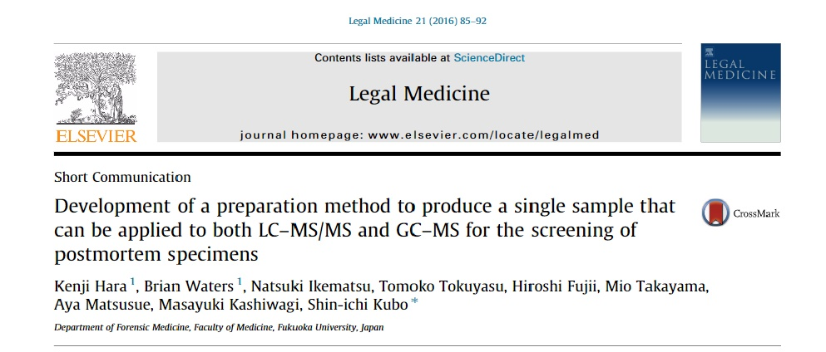
Preparation Method
The current method is based on this publication by our group (Hara et al., 2016)

Slide 10
Extraction Methods
Method A
(for acidic / neutral drugs)
Method B
(for basic drugs)
0.2 g of tissue, add 0.8 mL d.H₂O
Add 0.01 mL IS solution
Homogenize in beads crusher for 1 min
Add 2.5 mL acetonitrile
Add 0.1 mL ammonia water
Add 0.06 mL 5M NaOH (pH >8)
Add 0.06 mL formic acid
Add 0.06 mL 5M HCl
Vortex, centrifuge, pass supernatant through Captiva ND Lipids cartridge, add 3.5 mL acetonitrile
Add 0.03 mL of 5M HCl (pH <3), 0.6 g of NaCl, 2 g of MgSO₄
Add 0.8 mL of 5M NaOH (pH > 8), 0.6 g of NaCl, 1 g of Na₂CO₃, 2.6 g MgSO₄
Add 0.15 mL ammonium formate, adjust pH to 6.5~7

Slide 11
Condition SPE column with 2~3 mL methanol
Equilibrate with 2 mL acetonitrile
Pass sample through Strata C18-E and Strata X-CW
Pass 4 mL acetonitrile +
0.15 mL ammonium formate
Pass sample through
Strata X-AW
Pass 4 mL acetonitrile +
0.15 mL ammonium formate
For most samples, analysis can be performed after this step
Add 0.06 mL acetic acid
Evaporate under N₂ at 60°C
Add 0.04 mL acetic acid and 0.01 mL formic acid before dryness
Evaporate, dissolve in 1.5 mL acetonitrile, adjust pH to 6~7, wash with 3 mL n-heptane x 4 or 5, add 0.1 ml formic acid, evaporate.
Reconstitute in NPA:MeOH (1:1), shoot on GC-MS.
Evaporate to dryness
Reconstitute in 0.1 % formic acid
Shoot on the LC-MS/MS

Slide 12
Extraction Methods
Both the acid/neutral and basic methods contain a similar number of steps and can be carried out simultaneously
Total extraction time is 2-3 hours, depending on the number and the condition of the samples
After GC-MS analysis, the samples can be re-evaporated and analyzed by HPLC, LC-MS, or LC-MS/MS
Addition of deuterated internal standards allows for semi-quantitative analysis of some compounds

Slide 13
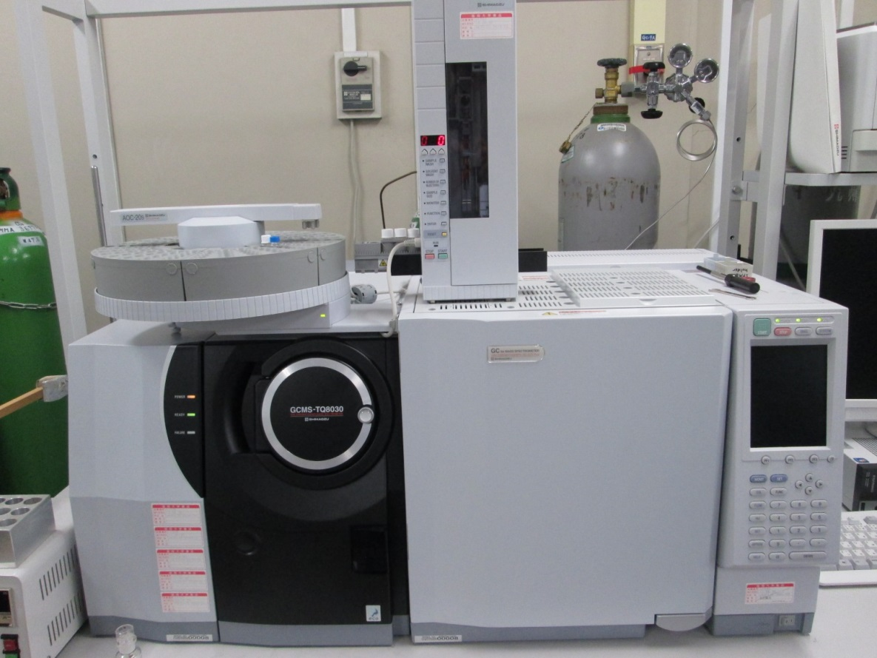
Instrumental Analysis
Initial screening performed by GC-MS
Instrument:
  Shimadzu TQ8030

Slide 14
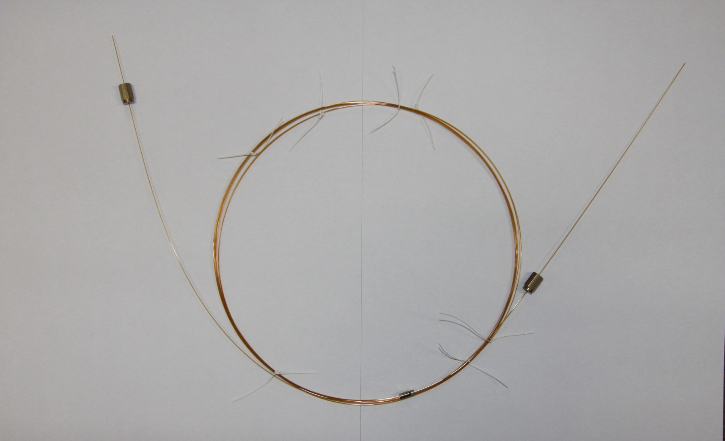
Capillary Column – Tandem Columns
Pre-column:
  ZB-SemiVolatiles
  (2 m x 0.18 mm I.D. x 0.36 μm df) (Phenomenex)
Separation column:
  BPX5
  (4 m x 0.15 mm I.D. x 0.25 μm df)
  (SGE)
From the injector
To the detector
Pre-column
Separation
Column
Connector

Slide 15
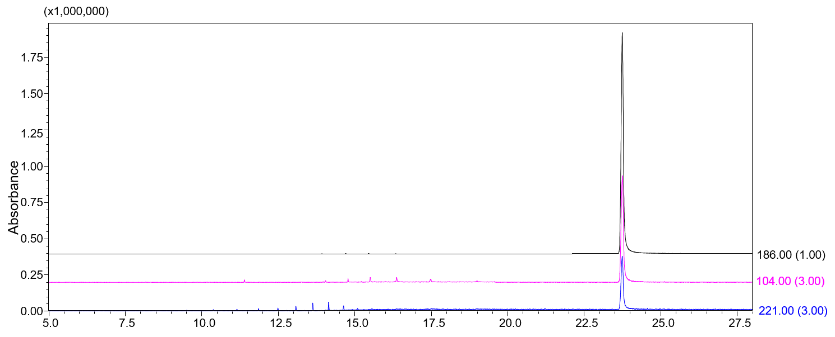
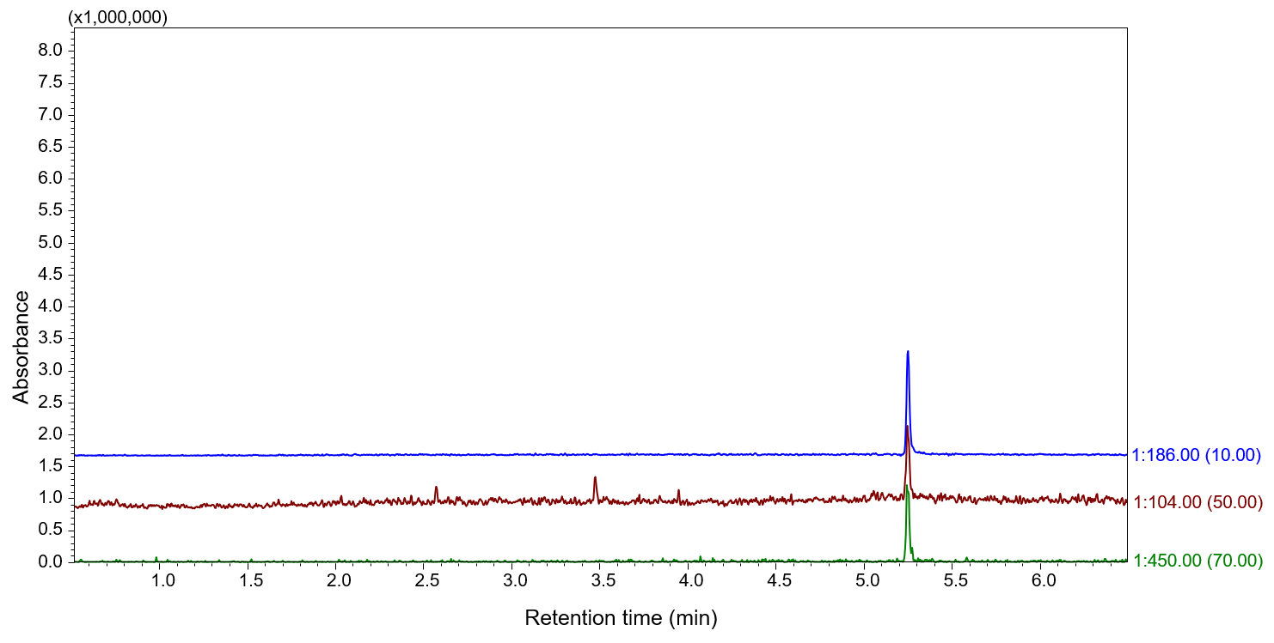
Fast
Gas Chromatography
Normal Conditions
RT: 23.7 min
Faster retention times
    Approximately 4.5 faster than normal conditions
Example:
    Suvorexant
Fast GC-MS
RT: 5.25 min

Slide 16
Instrument Conditions
Oven program: 70°C for 0.5 min, to 200°C at 70°C/min, to 340°C at 50°C/min, hold 4 min.
Total run time, 9.16 min.
Other temperatures: Injector 270°C; ion source 230°C; interface 300°C
Carrier gas: Helium at 2.32 mL/min
Injection: Split mode (1:22)
MS parameters: Scan mode, m/z 40-550, 5000 amu/s
MS/MS parameters: Multiple Reaction Monitoring (MRM) mode

Slide 17
Results and Findings
The developed method was successful in clearly identifying drugs from putrefied specimens.
The fast GC method lowered the analysis time to under 10 minutes.
The use of tandem mass spectrometry helped to reduce the influence of background noise and interfering substances.

Slide 18
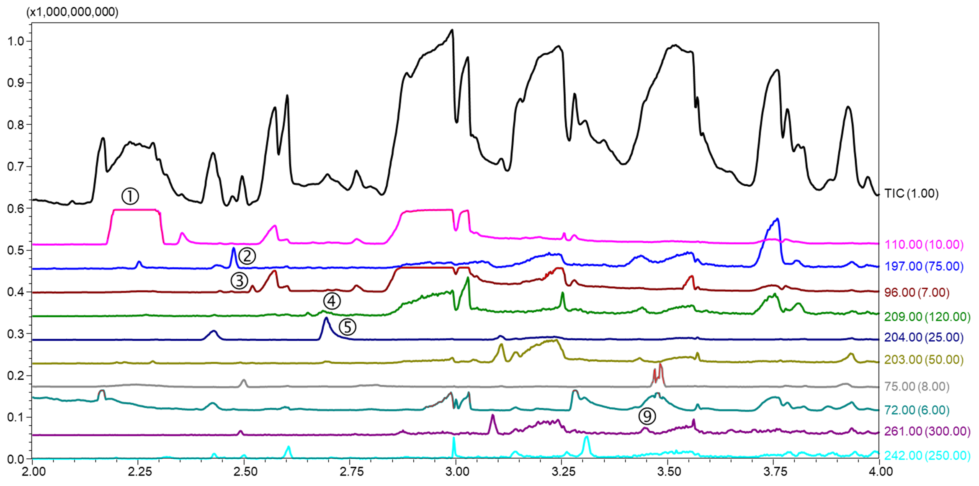
Results
① Acetaminophen-d3 (IS)
② Caffeine-d3 (IS)
③ Lidocaine-d10 (IS)
④ Phenobarbital-d5 (IS)
⑤ Phenobarbital
⑥ Chlorpheniramine
⑦ Promethazine-d3 (IS)
⑧ Promethazine
⑨ Diazepam-d5 (IS)
⑩ Zolpidem-d7 (IS)
A scan chromatogram of an actual putrefied liver sample using the often utilized QuEChERS method.

Slide 19
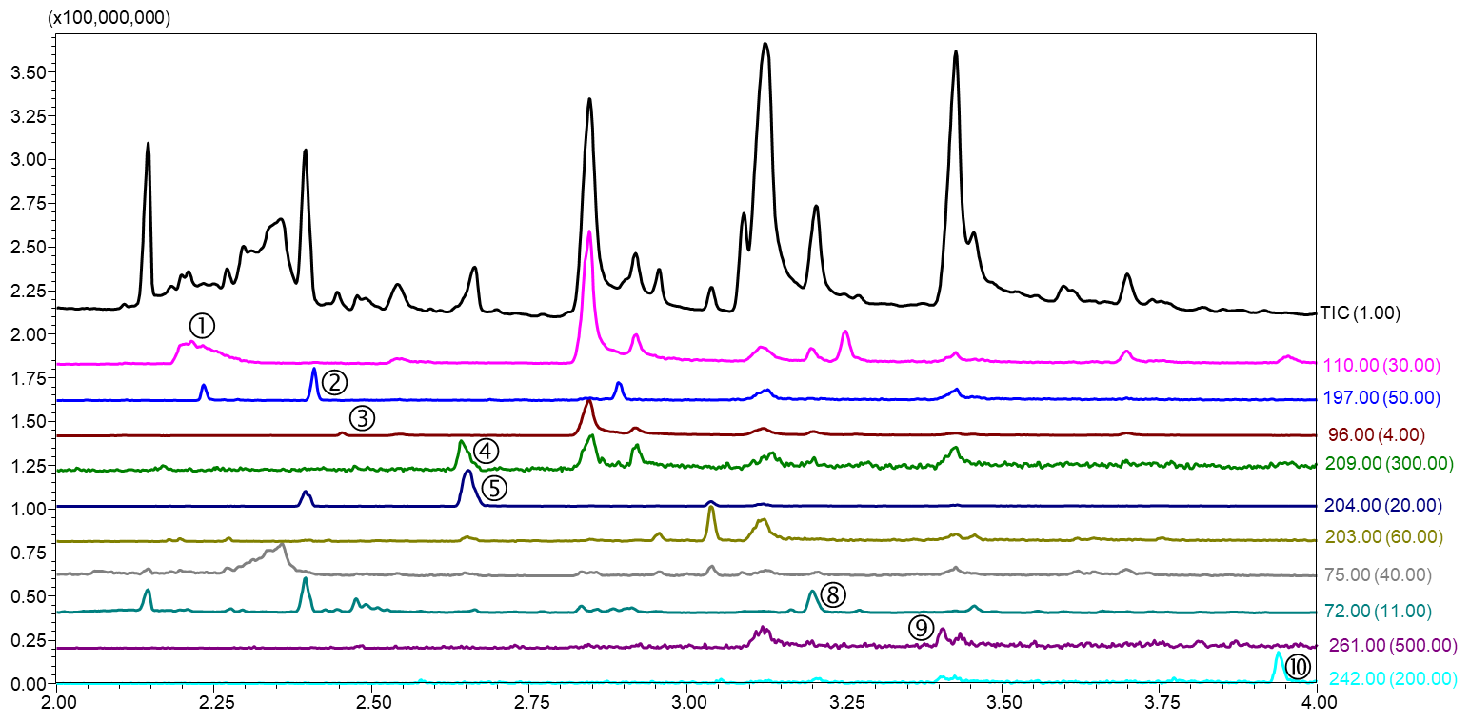
Results
① Acetaminophen-d3 (IS)
② Caffeine-d3 (IS)
③ Lidocaine-d10 (IS)
④ Phenobarbital-d5 (IS)
⑤ Phenobarbital
⑥ Chlorpheniramine
⑦ Promethazine-d3 (IS)
⑧ Promethazine
⑨ Diazepam-d5 (IS)
⑩ Zolpidem-d7 (IS)
An extracted ion chromatogram from the same putrefied liver sample using the method documented in our publication.

Slide 20
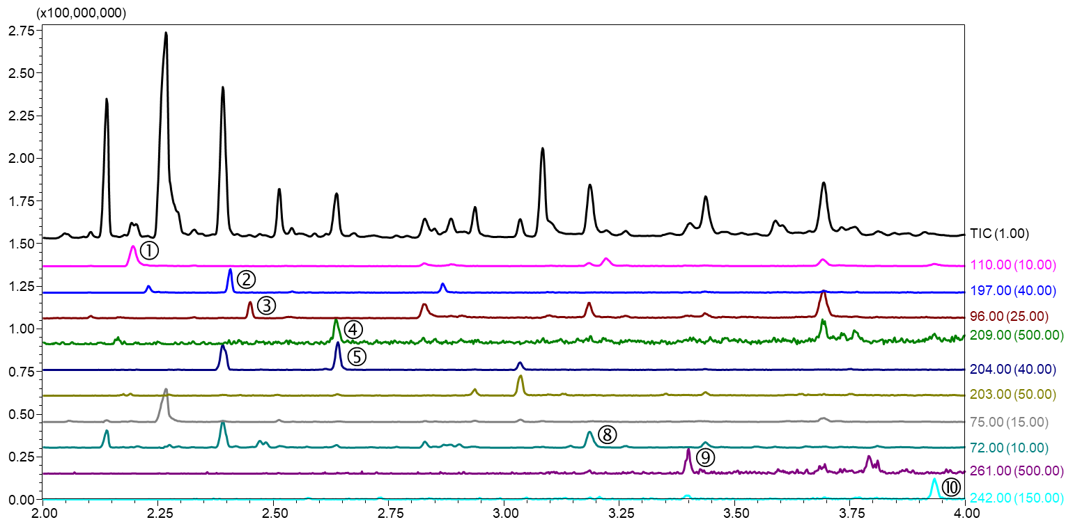
Results
① Acetaminophen-d3 (IS)
② Caffeine-d3 (IS)
③ Lidocaine-d10 (IS)
④ Phenobarbital-d5 (IS)
⑤ Phenobarbital
⑥ Chlorpheniramine
⑦ Promethazine-d3 (IS)
⑧ Promethazine
⑨ Diazepam-d5 (IS)
⑩ Zolpidem-d7 (IS)
The extracted ion chromatogram from the same putrefied liver sample processed using Method B from this presentation.

Slide 21
Improvement of the Chromatogram (Scan – TIC)
QuEChERS Method
Method B from publication
Method B from this presentation

Slide 22
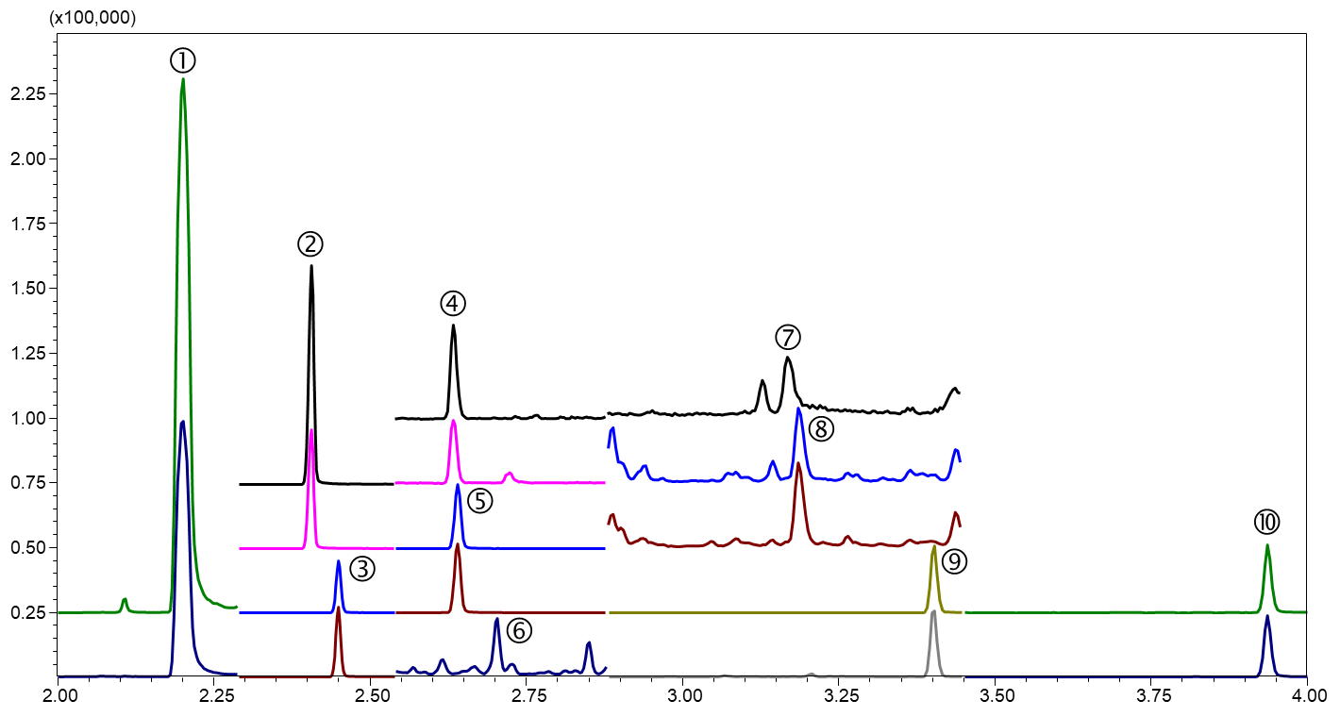
Results
① Acetaminophen-d3 (IS)
② Caffeine-d3 (IS)
③ Lidocaine-d10 (IS)
④ Phenobarbital-d5 (IS)
⑤ Phenobarbital
⑥ Chlorpheniramine
⑦ Promethazine-d3 (IS)
⑧ Promethazine
⑨ Diazepam-d5 (IS)
⑩ Zolpidem-d7 (IS)
The MRM chromatogram of the same extracted sample from the previous slide.

Slide 23
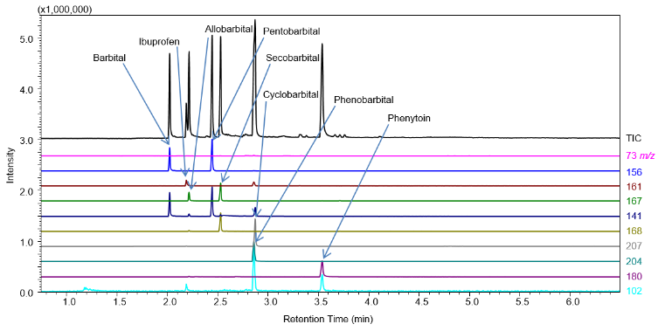
Results
This extracted ion chromatogram of acidic compounds extracted from a spiked putrefied liver sample using the proposed Method A.

Slide 24
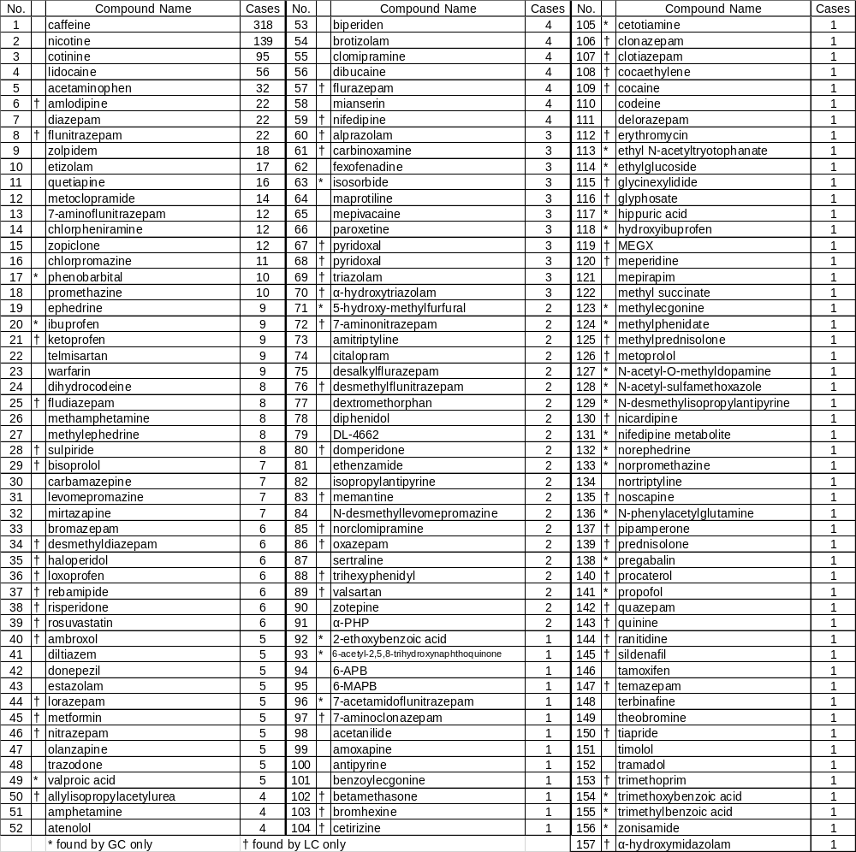
List of detected compounds and number of cases found
Using this extraction method on routine cases
Data from over a 5-year period (2012~2017)
444 autopsy cases

Slide 25
Detected Compounds
Some compounds are only detectable by GC or LC, not both
It is desirable to have preparation methods that can accommodate either analysis method
Both GC-MS and LC-MS/MS
(69 compounds)
LC-MS/MS only
(61 compounds)
GC-MS
only
(27
compounds)
Total: 157 compounds

Slide 26
Conclusion & Significance
Putrefied specimens are often the only remaining samples left from severely decomposed cadavers.
The combination of a robust preparation method and analysis with fast GC-MS/MS could aid the forensic medicine and toxicology communities in elucidating important information from these often-overlooked biological matrices.

Slide 27

Thank you for your attention!
Please join us in Fukuoka, Japan, for the 24th Congress of the International Academy of Legal Medicine, June 5-8
www.ialm2018.org

