Slide 1
Novel peptides for anti-amyloid therapy and MRI diagnosis in Alzheimer’s Disease
Professor Brain Austen
St George’s Neurodegeneration
Unit
www.sguk.depts/ndu
Balpreet Matharu Duncan Hiscock Nick Spencer Franklyn Howe Brian Austen

Slide 2
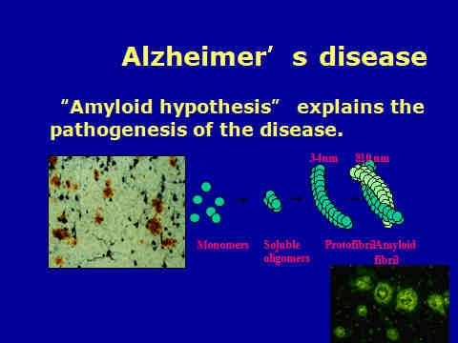

Slide 3
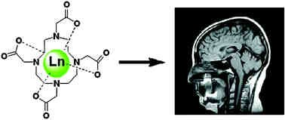

Many (35%) MRI scans on patients are performed with the use of contrast agents which enhance selective tissues by increasing relaxation of adjacent water protons. Gd
is the most common contrast agent, chosen as it contains 7 unpaired electrons which increase T1 longitudinal relaxation (protons realigning with the external field) and reduce T2 transverse relaxation (time for protons to exchange energy with other nuclei). Free Gd is toxic unless complexed with a stable ligand.

Slide 4


APP
Extracellular domain
Aβ
Cytoplasmic tail
N
C
--
Membran
e
β-Secretase
α-Secretase
γ-Secretase
40 42
Aggregation domain
NH2------VKMDAEFRHDSGYEVHHQKLVFFAEDVGSNKGAIIGLMVGGVVIATVIVITLVMLKK-------COOH
NL
GQ
K
VI
G
F
X
Australian mutation 723
Swedish double mutation 670/671
Flemish mutation 692
Dutch mutation
Florida mutation 717
Italian
692
mutation
692
London mutations 716
Inversion FFVLK
Retroinversion ffvlk (D-amino acid residues)
Anti-toxicity properties published in Peptides (2010) 31;1866-1872

Slide 5
Synthesised MRI contrast agents for neurodegenerative disease
Contrast β−Amyloid-binding Transport
R1
DOTA- Gly-DArg-DPhe-DPhe-DVal-DLeu-DLys-Gly-DArg-Gly-Pentadiamine Gd
Contrast
β−Amyloid-binding Transport
R2
DOTA –Gly-DArg-DPhe-DPhe-DVal-DLeu-DLys-Gly-hexaDArg Gd
β−Amyloid binding
Contrast SynB
R3
DOTA –Gly-DArg-DPhe-DPhe-DVal-DLeu-DLys-DArg-rlsysrrrf-NH2 Gd
DOTA-Gly-Darg-Lys-DGly-DThr-DThr-DVal-DAla-DThr-Arg-NH2
R4
Contrast
Β−Amyloid binding Transport
R5
DOTA-Gly DArg-DPhe-DPhe-DVal-DLeu-Lys(Biot)-r-Ser(Glc)-Gly-NH2

Slide 6
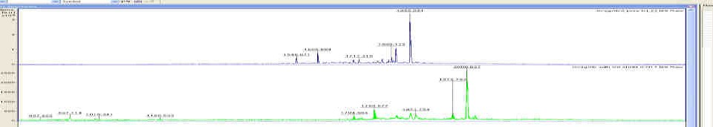


R5+Gd
R5
ImagNoB FrA0001, ImagNoB Plus Gd 0001, imagRNoB FrA 0001, ImagRNoB Gd complex 0001, ImagSynB FrB neat0001, ImagSynB FrB neat plus Gd0001 Shimadzu Biotech Axima CFR 2.7.2.20070105
%Int. 74 mV 326 mV 349 mV 559 mV 1266 mV 1038 mV
2786
173
R3 + Gd
R3
R2 + Gd
R2
173
1394
2344
2633
2825
380
6[c].M
46
192
327
1317
2588
2343
5[c].M
1172
2183
2441
4[c].L
1702
2139
R1 +Gd R1
2500 3000
Mass/Charge
3[c].L
100
1548
1724
2[c].L
50
1504
0
500
1000
1500
2000
3500
4000
4500
50001[c].L
O
^{NH}2
^{NH}2
N N
H
O
^{NH}2 ^{NH}2
^{NH}2
N N
H
^{NH}2
N N
H
O
^{NH}2
^{NH}2
N N
H
OH
^{NH}2
N N
H
^{NH}2
N N
H
OH
N ^{N}
_{H} O
_{H} O
_{H} O
_{H} O
_{H} O
OH
_{H} O
_{H} O
_{H} O
N N
^{H} O
N
O
H
O
H
O
H
OH
_{H} O
_{H} O
_{H} O
O
H
N N
H
O
H
N N
H
O
H
N N
H
O
H
N N
H
O
H N
^{H} O ^{H} O ^{H} O H
N N
N N
N N N
N
N H
N N
H
N N
N N N N
N
N N
N N
N N N
O
H _{O} H _{O} ^{NH}₂
N N
N
N N N N
N N
^{H} O
O
O
H H H ^{N}
^{NH}2
OH
O
H H H
O O O
O
O
O
O
O
^{NH}2
OH
N ^{N}
O
H
N N
^{NH}2
O O
O H
O
N N
H
N N
H
N N
H
N N
O
OH
N ^{N}
O
H
N N
^{NH}2
H
N N
OH
OH
H
N N
O
HO
O
HO
O
^{NH}2
^{NH}2
^{NH}2
^{NH}2
HO
O
^{NH}2
^{NH}2
MW = 1579
MW - 2160.6
MW = 2630
R1
R2
R3

Slide 7
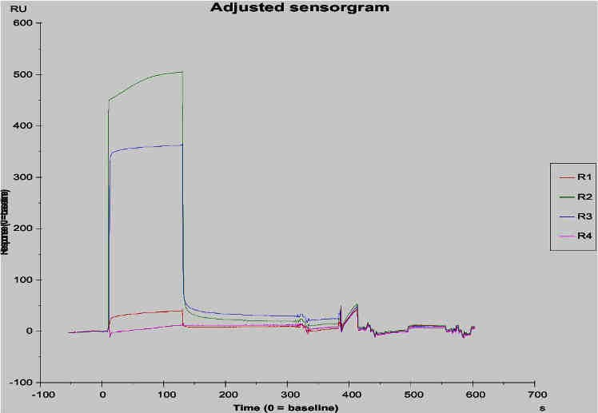
FC2-1 100uM R1-R4 binding to amyloid 1-40 fibrils
Interaction analysis on Biacore

Slide 8
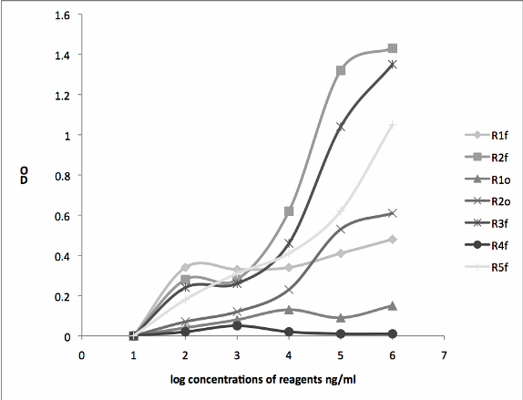
Binding of biotinylated reagents to Abeta40 oligomers (o) and fibrils(f).

Slide 9
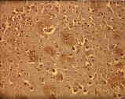
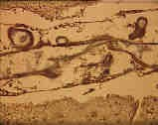
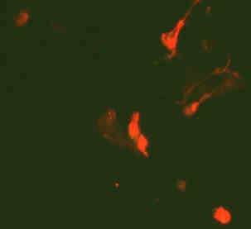
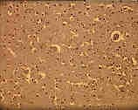
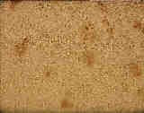
Preliminary data has validated the function of these agents, but further work is needed to optimise their effectiveness at highlighting β-amyloid and to validate the correlation of MRI to histopathology
(A) AD section plus R2 (B) AD section plus R2
(C) Young control plus R2 (D) AD section plus antibody
In AD post-mortem sections, R2 stained plaques (A) and vascular amyloid (B), in a similar fashion to Aβ antibodies (D). Sections froma control young patient did not bind R2 (C).
SW-APP 293 cells transfected with the amyloid precursor protein, treated with proteasome inhibitor, lactalysin, to accumulate Aβ, took up and retained R2. Visualised via incorporated biotin in R2.

Slide 10
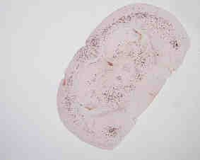
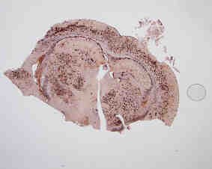


Amyloid deposition with age
5X FAD mice

Slide 11






Ex-vivo MRI
Reagent
R1
TG
R2
Non-TG
TG
TG
Pre-incubation
R3
TG

Slide 12
60
Distribution of R1 in mouse
muscle blood kidney bladder/urine lung
liver stomach SI/LI
total brain tibia/femur skin thyroid carcass injectionsite
50
40
%ID
30
20
10
0
0 10 20 30 40
time(min)
50 60 70
By Duncan Hiscock, GE Healthcare

Slide 13
Compound | 2 minute brain uptake (%ID-kg/g) | Brain Clearance (2:30 minute ratio)
¹⁵³Gd-(DOTA)-rGffvlkGrG-pentadiamine | 0.0046 | 3.3
¹⁵³Gd-(DOTA)-rGffvlkKrrrrrrr-NH2 | 0.0058 | 7.9
¹⁵³Gd-(DOTA)-Grffvlkrrlsysrrrf-NH2 | 0.0052 | 2.1
PET gold standard | 0.22 | 9.0
SPECT gold standard | 0.09 | 12.2

Slide 14
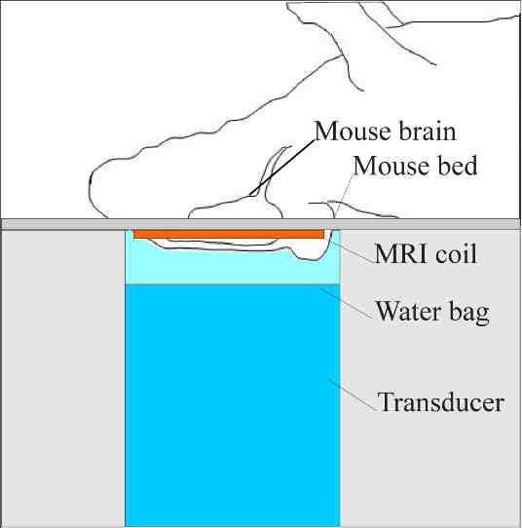
US/MR SYSTEM

Slide 15
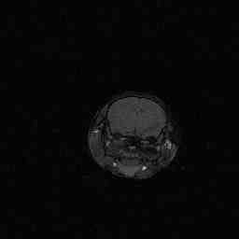
T1 change after
injection
1200
1000
800
600
400
200
0
T1 (ms)
0
10
20
30 40
Time after injection (min)
50
60
70

Slide 16
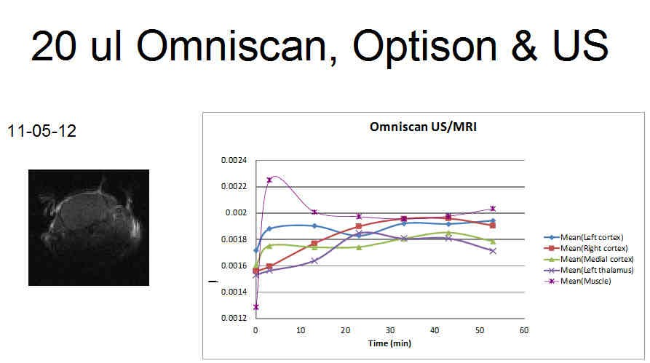

Slide 17
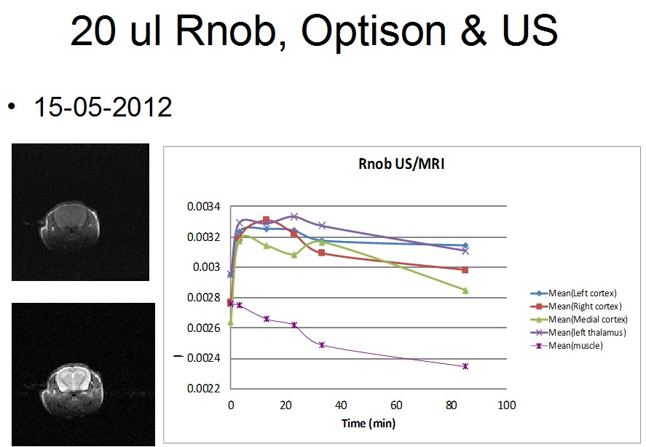
500/14 ms TR/TE
2000/40 ms TR/TE

