Slide 1
Evaluation of ZOSTAVAX®
Via the Intradermal Route Using the MicronJet™
Presented by:
Brian K. Meyer
4th International Conference on
Vaccines and Vaccination
Valencia, Spain
September 24-26, 2014

Slide 2
Overview
ZOSTAVAX® Vaccine Background
Intradermal Vaccine Delivery
  MicronJet™
  Human Skin and Device Depth
Pre-clinical considerations and studies
Clinical Design
Clinical Outcomes
  Geomean Titers
  ELISPOT Data
  Safety
Conclusions

Slide 3
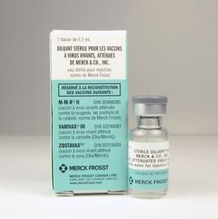
ZOSTAVAX®
Vaccine to prevent shingles due to
reactivation of varicella
Administered to ages 50 and older
Provided by reconstituting a lyophilized cake in a glass vial with sterile diluent (water)
Subcutaneous administration using a staked needle, single-dose

Slide 4
Intradermal Vaccine Delivery
Vaccines Delivered Intradermally
  BCG
  Fluzone® Intradermal
  Several rabies vaccines
Other vaccines being investigated via the intradermal route (www.clinicaltrials.gov)
We evaluated the intradermal delivery of ZOSTAVAX®

Slide 5
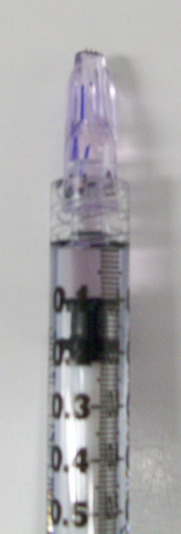
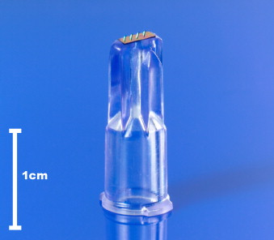
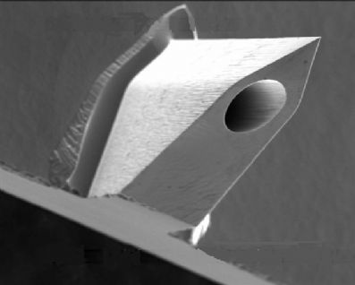
MicronJet™
MicronJet
Silicon Needle
0.1 mL
3 Silicon microneedles
600 microns in length
Polycarbonate Luer-loc hub
Attaches to a 1 mL syringe
Targets epidermis
Ref. 31, 32

Slide 6
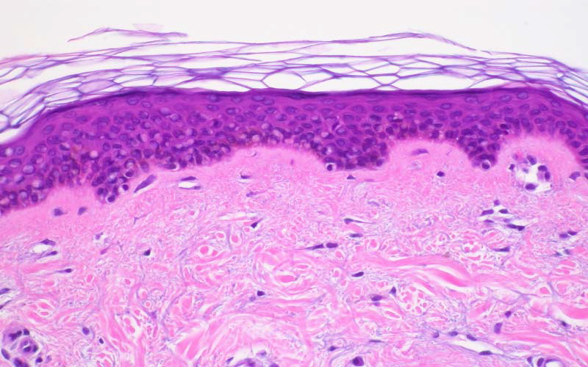
Human Skin and Intradermal Device Depth
FLUZONE®
Intradermal
1500 μm
MicronJet
600 μm
Stratum Corneum
Epidermis
Papillary Dermis
Reticular Dermis
(www.istock.com)

Slide 7
Pre-Clinical Considerations and Studies
Subcutaneous administration of ZOSTAVAX®
  ZOSTAVAX® administered by reconstituting 1 vial in 0.7 mL diluent (water)
  Administer 0.65 mL subcutaneously
Intradermal administration of ZOSTAVAX®
  Full-dose, 1/3, 1/10, 1/27 Dose ID
  Full Dose
    0.15 mL maximum volume per injection
    Re-constituted 2 vials in 0.35 mL diluent each
    2 injections of 0.15 mL each
  1/3 dose
    Re-constitution in 0.3 mL water, administer 0.1 mL
  1/10 dose
    Re-constitution in 1 mL water, administer 0.1 mL
  1/27 dose
    Re-constitution in 2.7 mL saline, administer 0.1 mL
  Performed syringeability studies with all doses and measured vaccine potency

Slide 8
Clinical Design
221 patients enrolled, 3 clinical sites
Partially Blinded Randomized Trial to evaluate the Immunogenicity and
Safety of Zostavax™
Groups
  Full-dose SC
  1/3 dose SC
  Full-dose, 1/3, 1/10, 1/27 Dose ID using the MicronJet
Evaluated a geometric mean fold rise from baseline in VZV-antibodies
ELISPOT

Slide 9
Titer / Geomean-Fold Rise (GMFR)

Slide 10
ELISPOT

Slide 11
SAFETY
Utilized a Vaccine Report Card
  Previously validated
  Subjects recorded daily oral temperatures and injection-site and systemic adverse experiences from Day 1 to 42 Post-vaccination
  Document injection site reactions (redness, swelling, pain/tenderness) within
  5 days of vaccination

Slide 12
SAFETY (continued)
Table 1. Subjects With Injection Site Adverse Events (Reldays 1 to 5)
 | Full SC | 1/3 SC | Full ID | 1/3 ID | 1/10 ID | 1/27 ID | Placebo
 | n (%) | n (%) | n (%) | n (%) | n (%) | n (%) | n (%)
Subjects in Population | 52 | 34 | 34 | 35 | 34 | 34 | 39
With one of more Injection Site AEs | 27 (51.9) | 7 (20.6) | 27 (79.4) | 22 (62.9) | 19 (55.9) | 19 (55.9) | 5 (12.8)
General Disorders and administration site conditions
Injection site anaesthesia | 0 (0) | 0 (0) | 0 (0) | 1 (2.9) | 0 (0) | 0 (0) | 0 (0)
Injection site erythema | 16 (30.8) | 5 (14.7) | 26 (76.5) | 20 (57.1) | 16 (47.1) | 18 (52.9) | 4 (10.3)
Injection site haematoma | 2 (3.8) | 0 (0) | 0 (0) | 0 (0) | 0 (0) | 0 (0) | 0 (0)
Injection site induration | 5 (9.6) | 2 (5.9) | 12 (35.3) | 12 (34.3) | 11 (32.4) | 10 (29.4) | 1 (2.6)
Injection site pain | 15 (28.8) | 5 (14.7) | 8 (23.5) | 9 (25.7) | 5 (14.7) | 6 (17.6) | 0 (0)
Injection site pruritus | 1 (1.9) | 2 (5.9) | 3 (8.8) | 3 (8.6) | 1 (2.9) | 1 (2.9) | 0 (0)
Injection site rash | 1 (1.9) | 0 (0) | 0 (0) | 0 (0) | 0 (0) | 0 (0) | 0 (0)
Injection site scab | 0 (0) | 0 (0) | 1 (2.9) | 0 (0) | 0 (0) | 0 (0) | 0 (0)
Injection site swelling | 13 (25) | 4 (11.8) | 13 (38.2) | 8 (22.9) | 6 (17.6) | 7 (20.6) | 2 (5.1)

Slide 13
Conclusions
ZOSTAVAX® delivered intradermally with the MicronJet had a GMFR point estimate that was 2-fold higher when compared to the standard, subcutaneous route
ZOSTAVAX® delivered intradermally using the MicronJet may result in enhanced immunogenicity when compared to subcutaneous delivery using a staked needle, as measured by gpELISA in adults 50 years and older
  An efficacy study would be required to establish this point
  The full dose for the 50-59 age group was atypically low vs. historical data
  Full dose was administered with the MicronJet with two 0.15 mL doses
A dose-response was observed for the intradermal route with the MicronJet
A fraction of the full dose with the MicronJet yielded similar gpELISA and ELISPOT values as compared to the full dose given subcutaneously
  A larger percentage of subjects in ID vaccinations reported injection site erythema and induration when compared to subcutaneous vaccination
Use of the MicronJet resulted in less injection site pain with the full dose when compared to subcutaneous delivery

Slide 14
Acknowledgements
Chan Beals
Leon Carayannopoulos
Keith Chirgwin
Jeffrey Chodakewitz
Amlan Dutta
Robert K. Evans
Alison Fisher
Laura George
Barry Gertz
Richard Haupt
Gary Herman
Joseph Heyse
David Kaufman
David Kaslow
John Konz
Kenneth Lasseter*
Myron Levin*
Yotam Levin
Devan Mehrotra
Lori Mixson
Richard Murray
Janie Parrino
Oscar Puig
Radha Railkar
Sangeetha Sagar
Andrea Schaeffer
Eric Sheldon*
John Shiver
Keiko Simon
Aubrey Stoch
I-Ming Wang
Julie Waterbury
Marian Wentworth

