Slide 1
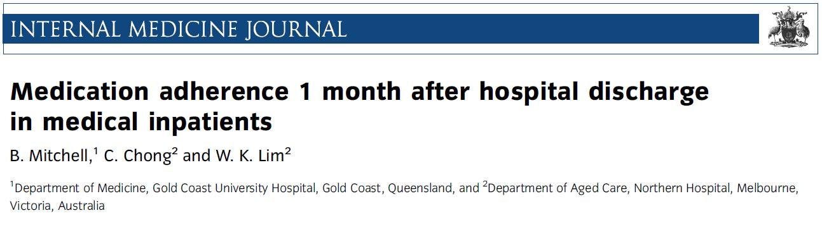


Annual conference & Medicare Expo on Primary Healthcare
The Oberoi, Dubai, UAE
Dr Brendan Mitchell
Volume 46, Issue 2, pages 185–192, February 2016
http://www.mybabygifts.com.au/images/hospitals/the-northern-hospital-epping.jpg
http://www.hassell.com.au/en/cms-projects/detail/gold-coast-university-hospital-396

Slide 2
Background
Definition: Medication adherence is the degree to which patients take medications as prescribed
Non-Adherence:
  To prescription medications typically reported as 20–50% ^{1–6}
  Is associated with increased rates of disease, death, hospital admissions and cost to healthcare systems.⁷⁻⁹
  Predictors of nonadherence include poor health, cognitive impairment, asymptomatic disease, inadequate follow up, side effects, non-belief in therapy, polypharmacy, complex regimens, poor relationship with physicians and medication cost
Majority of data from overseas studies

Slide 3
Aims
Primary:
To determine the rate of adherence to medications after discharge from acute general medical hospital admission
Secondary:
Identify factors that may be associated with non-adherence
Describe medication changes during hospital admission and in the post-discharge period
Notes:
3

Slide 4
Methods
Prospective cohort study
Patients discharged from medical wards
Participants were identiﬁed by a list of potential discharges generated by hospital administration and sampled consecutively
Exclusion criteria:
  discharge to residential care facility or rehabilitation
  patients with two or less medications
  patients ≤ 18 years of age
  person managing medications unable to speak English
Admission & discharge medications and demographic info obtained from medical records
Follow up of participants was conducted via telephone call by a single researcher 30-40 days after discharge
Notes:
4

Slide 5
Methods
At follow up medication regimens were compared to discharge medications
  If changes were made it was determined whether these were intentional or unintentional
  For intentional non-adherence, patients were asked to identify the primary reason for the change
Other data including outpatient appointments, GP follow up, representation/readmission to hospital also collected at this time
Predictors of non-adherence were evaluated using binary logistical regression
Multiple logistical regression was undertaken for the primary dependent variable (non-adherence to regular medications at follow up) - Variables with a P-value of <0.05 or approaching 0.05 in the univariate analysis were candidates in the multivariate analysis using a Forced Entry Method
Notes:
5

Slide 6
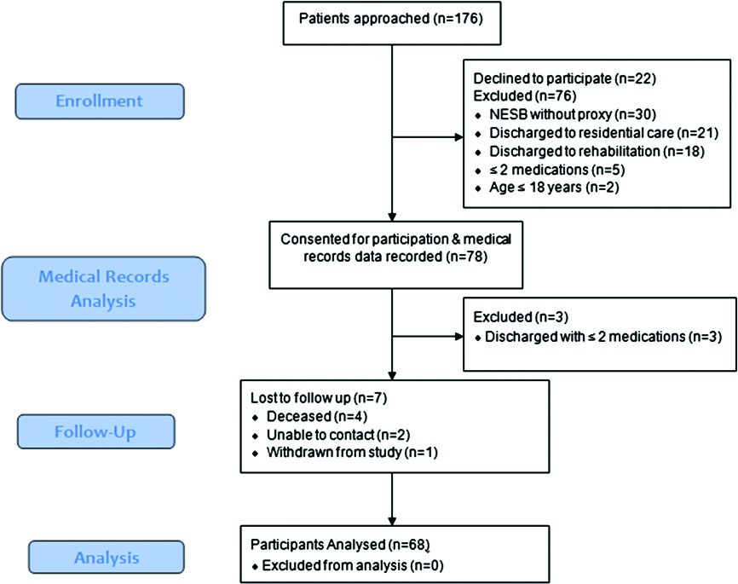
Methods
Notes:
6

Slide 7
Demographics
AGE:
69.5 (±1.67) years
LENGTH OF STAY:
6.97 (±5.48) days
Notes:
7

Slide 8
Results
Intentional non-adherence (n=11)
Unintentional non-adherence (n=11)
Both (n=5)
Notes:
8

Slide 9
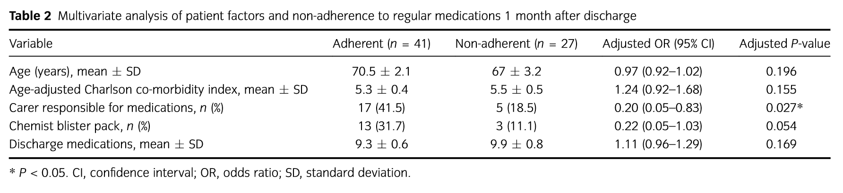
Results
Using multivariate analysis, presence of a carer responsible for medications was associated with signiﬁcantly lower non-adherence (odds ratio (OR) 0.20 (0.05–0.83), P = 0.027) when adjusted for age, co-morbidities, chemist blister pack and total number of discharge medications
Notes:
9

Slide 10
Results
Notes:
10

Slide 11
Results
Average Medications on Admission: 8.40 (±4.24)
Average Medications on Discharge: 9.48 (±4.13)
Average Medications at Follow Up: 8.62 (±3.77)
Notes:
11

Slide 12
Discussion
The rate of adherence to medications is suboptimal and is consistent with prior overseas studies
Non-adherence to medications was observed to be equally attributable to intentional and unintentional non-adherence
Having a carer responsible for medications may improve adherence
  Accounted for approximately one third of our patient population; all of whom were immediate family members
  Involving family where there is consent to do so may be an effective strategy in improving adherence
  Generalisability of these findings is limited by the dependence of other variables in these patients (eg cognitive and/or functional impairment)
  Foebel et al. (10) found the presence of a caregiver at home significantly improved medication adherence in patients with heart failure and mild cognitive impairment
Notes:
12

Slide 13
Discussion
The most commonly cited reason for intentional non-adherence was that the medication was “unnecessary”
  Demonstrates that belief in therapy may be an predictor of adherence
  If patients do not understand the benefits of a medication, and/or the detriment of not taking the medication they are more likely to be non-adherent
  Particularly true for asymptomatic disease (eg Hypertension, hypercholesterolaemia)
Only two thirds of patients visited their GP in the month after discharge from hospital
  Most effective strategies for improving non-adherence involve regular monitoring, follow up and feedback
  Ensuring patients see their family doctor soon after discharge may improve adherence to new medications through reinforcement
Notes:
13

Slide 14
Discussion
Polypharmacy was overwhelmingly common
  Average did not reflect the true average as the study excluded patients taking ≤2 medications
  Some patients taking >20 medications
  Average increased from admission → discharge and admission → follow up
  Admission to internal medicine service is the ideal time for medication reconciliation and to rationalise medication regimens
Not all non-adherence is detrimental
  Eg. Large numbers of patients prescribed gastric acid suppressants which are continued long term ¹¹
  If patients identify that a medication is unnecessary where the doctor has failed to do so, then this is likely to be a positive outcome
  Ideally, it should prompt discussion with their physician and regular review of their medications, rather than self-management of medications
Notes:
14

Slide 15
Limitations
Limitations
  Over the counter & complimentary medicines not included (as they are not reliably documented)
  Unable to include non-English speaking participants
  Relatively small sample size
Notes:
15

Slide 16
Take Home Messages
40% of patients were non-adherent to one or more regular medications one month after discharge from hospital
Intentional and unintentional non-adherence were equally attributable
Having a carer responsible for medications may be associated with a significant improvement in non-adherence
Hospital admission is the ideal time for medication reconciliation and rationalisation of medication regimens
Only 67% of patients visited their family doctor in the month following discharge from hospital
Need to involve patients and their families in their care, rather than the traditional model of prescribing medications and assuming they will take them
Notes:
16

Slide 17
References
1 Osterberg L, Blaschke T. Adherence to medication. N Engl J Med 2005; 353: 487–97.
2 Omori DM, Potyk RP, Kroenke K. The adverse effects of hospitalization on drug regimens. Arch Intern Med 1991; 151: 1562–4.
3 Kripalani S, Schmotzer B, Jacobson TA. Improving medication adherence through graphically enhanced interventions in Coronary Heart Disease (IMAGE-CHD): a randomized controlled trial. J Gen Intern Med 2012; 27: 1609–17.
4 DiMatteo MR. Variations in patients’ adherence to medical recommendations: a quantitative review of 50 years of research. Med Care 2004; 42: 200–9.
5 Voils CI, King HA, Neelon B, Hoyle RH, Reeve BB, Maciejewski ML et al. Characterizing weekly self-reported antihypertensive medication nonadherence across repeated occasions. Patient Prefer Adherence 2014; 8: 643–50.
6 Molloy GJ, Messerli-Burgy N, Hutton G, Wikman A, Perkins-Porras L, Steptoe A. Intentional and unintentional nonadherence to medications following an acute coronary syndrome: a longitudinal study. J Psychosom Res 2014; 76: 430–2.
7 Senst BL, Achusim LE, Genest RP, Cosentino LA, Ford CC, Little JA et al. Practical approach to determining costs and frequency of adverse drug events in a health care network. Am J Health Syst Pharm 2001; 58: 1126–32.
8 Nelson MR, Reid CM, Ryan P, Willson K, Yelland L. Self-reported adherence with medication and cardiovascular disease outcomes in the Second Australian National Blood Pressure Study (ANBP2). Med J Aust 2006; 185: 487–9.
9 Bitton A, Choudhry NK, Matlin OS, Swanton K, Shrank WH. The impact of medication adherence on coronary artery disease costs and outcomes: a systematic review. Am J Med 2013; 126: 357.e7–357.e27
10 Foebel AD, Hirdes JP, Heckman GA. Caregiver status affects medication adherence among older home care clients with heart failure. Aging Clin Exp Res 2012; 24: 718–21.
11 Scales DC, Fischer HD, Li P, Bierman AS, Fernandes O, Mamdani M et al. Unintentional continuation of medications intended for acute illness after hospital discharge: a populationbased cohort study. J Gen Intern Med 2015.
Notes:
17

Slide 18
Thank you!
Notes:
18

