Slide 1

Department of Physiology and Pharmacology
Decreased Nuclear Receptor Activity Mediates Downregulation of Drug Metabolizing Enzymes in Chronic Kidney Disease Through Epigenetic Modulation
October 20, 2014
Brad Urquhart, PhD
Assistant Professor
Department of Physiology and Pharmacology
Department of Medicine (Nephrology, Clinical Pharmacology)
Department of Paediatrics
Lawson Health Research Institute

Slide 2
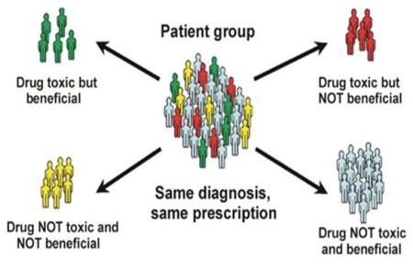
Imperfection of Drug Therapy
Disease
Genetics
Environment

Slide 3
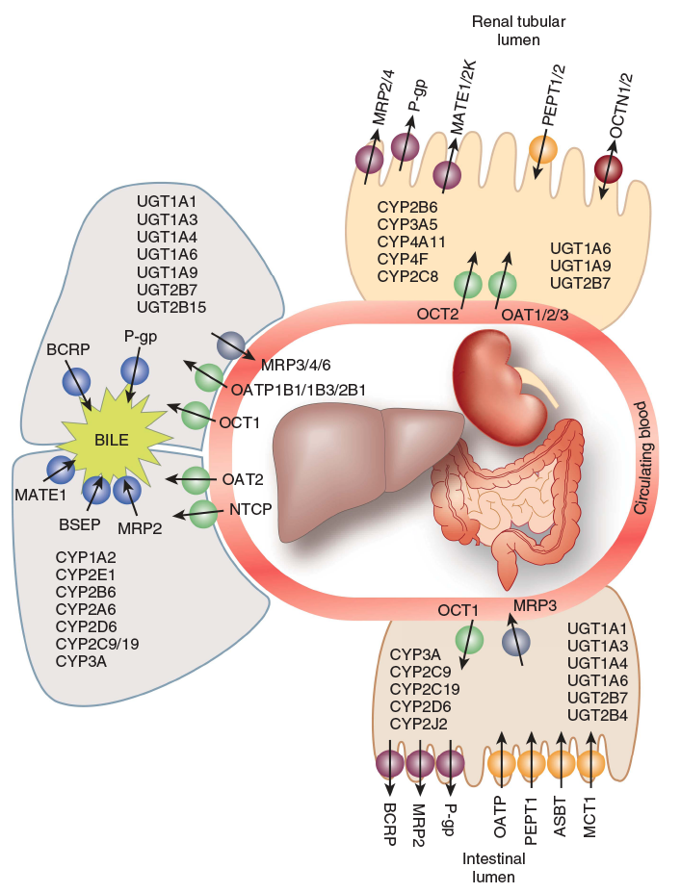
Factors Mediating Drug Disposition
Absorption
Distribution
Metabolism
Excretion
Yeung et al. Kidney International (2014)

Slide 4
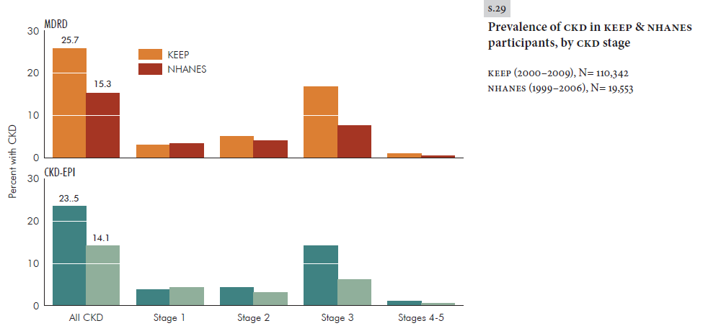
Chronic Kidney Disease (CKD)
Stage | Description | GFR (ml/min/1.72m²)
1 | Kidney damage with normal or ↑GFR | ≥ 90
2 | Kidney damage with mild ↓GFR | 60–89
3 | Moderate ↓GFR | 30–59
4 | Severe ↓GFR | 15–29
5 | Kidney failure | <15 or anuric
Characterized by a progressive decline in renal function over time.
Major causes of CKD include diabetes and renal vascular disease (including high blood pressure)
CKD is estimated to affect between 1.9 million and 2.3 million Canadians
Percent of population
Am J Kidney Dis. 2011;57(3)(suppl 2):S32-S56
Notes:
Patients average more than 7 medications to manage CRF and associated illnesses such as diabetes and hypertension.
Patients with poor kidney function experience about 2.5 times the number of ADRs as other patients

Slide 5
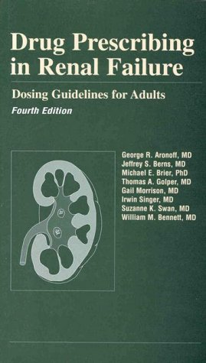
Drugs and CKD
Patients with CKD take 7-12 medications concurrently to control a variety of co-morbidities.
These patients have an increased incidence of adverse drug events, often due to increased blood drug concentrations.
Many drugs are excreted by the kidney so GFR adjusted dosing in patients with CKD is common.

Slide 6
Drug Elimination
Does CKD impact hepatic drug metabolism?
Wienkers and Heath (2005) Nat Rev Drug Discov. 4 (10) 825-33
Notes:
ADR higher in CRF
Work out how to say drug clearance
Elimination mechanisms of top 200 drugs

Slide 7
Cytochrome P450 Mediated Drug Metabolism
Shimada et al. (1994) J. Pharmacol. Exp. Ther. 270 (1) 414-23

Slide 8
  Nuclear Receptor and Epigenetic Changes in CYP3A and CYP2C Mediated Metabolism in CKD.
Hypothesis
Altered drug metabolism in CKD is secondary to decreased nuclear receptor binding to the CYP3A and CYP2C promoter which is associated with histone modulation.
Objective
To determine nuclear receptor binding in CKD.
To investigate the epigenetic modulation of hepatic drug metabolizing enzymes in CKD.
To evaluate uremic toxins that may downregulate hepatic CYP3A.

Slide 9
  Nuclear Receptors
Modified from Huss et al. 1999
HNF-4α
RNA Pol II
PXR
RXR
XRE
HNF-4α
TATAA
CYP3A
-136
-118
-110
-86

Slide 10
Epigenetic Modifications
AC
AC
AC
AC
AC
“Gene On”
AC
H3
H4
Activating
Me
Me
Me
Me
K4
R3
H3
H4
“Gene Off”
Silencing
Me
Me
Me
Me
Me
Me
K9
K27
H3
H3

Slide 11
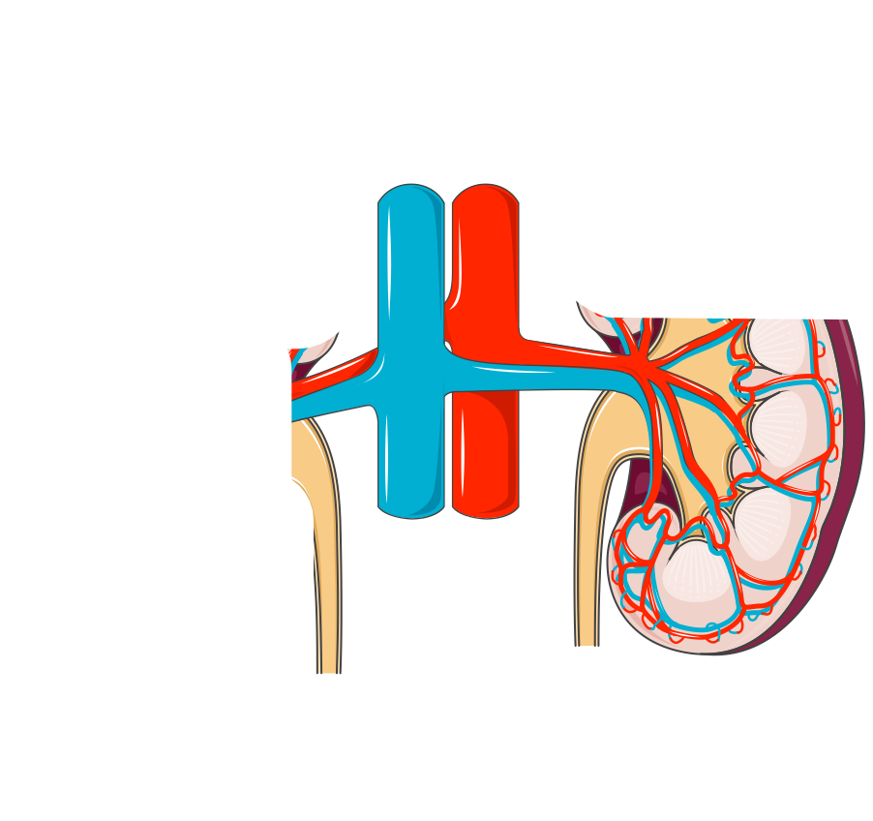
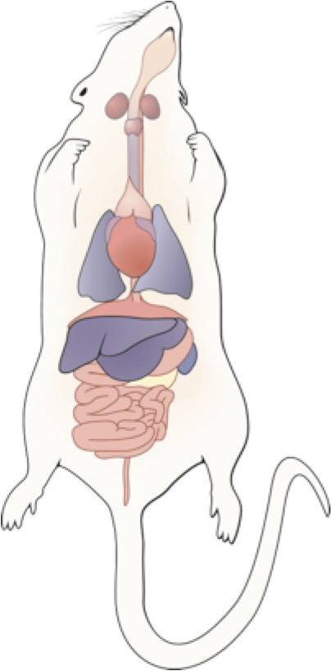
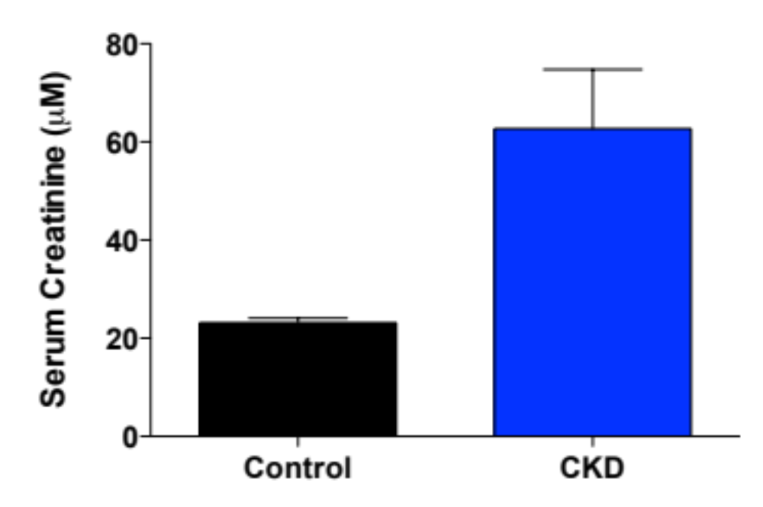
Experimental Model
*

Slide 12
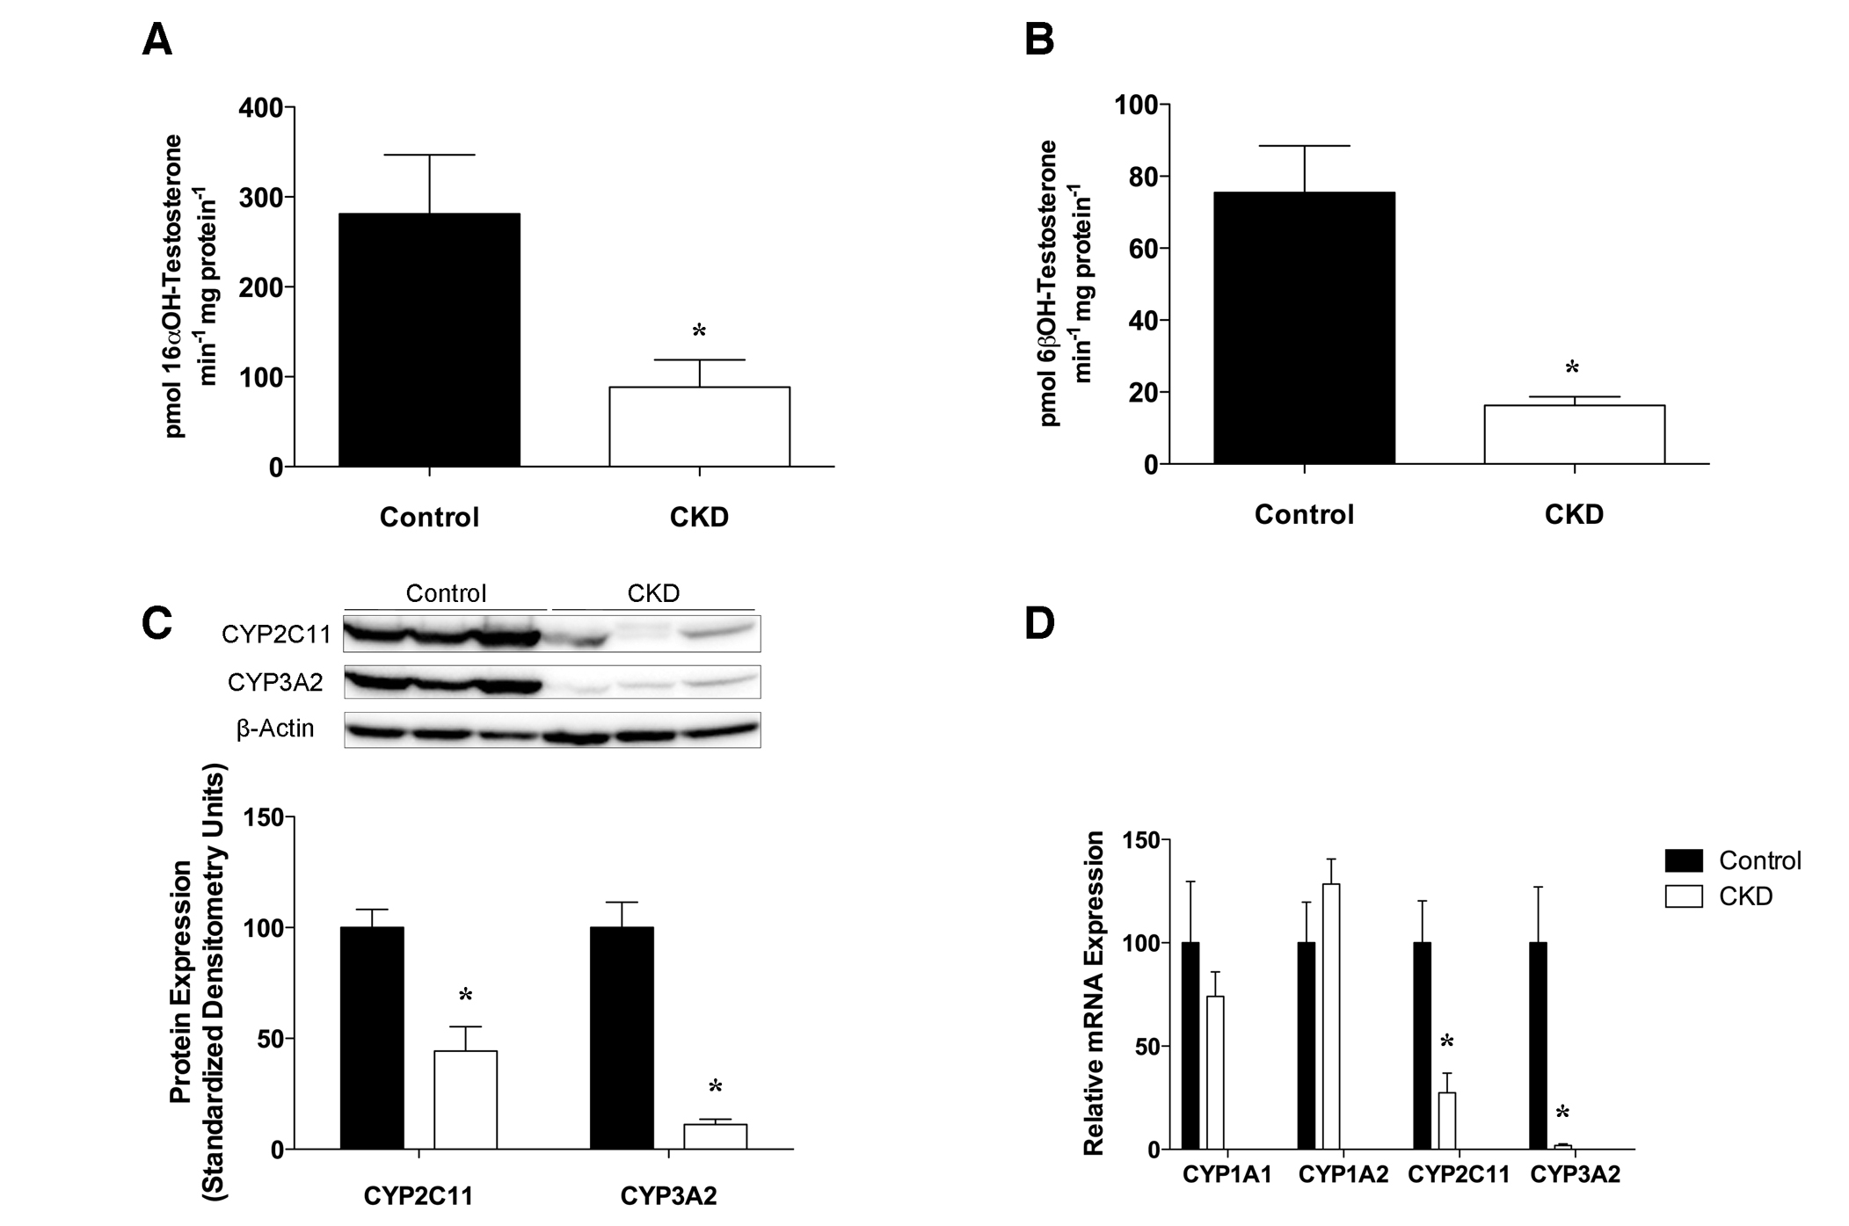
P450 Expression & Activity
CYP2C11
CYP3A2
Velenosi et al. (2014) FASEB J

Slide 13
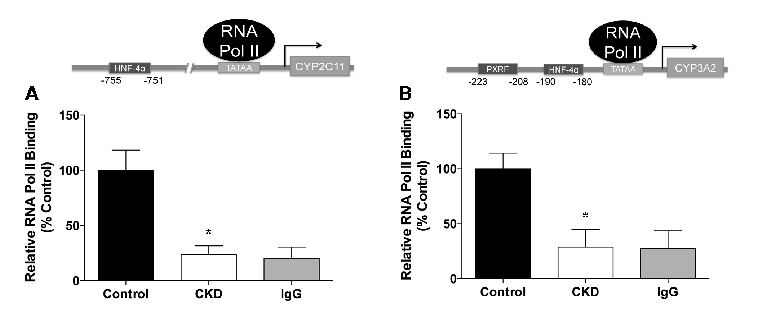
CYP2C11 & CYP3A4 Transcription is Decreased in CKD
Velenosi et al. (2014) FASEB J

Slide 14
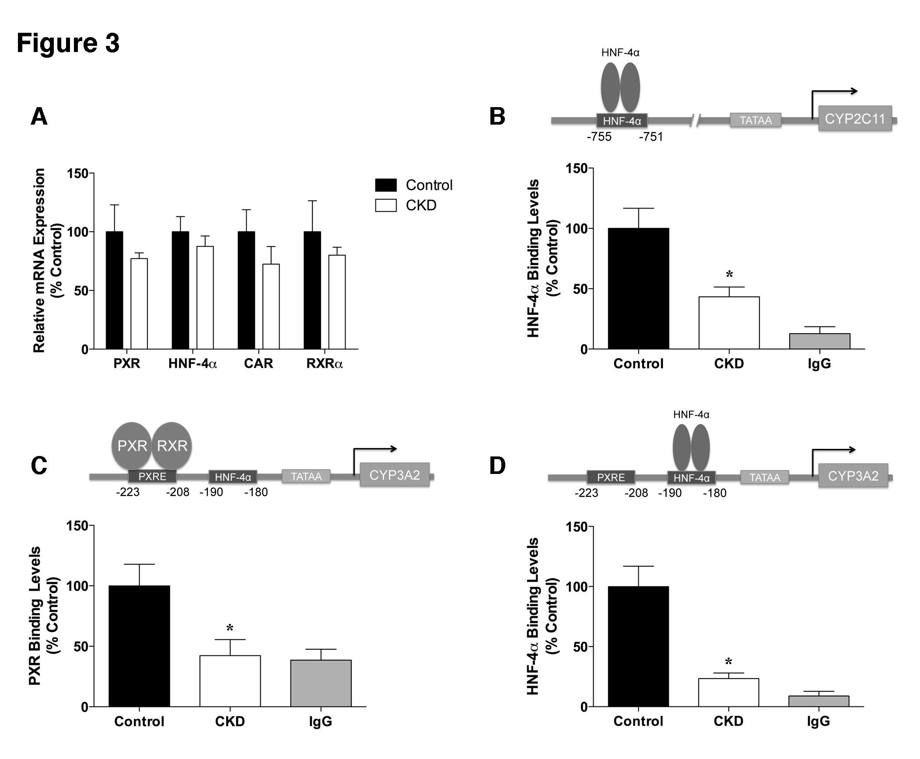
Nuclear Receptor Binding is Decreased in CKD
Velenosi et al. (2014) FASEB J

Slide 15
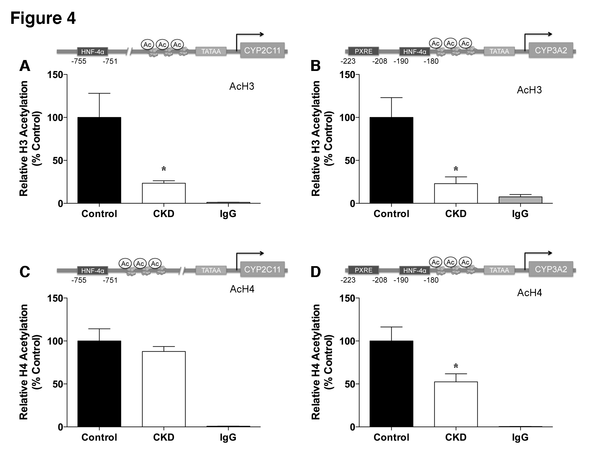
Histone Acetylation is Decreased in CKD
Velenosi et al. (2014) FASEB J

Slide 16
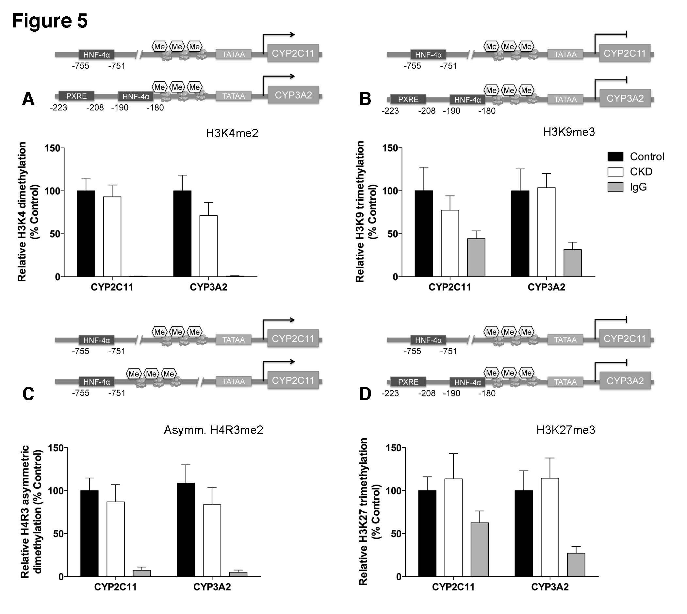
Histone Methylation is Unaltered in CKD

Slide 17
Possible Mechanism For Hepatic Drug Metabolizing Enzyme Down-regulation in CKD.
CONTROL
UREMIA
Mechanism?
Enzyme
Enzyme
mRNA
mRNA
PXR
RXR
HNF-4α
RNA Pol II
PXR
RXR
HNF-4α
RNA Pol II
Ac
Ac
Ac
CYP
Ac
Ac
Ac
CYP

Slide 18
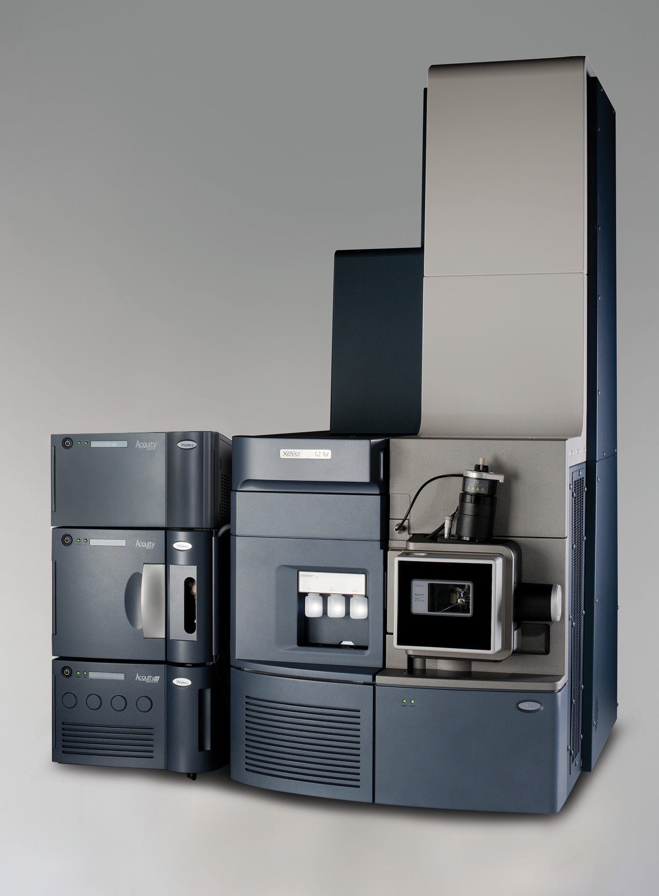
  Metabolomics
Hundreds of uremic toxins accumulate in kidney disease.
Do any of them accumulate in the liver?
Sensitive QTOF mass spectrometer: can quantify and identify small molecules.
Application to drug toxicity : pharmacometabolomics
XEVO-G2-S Mass Spectrometer

Slide 19
Metabolomic Investigation
Control
Homogenize in acetonitrile
Chronic Kidney Disease
Homogenize in acetonitrile
UPLC-MS

Slide 20
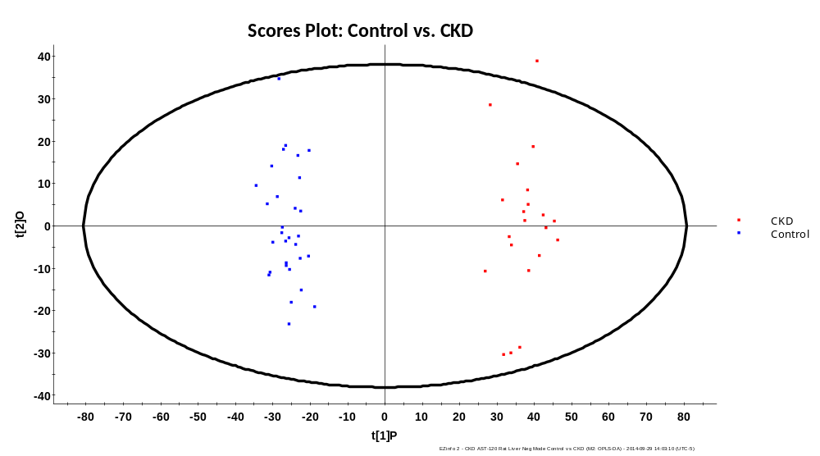
Hennop, Velenosi et al. unpublished

Slide 21
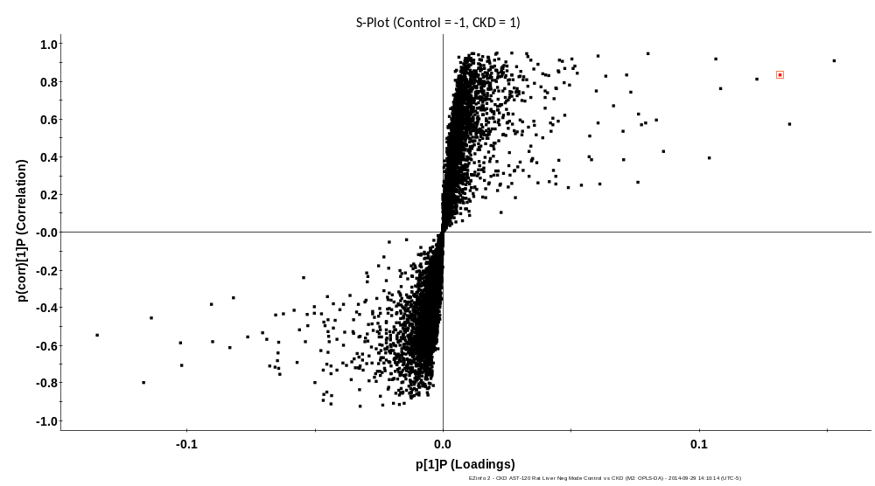
  Metabolomics of Liver Samples in CKD

Slide 22
  Conclusions and Future Directions
CONCLUSIONS
PXR and HNF4α binding to CYP2C11 and CYP3A2 promoters is decreased in CKD.
Changes in histone acetylation are associated with decreased CYP2C11 and CYP3A2 expression in CKD.
FUTURE DIRECTIONS
Metabolomic investigation to determine which uremic toxins are elevated in the liver.

Slide 23








Acknowledgements
Tom Velenosi,
PhD Candidate
David Feere, MSc
Urquhart lab
Dave Feere, MSc
Anzel Hennop
Andrew Kucey
Alvin Tieu
Dr. Ben Thomson
Tom Velenosi
Andrew Wong
Collaborators
Dr. Tom Nolin (University of Pittsburgh)
Dr. Andrew House
Linda Asher, RN
Dr. Ben Thomson

Slide 24
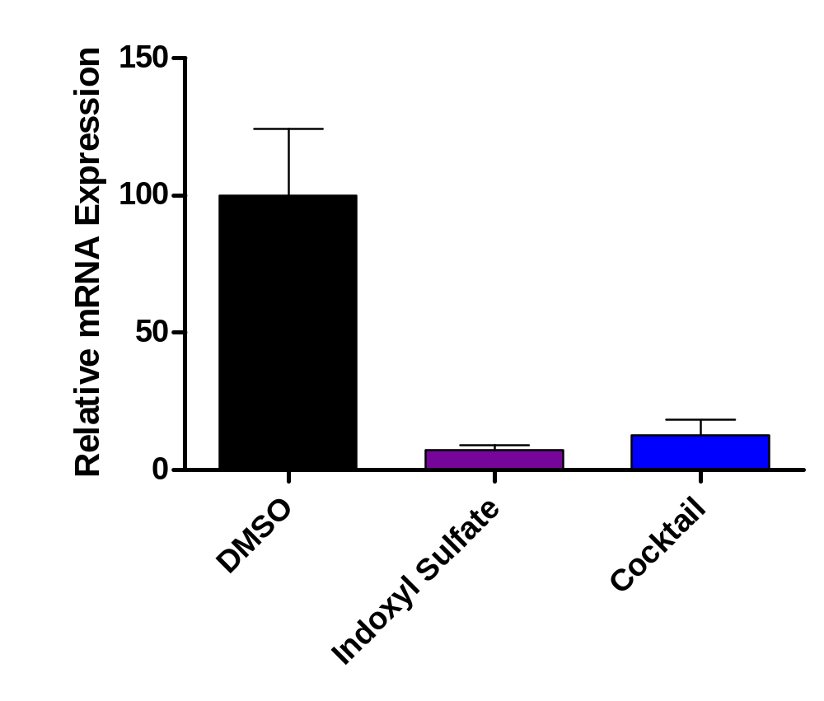
Human Hepatoma cell line (Huh7) CYP3A4 mRNA
Expression
Cocktail:
CMPF
Creatinine
P-Cresyl sulfate
Indoxyl Sulfate
Guanidinosuccinic acid
Hippuric acid
Indole-3-acetic acid
Methylguanidine
Urea
*
*
Velenosi et al. unpublished

Slide 25
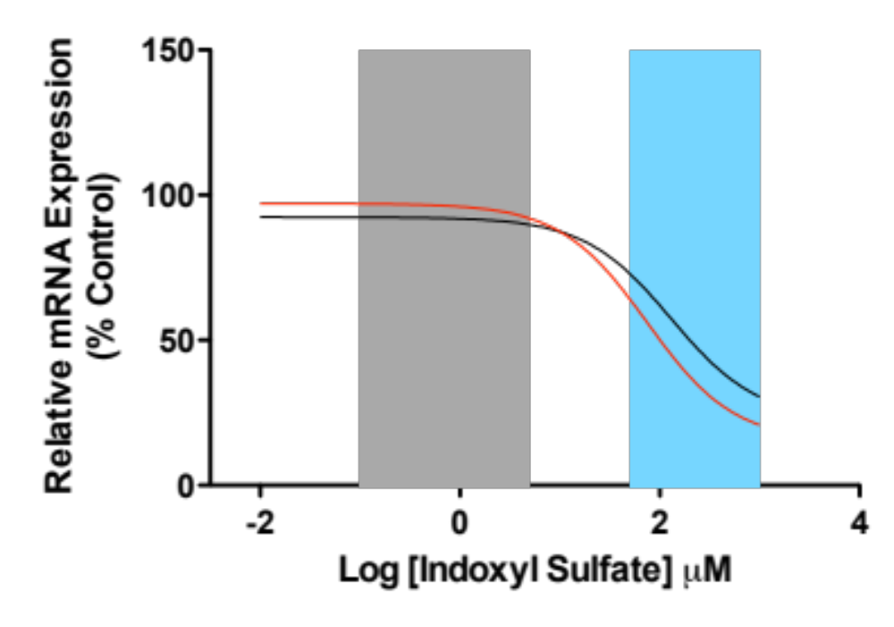
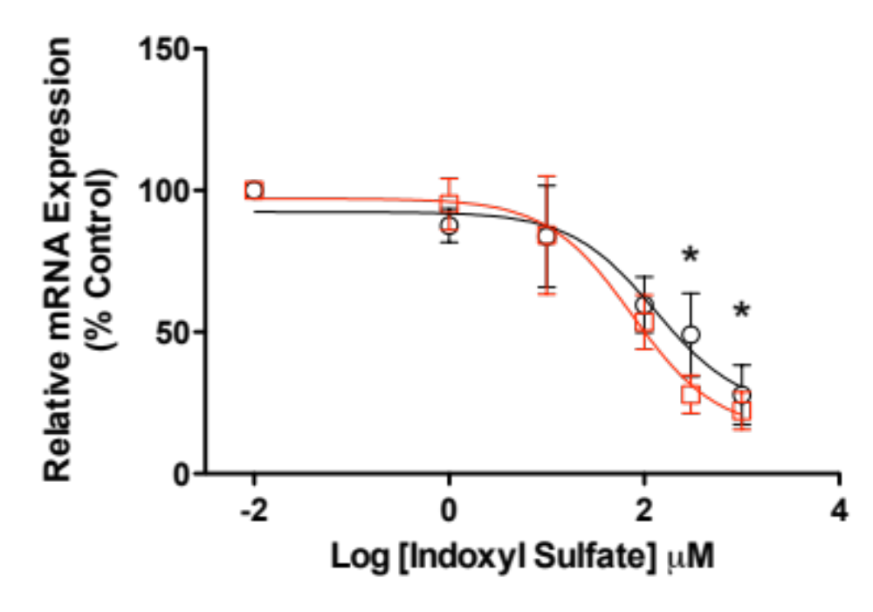
Indoxyl Sulfate Down-Regulates Hepatic CYP3A4
Normal
Uremia
NO FBS Media
FBS Media
Velenosi et al. unpublished

Slide 26
Possible Mechanism For Hepatic Drug Metabolizing Enzyme Down-regulation in CKD.
I
CONTROL
UREMIA
Mechanism?
Enzyme
Enzyme
mRNA
mRNA
Indoxyl Sulfate?
PXR
RXR
HNF-4α
RNA Pol II
PXR
RXR
HNF-4α
RNA Pol II
Ac
Ac
Ac
CYP
Ac
Ac
Ac
CYP

