Slide 1
Pricing of Carbon and Funding of Low Carbon Transition Under a 2⁰C Regime
Bose Varghese
24-Oct-2016

Slide 2
Infosys Limited
A $9.5 billion company headquartered in Bengaluru, India
A global leader in technology services and consulting
Over 190,000 employees
Clients in over 50 countries
Committed to becoming carbon neutral by 2018
Committed to becoming RE100 by 2018
Member of the Carbon Pricing Leadership Coalition (CPLC)
Internal carbon pricing has been done with the support of WRI

Slide 3
Internal carbon pricing – Infosys approach
Emission Category | FY 2016 (tCO2e) | FY 2018 Projection (tCO2e) | Strategy to become neutral | %
Scope 1 | 17950 | 13500 | Offset | 100%
Scope 2 | 153300 | 236000 |  | 100%
 |  | 4720 | EE | 2%
 |  | 33040 | Captive RE | 14%
 |  | 132160 | Wheeled RE | 56%
 |  | 66080 | REC/Offset | 28%
Scope 3 | 177505 | 221000 | Offset | 100%
Total emissions | 348755 | 470500
Our pricing of carbon was related to our carbon neutral commitment.
The price should generate the funds required to become carbon neutral.

Slide 4
2⁰C - What it takes
Peaking of emissions by 2020
Total emissions should drop to about 40 GtCO2e by 2030 (Estimated emissions in 2030 based on current INDCs: 55 GtCO2e)
Business as usual scenario: 16% increase in energy-related emissions by 2040 (2⁰C regime demands 41% reduction energy-related emissions by 2040)
Move toward carbon neutral by the end of the century
At current emission levels, the remaining carbon budget of about 900 GtCO2e will be consumed by 2040
  PwC’s Low Carbon Economy Index estimates that 2-3% annual global emissions reduction is required under a 2⁰C regime
  60% cut in emissions from China alone by 2040 from current levels

Slide 5
2⁰C – At what cost
Projected annual investment from 2015-2030: over 1100 billion (700 on EE and 400 on RE)
In 2015, 330 billion was invested in RE alone
India’s INDC commitment of 33-35% reduction in emission intensity of GDP by 2030 below 2005 levels is estimated to cost 2.5 trillion dollars
Where will this money come from? Put a price on carbon?
Need mechanisms to turn carbon price into low carbon transition fund

Slide 6
Cap-and-trade
Market-based
Policy tool that puts a cap on emissions over a period; emission reduction is guaranteed
Allowances are allocated to participating parties or auctioned
Market determines the optimal price of allowances
Allowances can be traded among participating parties
Theoretically, cap-and-trade finds the least cost option to achieve the emissions cap
Offers flexibility to parties – doesn’t mandate any particular approach or intervention

Slide 7
Why cap-and-trade may not fit under a 2⁰C regime
Faced with a massive emission reduction target, what will be the right cap?
Sort term caps that get revised downwards in the long term
- likely to miss opportunities for transformational change
- likely to delay attainment of long term goals
Long terms caps with short term check-points
Under a 2⁰C regime, who can get away with having surplus allowances to sell?
Emissions
Time

Slide 8
Emissions tax
Puts a price on emissions
Emission reduction is not guaranteed
Market determines the optimal emission reduction
Therefore the tax revenue must be invested in promoting low carbon technologies so that emission reduction targets can be achieved
Emissions
Time

Slide 9
International offsets
Buying emission reduction achieved in another country to offset own emissions
Emission reduction is more certain
Demand-supply within the market will determine carbon price
Under a 2⁰C regime, who should be allowed to sell emission reduction? If a country is able to reduce emissions, shouldn’t it get a share of the global target?

Slide 10
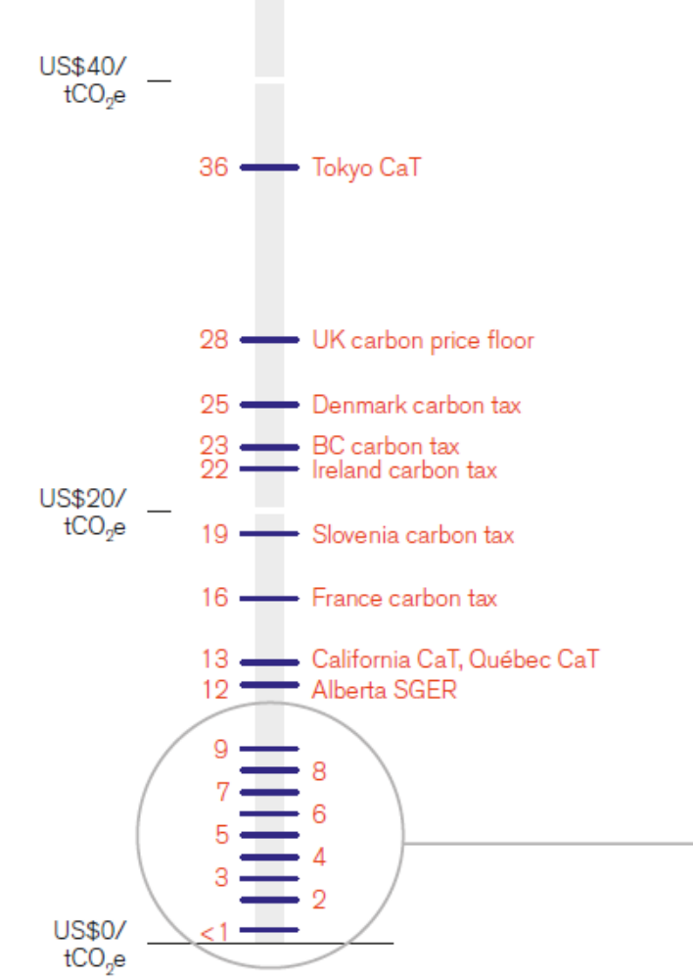
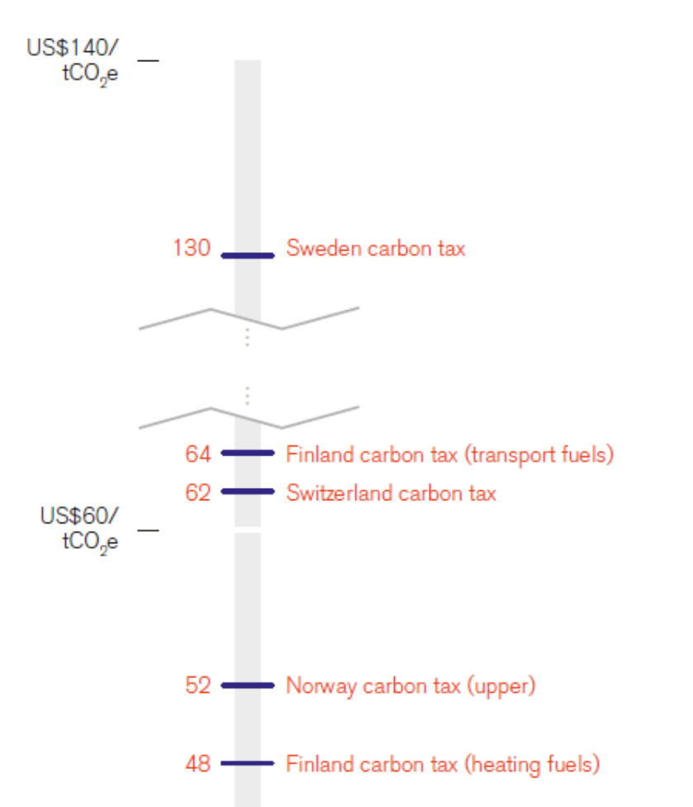
2⁰C – At what cost
State and Trends of Carbon pricing, The WB Group, 2015

Slide 11
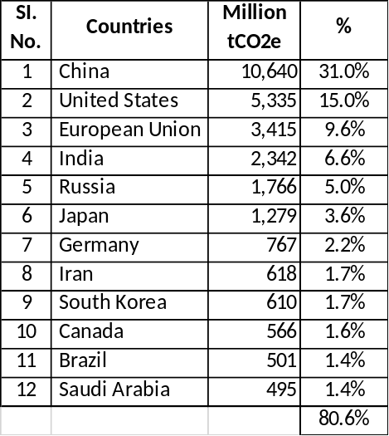
Emissions
Trends in Global CO2 Emissions, 2015 Report, PBL Netherlands Environment Agency

Slide 12
References
Climate Change 2014, Synthesis Report, IPCC
IPCC
CO2 Emissions from Fuel Combustions highlights, IEA, 2015
Climate Change 2014, Mitigation of Climate Change, Working Group III Contribution to the Fifth Assessment Report of the Intergovernmental Panel on Climate Change
Climate Change and Nuclear Power, IEA, 2016
Climate Change and Nuclear Power, IEA, 2015
Benjamin M. Sanderson, Brian C. O'Neill, and Claudia Tebaldi, What would it take to achieve the Paris temperature targets? Geophysical Research Letters, July 2016
Trends in Global CO2 Emissions, 2015 Report, Background Studies, PBL Netherlands Environment Agency
State and Trends of Carbon pricing, The WB Group, 2015

Slide 13
Thank you

