Slide 1
Solvent Interaction Analysis (SIA):
A New Approach to Structure-Focused Clinical Proteomics
Boris Zaslavsky
Analiza / Cleveland Diagnostics
Cleveland, Ohio
USA

Slide 2
Protein Biomarker Features
Expression level
Structure
Protein-protein and protein-ligand interactions

Slide 3
Aqueous Two-Phase Partitioning - Fundamentals (1):
Solvent is water, with added polymers and salts
Example 1
Example 2
17.7% Ficoll
5.7% Dextran
76.6% Water
6.7% Ficoll
15.6% Dextran
77.7% Water
4.9% PEG
1.8% Dextran
93.3% Water
2.6% PEG
7.3% Dextran
90.1% Water

Slide 4
Aqueous Two-Phase Partitioning - Fundamentals (2):
K, the partition coefficient, is defined as the ratio of solute concentrations in the two phases
All procedures are performed with a liquid handling workstation and the concentration assay instrument: using UV- or fluorescence reader or ELISA immunoassay
Add solute
Sample and
analyze
Aqueous
Phases
Mix
Settle
PEG-rich phase
Dex-rich phase
C_{top}
C_{bot}

Slide 5
Solvent Interaction Analysis
Measured Property – protein-solvent interactions (inaccessible by other means in HTS mode)
Defined by nature and arrangement of solvent-exposed groups (i.e. by 3-D structure)
Sensitive to changes in:
  Chemical structure;
  Conformation;
  Protein-protein and protein-partner interactions

Slide 6

Sensitivity of SIA (1):
Effect of Amino Acid Sequence

Slide 7
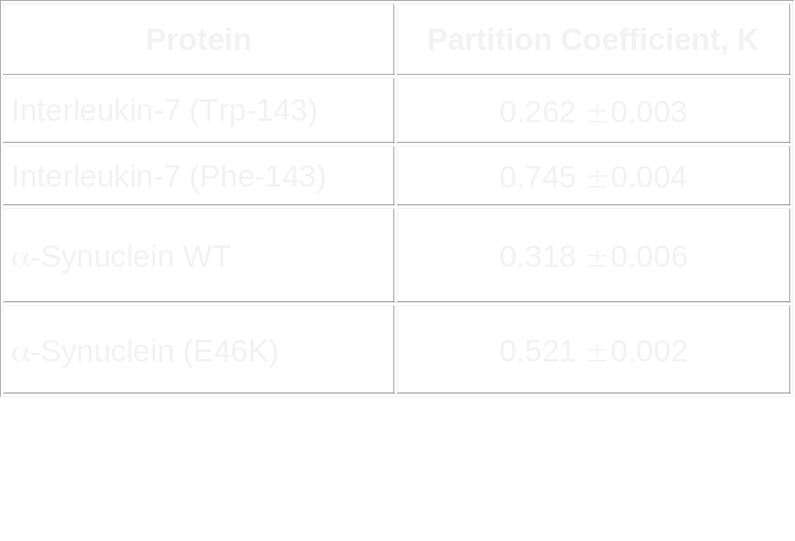
Sensitivity of SIA (2):
Effect of Amino Acid Replacement on
Protein Partitioning

Slide 8
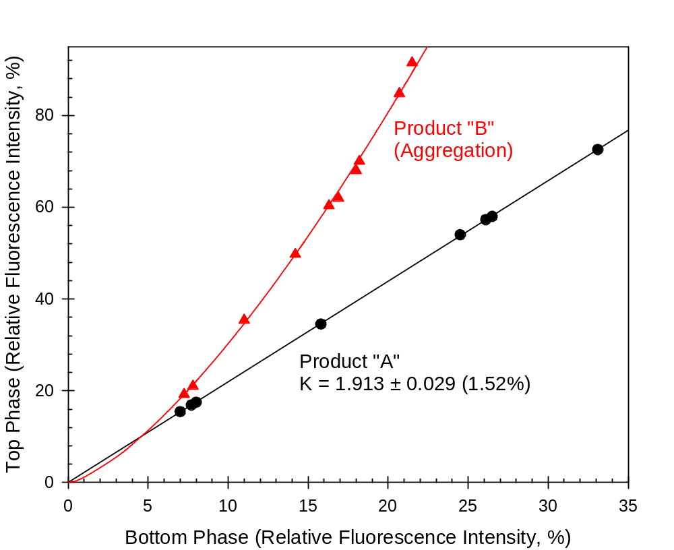
Sensitivity of SIA (3):
Protein Aggregation
Product A - Pure Protein
Product B - Same Protein in the Presence of an Excipient
Aggregation is easily detected!

Slide 9
Sensitivity of SIA (4):
Effect of Altered Glycosylation on Hemoglobin Partitioning
Glycohemoglobin Control-N contains 7.6% GHb; Glycohemoglobin Control-E contains 15.0% GHb
ATPS | Control-N 7.6% GHb | Control-E 15.0% GHb
#1 | 0.573 ± 0.027 | 0.634 ± 0.019
#2 | 0.337 ± 0.021 | 0.269 ± 0.009
#3 | 0.205 ± 0.020 | 0.290 ± 0.015
#4 | 0.836 ± 0.015 | 1.113 ± 0.029
#5 | 1.025 ± 0.018 | 1.277 ± 0.011

Slide 10
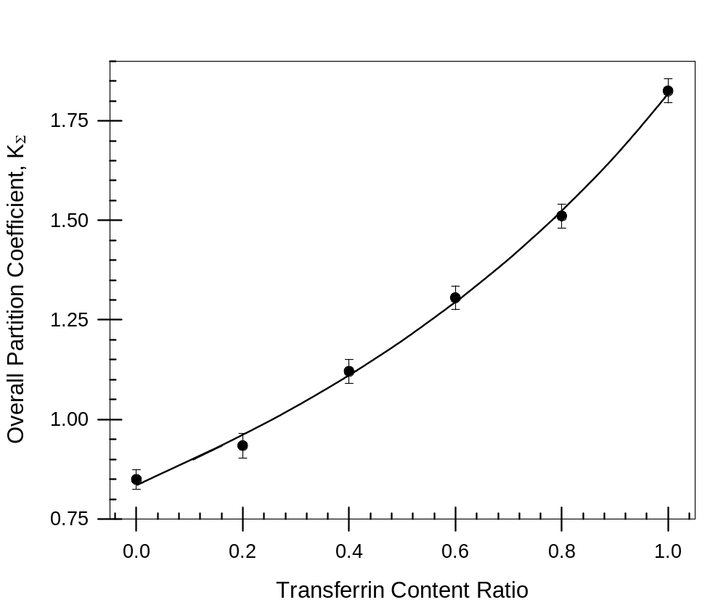
Sensitivity of SIA (5):
Carbohydrate-Deficient Transferrin
Transferrin K ~1.78
CDT K ~0.845
CDT – desialylated Tf

Slide 11
Biologically Relevant Observations (1)
Partition coefficient of a protein in vitro and in serum may differ under the same SIA conditions
Protein (human) | K-value (pure protein) | K-value (in serum/plasma)
Transferrin | 1.78 ± 0.04 | 0.53 ± 0.12
Prostate specific antigen | 1.90 ± 0.06 | 1.11 ± 0.01
Albumin | 0.69 ± 0.01 | 1.28 ± 0.02
Immunoglobulin G | 4.42 ± 0.02 | 4.19 ± 0.04

Slide 12
Biologically Relevant Observations (2)
Partition coefficient of a protein in different biological fluids (e.g., serum and urine) may differ
Protein | K-value (in serum) | K-value (in urine)
Prostate specific antigen | 1.11 ± 0.01 | 1.60 ± 0.10

Slide 13
Discovery of Structural Changes in Cancer
Structural Classification + Biological Identification
Solvent Interaction
Analysis Assay:
1000s of simultaneous experiments
MS:
Label-free Discovery
Multiplexed
ELISA:
ELISA:
Discovery (known proteins)
Clinical screening
Discovery (known
Proteins
Clinical screening

Slide 14
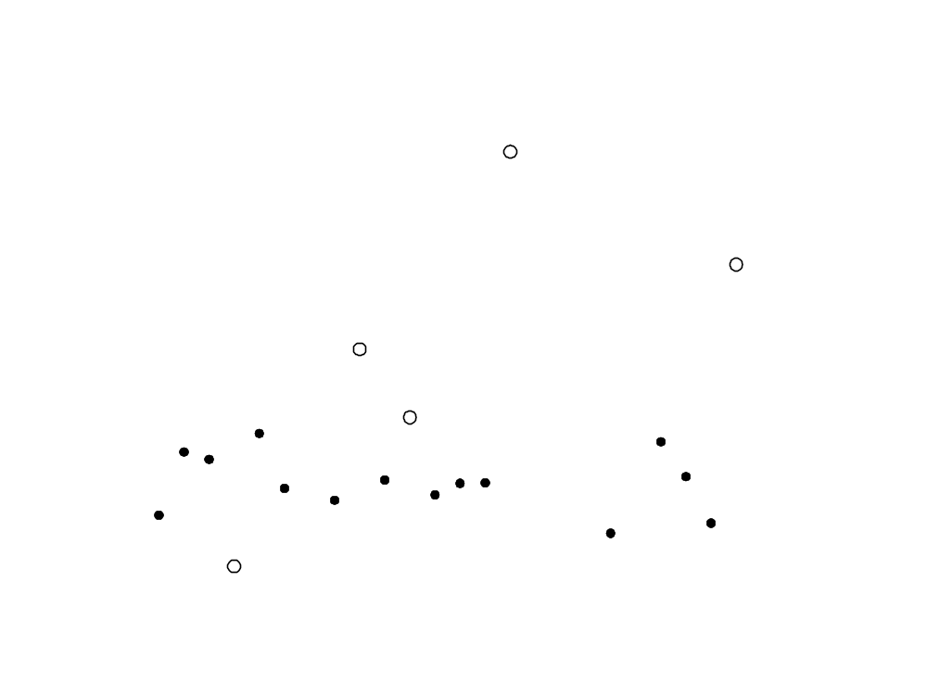
How to Choose SIA Chemistries: Example
Dashed lines denote experimental error limits
White symbols are systems that can be used for a biomarker test
Notes:
Each protein that undergoes structural changes (or protein-protein interactions) was examined with 24 proprietary test chemistries. In this shotgun approach, many tests failed due to variety of technical reasons (e.g., the instrument signal was out of range), and many did not show statistically significant differences between the pooled samples and were thus disqualified. Test chemistries that are potential useful as structural tests are denoted outside the error bars (typically related to the ELISA error bars and not to the SIA inherently tight CV). For example, system #15 produced a change in the measured signal of over 120% between the normal and positive cases. The choice of a specific test chemistry depends on additional criteria, including insensitivity to changes that are not related to cancer, ease of handling, cost, and ability to multiplex with additional proteins to result in a highly specific test. These considerations are typically evaluated downstream during test development.

Slide 15
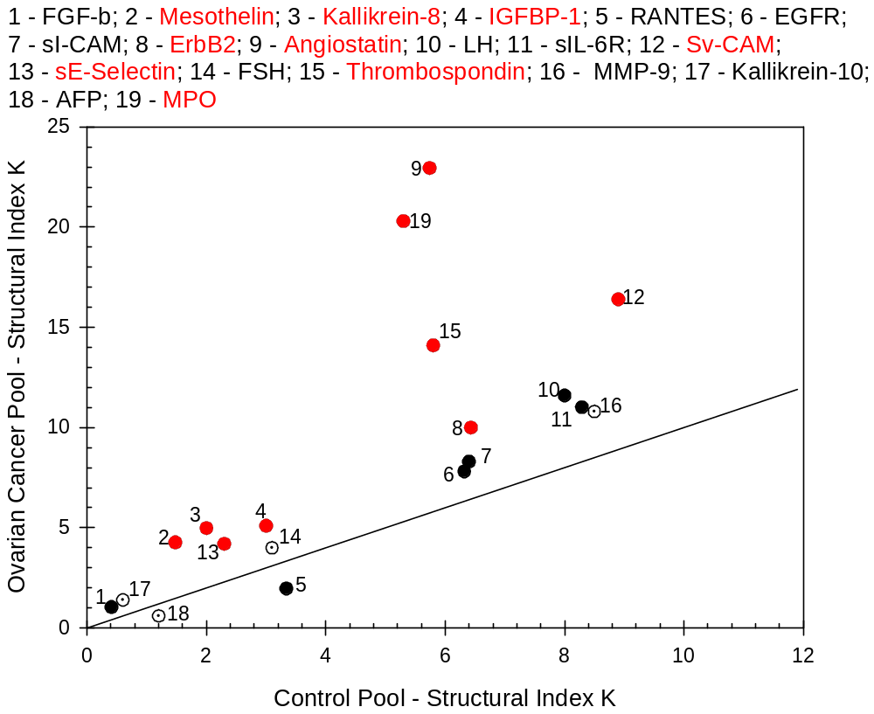
Stage I Ovarian Cancer vs. Control Pools (Benign)
Multiplexed Immunoassay (7/06)
RED: 1st choice
No structural changes
Notes:
A second tier study demonstrated several proteins whose structural index K values for cancer and control were sufficiently outside the equi-value line.

Slide 16
Building an SIA-Based Assay
Structural Classification + Biological Identification
Solvent Interaction
Analysis Assay:
1000s of simultaneous experiments
MS:
Label-free Discovery
Multiplexed
ELISA:
ELISA:
Discovery (known proteins)
Clinical screening
Discovery (known
Proteins
Clinical screening

Slide 17
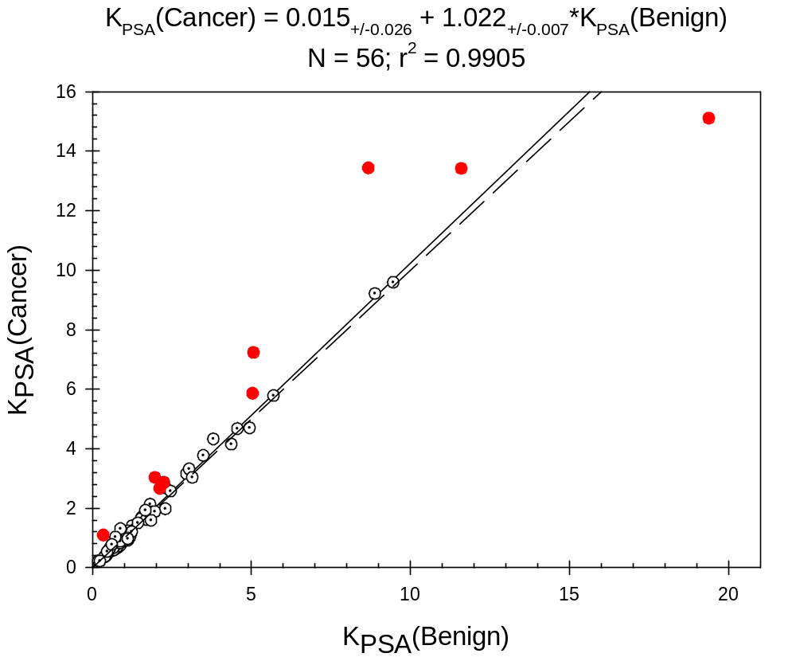
Example of ATPS screen
Prostate Specific Antigen (malignant vs benign)

Slide 18
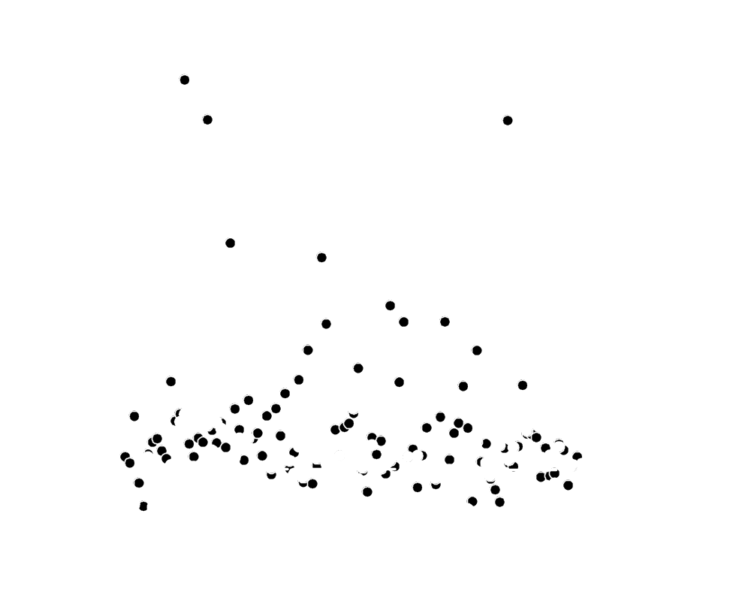
Total Serum PSA Level Is Not Predictive of Cancer

Slide 19
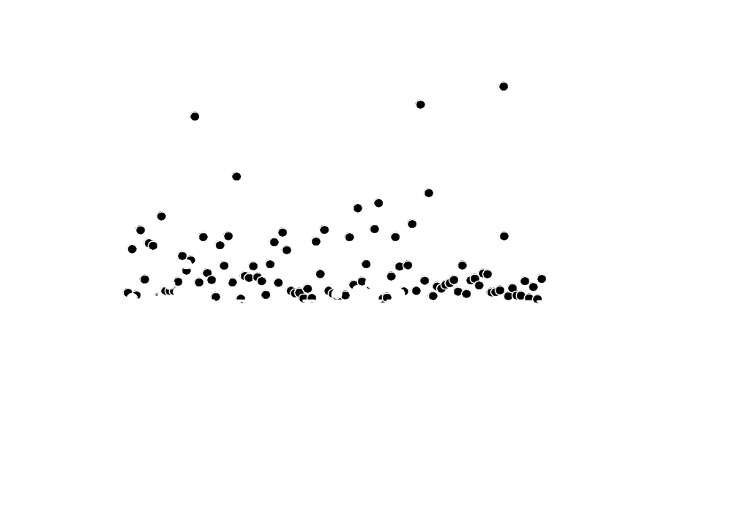
PSA Structure Is Cancer Predictive

Slide 20

PSA/SIA outperforms existing tPSA Test
Parameter | Value
AUC | 0.90
Standard Error | 0.02
95% CI | 0.85 – 0.94
P value | <0.0001
AnalizaDx
tPSA
Notes:
20

Slide 21
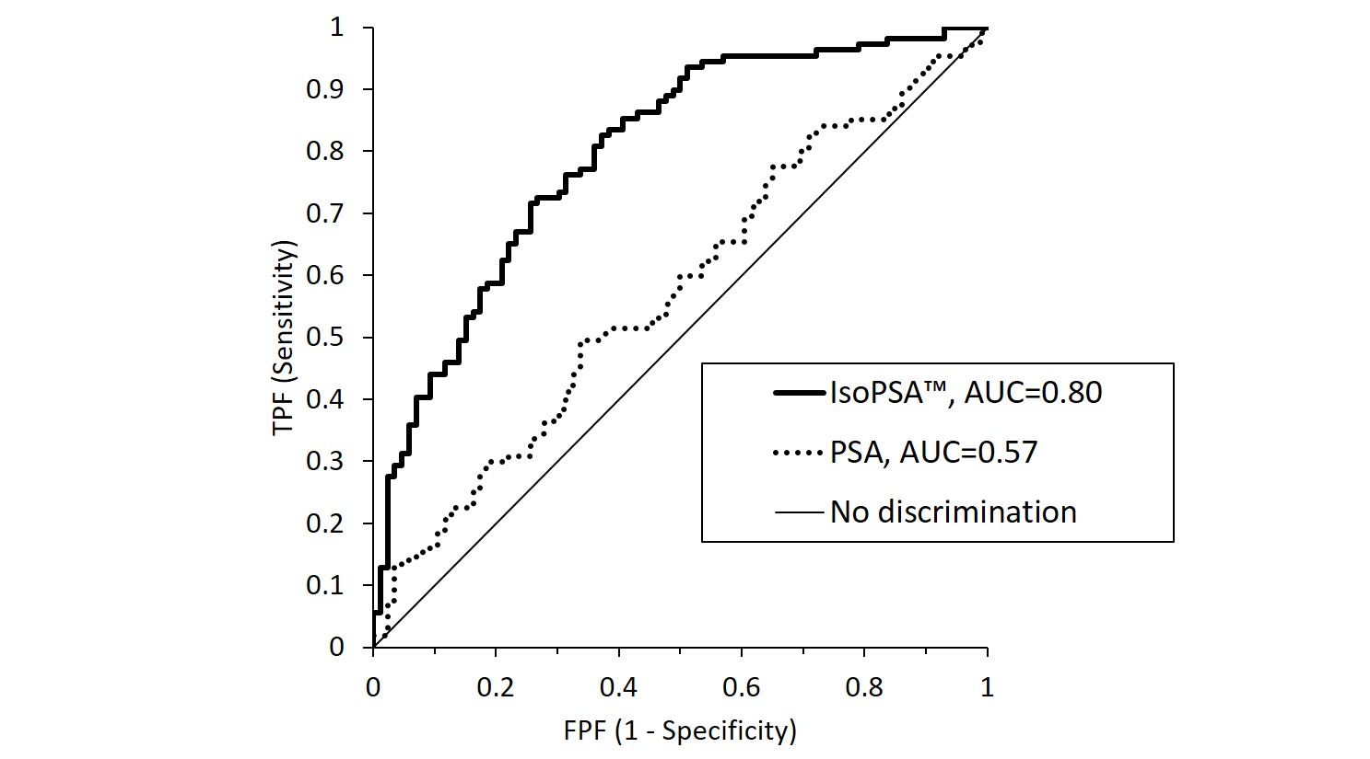
Benign & Cancer IsoPSA vs. PSA > 4 ng/ml

Slide 22
Feasibility Data: Structural Biomarkers for Breast Cancer
Notes:
The final example directly compares our structural test against the gold-standard tests for breast cancer today – two different types of mammography. The comparison is performed using a conventional statistical test called Receiver-Operating Characteristics (ROC), a test that essentially compares the trade-off between sensitivity and specificity (defined in the next slide) of any diagnostic test.
No diagnostic test is 100% sensitive and 100% specific. Depending on the significance of making one type of mistake vs. another, alternative tests can be quantitatively compared. For example, mammography can typically detect 70% of breast cancer cases (sensitivity) but at a cost of making a mistake rate of 30% in flagging normal cases as potentially positive (100 – specificity). The comparison between ANALIZA’s-Newco’s performance and that of mammography is remarkable.
We already have plans to further refine and improve the test, and follow-up studies that focus on early breast cancer studies, cross-sensitivity to other conditions and cancers, etc., will be performed. However, the number of patients involved in this early study, and the significant performance improvement of this low-cost serum based test over expensive mammography can not be under-appreciated.

Slide 23
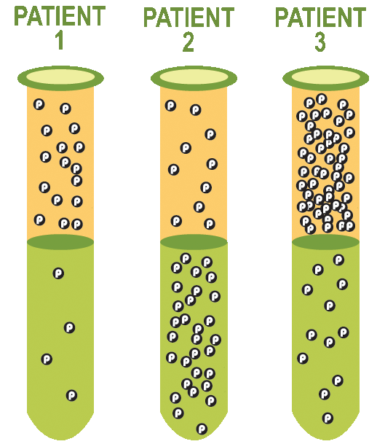
Solvent Interaction Analysis – The Assay
Focus:
Use change in protein structure to identify healthy vs. disease
CDx technology:
Biofluid placed in aqueous two-phase system
Proteins partition between top & bottom based on structure
Specific ratio (K) for protein + structure + SIA chemistry
16
4
10
30
48
12
K =
K= 4 .3 4
Amount= 20 40 60
Notes:
23

Slide 24
Thank You

Slide 25
De Novo Discovery of Structurally Changed Biomarkers in Cancer
Structural Classification + Biological Identification
Solvent Interaction
Analysis Assay:
1000s of simultaneous experiments
MS:
Label-free Discovery
Multiplexed
ELISA:
ELISA:
Discovery (known proteins)
Clinical screening
Discovery (known
Proteins
Clinical screening

Slide 26
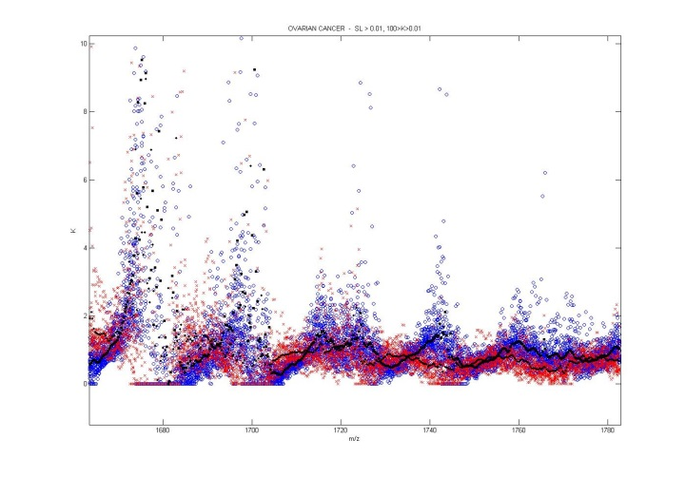

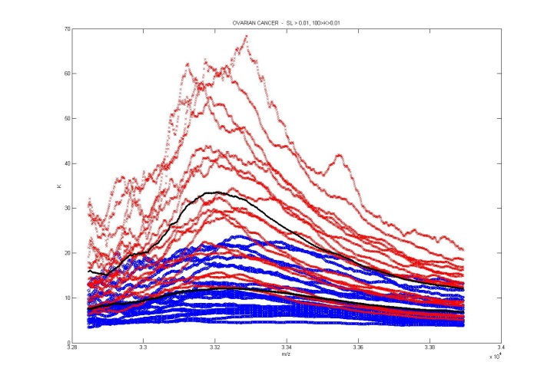
Label-Free, MS-Based Discovery
Peptides:
Exoproteases?
Albumin?
Amplification?
Isoforms
Protein-Protein Interactions

Slide 27

What Does ΔK at Same M/Z Mean?
Stage I OC
SELDI/TOF
Q10 chip
NCI 3/07
18 cancer
20 normal

Slide 28
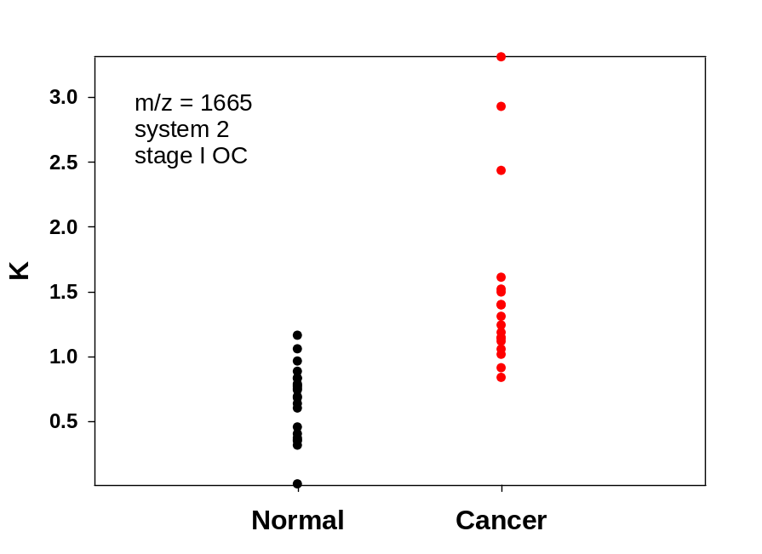
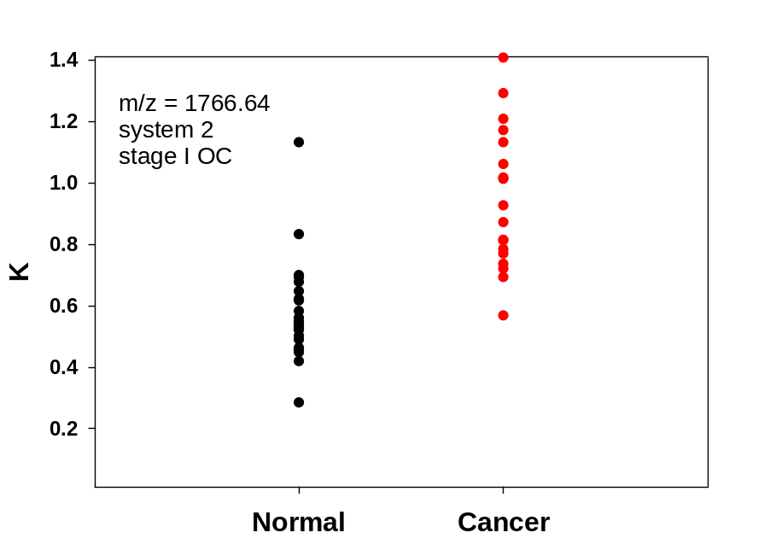
M/Z Data is Easily Converted to Standard Stem Plots

Slide 29
Multivariate Marker Performance:
Stage I Ovarian Cancer
34 potential biomarkers selected visually from composite MS plots
Biomarker selection¹ using:
  Wilcox test
  Forward selection with mahalanobis distance
  SVM recursive feature elimination
Final set leave-one-out cross validation performance:
  10 biomarkers: 100% correct classification
  3 biomarkers: ~90% correct classification
¹ Lixin Gong, Insightful Corp., using S+ ProteomeLab 2.0

