Slide 1


‘Development and feasibility of an Internet-based self-management intervention for spousal caregivers of people with early-stage dementia’
L.M.M. Boots
Maastricht University - The Netherlands

Slide 2



Background (I)
New case every 4 seconds
No cure
Rising costs of care
80% caregivers overburdened
Ageing population: ⬇formal healthcare
→ Internet interventions
Notes:
Background:
Because of the expected increase in people with dementia, no cure in sight and the rising costs of care → focus on caregiver
informal caregiving can put a great strain on family members and often causes burden and stress
Therefore, increasing need for effective caregiver interventions
However, the aging of the population leads to decrease in available formal healthcare
With Internet interventions we might be able to meet the educational and support needs of informal caregivers at reduced costs

Slide 3
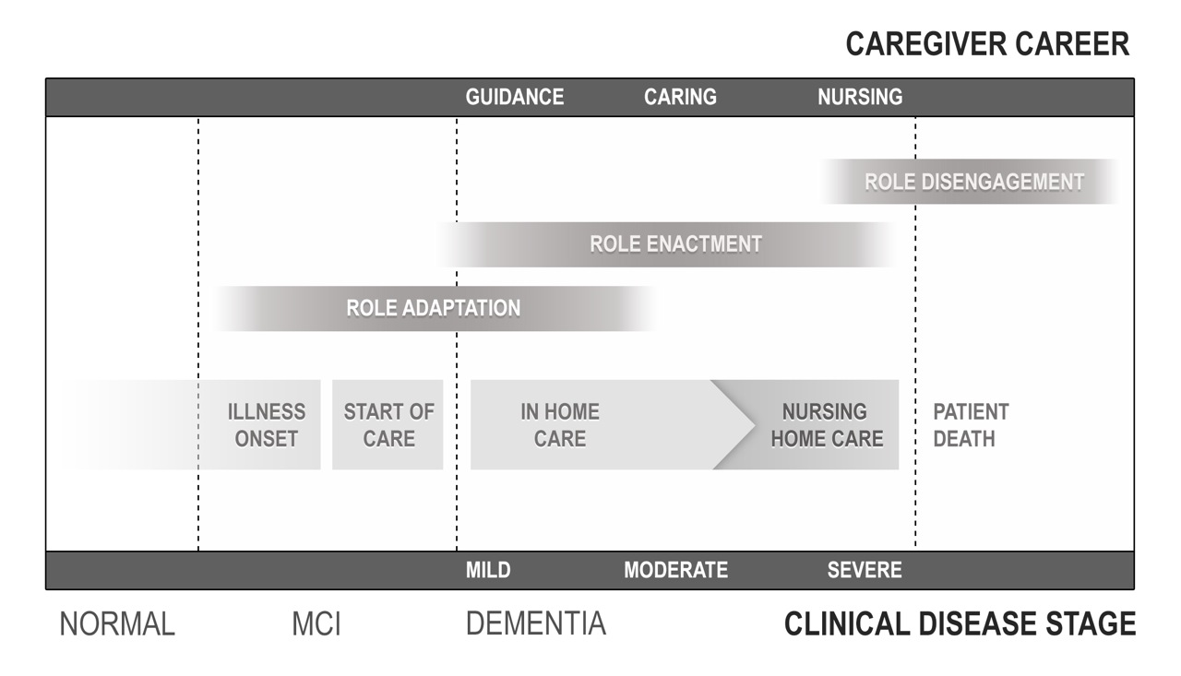
Background (II)
De Vugt & Verhey (2013) Neurobiology of Ageing
Notes:
Because the degree of strain and burden/practical support in daily life is still low in the pre-dementia stage, this provides great opportunity to empower informal caregivers with support and information
Advice how to accept, cope, adapt to changing roles
Prevent overburdening in later stages

Slide 4
MRC Framework¹
Defining intervention
Acceptability
Feasibility
Effect
¹Campbell et al. (2000) BMJ; 321: 694-696
Notes:
Therefore, we the current study aims to develop and evaluate an Internet-based program for early-stage dementia caregivers.
As recommended by the MRC Framework for design and evaluation of complex interventions, the current study conducts a step-wise approach to (1) define the intervention based on the literature and target audience; (2) explore feasibility and finally; (3) evaluate its effects

Slide 5

Phase I: Defining intervention
Theory
User and professional input
Literature review
Prototype
Notes:
Phase I: How should such a program look like?
To answer that question we looked at multiple aspects.
We performed literature review to review the existing evidence and theory + based program on potential user and professional input by means of qualitative interviews.

Slide 6
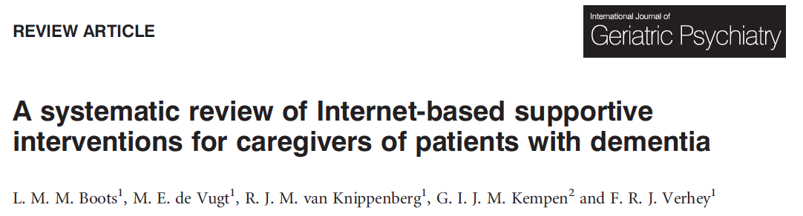
Int J Geriatr Psychiatry 2014; 29: 331-344
Notes:
The review aimed to provide an overview of the evidence for effectiveness, feasibility, and quality of studies focused on Internet interventions for dementia caregivers → to see what’s already out there + which components we should incorporate in such a program in order to be effective.
We performed a systematic search of the literature up to January 2013 and assessed the quality of the included studies according to the Cochrane Level of Evidence and criteria set by the Cochrane Back Review Group in order to make valid statements about the studies’ outcomes

Slide 7



Successful Internet based interventions
Include multiple components
- Are tailored to specific needs
- Not only computer/ internet,
but also contact with real humans
Boots et al. (2014) Int J Geriatr Psychiatry; 29: 331-344
Notes:
Taken the quality of the included studies into account, we can conclude that programs with the most effect on caregiver well-being comprised of multiple components (so not only information for instance, but also assignments and real-life examples), were tailored to the needs of the individual and had the opportunity to interact with other caregivers and/or a coach.

Slide 8

Input from users and professionals
4 focus groups: 6-8 caregivers per group
12 interviews with experienced health care professionals
Focus: needs and wishes intervention content and design
Boots et al. (submitted)
Notes:
the program was developed in collaboration with the target audience to fit the content of the program to their needs. By means of in-depth, exploratory focus group interviews we gained more insight in early-stage caregiver motivations and hindrances to participate in an early stage intervention program and to explore their wishes and needs with regard to the content and design of the intervention.
We also interviewed experts who deal with dementia caregivers on a daily basis and combined their point of view with the caregivers’ to create the content

Slide 9
Input users and professionals
9 themes
Balans in activities
Social support
Acceptance
Focus on positivity
Stress and relaxation
Insecurity
Self-reflection
A changing partner
Communication with partner and social circle
Notes:
Based on the focus group interviews and the interviews with professionals 9 themes were created for the early-stage caregivers to choose from.
The content of the modules was validated by experts in the dementia field.

Slide 10
Input users – self management
Early stages: needs paradox
Self management
  no concrete solutions
  help to find best way to cope
Empowerment
  - strengthen problem solving competences
Boots et al. (submitted)
Notes:
The focus group results also showed that in the early stages, caregivers struggled with acknowledging specific needs due to fear of stigma and the negativity of available information.. However, despite their difficulty to pinpoint clear needs, caregivers do face many changes and problems in the early stages and find it difficult to cope
Self-management interventions could fit the early-stage needs-paradox, as it is
not aimed at giving concrete solutions to problems
But helps caregivers to look at their own situation and find best ways to cope with a continuously changing situation.
ZM aims to ‘empower’ caregivers so that they remain in control by strengthening their problem-solving competences.

Slide 11
Partner in Balance: Online Self-management
Intake (face-to-face)
8 weeks online modules
Evaluation (face-to-face)
Contact with coach: email and telephone
Contact with other caregivers: forum
Notes:
Based on the previously mentioned, the online self-management program will combine face-to-face care with online modules and consist of multiple component:
intake with a personal coach : discuss current situation and choose 4 modules
8 weeks online modules while staying in touch with coach through email
Evaluation with coach (was it useful, gained knowledge how to tackle unwanted situations in the future, possiblity to choose additional modules)
Possiblity to interact with other caregivers on the discussion forum → wish of the target audience

Slide 12
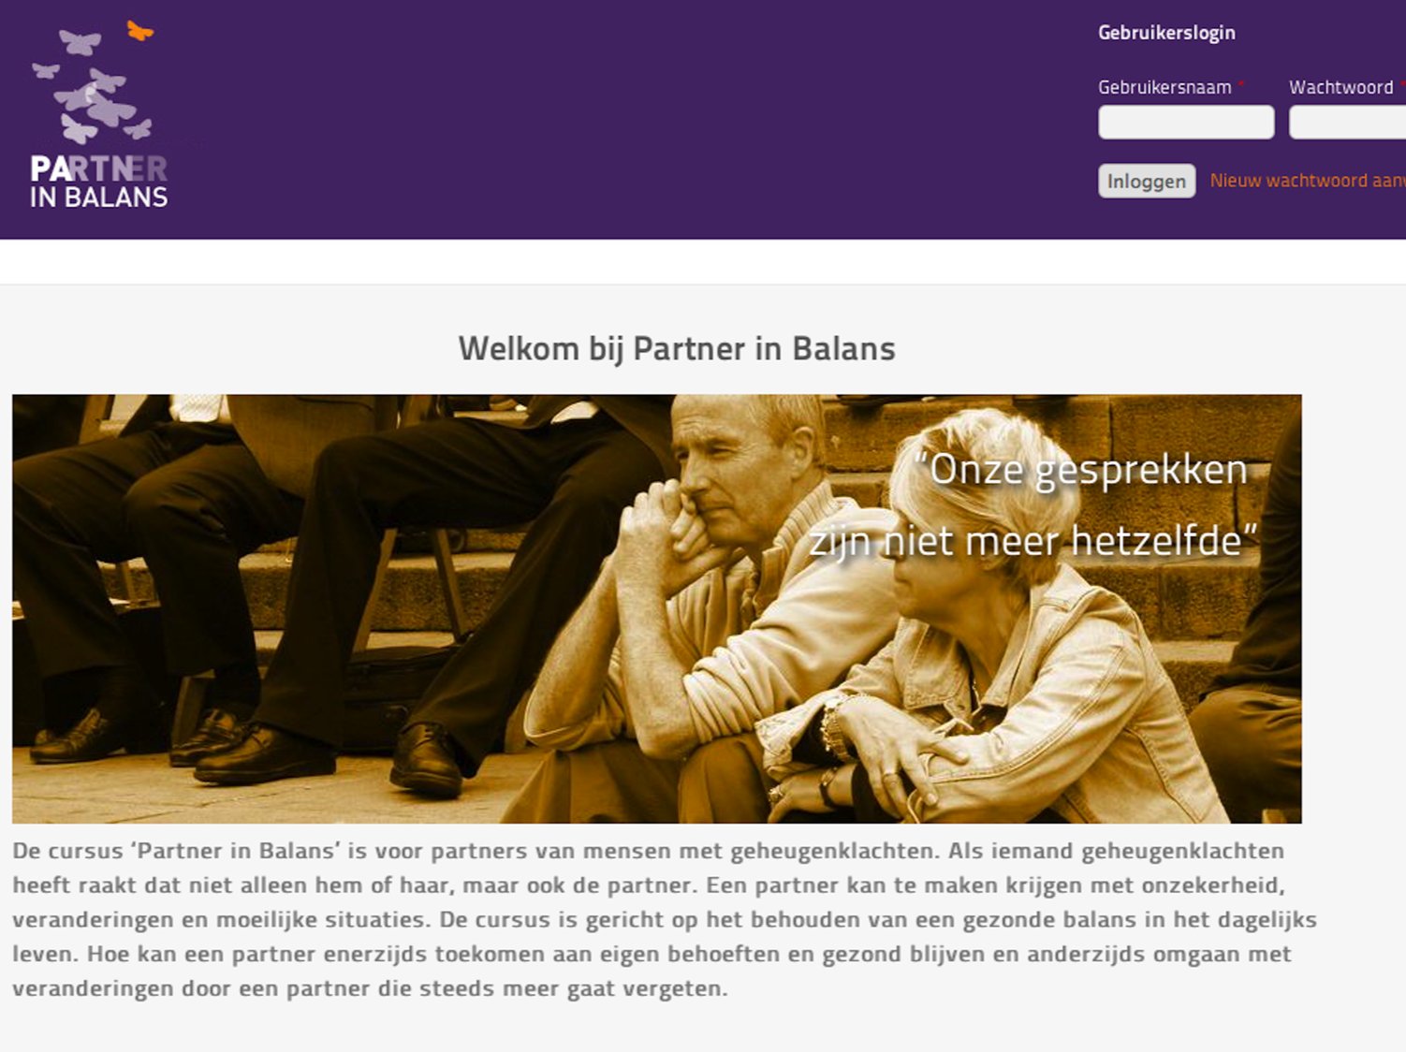
Notes:
After the intake participants can go to the course website and log in to their personal page where their chosen modules will be made available

Slide 13
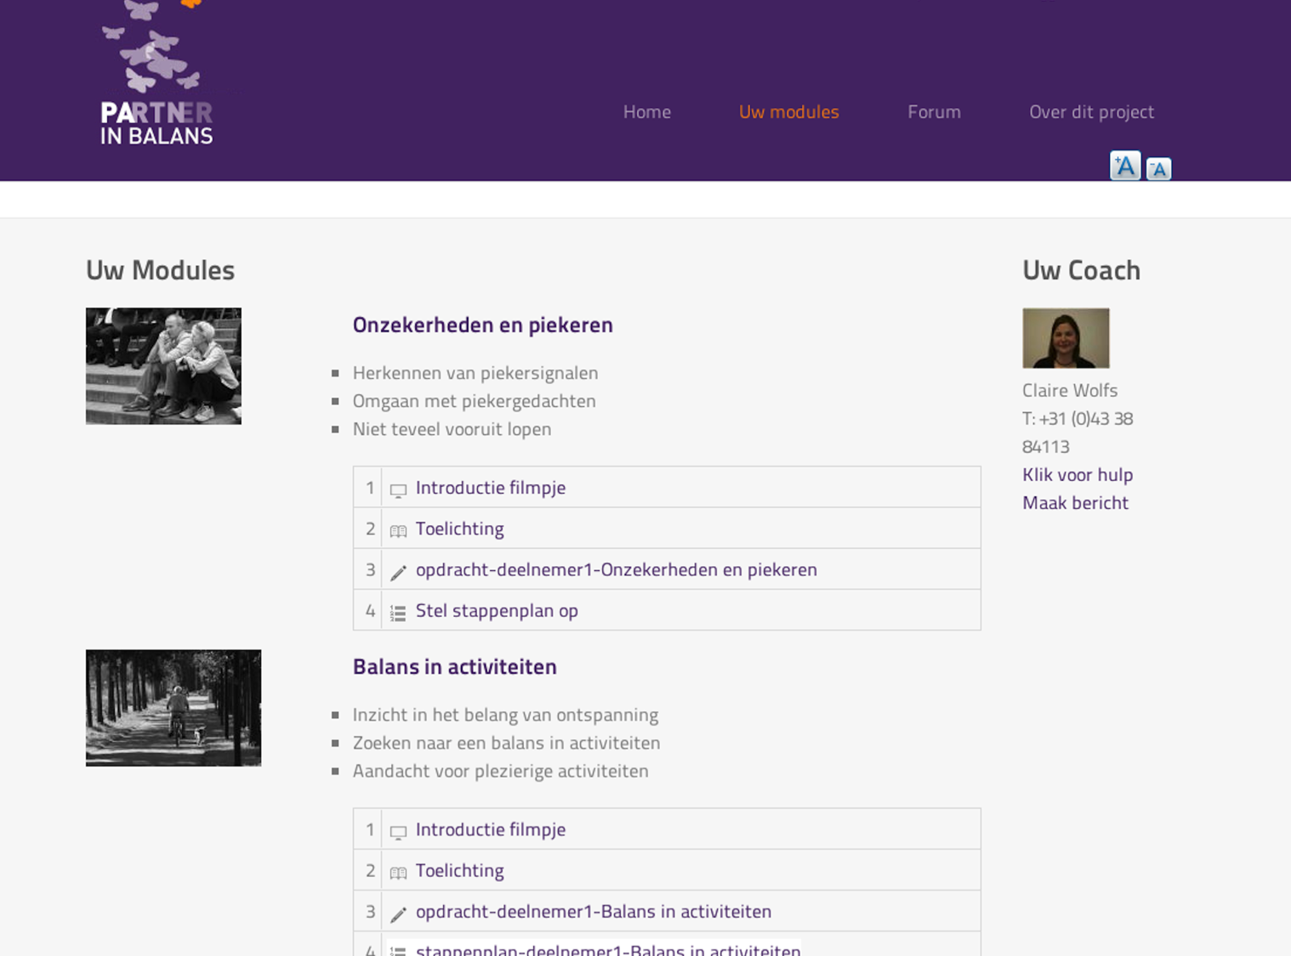
Notes:
Modules consist of individualized sessions with education, self-reflecting assignments and a change plan, guided by the personal coach who will provide feedback after each module and offer assistance when needed.

Slide 14
MRC Framework¹
Defining intervention
Acceptability
Feasibility
Effect
¹Campbell et al. (2000) BMJ; 321: 694-696
Notes:
New program + older population → important to test feasibility and acceptability before moving forward with an effect study

Slide 15
Phase II: Acceptability and feasibility: Pilot Study
One-group pre-test post-test design* (n = 10)
Feasibility of the program
Program Participation Questionnaire*
Preliminary effects
CSES, PMS, GAS, HADS
Adapt intervention to increase user-friendliness
*Design and questionnaire based on similar studies (Teel & Leenerts (2005); Nurs Res: 193-201, Sander et al. (2009); J Head Trauma Rehab: 248-261, Fick et al., 2011); J Gerontol Nurs: 39-47)
Notes:
- To study the feasibility of the intervention program, the “Program Participation Questionnaire” was used. This questionnaire included 30 items measuring usability, clarity, comfort with the format, acceptability, likes and dislikes with items and cut-off scores based on previously conducted studies comparable to ours.
Since the online self-management intervention “Partner in Balans” was aimed at supporting spousal caregivers in the early stages and increasing their confidence level, it was expected to affect caregiver feeling of confidence (CSES), perceived control (PMS) and goal attainment (GAS). In addition, as the program aims to prevent or decrease psychological complaints we measured depressive symptoms (HADS).
With the pilot study we also aimed to adapt the intervention for future users to increase user-friendliness

Slide 16
Program Participation Questionnaire
Sum scores
Min | 54
Max | 234
≤144 | ☹
≥145 | ☺
Mean | 208
Mean item scores
Notes:
The items could be scored on a 7-point Likert scale.
The minimum score was 54, indicating a poor evaluation of the feasibility. The maximum score was 234, indicating a good evaluation of the feasibility.
To determine if the feasibility was acceptable, a threshold of 144 or lower was set to indicate a non-acceptable feasibility, requiring major revisions. A threshold of 145 or higher was set to indicate an acceptable feasibility with potential minor revisions. A mean sum score of 208,00 was found. Given the threshold of 145 or higher, this score indicates an acceptable feasibility.
Participants rated the content of the program and the number and structure of the modules, the personal coach and the overall satisfaction positively.
However, dissatisfaction was found concerning the discussion forum and the “help” button. Participants felt a threshold to participate on the discussion forum, since they didn’t know what to talk about or how to begin a conversation. They thought it would be helpful to have a coach or researcher ‘feed’ the discussion forum from time to time, so they could react to it in stead of initiate. The ‘help’ button was considered useful if necessary, but participants hardly used it. They did, however, felt that the button should stay on the website, since it could be of use when needed.

Slide 17
Phase II: Pilot study – preliminary effects (I)
Instrument | Paired difference |  | t | P*
 | Mean | SD
Caregiver Self-Efficacy Scale (CSES) care management | 5,00 | 6,31 | 2,51 | ,03
Caregiver Self-Efficacy Scale (CSES) service use | 9,40 | 8,46 | 3,51 | ,01
Pearlin Mastery Scale (PMS) | 1,80 | 3,08 | 1,85 | ,09
Hospital and Anxiety Depression Scale (HADS) – depression | -2,80 | 1,87 | -4,72 | ,00
*Significant difference at P<,05
Notes:
Preliminary effects were found in the pilot study: on post-test measures caregiver self-efficacy as measured by care management and service use had increased and depression decreased. Feelings of control did not significantly change

Slide 18
Phase II: Pilot study – preliminary effects (II)
GAS
Participant | Baseline | T-score* (Achieved) | Change
1 | 25,2 | 43,8 | 18,6
2 | 22,6 | 54,6 | 32,0
4 | 25,2 | 56,2 | 31,0
5 | 30,0 | 60,0 | 30,0
7 | 30,0 | 70,0 | 40,0
8 | 30,0 | 60,0 | 30,0
9 | 30,0 | 30,0 | 0,0
10 | 30,0 | 55,0 | 25,0
*Effective goal achievement at T≥50
Notes:
To evaluate goal achievement, Goal Attainment Scores were determined pre-test and post-test. Individual t-scores were calculated to indicate achievement rating. The table summarizes the individual t-scores for GAS for eight participants. Of the eight participants, six participants scored an achievement t-score of 50 or higher, indicating positive effects on goal achievement. Two participant did not set goals since they felt the situation was not fixable or they didn’t know what they wished to change.

Slide 19
MRC Framework¹
Defining intervention
Acceptability
Feasibility
Effect
¹Campbell et al. (2000) BMJ; 321: 694-696
Notes:
The pilot study results are promising, but obviously not enough to say something about the real effects of the program. Therefore, the next step will be to evaluate the potential effects of PiB

Slide 20
Phase III: Effectiveness
RCT: 80 spousal caregivers of early-stage PwD
‘Partner in Balance’ vs. Waiting list condition
Effectiveness
Process evaluation
Costs
Expected results: fall 2015
Notes:
We will evaluate the effect of PiB compared to a waiting list control group in an RCT with 80 participants. We will evaluate the effects on self-efficacy, control and depression and perform a process and costs evaluation. The study is currently on-going, results can be expected in the fall of 2015

Slide 21
Conclusions
Defining intervention
Acceptability
Feasibility
Effect
Internet interventions can improve CG well-being if comprised of multiple components, tailored + interaction
Content should fit early-stage CG needs
Feasibility of ‘Partner in Balance’ sufficient
Previous studies provide support to move forward with phase III: effect study (RCT)
Notes:
We can conclude that Internet interventions for dementia caregivers can improve various aspects of caregiver wellbeing, provided they comprise multiple components + are tailored to the individual + include interaction with a coach and/or other caregivers.
The results of the feasibility study are promising and enabled us to make specific adaptations to the program to increase user-friendliness. However, the small sample size and the lack of a control group limited the ability to make valid statements about the preliminary effects of the intervention. Results from the provide support to move forward with a full-scale randomized controlled trial on the effectiveness of the online intervention.

Slide 22


Thank you for your attention
More info: l.boots@maastrichtuniversity.nl
Acknowledgements
Marjolein de Vugt, PhD
Prof. Frans Verhey
Prof. Ruud Kempen
Claire Wolfs, PhD
Inge Klinkenberg, PhD

