Slide 1
Bio-Based Polyethylene Blends Including Non-Wood Biomass Materials
Bo Shi and Greg Wideman
August 10-12 2015

Slide 2
Agenda
Introduction
Environmental sustainability
Bio-based polymer
Filler in plastics
Objective
Material preparation
Torrefaction
Milling
Thermoplastic processing
Thermoplastic blending
Injection molded articles
Conclusion

Slide 3
Introduction

Slide 4

Sustainability: The Global Business Perspective
World Business Council for Sustainable Development (WBCSD) strategy
  Dealing with a carbon-constrained economy
  Living in a water-constrained world
  Encouraging sustainable production and consumption
  WBCSD 2050 Vision
  Halving carbon emission by 2050 (based on 2005)
  Delivering a 4X to 10X improvement in resource & material use
  Incorporating externality costs: carbon, ecosystem, water…
  Vision 2050: the New Agenda for Business, WBCSD

Slide 5
The World of Bio-Based Polymers
Bio-based & biodegradable polymers
  Regenerated and modified natural polymers
    Cellulose-based: Rayon, cellophane, Lyocell, Tencel, etc.
    Starch-based: Thermoplastic starch (TPS)
    Proteins, chitosan, lignin, etc.
  Polylactic acid (PLA): from bio-derived monomer
  PHA: microbially produced via fermentation
100% Bio-based and non-biodegradable
  Green polyethylene: from sugarcane
Partially bio-based polymers
  Polyesters: SORONA™, polyurethane, polyamide, unsaturated polyester
  Polybutylene succinate (Bio-PBS): bio-diol or bio-diacid
Non bio-based, 100% biodegradable
  PCL, PBS, aliphatic aromatic copolyesters, etc.

Slide 6
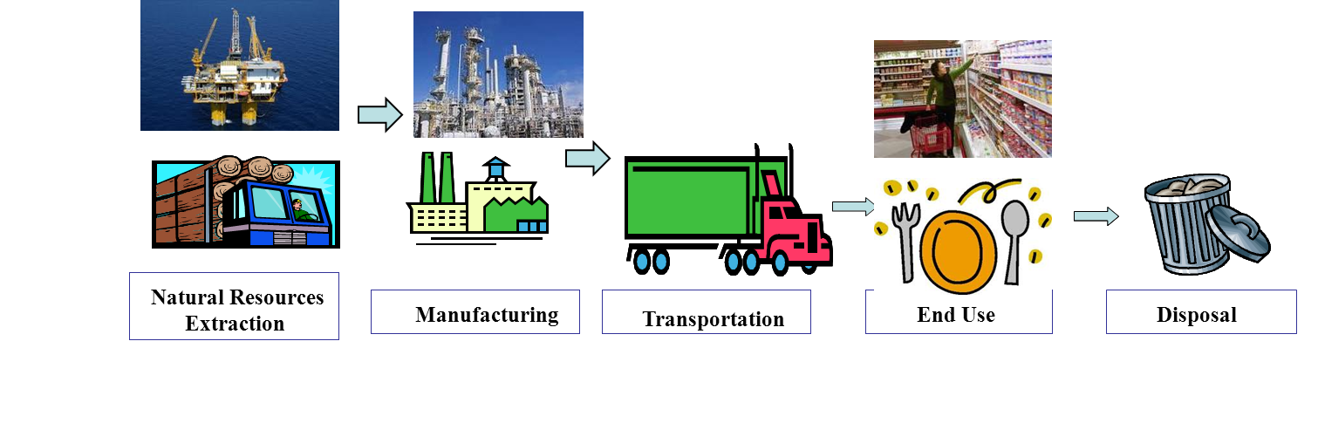
Market Success Criteria of Bio-Based and/or Biodegradable Polymers
Performance
  Must meet application requirements.
Processability
  Acceptable line speed or cycle time
Cost: Market acceptable cost level
Life cycle assessment (LCA) benefits
  Meaningful savings in energy input and emissions of green house gases (GHG), etc.
Resource sustainability: food vs. non-food, etc.

Slide 7
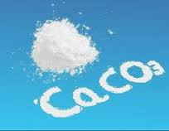
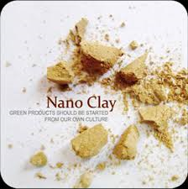
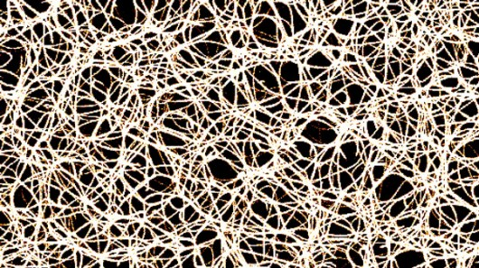
Fillers in Plastics
Calcium carbonate as a major engineered filler
  Ground
  Precipitated
Talc
  It is used to stiffen thermoplastics
Clay
  Nanoclay
Wood flour
  Saw dust
Fiber
  Milled glass fiber
  Carbon fiber
  Wood fiber
  Non-wood fiber

Slide 8
Objective and Approach
Investigate thermoplastic processability of organic fillers in bio-based polyethylene for rigid packaging applications
Technical approach uses extrusion compounding and injection molding
  Non-wood filler preparations
    Torrefaction
    Milling
  Thermoplastic compounding
  Injection molded articles
  Tests of the injection molded articles

Slide 9
Material Preparation and Thermoplastic Processing

Slide 10
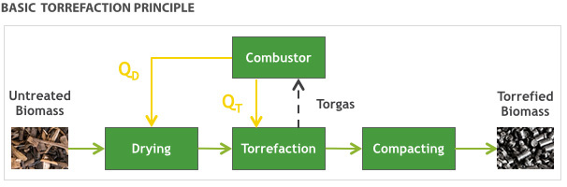
Torrefaction
What is torrefaction?
  It is a thermal process that involves heating the biomass to temperatures between 250 and 300 degrees Celsius in an inert atmosphere
International Biomass Torrefaction Council (IBTC) provides more information
Miscanthus torrefaction process

Slide 11
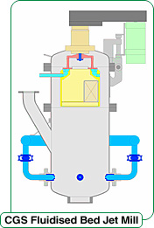
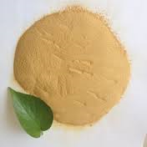
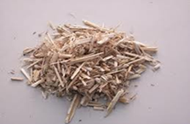

Fluid Bed Jet Milling
What is jet milling?
  Jet milling is a process of using highly compressed air or other gasses, usually in a vortex motion, to impact fine particles against each other in a chamber. This gradually reduces them in size, resulting in powders that have any particle size dimensions
Kenaf core milling process

Slide 12
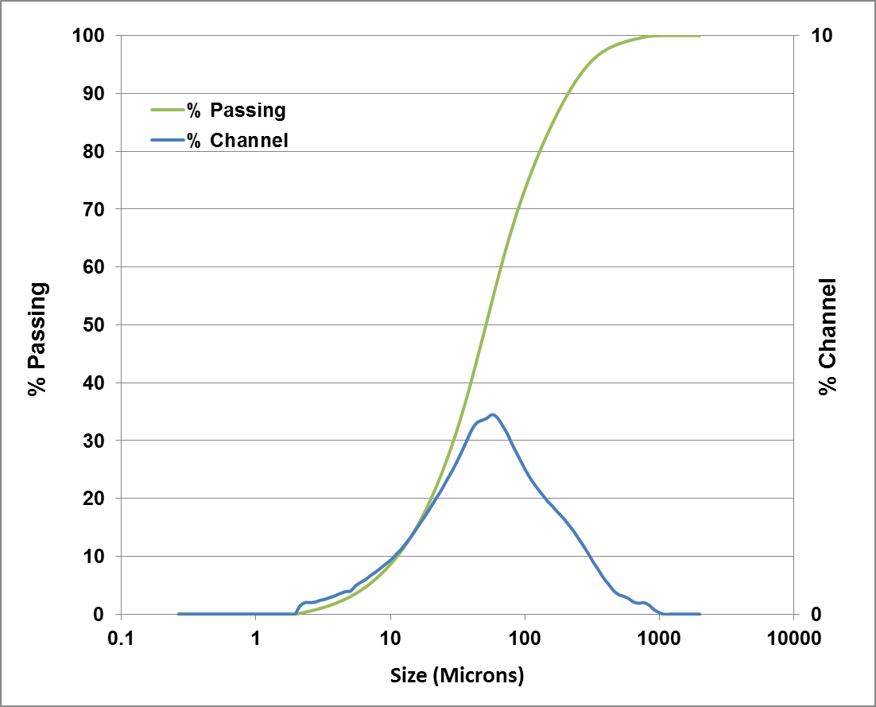
Typical Filler Particle Size Distribution
The mean particle size of the torrefied biomass decreased with an increase in torrefaction temperature
Target particle size:
dv50= 50 microns

Slide 13


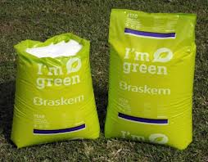
Thermoplastic Blend Technical Feasibility
Synthetic and Renewable
Polymer
+
Natural Biomass
Torrefied Miscanthus or kenaf core
Twin Screw
Extrusion
Thermo Prism™ USLAB 16
Binary Polymer Blends
Injection
Boy 22D Injection Machine
Molded Articles
Notes:
Bo
Mill down to 25 micron or less for potential inclusion in injection molding process
May provide different inclusion level than torrefied core & allows potential for color besides black
Moisture sensitivity might be an issue with milled core
CAUTION: talk about Battelle potential work with core in injection molding; how do we proceed to capture Bo’s IP work?

Slide 14
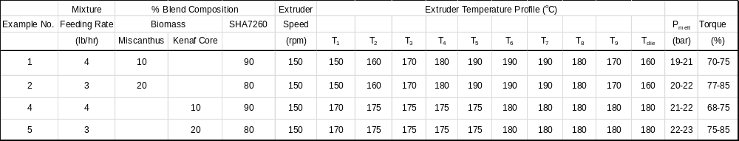
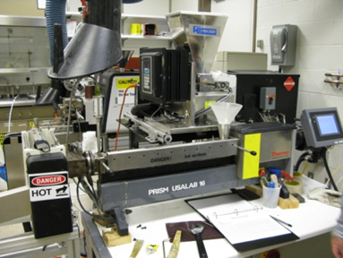

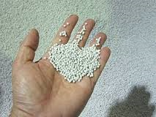

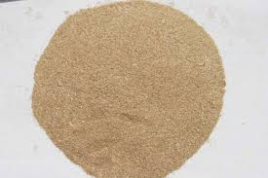
Green PE and Filler Compounding
Resin processing conditions

Slide 15
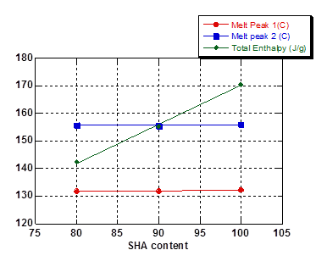
Green PE and Milled Kenaf Core DSC (1)
None effect on:
Glass transition T
(shown in next slide)
Melt onset/peak T
There is an effect on:
Total enthalpy
decreases
The results for
torrefied miscanthus
are similar

Slide 16
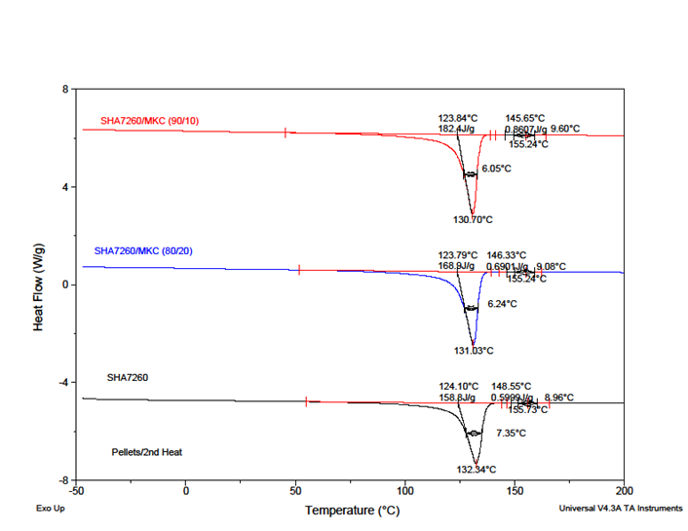
Green PE and Milled Kenaf Core DSC (2)
TA Instruments’ Q200 Differential Scanning Calorimeter
The results for torrefied miscanthus are similar

Slide 17
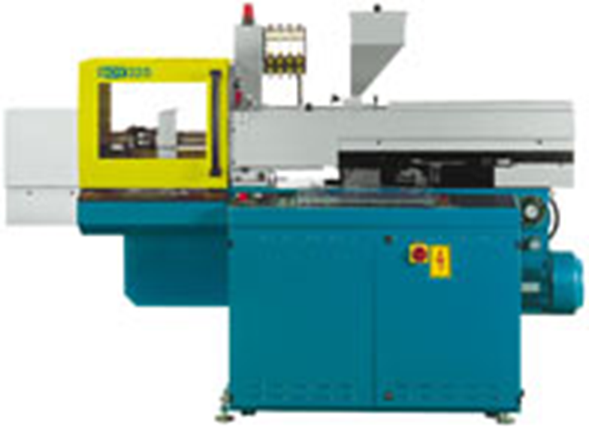
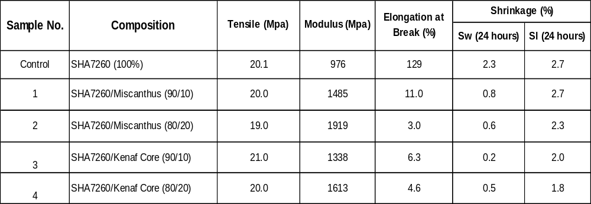
Molded Sample Mechanical & Shrinkage Data
Injection molding conditions
  Heating bands 1 to 3: 200, 190
  and 185ºC
  Nozzle temperature: 180ºC
  Mold temperature: 75ºF

Slide 18
Conclusion

Slide 19
Melt Extrusion is One of Options…
Bulky non-wood materials such as miscanthus and kenaf core are successfully densified via
  Torrefaction
  Fluid bed jet milling
  Average filler particle size is about 50 microns
Resin compounding didn’t rely on any compatibilizers
Blend thermal properties are not affected significantly by the presence of organic fillers
Injection molded articles made from blends of green PE and miscanthus or kenaf core, respectively
Mechanical properties of injection molded articles
  Dimensionally stable
  Comparable tensile versus neat green PE
  Lower elongation and high modulus versus the neat green PE

Slide 20

Questions

