Slide 1

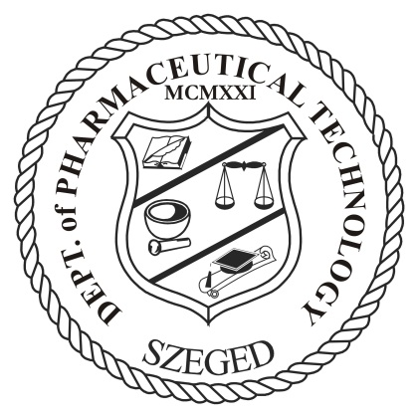
Characterisation of nanostructured lipid carriers loaded with Ibuprofen
Blanka Sütő, Mária Budai-Szűcs, Péter Sipos, Erzsébet Csányi,
Piroska Szabó Révész, Szilvia Berkó
Department of Pharmaceutical Technology, Faculty of Pharmacy, University of Szeged, Hungary
5th International Conference on Pharmaceutics & Novel Drug Delivery Systems
16-18th March 2015, Dubai

Slide 2
About Ibuprofen (IBU) I.
Non Steroidal Anti-inflammatory Drug (NSAID), used to:
relieve acute/chronic pain,
soothe fever,
reduce inflammation (arthritis)
Available on the market as:
oral-
topical dosage form

Slide 3
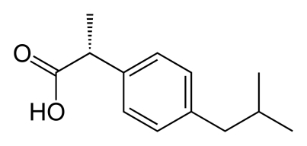
About Ibuprofen (IBU) II.
Biopharmaceutical Classification System (BCS) group II:
low water solubility
high permeability
Side effects:
bleeding/ulceration of the gastric mucosa
cardiovascular risk (hypertension, myocardial infarction)
low bioavailability
melting point | 75-77.5 °C
water solubility | 21 mg/L (at 25 °C)
logP | 3.97
pKa | 4.91

Slide 4
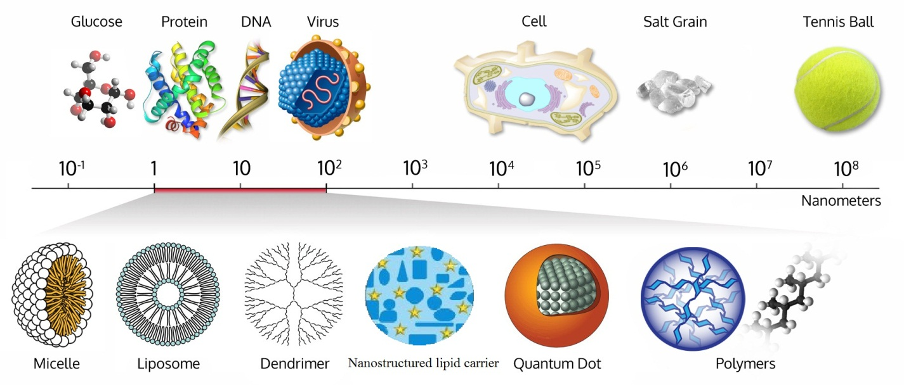
Possible methods to improve bioavailability
Modification of the API’s properties
  micronisation
  nanonisation
  amorphisation
Development of drug delivery systems
  liposomes
  micro-/nanoemulsions
  dendrimers
  polymer nanoparticles
  lipid nanoparticles
wichlab.com

Slide 5
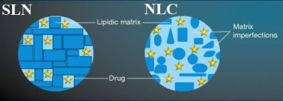
Solid Lipid Nanoparticles (SLN)
Nanostructured Lipid Carriers (NLC)
Derived from o/w emulsions
Liquid lipid solid lipid
Composition:
lipid phase: 0.1-30%
surfactant: 0.5-5%
particle size: 40-1000 nm
  Solid lipid + liquid lipid
  Improved physicochemical stability
Higher drug loading capacity
Andrade et al., Nanomedicine 6, 123-141, 2011

Slide 6
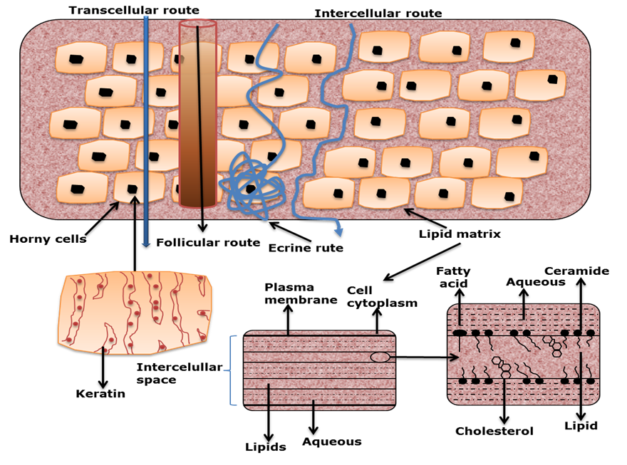
Possible administration routes
Dermal
Parenteral
Peroral
Ocular
Nasal
Pulmonar
Sezer,Ali Demir . Recent Advances in Novel Drug Carrier Systems. InTech, 2012.

Slide 7
Dermal use of NLC systems
Increasing skin penetration of low water soluble drugs
Protection of API and the skin (oxidation, light, hydrolysis)
Controlled drug release
Biodegradable lipids
(low toxicity, good tolerability)
Small size direct contact with the stratum corneum
  Increased API penetration
Occlusive properties
  Increased skin hydration
Müller et al., H&PC Today, Vol. 9 nr. 2 March/April 2014

Slide 8
Composition of Ibuprofen-loaded NLC (IBU-NLC)
Lipid phase
Witepsol E85
Migylol 812
Aqueous phase
Lutrol F68
Purified water
API:
Ibuprofen
Preparation method:
Hot high pressure homogenisation
Emulsiflex C-3 high pressure homogeniser

Slide 9
Preparation of IBU-NLC
Dissolving IBU in the melted lipid phase
Dispersing the aqueous phase in the lipid phase
Homogenisation to obtain the pre-emulsion
Subjection to high pressure homogenisation
Cooling down the NLC dispersion in an ice bath
Gelation to obtain the final formulation
Shah, Rohan. Lipid Nanoparticles: Production, Characterization and Stability. New York: Springer, 2015. Print.

Slide 10
1. Particle size- and zeta potential determination
Photon correlation spectroscopy (PCS)
Electrophoretic mobility measurements
Laser diffraction (LD)
Sample | Z-ave (nm) | Zeta potential (mV) | PDI | d(0.1) (nm) | d(0.5) (nm) | d(0.9) (nm) | Span
blank NLC | 114 ± 2.2 | -15.9 ± 0.7 | 0.15 ± 0.1 | 67 ± 0 | 118 ± 0 | 204 ± 0.6 | 1.16 ± 0
IBU-NLC | 106 ± 1.7 | -18.4 ± 1.3 | 0.18 ± 0.3 | 74 ± 0 | 122 ± 0 | 205 ± 0.6 | 1.07 ± 0

Slide 11
2. Determination of crystallinity
X-ray diffraction (XRD)
Bruker D8 Advance diffractometer
40 kV and 40 mA from 3-40 2θ, scanning speed 0.1/s , step size 0.010.

Slide 12
3. Interaction between the components
Raman spectroscopy – spectral analysis
Measurement conditions:
at least 5 measurements at 532 nm
power: 3 mW on a 3 μm diameter spot
aperture of pinhole: 50 µm
48 scans
spectral resolution: 4 cm⁻¹
Thermo Fisher DXR Dispersive Raman spectrometer + Olympus MPlan 10x/0.25 BD microscope

Slide 13
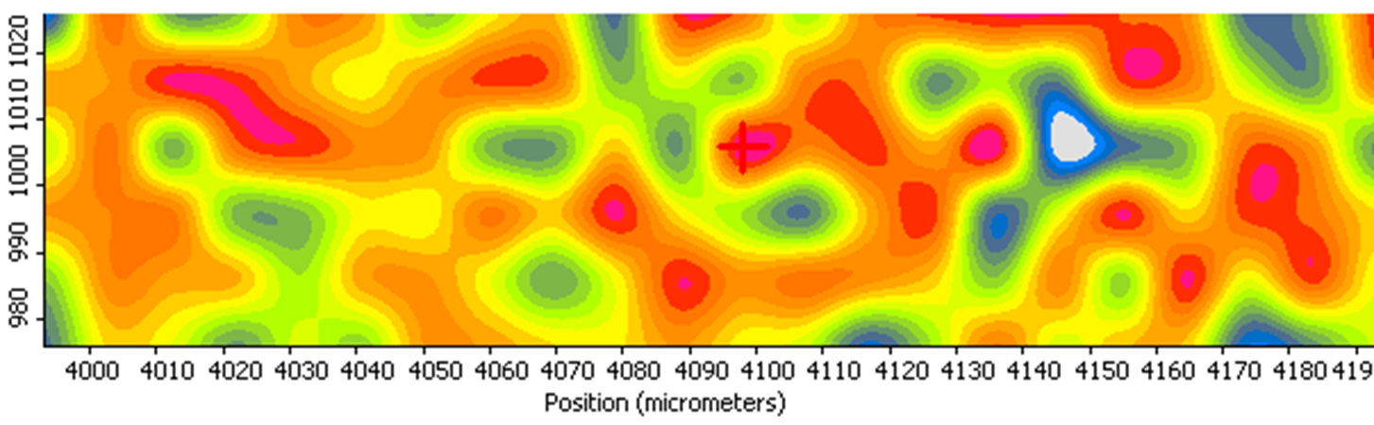
3. Localization of Ibuprofen
Raman spectroscopy – mapping
Result: Ibuprofen could be found throughout the whole sample, which suggests homogenous distribution in the lipid phase

Slide 14
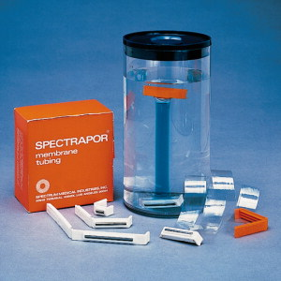
4. In vitro dissolution
Sample: IBU-NLC dispersion vs. IBU suspension
Dissolution study: dialysis bags (regenerated cellulose membrane, MWCO: 12-14 kDa)
Temperature: 37 °C
Time: 6 hours
Acceptor medium: phosphate buffer solution, pH = 7.44
UV spectrophotometric analysis at 263 nm
Result: 2.59-fold higher diffusion from IBU-NLC
SpectraPor® dialysis bag
2-way ANOVA;
** p<0.01 vs. IBU suspension
**** p<0.0001 vs. IBU suspension

Slide 15
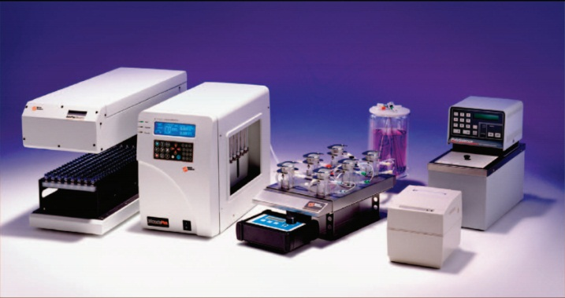
5. Ex vivo permeation
Samples: IBU-NLC gel vs. IBU gel
Excised human skin mounted on a vertical Franz diffusion cell
Temperature: 37 °C
Time: 6 hours
Acceptor medium: phosphate buffer solution, pH = 7.44
UV spectrophotometric analysis at 263 nm
Result: 20.61-fold higher permeation from IBU-NLC gel
Hanson Microette TM Topical & Transdermal Diffusion Cell System
2-way ANOVA;
** p<0.01 vs. IBU gel
*** p<0.001 vs. IBU gel

Slide 16
Summary
Characterisation of the prepared IBU-NLC system:
Mean particle size: 106 nm
Zeta potential: -18.4 mV
XRPD: confirmed amorphous state of the particles
Raman spectroscopy: no chemical bonds, homogenous drug distribution in the lipid phase
In vitro dissolution: IBU-NLC > IBU suspension
Ex vivo permeation: IBU-NLC gel >>> IBU gel
IBU-NLC gel is a promising alternative for IBU gels in the treatment of arthritis

Slide 17


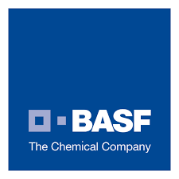


Acknowledgments
Dr. Pharm. Mária Budai-Szűcs, Ph.D.
Dr. Pharm. Péter Sipos, Ph.D.
Dr. Pharm. Erzsébet Csányi, Ph.D.
Prof Dr. Pharm. Piroska Szabó Révész, D.Sc.
Dr. Pharm. Szilvia Berkó, Ph.D.
Azelis Ltd.
BASF SE
Campus Hungary Program

Slide 18
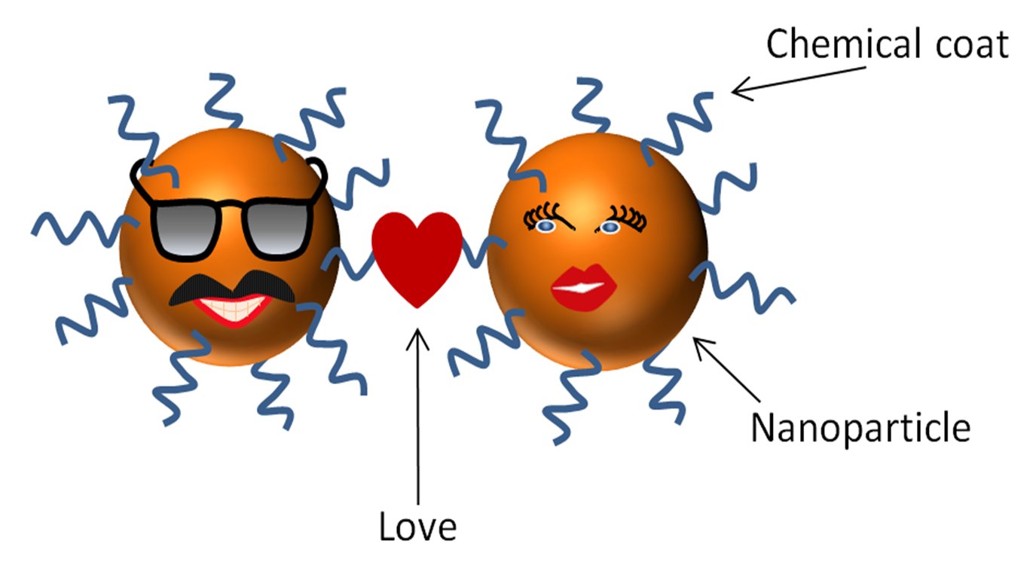
Thank you for your attention!

