Slide 1
Renewable Ionic Liquids for the Valorization of Lignocellulosic Biomass
Blake A. Simmons, Ph.D.
Chief Science and Technology Officer
Vice-President, Deconstruction Division
June 14, 2016

Slide 2
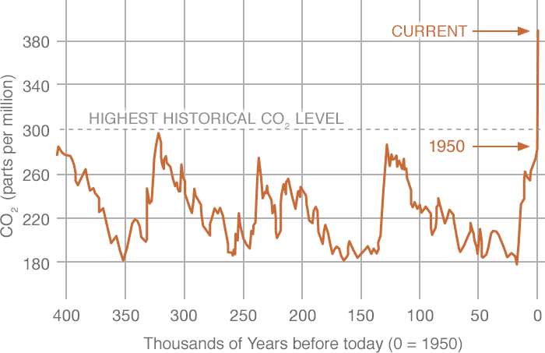
Biofuels: Motivation
Source: NASA
Consumption of fossil fuels creates energy security challenges and potential negative impacts of climate change
These concerns resulted in Energy Independence and Security Act of 2007 and the Renewable Fuels Standard
Lignocellulose biomass conversion offers the possibility of a sustainable, renewable, and significant source of fuel

Slide 3
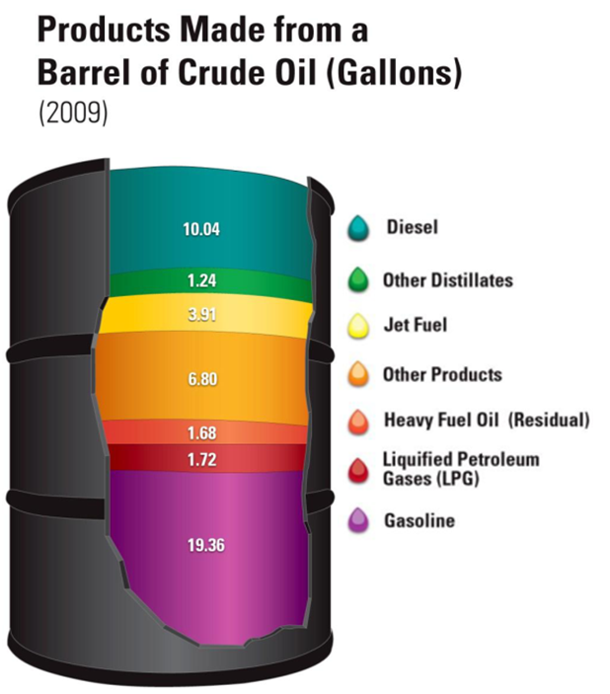
Beyond Biofuels: Replacing the Whole Barrel of Oil with Renewables
In order for a new low carbon, “bio-based” economy to occur, we must develop replacements for all products currently derived from oil
Requires an integrated “systems of systems” approach to feedstock valorization

Slide 4




Joint BioEnergy Institute
Seven Partners
One Location
Funded by US Department of Energy
Started in 2007
Renewed in 2012
$25M/year

Slide 5
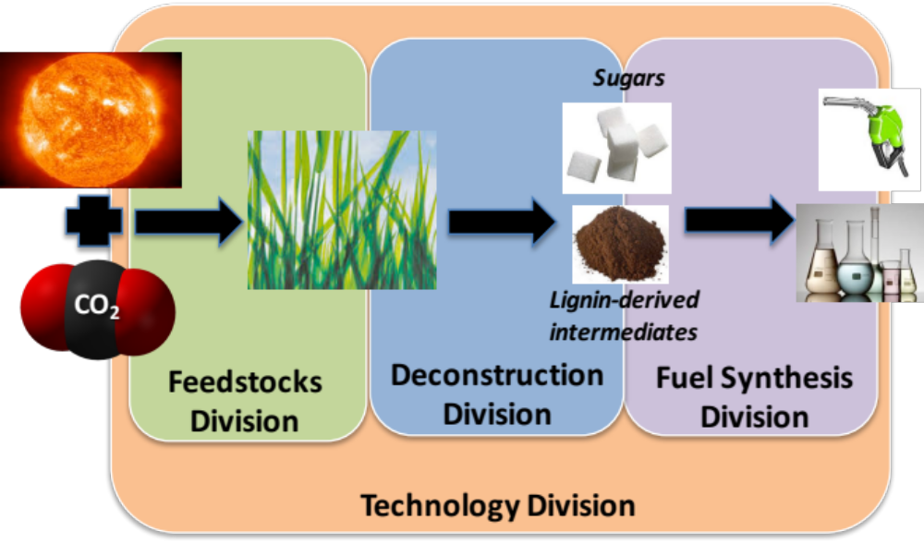
JBEI’s Mission: Basic Science to Convert Cellulosic Biomass to Drop-in Fuels and Chemicals
JBEI’s mission is to provide the scientific basis for converting lignocellulosic biomass to renewable liquid transportation fuels that are compatible with existing and proposed engines and the current fuel-distribution infrastructure, as well as the production of renewable chemicals, that enable a thriving US bioeconomy.

Slide 6
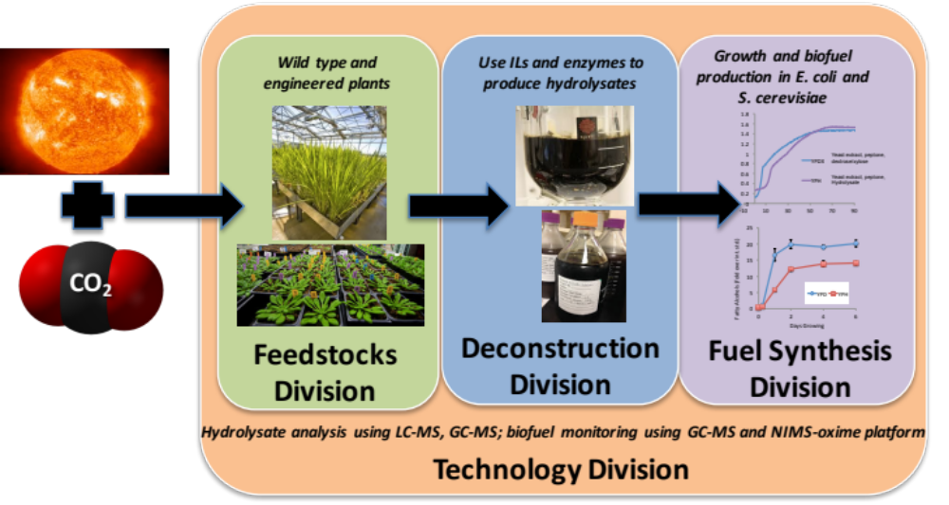
JBEI - An Integrated Feedstocks to Fuels Bioenergy Research Center
Knowledge transfer

Slide 7
JBEI’s Approach to Biofuels Production
Deconstruction Mission:
Provide the science and technology foundation for a scalable, affordable biomass conversion process using ionic liquids.

Slide 8
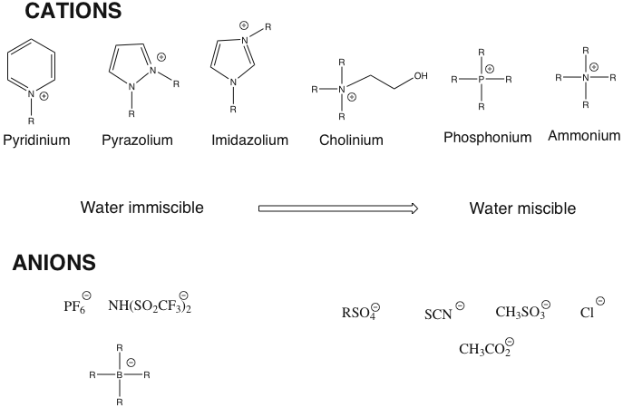
Certain Ionic Liquids (ILs) are Effective Biomass Solvents
Room Temperature, Molten Salts
Cation determines:
stability
properties
Anion determines:
- chemistry
- functionality
1-ethyl-3-methylimidazolium acetate, abbreviated
as [C₂mim][OAc], dissolves > 20 wt% cellulose
Simmons, B. et al., Ionic Liquid Pretreatment, Chem Eng Prog, 2010, 3, 50-55

Slide 9
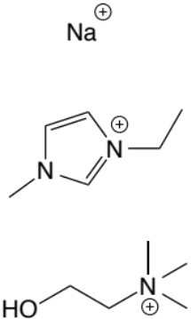
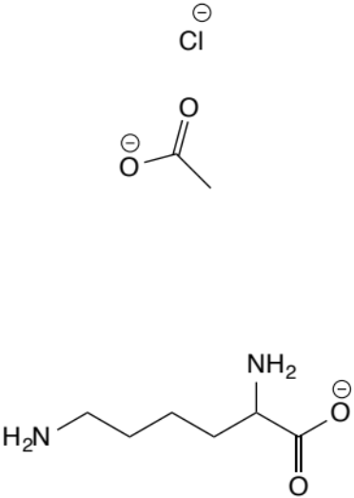
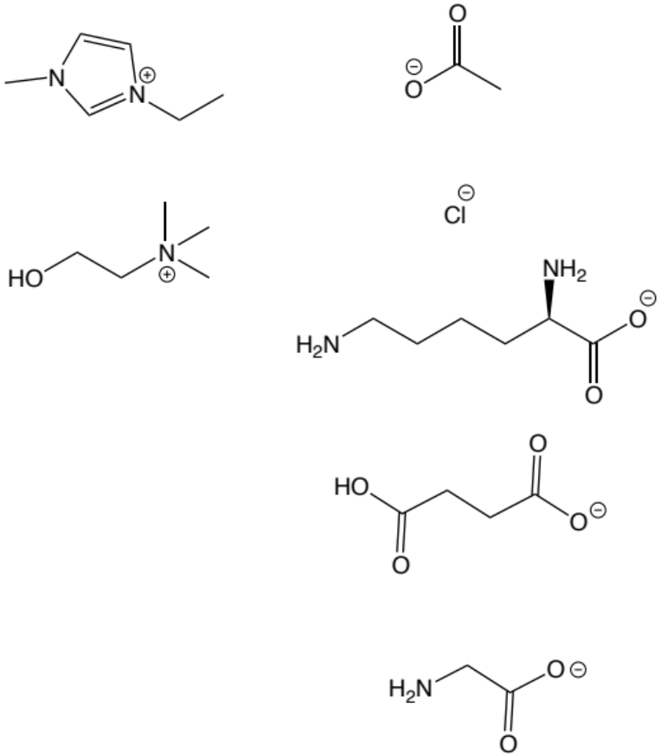
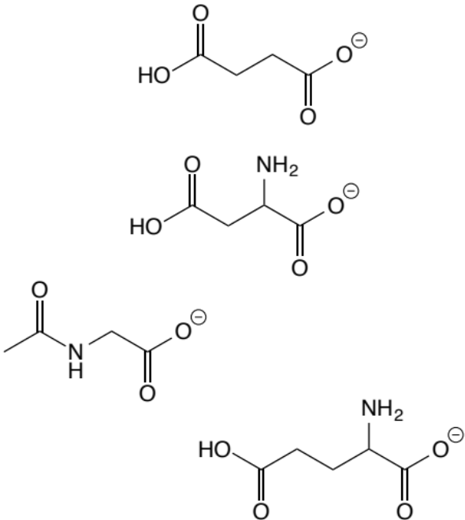
Selection of Ionic Liquids Alter Solution Conditions and Downstream Requirements
Cations
Anions
Ionic Strength
pH
Specific
Ions
Water Activity
We have been investigating pretreatment efficacy, enzyme stability/activity, and microbial viability as a function of defined solvent conditions

Slide 10
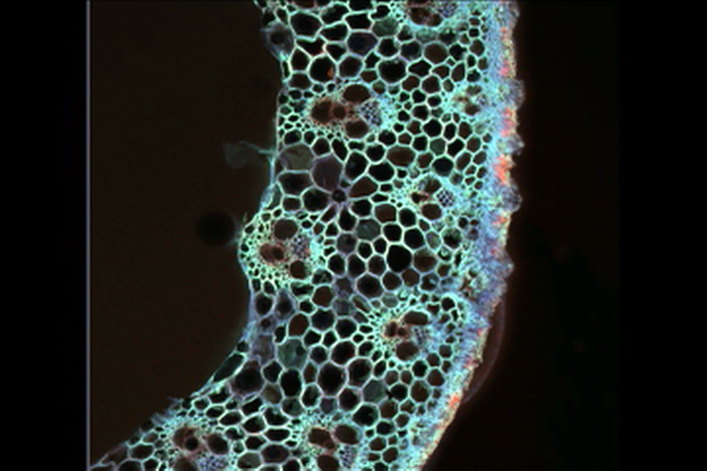
ILs Significantly Impact Lignocellulose

Slide 11
Developing an IL Conversion Technology that is Affordable and Scalable
Challenge: Ionic liquids are compelling but nascent conversion technology, and common perception is that they are too expensive for biorefineries.
Solution: Develop science-based solutions techniques that enable process engineering and deployment:
  Maximize sugar yields
  Renewable, low-cost ionic liquids
  Efficient and cheap method of IL recovery and recycle
  Process integration
  Lignin valorization
Feedstocks
Lignin
Pretreatment
IL Recycle
Saccharification
Fuels Synthesis

Slide 12
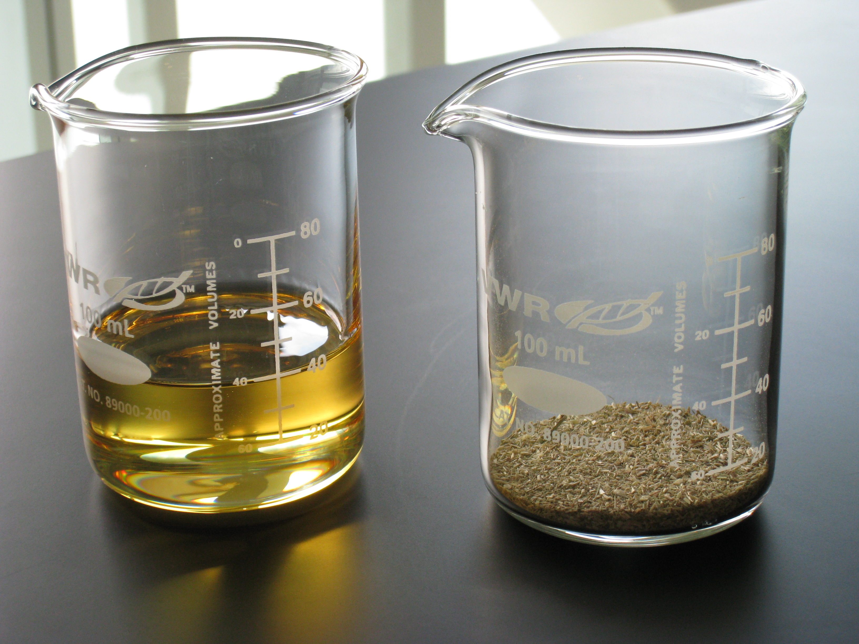
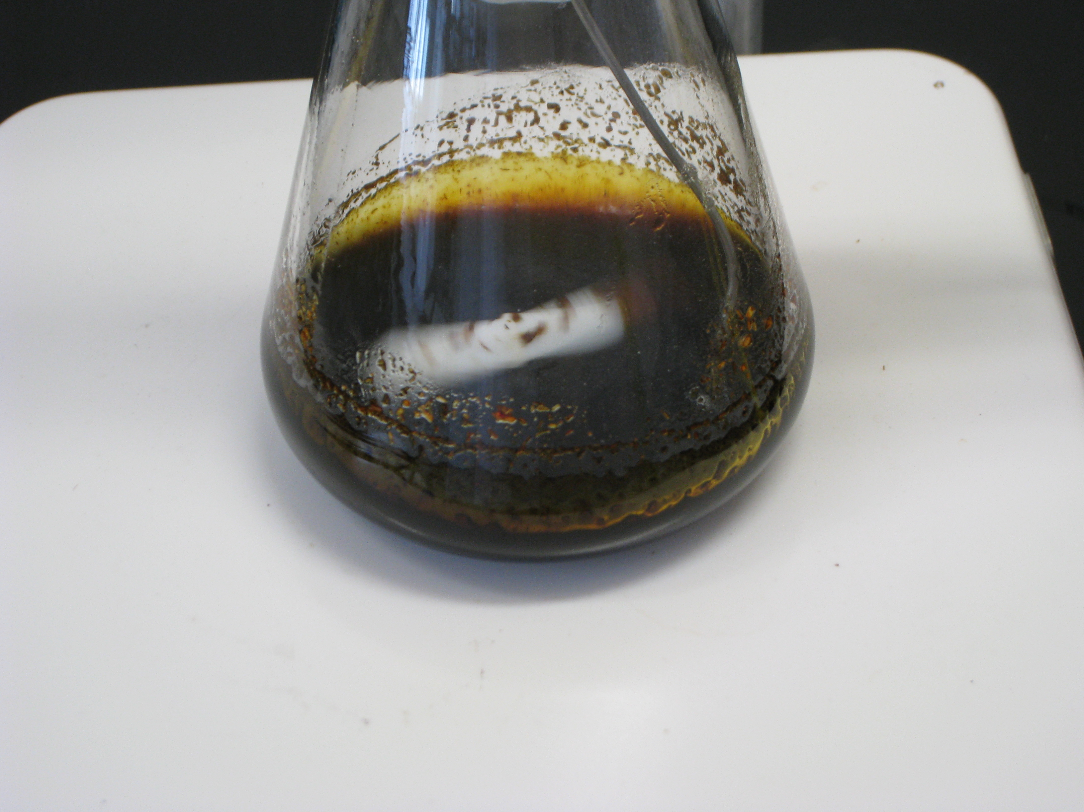
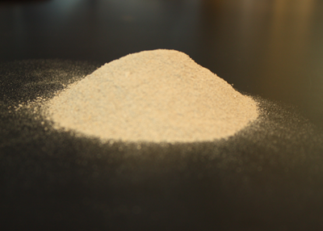
We Have Established an Effective Ionic
Liquid Pretreatment Baseline Process
[C₂C₁im][OAc]
Switchgrass
Anti-solvent
Heat
Stir
Advantages:
  Increased enzyme accessibility
  Decreased lignin
  Significantly impacted cellulose crystallinity
Challenges:
  IL recovery and recycle
  Process integration
  IL cost

Slide 13


IL Pretreatment Generates High Sugar Yields
13
Inter-BRC comparative biomass pretreatment study
IL generate highest glucose yields
ILs can handle an unparalleled range of biomass feedstocks
ILs can effectively pretreat at high solids loading with large particle sizes
Glucose yields in solution following 72 hours of enzymatic hydrolysis at 3 mg enzyme/g glucan of pretreated corn stover solids
Gao et al., Biotech for Biofuels, 2014
Singh et al. Frontiers in Energy Res., 2015

Slide 14
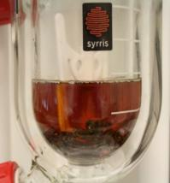
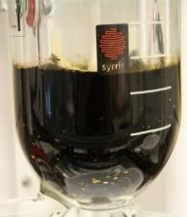
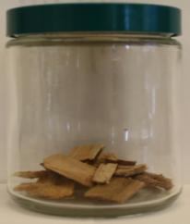
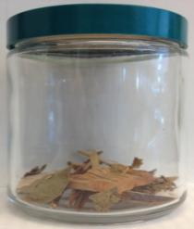
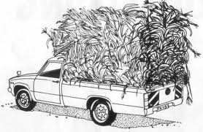
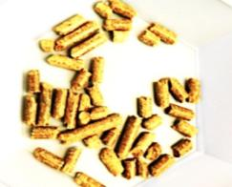
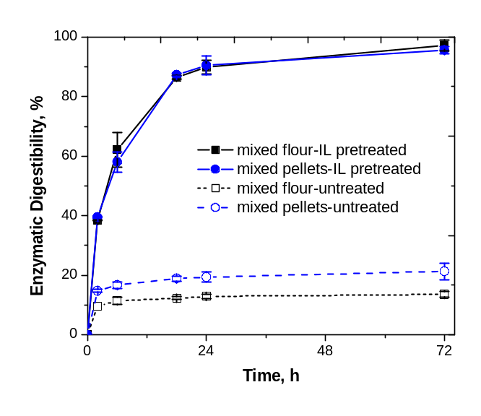
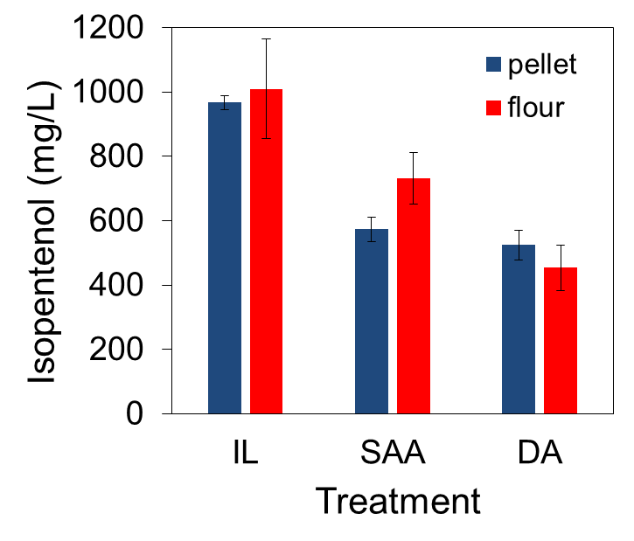
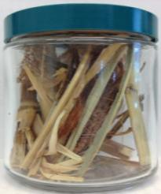
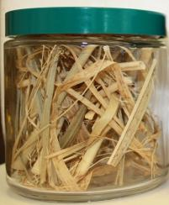
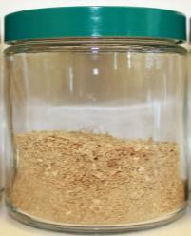
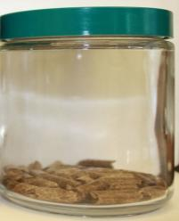
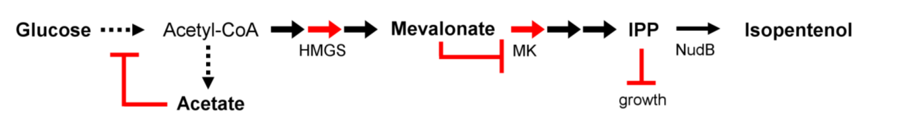
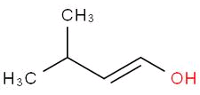
IL Pretreatment is Effective on Mixed Feedstocks
A biorefinery must be able to efficiently convert any biomass feedstocks that are available regionally and year-around.
Pine
Eucalyptus
IL Ammonia Acid
Corn stover
Switchgrass
Mixed flour
Mixed pellets
90% sugar yield within 24 hours
Isopentenol yield at 48h
IL pretreatment is equally efficient on both bulk and densified feedstocks.
w/Fuels Synthesis
(Mevalonate pathway in E. coli)
Shi et al., 2013, Biofuels; Shi et al., Biotechnology for Biofuels, submitted
Notes:
From economic standpoint, A biorefinery must be able to efficiently convert any biomass feedstocks that are available regionally and year-around.
Unlike many other biomass fractionation techniques which can only handle a range of biomass feedstocks, Our recent study has showed that IL pretreatment is effective on multiple and mixed feedstocks.
In this case, we blended four common biomass feedstocks including pine, eucalyptus, corn stover, and switchgrass and demonstrated equally high sugar yield and fast sugar release kinetics.

Slide 15
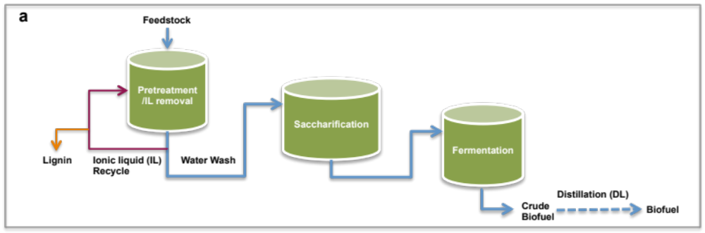
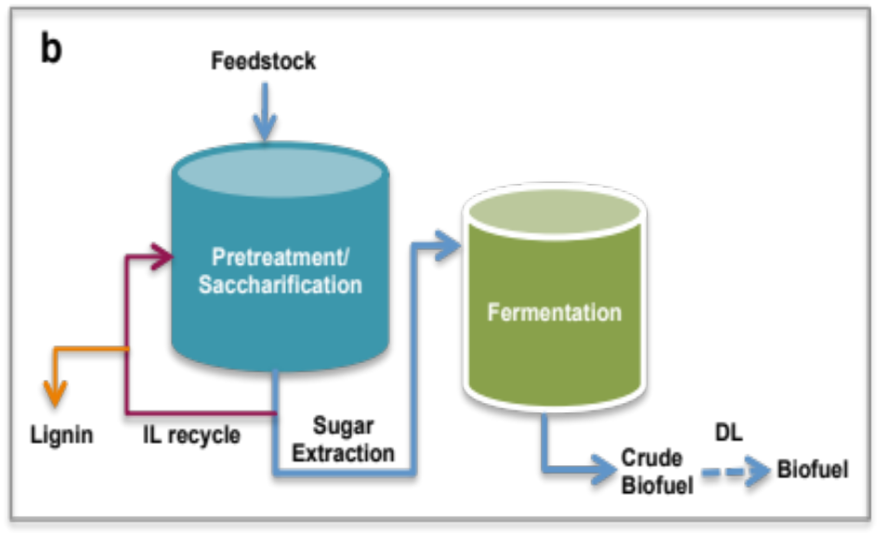
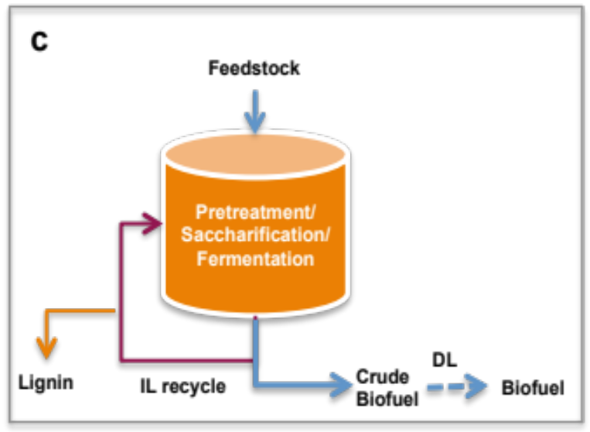
Process Integration Scenarios
J. Shi et al., Green Chem., 2013, 15, 2579
Jian Sun et al., under review

Slide 16
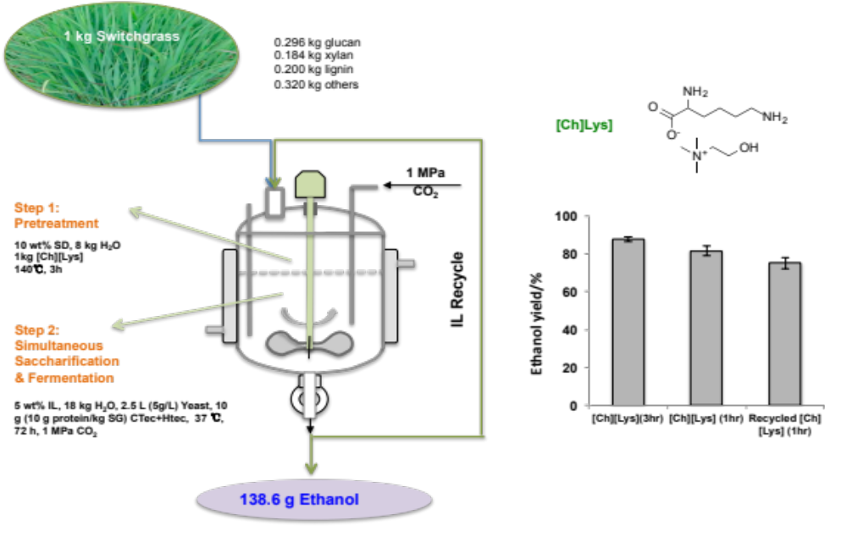
integrated process for biomass-to-biofuels
[Ch][Lys]
Overall yield of glucose from liquid streams=89.9%; overall yield of xylose from liquid
streams=93.8%; ethanol production: 0.149 g ethanol/g switchgrass; ethanol yield on glucose basis: 87.7%.
Jian Sun et al., under review

Slide 17
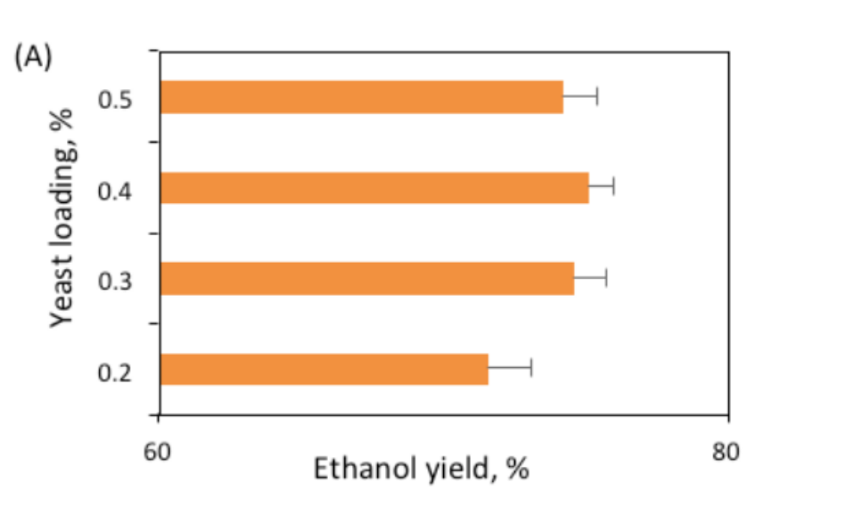
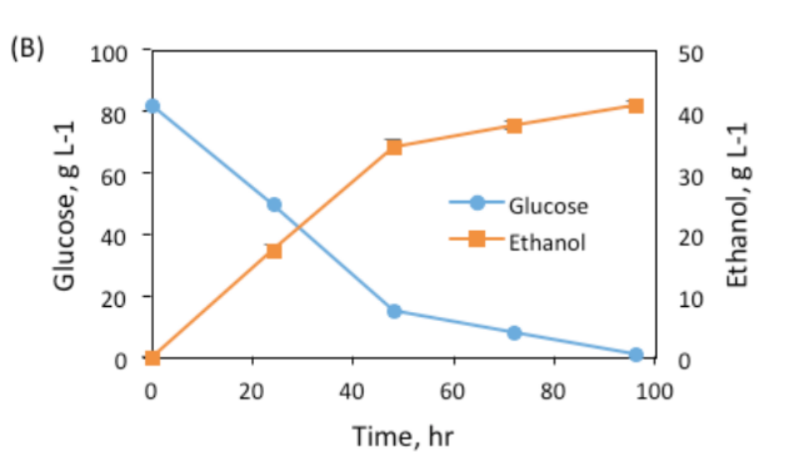
Novel “Bionic Liquids” Enable Integrated Process for Biomass-to-biofuels
IL: [Ch][Lys]
One vessel, high solids loading (34%)
Simultaneous saccharification and fermentation (SSF) using fed batch conditions
Generates ~75% ethanol yields with no clean-up or separations
Feng Xu et al., Energy and Environmental Science, 2016

Slide 18
Summary
“Bionic liquids” derived from lignin and hemicellulose waste streams are a promising solution to multiple issues within a biorefinery context
Process integration/consolidation significantly decreases CAPEX and OPEX
Bionic liquids derived from amino acids enable process consolidation of pretreatment + saccharification + fermentation

Slide 19
Benchmarking Impact - Economics
Feng Xu et al., Energy and Environmental Science, 2016

Slide 20
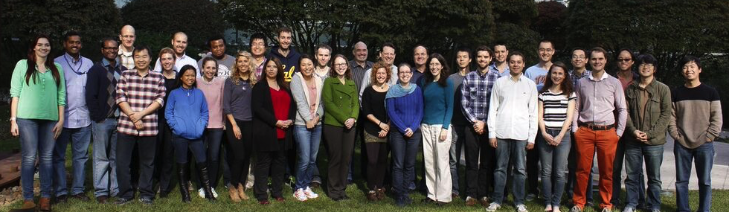
Acknowledgments
DOE Office of Science for $$
Jay Keasling, Paul Adams, Henrik Scheller, Nicholas Everson and the rest of the JBEI team
Team Deconstruction:

