Slide 1
Climate Change Vulnerability Projection in Georgia
Earth Science and Climate Change Conference
June 16-18, 2015
Alicante, Spain
Binita KC
Resilient Cities Lab
School of Public Policy and Urban Affairs
Northeastern University
Boston, Massachusetts, USA
leebinita@gmail.com
J. Marshall Shepherd
Department of Geography
University of Georgia
Athens, Georgia, USA
marshgeo@gmail.com
Cassandra Johnson Gaither
USDA Forest Service
Athens, Georgia, USA
jamieclaud@gmail.com

Slide 2
Outline
Climate Change in the Southeast United States
Impacts of Climate Change
Vulnerability
Methodology
Results
Conclusion

Slide 3
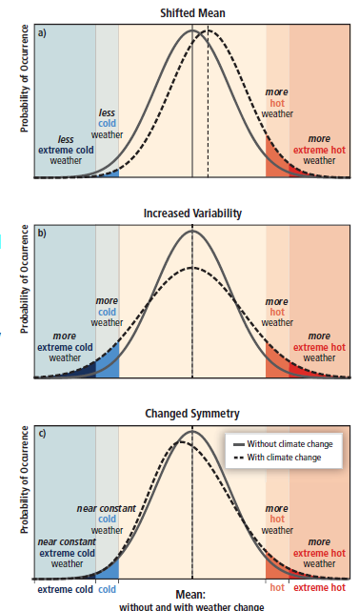
Climate Change
  Climate change refers to a statistically significant variation in either the mean state of the climate or in its variability, persisting for an extended period (typically decades or longer) (IPCC 2007)
SREX, 2012
Notes:
These three graphs are taken from IPCC’s Special Report on Managing the Risks of Extreme Events and Disasters to Advance Climate Change Adaptation (SREX). Shows relationship between climate change and extreme weather and climate events. A changing climate leads to change in the frequency, intensity , spatial extent , duration and timing of extreme weather and climate events. The changes in the extremes can be linked to change in the mean, variance or shape of probability distributions.
The effect of changes in temperature distribution on extremes.
(a) effects of a simple shift of the entire distribution toward a warmer climate;
(b) effects of an increase in temperature variability with no shift in the mean;
(c) effects of an altered shape of the distribution, in this example a change in symmetry toward the hotter part of the distribution.

Slide 4
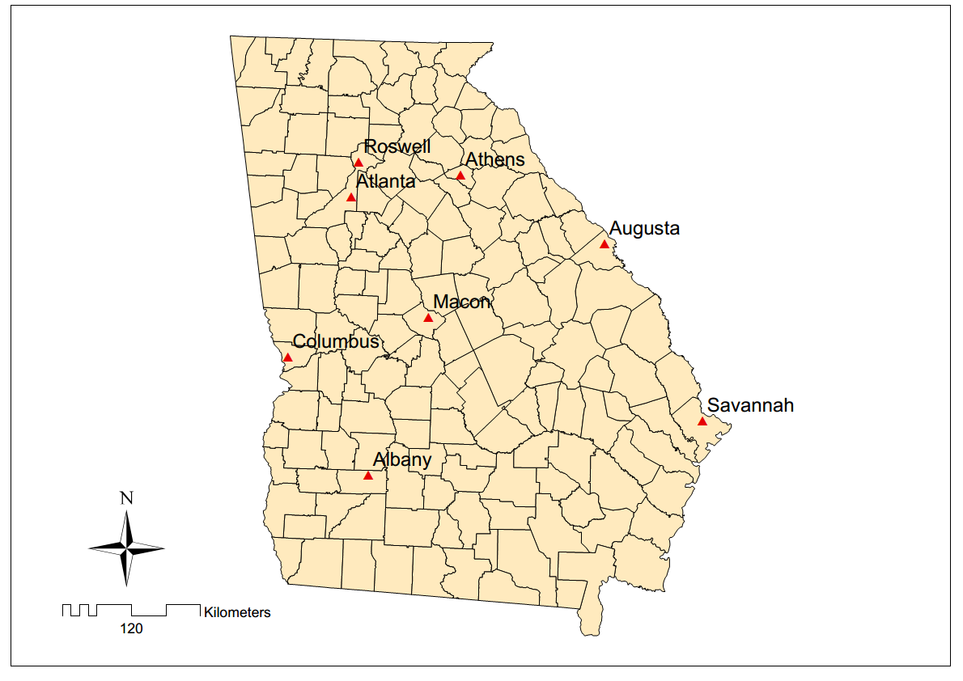
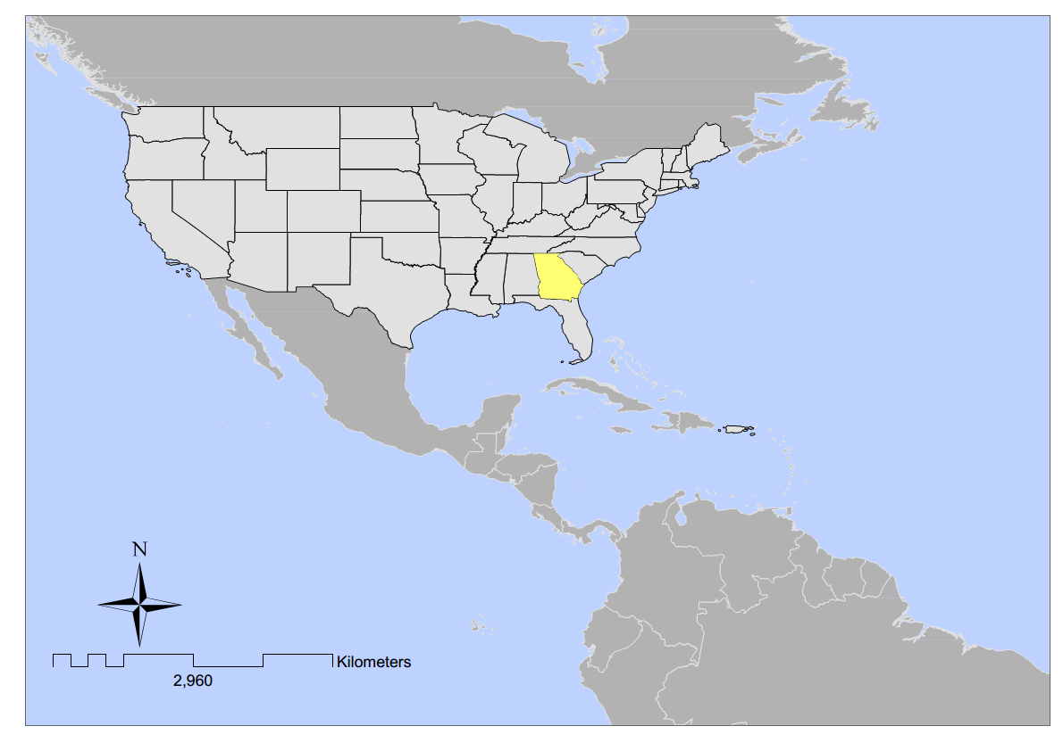
Study Area
Notes:
Georgia is one of the fastest growing states in the nation. From 2000 to 2010, Georgia’s population increased by 18.3 percent (compared to a national population increase of 9.7 percent for the same period) (U.S. Census Bureau 2011); and Georgia ranked tenth in terms of percent change in population from 2010 to 2012 (U.S. Census Bureau 2012b). Much of the state’s population growth and economic expansion in recent decades has centered in and around metropolitan Atlanta counties in the north part of the state (Hartshorn and Ihlanfeldt 2000); but Georgia still contains a substantial number of rural, “Black Belt” counties, mostly in the southern part of the state, with resource-based industries as an economic mainstay (Wimberly and Morris 1997).
The Black Belt is a band of mostly rural counties stretching from southern Virginia down through the Carolinas, Georgia, Alabama, Mississippi, and over to east Texas which have higher than average percentages of African-American residents (Wimberly and Morris 1997; McDaniel and Casanova 2003). African Americans residing in this region have relatively higher poverty compared to the rest of the United States (Hoppe 1985; Falk and Rankin 1992; Falk et al. 1993); and a notable gap persists in social well-being of African Americans in this region compared to Whites and African Americans outside this region (Doherty and McKissick 2002; Webster and Bowman 2008).
Importantly, the historically-rooted, racial bifurcation of the state’s population into “black” and “white” subcultural groupings has given way to a significant third force, manifested as the unprecedented growth in immigrant/migrant populations of both Hispanics and Asians across Georgia (Zúñiga and Hernández-León 2001;Yarbrough 2007). Between 1990 and 2000, Georgia’s Hispanic population increased 324 percent and 96.1 percent from 2000 to 2010; Asians increased 155 percent and 82 percent, respectively, during these decades (U.S. Census Bureau, 1990, 2000a, 2000b, 2002, 2012a).

Slide 5
Climate Change in the Southeast United States
United States National Climate Assessment (Karl et al. 2009 and Melillo et al. 2014)
  1.1º C rise since 1970s, decline in frost days per year
  Heavy precipitation events in the Northeastern United States
  12-14 % increase in drought since the mid-1970s
  Frequent and intense hurricanes and floods (Kunkel et al. 2010, Shepherd and Knutson 2007)
  Intense heat (Meehl and Tebaldi 2004)
  Urban heat island (Zhou and Shepherd 2010)
Notes:
The climate of the Southeast is uniquely warm and wet. The average annual temperature of the Southeast did not change significantly over the past century as a whole. Similarly, Tebaldi et al. (2012) report that warming hole, which is the slow warming in parts of the Southeast United States including Georgia, has disappeared in recent decades which is consistent with the warming trend in Southeast. Since 1970, however, annual average temperature has risen about 2°F, with the greatest seasonal increase in temperature occurring during the winter months. The number of freezing days in the Southeast has declined by four to seven days per year for most of the region since the mid-1970s. Despite reported increases in precipitation, areas experiencing moderate to severe drought have increased in recent decades in the region.
2012 hottest year on record
United States National Climate Assessment (Melillo et al. 2014)
1.5°C to 2.5°C , 2.5°C to 5.5°C rise under low and high emissions scenario
Frequent heavy precipitation events, heat events (once in 20 year events)
Decrease in water availability

Slide 6
Climate Change in the Southeast United States
  1.5°C to 2.5°C - low emission scenario
  2.5°C to 5.5°C - high emissions scenario
  floods exceeding historic water level of 3.5 feet to 8 feet above the local high tide line are forecasted by the mid-end of century
  Impacts
  Heat-related stresses
  Crops damage
  Infrastructure damage
  Disease outbreak
  Decreased water availability
Notes:
It has been widely discussed in the literature that climate change and globalization act simultaneously as “double exposures” among poor residents of large cities. Mainly due to reduced demand and wages for low-skilled workers which rises the income inequality and results into increased spatial concentration of poverty within central city (Castells, 1998; Jargowsky, 1997). This will ultimately lead to physical vulnerability of these groups to weather-related events
Hence, the US Global Change research program report cites that both urban and rural areas are affected by climate change due to
Heat-related stresses
Crops damage
Infrastructure damage
Disease outbreak
Decreased water availability

Slide 7
Vulnerability Components
Vulnerability
  The degree to which a system is susceptible to, and unable to cope with, adverse effects of climate change, including climate variability and extremes (IPCC 2007)
  Vulnerability = f (Exposure, Sensitivity, Adaptive Capacity)
Notes:
Vulnerability divided into –social vulnerability and biophysical vulnerability. Social vulnerability represents a set of socioeconomic factor that exists independent of occurrence of hazard depending on people’s ability to cope with stress or
change. The nature of social vulnerability will depend on the nature of the hazard to which the human system in question is exposed: although social vulnerability is not a function of hazard, certain properties of a system will make it more vulnerable to certain types of hazard than to others. For example, quality of housing will be an important determinant of a community’s (social) vulnerability to a flood or windstorm, but is less likely to influence its vulnerability to drought. Nonetheless, certain factors such as poverty, inequality, health, access to resources and social status are likely to determine the vulnerability of communities and individuals to a range of different hazards (including non-climate hazards). We may view such factors as “generic” determinants of social vulnerability, and others such as the situation of dwellings in relation to river flood plains or low-lying coastal areas as determinants that are “specific” to particular hazards, in this example, flooding and storm surges.
Whereas in biophysical vulnerability climate scientists often view vulnerability in terms of occurrence and impacts of weather and climate related events and is a function of the frequency and severity (or probability of occurrence) of a given type of hazard.
A hazard may cause no damage if it occurs in an unpopulated area or in a region where human systems are well adapted to cope with it.

Slide 8
Vulnerability Components
Social vulnerability
  Internal characteristics of a system
  (Adger 1999, Adger and Kelly 1999, Cross 2001, Cutter et al. 2003 and Cutter and Finch 2008)
Biophysical vulnerability
  frequency and severity of hazard
    floods (Baum et al. 2008)
    heat waves (Reid et al. 2009)
    hurricanes (Frazier et al. 2010)
Hazard of place model
  Settlements (Brooks 2003, Cutter et al. 2003)
Notes:
Vulnerability divided into –social vulnerability and biophysical vulnerability. Social vulnerability represents a set of socioeconomic factor that exists independent of occurrence of hazard depending on people’s ability to cope with stress or
change. The nature of social vulnerability will depend on the nature of the hazard to which the human system in question is exposed: although social vulnerability is not a function of hazard, certain properties of a system will make it more vulnerable to certain types of hazard than to others. For example, quality of housing will be an important determinant of a community’s (social) vulnerability to a flood or windstorm, but is less likely to influence its vulnerability to drought. Nonetheless, certain factors such as poverty, inequality, health, access to resources and social status are likely to determine the vulnerability of communities and individuals to a range of different hazards (including non-climate hazards). We may view such factors as “generic” determinants of social vulnerability, and others such as the situation of dwellings in relation to river flood plains or low-lying coastal areas as determinants that are “specific” to particular hazards, in this example, flooding and storm surges.
Whereas in biophysical vulnerability climate scientists often view vulnerability in terms of occurrence and impacts of weather and climate related events and is a function of the frequency and severity (or probability of occurrence) of a given type of hazard.
A hazard may cause no damage if it occurs in an unpopulated area or in a region where human systems are well adapted to cope with it.

Slide 9
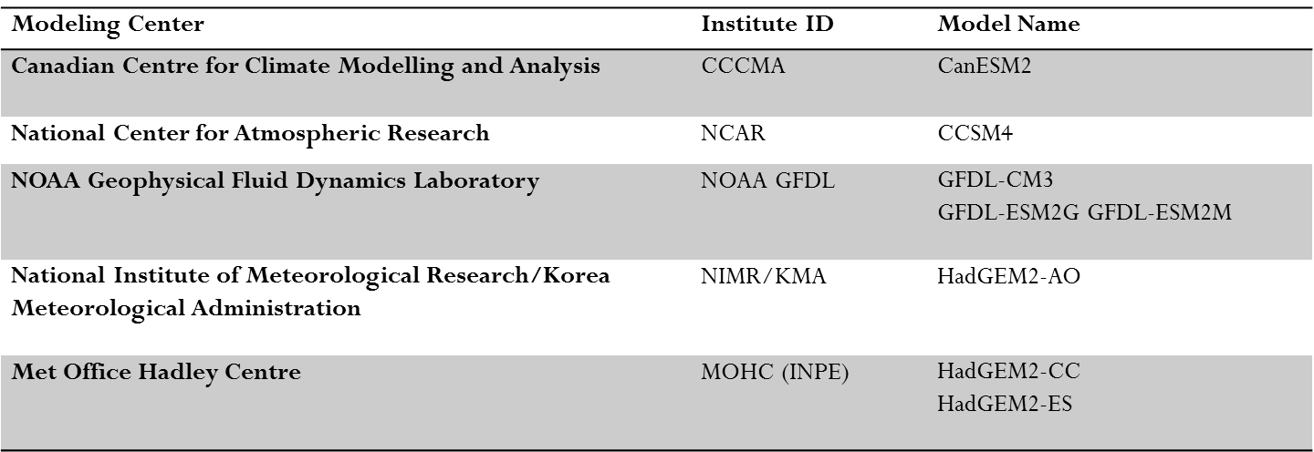
Datasets
  Climate Data
    World Climate Research Programme's CMIP5 (Taylor et al. 2011): 2025-2034
    RCP 4.5, RCP 8.5
      Mean monthly Temperature and Precipitation
      Daily Temperature (maximum) and Precipitation
    Ensemble averages of Global Climate Models
Notes:
County-wide data for white male/female, African American male/female, Hispanic male/female and non-white population male /female were obtained from the Georgia Department of Public Health, Office of Health Indicators for Planning (http://oasis.state.ga.us/oasis/oasis/qryPopulation.aspx). This data was acquired for years 2000, 2005, and 2010 and served as the base population for future projection. Survival rate was calculated from Georgia life table. Persons that lived between age x and x+1 (Lx) were obtained from the 1999-2001 Decennial Georgia life table downloaded from Center for Disease Control and Prevention website (http://www.cdc.gov/nchs/nvss/mortality/lewk4.htm ). The life table was not available for counties; hence, the state life table was used instead. Persons that lived at specific age (Lx) were summed up to five years periods to calculate the five-year survival rate of the age cohort for White male, White female, African American male and African American female. Since Lx was not available for non-white population, African American male/female survival rate was used to as a proxy for the survival rate of non- white populations.
Five-year fertility rate was calculated using live births per 1000 women within the 10-49 age range for white, nonwhite, Hispanic, and African American female population in all counties. The fertility rates were downloaded from Georgia Department of Public Health, Office of Health Indicators for Planning (http://oasis.state.ga.us/oasis/oasis/qryMCH.aspx ).
Male –female sex ration from National vital statistic
2012 employment data for all the counties in Georgia was obtained from Georgia Department of Labor (http://explorer.dol.state.ga.us/gsipub/index.asp?docid=387). Employment projection for 2020 for the state of Georgia was obtained from Bureau of labor statistics

Slide 10
Datasets
  Sea level rise: Costal Inundation
  Surging Seas- Climate Central
Social Data
  Georgia Department of Public Health
  Centers for Disease Control and Prevention
  National Vital Statistics
  Georgia Department of Labor
  Bureau of Labor Statistics
  Woods and Poole (2009)
Notes:
County-wide data for white male/female, African American male/female, Hispanic male/female and non-white population male /female were obtained from the Georgia Department of Public Health, Office of Health Indicators for Planning (http://oasis.state.ga.us/oasis/oasis/qryPopulation.aspx). This data was acquired for years 2000, 2005, and 2010 and served as the base population for future projection. Survival rate was calculated from Georgia life table. Persons that lived between age x and x+1 (Lx) were obtained from the 1999-2001 Decennial Georgia life table downloaded from Center for Disease Control and Prevention website (http://www.cdc.gov/nchs/nvss/mortality/lewk4.htm ). The life table was not available for counties; hence, the state life table was used instead. Persons that lived at specific age (Lx) were summed up to five years periods to calculate the five-year survival rate of the age cohort for White male, White female, African American male and African American female. Since Lx was not available for non-white population, African American male/female survival rate was used to as a proxy for the survival rate of non- white populations.
Five-year fertility rate was calculated using live births per 1000 women within the 10-49 age range for white, nonwhite, Hispanic, and African American female population in all counties. The fertility rates were downloaded from Georgia Department of Public Health, Office of Health Indicators for Planning (http://oasis.state.ga.us/oasis/oasis/qryMCH.aspx ).
Male –female sex ration from National vital statistic
2012 employment data for all the counties in Georgia was obtained from Georgia Department of Labor (http://explorer.dol.state.ga.us/gsipub/index.asp?docid=387). Employment projection for 2020 for the state of Georgia was obtained from Bureau of labor statistics

Slide 11
Methodology
Anomalies in mean temperature and precipitation (KC et al. 2015)
    Z-score - anomalies in mean decadal temperature and precipitation in the 2030s compared to baseline climate (1971 -2000)
Extreme Events
    Heat wave (Anderson and Bell 2011, Kyselý et al. 2011, Zacharias et al. 2014)
      > 97.5 percentile of daily maximum temperature 3 days in a row
    Extreme precipitation days (Shepherd et al. 2007)
      days >25 mm of rainfall
    Mean decadal frequency
Notes:
KC B, J M Shepherd, C Johnson Cassandra

Slide 12
Methodology
Cohort Component Projection (Dr. Tim Chapin at Florida State University)
  Population Projection in 2030
    Five year cohort
    Survival rate
    Migration rate
    Fertility rate
Constant share method
  Local economy is well integrated with the regions economy
Notes:
”). It utilizes historic employment data of a larger area (for example, state level) to project the employment status of a component sub-area (for example county level). A primary assumption of these techniques is that the growth of a smaller area will emulate the growth of its pattern area. A constant share occurs when employment in the industry grows at the exact same rate both in the local economy and in the reference region economy. 2012 employment data for all the counties in Georgia was obtained from Georgia Department of Labor (http://explorer.dol.state.ga.us/gsipub/index.asp?docid=387). Employment projection for 2020 for the state of Georgia was obtained from Bureau of labor statistics (http://www.bls.gov/emp/#tables). At first, ten year growth rate in Georgia from 2010 to 2020 is calculated and the same rate is applied at county level to obtain total population projection, population involved in agriculture, forestry, fishery, and hunting and construction in all the counties. Total employment projection as well as people involved in forestry, fishing hunting and construction were obtained for all the counties in Georgia based on the constant share method.

Slide 13
Climate Change Vulnerability
Social vulnerability
  African American, Hispanic, Elderly, Infant, Natural resource based population, and Construction industry, Personal income per capita
Decadal anomalies in temperature and precipitation
Mean decadal frequency of extreme precipitation and heat wave events
Sea level rise
  percentage of land inundated by 1, 2, 3, and 4 feet above Mean Higher High Water levels
  modified “bath tub” approach, modeling hydrological connectivity and locally adjusted MHHW

Slide 14
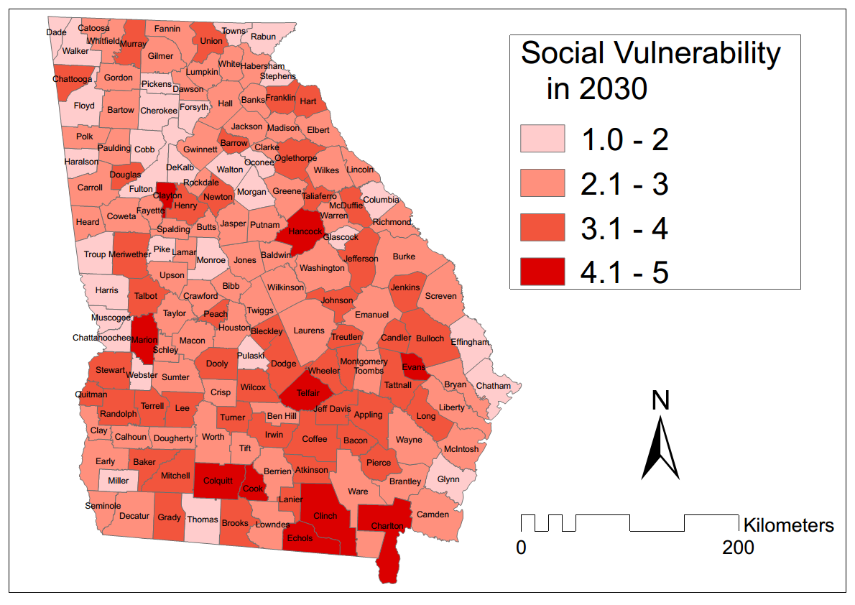
Social Vulnerability

Slide 15
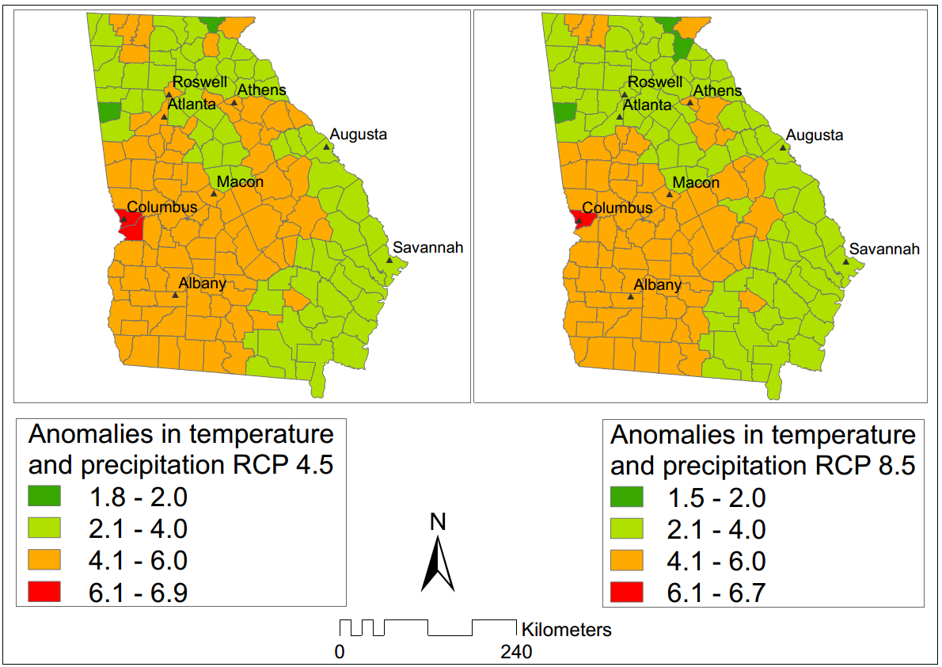
Temperature and Precipitation Anomalies

Slide 16
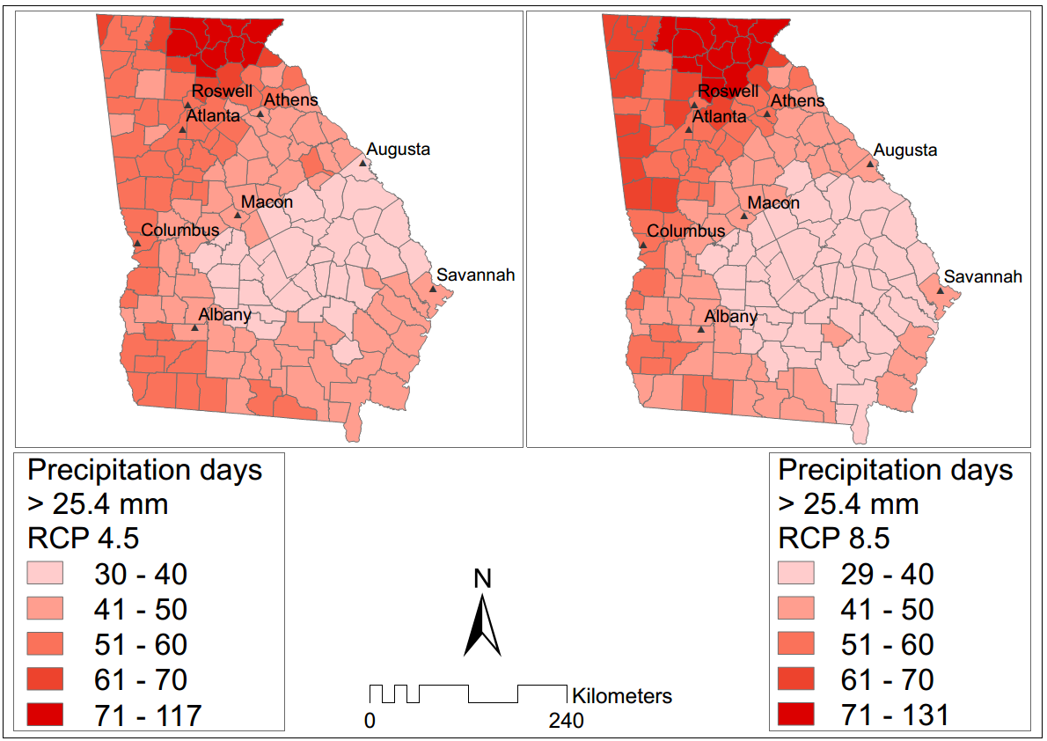
Extreme Climate Projection

Slide 17
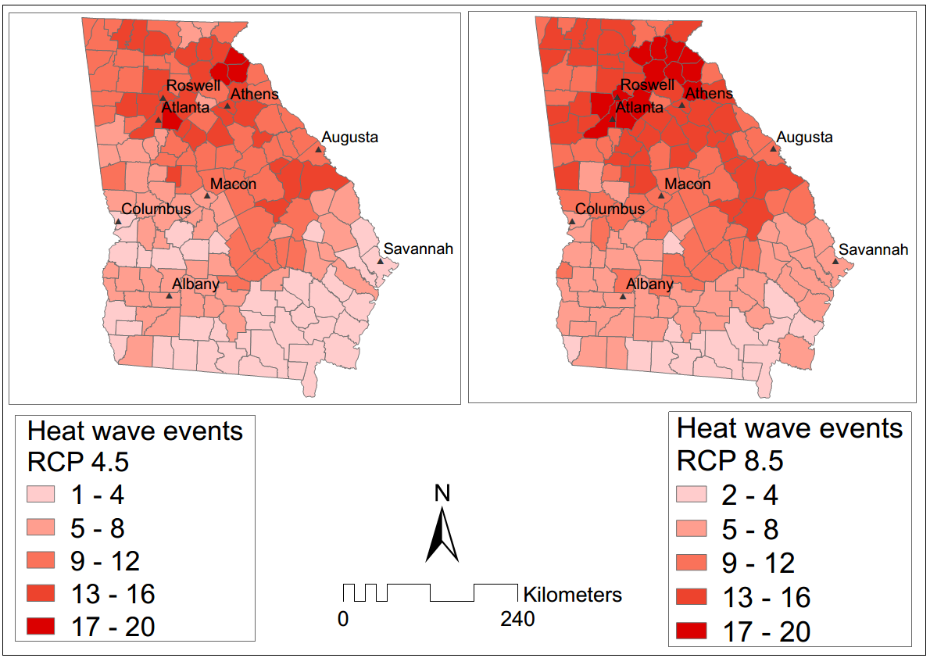
Extreme Climate Projection

Slide 18
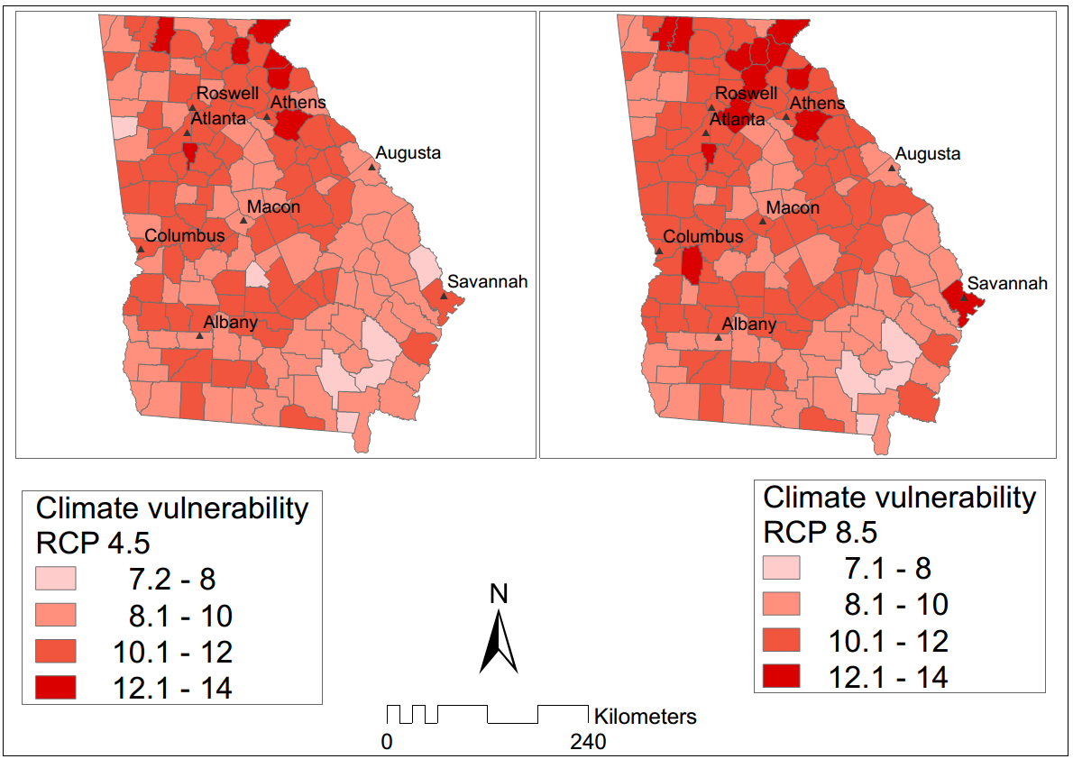
Climate Vulnerability Projection

Slide 19
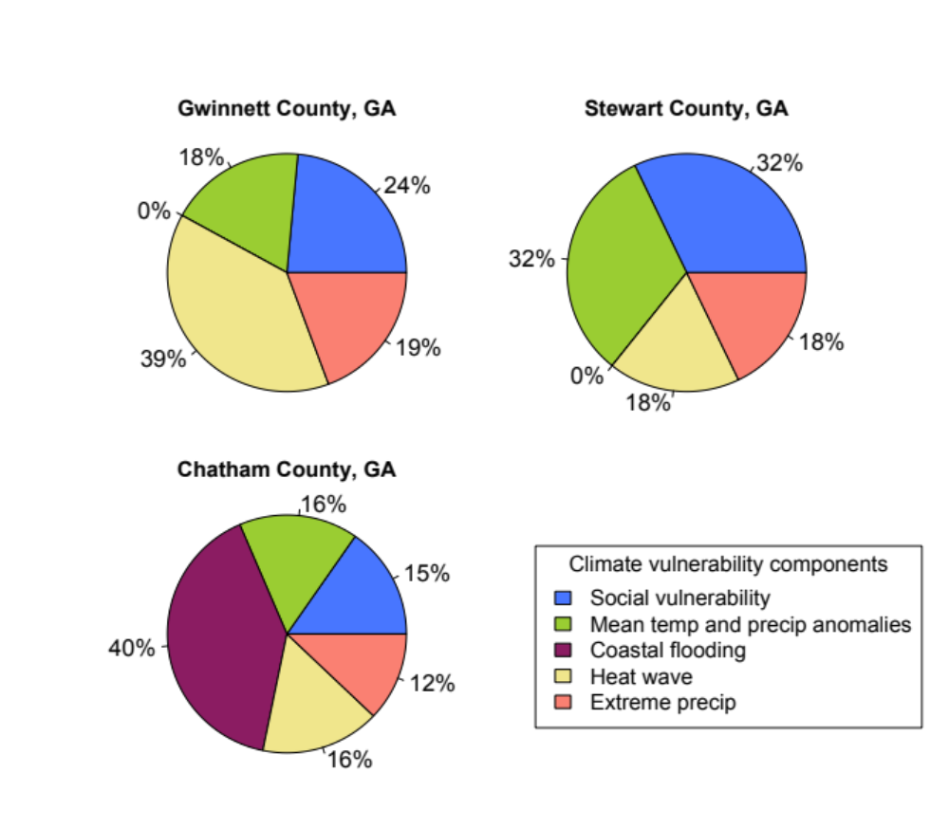
Vulnerability Components

Slide 20
Conclusion
Increased heat waves frequency in Atlanta metro
Frequent heavy precipitation in the northern and southeastern counties
Higher anomalies in mean temperature and precipitation in the western counties
Metro Atlanta and southwest Georgia are climatologically and socially vulnerable
Geographic vulnerability is high in coastal counties
Notes:
Short-term projection of vulnerability in the 2030s can be utilized by individuals, communities and planners and to prepare adaptation plans

Slide 21
Thank You!
leebinita@gmail.com

