Slide 1
PAIN MANAGEMENT
THERAPEUTIC AND
NON-THERAPEUTIC INTERVENTIONS
Roy Krishna, PhD, FCP.
Touro University Nevada
College of Osteopathic Medicine

Slide 2


Slide 3
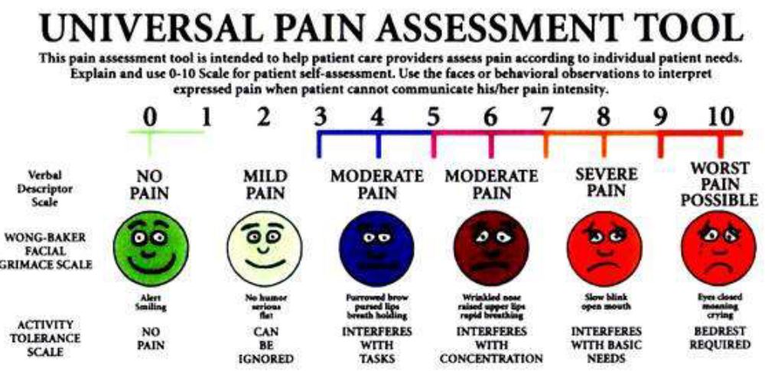
Pain Management

Slide 4
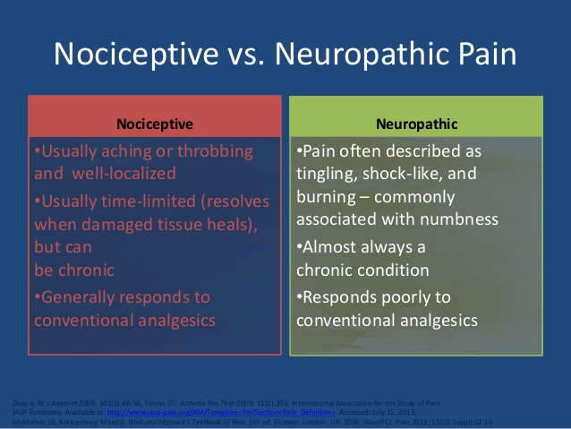
Nociceptive vs. Neuropathic Pain

Slide 5
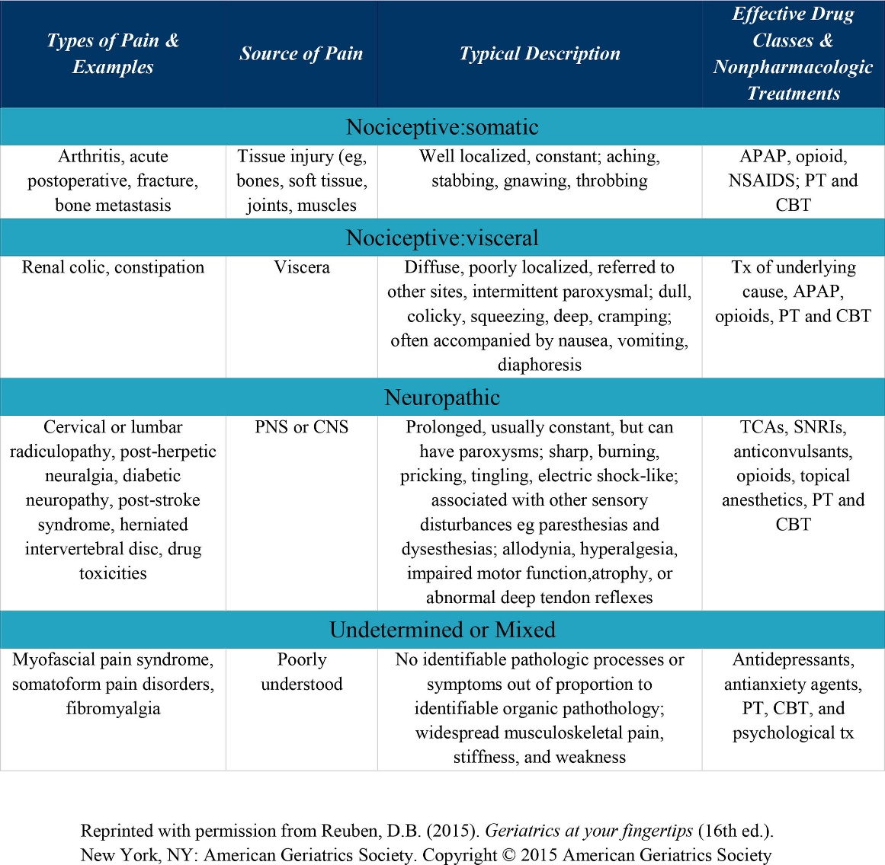

Slide 6
Pain Management
Chronic Malignant Pain: Cancer, HIV/AIDS, MS, End Stage Organ Failure, CHF, Parkinsons.
Chronic Non-Malignant Pain: Musculoskeletal, RA, Migraine, Post-amputation, Diabetic neuropathy, Post-herpetic neuralgia, Sickle cell anemia.

Slide 7
Pain Management
Treatment Options
Non-opioids
Antidepressants
Anticonvulsants
Opioids
Cognitive Behavioral Therapy
CAM

Slide 8
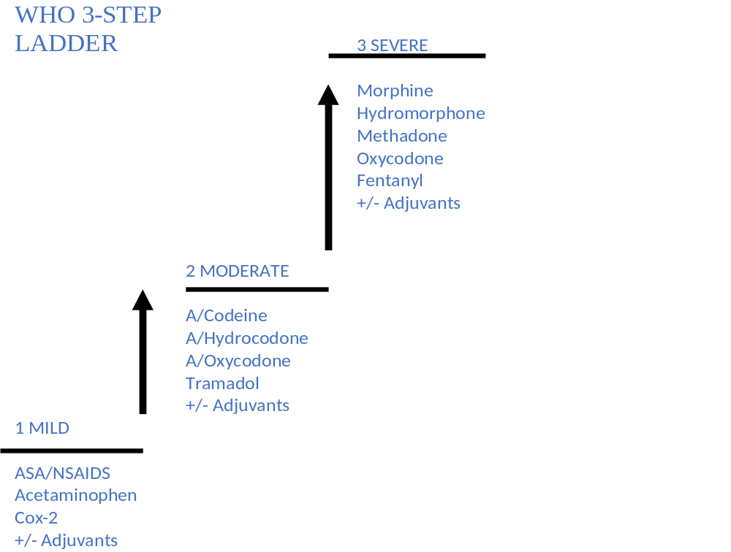

Slide 9
Non-opioid medications
Acetaminophen 650mg tid-qid : concern for hepatic toxicity >3-4grams
NSAIDs including Ibuprofen, Naproxen, COX-2 inhibitor: concern for gastric / renal toxicity, platelet dysfunction, may inhibit anti-hypertensive medications

Slide 10
Opioid combination products
The following opioids are available as combination products with acetaminophen, aspirin, or ibuprofen
  Codeine; hydrocodone; oxycodone; propoxyphene
Typically used for
  Moderate episodic (PRN) pain
  Breakthrough pain in addition to a long-acting opioid.
Never prescribe more than one combination drug at any one time.

Slide 11
Pain Management
Opioid Dose Escalation
Always increase by a percentage of the present dose based upon patient’s pain rating and current assessment
50-100% increase
25-50% increase
Severe pain
7-10/10
Moderate pain
4-6/10
25% increase
Mild pain
1-3/10

Slide 12
Pain Management
Breakthrough Pain
Long acting opioids for persistent pain.
Short acting opioids (rescue) for breakthrough pain.
Rescue dose is 10-15% of 24 h daily dosage.
Oral rescue doses every 1-2h, parenteral every 15-30min.

Slide 13
Pain Management
Fibromyalgia
Widespread pain for at least 3 months
Pain on both sides of the body
Pain above and below the waist
Axial skeletal pain

Slide 14
Pain Management
Fibromyalgia
Pregabalin
Duloxetine/Gabapentin
Tizanidine
Trazodone (sleep disturbance)
Amitriptyline/Nortriptyline

Slide 15
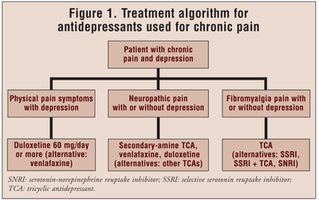

Slide 16
Pain Management
Migraine
Pressure in frontal region spreading to periorbital and retroorbital region.
Nausea and light sensitivity
Nasal stuffiness

Slide 17
Pain Management
Migraine
Antiemetic with NSAID’s
NSAID’s with triptans
Antiemetic with triptans
Antiemetic with NSAID’s and triptans

Slide 18
Pain Management
Neuropathic Pain
Pain initiated by lesion or neural dysfunction:
Peripheral neuropathy
Trigemnial neuralgia
Central post-stroke pain
Spinal cord injury

Slide 19
Pain Management
Neuropathic Pain
Diabetic peripheral neuropathy:
Pregabalin/Duloxetine
Post-herpetic neuralgia:
Gabapentin/Pregabalin
Trigemnial neuralgia
Carbamezapine

Slide 20
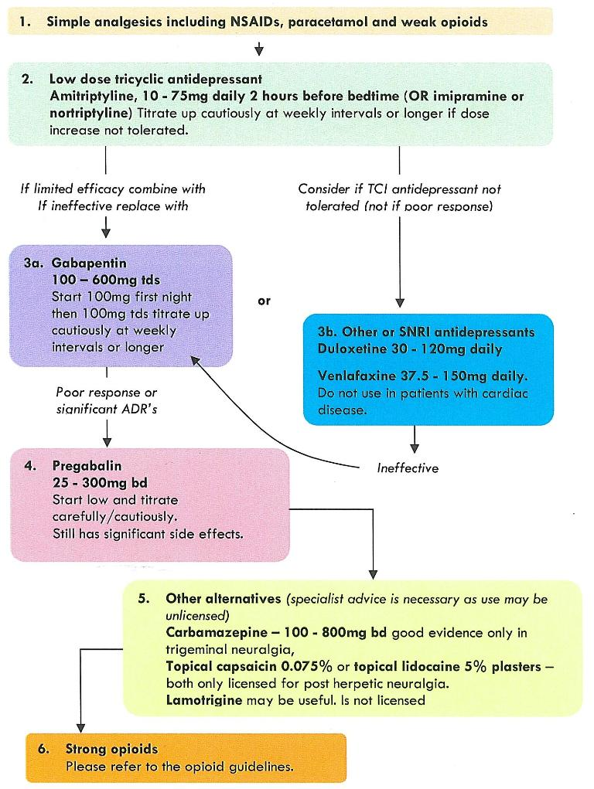

Slide 21
Pain Management
Diabetic Peripheral Neuropathy
1st Tier:
Duloxetine, oxycodone, pregabalin, TCA’s
2nd Tier:
Carbamezapine, gabapentin, lamotrigine, tramadol, venlafaxine.
Adjunct:
Topical lidocaine, citalopram, paroxetine, topiramate, phenytoin.

Slide 22
Pain Management
Cancer Pain
Pain (1-3): NSAID’s, hydrocodone
Pain (4-6): Morphine 10mg PO PRN, Oxycodone 5mg PO PRN plus NSAID’s, antidepressants, antiepileptics
Pain (7-10, Pain Crisis): Morphine 20mg PO PRN, 30% increase in current opioid regimen (sustained and immediate release), hydromorphone, oxycodone for rescue dosing. PCA Pump.

Slide 23
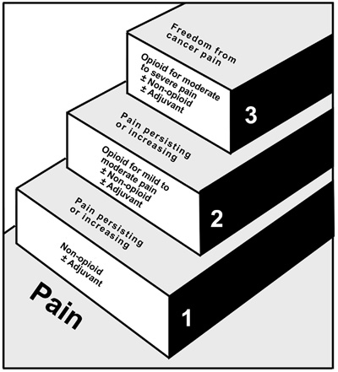
Cancer Pain Management
WHO Step Ladder
Source: World Health Organization. Technical Report Series No. 804, Figure 2. Geneva: World Health Organization; 1990. Reprinted with permission.

Slide 24
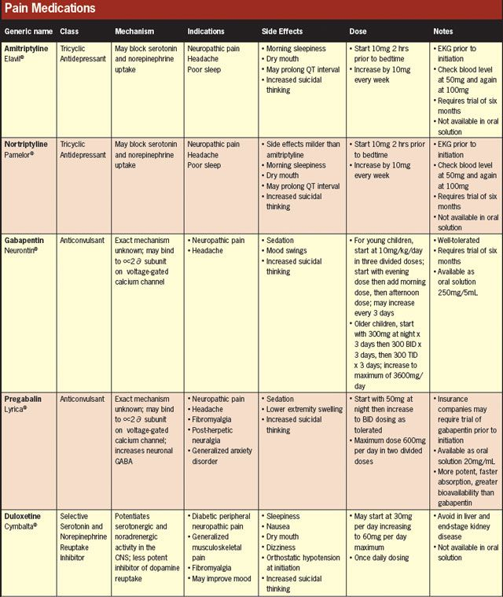

Slide 25
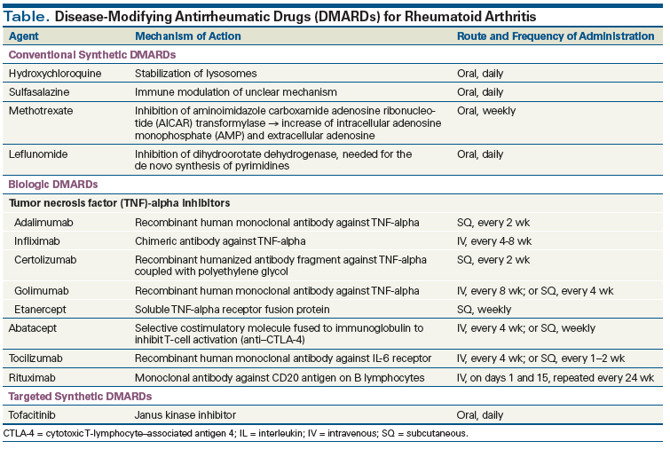

Slide 26
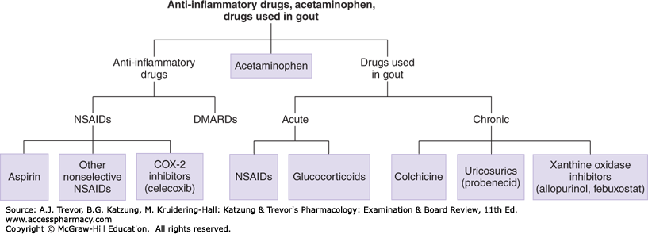

Slide 27
Osteopathic Manipulative Medicine
(OMM)
Holistic approach to patient care—encompassing the integration of structure and function, emotional and social aspects of health and healing.
Providing unique musculoskeletal diagnostic examinations and manual therapies.
Restoration of somatic dysfunction.

Slide 28
Osteopathic Manipulative Medicine
(OMM)
The body is a unit; the person is a unit of body, mind, and spirit.
The body is capable of self-regulation, self-healing, and health maintenance.
Structure and function are reciprocally interrelated.
Rational treatment is based upon an understanding of the basic principles of body unity, self-regulation, and the interrelationship of structure and function.

Slide 29
Osteopathic Manipulative Medicine
(OMM)
Table 1. Descriptions of some of the more commonly used OMT techniques according to the Glossary of Osteopathic Terminology.11
• High velocity/low amplitude thrust involves a rapid, therapeutic force of brief duration that travels a short distance within the anatomic range-of-motion of a joint, and that engages the restrictive barrier in one or more planes of motion to elicit release of restriction. It is also known as a thrust technique.
• Muscle energy involves a technique in which the patient’s muscles are actively used on request, from a precisely controlled position, in a specific direction, and against a distinctly executed physician counterforce, in order to achieve release of myofascial tissues.
• Direct myofascial release engages the restrictive barrier of the myofascial tissues. The tissues are then loaded or tractioned with a constant force until tissue release occurs.
• Indirect myofascial release involves dysfunctional tissues that are guided along the path of least resistance until free movement is achieved.
• Counterstrain considers dysfunction to be a continuing, inappropriate strain reflex, which is inhibited by applying a position of mild strain in the direction opposite to that of the reflex. This is accomplished by specific directed positioning about the point of tenderness to achieve the desired therapeutic response.
• Osteopathy in the cranial field involves techniques based on the primary respiratory mechanism and balanced membranous tension.

Slide 30
Pain Management
Herbal Medications
Ginger
White Willow Bark
Devil’s Claw
Feverfew
St. John’s Wort
Curcumin

Slide 31
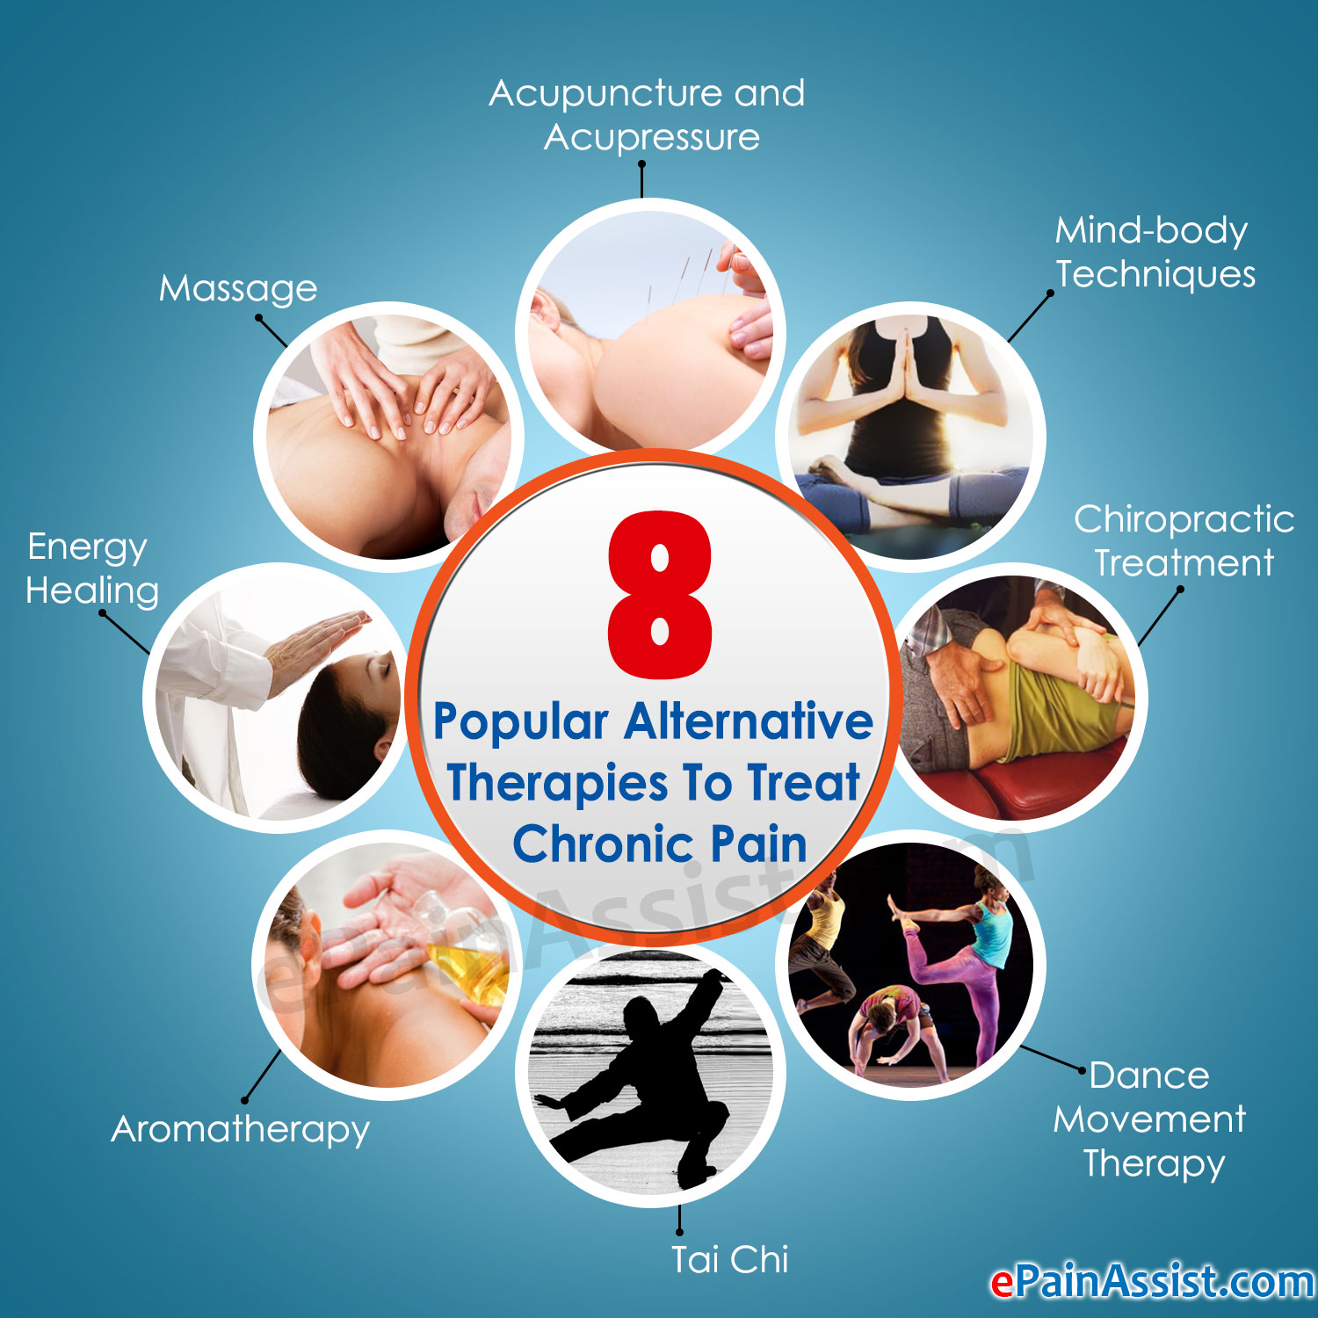

Slide 32
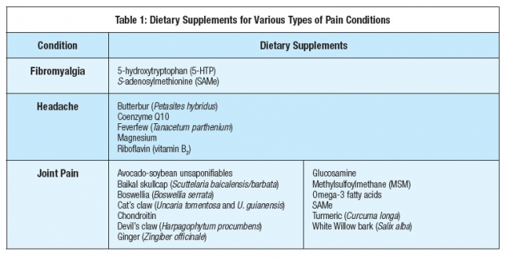

Slide 33
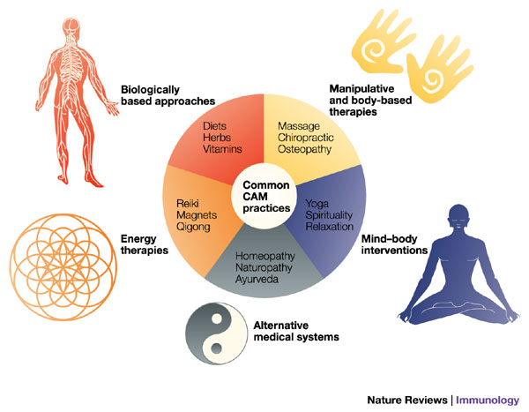

Slide 34
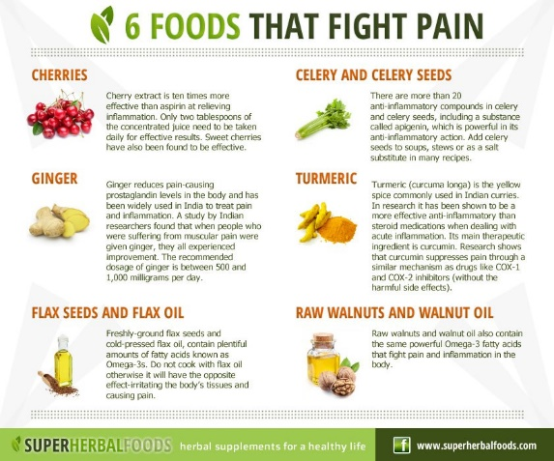

Slide 35
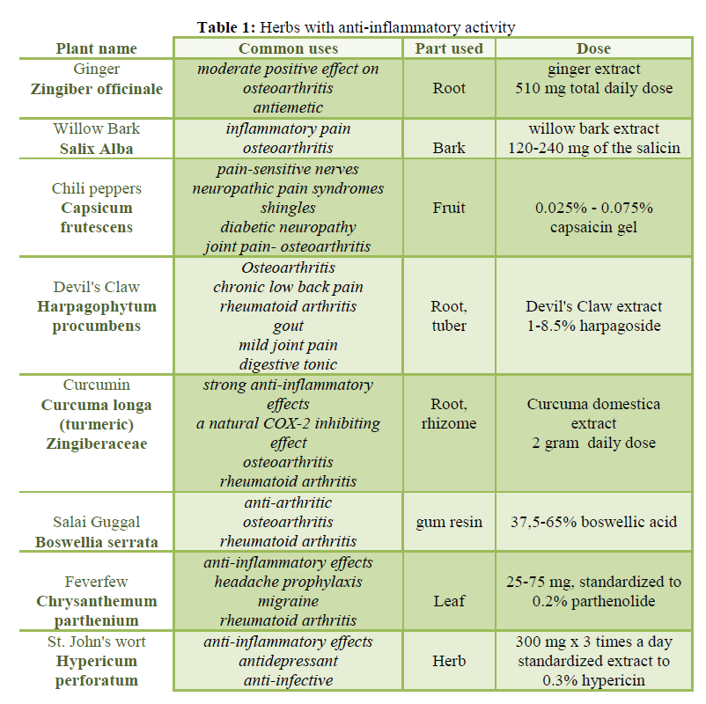

Slide 36
References
Mark S. Wallace, Peter S. Staats. Pain Medicine & Management. Mcgraw Hill, 2014.
Management of Opioid Therapy for Chronic Pain, Clinical Practice Guidelines, Department of Veterans Affairs, Washington, DC. 2010.
FDA Education Blueprint for Health Care Providers involved in the Management or Support of Patients with Pain (May 2017).
Guideline for prescribing opioids for chronic pain, Centers For Disease Control, 2017. https://www.cdc.gov/drugoverdose/pdf/guidelines_factsheet-a.pdf
Enkelejda et al. Complimentary and Alternative Medicine for Pain. Eur. Scientific Journal, March 2013. Vol 9.
Osteopathic Medicine Approach to Pain Management. Practical Pain Management. Vol 10. 2017.

