Slide 1

Food Safety Lawsuits in the Untied States – A 25 Year Perspective
Barcelona June 11-12, 2018

Slide 2
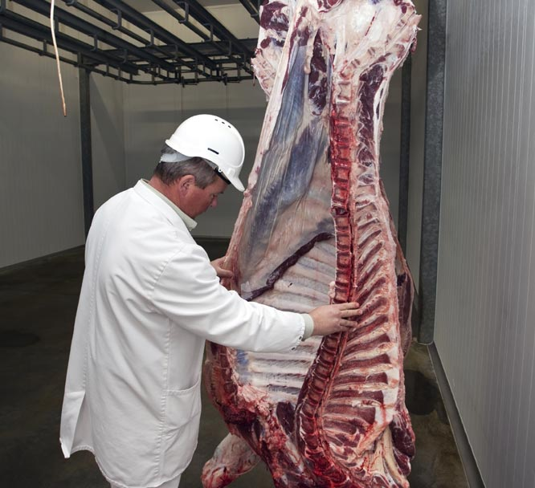
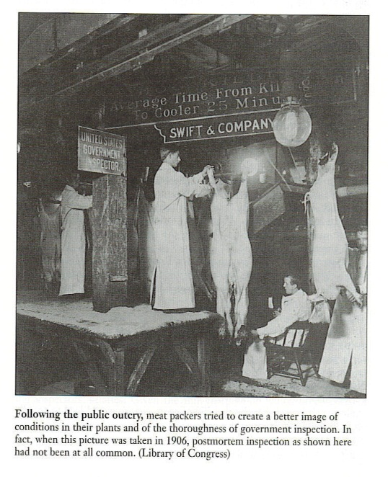
The “poke and sniff” system was designed to prevent rotten, blemished, or damaged meat from entering the food supply.
Cuts of meat with lesions, growths and abrasions were found by inspectors, who used their sense of smell and touch to identify contaminated meat from clean cuts.
The “command and control” approach meant that the USDA inspectors were in control of the facility and meat safety was the responsibility of U.S. Government.

Slide 3
A History of Food Safety and Litigation
“In construing both the Wholesome Meat Act and the Wholesome Poultry Products Act we are mindful that the presence of salmonellae can be detected only by microscopic examination. No one contends that Congress meant that inspections should include such examinations. We think it follows therefore that Congress did not intend the prescribed official legends to import a finding that meat and poultry products were free from salmonellae.”
“The American consumer knows that raw meat and poultry are not sterile and, if handled improperly, perhaps could cause illness.” In other words, American housewives and cooks normally are not ignorant or stupid and their methods of preparing and cooking of food do not ordinarily result in salmonellosis.”
APHA v. Butz, 511 F.2d 331, 334 (1974).

Slide 4

A Warning Ignored
In 1983 the New England Journal of Medicine reported two outbreaks of an unusual gastrointestinal illness that affected at least 47 people in Oregon and Michigan in February through March and May through June 1982 in Oregon and Michigan that affected at least 47 people. The outbreaks were associated with eating at restaurants belonging to the same fast-food restaurant chain in Oregon and Michigan.
E. coli O157:H7 was isolated from 9 of 12 stools collected within four days of onset of illness in both outbreaks and from a beef patty from a suspected lot of meat in Michigan.

Slide 5

California – A Missed Opportunity
In late December, the San Diego County Department of Health Services was notified of a child with E. coli O157:H7 infection who subsequently died. After the Washington outbreak was reported, reviews of medical records at five hospitals revealed an overall 27% increase in visits or admissions for diarrhea during December 1992 and January 1993 compared with the same period 1 year earlier. Illnesses of 34 patients met the case definition The outbreak strain was identified in stool specimens of six patients. Fourteen persons were hospitalized, seven developed HUS, and one child died. The median age of case-patients was 10 years.

Slide 6

“The Beef Industry’s 911”
From November 15, 1992, through February 28, 1993, more than 600 laboratory-confirmed infections with E. coli O157:H7 and four associated deaths occurred in four states: Washington, Idaho, California, and Nevada. In Washington, as a result of publicity and case-finding efforts, during January-February 1993, 602 patients with bloody diarrhea or HUS were reported to the state health department. Onsets of illness peaked from January 17 through January 20. Of the patients, 30% were hospitalized; 30 developed HUS, and three died. The median age of patients was 7.5 years.

Slide 7
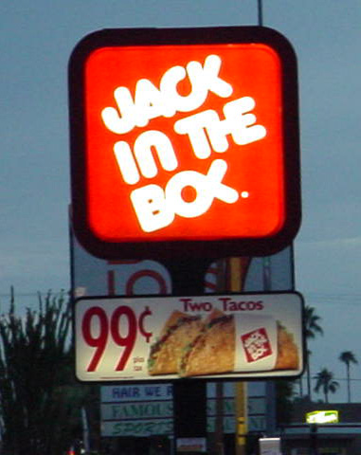

Litigation as Incentive – 25 Years Later
Jack in the Box

Slide 8
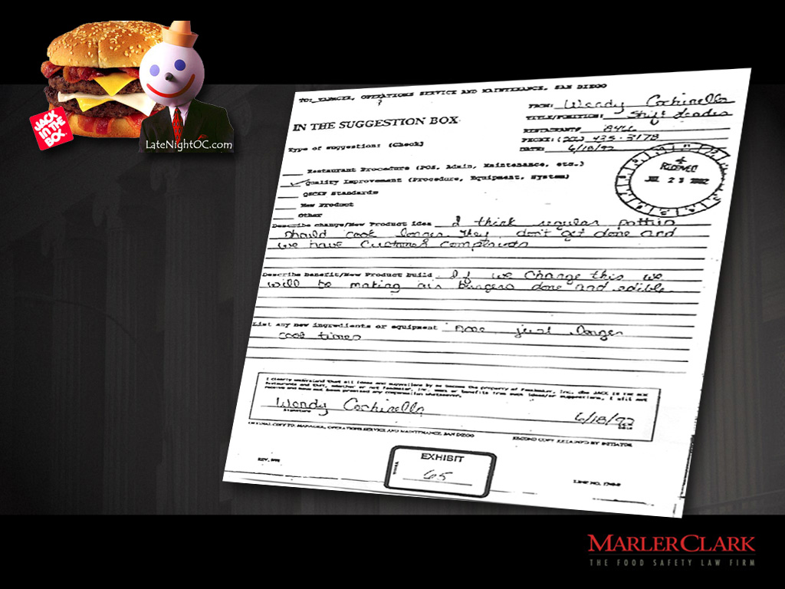
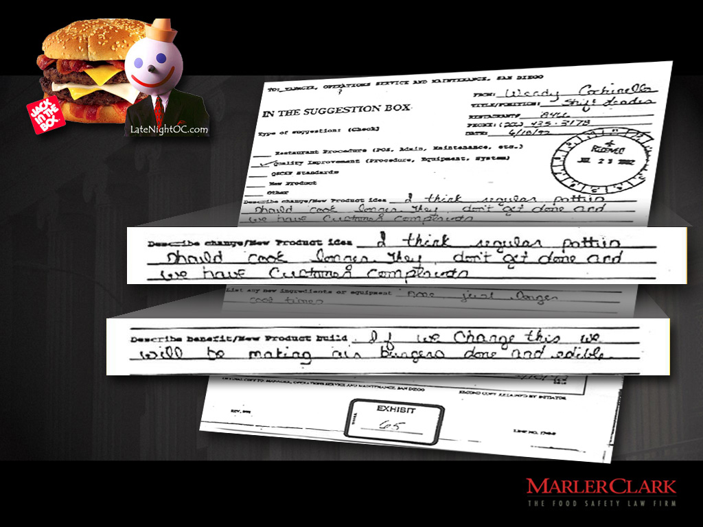
Notes:
8

Slide 9
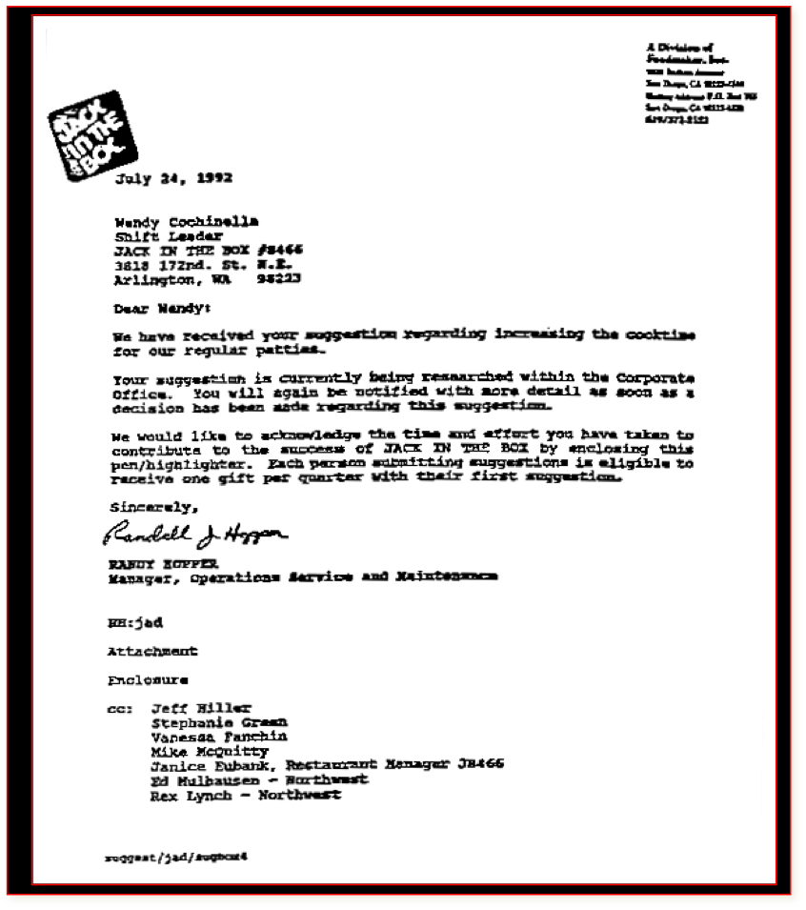
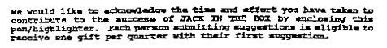
Notes:
9

Slide 10
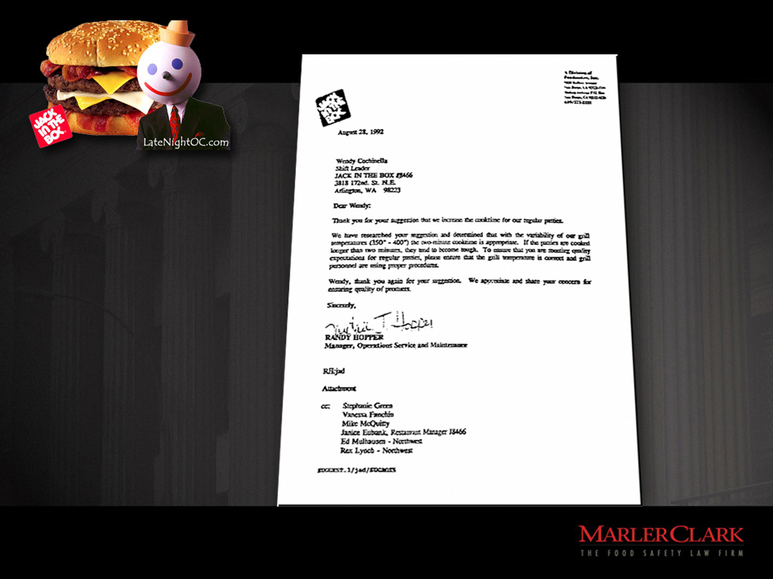

Notes:
10

Slide 11

What we all want to Avoid

Slide 12
The Most Historic Shift In USDA Enforcement Policy for Meat
“To clarify an important legal point, we consider raw ground beef that is contaminated with E. coli O157:H7 to be adulterated within the meaning of the [FMIA]. We are prepared to use the Act’s enforcement tools, as necessary, to exclude adulterated product from commerce. Finally, we plan to conduct targeted sampling and testing of raw ground beef at plants and in the marketplace for possible contamination.”
September 28, 1994
FSIS Administrator, Michael Taylor, in a speech to the AMI

Slide 13
E. coli O157:H7 as an Adulterant
MEAT INDUSTRY REACTION:
“How can FSIS treat E. coli in hamburger meat as an adulterant subject to enforcement strategies, while not applying the same standard to salmonella in broilers…Such gross policy interpretation favoring the poultry industry and disfavoring the beef industry is a travesty indeed.” —Rosemary Mucklow
FOOD MARKETING INSTITUTE:
“It is essential that nothing dilute the consumer message that the proper cooking of meat eliminates foodborne pathogens.”
And so, of course, they sued the USDA

Slide 14
Meat Inspection Totally RE-Invented:
From “Command and Control” Model to HACCP-based Model
HACCP placed the responsibility for meat safety on the manufacturer
Inspectors are there to confirm that the HACCP plan is in place & working
USDA implemented microbiological testing in-plant and at retail

Slide 15

A Positive Tend Line
Marler Clark
Revenue
E. coli O157:H7

Slide 16



Food Production is a Risky Business
Competitive Markets
Stockholder Pressures
for Increasing Profits over Long-term Safety
Brand Awareness Risks
Not least of all, those pesky lawyers

Slide 17
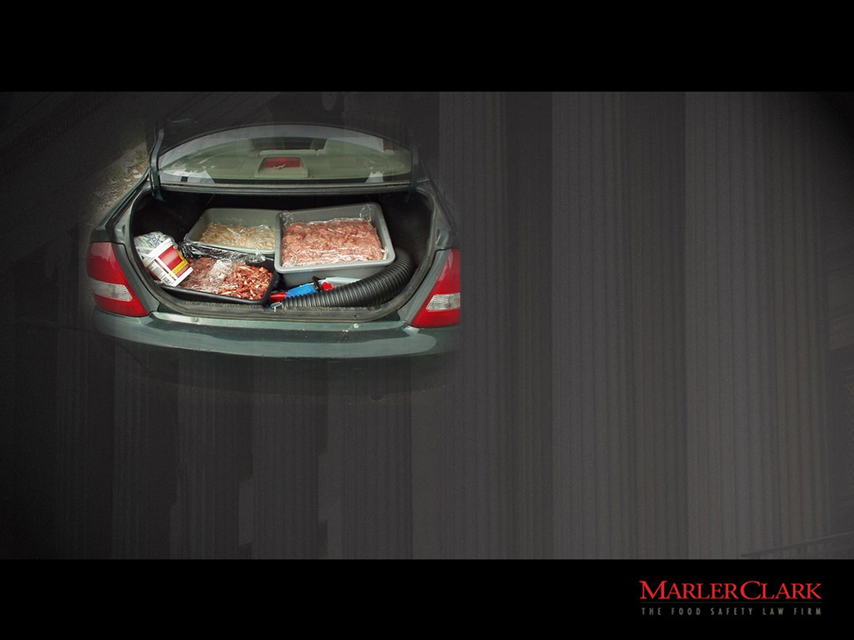
Strict Product Liability
Strict Liability
  Are you a manufacturer?
  Was the product unsafe?
  Did product
  cause injury?
Punitive Damages
/Criminal Liability
  Did you act with conscious disregard
  of a known safety risk?
Negligence
  Are you a product seller?
  Did you act “reasonably”?
Notes:
17

Slide 18

Who is a Manufacturer?
A “manufacturer” is defined as a “product
seller who designs, produces, makes, fabricates, constructs,
or remanufactures the relevant product or component part of a product before its sale
to a user or consumer.”
RCW 7.72.010(2); see also Washburn v. Beatt Equipment Co.,
120 Wn.2d 246 (1992)
Notes:
18

Slide 19

Pathway of a Foodborne Illness Investigation
Ill person
Health Care Provider
Specimen collection
Organism identified

Slide 20
Pathway of a Foodborne Illness Investigation
Ill person
Health Care Provider
Specimen collection
Organism identified
Public Health Laboratory
If there are more ill persons than expected, an OUTBREAK might be underway.
Epidemiologic investigation

Slide 21
Pathway of a Foodborne Illness Investigation
Ill person
Health Care Provider
Specimen collection
Organism identified
Public Health Laboratory
Epidemiologic investigation
Environmental investigation
Product Recall
Product Trace Back

Slide 22

It is a Global Food Economy

Slide 23
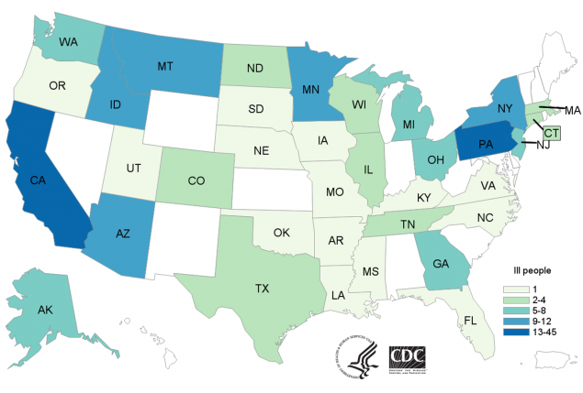
More Still To Do – 203 with E. coli O157
Romaine Letter from Arizona
Number will Likely Rise
Product Exported to Canada
50% Hospitalized
70% Women
26 with HUS
5 Death so Far

Slide 24

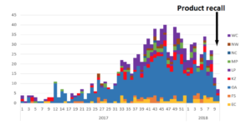
A South African Polony Tragedy
1,027 cases have been reported since January 2017.
743 cases were reported in 2017.
264 cases in 2018.
Females account for 55% cases where gender is reported.
Ages range from birth to 92 years.
200 patients are known to have died.

Slide 25

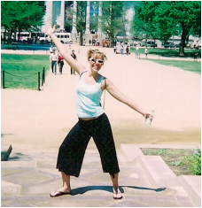

Stephanie Smith Before
20-year-old Dance Instructor
High School Graduate
Running Three Just for Kix Dance Studios
Boyfriend – looking forward to marriage and children

Slide 26

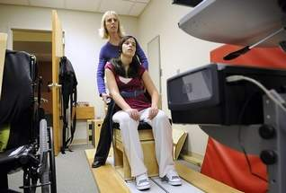

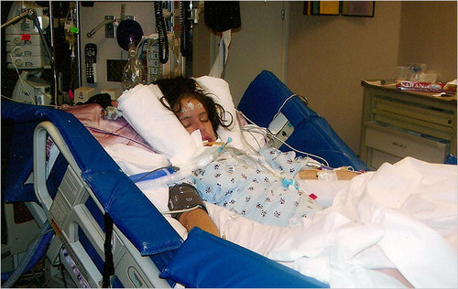
Stephanie Smith After
E. coli O157:H7 after eating hamburger
Hospitalized September 27, 2007 – June 18, 2008
Hemolytic Uremic Syndrome
Stroke leaving her brain injured and unable to walk
Acute Kidney Failure – Two months of dialysis – will require multiple transplants
Neurogenic Bowel and Bladder
Will not have children
Past Medical Expenses $1,886,434
Future Care Costs $29,445,688
Wage Loss $1,229,085

Slide 27


Linda Rivera Before
Wife, Mother of Six
Worked with Disabled Children
Dedicated “Sports Mom”

Slide 28
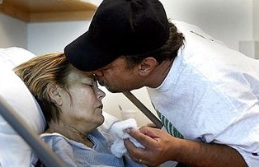
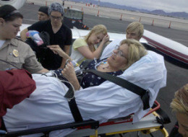
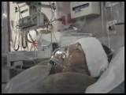
Linda Rivera After
E. coli O157:H7 Cookies
Hospitalized May 3, 2009 – May 20, 2011
Large Intestine Removed
Stroke
Mechanical Ventilation
Multiple Septic Infections
Missed Three Kid’s Graduations
Dialysis, Plasma Exchange
Congestive Heart Failure
Hospice Care Suggested Multiple Times
Liver Failure
Hemolytic Uremic Syndrome
Dialysis
Dr. Siegler: “Linda has survived the severest multi-organ (bowel, kidney, brain, lung, gall bladder, pancreas and liver) E. coli case I have seen in my extensive experience.”
Medical Bills to date $5,537,755
Future Care Costs $26,289.768 to $61,769,699

Slide 29

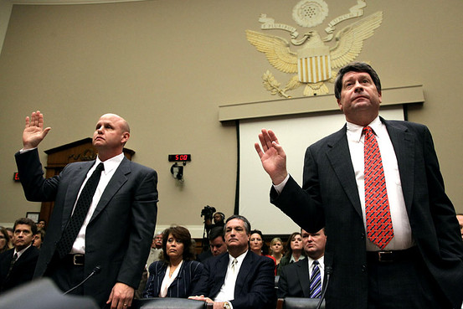

Are things are Different Today?

Slide 30
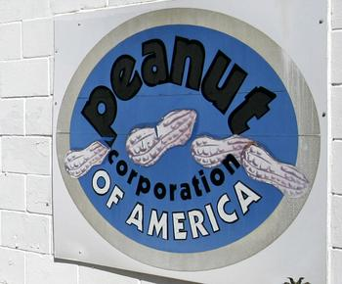
It Started with just a Little Salmonella
714 persons infected with the outbreak strain of Salmonella Typhimurium were reported from 46 states.. Additionally, one ill person was reported from Canada.
Among the persons with confirmed, reported dates available, illnesses began between September 1, 2008 and March 31, 2009. Patients ranged in age from <1 to 98 years. The median age of patients was 16 years which means that half of ill persons were younger than 16 years. 21% were age <5 years, 17% were >59 years. 48% of patients were female. Among persons with available information, 24% reported being hospitalized.
Nine deaths: Idaho (1), Minnesota (3), North Carolina (1), Ohio (2), and Virginia (2).

Slide 31
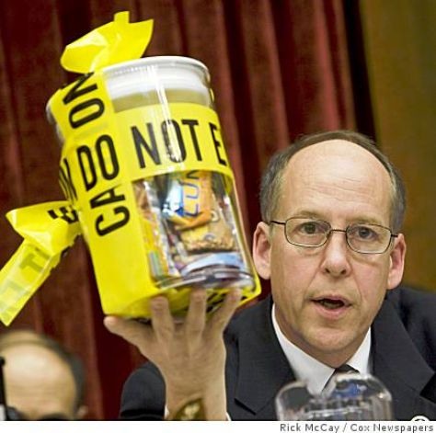
Then there were Congressional Hearings
“Turn them loose,” Parnell had told his plant manager in an internal e-mail disclosed at the House hearing. The e-mail referred to products that once were deemed contaminated but were cleared in a second test last year.
Parnell ordered products identified with salmonella to be shipped and quoting his complaints that tests discovering the contaminated food were “costing us huge $$$$$.”
Parnell insisted that the outbreak did not start at his plant, calling that a misunderstanding by the media and public health officials. “No salmonella has been found anywhere else in our products, or in our plants, or in any unopened containers of our product.”
Parnell complained to a worker after they notified him that salmonella had been found in more products. “I go thru this about once a week,” he wrote in a June 2008 e-mail. “I will hold my breath ………. again.”

Slide 32
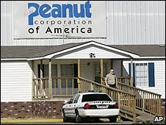
Then a 76 Count Federal Indictment
Stewart Parnell, the former owner of Peanut Corp. of America
Michael Parnell, who is Stewart Parnell’s brother and a former supervisor
Samuel Lightsey, a onetime plant operator
Mary Wilkerson, a former quality-assurance manager
Daniel Kilgore, plant manager
Allegations Include:
Mail Fraud
Wire Fraud
Introduction of Adulterated and Misbranded Food into Interstate Commerce with Intent to Defraud or Mislead
Conspiracy

Slide 33
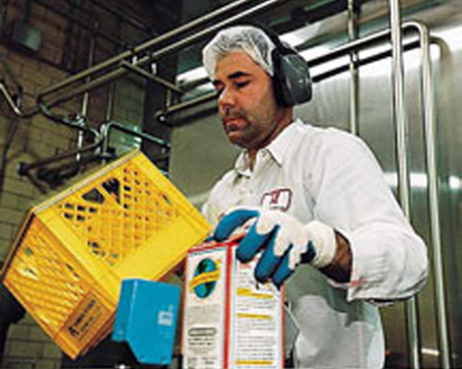
Planning AGAINST Litigation –
What Is Really Important
Identify Hazards
  HACCP
  Do you have
  qualified and committed people?
What is the Culture?
Involve Vendors
and Suppliers
  Do they really
  have a plan?
  Ever visit them?
Notes:
33

Slide 34
















Planning AGAINST Litigation –
Establish Relationships
They are your best friends!

Slide 35
Lessons Learned From Litigation
You can insure the brand’s and the company’s reputation
Arm yourself with good, current information
Since you have a choice between doing
nothing or being proactive, be proactive
Make food safety part of everything you, your suppliers and customers do
Notes:
35

Slide 36

Questions

