Slide 1
DETERMINATION OF ACRYLAMIDE USING IMMUNO-ENZYMATIC METHOD IN COMMERCIAL DOG AND CAT FOOD
Prof.Dr. Bilal Cem LİMAN
University of Erciyes
Turkey

Slide 2
Acrylamide
Acrylamide is an essential industrial and scientific chemical
It is estimated worldwide production more than 200 million kg /year
The acrylamide monomer is a white,odourless, crystalline solid at room temperature
One of the latest discovered neurotoxic and carcinogenic substances in foodstuffs is acrylamide.

Slide 3
Acrylamide formation
The major acrylamide formation mechanism in food involves the Maillard reaction of the amino acid asparagine with reducing sugars
Solubility of acrylamide in solvents is variable ,highest in water

Slide 4
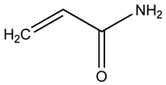
Structure of acrylamide
Acrylamide (CH²=CH-CO-NH²; 2-propenamide)

Slide 5
Toxicological profile
(Absorption, distribution, metabolism, excretion)
Rapid and complete absorption by oral, inhalation and dermal routes in a range of species
Rapid distribution to a range of tissues and organs
Accumulation in liver, kidney, testes, epididymis, skin and red blood cells
Metabolised to Glycidamide
60% dose excreted in urine in 24 h
Information on bioavailability from foodstuffs as consumed needed
Animals-Incomplete information available

Slide 6
Acute Chronice dose studies
Oral LD₅₀ in rats, mice, guinea pigs and rabbits 107-203 mg/kg bw
Skin and eye irritant and skin sensitization
Main effect non-lethal reversible neurotoxicity (peripheral nerves)

Slide 7
Clinical signs
sweating,
nausea,
myalgia,
speech disorders,
numbness and weakened extremeties
abnormal manner
vomited
Convulsions
ataxic and displayed hypermetria.
nephropathy

Slide 8
Aim(Importance of Acrylamide Determination)
Acrylamide is a known carcinogen in laboratory animals,
impairing fertility in male animals
and causing nerve damage in animals
the starch-rich foodstuffs may be a neurotoxin in dogs
The aim of this study is to detect possible acrylamides levels in dry cat and dog food

Slide 9
Materials and methods
Analitical method which is immunoenzymatic method.
The test is a direct competitive ELISA based on the recognition of Acrylamide by specific antibodies
used commercial ELISA kit
42 cat and dog food were randomly collected and analyzed
In order to analyse food samples for Weigh 2.0 g of a representative sample
Extraction/Clean Up with Methanol/deionized water
Derivatization Procedure (Derivatization Reagent reconstitution solution)

Slide 10
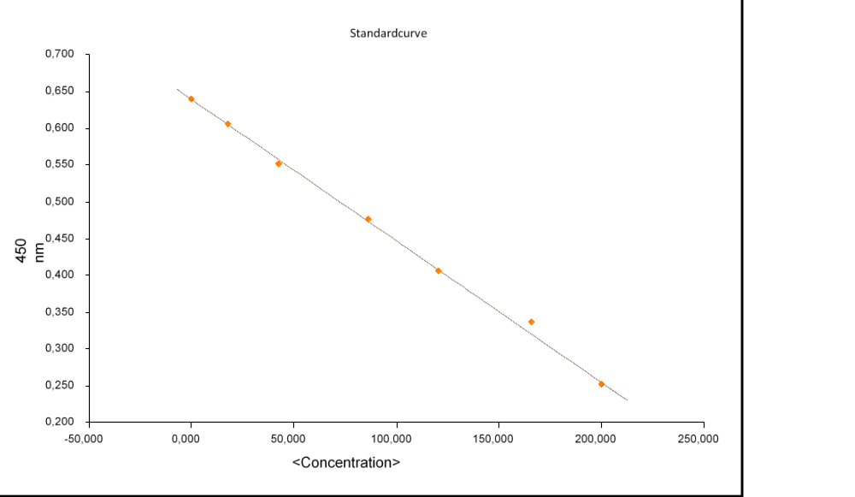

Slide 11
Results
33% (14 samples) presence of acrylamide have been found
highest acrylamide level is 155 ppb
the lowest is 45 ppb,
average acrylamide level is 87.35 ppb

Slide 12
Table1, Statistical Findings
Pet foods | N | Range | Minimum | Maximum | Average |  | Std. deviation | variance
 |  |  |  |  | values | Std error
 | 14 | 110,00 | 45,00 | 155,00 | 87,3571 | 8,42589 | 31,52681 | 993,940

Slide 13
Discussion 1
immunoenzymatic detection appears to be an effective analytical technique for use in cat and dog food due to its high sensitivity, low cost, and easy handling
simple and low-cost alternative to chromatographic methods and is suitable and sensitive for the rapid determination of acrylamide in petfood samples
immunoenzymatic method can be used as a standart technique on cat and dog food but It should be supported by more sensitive methods
it was below the level that would affect the health of cats and dogs.

Slide 14
Discussion 2
The possibility of acrylamide toxicity occurring in pet animals, especially,immature animals,
and should not be ignored when neurological cases are seen.
Further studies are needed to quantify the risk acrylamide in foodstuffs poses to dogs and cats.

Slide 15
REFERENCES
Jerry M. Rice, Mutation Research 580 (2005) 3–20
L Le Roux-Pullen, D Lessing,Jl S.Afr.vet.Ass. (2011) 82(2): 129–130
Pulley M T 1999 Acrylamide neuropathy
Preston,A.,et all analytica chimica acta 6 0 8 ( 2 0 0 8 ) 178–185

