Slide 1

QUANTIFICATION OF OCULAR TRAUMA
PROF. B. SHUKLA,
FACS,FAMS,Ph.D.,D.Sc.
DIRECTOR OF RESEARCH
R.J.N.OPHTHALMIC INSTITUTE
GWALIOR, INDIA.

Slide 2

NO FINANCIAL INTEREST

Slide 3


Slide 4

I WISH I COULD QUANTIFY OCULAR TRAUMA ALSO SO EASILY AND ACCURATELY

Slide 5

QUANTIFICATION
EASY AND ACCURATE IN BASIC SCIENCES LIKE PHYSICS & MATHS.
IN MEDICAL SCIENCE DIFFICULT AND COMPLICATED
HENCE SOME COMPROMISE BECOMES NECESSARY
EVEN THEN THERE IS A RAPID SHIFT FROM QUALITATIVE TO QUANTITATIVE ASSESSMENT

Slide 6
QUANTIFICATION IN MEDICAL SCIENCE
EARLIER DECISION WAS BASED ON CLINICAL EXPERIENCE MAINLY
FEW THINGS LIKE PULSE, B.P. AND TEMPERATURE COULD BE QUITE ACCURATELY MEASURED
HOWEVER SYMPTOMS LIKE PAIN & REDNESS ARE DIFFICULT TO QUANTIFY

Slide 7
QUANTIFICATION OF OCULAR TRAUMA
NOT A SINGLE DISEASE OF A SINGLE PART OF EYE BALL OR ADNEXA
IT IS CAUSED BY A VARIETY OF AGENTS IN A VARIETY OF WAYS
ACCURATE ASSESSMENT IS DIFFICULT
EVEN SOME ASSESSMENT IS USEFUL FOR MANY REASONS

Slide 8
QUANTUM OF DAMAGE DEPENDS UPON
MASS & VELOCITY OF THE STRIKING AGENT
ITS SITE AND DIRECTION
ITS CHEMICAL NATURE
DURATION OF CONTACT
DELICATENESS OF THE TISSUES INVOLVED

Slide 9
METHODS OF MEASUREMENT
QUANTUM OF DAMAGE IS ASSESSED IRRESPECTIVE OF THE CAUSATIVE AGENT
FUNCTIONAL DAMAGE IS MORE IMPORTANT AS IT AFFECTS THE EARNING CAPACITY
STRUCTURAL AND FUNCTIONAL DAMAGE ARE ADDED TO ASSESS TOTAL DAMAGE OF ONE EYE
IN BILATERAL CASES DAMAGE TO EACH EYE IS ADDED

Slide 10
EARLIER METHODS
OCULAR TRAUMA USUALLY AFFECTS CHILDREN & YOUNG PERSONS WHO HAVE NORMAL VISION
VISION AFTER TRAUMA IS NOTED WHICH IS A MEASURE OF DAMAGE TO VISION PRESUMING PRE-TRAUMA VISION WAS NORMAL
HOWEVER IT IS NOT SO IN MANY CASES

Slide 11
METHODS OF TRUAMA QUANTIFICATION
PRIMARY ASSESSMENT: SOON AFTER OR AT THE EARLIEST TIME
CAN BE DONE BY TRAUMA INDEX
FOR PROGNOSIS : OCULAR TRAUMA SCORE IS USEFUL CALCULATED FROM THE PRIMARY ASSESSMENT
TOTAL LOSS : CALCULATED FROM OCULAR TRAUMAGRAM

Slide 12
TRAUMA INDEX ( T.I. )
  T.I. = ½ (S/2 + F ) x T/100 where
  S is structural loss calculated in %
  F is functional loss calculated in %
  T is approximate recovery time in %
SHUKLA & KHANNA ,I.J.O. (1981)

Slide 13
STRUCTURAL LOSS
INCLUDES EYE BALL & ADNEXA
( ORBIT, LIDS, LACRIMAL APP. )
20% : MILD LOSS
40 % : MODERATE LOSS
60 % : SEVERE LOSS
80% : VERY SEVERE LOSS
100 %: TOTAL LOSS

Slide 14
FUNCTIONAL LOSS
POST-TRAUMA V.A. % LOSS
    6/6 0 %
    6/9 10 %
    6/12 20 %
    6/18 30 %
    6/24 40 %
    6/36 50 %
    6/60 60 %

Slide 15
FUNCTIONAL LOSS
POST-TRAUMA V.A. LOSS %
    5/60 65 %
    4/60 70 %
    3/60 75 %
    2/60 80 %
    1/60 85 %
    C.F. or H.M. 90 %
    P.L. + 95 %
    NO P.L. 100 %

Slide 16
CALCULATION OF TOTAL FUNCTIONAL LOSS
VISUAL ACUITY 80 %
VISUAL FIELDS 05 %
OCULAR MOTILITY 05 %
OCULAR TENSION 05 %
LACRIMAL DYSFUNCTION 05 %
  TOTAL 100 %

Slide 17
IMPORTANCE OF TIME
THREE PERSONS MAY BE INJURED IN AN EYE IN THREE DIFFERENT WAYS AND THE VISION MAY BE 1/60 IN EACH PERSON
FIRST MAY RECOVER IN 4 DAYS, SECOND IN 4 WEEKS AND THE THIRD IN 4 MONTHS
INITIAL ASSESSMENT IS EQUAL WHICH IS MISLEADING. TIME OF RECOVERY HAS ALSO TO BE SEEN
HENCE IN TRAUMA INDEX TIME IS CONSIDERED

Slide 18
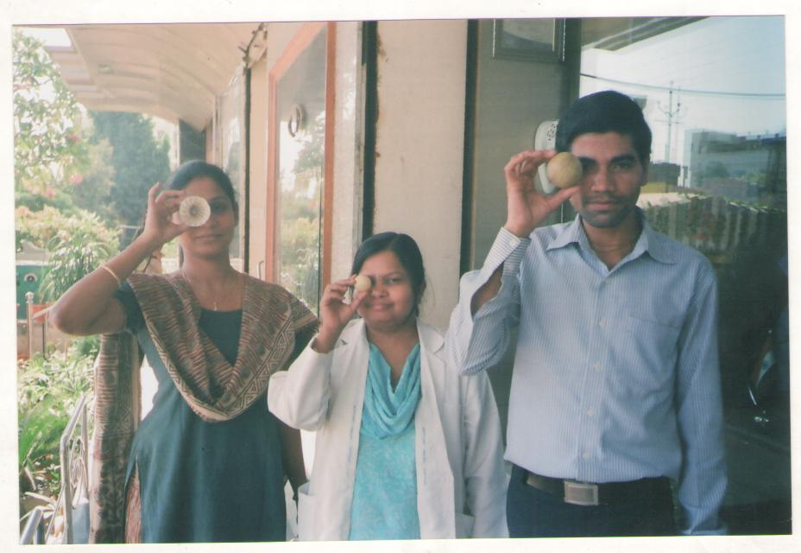
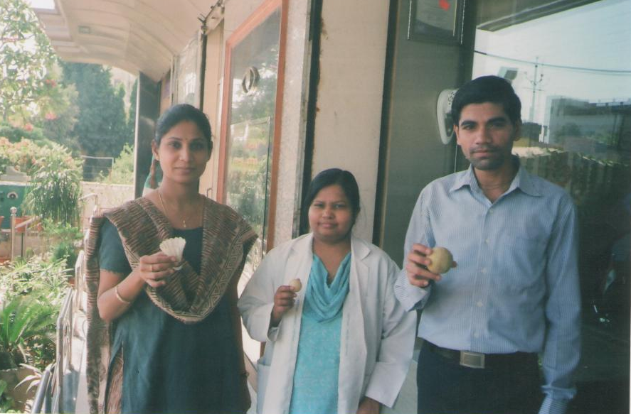

Slide 19
RECOVERY TIME IN %
RECOVERY TIME EQUIVALENT %
    1 DAY 01 %
    2 DAYS 05 %
    3 DAYS 10 %
    4 DAYS 15 %
    5 DAYS 20 %
    1 WEEK 30 %
    2 WEEKS 40 %
    3 WEEKS 50 %
    4 WEEKS 60 %

Slide 20
RECOVERY TIME IN %
RECOVERY TIME EQUIVALENT %
    2 MONTHS 65 %
    4 MONTHS 70 %
    6 MONTHS 75 %
    8 MONTHS 80 %
    10 MONTHS 85 %
    1 YEAR 90 %
    2 YEARS 95 %
    3 YEARS 100 %

Slide 21
GRADATION ON TRAUMA INDEX
T.I. GRADE NUMBER %
01 – 10 MILD 185 37.0 %
11 – 50 MODERATE 198 39.6 %
51 – 100 SEVERE 117 23.4 %
TOTAL 500 CASES

Slide 22
OCULAR TRAUMA SCORE
( O.T.S. )
PUBLISHED BY KUHN ET AL (2002)
AIM IS TO KNOW THE PROGNOSIS
BASED ON INITIAL ASSESSMENT
MAINLY DEPENDS ON INITIAL VISION
OTHER FACTORS ARE RUPTURE, A.P.D, PERFORATION, ENDOHTHALMITIS
EACH FACTOR IS GIVEN A RAW POINT
THE TOTAL IS OTS WHICH IS GRADED

Slide 23
RAW POINTS DISTRIBUTION
VARIABLES RAW POINTS
INITIAL VISION 60 – 100
(NLP TO 20/40)
RUPTURE - 23
ENDOPHTHALMITIS - 17
PERFORATION - 14
RETINAL DETACHMENT - 11
A.P.D. - 10

Slide 24
GRADING OF O.T.S.
RAW POINTS TOTAL O.T.S. GRADE
00 – 44 1
45 – 65 2
66 – 80 3
81 –91 4
92 – 100 5

Slide 25
ESTIMATION OF FINAL VISUAL RECOVERY
OTS N.L.P. 1/200-19/200 20-40 or better
1 74 % 07 % 01 %
2 27 % 18 % 15 %
3 02 % 31 % 41 %
4 01 % 03 % 73 %
5 00 % 01 % 94 %

Slide 26
LIMITATIONS OF O.T.S.
ONLY VISIUAL RECOVERY SHOWN
FIELDS, TENSION, MOTILITY ARE NOT TAKEN INTO CONSIDERATION
STRUCTURAL DEFORMITIES ARE NOT CONSIDERED
FINAL VISION DEPENDS ON Rx ALSO
STUDY IN USA MAY NOT BE APPLICABLE IN OTHER DEVELOPING COUNTRIES LIKE INDIA

Slide 27
CONSTRUCTION OF OCULAR TRAUMAGRAM
CONSTRUCTED ON AN ORDINARY GRAPH PAPER SHOWING 1 SQ.CM. SQUARES
A HORIZONTAL LINE IS DRAWN NEAR THE BASE OF THE GRAPH PAPER SHOWING THE TIME WHEN OCULAR TRAUMA OCCURS
A CENTRAL VERTICAL LINE DEMARCATES STRUCTURAL DAMAGE ON THE LEFT SIDE AND FUNCTIONAL DAMAGE ON THE RIGHT SIDE
ANOTHER VERTICAL LINE IS DRAWN IN EXTREME RIGHT SIDE WHICH SHOWS WEEKLY TIME INTERVAL

Slide 28
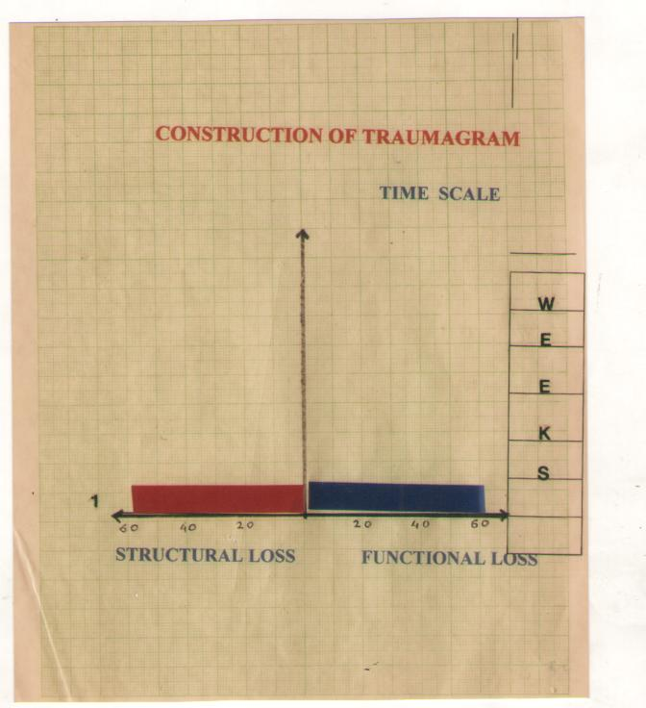
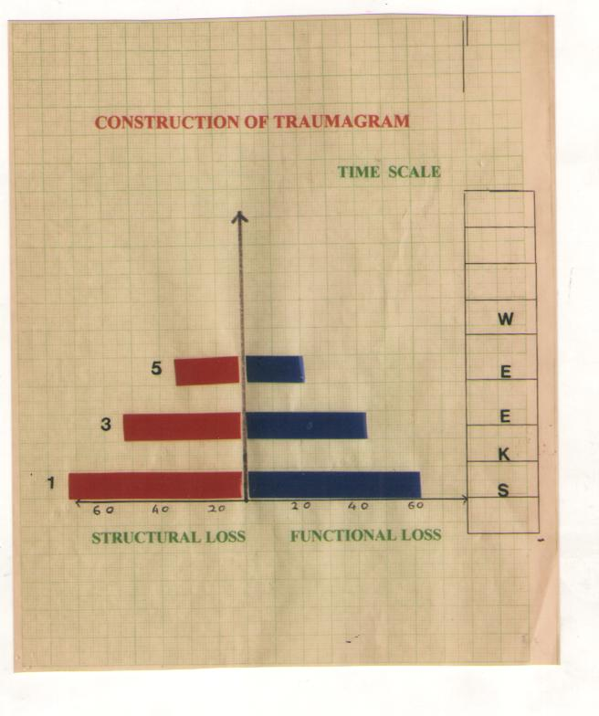

Slide 29
CONSTRUCTION OF OCULAR TRAUMAGRAM
RECORDING IS STARTED FROM THE BEGINNING OF OCLAR TRAUMA AND RECORDED WEEKLY FOR STRUCTURAL AND FUNCTIONAL LOSS
IN THE FIRST RECORDING ONE DOT IS MADE ON THE LEFT SIDE SHOWING ON THE LOWEST HORIZONTAL LINE. IT REPRESENTS STRUCTURAL LOSS AND ONE DOT ON THE SAME LINE ON THE RIGHT SIDE REPRESENTING FUNCTIONAL LOSS. THESE DOTS ARE JOINED BY A LINE
AT WEEKLY INTERVAL STRUCTURAL LOSS AND FUNCTIONAL LOSS ARE MARKED BY A POINT ON THEIR RESPECTIVE LINES

Slide 30
AT THE END OF 8 WEEKS, THE UPPER END OF THE LINE SHOWING STRUCTURAL LOSS AND UPPER END OF THE LINE SHOWING FUNCTIONAL LOSS ARE JOINED
THIS WOULD MAKE ROUGHLY A TRANGULAR AREA WHICH IS CALLED OCULAR TRAUMAGRAM
SEVEN OCULAR TRAUMAGRAMS ARE CONSTRUCTED IN DIFFERENT THEORETICAL SITUATIONS
IN THE FIRST FOUR TRAUMAGRAMS THE TIME INTERVAL IS REPRESENTED IN PERCENTAGE. 10% REPRESENTS 1 WEEK INTERVAL

Slide 31
TYPES OF TRAUMAGRAM
A TYPE : STANDARD
V TYPE : INVERTED
X TYPE : COMPLICATED
Y TYPE : LATE CHANGES
H TYPE : PARALLEL CHANGES
K TYPE : STRUCTURE FIXED AND FUNCTION VARIABLE
L TYPE : ONLY STRUCTRAL CHANGE
: IRREGULAR PATTERN

Slide 32
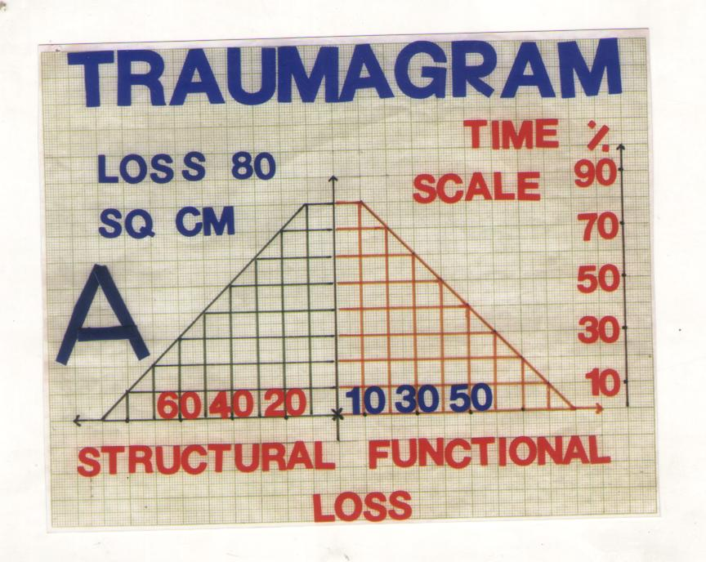

Slide 33
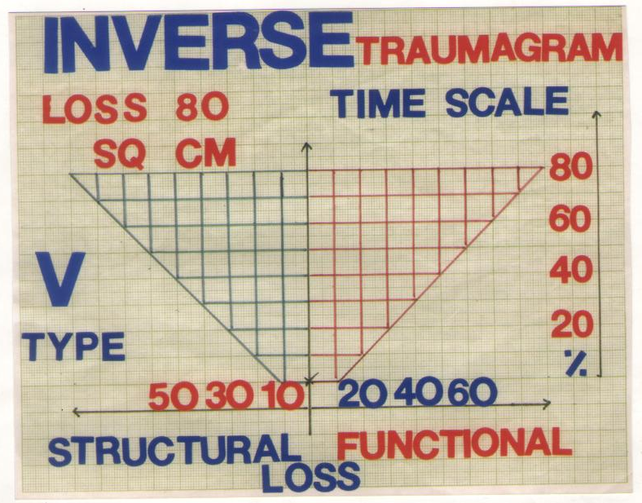

Slide 34
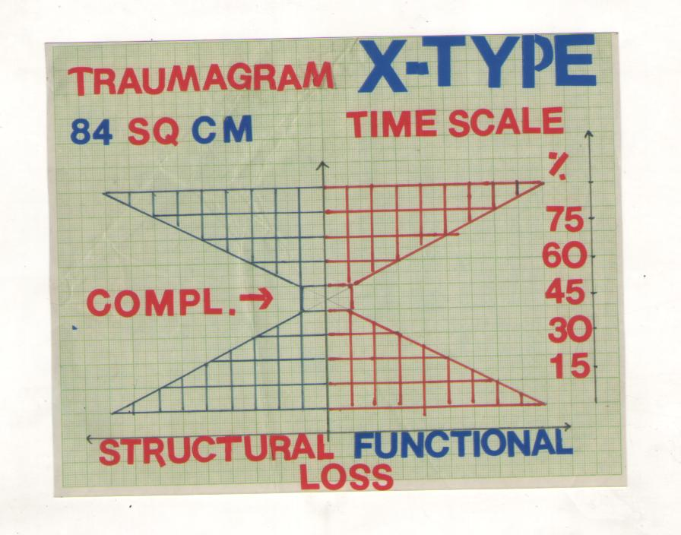

Slide 35
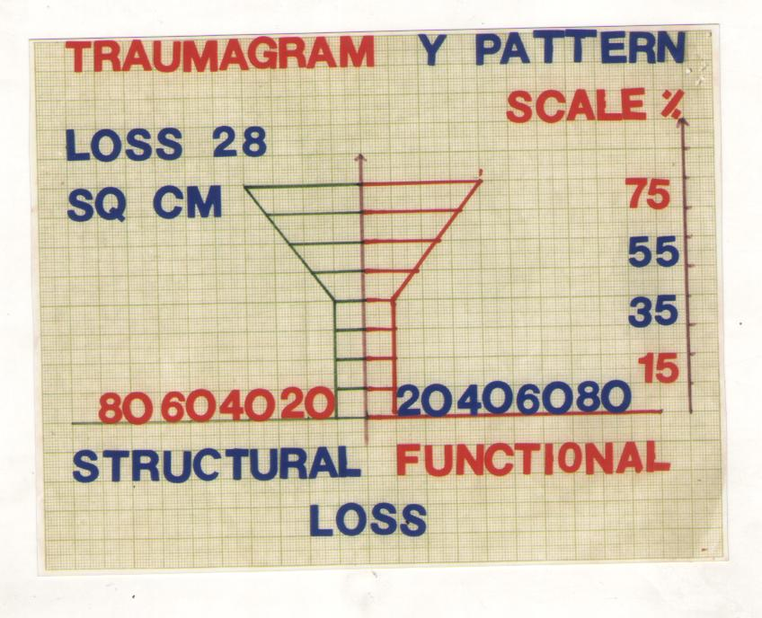

Slide 36
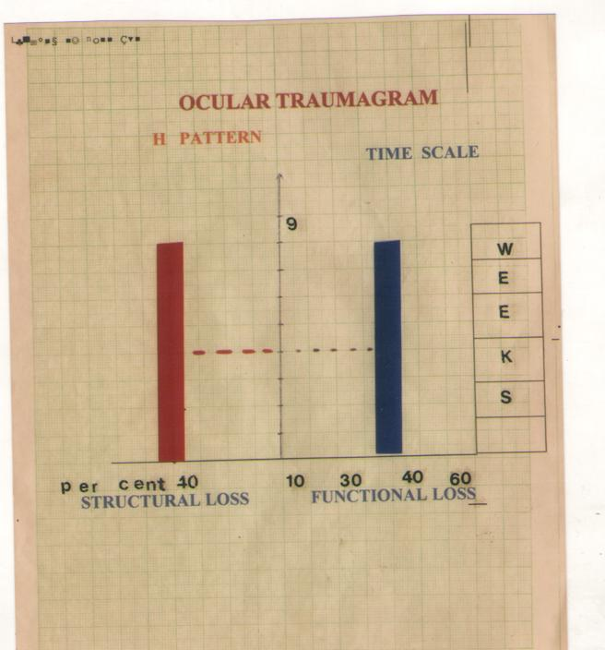
H TYPE : PARALLEL CHANGES

Slide 37
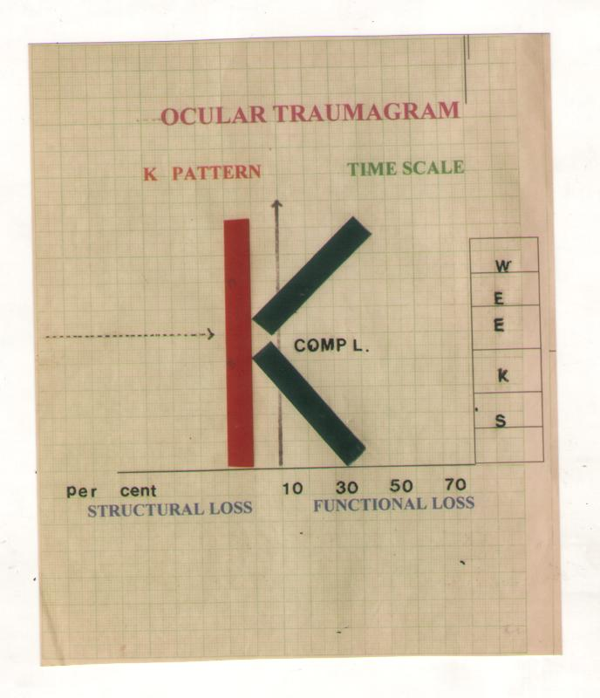
K TYPE : STRUCTURAL CHANGES FIXED
: FUNCTIONAL CHANGES VARIABLE

Slide 38
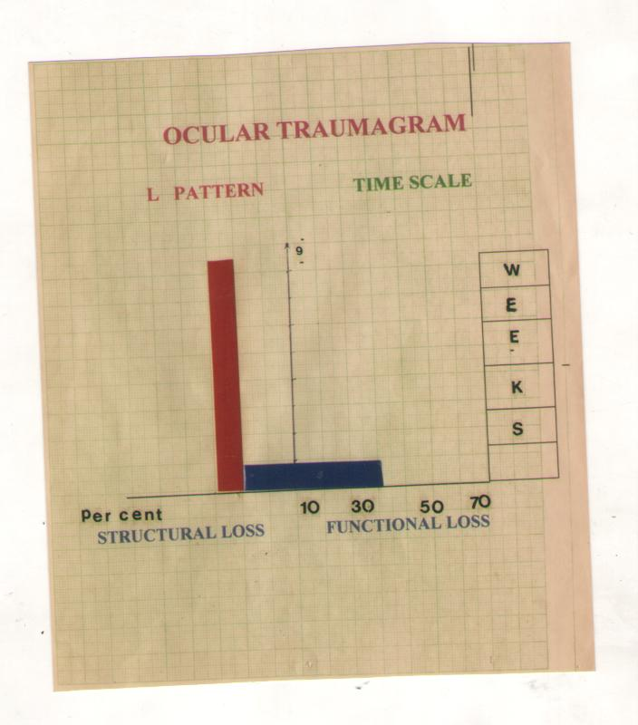
L TYPE : ONLY STRUCTRAL CHANGE

Slide 39
ADVANTAGES OF OCULAR TRAUMAGRAM
1. EXACT CALCULATION IS DONE FOR THE STRUCTURAL & FUNCTIONAL DAMAGE DUE TO TRAUMA
2. WEEKLY, MONTHLY AND TOTAL ASSESSMENT CAN BE DONE
3. EFFECT OF TREATMENT AND/OR COMPLICATION CAN BE NOTED
4. TAKES INTO ACCOUNT DAMAGE TO THE OCULAR ADNEXA ( LIDS, ORBIT, LACRIMAL APP. ) ALSO

Slide 40
ADVANTAGES OF OCULAR TRAUMAGRAM
5. THIS IS OF GREAT IMPORTANCE IN MEDICO- LEGAL CASES IN ASSESSING THE EXACT MAGNITUDE OF DAMAGE TO EYE AND THUS ASSESING THE QUANTUM OF PUNISHMENT
6. IN THIS STUDY WE CAN ANALYZE STRUCTURAL AND FUNCTIONAL LOSS SEPARATELY
7. A DISEASE IS BASICALLY VARABLE LOSS IN STRUCTURE AND OR FUNCTION. THUS IN FUTURE IT MAY BE POSSIBLE TO QUANTIFY OTHER DISEASES AS WELL
8. IT COULD GUIDE EVEN THE TREATMENT MODALITY IN A GIVEN CASE

Slide 41
LIMITATIONS OF OCULAR TRAUMAGRAM
LONG FOLLOW UP IS REQUIRED
PATIENT’S CO-OPERTION IS OFTEN POOR
STRUCTURAL LOSS DEPENDS ON CLINICAL JUDGEMENT WHICH MAY BE VARIABLE
STILL SOME THING IS BETTER THAN NOTHING

Slide 42
CONCLUSIONS
BY OCULAR TRAUMAGRAM TOTAL LOSS CAN BE ASSESED AT DIFFERENT PERIODS
THE IMPACT OF TREATMENT AND COMPLICATION CAN BE JUDGED
IN TRAUMAGRAM THE TOTAL LOSS IS DIRECTLY READ FROM GRAPH PAPER IN TRAUMA UNITS
IN ALL METHODS THERE IS SOME ELEMENT OF SUBJECTIVITY HENCE IN ALL METHODS ACCURACY CAN NOT BE VERY HIGH

Slide 43
CONCLUSIONS
YET QUANTITATIVE ASSESSMENT IS VALUABLE FOR MANY REASONS
IT GIVES SOME IDEA OF THE SEVERITY AND PROGNOSIS OF A GIVEN CASE
QUANTITATIVE ASSESSMENT IS IMPORTANT IN GIVING COMPENSATION FOR INJURIES IN INDUSTRIES

Slide 44
CONCLUSIONS
THE PRINCIPLE OF CALCULATION IS STRUCTURAL AND FUNTIONAL LOSS IN A DISEASE IN RELATION TO TIME
DISEASEAFTER ALL A VARIABLE LOSS OF STRUCTURE AND/OR FUNCTION
THIS IN PRINCIPLE CAN BE APPLICABLE TO MANY OTHER DISEASES WHICH CAN BE QUANTIFIED

Slide 45
THANKS FOR
YOUR NON-TRAUMATIC
ATTENTION

