Slide 1
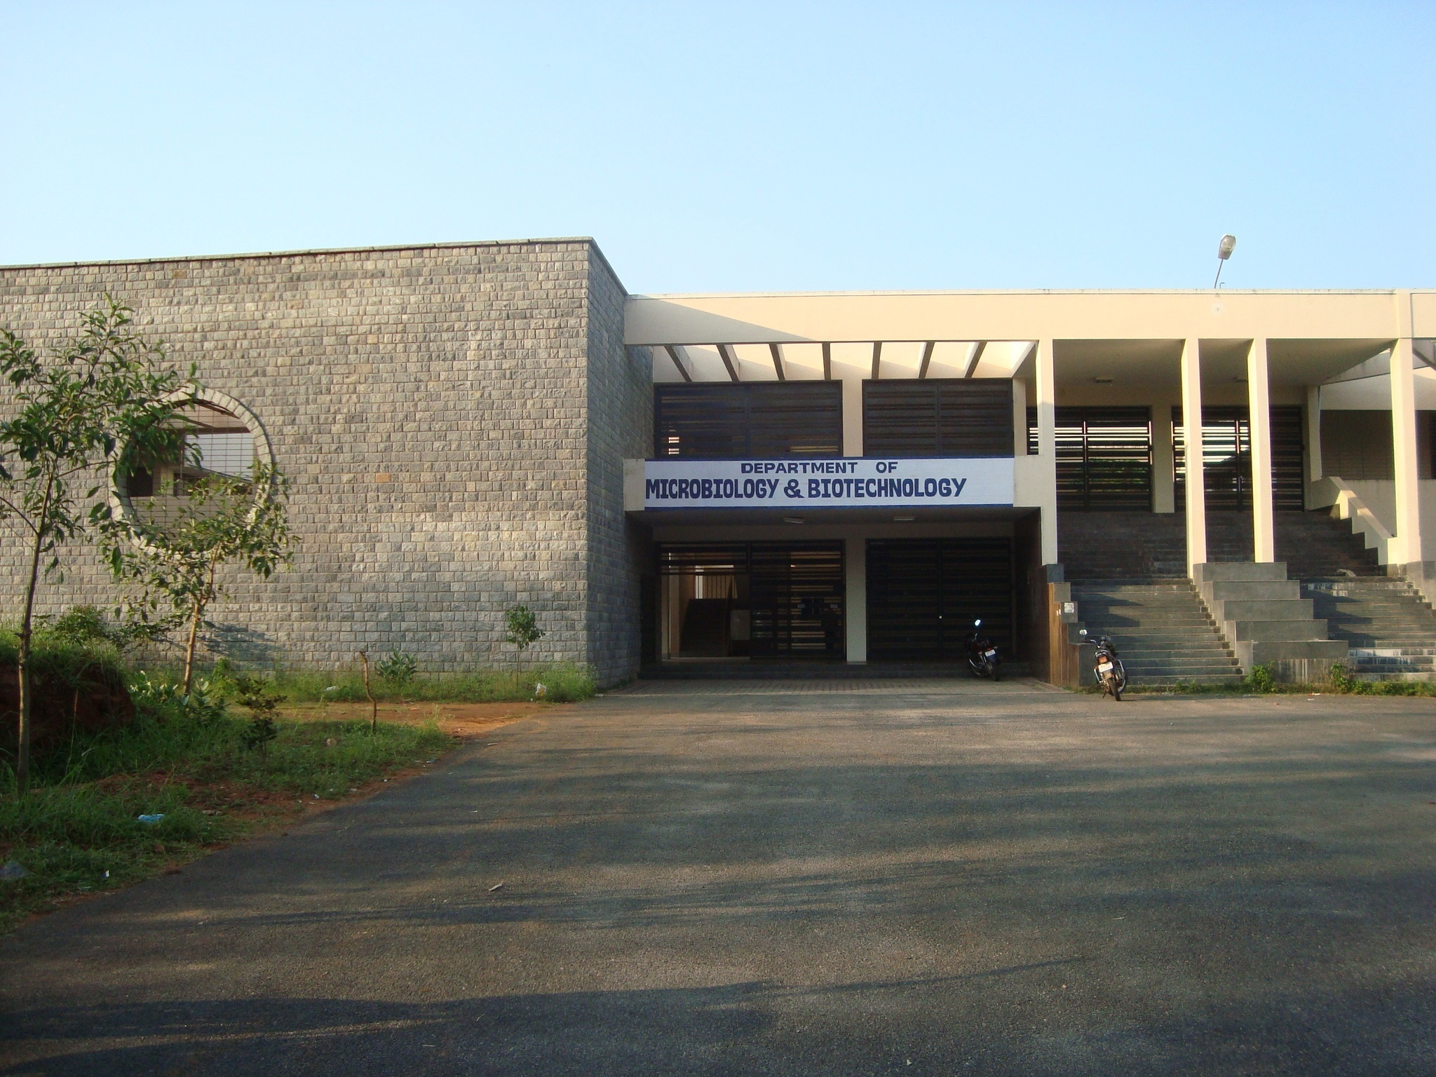

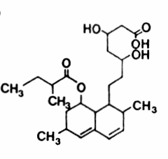
Purification of Lovastatin from Aspergillus terreus (KM017963) and Evaluation of its Anticancer and Anti-oxidant Propertiesc
Presented by
Bhargavi S D
Research scholar
Department of Microbiology and Biotechnology
Bangalore University
Bangalore

Slide 2
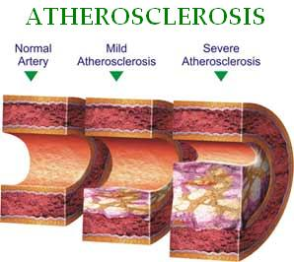
Higher LDL levels/hypercholesterolemia, atherosclerosis
Angina, coronary artery diseases, stroke.
Cholesterol-controlling medications- Statins
Introduction
Statins are the world's most prescribed drug in world to combat hypercholesterolemia.
Merck in1979 reported Lovastatin from Aspergillus terreus-,1987 FDA Approval.
An estimated 30 million people worldwide take statins
Lovastatin
Compactin Natural statins
Atorvastatin
Fluvastatin
Pravastatin Semi-synthetic forms
Rosuvastatin
Simvastatin

Slide 3
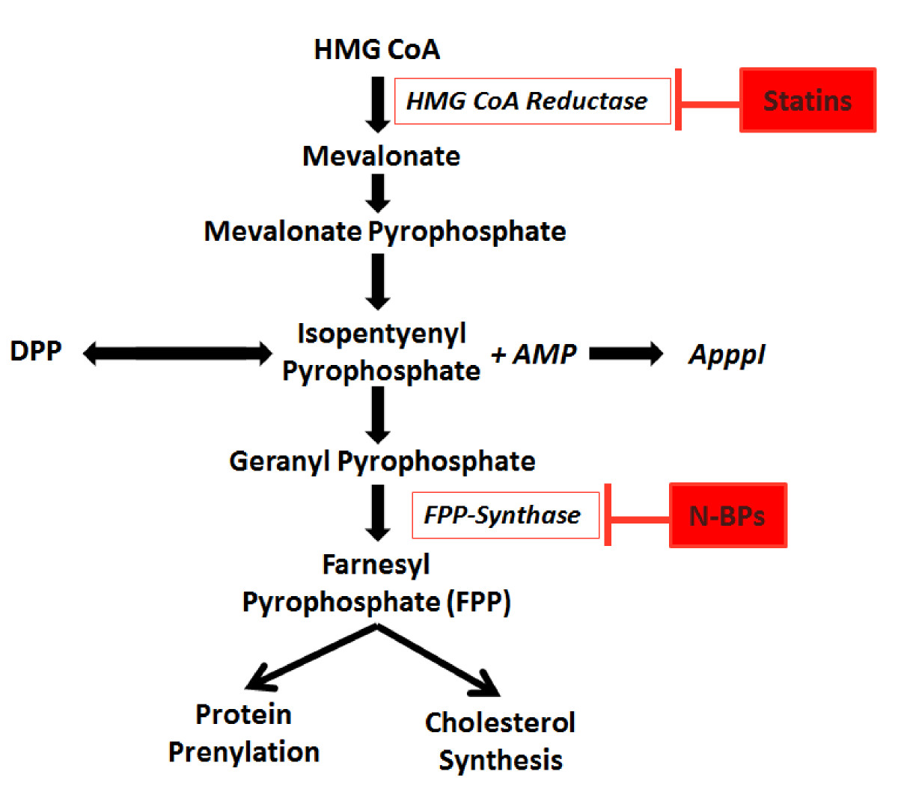
Mode of action of lovastatin

Slide 4
Diverse applications of lovastatin
Cardio-vascular: Cholesterol level-Artherosclerosis (Praveen et al., 2014).
Bones: Osteoporosis, fractures (Li et al., 2003).
Neuro-degenerative: MS/Parkinsons/Alzheimers
(Schuster et al., 2009)
Rheumatoid arthritis (Doornum et al., 2004).
Antifungal activity: Candida sp., Cryptococcus neoformans Saccharomyces cerevisiae (Chamilos et al., 2003)
Anti-cancerous: Propoptotic (Masa et al., 2004, Elena et al., 2008, Julie et al., 1997, Linda et al., 2010).
Antioxidant: Epithelial cell damage-
NADP(H), OH-, ROS, ONOO-NO- scavenger
(Mohan-Kumari et al., 2011)

Slide 5
Lovastatin as anticancer agents
Lovastatin is reported to reduce proliferation of
Lung cancer (Elena et al., 2008)
Breast cancer (MCF-7), (Julie et al., 1997)
Liver cancer (HepG2) (Linda et al., 2010)
and
Cervical cancer (HeLa cells): is the second most common cancer in women worldwide and thus is one of the leading causes of mortality in women (Fritz et al., 2003).

Slide 6
Fungal organisms reported for lovastatin production
Aspergillus spp. (Lopez et al., 2003, Praveen et al., 2014)
Penicillium spp. (Latha et al., 2011)
Monascus spp. (Sayyad et al., 2007)
Trichoderma spp. (Siamak et al., 2003)
Pleurotus spp. (Julio et al., 2003) are widely reported soil fungi capable of lovastatin production.
However, Commercial production of lovastatin employs
A. terreus (ATCC-20542) (a soil fungus)

Slide 7
Objectives of the Study
Lovastatin produced by a fungus, Aspergillus terreus (KM017963) isolated by us from tropical soil was used for the present study (Praveen et al., 2014).
Purification of lovastatin from A. terreus by adsorption chromatography
Evaluation of anticancer and anti-oxidant property of purified lovastatin using HeLa cells.

Slide 8
1. Materials and Methods
1.1 Culturing of A.terreus by Solid State Fermentation (SSF)
Wheat bran (40g) as substrate
Inoculated with spore suspension (10^{7/8}ml spores) of A. terreus (KM017963)
Incubated at 28⁰C for 7 days

Slide 9
1.2 Extraction
Inoculated substrate was dried at 40◦C for 24h
Crushed to powder
Ethyl acetate (150 ml) was added
Filtrate was dried using rotary vacuum evaporator

Slide 10
1.3 Purification of lovastatin
One gram of dried crude lovastatin extract was loaded on to pre-packed silica gel column
Elution with benzene (100%),
And combination of Benzene: Acetonitrile in the following ratio
95:5, 90:10, 85:15, 80:20
Acetonitrile (100%)
Thin Layer Chromatography (TLC)

Slide 11
1.4 Detection of Lovastatin by Thin Layer Chromatography (TLC)
Organic phase (20 µl) was spotted on TLC plate
Dichloromethane: Ethyl acetate (70:30)
R_{f} comparison with standard Lovastatin (Sigma)

Slide 12
1.5 Quantification of Lovastatin by
High Performance Liquid Chromatography (HPLC)
C-18, (250mm x 4.6mm I.D micro metre) column with diode array detector
Injection volume 20 µL
Eluent (mobile phase) :Acetonitrile and Water (70:30) (acidified with phosphoric acid (0.1%).
Flow rate ~ 1.0ml/min.
Detection at 238 nm

Slide 13
HeLa cell line as model system
Cytotoxicity study by MTT assay
Oxidative stress detection by
Hydroxy radical scavenging assay
GSH assay
DNA damage and cell cycle studies by
Comet assay and flow cytometry respectively
Determination of Mitochondrial membrane potential by rhodamine123

Slide 14
Anticancer and Antioxidant assays were carried out following the standard protocols of authors mentioned below
Genotoxicity Test by Comet assay- Collins et al., 1993
Cytotoxicity test by MTT assay: Denizot and Lang (1986)
Cell Cycle studies following protocol of Bishayee et al.,2013
Hydroxyl Radical assay (Deoxyribose assay)- Halliwell et al., 1987
Mitochondrial Membrane Potential (MMP) analysis- Cossarizza et al., 1993
Glutathione (GSH) assay- Boyne and Ellman (1972)

Slide 15
2. Results and Discussion

Slide 16
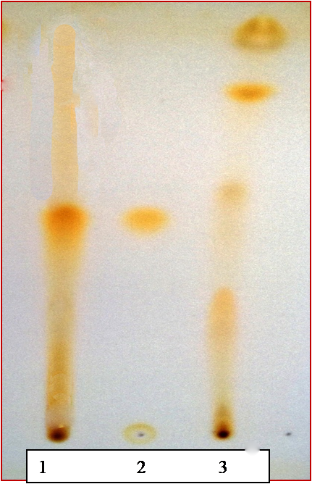
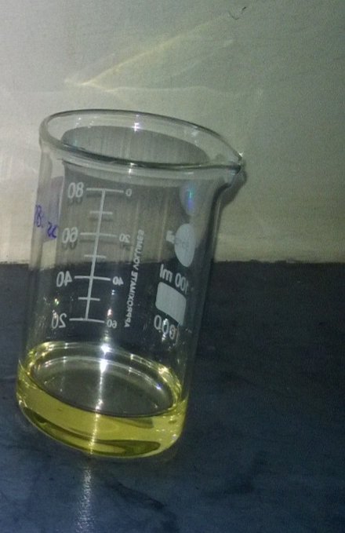
2.1. Detection of purified lovastatin by
Thin Layer Chromatography (TLC)
Spotted on TLC sheet
Pooled 80:20 fraction of Benzene:Acetonitrile
Detection of lovastatin in 80:20 fraction of Benzene:Acetonitrile by TLC
Lane 1: Purified lovastatin from A. terreus (KM017963)
Lane 2: Lovastatin standard (Sigma)

Slide 17
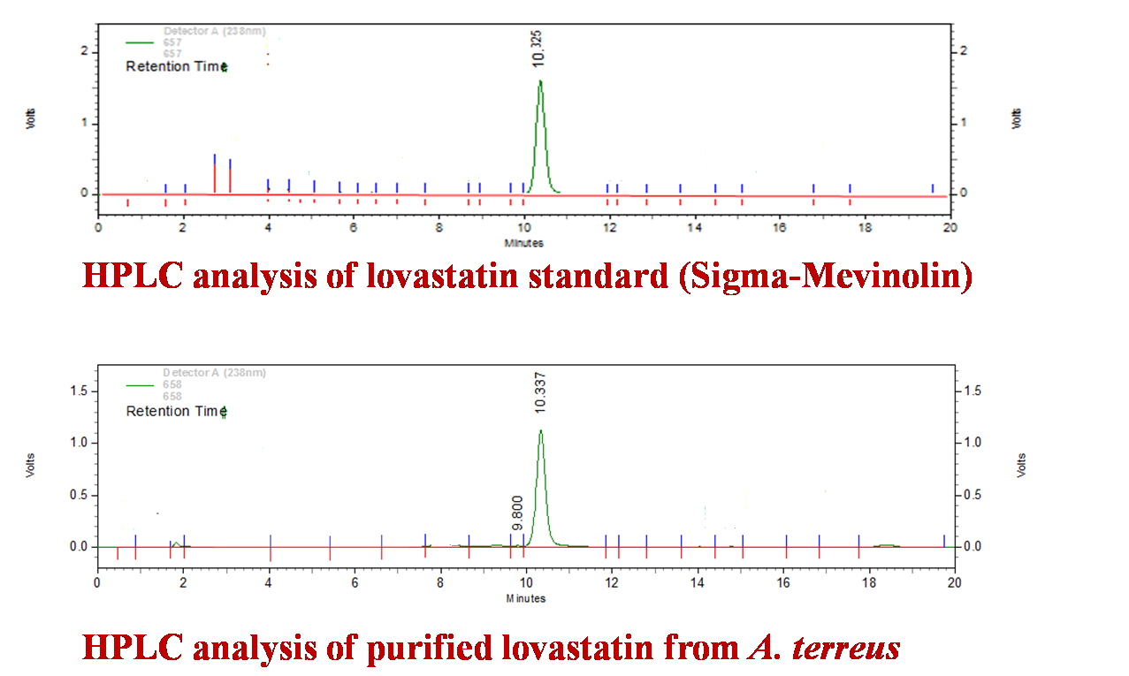
2.2 Quantification of purified lovastatin by High Performance Liquid Chromatography (HPLC)
Lovastatin standard

Slide 18
2.3. Cytotoxicity
Lovastatin showed significant dose dependent cytotoxic effect on HeLa cells (Figure 2).
50% inhibition was found to be at 160 μg/ml.
Results indicate that lovastatin is a strong cytotoxic agent which partially explains its anticancer activity and can be suggested for the use as chemotherapeutic agent
Percentage inhibition of HeLa cells indicating cytotoxic effect of purified lovastatin

Slide 19
2.4. Hydroxyl radical scavenging assay
Lovastatin showed moderate hydroxyl radical scavenging activity (54.06%) at tested concentration as compared to its positive control (catechin) which showed 86.86%
Control
Lovastatin
Hydroxyl radical scavenging activity of standard, catechin and purified lovastatin

Slide 20
2.5. Glutathione (GSH) assay
Lovastatin showed moderate reduction in total glutathione (41.53%) as compared to its positive control (ascorbic acid) which showed 68.85% reduction.
Reduction (percentage) of total GSH in lovastatin treated HeLa cells.

Slide 21

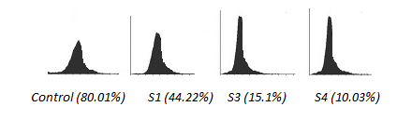
2.6. Mitochondrial Membrane Potential (MMP) assay
Lovastatin at tested concentration showed significant decrease in uptake of Rhodamine 123 (Rh123) by HeLa cells at 10.03% as compared to untreated control (80%) .
Control(Untreated) Treated with lovastatin
Fluorescence microscopic images of untreated HeLa cells (control) and treated HeLa cells with purified lovastatin
Control Treated with lovastatin
Flow cytometric analysis of Rh123 treated HeLa cells (control) and
Rh123 treated HeLa cells
exposed to purified lovastatin

Slide 22
2.7. Cell cycle study
Propidium iodide staining showed suppressed proliferation of HeLa cells in cultures containing lovastatin.
Cells show cell cycle arrest of 20.09%, 65.58% and 9.24% at SubG0/G1, G0/G1 and S phase respectively as compared to untreated cells (0.0%).
This result suggests that lovastatin do not allow the cells to grow from SubG0/G1 to next phase of cell cycle and at the same time it might induce the apoptosis.

Slide 23
Cell growth arrest (percentage) of HeLa cells by purified lovastatin at SubG0/G1, G0/G1, S and G2/M phases.

Slide 24
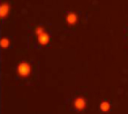
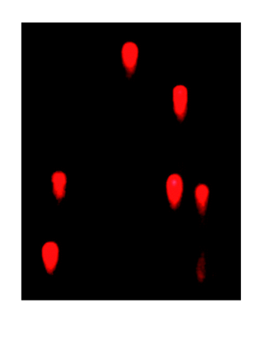
2.8. DNA damage (Genotoxicity) by comet assay
Result of the comet assay said that lovastatin showed moderate DNA damage seen as tailing of DNA (Figure 3).
Control (untreated) Treated with lovastatin
Fluorescent microscopic images of DNA fragmentation of HeLa cells exposed to purified lovastatin

Slide 25
3. Conclusion
Our present study adds onto some recent evidences to show that lovastatin are not only capable of reducing cardiac disease related mortality, but cancer incidence is also reduced worldwide by 28-33% (Elena et al., 2008, Julie et al., 1997, Linda et al., 2010).
Results also suggest the probable use of lovastatin in association with conventional treatment as apoptosis-triggering agents in HeLa cells. However, the interaction between lovastatin and chemotherapeutics used for cancer treatment should be examined.
Overall, lovastatin from A.terreus (KM017963) can be suggested as a potent anticancer agent.

Slide 26
Acknowledgments
This work was supported by the SERB, Govt. of India, vide grant number -DST/SO/FNo.SERB.SR/SO/ PS/046/2011.

Slide 27
THANK YOU

Slide 28
4. References
Latha, D. Prasanna, KPJ Hema Latha, and D. Sri Rami Reddy. "Production of lovastatin by solid state fermentation by Penicillium funiculosum NCIM 1174."Drug Invention Today 3.6 (2011).
Lopez, JL Casas, et al. "Production of lovastatin by Aspergillus terreus: effects of the C: N ratio and the principal nutrients on growth and metabolite production." Enzyme and Microbial Technology 33.2 (2003): 270-277.
Sayyad, Sadik Ali, et al. "Optimization of nutrient parameters for lovastatin production by Monascus purpureus MTCC 369 under submerged fermentation using response surface methodology." Applied Microbiology and Biotechnology73.5 (2007): 1054-1058.

Slide 29
Alarcon, Julio, et al. "Production and purification of statins from Pleurotus ostreatus (Basidiomycetes) strains." Zeitschrift für Naturforschung C 58.1-2 (2003): 62-64.
Fritz, G., C. Brachetti, and B. Kaina. "Lovastatin causes sensitization of HeLa cells to ionizing radiation‐induced apoptosis by the abrogation of G2 blockage."International journal of radiation biology 79.8 (2003): 601-610.
Li, Xudong, et al. "Lovastatin inhibits adipogenic and stimulates osteogenic differentiation by suppressing PPARγ2 and increasing Cbfa1/Runx2 expression in bone marrow mesenchymal cell cultures." Bone 33.4 (2003): 652-659.
Schuster, Stefan, et al. "The 3-hydroxy-3-methylglutaryl-CoA reductase inhibitor lovastatin reduces severity of L-DOPA-induced abnormal involuntary movements in experimental Parkinson's disease." The Journal of Neuroscience28.17 (2008): 4311-4316.

