Slide 1
PHYSICAL AND FINANCIAL ABUSE IN THE ELDERLY POPULATION IN MANISA, TURKEY
CENGIZ OZYURT,B., BILGIN B., OZCAN C.
Celal Bayar University Faculty of Medicine Public Health Department

Slide 2
Elder abuse is a single or repeated act, or lack of appropriate action, occurring within any relationship where there is an expectation of trust, which causes harm or distress to an older person.
This type of violence constitutes a violation of human rights and includes physical, sexual, psychological, emotional; financial and material abuse; abandonment; neglect; and serious loss of dignity and respect.

Slide 3
The most common types of abuse in high- or- middle-income countries (WHO):
physical abuse: 0.2-4.9%;
sexual abuse: 0.04-0.82%;
psychological abuse: 0.7-6.3% (based on substantive threshold criteria);
financial abuse: 1.0-9.2%; and
neglect: 0.2-5.5%.

Slide 4
In Turkey
physical abuse: 1.5-25.7%;
psychological abuse: 0.7-9.4%;
financial abuse: 0.3-14.7%;
neglect: 0.4-27.4%.

Slide 5
Elder abuse can lead to physical injuries – ranging from minor scratches and bruises to broken bones and head injuries leading to disability – and serious, sometimes long-lasting, psychological consequences, including depression and anxiety.
For older people, the consequences of abuse can be especially serious because their bones may be more brittle and convalescence longer.
Even relatively minor injuries can cause serious and permanent damage, or even death.
A 13-year follow-up study found that victims of elder abuse are twice more likely to die than those not reporting abuse.

Slide 6
Globally, the number of cases of elder abuse is projected to increase as many countries have rapidly ageing populations whose needs may not be fully met due to resource constraints.
It is predicted that by the year 2050, the global population of people aged 60 years and older will more than double, from 900 million in 2015 to about 2 billion.

Slide 7
Risk factors
Individual
Risks at the individual level include poor physical and mental health of the victim, and mental disorders and alcohol and substance abuse in the abuser.
Other individual-level factors, which may increase the risk of abuse, include gender of victim and a shared living situation.
While older men have the same risk of abuse as women, in some cultures where women have inferior social status, elderly women are at higher risk of neglect and financial abuse (such as seizing their property) when they are widowed. Women may also be at higher risk of more persistent and severe forms of abuse and injury.

Slide 8
Risk factors
Relationship
A shared living situation is a risk factor for elder abuse. It is not yet clear whether spouses or adult children of older people are more likely to perpetrate abuse.
An abuser's dependency on the older person (often financial) also increases the risk of abuse. In some cases, a long history of poor family relationships may worsen as a result of stress when the older person becomes more care dependent.
Finally, as more women enter the workforce and have less spare time, caring for older relatives may becomes a greater burden, increasing the risk of abuse.

Slide 9
Risk factors
Community
Social isolation of caregivers and older persons, and the ensuing lack of social support, is a significant risk factor for elder abuse by caregivers.
Many elderly people are isolated because of loss of physical or mental capacity, or through the loss of friends and family members.

Slide 10
Risk factors
Socio-cultural
Socio-cultural factors that may affect the risk of elder abuse include:
depiction of older people as frail, weak and dependent;
erosion of the bonds between generations of a family;
systems of inheritance and land rights, affecting the distribution of power and material goods within families;
migration of young couples, leaving elderly parents alone, in societies where older people were traditionally cared for by their offspring;
lack of funds to pay for care.

Slide 11
Aim
The aim of this study is to determine the prevalence of elderly abuse in two different settlement regions (rural and suburban) of Manisa and evaluate the potential risk factors.

Slide 12
Method
This study investigated physical and financial abuse in an elderly population of age 65 and older, residing in two different settlement regions (rural and urban) of Manisa Province.
The population of this cross-sectional study was 3163 elderly individuals who were living at the region of two randomly selected primary medical services (one at rural area, other at urban area) in April 2015.

Slide 13
Method
The sample size was calculated using the software of Epi info 7.0; thereby, 480 elderly individuals were enrolled.
Each individual was randomly selected from his/her registration at the Manisa Public Health Deparment.
All data were collected by face-to-face interview and a standardized questionnaire form, that involved sociodemographic characteristics, health and social status,
Katz index was used. The rate of participation was 88.9% (n=427).

Slide 14
Adults aged 65 years and over were asked whether a close family member or relative had recently frightened them by shouting, insulting, or speaking roughly (verbal abuse);
pushed, slapped, shoved, or been physically rough with them in any other way (physical abuse);
taken money or property from them without their consent (financial abuse).
In addition, all adults who were in regular contact with people of pensionable age were asked whether they had recently found themselves shouting at, insulting, or speaking roughly to them or pushing, slapping, shoving, or being rough with them in any other way.

Slide 15
All data was evaluated using descriptive analysis and chi square test. Logistic regression was used for multivariate analysis.

Slide 16
Results
The mean age of the study group was 72.9±6.7.
The majority of individuals (86.4%) had a chronic disease for which continuous drug administration was required, 49.6% was women, 35.1% was graduated from elementary school and %23.4 was living alone.
More than 79.4 of elderly could have done daily living activities easily, less than 5% were depent in one or more basic activities of their daily life.

Slide 17
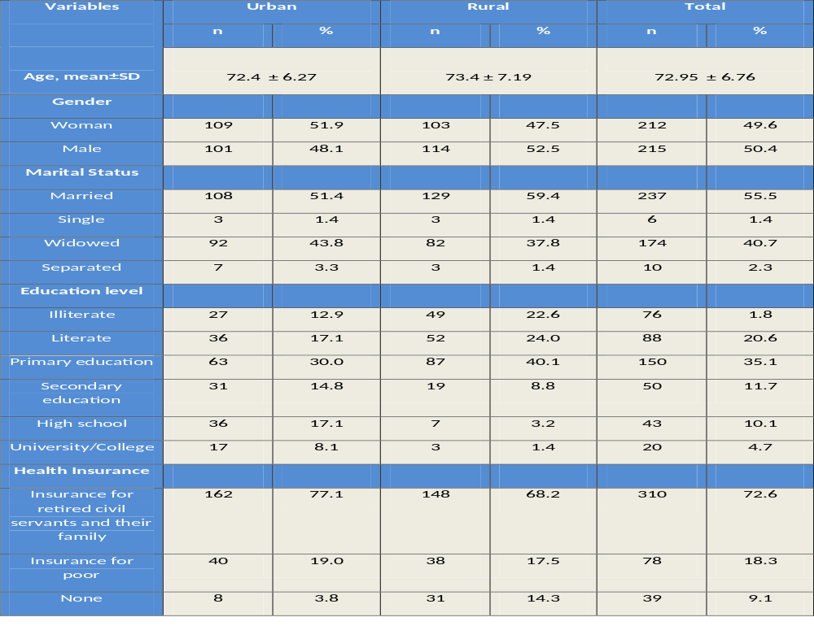

Slide 18
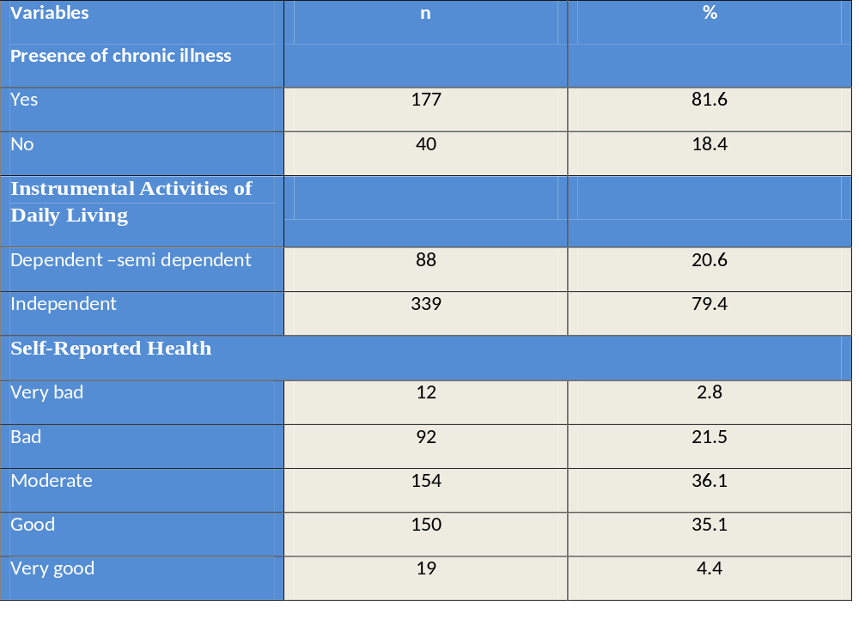

Slide 19
Abuse(11.3%) (urban 13.0%, rural 9.6% , p>0.05)
      Physical violence 5.4
      Emotional/psychological abuse 10.3
      Financial abuse 2.7

Slide 20
The risk factors of elderly abuse
being 85 years of age and over,
having worse percieved health status,
social isolation,
insufficient income
lack of accessibility in health care.

Slide 21
In conclusion
Low rates of physical and financial abuse were found in Manisa. Preservation of the traditional family structure in this populations seems to be providing protection against elderly abuse.

Slide 22
Old people constitute a valuable and important part of human resources of community.
Any kind of abuse and neglect of the elderly is not acceptable.
Therefore, it’s required to prevent and determine abuse and neglect of the elderly by means of the measurements are to be taken and various attempts.

Slide 23
For this reason, It is suggested that elder abuse should be entegrated in nursing education curriculum and in-service trainings, especially primary health care nurses should identify elders at risk, frequently observe this elders and carry out works to prevent elder abuse and mass communication means should be used to increase the awereness of public.

