Slide 1

2nd International Conference and Expo on Novel Physiotherapies , London, UK June -10, 2016
Effectiveness of Therapeutic Exercise and Yoga on Pain, Physical Disability, Psychological Well Being and Mobility among Middle Aged Patients with Knee Osteoarthritis
Dr.BEULAH JEBAKANI
Asso.Professor, College of physiotherapy
Mtpg & Rihs,
Govt. of Puducherry Institution.
INDIA

Slide 2
CONTENT OUTLINE
Introduction
Background of the study
Review of literature
Methodology
Result
Conclusion

Slide 3
INTRODUCTION
What is Osteoarthritis
pain on motion, stiffness and decreased range of motion in early stages.
restricted participation in activities and behaviours of their choice.
affects not only physical health but also emotional health(Sullivan, 2007).

Slide 4

9.6% of men and 18.0% of women over the age of 60 years.
Fourth leading cause of disability by the year 2020 and estimated that 130 million will have worldwide
Around 40 million - severely disabled by 2050
Prevalence rate of 22% to 39% (Ebenezar et al.,2011)
.

Slide 5
BACKGROUND OF THE STUDY
Disability leads to
work , recreational , social limitation
alterations in gait
varus/valgus alignment deformities
muscle imbalances (Helmick et al., 2008).

Slide 6
Exercise prescription are variable
Clinically practicable regimens are likely to lead to greater compliance and improved outcomes .
Limited evidence exists for yoga.

Slide 7
OBJECTIVES
To assess the knee pain, physical disability, mobility and psychological well-being of patients with knee osteoarthritis.
To compare the effectiveness of therapeutic exercise and yoga on the outcomes measures such as knee pain, physical disability, mobility and psychological well-being between the experimental and control groups.

Slide 8
METHODOLOGY
Experimental research with a pretest-posttest control group design, involving three groups.
Out come measures | Variables / parameters | Instruments | Authors
Primary outcome measure | Self reported physical disability | Knee Injury And Osteoarthritis outcome score ( KOOS) | Ewa M Roos (2003)
Secondary outcome measure | Psychological well-being | Psychological general wellbeing index (PGWB) | Dupoy(1984)
Secondary outcome measure | Self reported pain | Visual analog scale (VAS) for pain | Scott & Huskis (1979)
Secondary outcome measure | Performance measure for mobility | Timed up and go test(TUG) | Podsiadlo& Richardson (1991)
Secondary outcome measure | Demographic and clinical data | Demographic and clinical proforma | Investigator

Slide 9
224- patients screened
Excluded n=10
214 Eligible patients
Excluded-n=28
Declined participation-6
Did not meet inclusion criteria-15
Not available for follow-up-7
Randomly allocated n=186
Therapeutic exercise group n=62
Yoga group n=62
Control group n=62
3 dropout-due to work at home
2 dropout due to personal work
3 dropout due to work at home
n=59 completed the study including the follow - up
n=60 completed the study including the follow-up
n=59
completed the study including the follow -up
Fig 4.1: Flow Chart Showing Patient Selection

Slide 10
SAMPLING CRITERIA
Inclusion Criteria
Subjects 50-65yrs based on the ACR criteria
K-L radiological grading 2 or 3 (Kellegren & Lawrence,1957)
Exclusion Criteria
Grade 1 & 4
Secondary knee osteoarthritis
Neurological disease, Haemophilic joints, cardiopulmonary or respiratory conditions,surgeries, psychiatric illness

Slide 11
INTERVENTION | GROUP-I(THERAPEUTIC EXERCISE +HOT PACKS) | DURATION
Warm –up | Static cycle - 5 minutes
Stretching exercises | Prone quadriceps stretch, hamstring stretch, calf stretch | 5 minutes
Strengthening exercises | Isometric quadriceps exercise, Straight leg raises, Standing calf raises, Hip abduction, Wall squats | 10 minutes
Progressive resistance exercise |  | 10 minutes
Balance exercises | Wobble board, Single leg standing ,Step up, Toe-walking, Heel walking | 5 minutes
Home programme | Walking,Isometric quadricep exercise (three setsfor ten repetitions),Stretching for hamstrings (15 seconds×2)Wall squatting. | 30 minutes

Slide 12
INTERVENTION | Group II(Yoga+Hotpacks) | DURATION
Shithilikarana vyayama ( loosening exercises) |  | 10 minutes
Yogic Sukshma Vyayamas (strengthening exercises) |  | 5 minutes
Yogasanas | Standing Asanas: Tadasana, Katichakrasana, Ardha katichakrasana Lying Asanas: Uttanapadasana, Pavanamuktasana, Sitting: Bhadrasana, Vakrasana , Ardha padma Paschimottanasana Makarasana | 20 minutes
Nadi Shudi Pranayama - Meditation |  | 3 minutes 2 minutes
Home Programme | Shithilikarana vyayama Tadasana Pavanamukthasana Bhadrasana Makrasana Pranayama | 30 minutes

Slide 13
GROUP III: CONTROL GROUP
Hot packs and isometric quadriceps exercise for 30 minutes.
3 alternate days for 4 week
Home Programme:
Walking and isometric quadriceps exercise (3 sets for 10repetitons) for 30 minutes.
No adverse reactions in any patient

Slide 14
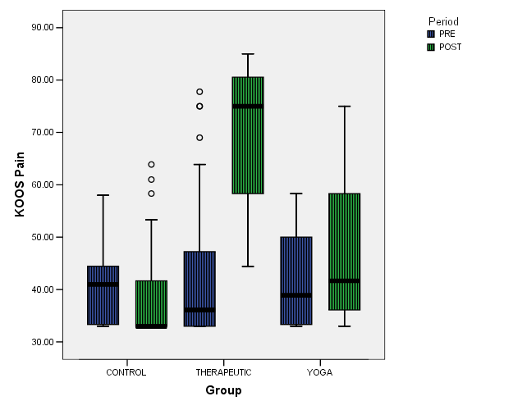
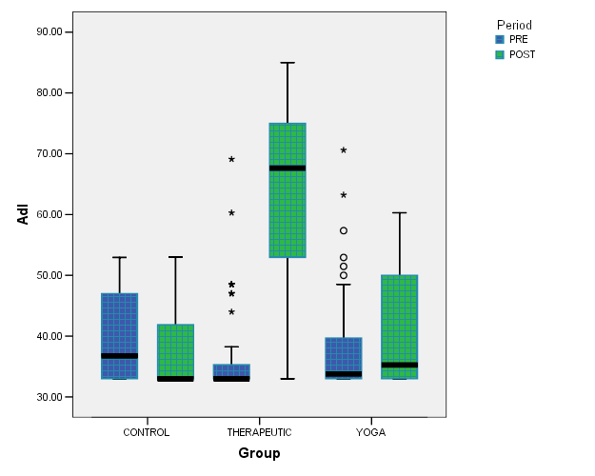
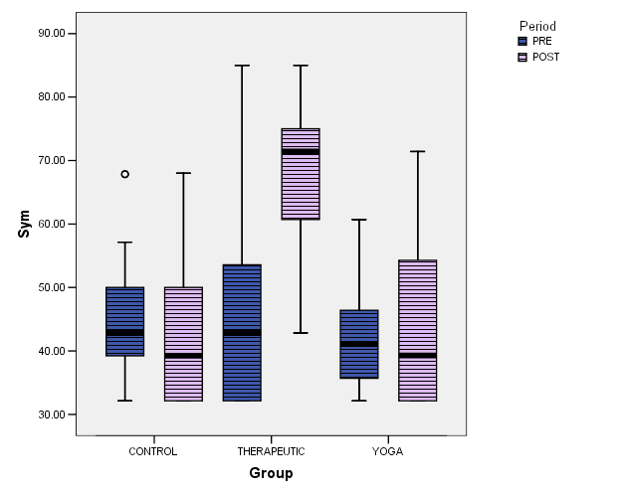
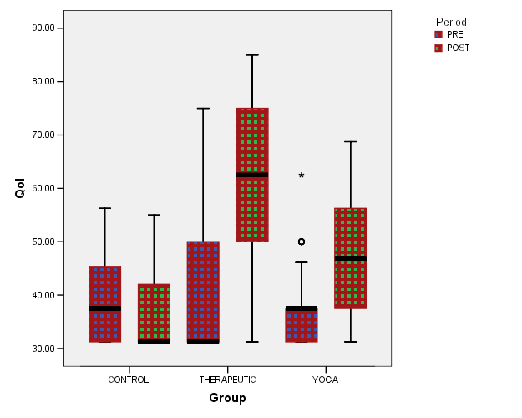
Box plots of Pre and post test KOOS- Pain, symptom ,ADL,QOL scores of Subjects of three Group

Slide 15
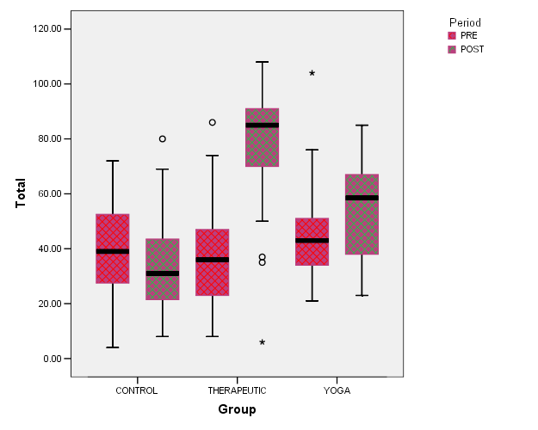
The pre test median comprehension scores of PGWB total scores was 36, 43, 39 compared with 85, 58, 31 in therapeutic exercise group, yoga group and control group respectively. The box plots show the values of the median and the first and third quartiles, the whiskers represent 1.5 times the interquartile range above and below the median and outliers are depicted in small circles.
Fig .11. Box Plot Showing Pre and Post Test PGWB total Scores of Subjects of Therapeutic, Yoga and Control Groups

Slide 16
Table 9. Comparison of Pre test and Post test knee pain scores across groups using Wilcoxon Signed Rank test
 | Groups | Pre Test Median (IQR)(25%&75% | PostTest Median (IQR)(25% &75%) | W value | Z value | p value
VAS | Therapeutic | 7.0(6.0-7.0) | 4.0(3.0-4.0) | 1711 | 6.665 | <0.001
 | Yoga | 7.0(5.5-7.0) | 6.0(5-7) | 780 | 5.937 | <0.001
 | control | 6.0(5.0-7.0) | 6.0(5.257.0) | 140 | 1.121 | 0.2669
Significant decrease in VAS pains scores in both therapeutic and yoga groups showed that interventions had effect in controlling pain of the patients.

Slide 17
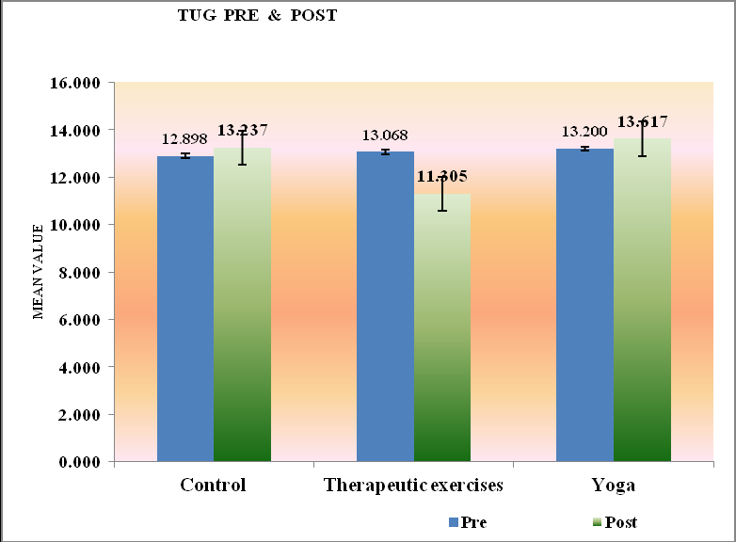
Comparison of Pre test and Post test mobility scores across(TUG) groups
Only in the therapeutic group the TUG score decreased significantly from pretest
(13.068±2.70) to posttest (11.305±2.660)‚t‘=9.891,p.<0.001. indicating that mobility improved in patients after therapeutic
exercises.

Slide 18
KEY FINDINGS
The mean differences in KOOS scores for the therapeutic exercise group were higher than those of the yoga and control groups.
The Dunn’s post hoc analysis of KOOS scores confirms therapeutic exercise as the most effective intervention to reduce physical disability.
The Dunn’s post hoc analysis of PGWBI scores confirms therapeutic exercise and yoga as the most effective intervention to improve Psychological well being.
In the “Timed Up and Go” test, the therapeutic exercise group consumed the least time to complete.

Slide 19
What the study adds new…….
The therapeutic exercise group performed exercises which required the subject to change directions, stand on one foot, and negotiate around objects and along with other exercises may have resulted in improvement as completion of these exercises required strength, coordination, balance, postural control, stability, and mobility

Slide 20
Whether the interventions that decrease pain ,physical disability and improved mobility also bring about significant improvements in Psychological well-being.
The data obtained in this study may offer an insight on the decision-making process for appropriate intervention .
There are limited research studies on yoga and therapeutic exercises.

Slide 21
LIMITATIONS
All the three groups consisted predominantly of women, which could have led to gender bias.
Extraneous variables like diet were not controlled.
Since no follow-up was done beyond the period covered by this study, the lasting effects of the interventions are not captured in this study.

Slide 22
Conclusion
Therapeutic exercises, along with standard care, can be an important management tool without any major adverse effects in knee osteoarthritis patients.

Slide 23
REFERENCES
O'Sullivan, S.B., & Schmitz, T.J. (2007). Physical Rehabilitation ((5thEd), . A. Davis Company
Wittenauer, R., Smith, L., & Aden, K. (2013). Background Paper 6.12 Osteoarthritis
Ebnezar J, Nagarathna R, Bali Y, Negendra HR.( 2011) Effect of integrated approach of yoga therapy on quality of life in osteoarthritis of the knee joint: A randomized control study. International journal of Yoga.;4:55–63.
Nayak, N.N.(2004). Yoga: a therapeutic approach. Physical Medicine Rehabilitation Clinics of North America15, 783–798
Iversen M.D.(2010). Managing hip and knee osteoarthritis with exercise:what is the best prescription.Therapeutic Advances in Musculoskeletal Disease.2(5):279-290.

Slide 24
THANK YOU

