Slide 1


Global Incidence and Prevalence of Acute Lymphoblastic Leukemia:
a 10-year Forecast
Bethlehem Solomon, MPH
140+ Diseases
Across 40+ Countries
3,400+ Patient Segments
10 Million Data Points

Slide 2
Contents
Background
ALL Headline Estimates
Case definition
Projection and forecasting methods
ALL Newly Diagnosed Incidence
ALL Diagnosed Prevalence
Stratified ALL Incidence
Conclusions
Patient Flow (if time permits)

Slide 3
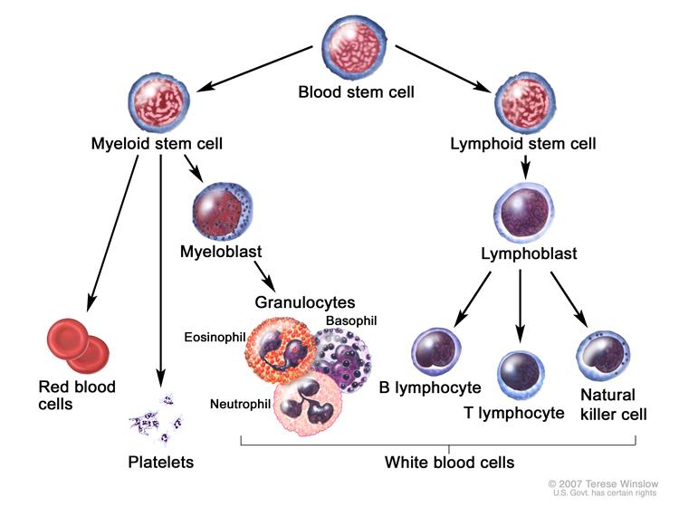
Background
Most often, leukemia is a cancer of the white blood cells, but some leukemias start in other blood cell types.
Subtypes
  Acute vs chronic
  Myeloid vs Lymphoblastic
ALL
  Quickly progressing disease
  Develops from early (immature)
  forms of lymphocytes
PDQ® Adult Treatment Editorial Board. PDQ Adult Acute Lymphoblastic Leukemia Treatment. Bethesda, MD: National Cancer Institute. Updated 07/21/2017. Available at: https://www.cancer.gov/types/leukemia/hp/adult-all-treatment-pdq. Accessed 03/16/2017. [PMID: 26389171]]

Slide 4





Risk Factors
Aging
Gender
Genetics
Radiation

Slide 5
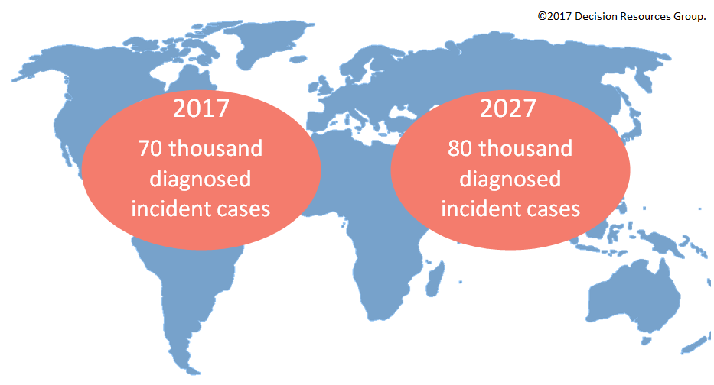
ALL Diagnosed Incident Cases

Slide 6

ALL Diagnosed Prevalent Cases

Slide 7
Case Definitions
We define a diagnosed incident case of ALL as any case registered with the ICD-10 code 91.0.
We define a diagnosed prevalent case of ALL as anyone living at a moment in time whose diagnosed within the preceding 12 month period.

Slide 8
Projection and Forecasting Methods
DRG forecasts available for 45 countries
45 countries ≈ 90% of world population
Global cases ≈ DRG total
÷
90%

Slide 9
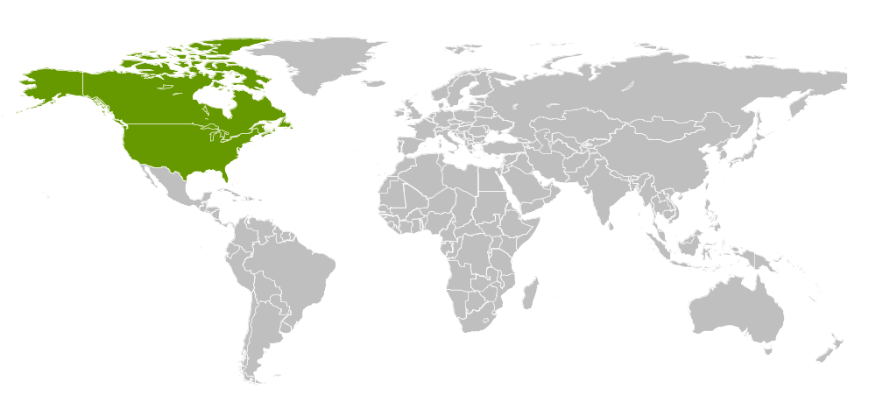
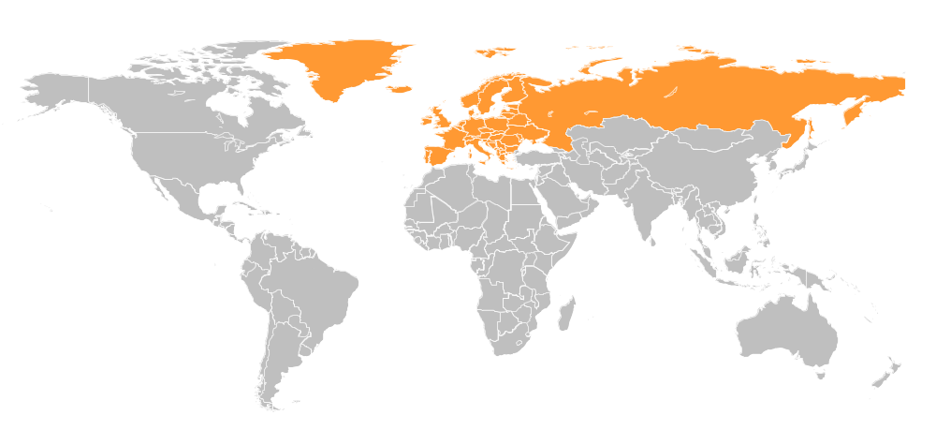
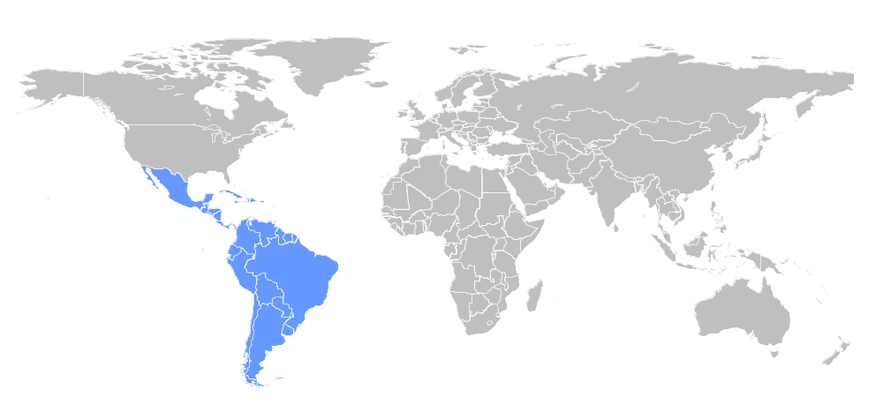
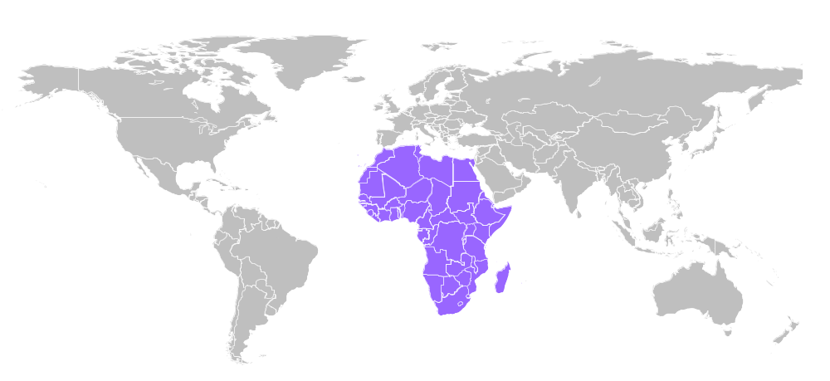
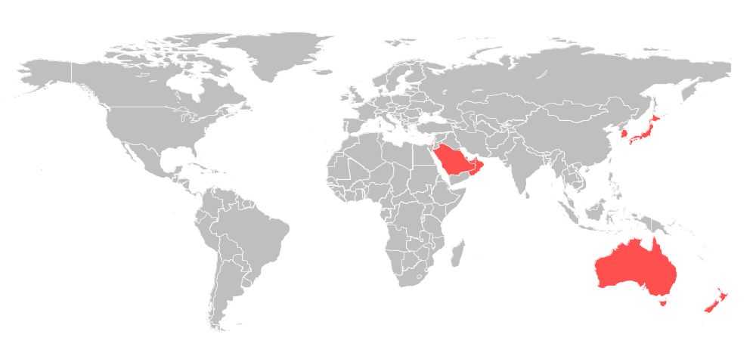
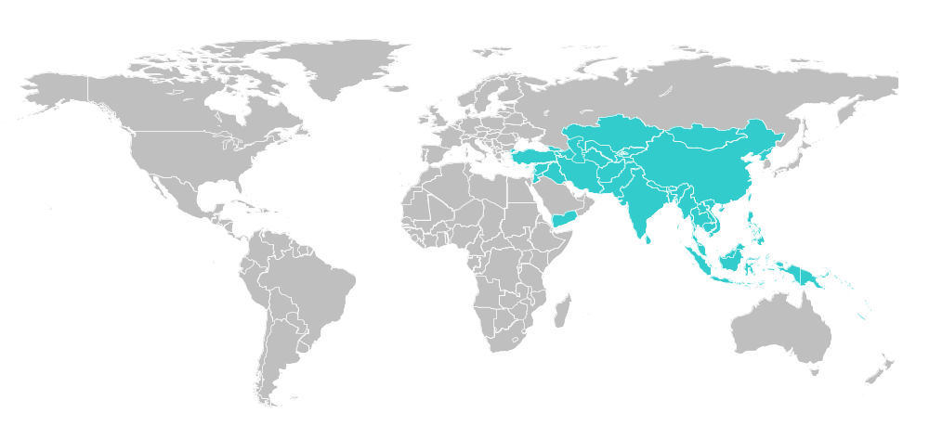
DRG Epidemiology regional coverage
82%
100%
78%
27%
89%
75%
89%
North America
North America
Europe
North America
Europe
Latin America
North America
Europe
Latin America
Africa
North America
Europe
Latin America
Africa
High-Income Asia-Pacific
North America
Europe
Latin America
Africa
High-Income Asia-Pacific
Lower-Income Asia-Pacific

Slide 10
Acute Lymphoblastic Leukemia Diagnosed Incident Cases

Slide 11
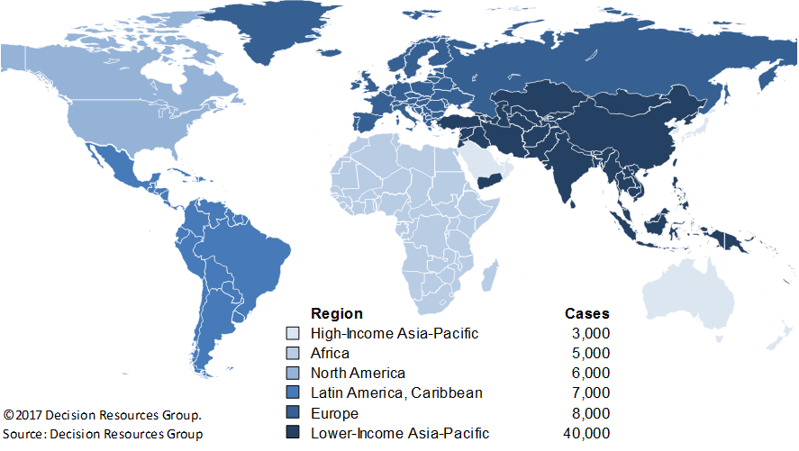
ALL Newly Diagnosed Incidence Cases in 2017

Slide 12
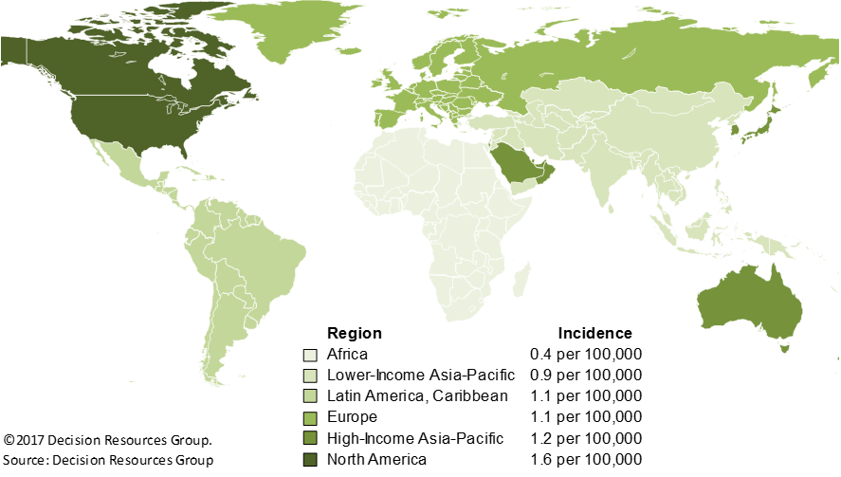
ALL Newly Diagnosed Incidence Rates in 2017

Slide 13
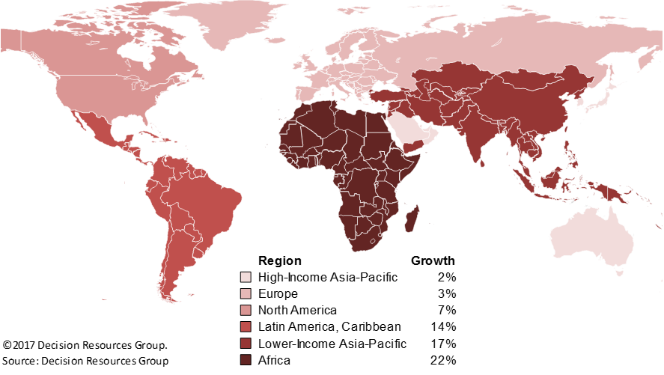
Growth of Diagnosed Incident ALL Cases

Slide 14
Acute Lymphoblastic Leukemia
Diagnosed Prevalent Cases

Slide 15

ALL Diagnosed Prevalent Cases in 2017

Slide 16
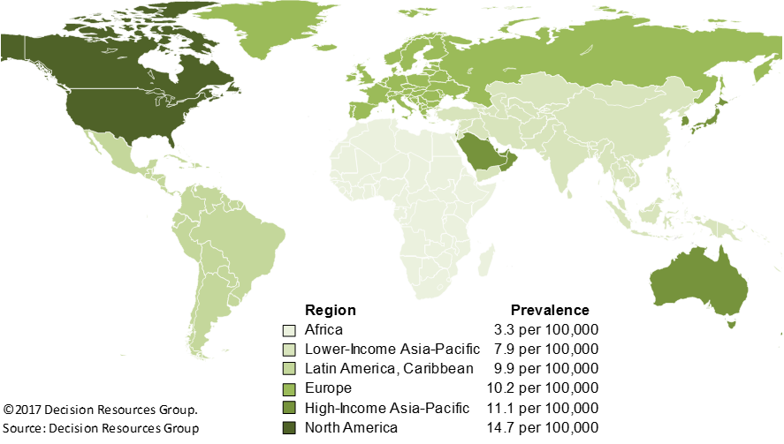
ALL Diagnosed Prevalence Rates in 2017

Slide 17

Growth of Diagnosed Prevalent ALL Cases

Slide 18
Acute Lymphoblastic Leukemia Incident Cases by Age and Country Income Levels
Pediatric (0-14)
Adult (15+)

Slide 19
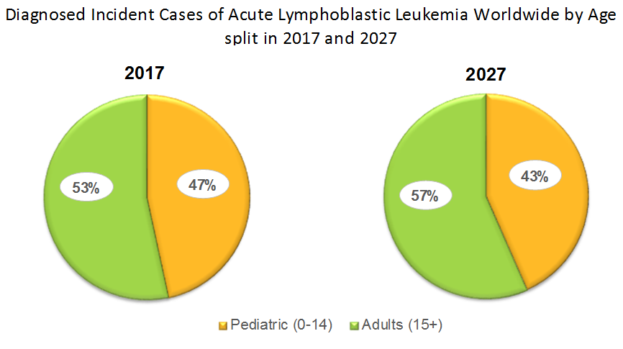
ALL Incident Cases by Age: 2017 and 2027

Slide 20
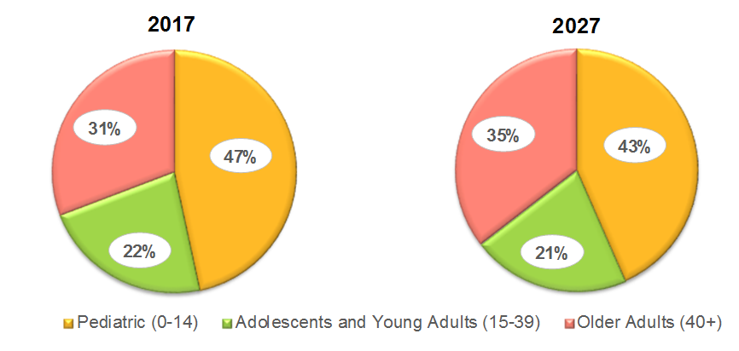
ALL Incident Cases by Age: 2017 and 2027

Slide 21
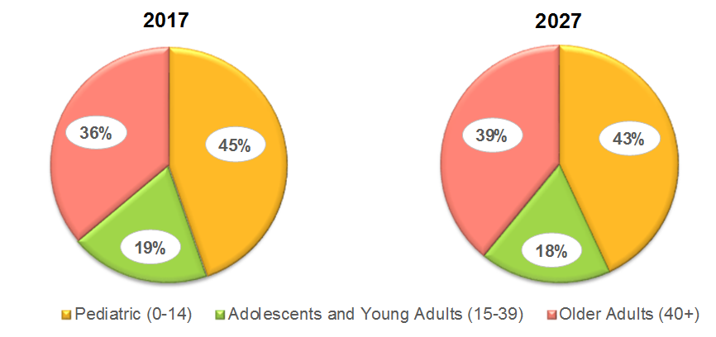
ALL Incident Cases in High Income Regions by Age

Slide 22
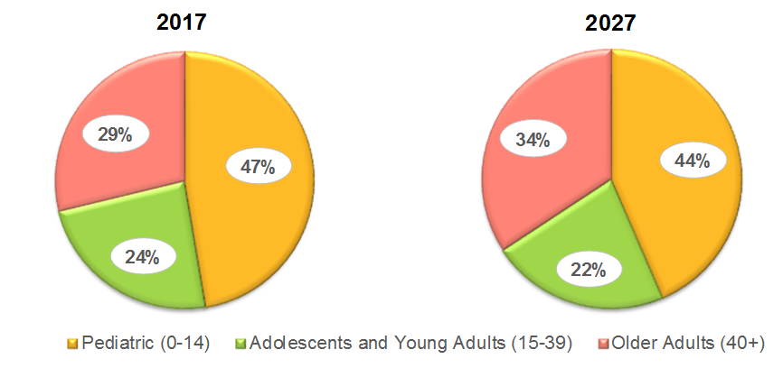
ALL Incident Cases in Low Income Regions by Age

Slide 23
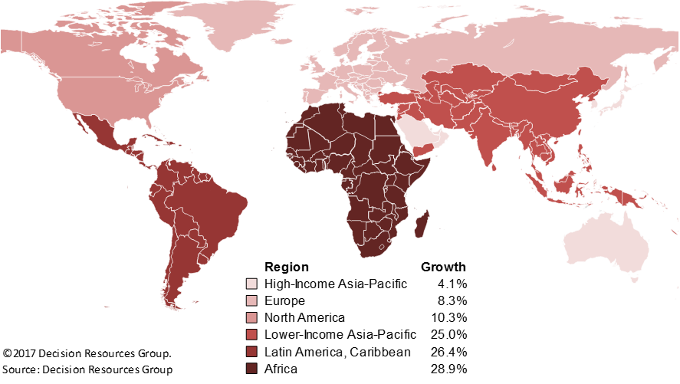
Growth in Adult (15+) Cases

Slide 24
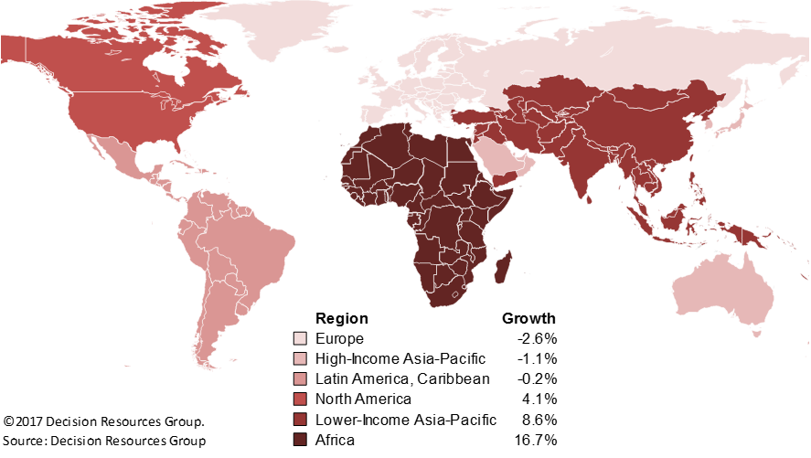
Growth in Pediatric (0-14) Cases

Slide 25
Factors Driving Epidemiological Trends
Developed countries
  Population aging
  Changes in population size
Developing countries
  Population aging
  Changes in population size
  Changes in disease diagnosis or survival
Factors incorporated in forecasting model
  Age
  Sex
  Low and middle-income countries: Economic growth impacting healthcare access

Slide 26
Conclusions
Growth of ALL cases in developing countries will exceed those of developed countries
Contributing factors
  Aging population will be the predominant factor in increasing ALL cases globally
  Economic growth is expected to result in earlier diagnosis and improved survival
Treatment of older patients with ALL is an unmet need that will continue to grow

Slide 27

Strategic DECISION-making is easier when you have
access to proprietary data and expert RESOURCES from
an integrated GROUP of best-in-class companies.
Questions?

Slide 28
Appendix

Slide 29
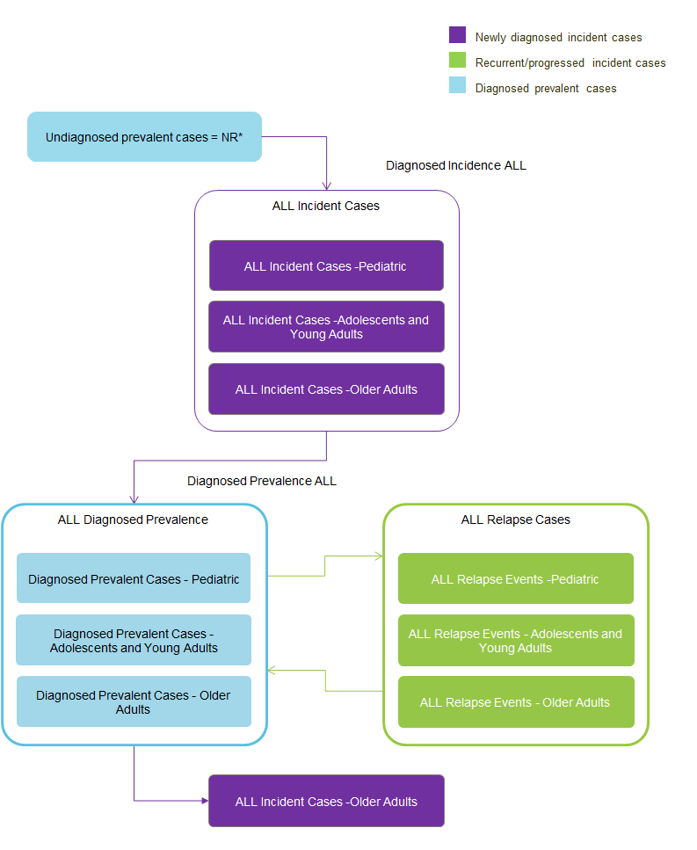

Slide 30
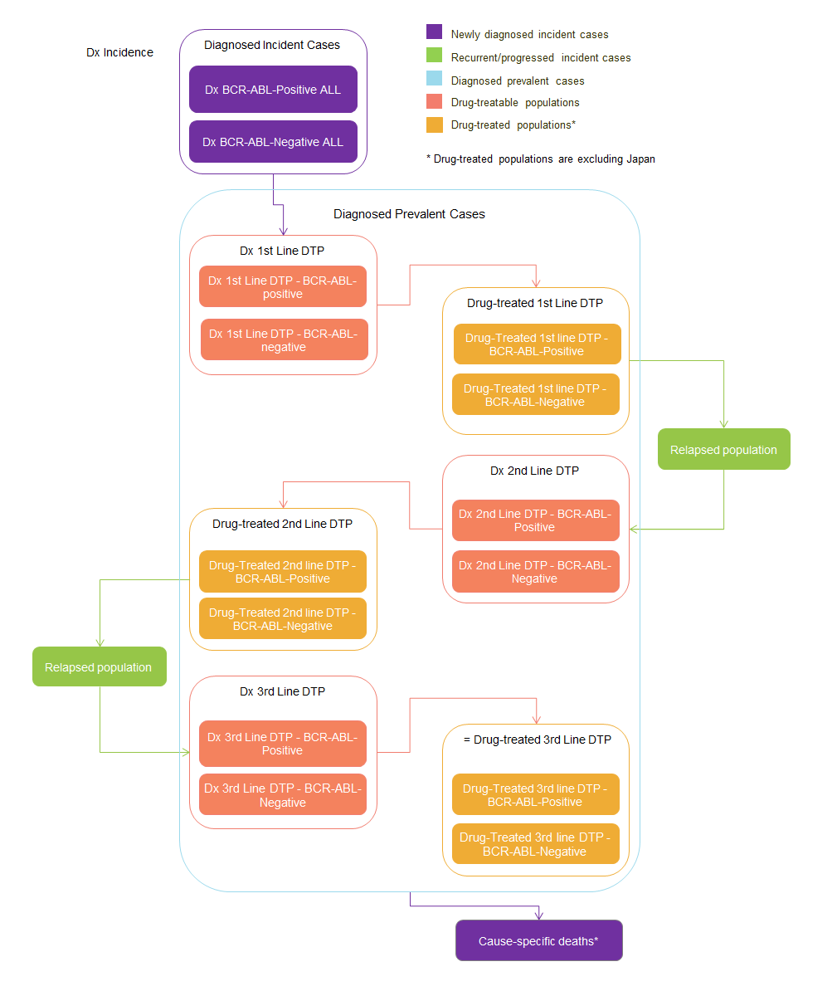

Slide 32
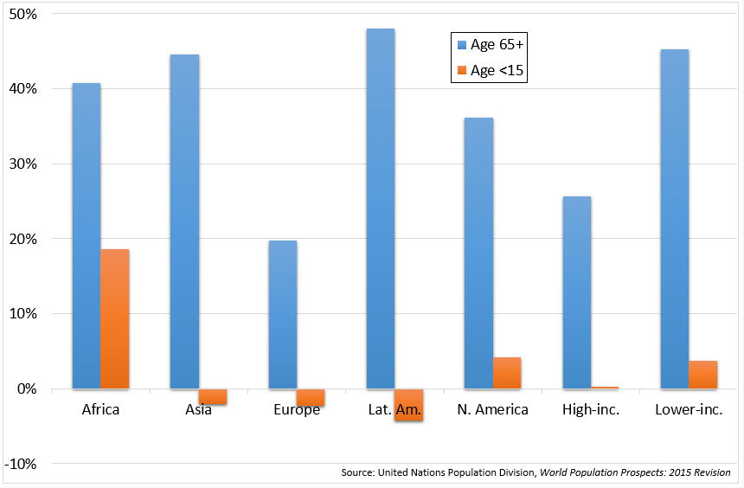
Population growth rates 2017-2027

Slide 34
Forecast methods
Quantify relationship between leukemia risk and GDP per capita
Use this relationship to forecast leukemia risk in lower income countries¹
Apply forecast leukemia risk to population forecast² to account for demographic changes
Project to world region totals
World Bank, USFDA
UN Population Division

Slide 35
Globalization and health
Change in demographic structure
  Population aging
  Decreasing fertility rate
  Increasing life expectancy
Spread of better healthcare and improved healthcare access
Adoption of ‘western’ lifestyles
  Diet
  Exercise
  Urbanization
Increased risk of chronic non-communicable diseases, including many cancers and leukemia

Slide 37
