Slide 1

Mission:
To prevent pregnancy in women addicted to substances while they
progress through the recovery process and after. This allows women
to become self-sufficient, achieve sobriety and stability, and gain the
necessary skills to care for their children.
Beth Meyer-Frank, RNP, JD
www.planningtoflourish.org planningtoflourish@gmail.com Facebook.com/planningtoflourish

Slide 2

Profiles of Women
“Cynthia”
29 y/o, methamphetamine, cannabis, and alcohol.
9 children - ages 11, 10, 7, 5 (twins), 3, 2, 1, 2
months. None are with her currently.
Domestic violence is a factor.

Slide 3
Profiles of Women
“Angela”
29 y/o, methamphetamine abuse.
11 pregnancies. 7 children. 15, 2 ten y/o’s - 9
months apart, 6, 4 y/o (twins), 8 months old.
There are 5 different fathers, but none are
involved. She’s letting her aunt adopt the baby.
Her mother-in- law has custody of the other
children.
She doesn’t want another pregnancy “right now”.

Slide 4
What we know about
addicted women
• 74% of addicted women reported sexual abuse.
•
52% of addicted women reported physical abuse.
•
72% of addicted women reported emotional abuse.
• Some studies show as high as 80% of women
seeking treatment for drug abuse reported histories of
sexual, and physical abuse.
(Women and Addiction: A Trauma-Informed Approach, by S. Covington, PhD, LCSW. November 2008,
Journal of Psychoactive Drugs.)
(NIDA -National Institute on Drug Abuse 2009)

Slide 5
What we know about
addicted women
Addicted women were found to have been:
• Abused sexually, physically, and emotionally by
more perpetrators.
• Abused more frequently.
• Abused for longer periods of time than non-
addicted women.
They also reported more incidents of incest and
rape.
(Women and Addiction: A Trauma-Informed Approach, by S. Covington, PhD, LCSW. November 2008,
Journal of Psychoactive Drugs.)
(NIDA -National Institute on Drug Abuse 2009)

Slide 6

What if we shift the
question about
trauma from:
Cultivating
“What’s wrong
with you?”
Compassionate
Culture
to
“What happened
to you?”

Slide 7

Effects of Addiction on Children
•
12% of children
in the United
States live with a
parent addicted to
alcohol or drugs.
• 8.3 million children under 18 years of age live with
at least one substance-dependent or substance abusing
parent.
(HHS, SAMHSA, Office of Applied Studies,2009)
(National Survey on Drug Use and Health (HSDUH) from 2002 to 2007 data)

Slide 8
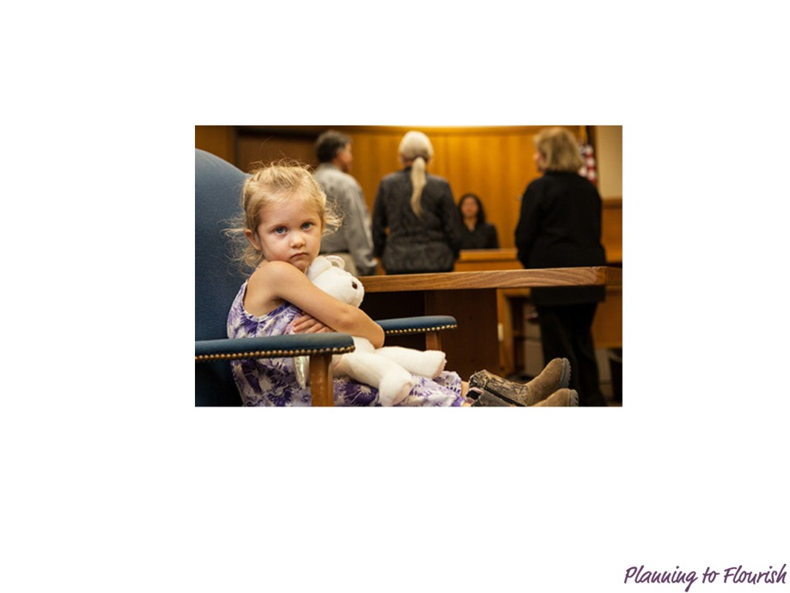
Effects of Addiction on Children
Children with parents who abuse alcohol or drugs are more likely:
• To experience abuse or neglect than children in other households.
• To be placed out-of-care of their parents.
• To stay in out-of-care placement longer than other children.

Slide 9
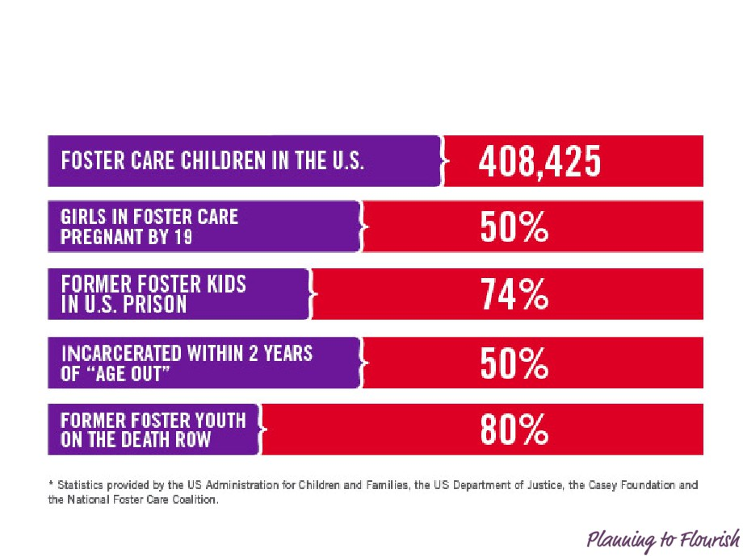
Foster Care Statistics

Slide 10
“If you think what happened to you
as a child doesn’t affect you as an
adult, think again.”

Slide 11

Solutions
Breaking the cycle
• Promoting Awareness
• Gender Responsive
Treatment
• Insight, Information,
and Incentives

Slide 12

Insight, Information,
and Incentives
For Women in Recovery

Slide 13
Insight, Information, and Incentives
for Women in Recovery
Pregnancy Life Plan
• How many children, ages, living with client, or
placed elsewhere
• Father(s) of children and other support systems
• Current medical and mental health issues
• Financial resources, job skills, housing, child
care, and transportation
• More children desired or not desired - Reasons
• Goals for herself and her children

Slide 14
Insight, Information, & Incentives
for Women in Recovery
Birth Control Information
• Written or video/DVD/digital
information with an overview of all
methods.
• Emphasis on the long acting reversible
contraceptives (LARCs).

Slide 15
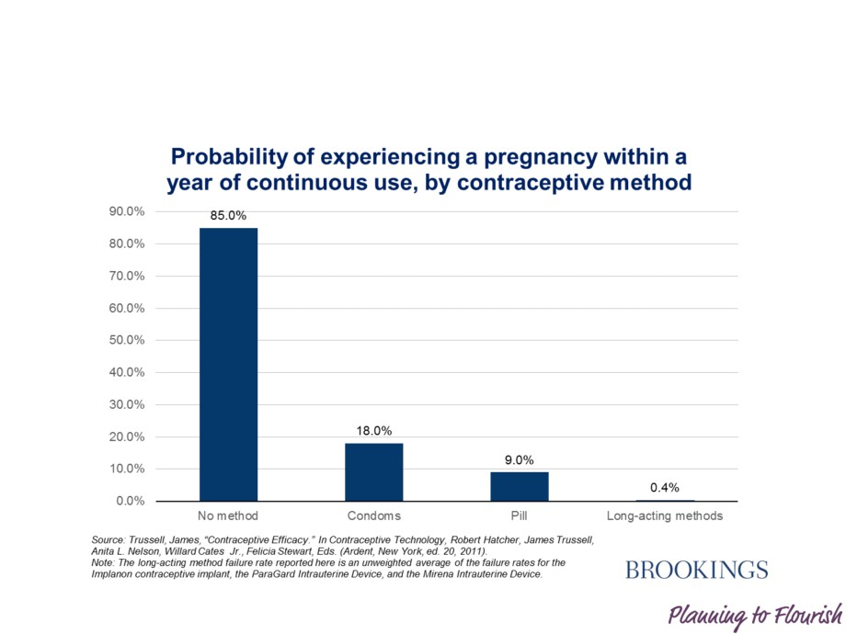
Contraception

Slide 16
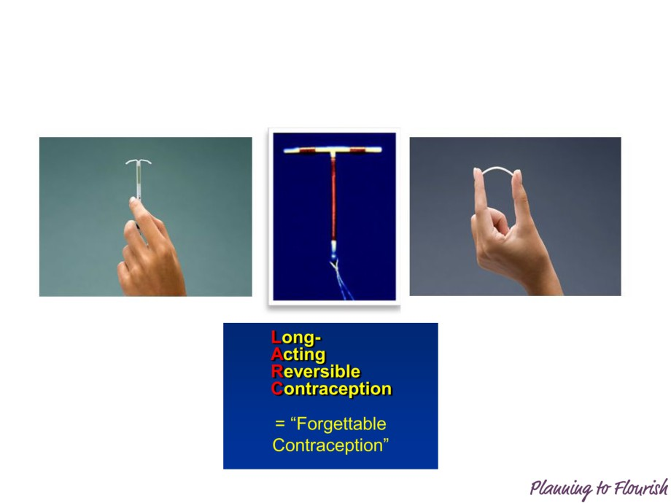
Contraception

Slide 17
Insight, Information, & Incentives
for Women in Recovery
Planning to Flourish Incentive Program
Women in recovery must:
• Be enrolled in a treatment program.
• Complete the Insight curriculum.
• Receive birth control Information while in the treatment program.
• Be referred for a well-woman exam and obtain a birth control
method, preferably a LARC.
• Bring in documentation of the exam and birth control method
received, and an incentive will be distributed through the treatment
program.

Slide 18
A successful Woman is one
who can build a firm foundation
with the bricks others have
thrown at her.
Source: Unknown

Slide 19

Ventura, California

Slide 20
Mission:
To prevent pregnancy in women addicted to substances while they
progress through the recovery process and after. This allows women
to become self-sufficient, achieve sobriety and stability, and gain the
necessary skills to care for their children.
Beth Meyer-Frank, RNP, JD
www.planningtoflourish.org planningtoflourish@gmail.com Facebook.com/planningtoflourish

