Slide 1


The environmental impact evaluation and testing of sustainable inorganic binders:
A green alternative to ordinary Portland cement by
Assist. Prof. Dr. Beste Cubukcuoglu
Beste.Cubukcuoglu@antalya.edu.tr
Department of Civil Engineering
Faculty of Engineering
Antalya International University
Turkey

Slide 2

CONTENT
INTRODUCTION
AIM
MATERIALS
METHODOLOGY
RESULTS and CONCLUSIONS

Slide 3
INTRODUCTION
Main debate is...
Concrete or Steel?
If concrete, why? If not, why?
If Steel, why? If not, why?

Slide 4
Material selection is all based on:
Type of application,
Economic concerns,
Architectural and
Functional concerns and issues related to sustainability

Slide 5
CONCRETE
More resistant to very high temperatures for longer peroid of time
Offer excellent protection from explosions
  For example: Burj Khalifa, Dubai – a very good example for concrete base buildings where around 330,000 cubic meters of concrete used to complete its construction (of course supported by steel rebar).
Speeds up the construction process by giving the ability to be pre-fabricated off site unlike to Steel

Slide 6
STEEL
Can be a more environmental friendly option compared to concrete due to concrete’s high carbon emissions during its production process
Steel is a recyclable materials and currently reinforced steel is the most preferred material to protect environment
Rebar is mosly made up 100% recycled scrap Steel and at the end of its life cycle it can be recovered, recycled and used again where concrete CANNOT do that at this high levels and with 100% efficiency.
Steel offers aesthetics that concrete may never be able to.

Slide 7
Steel vs. Concrete!
In reality, both concrete and Steel have advantages and disadvantes so why we should choose one over another where it would be possible to apply them together.
Reinforcing concrete with Steel has major benefits. It is by far a lot better than either concrete or Steel by their own.

Slide 8
So!....
How can we make a more environmental friendly and stronger material with higher durability, less production costs and maintenance cost. ?
What about producing green concrete which is basicaly rely on green cement? What about producing a green reinforcing concrete?
In the light of discussion we have started to think about more sustainable construction materials which can reduce the detrimental impacts of cement whereas carries similar or better characteristics which will not effect the quailty, durability and cost of the final product or buildings.

Slide 9
AIM
To reduce the cement content in reinforced concrete by using sustainable alternative binding agents.

Slide 10
MATERIALS
Sustainable construction materials should not only be environmental friendly but also provide high level of safety and cost effectiveness over the long term.
Low grade magnesium oxide (LGMgO),
pulverised fuel ash (PFA),
Steel slag and
hydrated lime
    are the materials proposed as a cement replacement.

Slide 11
METHODOLOGY
Setting Time
Unconfined Compressive Strength (UCS)
Leaching Tests (Monolithic and Granular)
Acid Neutralisation Capacity (ANC)
Diffusion Test
SEM
XRD analyses
And many others….

Slide 12

RESULTS
RESULTS

Slide 13
Cement-binder substitution ratios
Mix | CEMI (%) | Binder (%)
CEMI-BINDER-1:1 | 50 | 50
CEMI-BINDER-1:2 | 33 | 67
CEMI-BINDER-1:3 | 25 | 75
CEMI-BINDER-1:4 | 20 | 80
CEMI-BINDER-1:5 | 17 | 83
CEMI-BINDER-1:6 | 14 | 86
CEMI-BINDER-1:7 | 12.5 | 87.5
CEMI-BINDER-1:8 | 11 | 89
CEMI-BINDER-1:9 | 10 | 90
*Binder = Slag / LGMgO / PFA / hlime
CEMI-hlime | 1:1 | 1:2 | 1:3 | 1:4 | 1:5 | 1:6 | 1:7 | 1:8 | 1:9
Water (%) | 60 | 60 | 60 | 60 | 60 | 60 | 60 | 60 | 60
CEMI-LGMgO | 1:1 | 1:2 | 1:3 | 1:4 | 1:5 | 1:6 | 1:7 | 1:8 | 1:9
Water (%) | 40 | 40 | 45 | 45 | 50 | 50 | 50 | 50 | 50
CEMI-PFA | 1:1 | 1:2 | 1:3 | 1:4 | 1:5 | 1:6 | 1:7 | 1:8 | 1:9
Water (%) | 20 | 20 | 20 | 20 | 20 | 20 | 20 | 20 | 20
CEMI-SLAG | 1:1 | 1:2 | 1:3 | 1:4 | 1:5 | 1:6 | 1:7 | 1:8 | 1:9
Water (%) | 18 | 15 | 15 | 15 | 18 | 15 | 15 | 15 | 15

Slide 14
UCS RESULTS

Slide 15
Figure 1 CEMI-only mix combinations for UCS 7, 28, 56 days and WI (28 days)
*Error bars with standard deviations included

Slide 16
Figure 2 CEMI-hlime mix combinations for UCS 7, 28 and 56 days
*Error bars with standard deviations included

Slide 17
Figure 3 CEMI-LGMgO mix combinations for UCS 7, 28, and 56 days and WI (28 days)
*Error bars with standard deviations included

Slide 18
CEMI-slag mix combinations for UCS 7, 28, and 56 days, WI (28 days)
*Error bars with standard deviations included

Slide 19
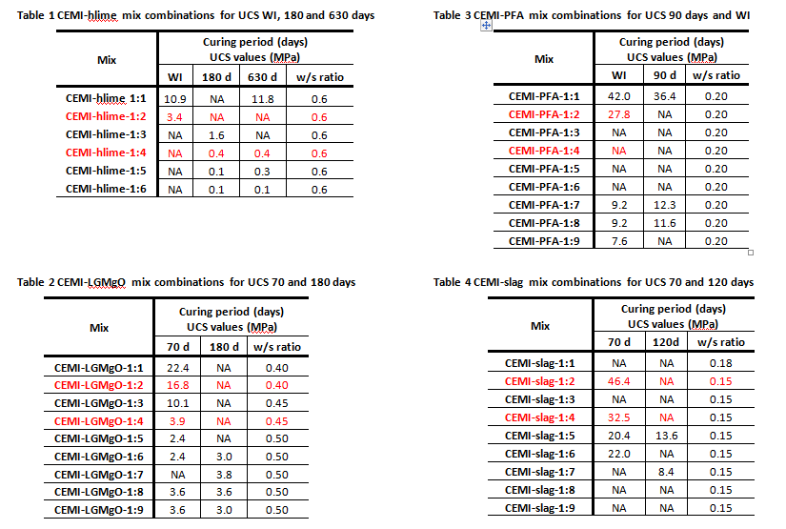

Slide 20
Leaching Test Results

Slide 21
Leaching Test Results –
Granular Leaching Test
CEMI:hlime ratio | Pb mg/l | Cd mg/l | Cr mg/l | Zn mg/l | Mo mg/l | As mg/l | Pb limit | Pb | Cd limit | Cd | Cr limit | Cr | Zn limit | Zn | Mo limit | Mo | As limit | As
1:1 | BDL | BDL | 0.07 | BDL | 0.04 | BDL | 50 | BDL | 5 | BDL | 70 | 0.7 | 200 | BDL | 30 | 0.42 | 25 | BDL
1:2 |  |  | 0.07 |  | BDL |  |  |  |  |  |  | 0.69 |  |  |  | BDL
1:3 |  |  | 0.08 |  | 0.01 |  |  |  |  |  |  | 0.8 |  |  |  | 0.14
1:4 |  |  | 0.07 |  | BDL |  |  |  |  |  |  | 0.7 |  |  |  | BDL
1:5 |  |  | 0.06 |  | 0.02 |  |  |  |  |  |  | 0.67 |  |  |  | 0.16
1:6 |  |  | 0.07 |  | 0.01 |  |  |  |  |  |  | 0.67 |  |  |  | 0.13
CEMI:hlime ratio | Co (mg/l) | Cu (mg/l) | Ni (mg/l) | Se (mg/l) | Ba (mg/l) | Sb (mg/l) | Co limit | Co | Cu limit | Cu | Ni limit | Ni | Se limit | Se | Ba limit | Ba | Sb limit | Sb
1:1 | 0.01 | BDL | 0.02 | BDL | 1.60 | BDL | na | 0.13 | 100 | BDL | 40 | 0.17 | 7 | BDL | 300 | 15.95 | 5 | BDL
1:2 | 0.01 |  | 0.02 |  | 1.49 |  |  | 0.10 |  |  |  | 0.15 |  |  |  | 14.87
1:3 | BDL |  | 0.02 |  | 1.85 |  |  | BDL |  |  |  | 0.16 |  |  |  | 18.53
1:4 | 0.01 |  | 0.02 |  | 1.65 |  |  | 0.12 |  |  |  | 0.17 |  |  |  | 16.46
1:5 | 0.01 |  | 0.02 |  | 1.71 |  |  | 0.12 |  |  |  | 0.14 |  |  |  | 17.11
1:6 | 0.01 |  | 0.02 |  | 2.09 |  |  | 0.12 |  |  |  | 0.17 |  |  |  | 20.85
*The WAC limits are highlighted in yellow
**BDL stands for Below Detection Limit

Slide 22
Granular Leaching Test Results
CEMI:LGMgO ratio | Pb (mg/l) | Cd (mg/l) | Cr (mg/l) | Zn (mg/l) | Mo (mg/l) | As (mg/l) | Pb limit | Pb | Cd limit | Cd | Cr limit | Cr | Zn limit | Zn | Mo limit | Mo | As limit | As
1:1 | BDL | BDL | 0.04 | BDL | BDL | BDL | 50 | BDL | 5 | BDL | 70 | 0.43 | 200 | BDL | 30 | BDL | 25 | BDL
1:2 |  |  | 0.06 |  |  |  |  |  |  |  |  | 0.58 |  |  |  | 0.03
1:3 |  |  | 0.05 |  |  |  |  |  |  |  |  | 0.50 |  |  |  | 0.02
1:4 |  |  | 0.05 |  |  |  |  |  |  |  |  | 0.52 |  |  |  | BDL
1:5 |  |  | 0.04 |  |  |  |  |  |  |  |  | 0.44
1:6 |  |  | 0.05 |  |  |  |  |  |  |  |  | 0.47
1:7 |  |  | 0.04 |  |  |  |  |  |  |  |  | 0.42
1:8 |  |  | 0.03 |  |  |  |  |  |  |  |  | 0.31
1:9 |  |  | 0.04 |  |  |  |  |  |  |  |  | 0.35
CEMI:LGMgO ratio | Co (mg/l) | Cu (mg/l) | Ni (mg/l) | Se (mg/l) | Ba (mg/l) | Sb (mg/l) | Co limit | Co | Cu limit | Cu | Ni limit | Ni | Se limit | Se | Ba limit | Ba | Sb limit | Sb
1:1 | BDL | BDL | 0.01 | BDL | 1.03 | BDL | na | BDL | 100 | BDL | 40 | 0.13 | 7 | BDL | 300 | 10.26 | 5 | BDL
1:2 | 0.01 |  | 0.02 |  | 0.42 |  |  | 0.13 |  |  |  | 0.16 |  |  |  | 4.18
1:3 | 0.01 |  | 0.02 |  | 0.49 |  |  | 0.13 |  |  |  | 0.16 |  |  |  | 4.86
1:4 | 0.01 |  | 0.02 |  | 0.11 |  |  | 0.13 |  |  |  | 0.16 |  |  |  | 1.06
1:5 | BDL |  | 0.01 |  | 0.06 |  |  | BDL |  |  |  | 0.13 |  |  |  | 0.62
1:6 |  |  | BDL |  | BDL |  |  |  |  |  |  | BDL |  |  |  | 0.09
1:7 |  |  | 0.02 |  | 0.05 |  |  |  |  |  |  | 0.15 |  |  |  | 0.51
1:8 |  |  | 0.02 |  | 0.03 |  |  |  |  |  |  | 0.17 |  |  |  | 0.32
1:9 |  |  | 0.02 |  | 0.01 |  |  |  |  |  |  | 0.16 |  |  |  | 0.11

Slide 23
Granular Leaching Test Results
CEMI:PFA ratio | Pb (mg/l) | Cd mg/l | Cr (mg/l) | Zn (mg/l) | Mo (mg/l) | As (mg/l) | Pb limit | Pb | Cd limit | Cd | Cr limit | Cr | Zn limit | Zn | Mo limit | Mo | As limit | As
1:1 | BDL | BDL | 0.04 | BDL | 0.19 | BDL | 50 | BDL | 5 | BDL | 70 | 0.40 | 200 | BDL | 30 | 1.9 | 25 | BDL
1:2 |  |  | 0.06 |  | 0.20 |  |  |  |  |  |  | 0.58 |  |  |  | 2.0
1:3 |  |  | 0.18 |  | 0.19 |  |  |  |  |  |  | 1.80 |  |  |  | 1.94
1:4 |  |  | 0.18 |  | 0.17 |  |  |  |  |  |  | 1.76 |  |  |  | 1.7
1:5 |  |  | 0.09 |  | 0.16 |  |  |  |  |  |  | 0.9 |  | 0.03 |  | 1.6
1:6 |  |  | 00.14 |  | 0.43 |  |  |  |  |  |  | 1.43 |  | BDL |  | 4.27
1:7 |  |  | 0.38 |  | 0.70 |  |  |  |  |  |  | 3.84 |  |  |  | 7.03
1:8 |  |  | 0.26 |  | 0.51 |  |  |  |  |  |  | 2.64 |  |  |  | 5.06
1:9 |  |  | 0.26 |  | 0.82 |  |  |  |  |  |  | 2.6 |  |  |  | 8.18
CEMI:PFA ratio | Co (mg/l) | Cu (mg/l) | Ni (mg/l) | Se (mg/l) | Ba (mg/l) | Sb (mg/l) | Co limit | Co | Cu limit | Cu | Ni limit | Ni | Se limit | Se | Ba limit | Ba | Sb limit | Sb
1:1 | 0.01 | BDL | 0.02 | BDL | 1.03 | BDL | na | 0.11 | 100 | BDL | 40 | 0.16 | 7 | BDL | 300 | 10.26 | 5 | BDL
1:2 | 0.01 |  | 0.02 |  | 0.42 |  |  | 0.11 |  |  |  | 0.16 |  |  |  | 4.18
1:3 | 0.01 | 0.01 | 0.02 |  | 0.49 |  |  | 0.12 |  | 0.07 |  | 0.16 |  |  |  | 4.9
1:4 | 0.01 | BDL | 0.02 |  | 0.11 |  |  | 0.11 |  | BDL |  | 0.16 |  |  |  | 1.06
1:5 | 0.01 |  | 0.02 |  | 0.54 |  |  | 0.1 |  |  |  | 0.17 |  | 0.06 |  | 5.4 |  | 0.13
1:6 | 0.01 | 0.01 | 0.02 |  | 0.26 |  |  | 0.12 |  | 0.04 |  | 0.18 |  | BDL |  | 2.60 |  | BDL
1:7 | 0.01 | 0.01 | 0.02 |  | BDL |  |  | 0.11 |  | 0.08 |  | 0.18 |  |  |  | BDL
1:8 | 0.01 | 0.01 | 0.02 |  | 0.10 |  |  | 0.12 |  | 0.08 |  | 0.15 |  |  |  | 1.01
1:9 | 0.01 | 0.01 | 0.02 |  | BDL |  |  | 0.13 |  | 0.08 |  | 0.14 |  |  |  | BDL

Slide 24
Granular Leaching Test Results
CEMI:slag ratio | Pb (mg/l) | Cd (mg/l) | Cr (mg/l) | Zn (mg/l) | Mo (mg/l) | As (mg/l) | Pb limit | Pb | Cd limit | Cd | Cr limit | Cr | Zn limit | Zn | Mo limit | Mo | As limit | As
1:1 | 0.18 | BDL | 0.01 | BDL | 0.03 | BDL | 50 | BDL | 5 | BDL | 70 | 0.18 | 200 | BDL | 30 | 0.32 | 25 | BDL
1:2 | 0.27 |  | 0.04 |  | 0.08 |  |  | 2.65 |  |  |  | 0.37 |  |  |  | 0.81
1:3 | 0.22 |  | 0.02 |  | 0.11 |  |  | 2.18 |  |  |  | 0.22 |  |  |  | 1.06
1:4 | BDL |  | 0.05 |  | 0.14 |  |  | BDL |  |  |  | 0.50 |  |  |  | 1.40
1:6 | BDL |  | 0.06 |  | 0.2 |  |  | BDL |  |  |  | 0.60 |  |  |  | 2.00
1:7 | 0.49 |  | 0.07 |  | 0.22 |  |  | 4.9 |  |  |  | 0.70 |  |  |  | 2.20
1:8 | BDL |  | 0.08 |  | 0.26 |  |  | BDL |  |  |  | 0.57 |  |  |  | 2.60
CEMI:slag ratio | Co (mg/l) | Cu (mg/l) | Ni (mg/l) | Se (mg/l) | Ba (mg/l) | Sb (mg/l) | Co limit | Co | Cu limit | Cu | Ni limit | Ni | Se limit | Se | Ba limit | Ba | Sb limit | Sb
1:1 | 0.01 | BDL | BDL | BDL | 3.29 | BDL | na | 0.14 | 100 | BDL | 40 | BDL | 7 | BDL | 300 | 32.89 | 5 | BDL
1:2 | 0.01 |  | 0.02 |  | 0.01 |  |  | 0.12 |  |  |  | 0.15 |  |  |  | 0.13
1:3 | 0.01 |  | BDL |  | 4.18 |  |  | 0.12 |  |  |  | BDL |  |  |  | 41.84
1:4 | 0.01 |  | 0.02 |  | 4.67 |  |  | 0.10 |  |  |  | 0.20 |  |  |  | 46.70
1:6 | 0.01 |  | 0.02 |  | 3.86 |  |  | 0.10 |  |  |  | 0.20 |  |  |  | 38.60
1:7 | BDL |  | BDL |  | BDL |  |  | BDL |  |  |  | BDL |  |  |  | BDL
1:8 | 0.01 |  | 0.02 |  | 0.94 |  |  | 0.10 |  |  |  | 0.15 |  |  |  | 9.43

Slide 25
Monolithic Leaching Test

Slide 26
The Measured Cumulative Leaching Rates (e_{n} *) of Contaminants from CEMI-hlime (mg/m²) at 28 days
 | e_{n} * (mg/m²) |  |  |  | e_{n} * (mg/m²) |  |  |  | e_{n} * (mg/m²) |  |  |  | e_{n} * (mg/m²)
 | Cr |  |  |  | Mo |  |  |  | Ni |  |  |  | Ba
CEMI:hlime ratio | Compliance (4d) |  | Characterisation (64d) |  | Compliance (4d) |  | Characterisation (64d) |  | Compliance (4d) |  | Characterisation (64d) |  | Compliance (4d) |  | Characterisation (64d)
1:1 | 4 | 6.25 | 10 | 25 | 2 | 5 | 4 | 20 | 2.1 | 3.75 | 4.2 | 15 | 9 | 37.5 | 80 | 150
1:2 | 4.4 |  | 11.4 |  | 1.6 |  | 4 |  | 2.3 |  | 4.4 |  | 39.2 |  | 158.5
1:3 | 3 |  | 9 |  | 0.3 |  | 0.7 |  | 0.2 |  | 0.5 |  | 31 |  | 144
1:4 | 3.4 |  | 8.3 |  | BDL |  | BDL |  | 0.3 |  | 0.6 |  | 53.2 |  | 147.4
1:5 | 3 |  | 8 |  |  |  |  |  | 0.2 |  | 0.4 |  | 63 |  | 183
1:6 | 3 |  | 8 |  |  |  |  |  | 0.5 |  | 0.5 |  | 39 |  | 127
BDL= below detection limit
e_{n} * (mg/m²) is obtained by multiplying the metal concentration measured in mg/l with Volume of leaching fluid in litres (l) and divided by area of the test specimen ; A(m²).

Slide 27
The Measured Cumulative Leaching Rates (e_{n} *) of Contaminants from CEMI-LGMgO (mg/m²) at 28 days
 | e_{n} * (mg/m²) |  |  |  |  | e_{n} * (mg/m²) |  |  |  | e_{n} * (mg/m²) |  |  |  |  | e_{n} * (mg/m²)
 | Cr |  |  |  |  | Mo |  |  |  | Ni |  |  |  |  | Ba
CEMI:LGMgO ratio | Compliance (4d) |  |  | Characterisation (64d) |  | Compliance (4d) |  | Characterisation (64d) |  | Compliance (4d) |  | Characterisation (64d) |  |  | Compliance (4d) |  |  |  | Characterisation (64d)
1:1 | 2.4 | 6.25 |  | 5.1 | 25 | BDL | 5 | 0.4 | 20 | 0.3 | 3.75 | 0.6 |  | 15 | BDL |  | 37.5 |  | BDL | 150
1:2 | 1.8 |  |  | 4.8 |  | 0.9 |  | 1.1 |  | BDL |  | BDL |  |  | 4.2 |  |  |  | 7
1:3 | 4.0 |  |  | 9.5 |  | 2.8 |  | 4.7 |  | 2.3 |  | 4.6 |  |  | BDL |  |  |  | 6.1
1:4 | 1.2 |  |  | 3.4 |  | BDL |  | 0.1 |  | BDL |  | BDL |  |  | 1.7 |  |  |  | 8.8
1:5 | 3.6 |  |  | 7.9 |  | 2.0 |  | 6.2 |  | 2.3 |  | 4.5 |  |  | 0.8 |  |  |  | 7.6
1:6 | 1.6 |  |  | 3.8 |  | BDL |  | 0.3 |  | 0.2 |  | 0.4 |  |  | BDL |  |  |  | BDL
1:7 | 1.7 |  |  | 3.5 |  |  |  | 0.4 |  | 0.3 |  | 0.6
1:8 | 1.8 |  |  | 3.5 |  | 0.4 |  | 0.4 |  | 0.2 |  | 0.3
1:9 | 1.6 |  |  | 3.2 |  | 0.5 |  | 0.5 |  | 0.1 |  | 0.3
 | Co |  |  |  |  | Cu |  |  |  | As
 | Compliance (4d) |  | Characterisation (64d) |  |  | Compliance (4d) |  | Characterisation (64d) |  | Compliance (4d) |  |  | Characterisation (64d)
1:1 | BDL | na | BDL |  | na | BDL | 15 | BDL | 60 | 1.2 |  |  | 2.2 |  |  | 20
1:2 | 4.5 |  | 7.9 |  |  | 4.9 |  | 8.5 |  | 0.3 |  |  | 0.3
1:3 | 2.9 |  | 6.6 |  |  | 3.0 |  | 4.8 |  | BDL |  |  | BDL
1:4 | 4.6 |  | 7.8 |  |  | 4.8 |  | 8.6
1:5 | 3.8 |  | 6.4 |  |  | 3.9 |  | 5.1 |  |  | 5
1:6 | BDL |  | BDL |  |  | BDL |  | BDL |  | 1.3 |  |  | 2.2
1:7 |  |  |  |  |  |  |  |  |  | 0.9 |  |  | 1.8
1:8 |  |  |  |  |  |  |  |  |  | 1.0 |  |  | 1.8
1:9 |  |  |  |  |  |  |  |  |  | 1.1 |  |  | 1.8

Slide 28
The Measured Cumulative Leaching Rates (e_{n} *) of Contaminants from CEMI-PFA (mg/m²) at 28 days
 | e_{n} * (mg/m²) |  |  |  | e_{n} * (mg/m²) |  |  |  | e_{n} * (mg/m²)
CEMI:PFA ratio | Cr |  |  |  | Mo |  |  |  | As
 | Compliance (4d) |  | Characterisation (64d) |  | Compliance (4d) |  | Characterisation (64d) |  | Compliance (4d) |  | Characterisation (64d)
1:1 | 1.6 | 6.25 | 3.6 | 25 | 10 | 5 | 18 | 20 | 14 | 5 | 30 | 20
1:2 | 3.7 |  | 4.5 |  | 9.7 |  | 18.1 |  | 16.1 |  | 14.0
1:4 | 7.3 |  | 8.6 |  | 7.8 |  | 17.4 |  | 30.9 |  | 30.3
1:7 | 2.0 |  | 4 |  | na |  | 3 |  | 2 |  | 3
1:8 | 3 |  | 6 |  | 3 |  | 8 |  | 2 |  | 3
1:9 | 3 |  | 9 |  | 4 |  | 17 |  | 2 |  | 3
 | Ni |  |  |  | Ba |  |  |  | Sb
 | Compliance (4d) |  | Characterisation (64d) |  | Compliance (4d) |  | Characterisation (64d) |  | Compliance (4d) |  | Characterisation (64d)
1:1 | na | 3.75 | 1 | 15 | 10 | 37.5 | 20 | 150 | na | 0.625 | 1 | 2.5
1:2 | 2.7 |  | 2.9 |  | 4.6 |  | 8.5 |  | 0.5 |  | 0.6
1:4 | 5.5 |  | 5.6 |  | 9.4 |  | 17.9 |  | 0.6 |  | 1.4
1:7 | na |  | 1 |  | na |  | na |  | na |  | na
1:8 |  |  | 1
1:9 |  |  | 1

Slide 29
The Measured Cumulative Leaching Rates (e_{n} *) of Contaminants from CEMI-steel slag (mg/m²) at 28 days
 | e_{n} * (mg/m²) |  |  |  |  | e_{n} * (mg/m²) |  |  |  | e_{n} * (mg/m²)
CEMI:slag ratio | Cr |  |  |  |  | Mo |  |  |  | As
 | Compliance (4d) |  |  | Characterisation (64d) |  | Compliance (4d) |  | Characterisation (64d) |  | Compliance (4d) |  | Characterisation (64d)
1:1 | 2.8 | 6.25 |  | 5.6 | 25 | 7.6 | 5 | 14.3 | 20 | 14.7 | 5 | 27.9 |  | 20
1:2 | 3.1 |  |  | 6.3 |  | 8.3 |  | 16.9 |  | 16.2 |  | 32.3
1:3 | 2.8 |  |  | 5.6 |  | 8.3 |  | 15.9 |  | 14.4 |  | 26.6
1:4 | 3.5 |  |  | 7.2 |  | 10.2 |  | 20.5 |  | 13.6 |  | 27.5
1:5 | 2.8 |  |  | 5.9 |  | 8.1 |  | 18.1 |  | 12.7 |  | 24.2
1:6 | 2.6 |  |  | 5.5 |  | 7.1 |  | 16.9 |  | 13.8 |  | 28.5
1:7 | 2.8 |  |  | 5.3 |  | 8.5 |  | 16.6 |  | 11.6 |  | 21.6
1:8 | 3.1 |  |  | 5.7 |  | 9.4 |  | 17.8 |  | 10.8 |  | 19.8
 | Ni |  |  |  |  | Ba |  |  |  | Sb
 | Compliance (4d) |  |  | Characterisation (64d) |  | Compliance (4d) |  | Characterisation (64d) |  | Compliance (4d) |  | Characterisation (64d)
1:1 | 1.4 |  | 3.75 | 2.8 | 15 | 4.3 | 37.5 | 12.6 | 150 | 0.1 | 0.625 | 1.1 | 2.5
1:2 | 1.7 |  |  | 3.6 |  | 7.4 |  | 21.6 |  | 0.6 |  | 2.4
1:3 | 1.2 |  |  | 2.7 |  | 12.4 |  | 39.2 |  | 1.8 |  | 2.0
1:4 | 1.8 |  |  | 3.6 |  | 16.4 |  | 57.9 |  | 0.7 |  | 2.1
1:5 | 1.3 |  |  | 2.7 |  | 16.2 |  | 54.0 |  | 0.8 |  | 2.6
1:6 | 1.2 |  |  | 2.6 |  | 13.1 |  | 53.1 |  | 0.9 |  | 2.0
1:7 | 1.3 |  |  | 2.4 |  | 0 |  | 0 |  | 0 |  | 0
1:8 | 1.1 |  |  | 2.1 |  | 0 |  | 0 |  | 0 |  | 0

Slide 30
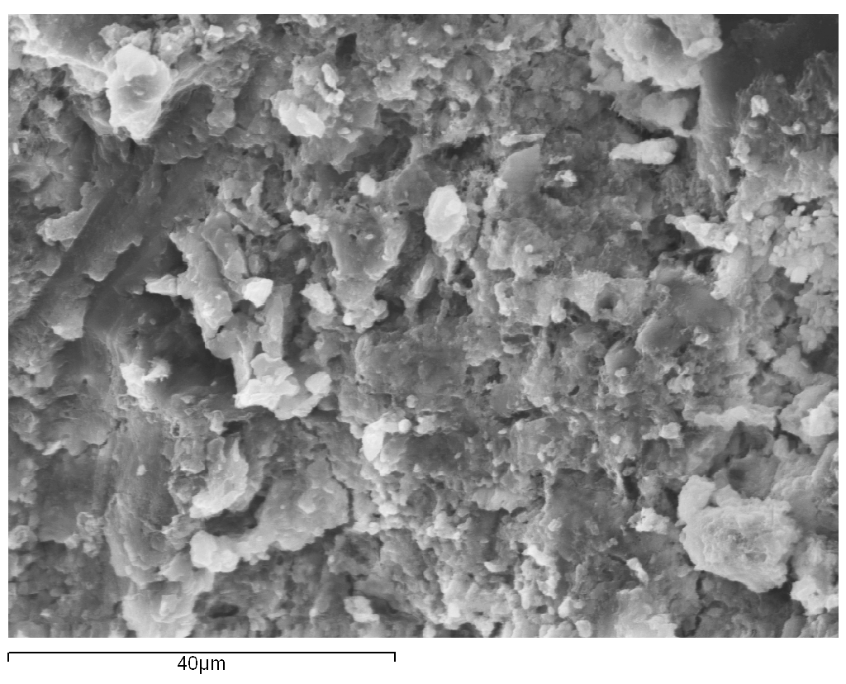
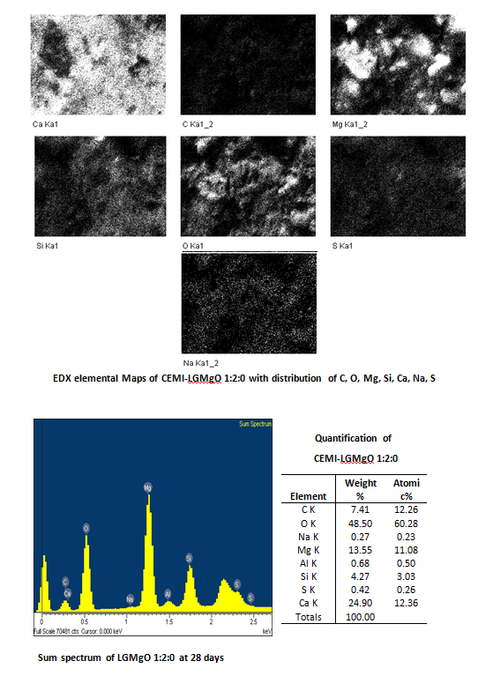
SEM image of CEMI-LGMgO 1:2 at 28 days’ curing age

Slide 31
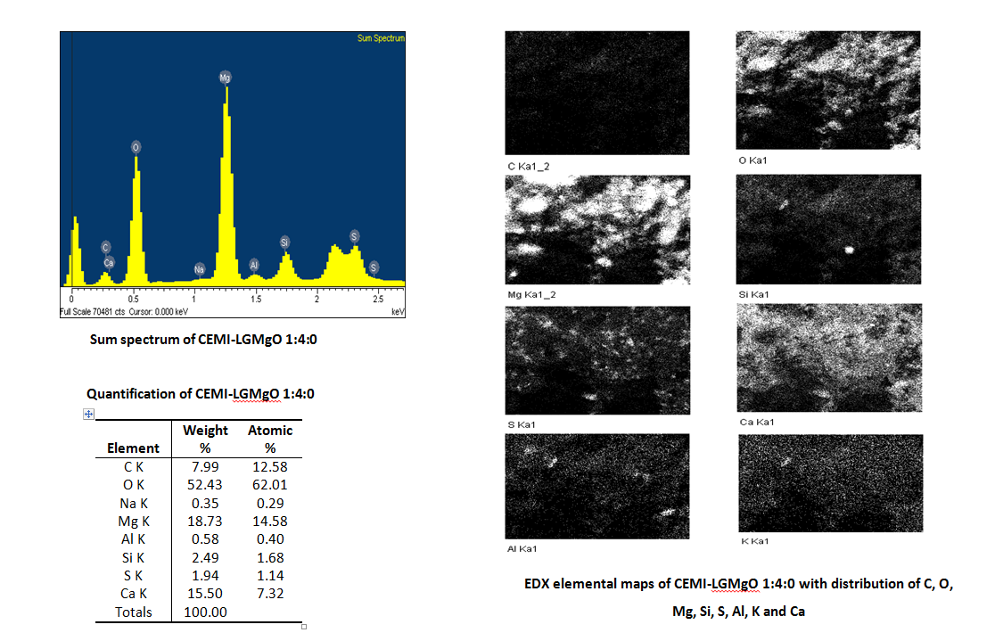
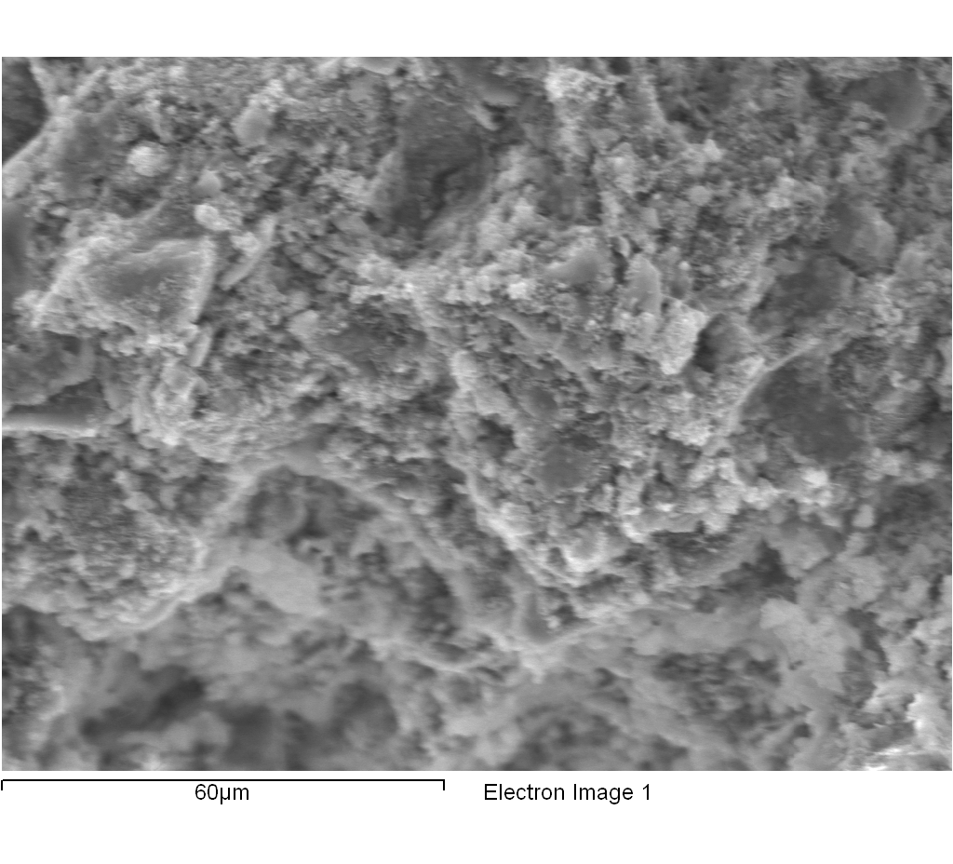
SEM image of CEMI-LGMgO 1:4 at 28 days’ curing age

Slide 32
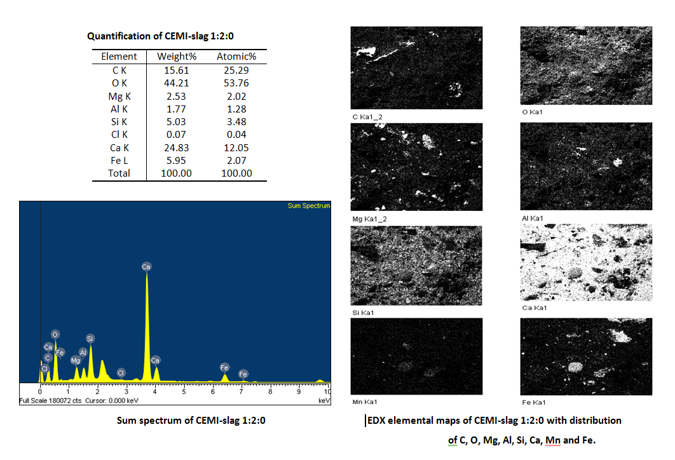
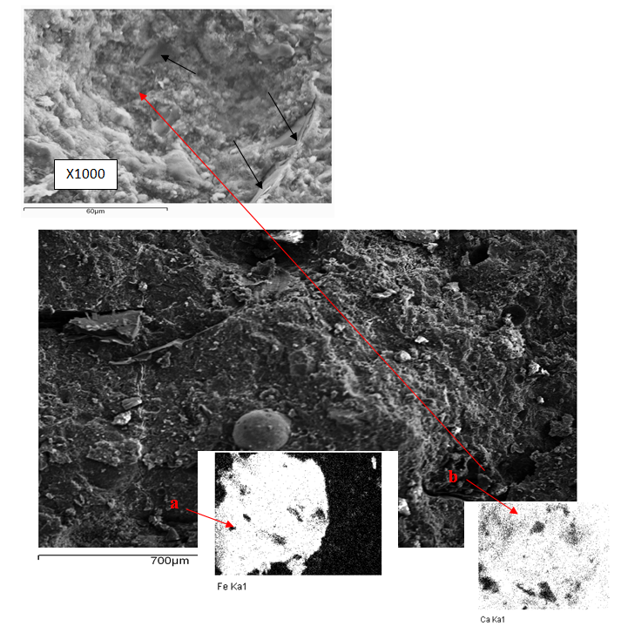
SEM image of CEMI-slag 1:2 at 28 days’ curing age
SEM image of CEMI-slag 1:2 at 28 days – large area scan (X90)

Slide 33
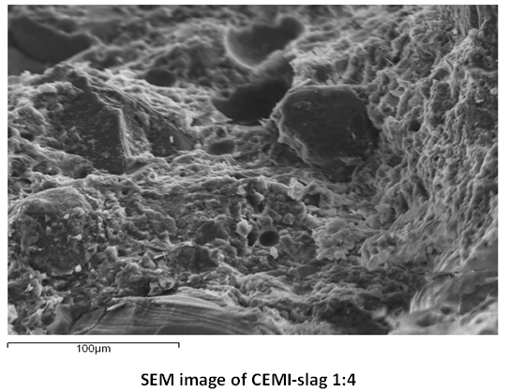
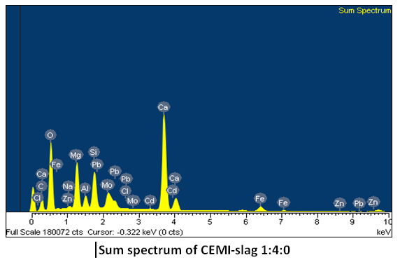
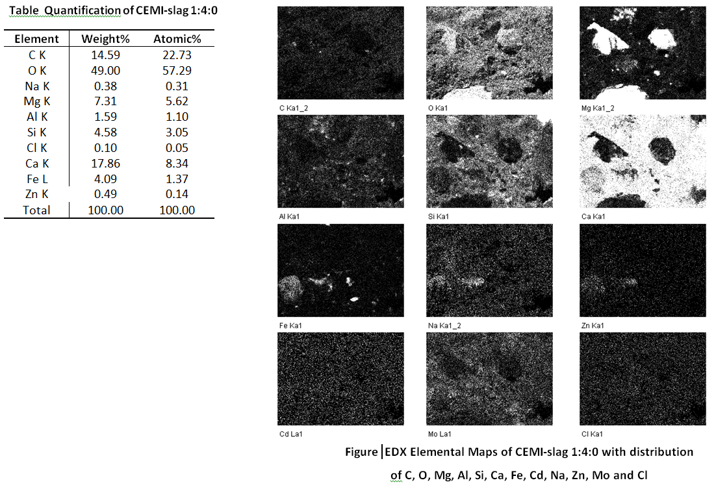
SEM image of CEMI-slag 1:4 at 28 days’ curing age

Slide 34
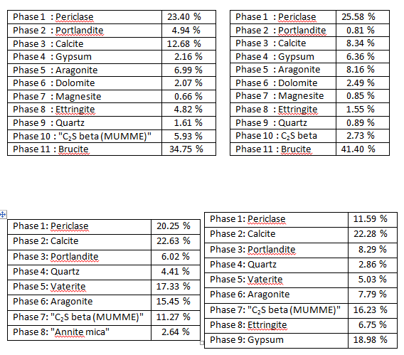
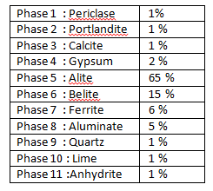
XRD Results
Quantitative Analysis -Rietveld
CEMI-LGMgO 1:2
CEMI-LGMgO 1:4
CEMI
CEMI-slag 1:2
CEMI-slag 1:4

Slide 35
CONCLUSIONS
LGMgO, PFA and slag blended mixtures performed well in terms of physical integrity - UCS development at ALL ratios studied (1:1 to 1:9).
Leaching test results clearly showed that the use of LGMgO, steel slag, PFA and hlime as alternative binders for EAFD S/S exhibited much better product performance in terms of granular leaching test regime when compared to the monolithic one.

Slide 36
CONCLUSIONS
SEM analysis was able to detect the formation of cement hydration products (portlandite and ettringite) formation of C-H and/or C-S-H cement hydration products.
Effective replacement of cement by LGMgO and steel slag (both waste by-products) at a ratio of 1:4 significantly improves both the economics and sustainability characteristics of this treatment technique.

Slide 37

Thanks for Listening! ☺
Any Questions, please?!

Slide 38


