Slide 1



Ultraviolet-fluorescent tattoo facilitates accurate identification of biopsy sites
Bertha Baum, DO
Hollywood Dermatology & Cosmetic Specialists

Slide 2
Thanks
Grateful for my mentor and friend Dr. Eduardo Weiss, who created this study and guided me through the process.
Thanks to all my teachers, attendings, family and friends.
This study was published in Dermatologic Surgery 2015 Nov;41(11):1249-56

Slide 3
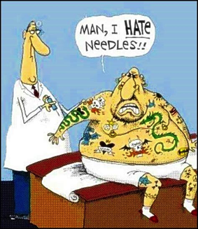
Objective of the study
To determine the efficacy of ultraviolet-fluorescent tattoos in facilitating correct identification of biopsy sites in patients suspected of having non-melanoma skin cancer.

Slide 4
Facts
In USA, more than 4.3 million patients undergo treatment for non-melanoma skin cancer each year (1).
Many patients wait weeks to months from the time of biopsy to the time of treatment. During this time, biopsy sites may heal to become imperceptible (2).
The inability to correctly identify a patient’s biopsy site is a common problem and is the most frequent reason for medical malpractice lawsuits (3).
Notes:
In addition, diffuse actinic damage, prior surgical scars, and multiple biopsy sitescan make distinguishing the site to be treated more difficult.

Slide 5
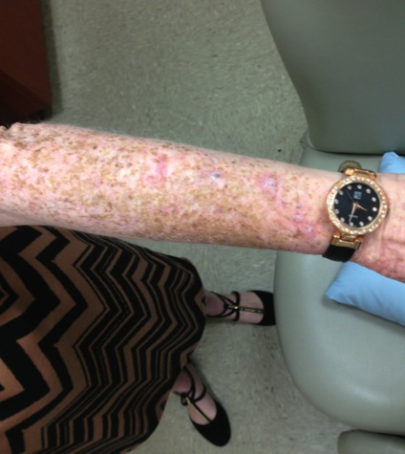
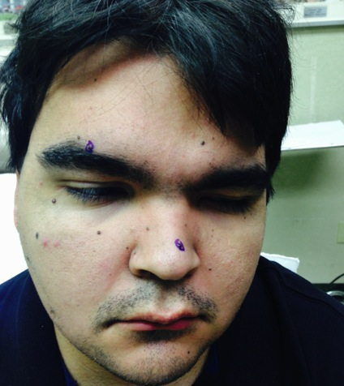
Identify the site?
Notes:
Actinic damage and gorlin syndrome

Slide 6
What is done today?
Methods to correctly identify surgical sites (2, 4):
  photography
  diagrams
  measurements to anatomical landmarks
  gauze dermabrasion
  biopsy site scar visualization
  patient assistance among others
When patients and physicians try to identify the site together, they are incorrect in 4-12% of cases (2, 5). Disagreement between patient and physician can lead to delay in treatment and increased costs (6).
Notes:
These methods bring about various challenges. Documentation and diagrams may be unclear. Patients often have difficulty remembering their biopsy sites. Other authors have demonstrated that patients incorrectly identify their own biopsy sites 16-30% of the time, and physicians incorrectly identify sites 6% of the time.

Slide 7
Failures
The use of biopsy site photography:
  decrease the number of wrong site surgeries (2)
  its adoption has been encouraged (2, 5, 7)
  pre-operative biopsy photos are often not provided or are of insufficient quality when patients are referred for treatment (8).
  Having a system to accurately identify biopsy sites is imperative to prevent wrong site surgery.

Slide 8
Tattoos in medicine
Tattoos are regularly used in the fields of surgery and radiation oncology to correctly identify tumor locations (9, 10).
However, these marks are permanent, and many patients dislike their appearance and seek future removal (11).
Ultraviolet tattoos, also known as invisible tattoos, are composed of a special ink that is invisible in natural light but fluoresces when exposed to a Wood’s lamp (360nm), more commonly known as a black light.
Notes:
Chuang and Gilchrest demonstrated the use of an ultraviolet tattoo in a single biopsy site on a young patient with basal cell nevus syndrome (6). No other studies to date have examined the efficacy or safety of invisible tattoos in dermatologic surgery.

Slide 9
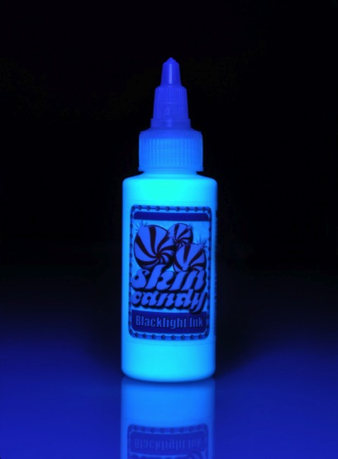
Invisible tattoo ink
http://www.wholesaletattoosupplies.com

Slide 10
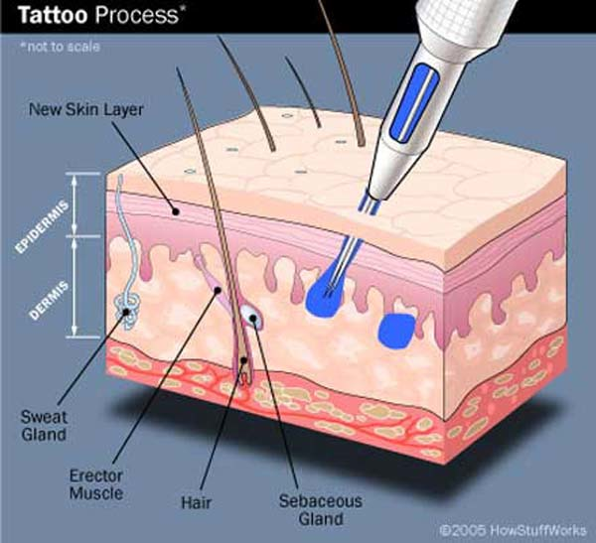
https://www.youtube.com/watch?v=EIR5pPiM3Bg

Slide 11
Methods
Between November 2013 and October 2014 , patients 18 years of age or older undergoing a skin biopsy for a suspected non-melanoma skin cancer in our outpatient dermatology clinic were invited to participate in this study.
Participants received written information about the study in either English or Spanish, and informed consent was obtained from each patient. The project proposal was approved by the Nova Southeastern Institutional Review Board.
Notes:
Exclusion criteria included a history of immunosuppression, prior biopsy or radiation at the site in question, history of an adverse reaction to tattoo ink, age less than 18 years, and pregnancy.

Slide 12
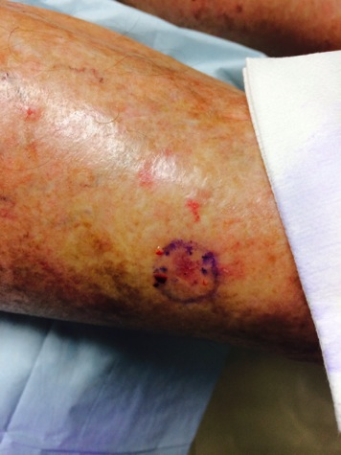
Technique
Notes:
Lesions suspected of being nonmelanoma skin cancer were marked with a surgical pen and photographed prior to biopsy (Figure 1A). Each lesion was cleaned using an alcohol swab, and a 1-2 cc solution of 1% lidocaine with epinephrine and bicarbonate was injected into the lesion and surrounding area. A standard shave biopsy with a 15 blade was performed.

Slide 13
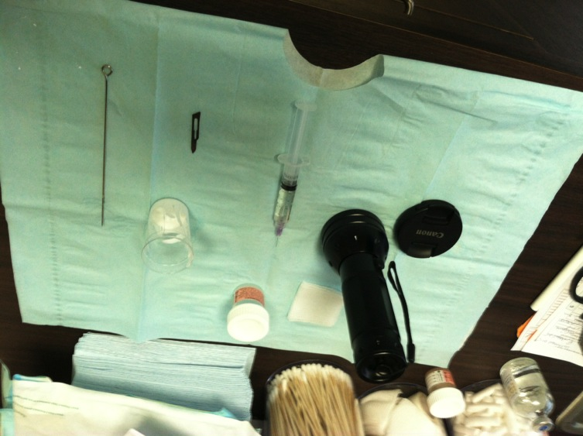
Materials
Notes:
Following the biopsy, 2-3 drops of SkinCandy Blacklight Invisible UV Tattoo Ink (SkinCandy Tattoo Supply; Burbank, CA) was placed in a small tattoo ink cup. A sterile 3 mm trephine was dipped in the ink cup to saturate the tip. The trephine was then gently pierced into the biopsy site to introduce the ink into the superficial dermis . This was repeated 4 times for a total of 5 passes. Hemostasis procedures were repeated as needed, and a bandage was applied.
Did you stop using the tattoo needles? I know that is what we were using in the beginning.

Slide 14
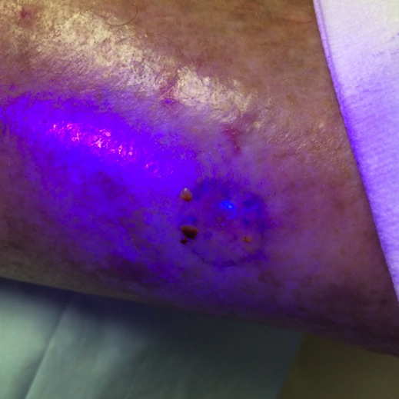
Tattoo immediately after
Notes:
Depending on the biopsy results, patients were asked to return in 4-8 weeks for further treatment as needed. Repeat photographs were taken at the time of the subsequent treatment procedure. At each visit, the patient and investigator attempted to identify the biopsy site with and without the use of a Wood’s lamp. Pre-biopsy photos were only used for confirmation after the site was identified. The visibility of the tattoos were graded by one of three dermatologists on three occasions- immediately after application (Figure 1B) and again at the follow-up visit both before and after the treatment procedure (Figure 1C,D). The level of fluorescence (LOF) was recorded using a grading scale from one to three (barely to very visible, respectively) using the Wood’s lamp. In cases where no further treatments were needed, patients were offered tattoo removal.

Slide 15
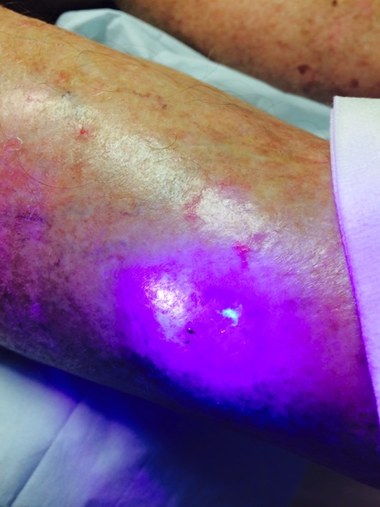
Tattoo at follow up visit

Slide 16
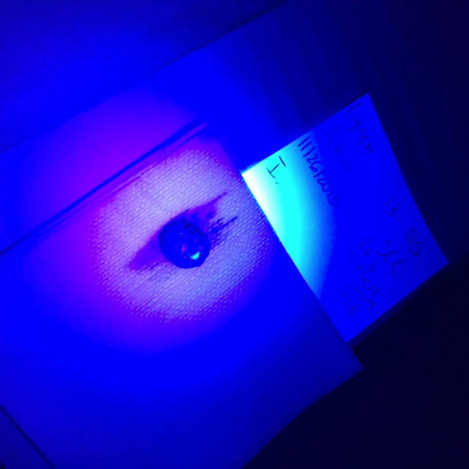
Tattoo removal

Slide 17
Patients
31 patients (11 women, 20 men; mean age 74 [range 53-96 years])
51 biopsies were performed in total with one to four biopsies per patient
Most of the biopsy sites occurred on the extremities
Out of the 51 total biopsies, 48 were nonmelanoma skin cancers including 39 squamous cell carcinomas (SCC) and 9 basal cell carcinomas. Two biopsy lesions were diagnosed as actinic keratoses and 1 was nonmalignant, acroangiodermatitis.
Notes:
though tattoos were also placed on the lip, ear, temple, and trunk. Immediately after tattoo application, all sites were fully fluorescent under the Wood’s lamp (LOF 3).

Slide 18
Results
Follow up visits for treatment occurred 7 to 161 days after tattoo application (mean 49 days). Two patients (5 SCCs biopsies) were lost to follow up; they did not respond to attempts to contact them. Another patient with two biopsy proven SCCs refused treatment and declined tattoo removal.
None of the participants have experienced any adverse reactions related to the tattoo to date.
Notes:
The two patients with actinic keratoses returned 3 weeks after tattoo application, at which time both tattoos were visible (LOF 2-3) and treated with liquid nitrogen. At their follow up visits, neither tattoos were visible .The patient with the nonmalignant biopsy, acroangiodermatitis, chose not to have her tattoo removed and did not return to the clinic.

Slide 19
Level of Fluorescence (LOF)
All tattoo sites corresponded with photos taken at the time of biopsy.
The majority of lesions (84%) demonstrated very visible fluorescence (LOF 3) at follow up; those tattoos had been present for an average of 46 days.
Four (9%) tattoos had a LOF of 2 at follow up; those had been present for an average of 49 days.
Three (7%) had a LOF of 1 at follow up; those tattoos had been present for an average of 92 days.

Slide 20
Identification
In 35% of cases, the patient was unsure of the biopsy site before Wood’s lamp illumination. Illumination was helpful to the physician in identifying the correct site in 7% of cases. None of the tattoos were visible in natural light.
The majority of patients were treated with Mohs micrographic surgery or surgical excision. After surgical treatment, none of the patients had visible evidence of residual tattoo.

Slide 21
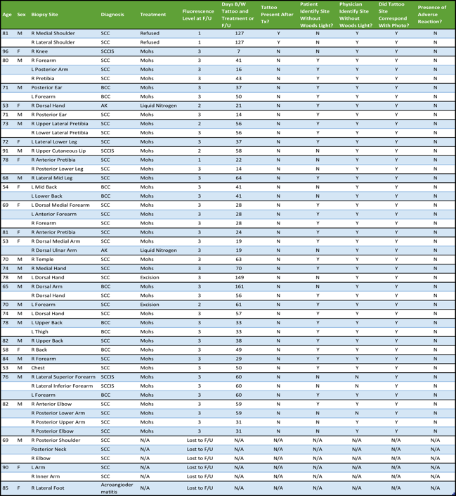

Slide 22

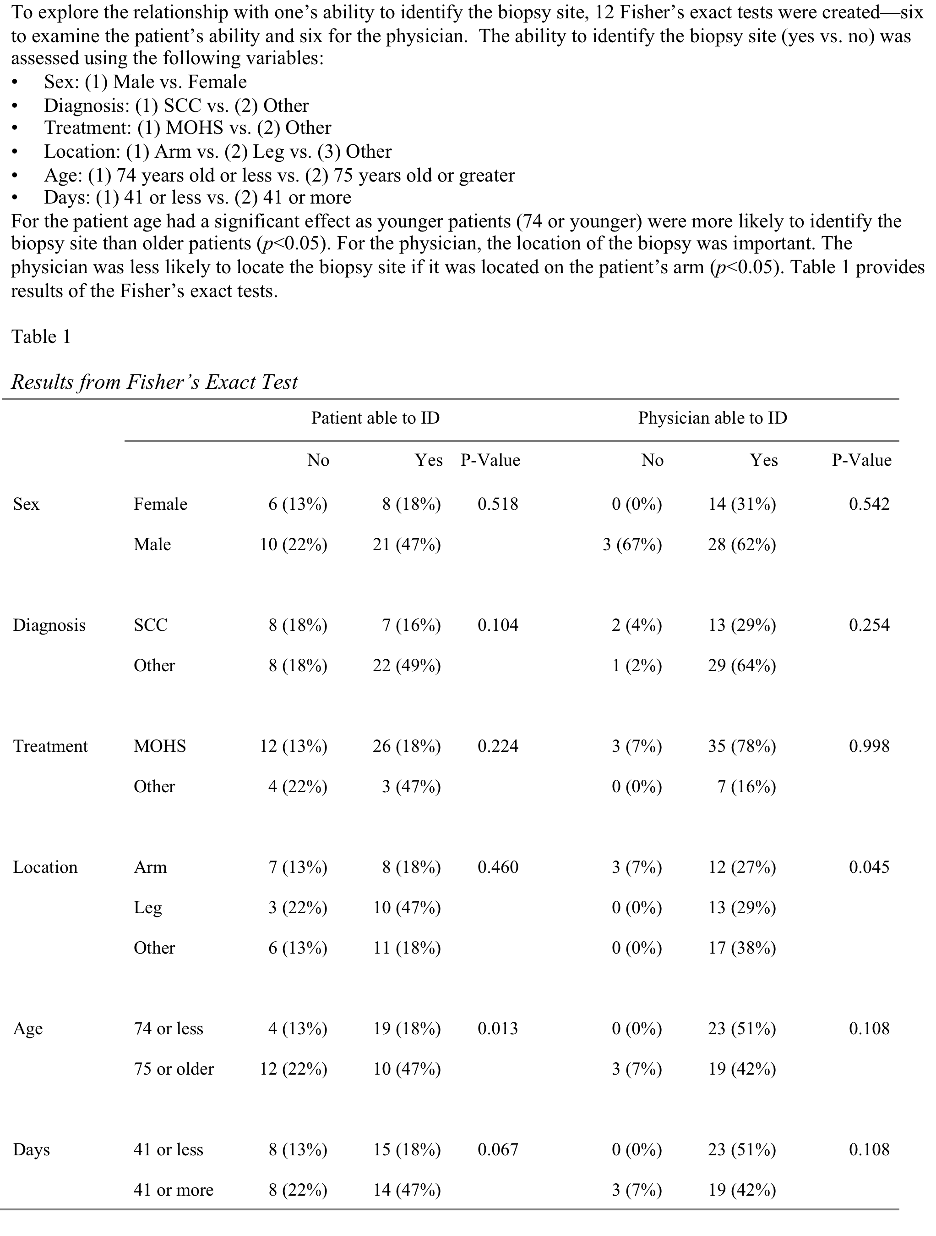
Patient able to ID
Physician able to ID
No
Yes P-Value
No
Yes
P-Value
Sex
Female
6 (13%)
8 (18%)
0.518
0 (0%)
14 (31%)
0.542
Male
10 (22%)
21 (47%)
3 (67%)
28 (62%)
Diagnosis
SCC
8 (18%)
7 (16%)
0.104
2 (4%)
13 (29%)
0.254
Other
8 (18%)
22 (49%)
1 (2%)
29 (64%)
Treatment
Mohs
12 (13%)
26 (18%)
0.224
3 (7%)
35 (78%)
0.998
Other
4 (22%)
3 (47%)
0 (0%)
7 (16%)
Location
Arm
7 (13%)
8 (18%)
0.460
3 (7%)
12 (27%)
0.045
Leg
3 (22%)
10 (47%)
0 (0%)
13 (29%)
Other
6 (13%)
11 (18%)
0 (0%)
17 (38%)
Age
74 or less
4 (13%)
19 (18%)
0.013
0 (0%)
23 (51%)
0.108
75 or older
12 (22%)
10 (47%)
3 (7%)
19 (42%)
Days
41 or less
8 (13%)
15 (18%)
0.067
0 (0%)
23 (51%)
0.108
41 or more
8 (22%)
14 (47%)
3 (7%)
19 (42%)

Slide 23
Discussion
In cases of suspected non-melanoma skin cancer, we have demonstrated an easy, accurate, and discrete method of marking biopsy sites with invisible tattoo ink.
Our method could be altered to involve ink inoculation with a punch biopsy tool, a blade, or a needle and could be used for biopsies of other cutaneous lesions.

Slide 24
Factors in LOF values
The small amount of variability in fluorescence levels seen at follow up may be due to a variety of factors.
A negative trend between fluorescence intensity and the length of time the tattoo remained in the skin was observed.
Depth of the biopsy and the amount of ink inoculation in the dermis may have varied slightly among patients.
Bleeding or the use of hemostatic agents may have also played a role. Importantly, every tattoo was visible at follow up.

Slide 25
Future: Better identification
Like previous studies, our results indicate an inability of dermatologists and patients to correctly locate biopsy sites with absolute confidence and accuracy.
While biopsy site photography can be helpful, photographs vary in quality, and are not always readily available.
Based on our results, if a patient had an invisible tattoo marker but not a suitable photograph, the biopsy site would still be easily identifiable.
Notes:
The frequency at which our investigators and patients misidentified or could not identify a specific site are consistent with previous reports.

Slide 26
Adverse effects of tattoo ink?
Tattoo ink is not FDA-regulated, and some authors have expressed concerns about the safety of ultraviolet tattoos.
Specifically, invisible tattoo ink has been reported to cause granulomatous reactions (13, 14, 15).
We acknowledge this potential complication; however, the amount of ink applied to the biopsy site during our described procedure is much less than the amount applied in traditional ornamental tattooing.

Slide 27
Is it safe?
Furthermore, the vast majority of these tattoos will be removed with treatment of the suspected skin cancer, and if they are not, the biopsy sites will likely be small and easily amenable to excision if desired.
None of our 31 patients developed any adverse reactions from the tattoo ink.
More studies are needed, and a larger group of people should be used.

Slide 28
Conclusions
In conclusion, our results demonstrate that ultraviolet ink tattoos provide an easy, inexpensive, reliable, and effective method of marking biopsy sites on the skin.
This method has the potential to improve patient safety and decrease malpractice costs by reducing the number of wrong site surgeries in dermatology.
Notes:
Submitted to JAAD recently,

Slide 29
References
1. Gery P. Guy, Jr, PhD, MPH, Steven R. Machlin, MS, Donatus U. Ekwueme, PhD, MS,K. Robin Yabroff, PhD, MBA. Prevalence and Costs of Skin Cancer Treatmentin the U.S., 2002-2006 and 2007-2011 Am J Prev Med 2014
2.Mcginness JL, Goldstein G. The Value of Preoperative Biopsy-Site Photography for Identifying Cutaneous Lesions. Dermatologic Surgery. 2010Feb.;36(2):194–7.
3.Perlis CS, Campbell RM, Perlis RH, Malik M, Dufresne RG. Incidence of and risk factors for medical malpractice lawsuits among Mohs surgeons. Dermatologic Surgery. 2006Jan.;32(1):79–83.
4. Campbell RM, Perlis CS, Malik MK, Dufresne RG. Characteristics of Mohs Practices in the United States: A Recall Survey of ACMS Surgeons. Dermatologic Surgery. 2007Sep.10;0(0):071009211231019–
5. Ke M, Moul D, Camouse M, Avram M, Carranza D, Soriano T, et al. Where Is It? The Utility of Biopsy-Site Photography. Dermatologic Surgery. 2010Feb.;36(2):198–202.
6. Chuang GS, Gilchrest BA. Ultraviolet-Fluorescent Tattoo Location of Cutaneous Biopsy Site. Dermatologic Surgery. 2012Mar.;38(3):479–83.
7. Vujevich JJ, Kimyai-Asadi A, Goldberg LH. Letter: Where Was That Biopsy Taken? Dermatologic Surgery. 2007Dec.7;33(12):1534–6.
8. Nemeth SA, Lawrence N. Site identification challenges in dermatologic surgery: A physician survey. Journal of American Dermatology. Elsevier Inc; 2012Aug.1;67(2):262–8.
9. Keller D, Jaffe J, Philp MM, Haluszka O, Khanna A. Should all endoscopically excised rectal polyps be tattooed? A plea for localization. Surg Endosc. 2012Nov.;26(11):3101–5.
10. Uyeda LM. Permanent dots in radiation therapy. Radiol Technol. 1987May6;58(5):409–11.
11. Alam M, Arndt KA. Laser removal of radiation tattoos. Ann. Intern. Med. 2002Apr.2;136(7):558.
12. White GM, Zhou HC, Burchette RJ. Biopsy followed by immediate curettage and electrodesiccation of suspected basal cell carcinomas at the first visit. JAMA Dermatol. 2013Aug.;149(8):980–1.
13. Schumann T, Peitsch WK, Ge´raud C, et al. Ultraviolet light tattoo complicated by granulomatous inflammation. J Am Acad Dermatol 2011;65:e124–6.
14. Bedocs PM, Cliffel M, Mahon MJ, Pui J. Invisible tattoo granuloma. Cutis 2008;81:262–4.
15. Kluger, N. (2012), Letter: Ultraviolet-Fluorescent Tattoo for Radiotherapy Marking?. Dermatologic Surgery, 38: 966–967. doi: 10.1111/j.1524-4725.2012.02413.x

Slide 30
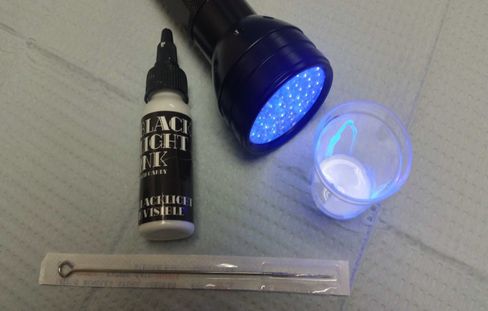
THANKS

