Slide 1
Biological Ice-Nucleating Macromolecules (INMs)
B. G. Pummer
Climate Change Conference
Valencia, 24.10.2016

Slide 2
Background
Water freezes at 0°C / 32°F / 273.15 K
Wrong!
Thermodynamics: freezing is favorable
Kinetics: cluster formation is hindered
Supercooling down to 230 K is possible (esp. in atmosphere)
Ice nuclei (IN) are catalysts that structure the water; are very exclusive group
Freezing at higher temperatures (up to 273 K)

Slide 3
Background
Why bother?
In the atmosphere: IN play a huge role
Cloud glaciation is critical for precipitation (weather) and albedo (global heat budget)
IPCC: cloud-aerosol interaction = least understood term in climate models

Slide 4
Ice nuclei: INPs and INMs
active sites (often INMs)
any particle INP [µm] INMs [nm]
INP-INA = INM-INA
INP = ice-nucleating particle
INM = ice-nucleating macromolecule
INA = ice nucleation activity

Slide 5
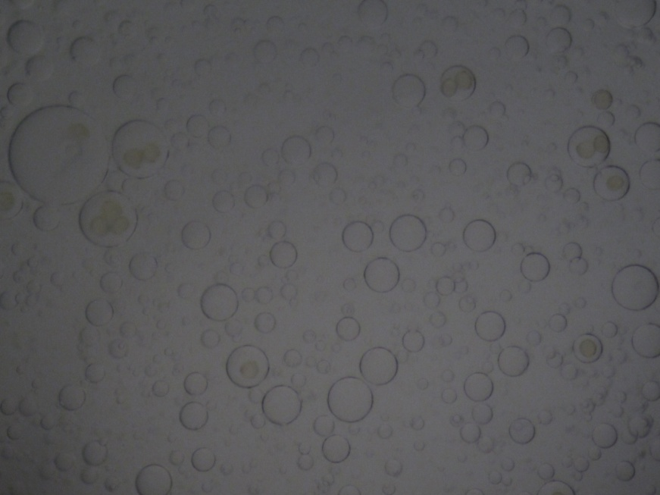
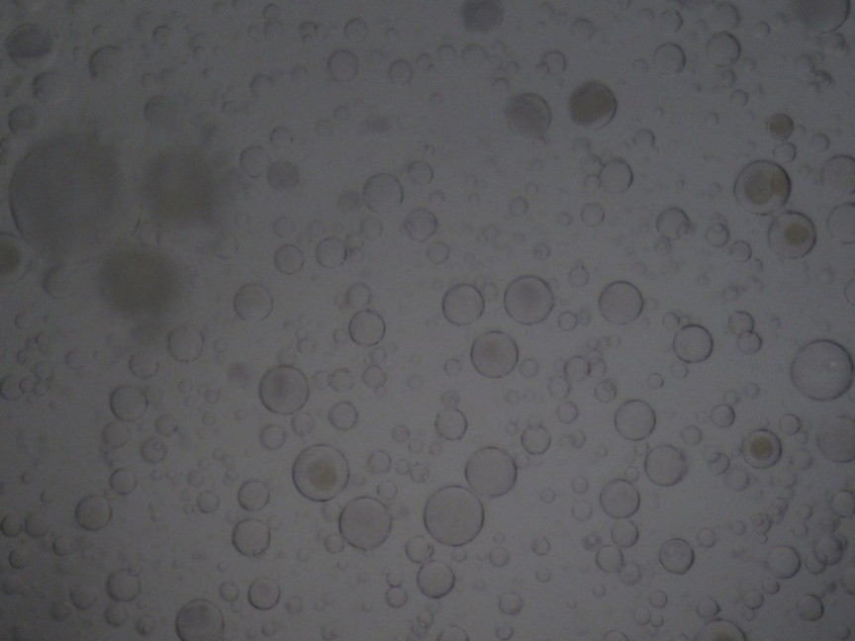
INMs: discovery
Birch pollen 259.0 K
Birch pollen 255.6 K
T_{hom} = 237 K
Pummer et al.: Atmos. Chem. Phys., 12, 2541-2550, 2012.

Slide 6
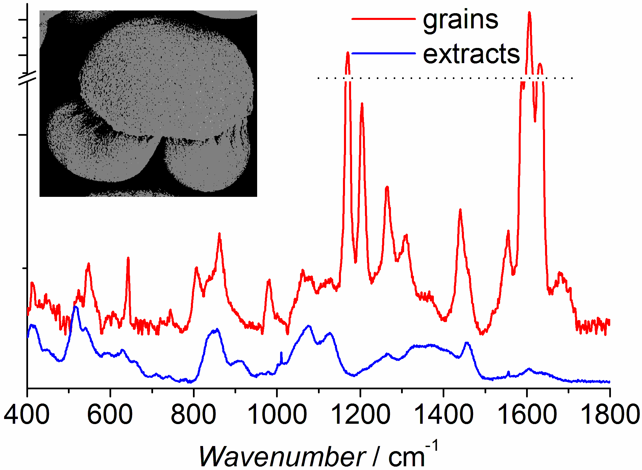
INMs: discovery
Sporopollenin
Cytosol
Biooligo- & -polymers
But Nobody Believed Me!
Pummer et al.: J. Raman Spectrosc., 44, 1654-1658, 2013.

Slide 7
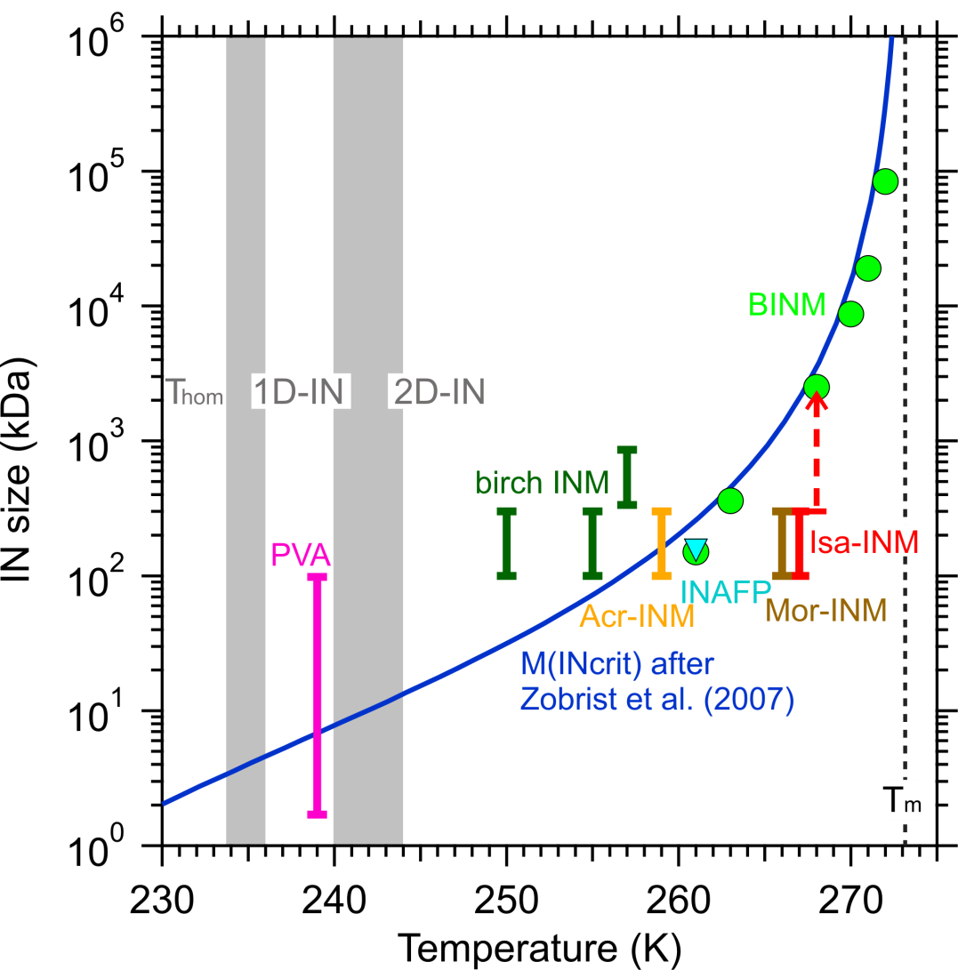
INMs: the size issue
for proteins:
10¹ kDa > 1.4 nm
10² kDa > 3.1 nm
10³ kDa > 6.6 nm
10⁴ kDa > 14.2 nm
Erickson (2009)
Pummer et al.: Atmos. Chem. Phys., 15, 4077-4091, 2015.

Slide 8
INMs: the solubility issue
ice formation here
„IN have to be insoluble“
INMs are in solution, but large enough to be ice templates
INMs carry hydration shells → site of embryo formation

Slide 9
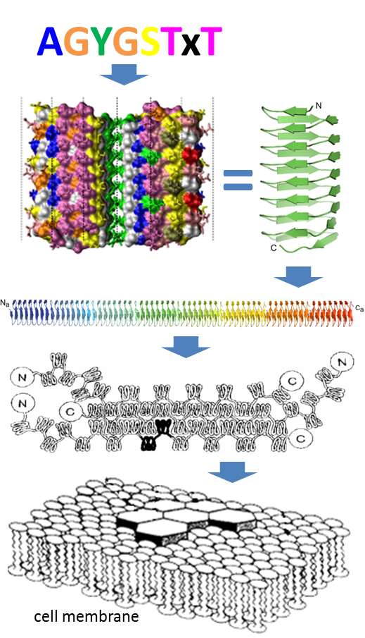
bactINMs
References:
Pandey et al. (2016)
Garnham et al. (2011)
Kajava and Lindow (1993)
Warren and Wolber (1991)

Slide 10
Type | Organism | INM? | Protein? | Sacch.? | References
Bact. | Pseudomonas syringae | + | + | + | Govindarajan and Lindow (1988)
 | Pantoea agglomerans (Erwinia herbicola) | + | + | + | Govindarajan and Lindow (1988)
Fungi | Rhizoplaca chrysoleuca | + | + | – | Kieft and Ruscetti (1990)
 | Fusarium avenaceum | + | + | – | Pouleur et al. (1992), Hasegawa et al. (1994)
 | Sarocladium (Acremonium) implicatum | + | + | –? | Pummer et al. (2015)
 | Isaria farinosa | + | + | –? | Pummer et al. (2015)
 | Mortierella alpina | + | + | –? | Fröhlich-Nowoisky et al. (2015)
 | Puccinia (rust) spp. | + | ?? | + | Morris et al. (2013a)
Animals | Tipula trivittata | + | + | +? | Duman et al. (1985, 1991), Neven et al. (1989)
 | Dendroides canadensis | + | + | –? | Olsen and Duman (1997)
 | Vespula maculata | + | + | – | Duman et al. (1984)
 | Eurosta solidaginis (phosphate spherules) | – | – | – | Mugnano et al. (1996)
 | Rana sylvatica | ?? | ?? | ?? | Storey and Storey (1985)
 | Mytilus edulis | ?? | ?? | ?? | Lundheim (1997)
Plants | Secale cereale leaves | + | + | + | Brush et al. (1994)
 | Prunus spp. wood | ?? | – | ?? | Gross et al. (1988)
 | Betula pendula pollen | + | – | + | Pummer et al. (2012)
 | Lobelia telekii fluid | + | – | +? | Krog et al. (1979)
 | Opuntia ficus-indica fluid | + | – | + | Goldstein and Nobel (1991)
 | cellulose | + | – | + | Hiranuma et al. (2015)
 | lignin | + | – | – | Gao et al. (1999)
 | some algae | +? | ?? | ?? | Schnell (1975), Wilson et al. (2015)

Slide 11
Effects of Experiments
Species | birch pollen | Snomax™ | Mortierella | Isaria | Saro-cladium
T_{INA} | 255 K | 271 K | 267 K | 269 K | 264 K
heat | 460 K | 310 / 415 K | <371 K | >335 K | >335 K
0.1 µm | none | - | none | none | none
300 kDa | none | - | none | minor | none
100 kDa | major | major | major | major | major
CN₃H₆Cl | none | major | major | major | major
H₃BO₃ | minor | - | none | none | none
proteases | none | major | major | major | major
lipases | none | minor | none | none | minor
saccharases | none | minor | none | none | none
Pummer et al., 2012, 2015; Fröhlich-Nowoisky et al., 2015

Slide 12
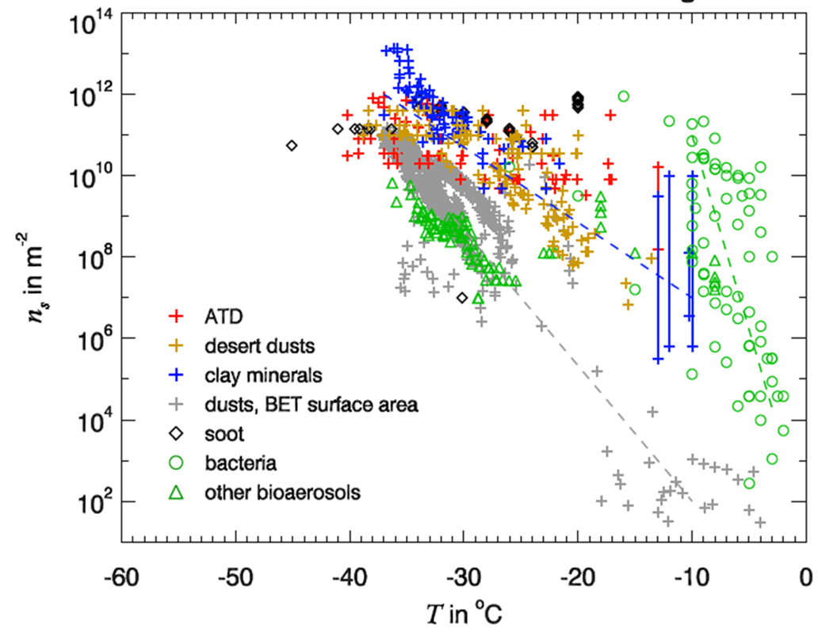
Atmospheric Relevance
Hoose and Möhler: Atmos. Chem. Phys., 12, 9817–9854, 2012.

Slide 13
Atmospheric Relevance
BioINMs are - mostly - easily extracted from carrier cells with water (Pummer et al., 2015)
In nature: water = clouds, precipitation, lakes, rivers, oceans, soil humidity
Distribution in soil, water, air
Precipitation increases atmos. IN conc. (Huffman et al., 2015)
Feedback cycle: IN <=> precipitation (Morris et al., 2014)
Huffman et al.: Atmos. Chem. Phys., 13, 6151-6164, 2013.
Morris et al.: Global Change Biol., 20, 341-351, 2014.

Slide 14
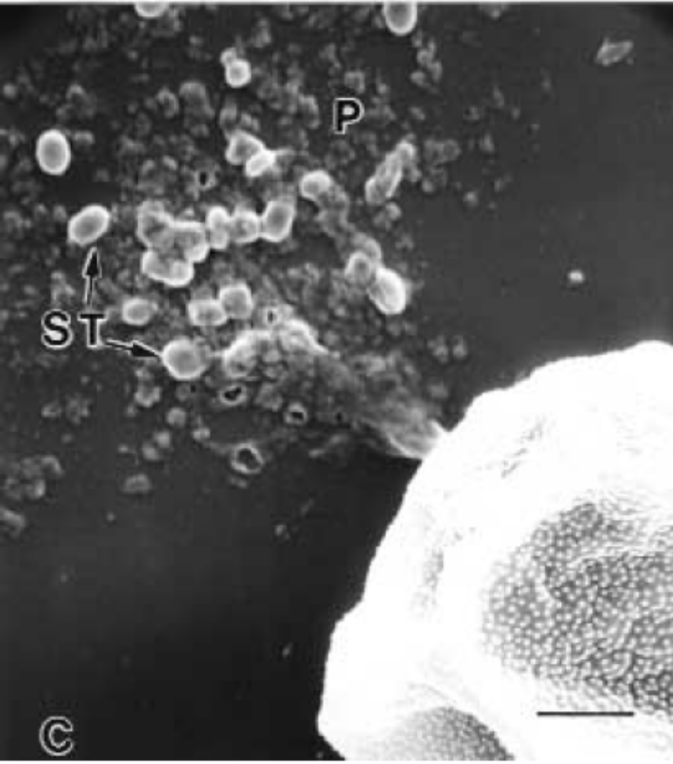
Atmospheric Relevance
Bursting processes
Grote et al.: J. Allerg. Clin. Immunol., 105, 1140-1145, 2000.

Slide 15
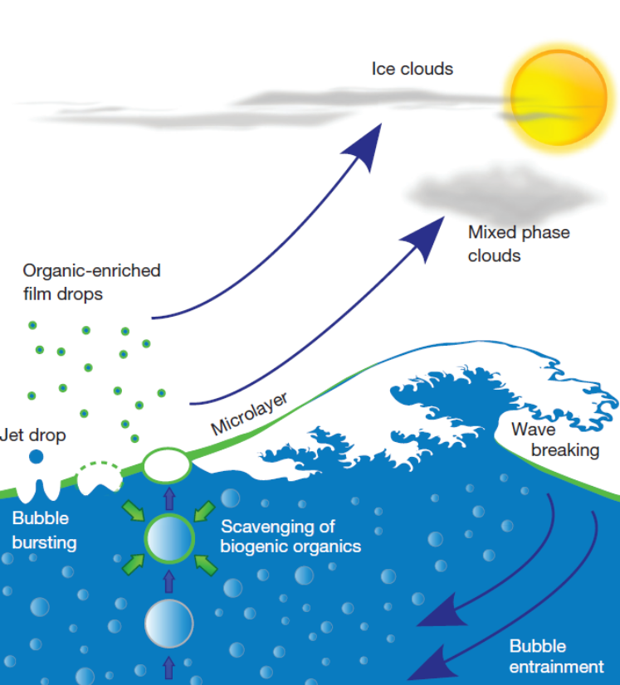
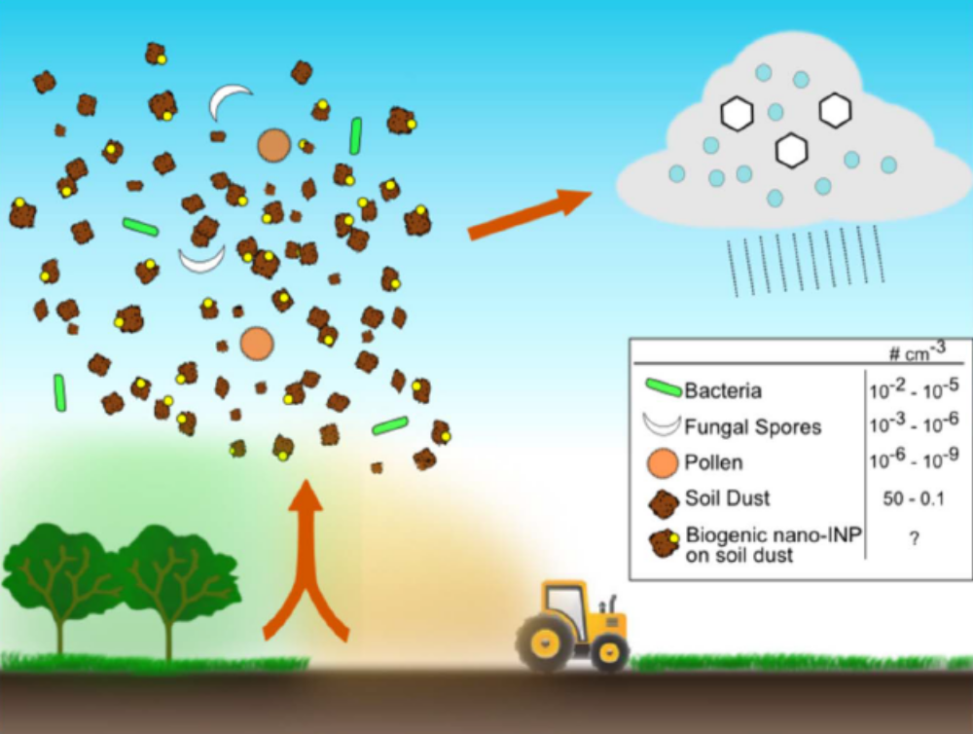
Atmospheric Relevance
Wilson et al.: Nature, 525, 234-238; 2015. (right)
O’Sullivan et al.: Sci. Rep., 5, 8082; 2015. (bottom)

Slide 16
Acknowledgement
Max Planck Society, Vienna University of Technology …for funding
WG Koop (Bielefeld), WG Stratmann (Leipzig)
Family & Friends
Thank you for your attention!
Questions?
Correspondence: b.pummer@mpic.de

