Slide 1
About OMICS Group
OMICS Group is an amalgamation of Open Access publications and worldwide international science conferences and events. Established in the year 2007 with the sole aim of making the information on Sciences and technology ‘Open Access’, OMICS Group publishes 500 online open access scholarly journals in all aspects of Science, Engineering, Management and Technology journals. OMICS Group has been instrumental in taking the knowledge on Science & technology to the doorsteps of ordinary men and women. Research Scholars, Students, Libraries, Educational Institutions, Research centers and the industry are main stakeholders that benefitted greatly from this knowledge dissemination. OMICS Group also organizes 500 International conferences annually across the globe, where knowledge transfer takes place through debates, round table discussions, poster presentations, workshops, symposia and exhibitions.

Slide 2
About OMICS International Conferences
OMICS International is a pioneer and leading science event organizer, which publishes around 500 open access journals and conducts over 500 Medical, Clinical, Engineering, Life Sciences, Pharma scientific conferences all over the globe annually with the support of more than 1000 scientific associations and 30,000 editorial board members and 3.5 million followers to its credit.
OMICS Group has organized 500 conferences, workshops and national symposiums across the major cities including San Francisco, Las Vegas, San Antonio, Omaha, Orlando, Raleigh, Santa Clara, Chicago, Philadelphia, Baltimore, United Kingdom, Valencia, Dubai, Beijing, Hyderabad, Bengaluru and Mumbai.

Slide 3


Title page
HDL Signaling in Macrophages
and its role in atherosclerosis protection
Bernardo Trigatti
Department of Biochemistry and Biomedical Sciences
Thrombosis and Atherosclerosis Research Institute
McMaster University
Hamilton, Canada
3rd International Conference on Integrative Biology
August 5, 2015, Valencia, Spain

Slide 4
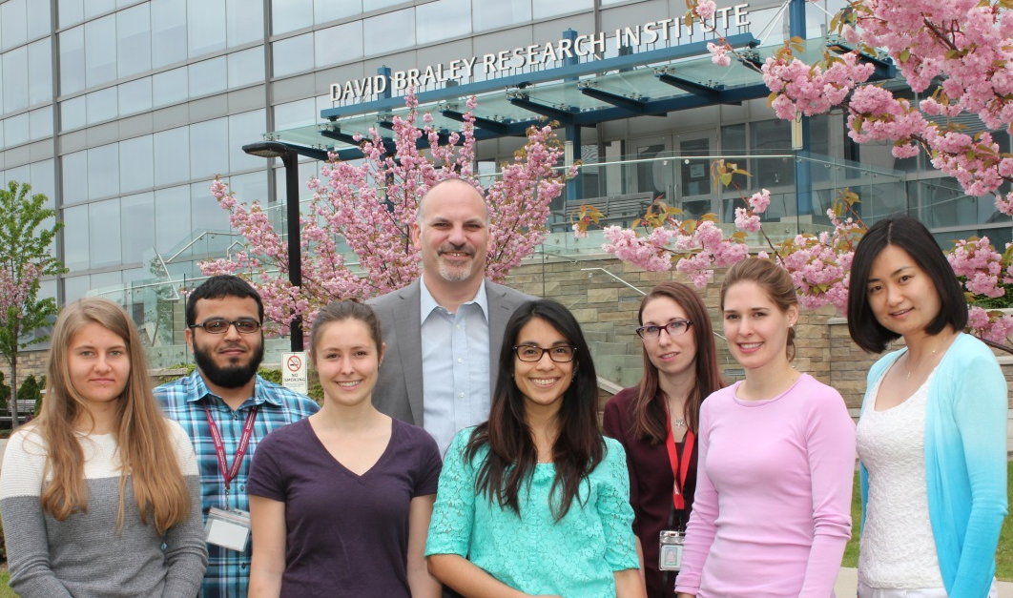


Acknowledgements
Monty Krieger —Cambridge, USA
Rick Austin — Hamilton, Canada
Suleiman Igdoura — Hamilton, Canada
Geoff Werstuck — Hamilton, Canada
Richard Lehner – Edmonton, Canada
Dennis Vance -- Edmonton, Canada
Khosrow Adeli — Toronto, Canada
Gary Lewis — Toronto, Canada
Former members
Current members
Aishah Al-Jarallah
Scott Covey
Omid Dadoo
Kelvyn Fernades
Mark Fuller
Ying Pei
Ali Rizvi
Vivienne Tedesco
David Wang
Yi Zhang
Yazeed Alshuweishi
Kristina Durham
Leticia Gonzalez
Melissa MacDonald
Jane McBride
Pei Yu
Funders
Canadian Institutes
of Health Research
Heart and Stroke
Foundation of Canada

Slide 5
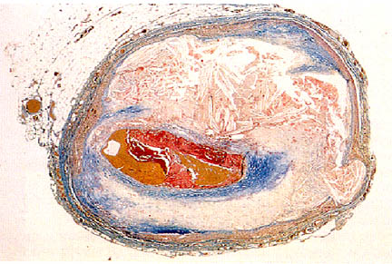
Atherosclerosis
Necrotic Core
Ruptured
Fibrous Cap
Thrombus
Slide Source:
Lipids Online Slide Library
www.lipidsonline.org

Slide 6
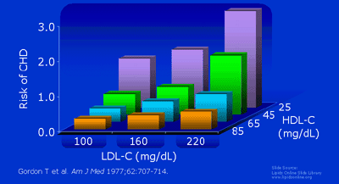
Heart disease risk versus LDL and HDL-cholesterol levels

Slide 7
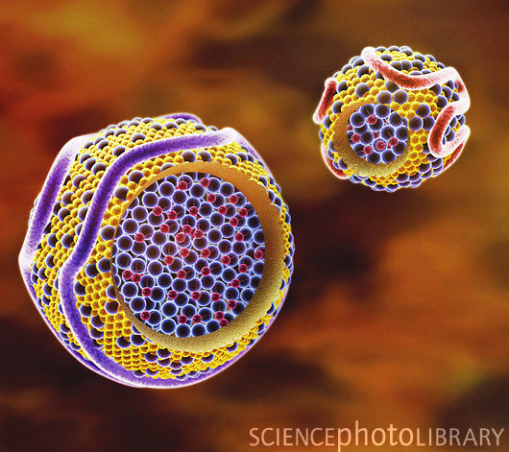
Low and High Density Lipoproteins
LDL
HDL
Apolipoproteins
Cholesterol
Esters
Triglycerides
Phospholipids
Cholesterol

Slide 8
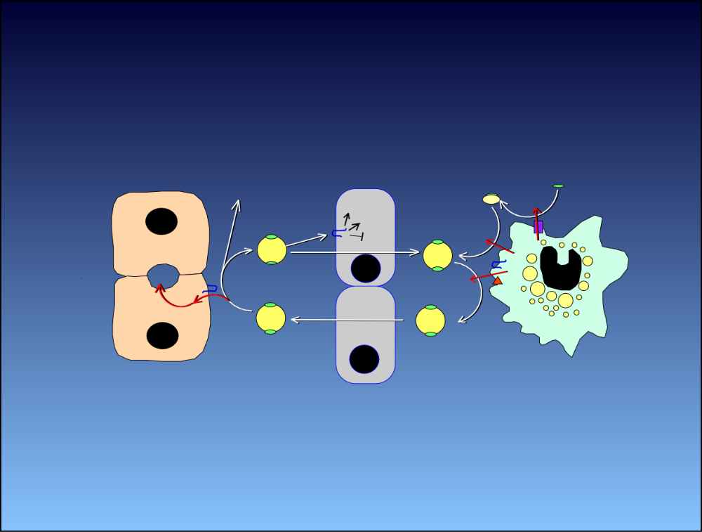
HDL: Reverse cholesterol transport and signaling
Degradation
(Kidney)
apoA1
migration
eNOS
HDL
ABCA1
apoptosis
SR-B1
ABCG1
blood
vascular
wall
Liver
Hepatocytes
Vascular
Endothelium
Macrophage
Foam Cell
Notes:
RCT is the movement of cholesterol by HDL from peripheral tissues to the liver for elimination from the body or recycling into newly synthesized lipoproteins. Both HDL as well as its precursor, lipid free apolipoprotien A1 can stimulate the efflux of excess cellular cholesterol via a variety of pathways. Current opinion is that there are two major pathways, each involving ATB-binding cassette transporters: ABCA1 and ABCG1. ApoA1 interacts with the ABCA1 leading to the efflux of cholesterol and PC and lipidation of apoA1 to form discoidal HDL particles. These continue to stimulate cholesterol efflux and the unesterified cholesterol that is loaded on the HDL particle eventually becomes esterified by LCAT to form spherical HDL particles which contain a hydrophobic core of CE. Spherical HDL can stimulate the efflux of UC via ABCG1. HDL can cross endothelial layer and enter the blood through which it carries cholesterol to the liver. HDL cholesterol is selectively taken up by the liver—this means that the cholesterol ester portion is taken up without the net uptake or degradatin of the particle. This is called selective cholesterol uptake and appears to be mediated primarily by SR-BI

Slide 9
Atherosclerosis
Necrotic Core
Ruptured
Fibrous Cap
Thrombus
Slide Source:
Lipids Online Slide Library
www.lipidsonline.org

Slide 10
Macrophages resist ER-stress induced apoptosis…
Annexin V
TUNEL
Thapsigargin
-
+
Serum
Newborn Calf

Slide 11
Macrophages resist ER-stress induced apoptosis … but become sensitive when lipoproteins are removed from serum
Annexin V
TUNEL
Thapsigargin
-
+
-
+
Serum
Newborn Calf
Newborn Calf
Lipoprotein Deficient
Pei Yu
Notes:
Mouse peritoneal macrophages. Experiment done by Pei Yu. Similar findings for tunicamycin and for OxLDL. We therefore did all of our experiments in LPDS

Slide 12
HDL but not LDL suppresses ER-stress induced apoptosis in macrophages
HDL but not LDL suppresses ER stress induced apoptosis in macrophages
Percent Apoptosis
HDL (µg/ml)
0
0
12.5
25
50
0
0
0
LDL (µg/ml)
0
0
0
12.5
25
50
Tunicamycin
-
+
Pei Yu
Notes:
Tunel staining—similar for up to 200 ug/ml LDL

Slide 13
HDL signaling in macrophages
HDL
SR-B1
S1PR1
Gα_{i}
PDZK1
PI3K
Akt 1
Bim
Necrotic core
Plaque instability
Apoptosis

Slide 14

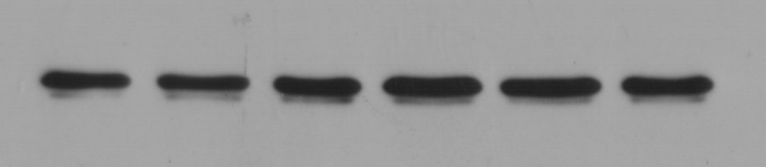
HDL treatment of macrophages reduces levels of the pro-apoptotic factor Bim
HDL (min)
0 10 30 60 120 240
Bim
β-Actin
Yi Zhang, Aishah Al-Jarallah

Slide 15
HDL mediated suppression of ER stress-induced apoptosis requires SR-B1
Wild Type
SR-B1 KO
*
*
*
NS
Free Chol Load
-
+
+
-
+
+
HDL
-
-
+
-
-
+
Yi Zhang, Aishah Al-Jarallah

Slide 16
HDL is unable to suppress ER stress-induced apoptosis in the absence of PDZK1
Wild Type
PDZK1 KO
Percent Apoptosis
Tunicamycin
-
-
+
+
-
-
+
+
HDL
-
+
-
+
-
+
-
+
Pei Yu
PDZK1 KO prevents HDL dependent suppression of macrophage apoptosis
S1PR1 KO prevents HDL dependent suppression of macrophage apoptosis

Slide 17
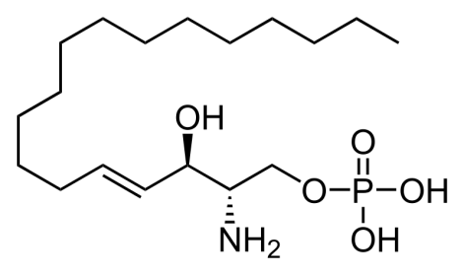
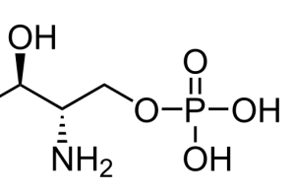
S1P is required for HDL mediated protection of macrophages from apoptosis
S1P Lyase Reaction
S1P
S1P
Lyase
Apoptosis (Cleaved Caspase 3)
H
+
Fatty
aldehyde
O
Phosphoethanolamine
Tunicamycin
-
-
-
+
+
+
Pei Yu
Leticia Gonzalez
Control Treated HDL
-
+
-
-
+
-
S1P-Lyase Treated HDL
-
-
+
-
-
+

Slide 18
Knockout of S1PR1 in macrophages reduces HDL mediated protection against ER-stress induced apoptosis
Control
S1PR1 KO
Percent Apoptosis
Tunicamycin
-
+
+
-
+
+
HDL
-
-
+
-
-
+
Leticia Gonzalez

Slide 19
HDL signaling in macrophages
HDL
SR-B1
S1PR1
Gα_{i}
PDZK1
PI3K
Akt 1
Bim
Necrotic core
Plaque instability
Apoptosis

Slide 20
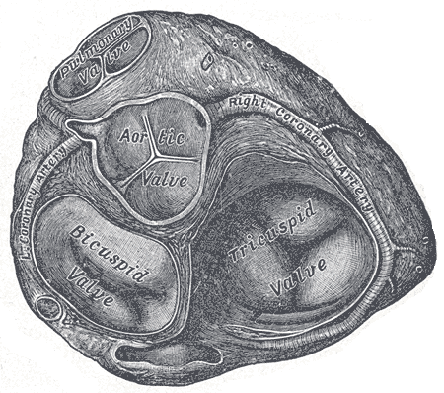
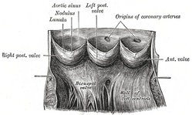
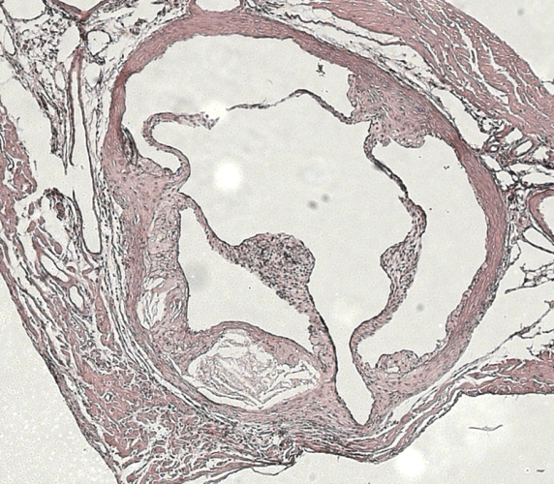
Measurement of atherosclerosis in mice
Aortic Sinus
Top
Cut Away
20th U.S. edition of Gray's Anatomy of the Human Body, 1918
Notes:
This is a diagram of the aortic sinus which is the base of the aorta as it leaves the left ventrical of the heart. It is separated from the ventricle by these valve pouches which prevent back-flow of blood into the ventrical. In mouse models of atherosclerosis, plaques develop reproducibly on the wals of the aortic sinus within the valve pouches. Furthermore, we can use the valve leaflets (walls oof the valve pouches) as anatomical landmarks to indicate where we are in the aortic sinus. We therefore section through the aortic sinus, looking for the valve pouches and stain either for lipid with Oil red O or for ECM components

Slide 21
Increased Bim immunofluorescence in atherosclerotic plaques of mice lacking
SR-B1 in bone marrow derived cells
Bone Marrow
*
SR-B1^{+/+}
Bim Fluorescence
(arbitrary units)
SR-B1^{-/-}
SR-B1^{+/+}
SR-B1^{-/-}
Yi Zhang, Aishah Al-Jarallah

Slide 22
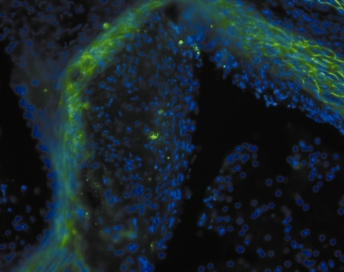
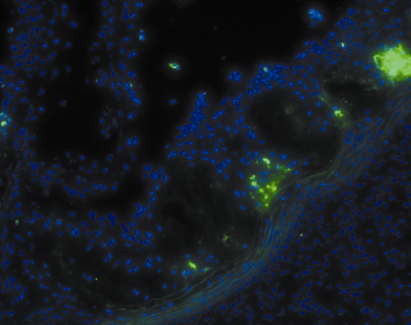
Increased apoptosis in atherosclerotic plaques of mice lacking SR-B1 in bone marrow derived cells
Bone Marrow
*
SR-B1^{+/+}
L
L
SR-B1^{-/-}
SR-B1^{+/+}
SR-B1^{-/-}
Apoptosis
Nuclei
Yi Zhang, Aishah Al-Jarallah

Slide 23
Increased necrotic core size in atherosclerotic plaques of mice lacking
SR-B1 in bone marrow derived cells
Bone Marrow
Necrotic Core Size
*
SR-B1^{+/+}
*
L
L
SR-B1^{-/-}
SR-B1^{+/+}
SR-B1^{-/-}
Apoptosis
Nuclei
Yi Zhang, Aishah Al-Jarallah

Slide 24
Summary
HDL
S1PR1
SR-B1
Bim
Apoptosis
Necrotic Core
PDZK1
Gα_{i}
Ruptured
Fibrous Cap
Thrombus
PI3K
Akt 1
Slide Source:
Lipids Online Slide Library
www.lipidsonline.org

Slide 26
Inactivation of SR-B1 in All Tissues of
LDL Receptor -/- Mice Results in Diet-Induced Coronary Artery Atherothrombosis
LDL r ^{-/-}
SR-BI^{-/-}LDL r ^{-/-}
Oil red O
(Lipids)
CD41 (red)
Platelets
15 % Fat, 1.25 % Cholesterol, 0.5 % Cholate; 3.5 weeks
Mark Fuller

Slide 27
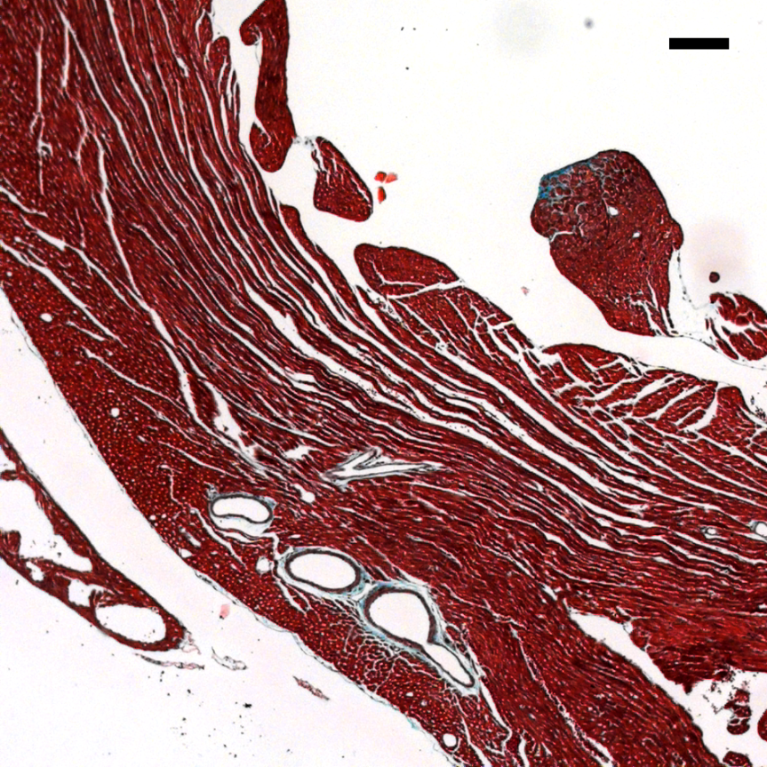
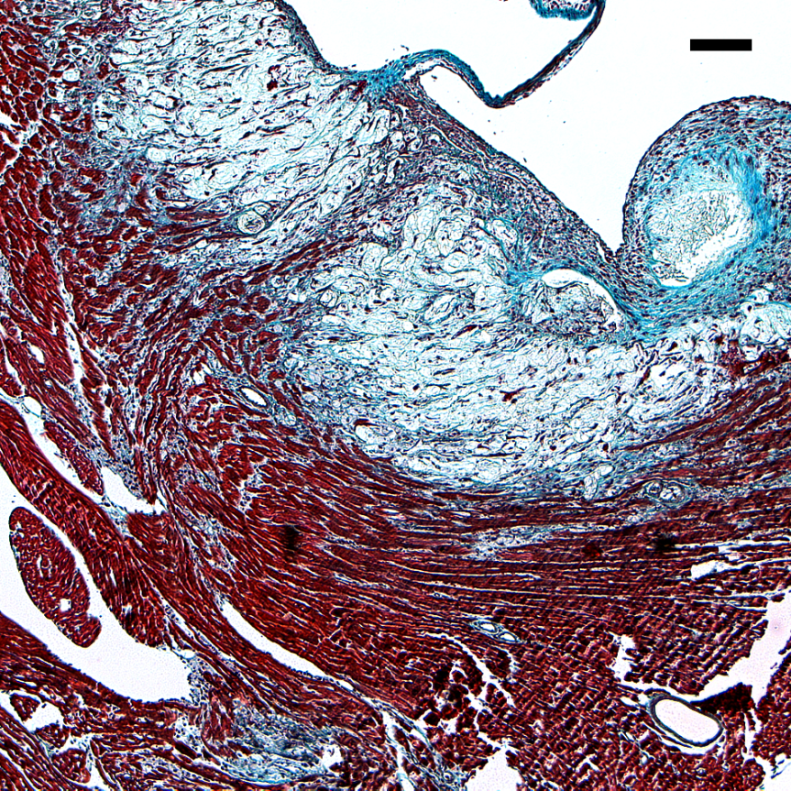
SR-BI^{-/-}LDL R^{-/-} Mice Fed High Fat, High Cholesterol Diet Develop Extensive Cardiac Fibrosis
LDL r ^{-/-}
SR-BI^{-/-}LDL r ^{-/-}
healthy
Infarcted
fibrotic
15 % Fat, 1.25 % Cholesterol, 0.5 % Cholate; 3.5 weeks; trichrome stain
Mark Fuller

Slide 28
Reduced Survival of SR-BI^{-/-}LDLr^{-/-} mice Fed an Atherogenic Diet
LDL r ^{-/-}
SR-BI^{-/-}LDL r ^{-/-}
Weeks on Diet
15 % Fat, 1.25 % Cholesterol, 0.5 % Cholate
Mark Fuller

Slide 29
Let Us Meet Again
We welcome you all to our future conferences of OMICS International
Please Visit:
http://integrativebiology.conferenceseries.com/
http://conferenceseries.com/
http://www.conferenceseries.com/genetics-and-molecular-biology-conferences.php

