Slide 1
4th International Conference on Agriculture and Horticulture
Measured Irrigation
Improving the water-efficiency of irrigation by changing the irrigation paradigm
Dr Bernard Omodei
www.measuredirrigation.com
Notes:
In this address I will introduce two irrigation concepts, namely, measured irrigation and evaporative irrigation. I will then discuss the significance of these concepts for the water-efficiency and energy-efficiency to various irrigation applications.

Slide 2
Definitions
Irrigation is referred to as measured if the volume of water delivered to each plant is controlled directly without the need to control the flow rate or the duration of the irrigation event.
Irrigation is referred to as evaporative if the application rate to each plant throughout the year is proportional to the nett evaporation rate (evaporation rate minus rainfall rate).

Slide 3
Introduction
With measured irrigation the volume control paradigm is totally different.
Notes:
Conventional irrigation systems use a timer or controller to control the opening and closing of solenoids in order to control the duration of the irrigation event and the frequency of irrigation. The volume of water delivered to a plant during the irrigation event is controlled by controlling the flow rate from the emitter and the duration of the irrigation event. The acceptance of this paradigm has led to the development of pressure compensating drippers whereby the flow rate from the dripper is relatively constant for a range of water pressures.
With measured irrigation the volume control paradigm is totally different. For measured irrigation the volume of water delivered to a plant during the irrigation event is controlled directly so that one does not need to control the flow rate from the emitter or the duration of the irrigation event. Experienced irrigation practitioners are often skeptical of an irrigation methodology that does not need to control the flow rate. I will therefore request that you restrain your skepticism and listen carefully.

Slide 4
The conventional volume control paradigm requires the control of two variables, namely, flow rate and time. Measured irrigation requires the control of a single variable, namely, volume. Once you change your focus of attention from flow rate and time to volume, the design of an irrigation system can change significantly.

Slide 5
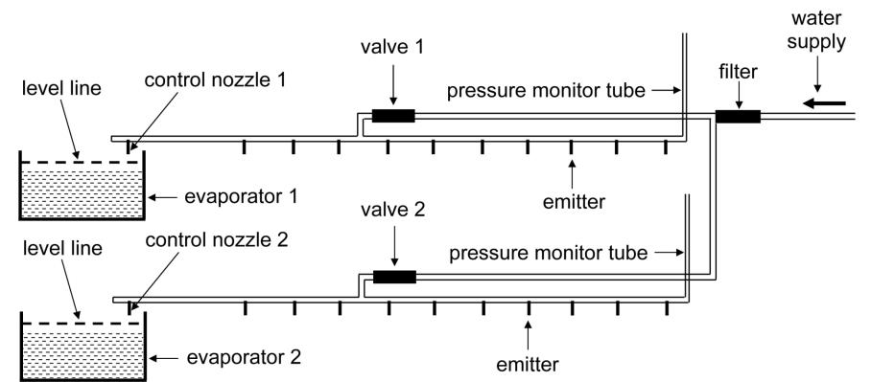
Schematic diagram for unpowered measured irrigation with 2 sectors

Slide 6
1. The water supply may be either pressurized or gravity feed.

Slide 7
2. The emitters in each sector should all be at approximately the same level.
level 1
level 2

Slide 8
3. For each sector, a control nozzle drips water into the evaporator
during the irrigation event.

Slide 9
4. Any combination of emitters and control nozzles may be used.
However, to keep things simple, let us assume that all the emitters and control nozzles are the same and so they will all deliver the
same volume of water during the irrigation event.

Slide 10
5. One needs to estimate the nett evaporation in mm for the location
for the hottest dry month of the year (call this E). For example,
in Adelaide the nett evaporation is about 267 mm in January.

Slide 11
6. One needs to choose the desired number of litres per week per dripper during the hottest dry month (call this A).

Slide 12
7. The following formula is used to calculate the surface area of evaporation required to deliver the desired litres per week per dripper during the hottest dry month.
surface area of evaporation = (n*A)/(E*7)
where n is the number of days in the hottest dry month.
Notes:
One needs to choose an evaporator with the appropriate surface area of evaporation to ensure that each dripper has the desired application rate in litres per week for the hottest dry month.

Slide 13
8. Suppose that many different emitters are used and for each emitter one knows the nozzle ratio
nozzle ratio = (flow rate of irrigation nozzle) / (flow rate of control nozzle)
To calculate the surface are of evaporation in this case one needs to choose the desired number of litres per week for the control nozzle during the hottest dry month.

Slide 14
9. A level line is marked on the inside of the evaporator about 3 cm below the overflow level.

Slide 15
10. For each sector, open the valve when the water level in the evaporator is about 1 cm below the level line. Close the valve
when the water level reaches the level line. The cycle continues indefinitely.

Slide 16
Advantages of unpowered evaporative measured irrigation
Notes:
.

Slide 17
Advantages
Save more water by controlling the application rate for each plant during the hottest dry month of the year, taking account of all relevant factors such as evapotranspiration, soil type, and leaf area .
Save more water by allowing the prevailing weather conditions to control the variations in the application rate for each plant throughout the year. The irrigation is evaporative, that is, the application rate for each plant is proportional to the nett evaporation rate.
The application rate is not affected by the water level at which the irrigation starts and the water level at which the irrigation stops.
Notes:
2. When the temperature increases, the evaporation rate increases and so the application rate increases. When it rains, extra water enters the evaporator and so the application rate decreases.
3. The control nozzle is simply replacing the evaporated water.

Slide 18
Advantages
You can adjust the irrigation frequency by adjusting the water level at which the irrigation starts. For example, if you require more frequent irrigation with less water, then start the irrigation when the water level is less than 1 cm below the level line.
For those months of the year when the rainfall exceeds evaporation, the water level will be above the level line and so there is no irrigation.
6. Gravity feed irrigation requires that the head of water in the water tank is higher than the emitters. As the water tank empties, the flow rate at the emitters will decrease. This would be a problem with conventional irrigation because of the need to control the flow rate.
Notes:
4. If you require less frequent irrigation with more water, then start the irrigation when the water level is more than one cm below the level line.

Slide 19
Advantages
Measured irrigation does not need to be pressurized and so it is more energy-efficient and no hose clamps are needed.
For conventional gravity feed systems in developing countries, a minimum head of water is recommended (greater than one metre). Measured irrigation is more energy-efficient because the head may be much lower.
9. Evaporative measured irrigation is an example of a low cost simple technology with a high level of control over the application rate to each plant.

Slide 20
Applications of measured irrigation
  Low cost measured irrigation for smallholders in developing countries.
  Measured irrigation from a rainwater tank.
3. Upgrading drip irrigation to measured irrigation.
Measured irrigation of seedlings in nurseries.
Solar-powered multi-sector measured irrigation.

Slide 21

Low cost measured irrigation for smallholders in developing countries
Part 1. Introduction

Slide 22
Low cost measured irrigation for smallholders in developing countries
Part 2. The evaporator

Slide 23
Low cost measured irrigation for smallholders in developing countries
Part 3. Irrigation frequency

Slide 24
Measured irrigation from a rainwater tank
Part 1. Introduction

Slide 25
Measured irrigation from a rainwater tank
Part 2. Nozzles

Slide 26
Measured irrigation from a rainwater tank
Part 3. Application rates

Slide 27
Measured irrigation from a rainwater tank
Part 4. The irrigation industry

Slide 28
Measured irrigation from a rainwater tank
Part 5. Automation

Slide 29
Measured irrigation from a rainwater tank
Part 6. Irrigation frequency

Slide 30
Measured irrigation from a rainwater tank
Part 7. Nozzle ratios

Slide 31
Upgrading drip irrigation to measured irrigation
Part 1. Introduction

Slide 32
Upgrading drip irrigation to measured irrigation
Part 2. Measured Irrigation Nozzle Selector Tool

Slide 33
Upgrading drip irrigation to measured irrigation
Part 3. Choosing an evaporator

Slide 34
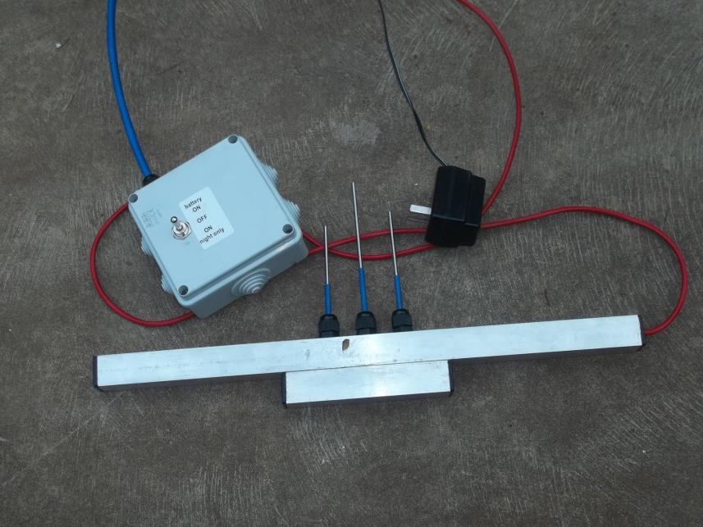

Slide 35
Measured irrigation of seedlings in nurseries
Part 1. Introduction

Slide 36
Measured irrigation of seedlings in nurseries
Measured irrigation of seedlings in nurseries
Part 2. Measured irrigation on a boom

Slide 37
Solar-powered multi-sector measured irrigation
More than eight community gardens in Australia are using solar-powered multi-sector measured irrigation.
I will now show some slides of the installation at Sophie’s Patch at Mount Barker in South Australia.

Slide 38
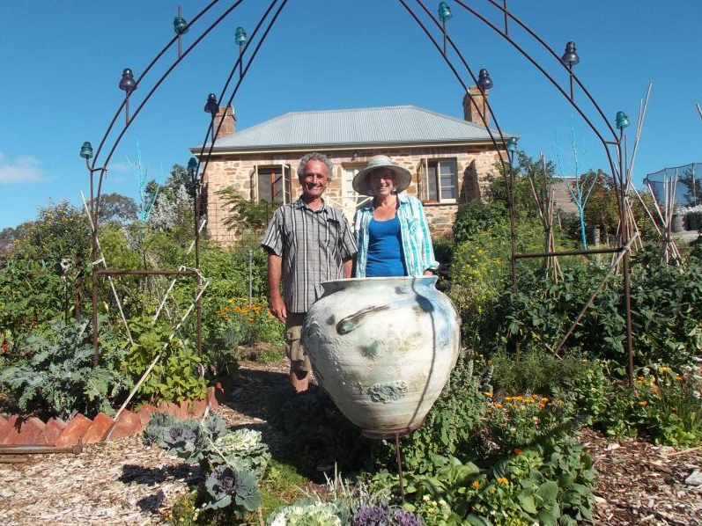
Sophie Thomson and Dr Bernie Omodei celebrate the successful installation of measured irrigation at “Sophie’s Patch”

Slide 39
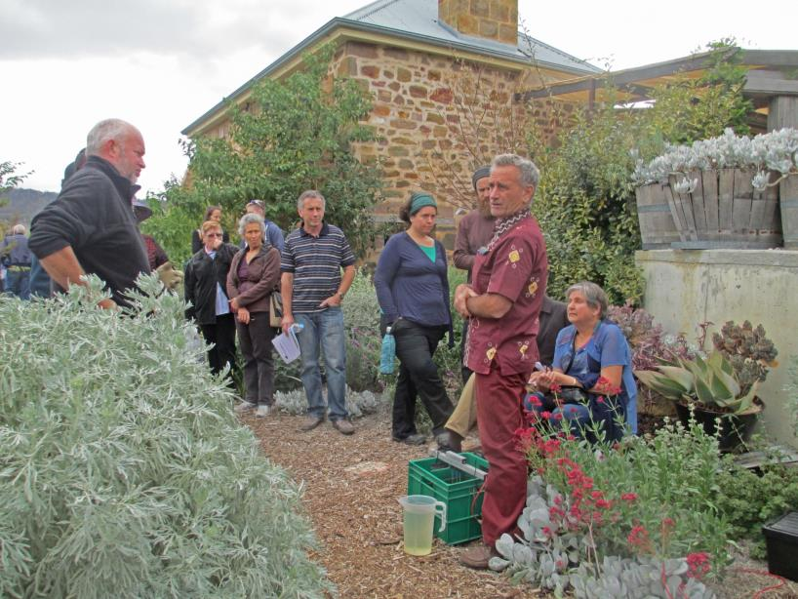
Dr Omodei explaining the evaporator and level sensor

Slide 40
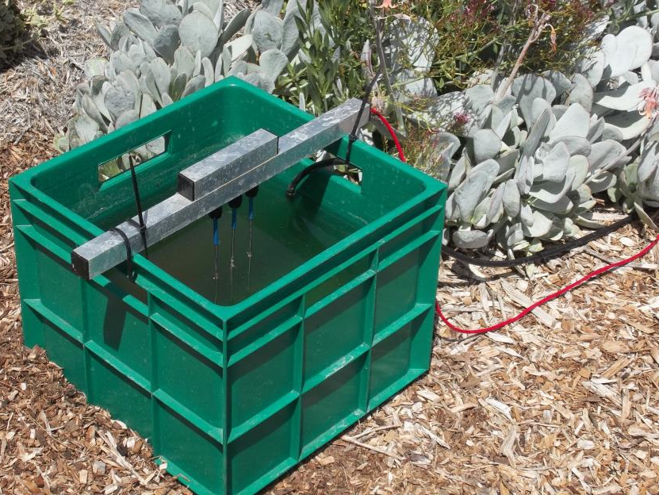
Level sensor and evaporator

Slide 41
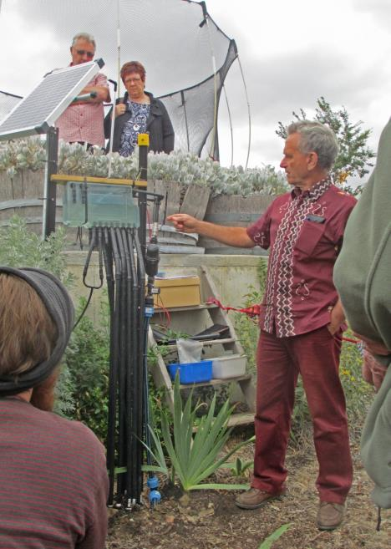
Flow splitter delivering water to 11 sectors

Slide 42
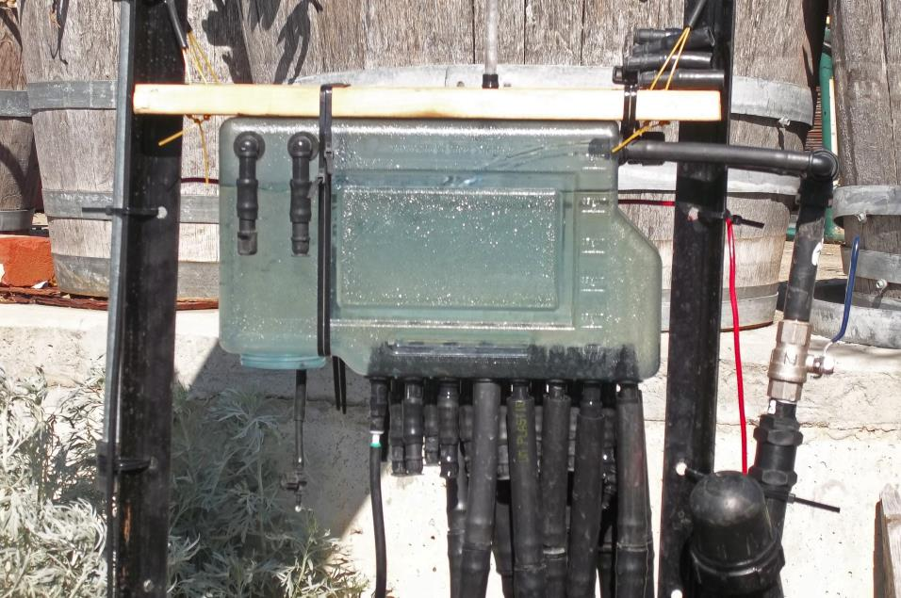
Green control nozzle delivering water to the evaporator

Slide 43
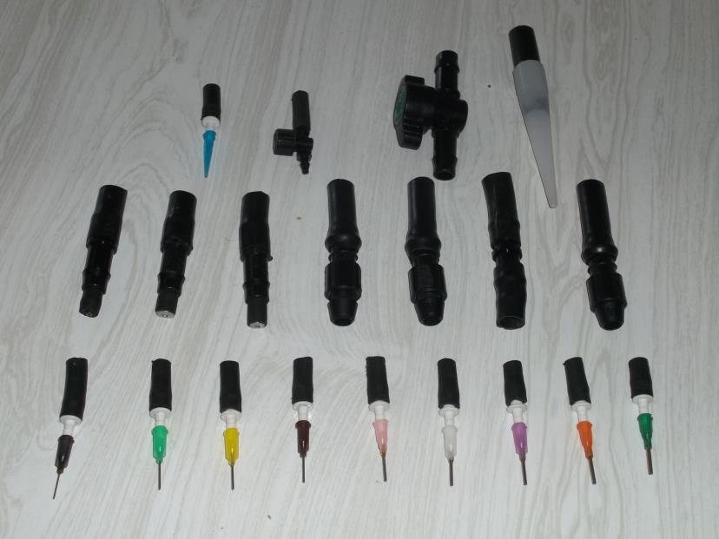
Flow-splitter nozzles available from Measured Irrigation

Slide 44
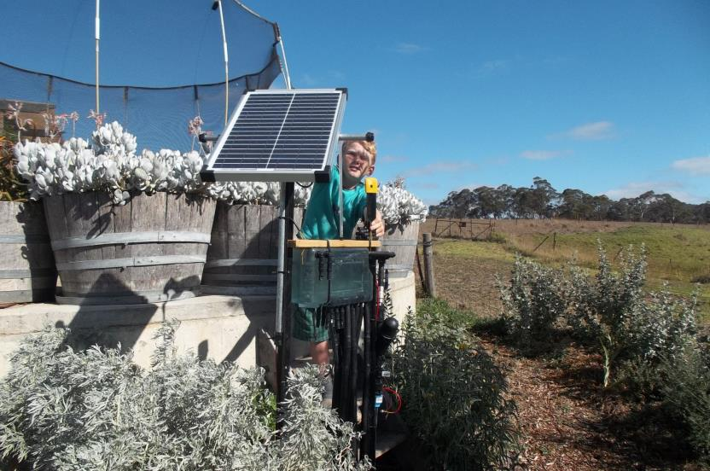
All the power needed comes from a 20 watt solar panel

Slide 45
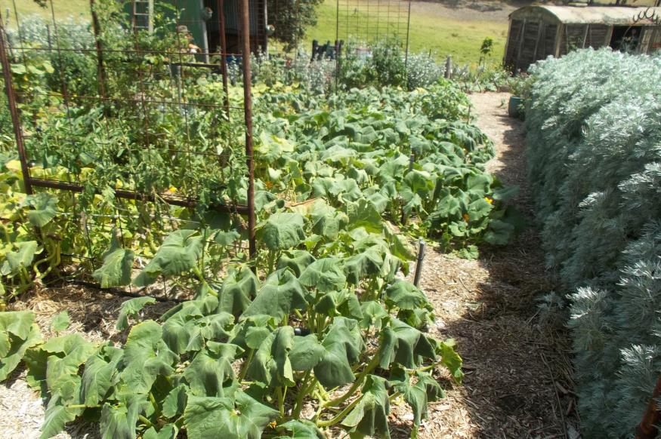
Sectors following the contours on sloping ground

Slide 46
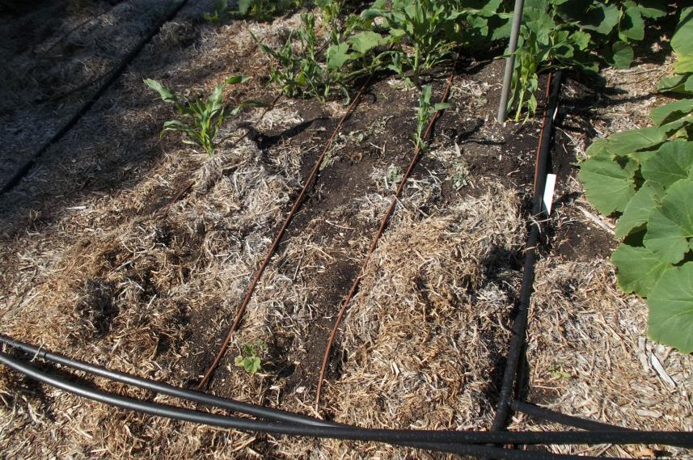
Vegetable garden sector using Netafim Landline 8 dripperline

Slide 47
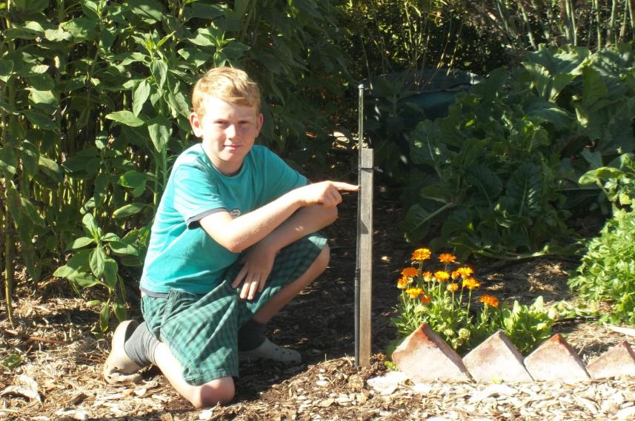
Pressure monitor tube indicates the head of water for the sector

Slide 48
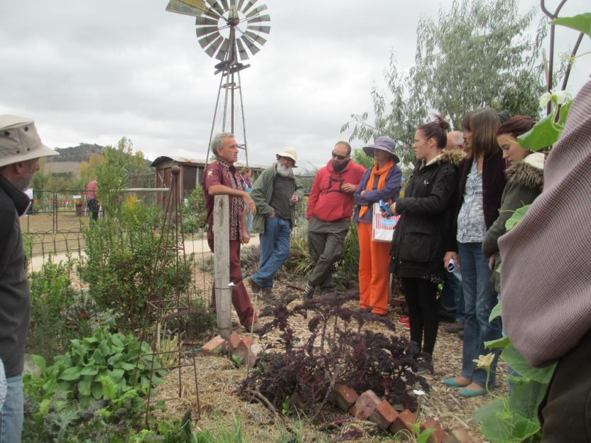
Demonstrating measured irrigation at the Garden Open Day

Slide 49
Accuracy and Uniformity
Published trials of measured irrigation have demonstrated
accuracy greater than 95% and uniformity greater than 90%.

Slide 50
Agri 2015
Measured Irrigation
Improving the water-efficiency of irrigation by changing the irrigation paradigm
Thank You
www.measuredirrigation.com

