Slide 1


International Summit on
Current Trends in Mass Spectrometry
July 13-15, 2015 New Orleans, USA
LIQUID CHROMATOGRAPHY-MULTISTAGE MASS SPECTROMETRY
ALONG WITH H/D EXCHANGE TO CHARACTERIZE
ANTIPLATELET DRUG DEGRADATION PATHWAYS.
A case report.
Bernard Do*, Fatma Amrani , Philippe-Henri Secrétanand Najet Yagoubi
*Hospital Pharmacist and Associate Professor
EA 401 Materials and Health

Slide 2
CONTEXT: IMPURITIES PROBLEM
The definition of the quality of pharmaceuticals
has changed in recent times…
Previously focus on purity, but
Greater emphasis on impurities, degradation products…
Affect both safety and efficacy

Slide 3
CHARACTERIZATION
OF IMPURITIES/DEGRADATION PRODUCTS
Organic impurities can arise during the manufacturing process (process-related), storage and/or delivery of the drug (drug-related).
Efforts to predict drug degradation through early identification of degradation products problems are important :
To highlight labile functionalities.
To anticipate potential risks with respect to patients’ safety.
To get regulatory approval.

Slide 4
CHARACTERIZATION
METHODOLOGY
Liquid chromatography-mass spectrometry is a technique of choice.
Unequivocal characterization of the structure of most trace to minor components (- enantiomers / epimers).

Slide 5
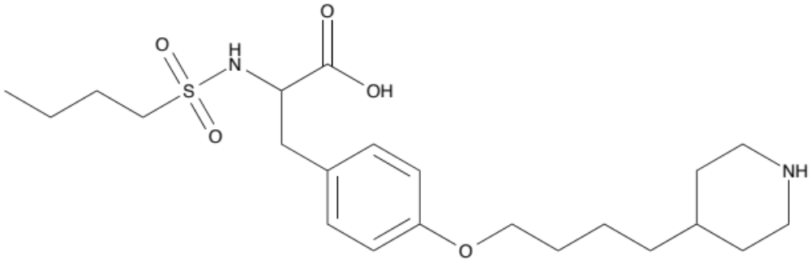
TIROFIBAN
Synthetic, nonpeptidic antagonist of fibrinogen receptor (GPIIb/IIIa),
Used in slow infusion for the treatment of acute coronary syndrome or in preventing premature myocardial infarction.

Slide 6
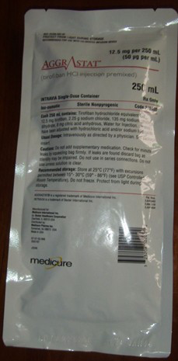
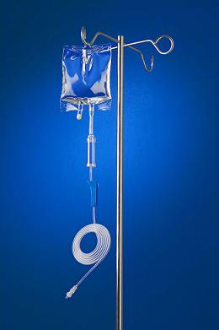

?

Slide 7
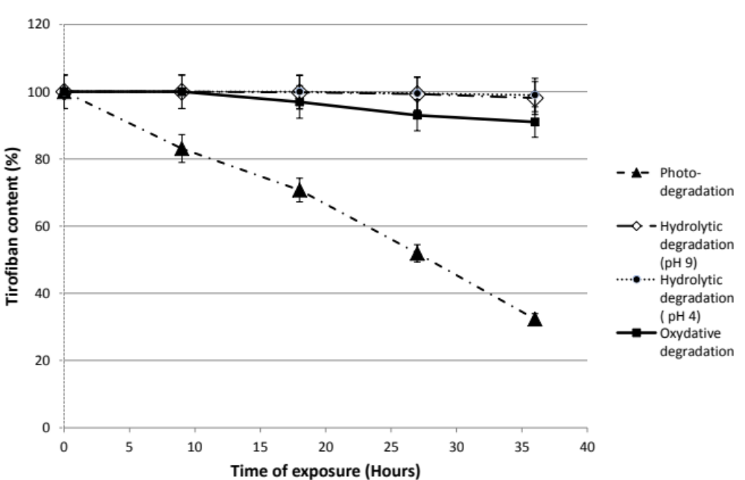
STRESS TESTING OUTCOME
Simulated sunlight
Need for a thorough understanding of molecular mechanisms related to the photo-degradation.

Slide 8
STRATEGY USED TO CHARACTERIZE THE PHOTOPRODUCTS (1)
hγ
DRUG
DRUG’S PHOTOPRODUCTS (PD_{S})
Development and optimization of
LC-UV
Direct infusion
Transfer of analytes to MS through LC
At least all the analytes detected in UV
are present in the ion chromatograms
ESI⁺/MS/LTQ-Orbitrap
HR-MS analysis
Molecular ions accurate mass
PDs chemical formulae; RdB; Nitrogen rule; error (ppm)

Slide 9
STRATEGY USED TO CHARACTERIZE THE PHOTOPRODUCTS (2)
HR-MS^{n} studies
Accurate mass of product ions
PDs/losses chemical formulae; RdB; Nitrogen rule
Origin of fragments and connectivities between them
Fragmentation pattern of the drug and PDs
+
Online
H/D exchange
H/D exchange
Number of labile hydrogens
Assignment of structure to PDs
Comparison of mass data and fragmentation pattern to that of the drug
Confirmation of the PDs proposed structures
Mechanistic explanation to PDs formation from the drug in a specific reaction condition

Slide 10
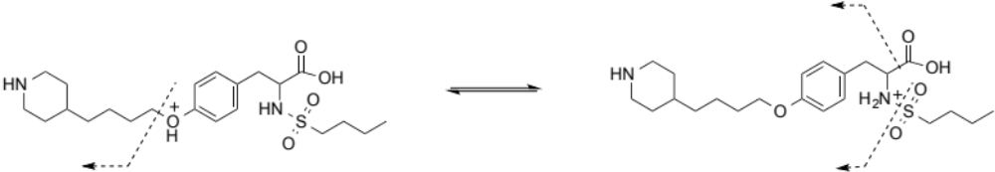
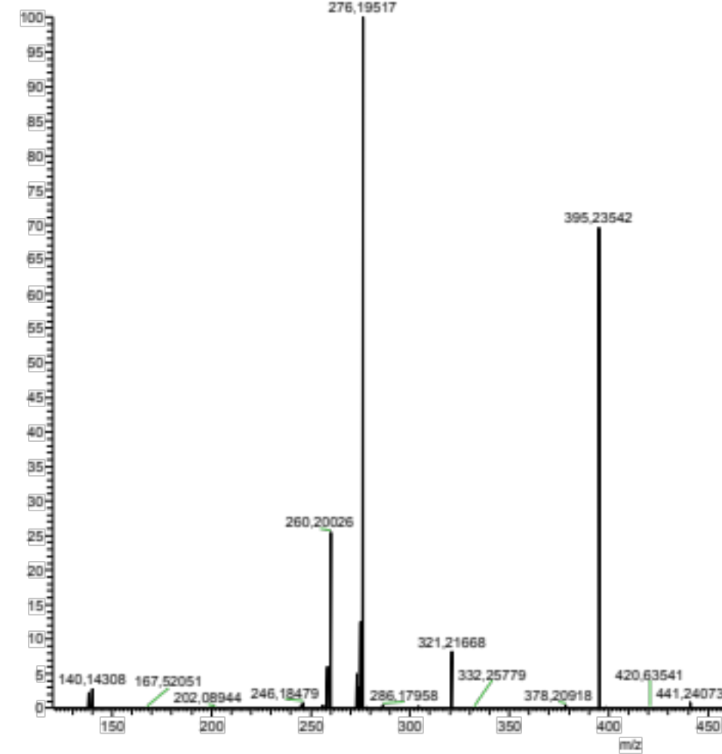


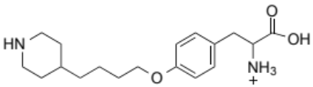

ANALYSIS OF PROTONATED DRUG BY ESI⁺/MS/MS
m/z 395
m/z 140
m/z 321
-
- CO

Slide 11
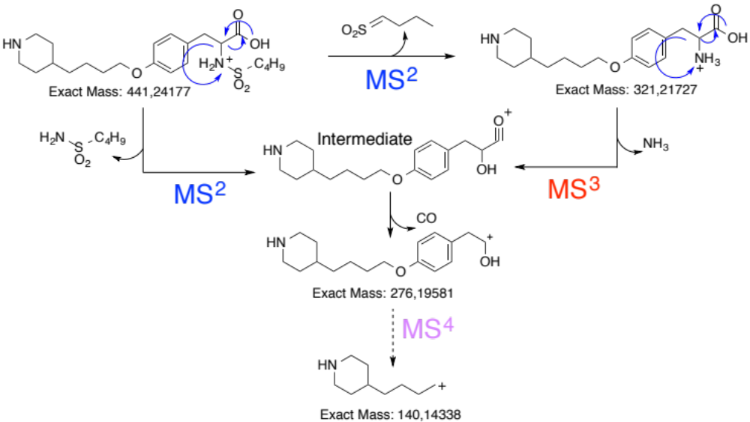
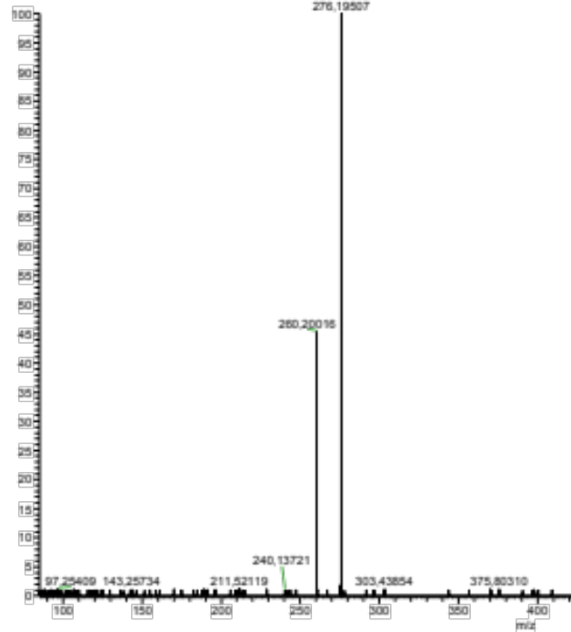
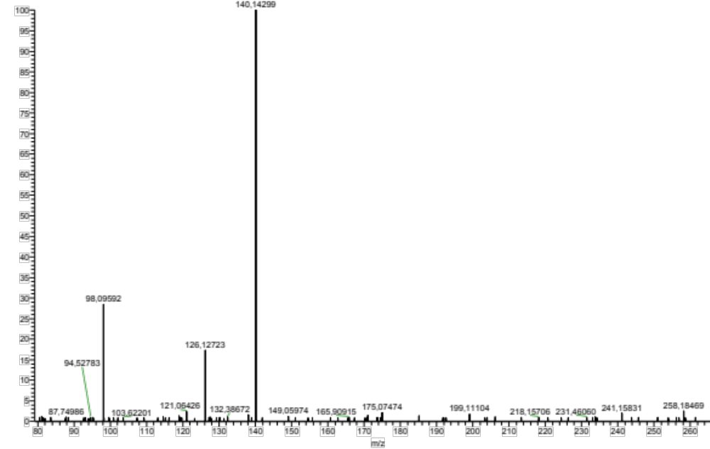
MS³
441->321->
MS⁴
441->321->276

Slide 12
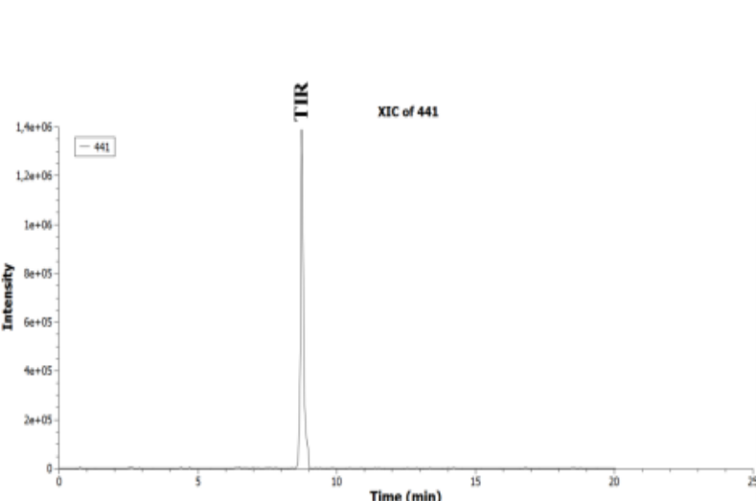
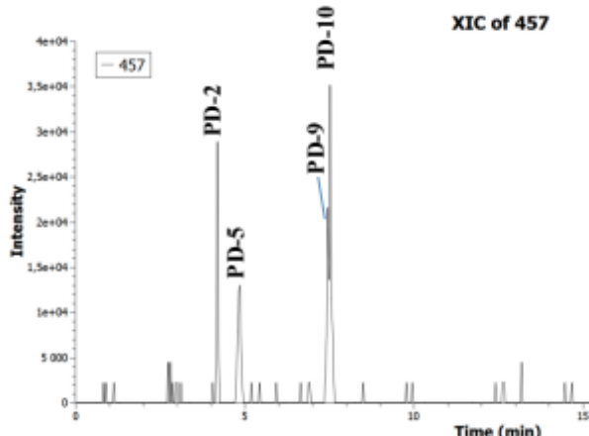
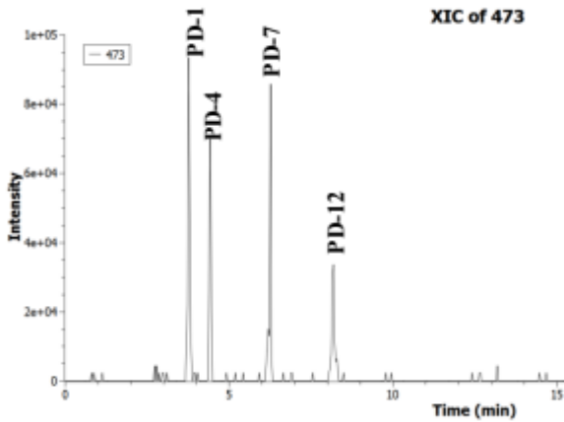
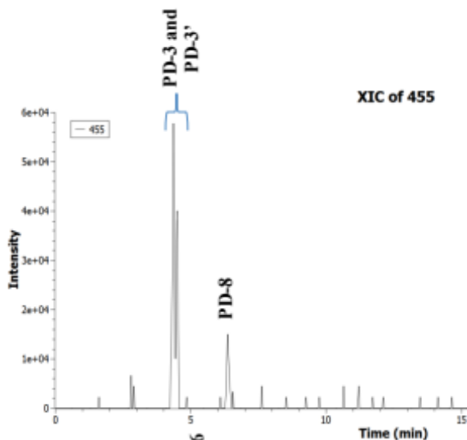
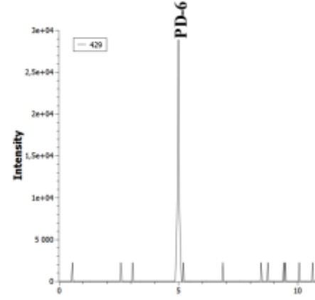
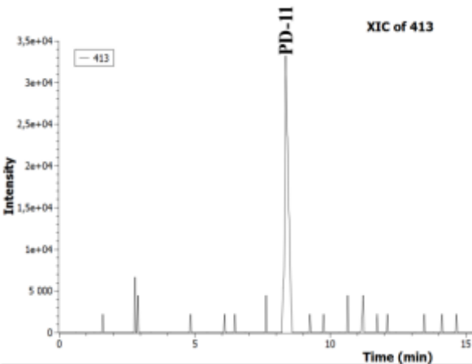
DRUG
C₂₂H₃₇N₂O₅S⁺
TIROFIBAN PHOTOPRODUCTS
hγ
C₂₂H₃₇N₂O₆S⁺
hγ
C₂₂H₃₇N₂O₇S⁺
hγ
hγ
hγ
C₂₂H₃₅N₂O₆S⁺
C₂₁H₃₅N₂O₄S⁺
C₂₁H₃₇N₂O₅S⁺
IRRADIATED SAMPLE
WITH 15 %
DRUG DECREASE

Slide 13

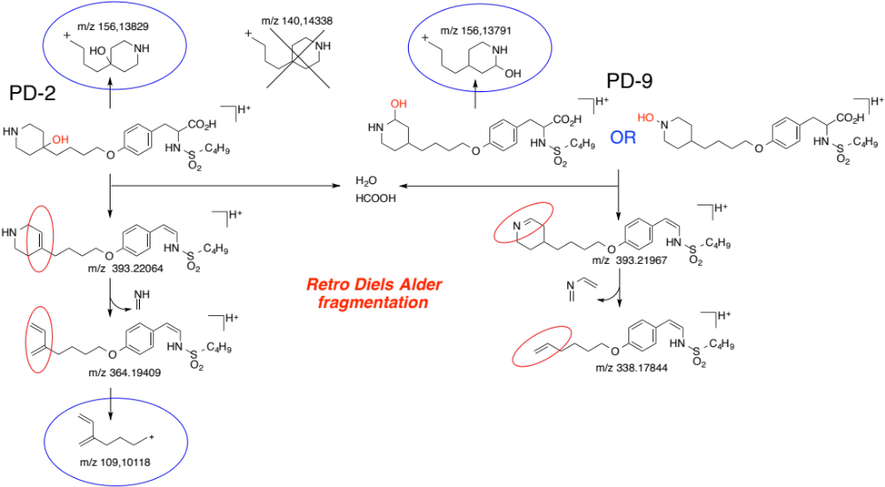
IDENTIFICATION OF C₂₂H₃₇N₂O₆S⁺ - OH-PIPERIDINE DERIVATIVES
LC-ESI⁺-MS/MS

Slide 14
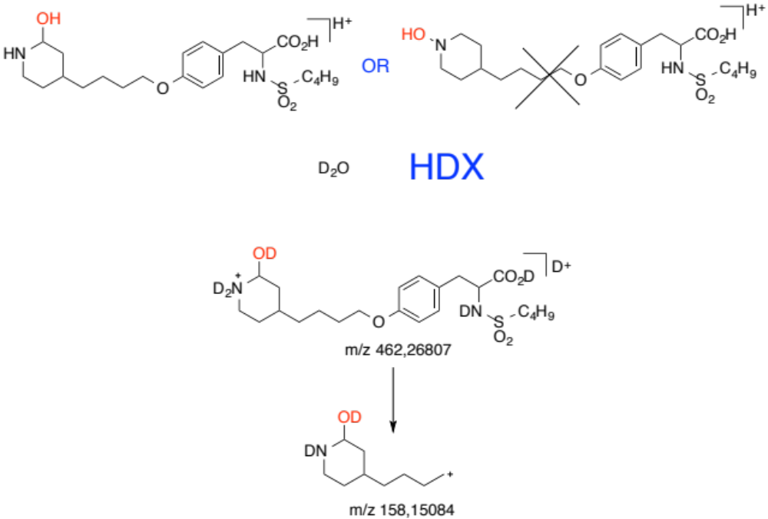
1,2 OH-PIPERIDINE VS HYDROXYLAMINE PIPERIDINE
5 LABILE HYDROGENS
2 LABILE HYDROGENS

Slide 15
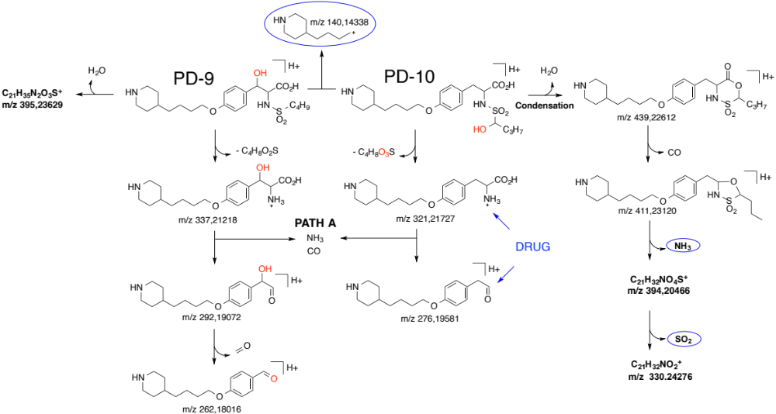
IDENTIFICATION OF C₂₂H₃₇N₂O₆S⁺ - NON OH-PIPERIDINE DERIVATIVES
LC-ESI⁺-MS/MS

Slide 16
CONSISTENCY OF CHROMATOGRAPHIC BEHAVIOR WITH RESPECT TO THE REVERSE-PHASE ELUTION
* Calculator: Chemdraw®

Slide 17
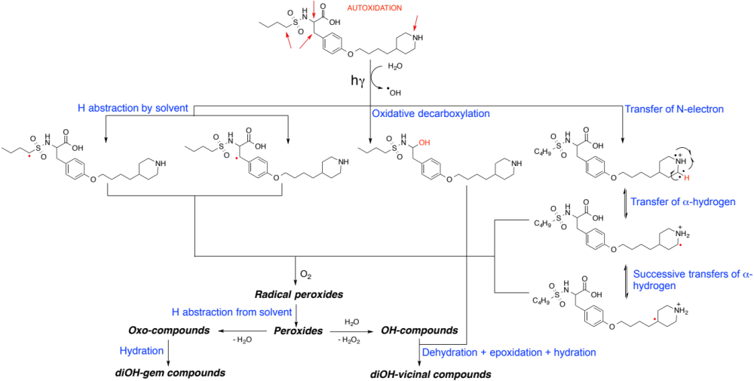
POSSIBLE PHOTO-DEGRADATION PATHWAYS
Simulated solar light

Slide 18
CONCLUSION
LC-HR-ESI/MS^{n}
Unequivocally characterize drugs’ degradation pathways.
Extensive knowledge
RSC Advances 5 (2015) 35586–35597
Journal of Pharmaceutical and Biomedical Analysis 105 (2015) 74–83
RSC Advances 5 (2015) 45068–45081
Of mechanistics
Of the nature & level
of products formed
Implement measures to mitigate
or hinder drug degradation
Assess risks
with respect to patients safety

Slide 19
THANK YOU FOR
YOUR KIND ATTENTION
N. Yagoubi, EA 401
E. Jubeli, EA 401
J. Saunier, EA 401
C. Aymes-Chodur, EA 401
P.H. Secrétan, EA 401
T. Henriet, EDQM
A. Solgadi, SAMM
M. Bernard, AGEPS
Jean-Houri, AGEPS
M-Pierre Berleur, AGEPS
H. Sadou-Yaye, Hôpital Pitié-Salpétrière
P. Tilleul, Hôpital Pitié-Salpétrière
A. Astier, Hôpital Henri-Mondor
B. Do, EA 401, AGEPS

Slide 20
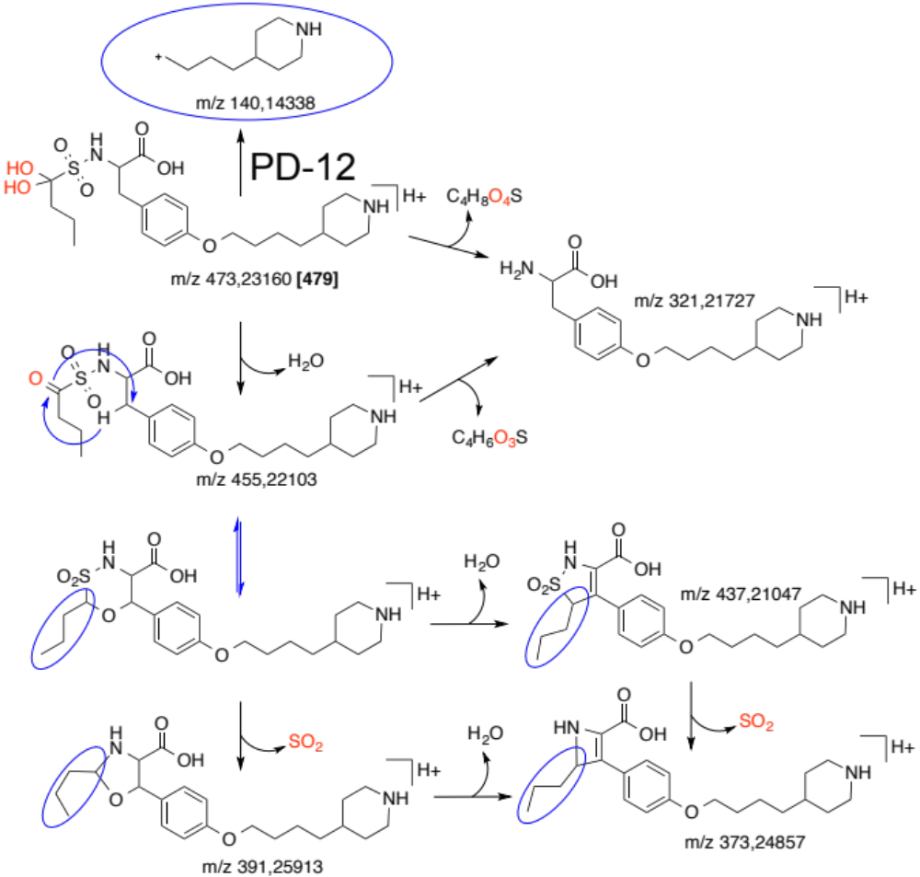
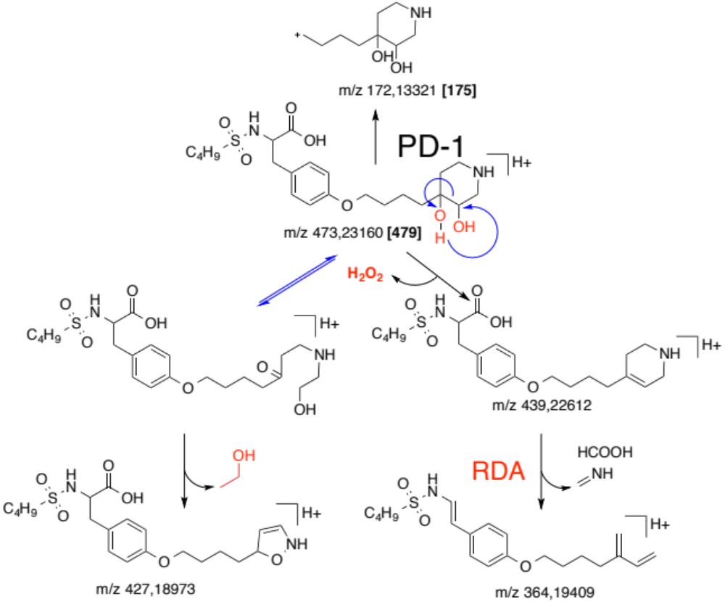
LC-ESI⁺-MS/MS
DIOL-COMPOUNDS
DIFFERENTIATION BETWEEN VICINAL AND GEMINAL DIOLS

Slide 21
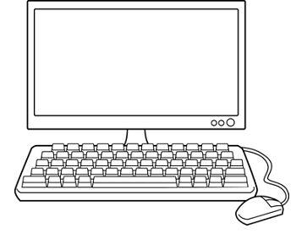

POTENTIAL IMPACT OF SAFETY UPON PHOTOTRANSFORMATION ?
Toxicological assessment : in silico approach
Comparison of photoproducts toxicological hazard to that of API by computerized structural alert screening.
Structural
Alerts?
Tirofiban and PDs structures
Potential toxicological hazard
In silico studies need to be confirmed by in vitro/vivo studies
Two softwares
Expert-based system : Derek Nexus (vers. 2014 0.1)
Knowledge-based system : Toxtree (2.6.0)

Slide 22
In silico assessment results for tirofiban (1)
 | Derek Nexus
Denomination | Carcinogenicity (C)/ Genotoxicity (G) | Organ toxicity | Irritation, respiratory sensitisation | Mutagenicity in Bacteria (Ames test)
Tirofiban | C: open* ; G : no alert | No alert | No alert | Inactive
PD-1 | C: open* ; G : no alert | No alert | No alert | Inactive
PD-2
PD-3
PD-3’
PD-4
PD-5
PD-6
PD-7
PD-8
PD-9
PD-10
PD-11
PD-12
*Open= lack of data

Slide 23
In silico assessment results for tirofiban (2)
 | Toxtree
Denomination | Carcinogenicity (C)/ Mutagenicity(G) | Skin sensitisation | Mutagenicity in Bacteria (Ames test)
Tirofiban | No alert | No alert | No alert
PD-1 | No alert | No alert | No alert
PD-2
PD-3
PD-3’
PD-4
PD-5
PD-6
PD-7
PD-8
PD-9
PD-10
PD-11
PD-12

