Slide 1
Big Data Winners and Losers:
The Ethics of Algorithms

Slide 2

Every Company is an Information Company

Slide 3











Information is Overwhelmingly Electronic

Slide 4



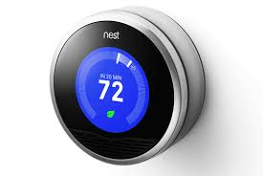
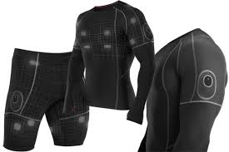


And is coming from more sources than ever

Slide 5
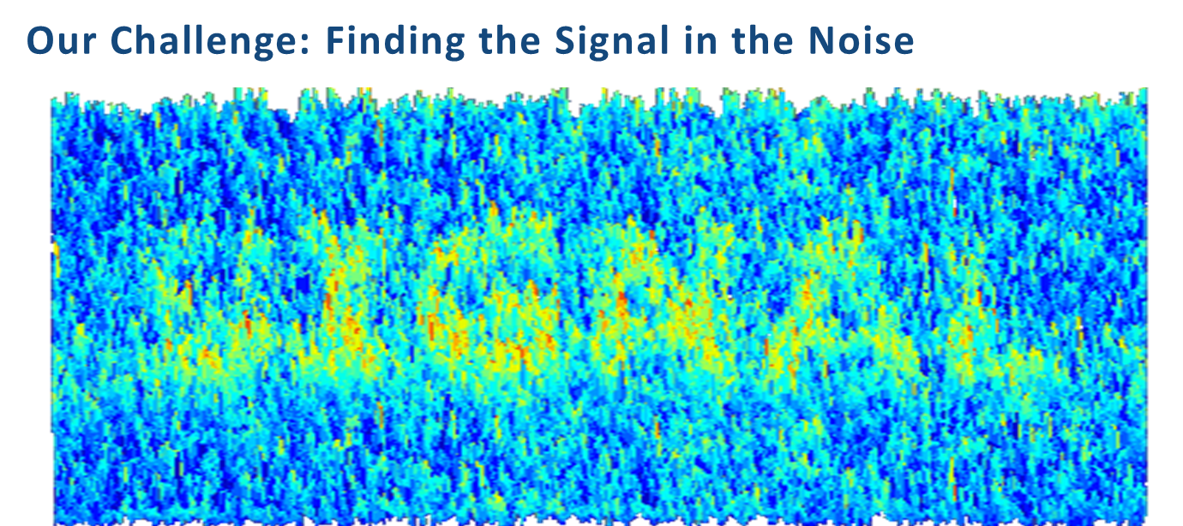

Slide 6

Insight into Human Conduct to Unparalleled Degree

Slide 7
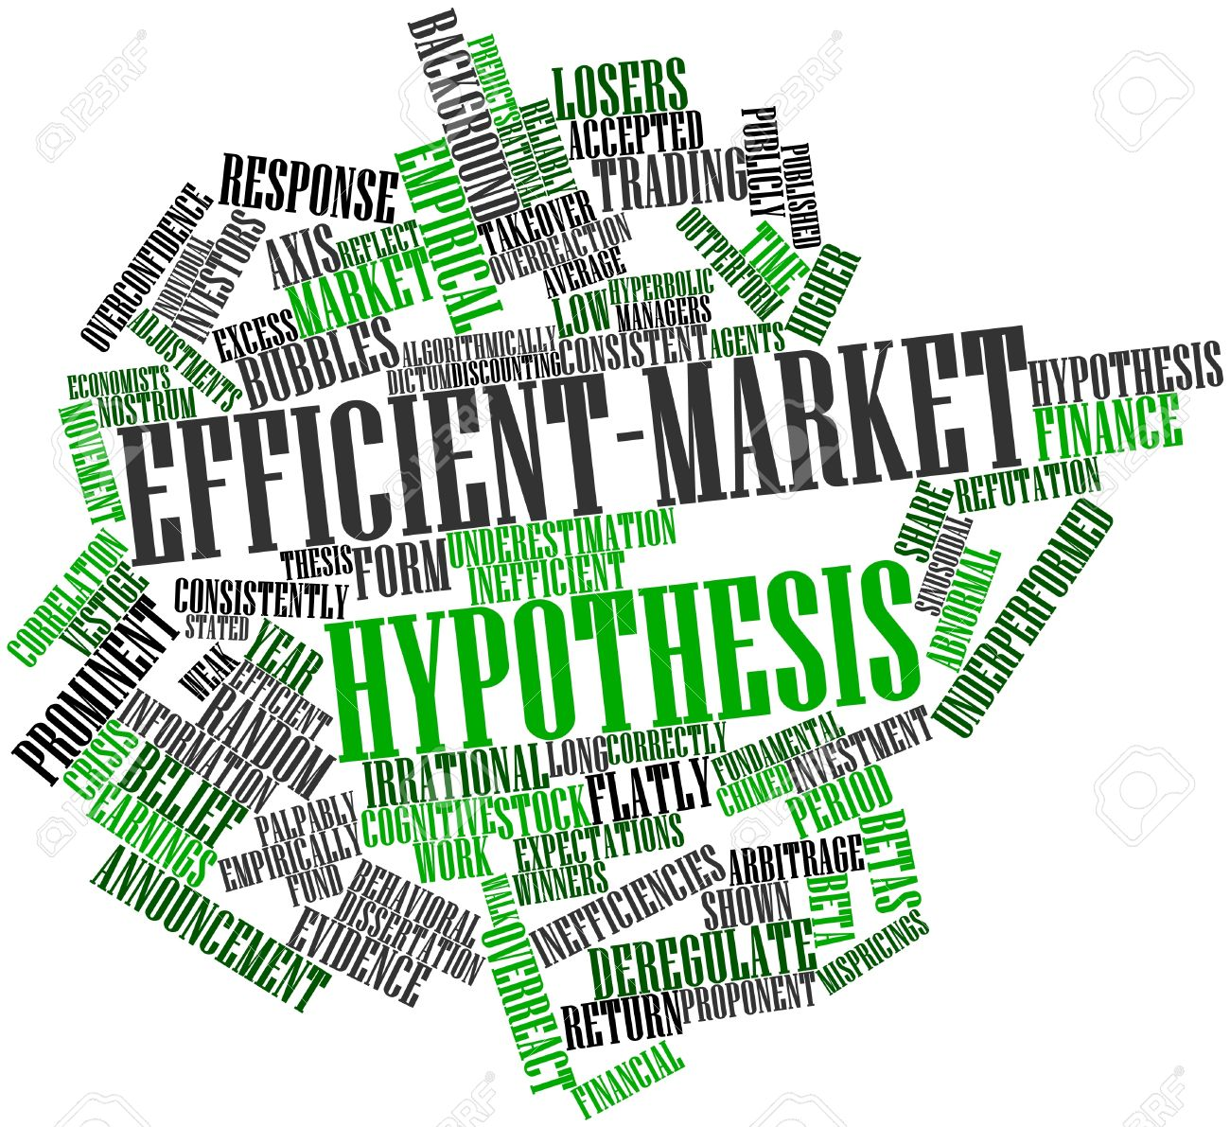
Unparalleled Market Efficiency
The Right (Public or Private) Product or Service
  Right time
  Right place
  Right consumer
  Right cost
  Right price

Slide 8

Unparalleled Potential for Disruption and Misuse

Slide 9

How Analytics Work
Every point of data has characteristics about it
  How it was created
  When it was created
  Who created it
  Its transmission
  Its content

Slide 10


Leveraging Analytics in the Legal Space
Once you find an example of what you’re looking for, analytics will find more like it.

Slide 11
What is the needle, anyway?
We fundamentally deal with facts.
Each data point is a fact: it puts a person at a place at a time doing an action.
Most legal scenarios involve a series of facts.
There are actors acting over a period of time.
Once you start unraveling the actors and their actions over time, analytics come in to play to augment your fact finding.

Slide 12
How do you start?
We usually know the basics of the story, or at least the allegations.
We usually can identify some of the main actors and the time period involved.
We can also identify where the facts most likely reside (almost always email).
Once you start finding a few facts, let the data speak for itself.

Slide 13

The Future of Analytics and the Law

Slide 14
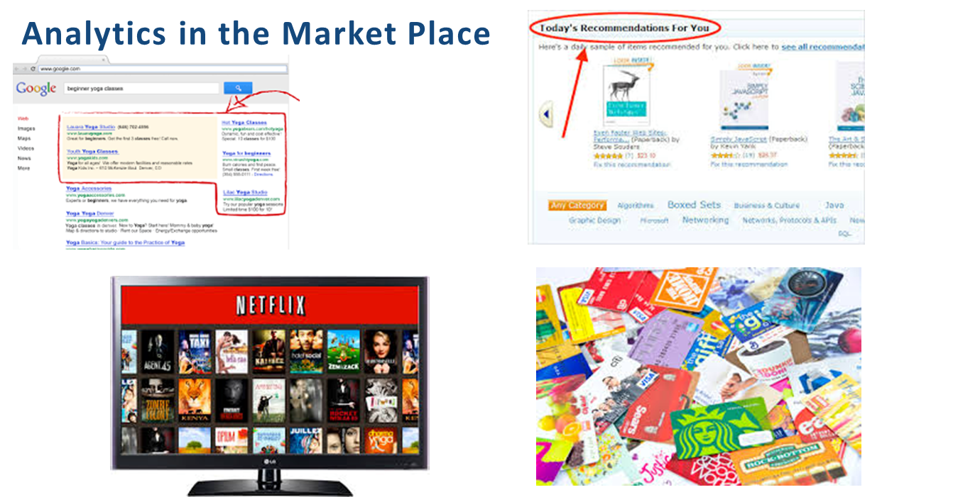

Slide 15
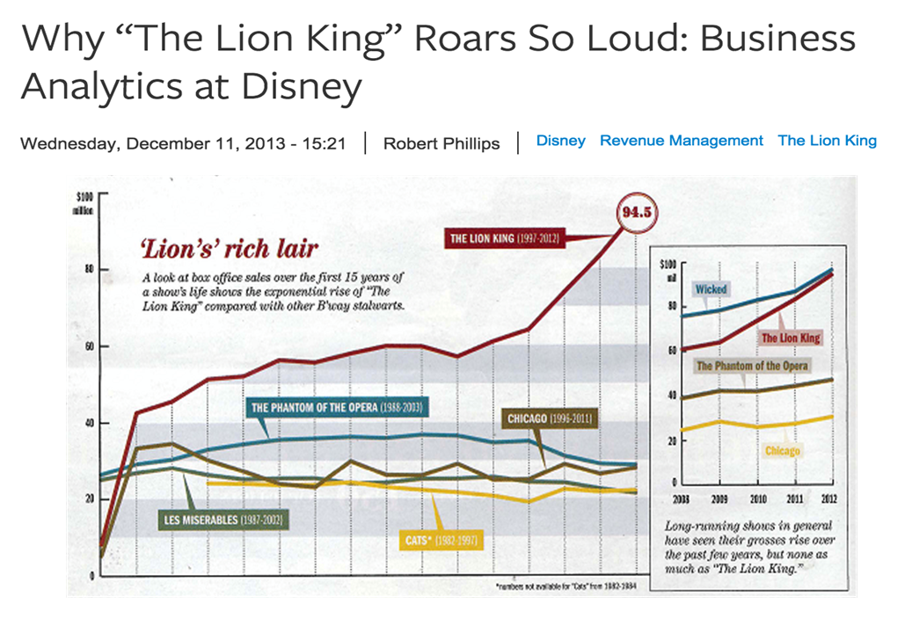

Slide 16







Slide 17

Cumulative Economic Impact

Slide 18

Putting people into groups and offering them stuff
This is the definition of discrimination

Slide 19
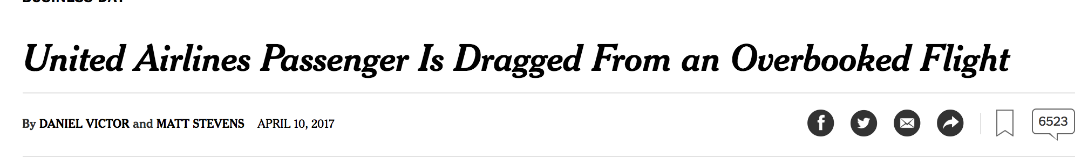

Algorithmic Bullying

Slide 20
The Role of Algorithms
United boards a plane, it isn’t overbooked, everyone is seated.
A deadheading flight crew of four arrives at the gate.
A scheduling algorithm decides that the crew has priority over passenger revenue.
A financial algorithm authorizes an offer of $800 (and no more) to volunteers to leave the plane. No one takes the offer.
A customer value algorithm determines which four passengers will cause the least lifetime revenue loss.
Stock price drop: $225M
Credit: John Robb

Slide 21
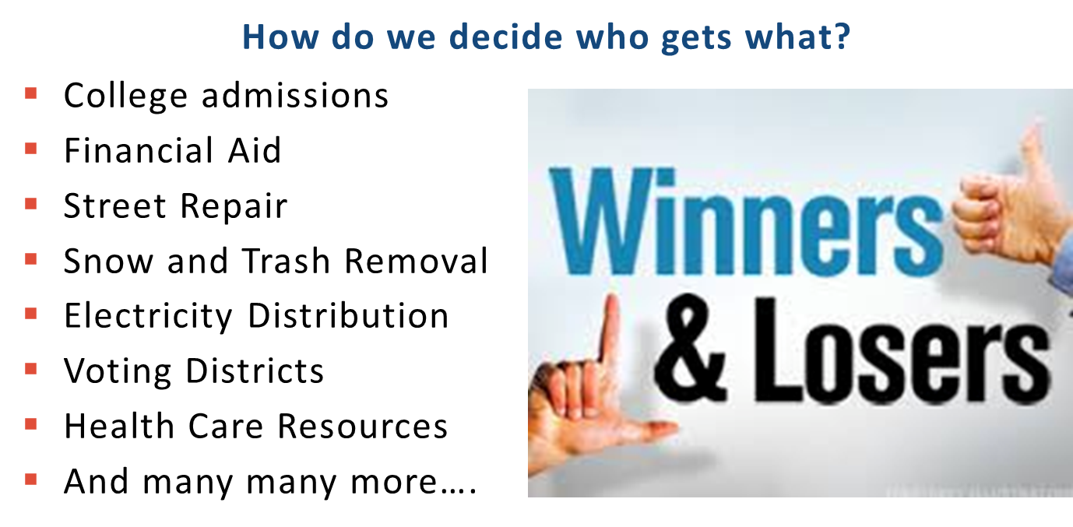

Slide 22

Current Laws and Regulations Don’t Fit Current Applications of Analytics
In 2012 Facebook conducted an “emotional contagion” study, manipulating the display of happy and sad content in the news feeds of 150,000 users to see if they would share happy or sad content

Slide 23
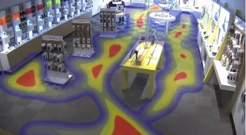
Notice and Consent

Slide 24

Data Ownership

Slide 25

Acting in a Legal Greenfield

Slide 26
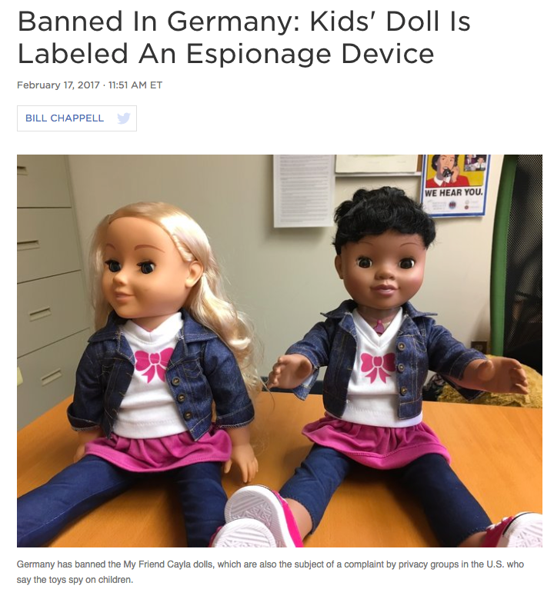
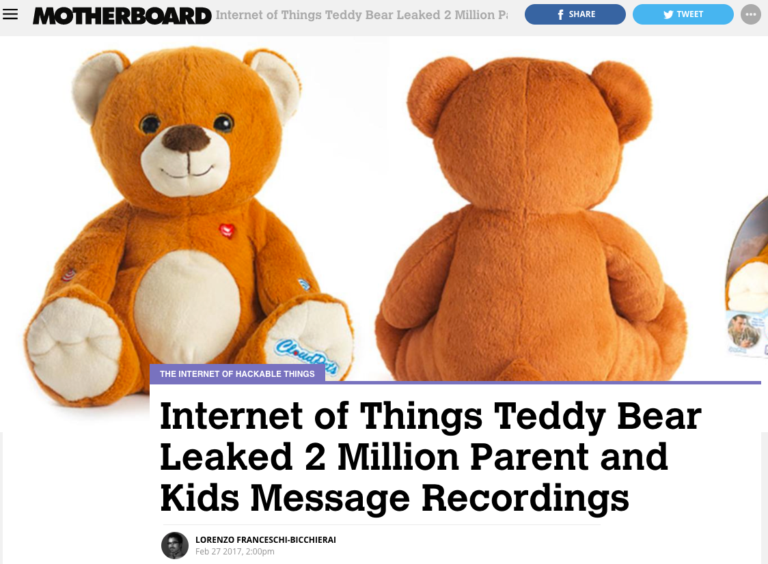
Thinking Through the Risks

Slide 27
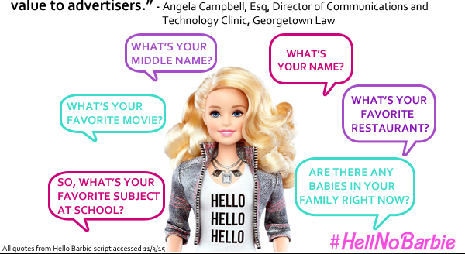
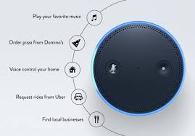
Hello Barbie vs. Amazon Echo
Understand the risks you are creating and act reasonably to mitigate them

Slide 28

The Way Forward
The law is based on reasonable conduct
Identify and quantify risks in analytics projects
Identify mitigation strategies
Include a diversity of opinion

Slide 29
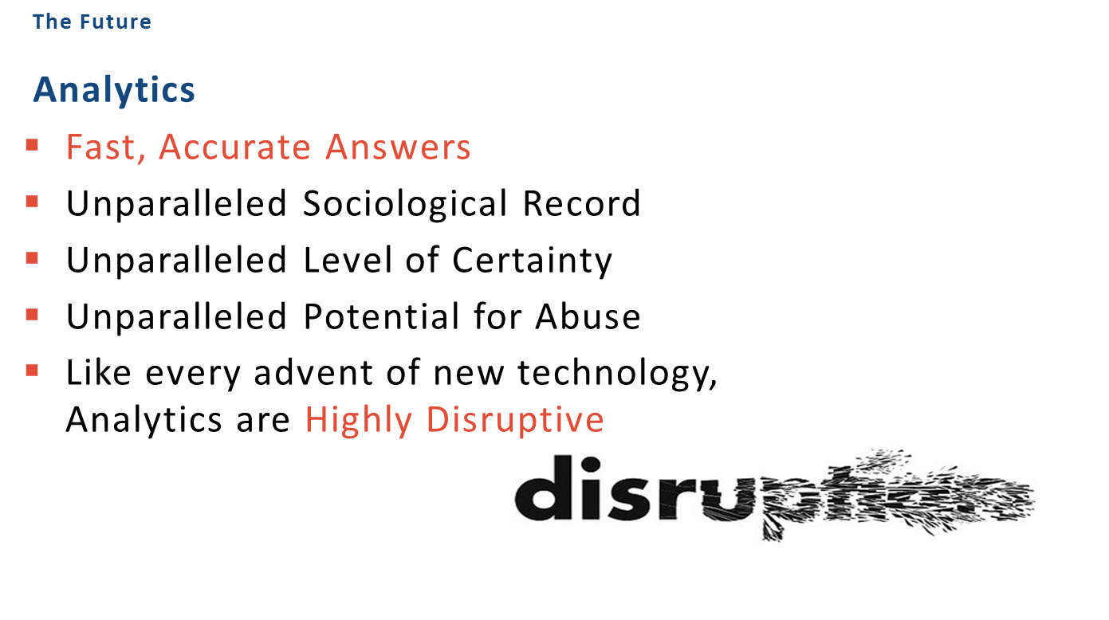

Slide 30
Questions?
Bennett B. Borden
Chief Data Scientist
Chair, Information Governance and eDiscovery
Drinker Biddle & Reath LLP
1500 K Street, N.W.
Washington, DC 20005-1209
(202) 230-5194
Bennett.Borden@DBR.com

