Slide 1
Lawyering in the Information Age:
Predicting Corporate Misconduct

Slide 2
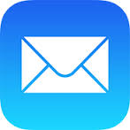
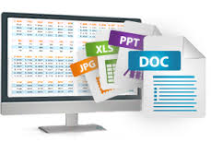
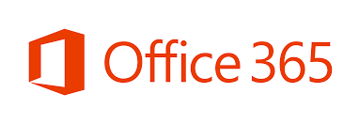

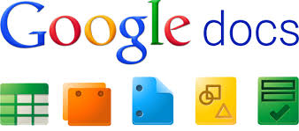
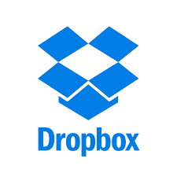



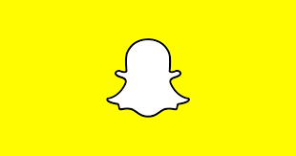

Information is Overwhelmingly Electronic

Slide 3
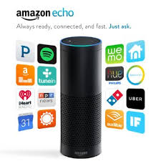
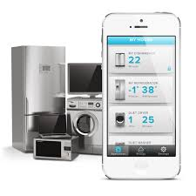
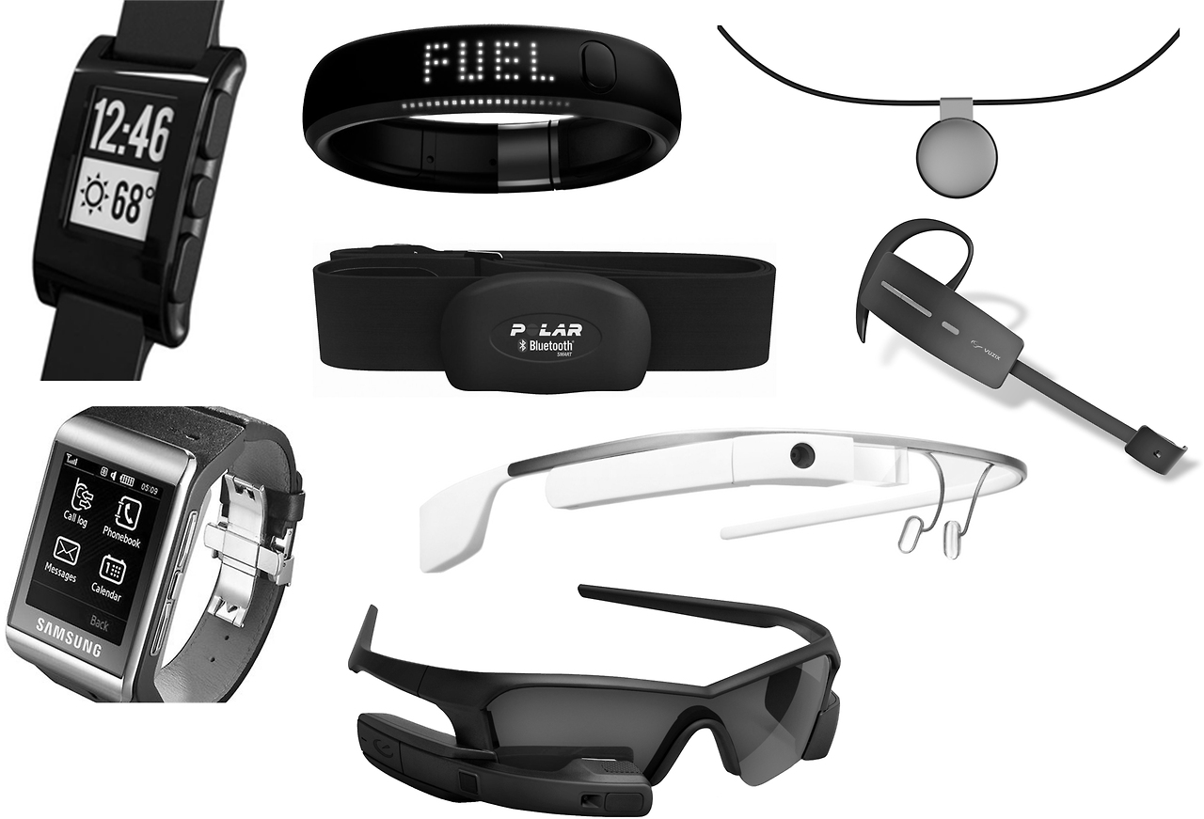
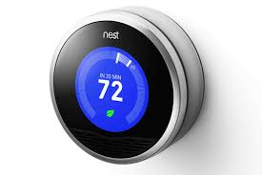
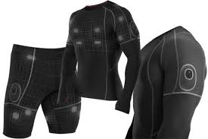
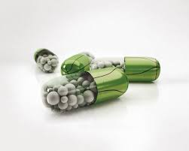
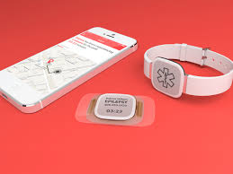
And is coming from more sources than ever

Slide 4
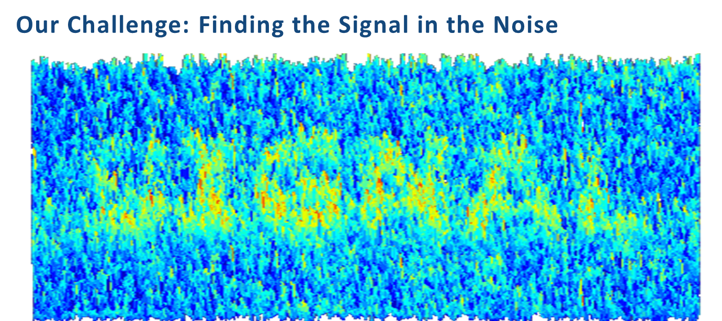

Slide 5

Insight into Human Conduct to Unparalleled Degree

Slide 6
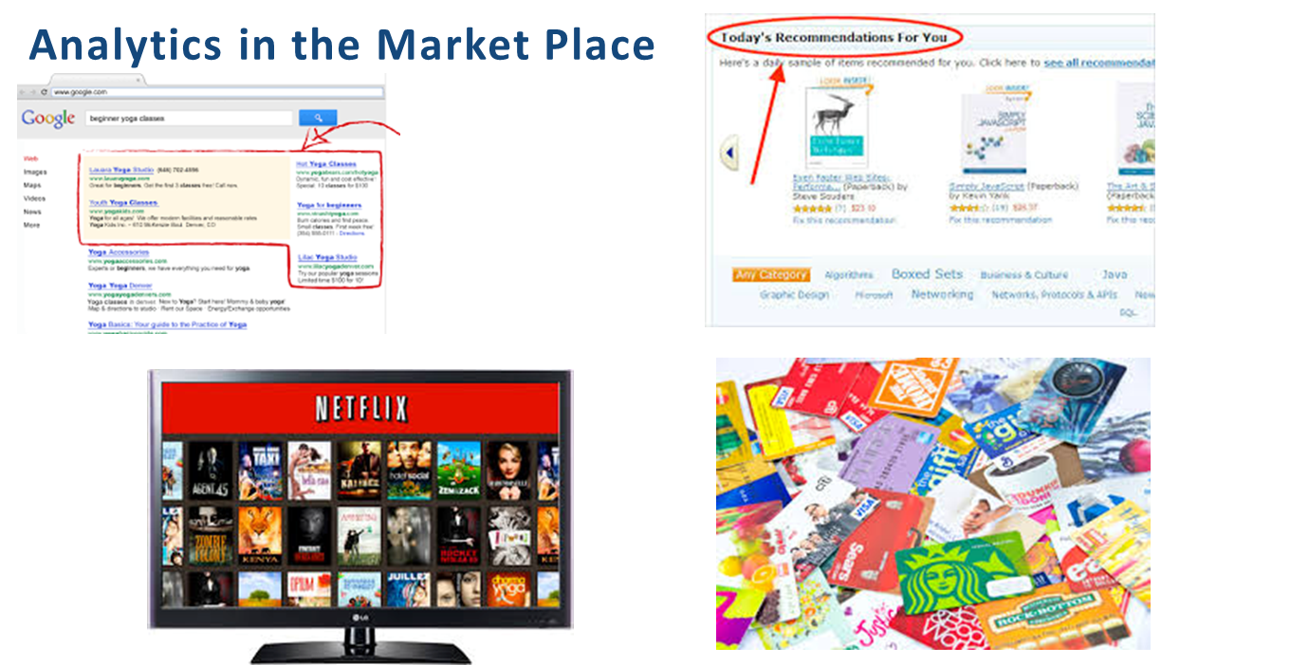
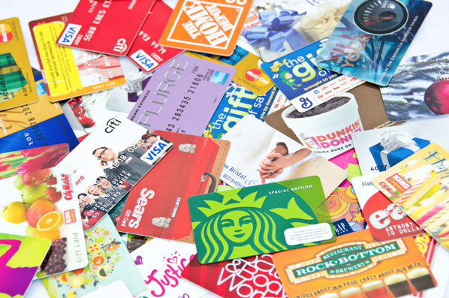
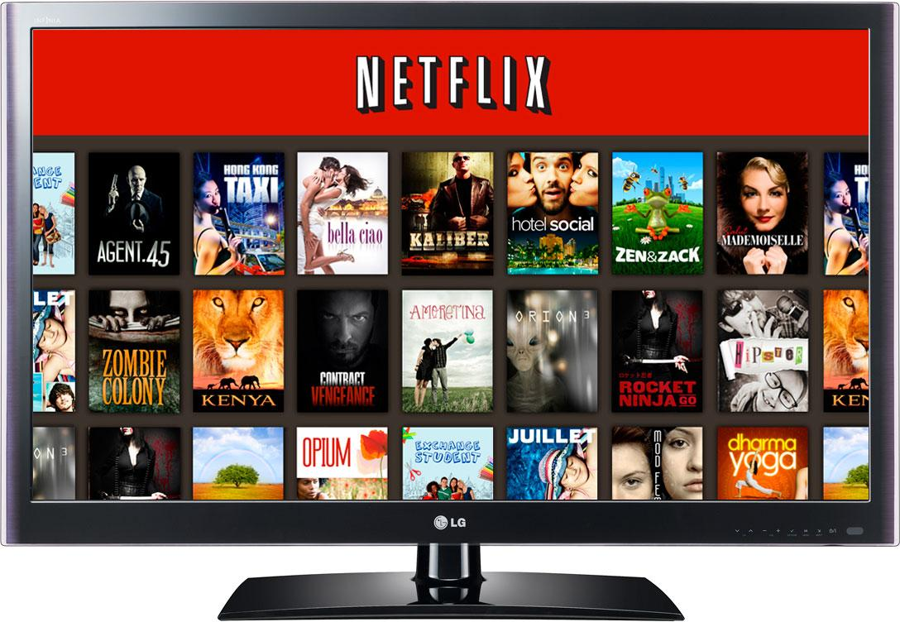
Analytics in the Market Place

Slide 7

Predicting Human Conduct
If we can predict conduct,
why can’t we predict misconduct?

Slide 8
Predictive Policing

Slide 9
How far can this be taken?

Slide 10
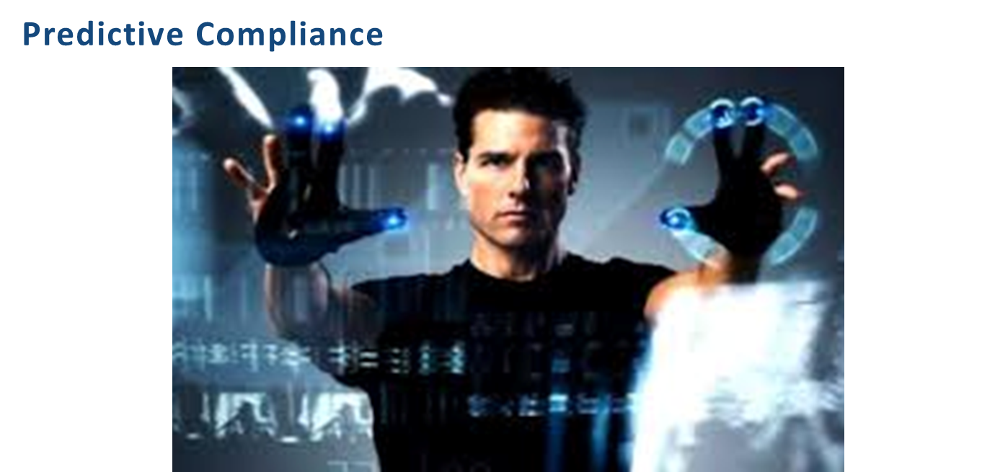

Slide 11
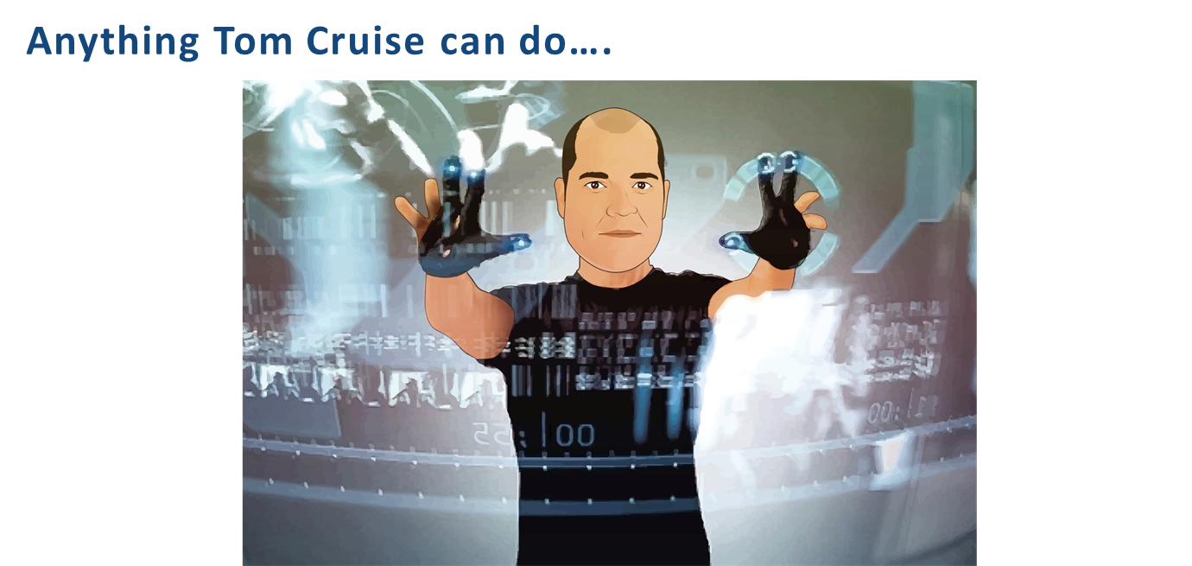

Slide 12
Predictive Compliance: Our Objectives
Identify patterns associated with misconduct
Detect these patterns in email and unstructured data
Develop models to be used in an early warning system to detect and prevent misconduct as it develops

Slide 13
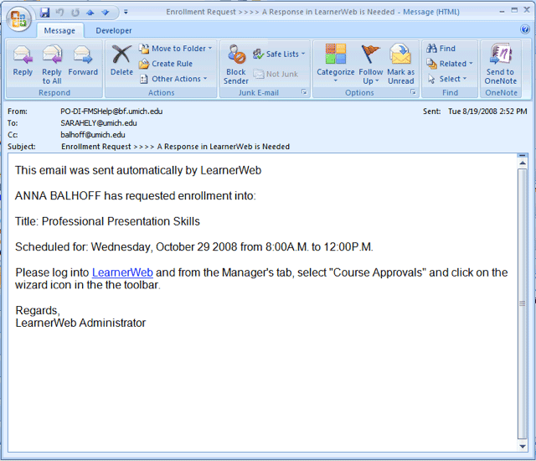
Email Transformation
Metadata
To
From
Date-Time
Domains
Attachments
…
Text

Slide 14
Metadata Features
Used many of the metadata features related to email
Developed aggregate features
  Internal vs. external communications vs.personal
  Number of correspondents
  Time of day (binned into before, during and after work hours)
  Days of week
  Time of year (e.g., reporting periods)
  Binary attachment (yes/no)
  Number of attachments
  Size of attachments
  Kinds of attachments
  And many more

Slide 15
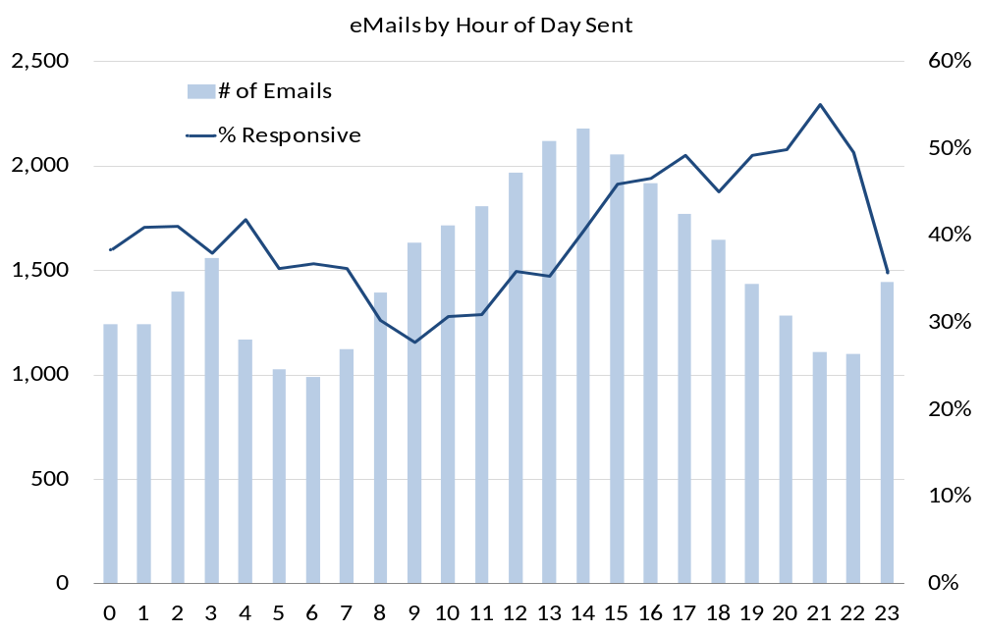

Slide 16
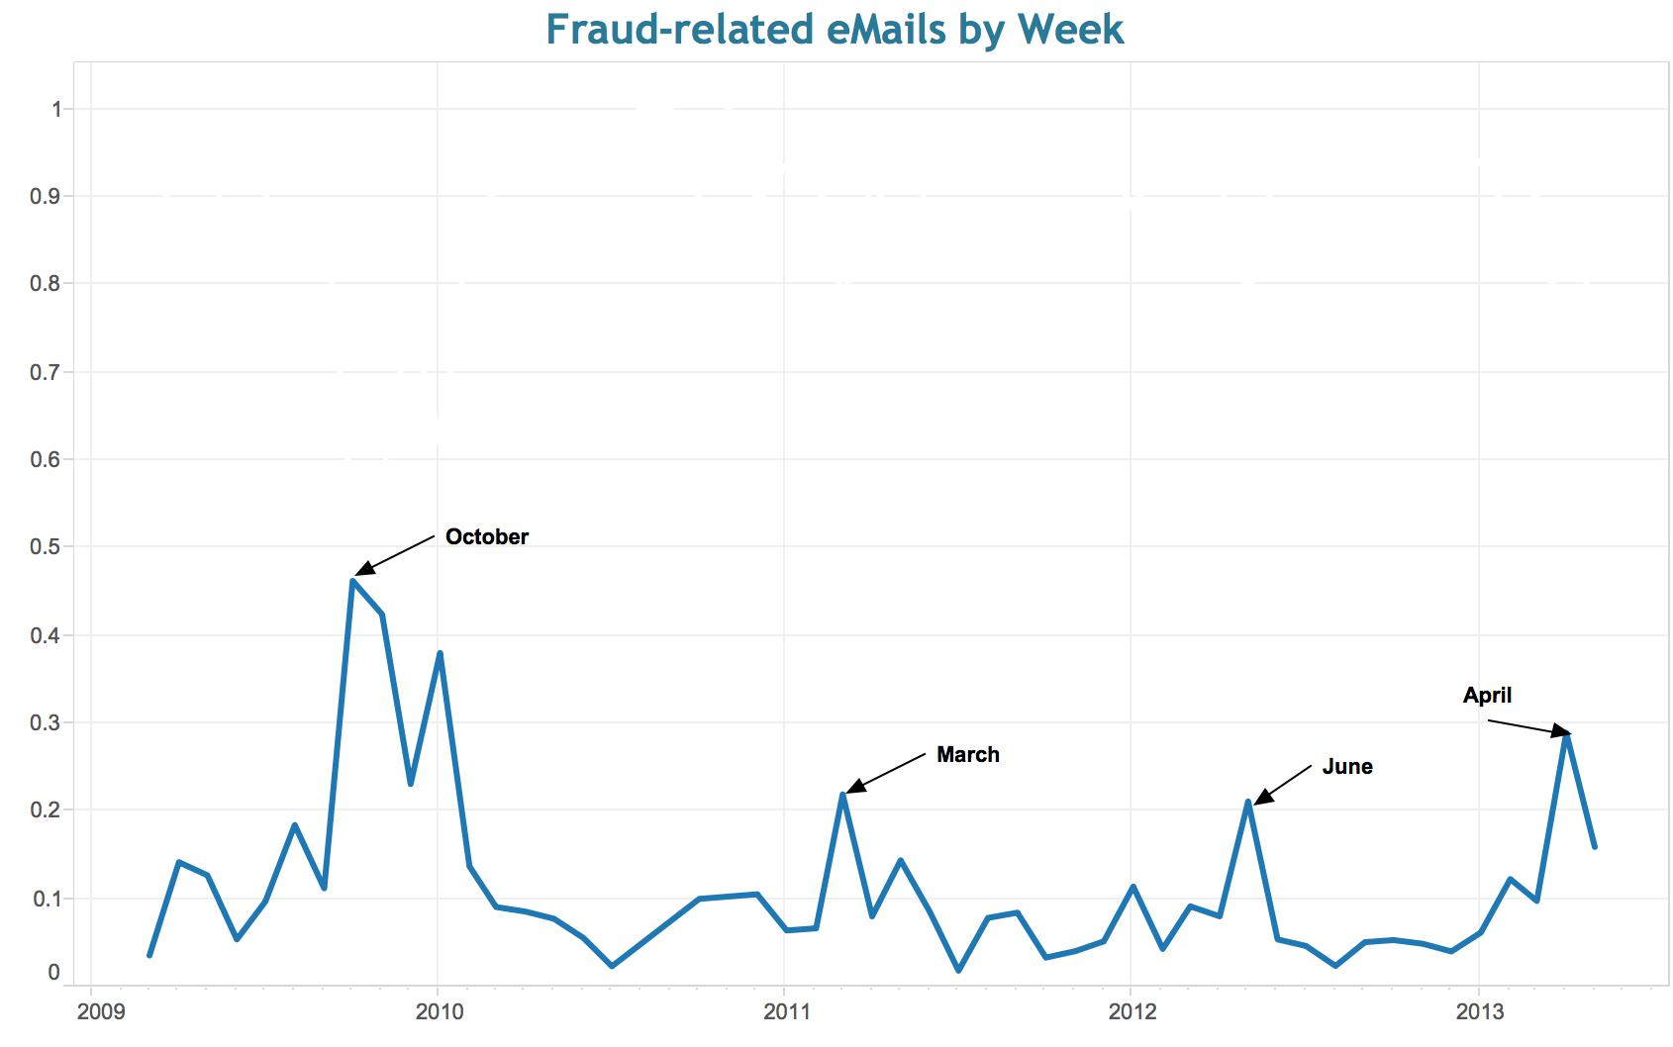
Communications Near Reporting Periods

Slide 17
Text Mining
Result:
1,300+ features
for every email
Distill content into words and phrases
Sentiment analysis
Sentiment polarities
Custom domain dictionaries

Slide 18
Oscar |  |  | Alpha
Term | Documents with hits |  | Term | Documents with hits
"Call me" | 43,048 |  | Trouble | 64,433
"Come by my office" | 23,510 |  | "Call me" | 63,511
"not legal" | 22,228 |  | wrong | 43,201
(Take w/2 (him OR her OR them) w/2 down) | 17,612 |  | breach | 35,379
"Keep it between" | 16,650 |  | dodge | 30,026
get around | 11,597 |  | (("Do not" OR "Don't") w/2 send) | 28,937
prohibit* | 11,158 |  | frame | 28,281
"under the table" | 9,789 |  | Violation | 27,904
hold up | 9,766 |  | ((“do not” or “don’t” w/2 tell) | 26,289
"talk to me" | 9,166 |  | unlawful | 19,532
"Cover up" | 8,675 |  | "not legal" | 19,288
((They OR she OR he) w/2 (owe* it to me)) | 7,055 |  | Fraud | 16,819
"lead on" | 6,252 |  | Secret | 15,669
"stay out" | 5,368 |  | Forge | 14,163
breach | 5,106 |  | criminal | 13,478
”don’t tell" | 4,064 |  | stress | 11,622
Violation | 3,788 |  | Misconduct | 10,878
unauthorized | 3,631 |  | Inappropriate | 10,775
"This is wrong" | 3,072 |  | forbidden | 10,250

Slide 19
Sentiment Analysis
71 sentiment dictionaries
Highly focused on conflict, cooperation, power, etc.
Worked with advisors from
  Social sciences
  Psychology of fraud and misconduct
  Intelligence and law enforcement
Sentiment Polarities

Slide 20
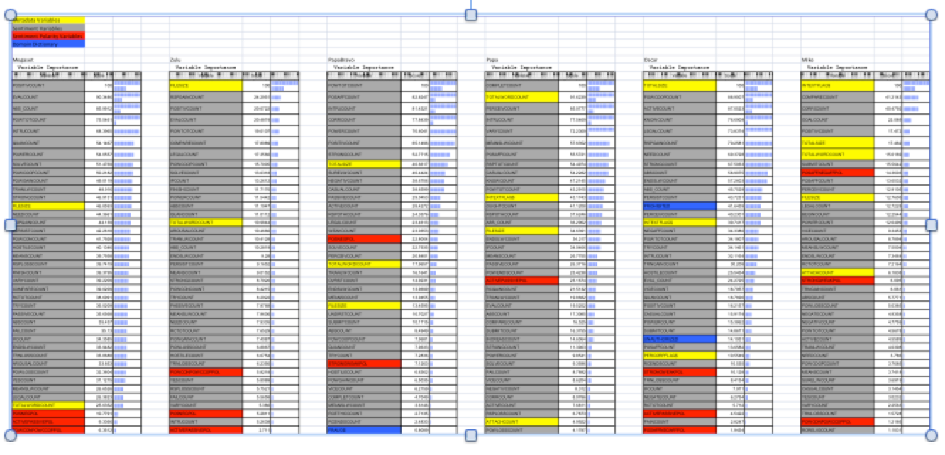
Metadata - Yellow
Sentiment - Gray
Sentiment Polarities - Red
Domain Dictionaries - Blue

Slide 21
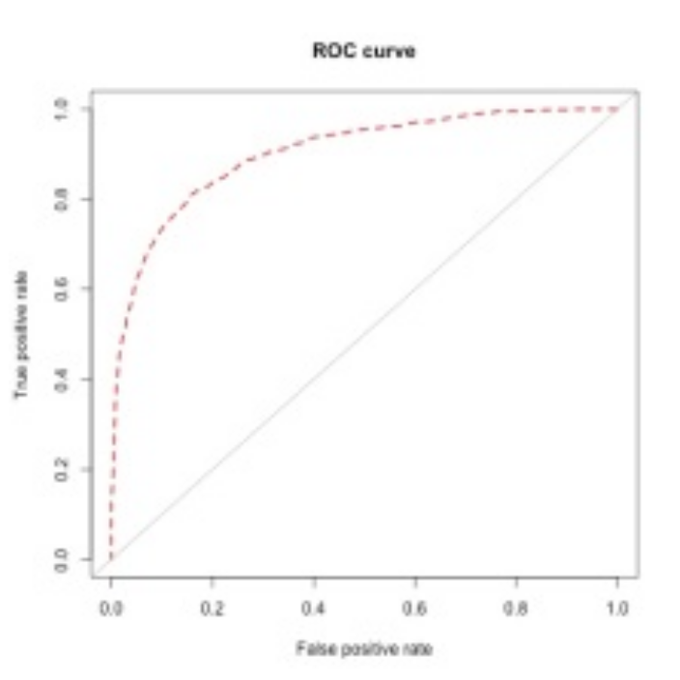
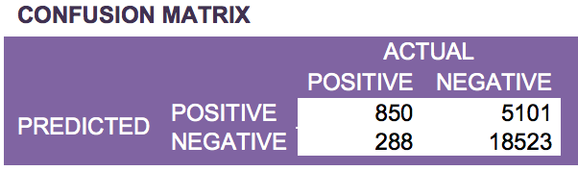
Results
ROC Curve
Accuracy | 79.7%
Precision | 15.6%
Recall | 77.2%
Specificity | 79.8%
AUC | 78.5%
True Positive Rate
False Positive Rate

Slide 22
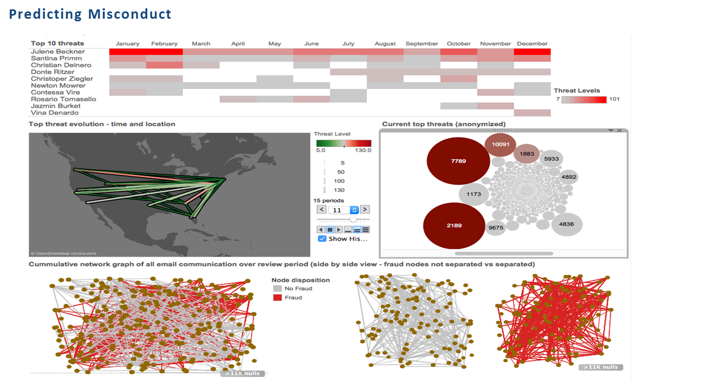

Slide 23
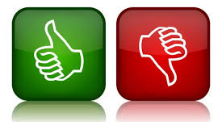
Predicting Human (Mis)Conduct – Good or Bad Idea?

Slide 24
Questions?
Bennett B. Borden
Chief Data Scientist
Chair, Information Governance and eDiscovery
Drinker Biddle & Reath LLP
1500 K Street, N.W.
Washington, DC 20005-1209
(202) 230-5194
Bennett.Borden@DBR.com

