Slide 1
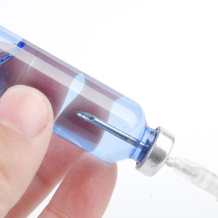
About OMICS Group
OMICS Group is an amalgamation of Open Access Publications and worldwide international science conferences and events. Established in the year 2007 with the sole aim of making the information on Sciences and technology ‘Open Access’, OMICS Group publishes 700+ online open access scholarly journals in all aspects of Science, Engineering, Management and Technology journals. OMICS Group has been instrumental in taking the knowledge on Science & technology to the doorsteps of ordinary men and women. Research Scholars, Students, Libraries, Educational Institutions, Research centers and the industry are main stakeholders that benefitted greatly from this knowledge dissemination. OMICS Group also organizes 1000+ International conferences annually across the globe, where knowledge transfer takes place through debates, round table discussions, poster presentations, workshops, symposia and exhibitions.

Slide 2
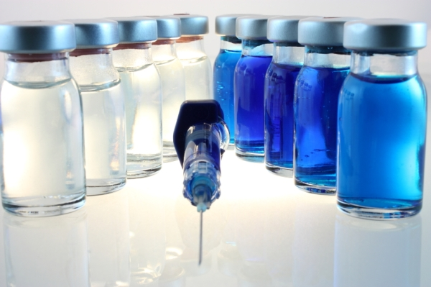
OMICS International Conferences
OMICS International is a pioneer and leading science event organizer, which publishes around 700+ open access journals and conducts over 500 Medical, Clinical, Engineering, Life Sciences, Pharma scientific conferences all over the globe annually with the support of more than 1000 scientific associations and 30,000 editorial board members and 3.5 million followers to its credit.
OMICS Group has organized 1000+ conferences, workshops and national symposiums across the major cities including San Francisco, Las Vegas, San Antonio, Omaha, Orlando, Raleigh, Santa Clara, Chicago, Philadelphia, Baltimore, United Kingdom, Valencia, Dubai, Beijing, Hyderabad, Bengaluru and Mumbai.

Slide 3
Purity, Endotoxin Level, and Trace Metal Comparison of Different Grades of Trehalose
Ben Nelson, PhD.
Formulation Solutions Manager
ben.nelson@pfanstiehl.com
http://www.pfanstiehl.com
NON-CONFIDENTIAL PRESENTATION

Slide 4
Protein and Cell Stabilization
Some Functions of Carbohydrates
Reduction in denaturation caused by heat, stress, oxidation
Prevention of mAb and protein aggregation
Improvements in post-thaw cell viability
Vaccine stabilization, membrane stabilization, phospholipid bilayer protection
Depression of phase transition temperature of dry lipids, rendering them more resistant to damage during desiccation, maintains liquid crystalline phase in the absence of water (glassy state)
Carbohydrates Used in Biotech Drug Products
Trehalose
Sucrose
Mannitol
Sorbitol

Slide 5
Marketed Drugs Formulated with Trehalose
Drug | Manufacturer | API Class | Formulation Type
Adcetris | Seattle Genetics | ADC | Lyophilized Powder
Avastin | Genentech/Roche | mAb | Solution
Blincyto | Amgen | Bispecific mAb | Lyophilized Powder
Gazyva | Genentech/Roche | mAb | Solution
Herceptin | Genentech/Roche | mAb | Lyophilized Powder
Lucentis | Genentech/Roche | mAb | Solution

Slide 6
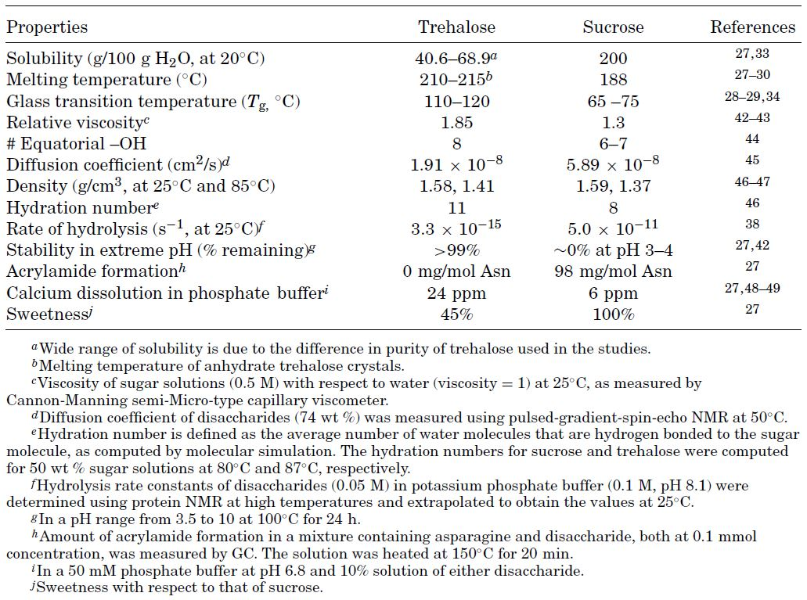
Trehalose and Sucrose
Comparison of Properties
Ohtake and Wang, J. Pharm. Sci., 100(6), 2020, (2011)

Slide 7
Glass Transition Temperature (T_{g})
The temperature at which and amorphous material transitions between glass and rubber states.
  Below T_{g} = glass state – lower mobility
  Above T_{g} = rubber state – higher mobility
The higher the T_{g} is above the storage temperature the less likely:
  Re-crystallization
  Chemical reactions: excipient/excipient and excipient/API (largely due to decreased mobility when in the glassy state)
Water acts as a plasticizer – the more water present, the lower T_{g} is.

Slide 8
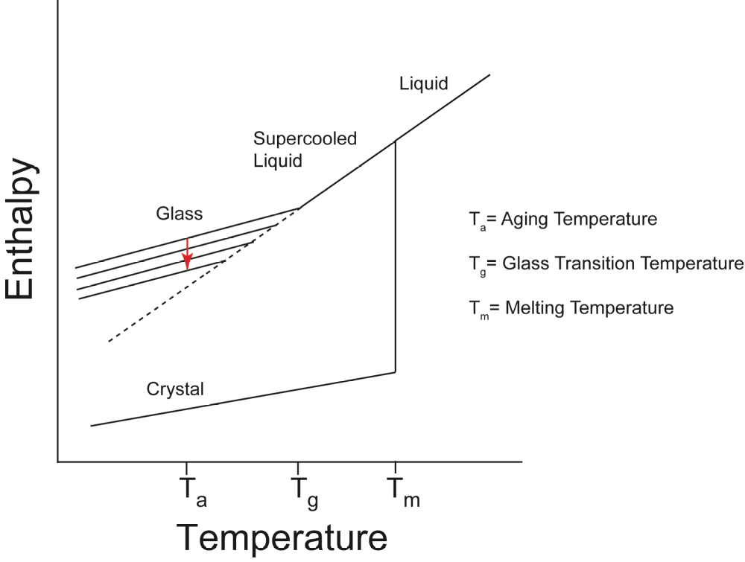
Enthalpy of the Amorphous State
Diagram depicting the energetics of a crystalline-liquid-amorphous system. As an amorphous material is held below its glass transition temperature, it relaxes to a lower energy state during a process referred to as aging or annealing.

Slide 9
DSC Thermograms of Trehalose Forms
Notes:
A: 100°C - Dehydration of the dihydrate
B: 120°C - Shift in the baseline corresponding to the Tg of amorphous trehalose
C: 132°C - Melting of α-Anhydrate
D: Exotherm of Crystallization of the β-Anhydrate. The crystallization temp is influenced by the presence of crystal nuclei and the thermal history of the sample
E: Melting of β-Anhydrate is reported from 190 - 215°C. Broad range thought to result from a kinetic loss of order rather than thermodynamic melting.

Slide 10
T_{g} Prime (T_{g}’)
In the majority of cases solutes do not crystallize at the solubility limit as the sample is freezing.
As the temperature is decreased, ice continues to form and the solution continues to concentrate until it is so viscous it turns to a glass.
This glass transition temperature is denoted T_{g}’
The “prime” mark is used to denote this is the glass formed by freeze concentration

Slide 11
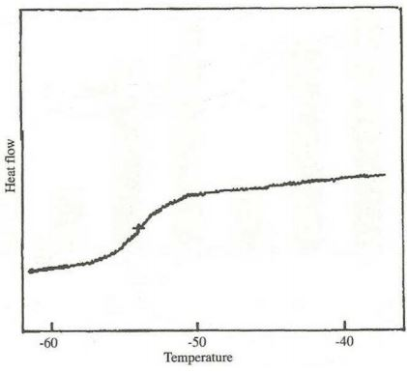
T_{g}’ DSC Thermogram

Slide 12
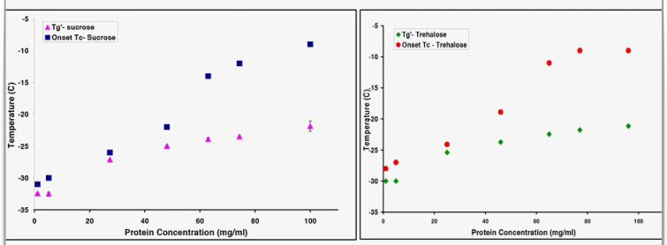
T_{g}’/T_{c} vs Protein Concentration
      T_{g}’ measured by DSC
      T_{c} measured by freeze drying microscopy
Every 1°C increase in product temperature results in ~13% reduction in primary drying time
  Sajal Patel Webinar

Slide 13
Equtorial OH Groups
The more equatorial OH groups a disaccharides has the stronger interactions with water
Helps Trehalose include itself in the water cluster with relative ease
Sucrose does not integrate into the water cluster creating a larger structure of the sugar-water clusters. This prevents it from getting into smaller places.

Slide 14
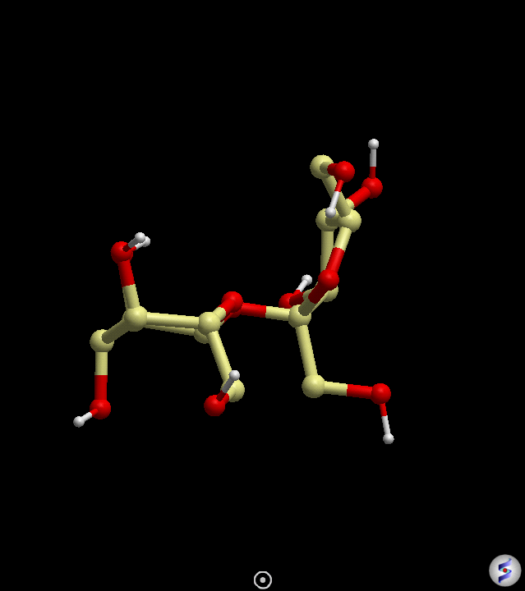
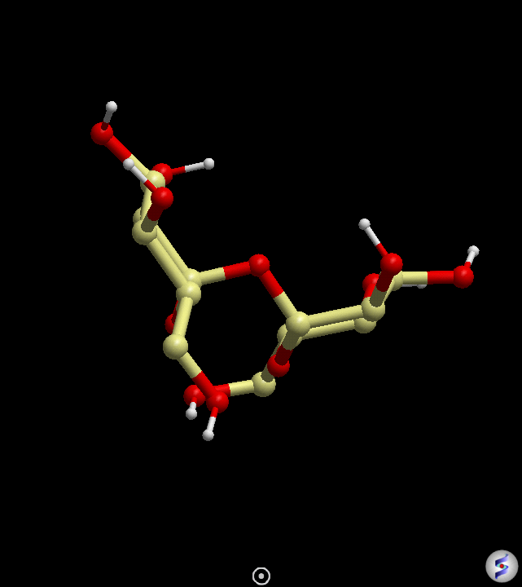

Slide 15
Rate of Hydrolysis
Free Energy of Glycosidic Bonds
  Trehalose <1 kcal/mol
  Sucrose = 27 kcal/mol
Higher free energy bonds renders the disaccharide more susceptible to hydrolysis
  Non-acid catalyzed hydrolysis rates at 25°C:
    Trehalose = 3.3 ×10⁻¹⁵ s⁻¹
    Sucrose = 5 ×10⁻¹¹ s⁻¹
  Stability after 1 hour in solution at pH = 3.5:
    Trehalose remaining >99%
    Sucrose remaining ~0%

Slide 16
Hydration Number
  Disaccharides at high concentration have a scarcity of water in their vicinity, thus intramolecular hydrogen bond formation is needed. The arrangement of intramolecular hydrogen bonds results in a folded configuration (around the glycosidic bond) and thus a reduction in hydration number
  Does this make the glycosidic bond more susceptible to glycolysis, resulting in more reducing sugars?
  Trehalose exhibits no such configurational changes

Slide 17
Total Impurities and Endotoxin Levels
Grade (# of Lots Tested) | Total Impurities (%) |  | Endotoxins (EU/g)
 | Data Range | Data Mean | Data Range | Data Mean
Food (6) | 0.69 – 1.00 | 0.84 ± 0.12 | 0.21 – 2.30 | 1.17 ± 0.77
Technical (6) | 0.42 – 0.68 | 0.54 ± 0.11 | 0.54 – 4.10 | 0.84 ± 0.12
Pfanstiehl High Purity (16) | 0.06 – 0.17 | 0.14 ± 0.03 | <LOQ – 0.33 | 0.06 ± 0.09*
*Only two lots tested above the LOQ (0.05 EU/g). For lots tested <LOQ a value of 0.025 was used in the calculation
of the mean.

Slide 18
Trace Metal Profile of Pfanstiehl Trehalose
Elements | V | Cr | Mn | Fe | Ni | Cu | Zn | As | Mo | Ru | Rh | Pd | Cd | Os | Ir | Pt | Hg | Pb
Limit (ppm) | 1 | 2.5 | 25 | 130 | 2.5 | 10 | 130 | 0.15 | 1.0 | 1.0 | 1.0 | 1.0 | 0.25 | 1.0 | 1.0 | 1.0 | 0.15 | 0.5
Limit of Quantitation (ppm) | 0.5 | 0.5 | 5 | 26 | 1 | 5 | 26 | 0.03 | 0.5 | 0.2 | 0.2 | 0.2 | 0.05 | 0.2 | 0.2 | 0.2 | 0.03 | 0.1
Lot 1 | <0.5 | <0.5 | <5 | <26 | <1 | <5 | <26 | <0.03 | <0.5 | <0.2 | <0.2 | <0.2 | 0.11 | <0.2 | <0.2 | <0.2 | <0.03 | <0.1
Lot 2 | <0.5 | <0.5 | <5 | <26 | <1 | <5 | <26 | <0.03 | <0.5 | <0.2 | <0.2 | <0.2 | <0.05 | <0.2 | <0.2 | <0.2 | <0.03 | <0.1
Lot 3 | <0.5 | <0.5 | <5 | <26 | <1 | <5 | <26 | <0.03 | <0.5 | <0.2 | <0.2 | <0.2 | <0.05 | <0.2 | <0.2 | <0.2 | <0.03 | <0.1
Lot 4 | <0.5 | <0.5 | <5 | <26 | <1 | <5 | <26 | <0.03 | <0.5 | <0.2 | <0.2 | <0.2 | <0.05 | <0.2 | <0.2 | <0.2 | <0.03 | <0.1
Lot 5 | <0.5 | <0.5 | <5 | <26 | <1 | <5 | <26 | <0.03 | <0.5 | <0.2 | <0.2 | <0.2 | <0.05 | <0.2 | <0.2 | <0.2 | <0.03 | <0.1
Lot 6 | <0.5 | <0.5 | <5 | <26 | <1 | <5 | <26 | <0.03 | <0.5 | <0.2 | <0.2 | <0.2 | <0.05 | <0.2 | <0.2 | <0.2 | <0.03 | <0.1
Lot 7 | <0.5 | <0.5 | <5 | <26 | <1 | <5 | <26 | <0.03 | <0.5 | <0.2 | <0.2 | <0.2 | <0.05 | <0.2 | <0.2 | <0.2 | <0.03 | <0.1
Lot 8 | <0.5 | <0.5 | <5 | <26 | <1 | <5 | <26 | <0.03 | <0.5 | <0.2 | <0.2 | <0.2 | <0.05 | <0.2 | <0.2 | <0.2 | <0.03 | <0.1
Lot 9 | <0.5 | <0.5 | <5 | <26 | <1 | <5 | <26 | <0.03 | <0.5 | <0.2 | <0.2 | <0.2 | <0.05 | <0.2 | <0.2 | <0.2 | <0.03 | <0.1
Lot 10 | <0.5 | <0.5 | <5 | <26 | <1 | <5 | <26 | <0.03 | <0.5 | <0.2 | <0.2 | <0.2 | <0.05 | <0.2 | <0.2 | <0.2 | <0.03 | <0.1

Slide 19
Pfanstiehl Know Your Product & Process Initiative
Additional Characterization
Particle Size
Polymorph
DSC
Residual Elemental Impurities
Nanoparticulates
Conductivity
Dexrtrins
Glucans
Impurity Profile
2D NMR
Functional Testing
Dissolution Studies
Customer Function (Formulation Stability Testing etc.)

Slide 20
¹H T₁ vs Impurity Content

Slide 21
¹H T₁ vs Impurity Content

Slide 22
Thank You

Slide 23
Contact Information
Ben Nelson
Pfanstiehl
1219 Glen Rock Avenue
Waukegan, IL 60085
Office: 847-599-5139
Email: ben.nelson@pfanstiehl.com

Slide 24
Let us meet again..
We welcome you all to our future conferences of OMICS International
2nd International Conference and Expo
on
Parenterals and Injectables
On
October 24-26, 2016 at Istanbul, Turkey
http://parenterals-injectables.pharmaceuticalconferences.com/

