Slide 1
Hemoglobin derivatives concentration enhancement after usage of magnetic treated water (MTW) through heavy metal chelation therapy
Bassem M. Raafat
Professor of Medical Physics
Faculty of Applied Medical Science
Taif University
KSA
Head of Biophysics Group
National Research Center
EGYPT

Slide 2

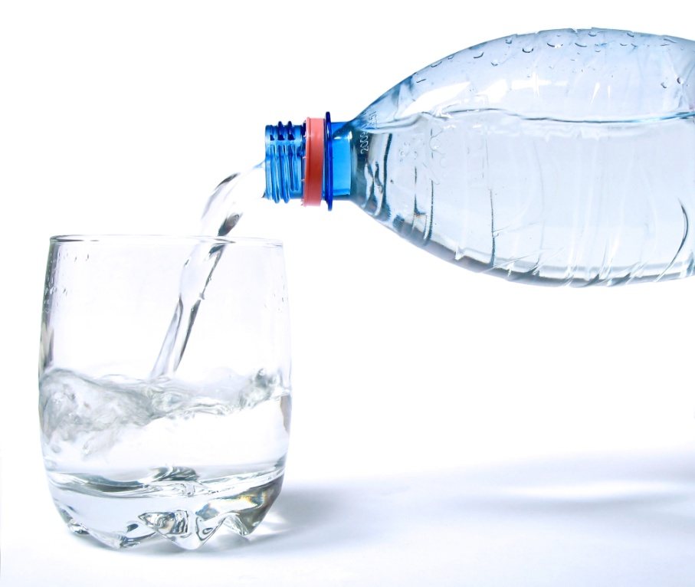
Water
is the world’s stream.
covers 70 % of the earth surface
is the major fluid of all organisms
Is the vital part of any life
Safe drinking water is essential to humans
and other life forms even though it provides
no calories or organic nutrients.
Access to safe drinking water has improved over the last
decades in almost every part of the world.

Slide 3
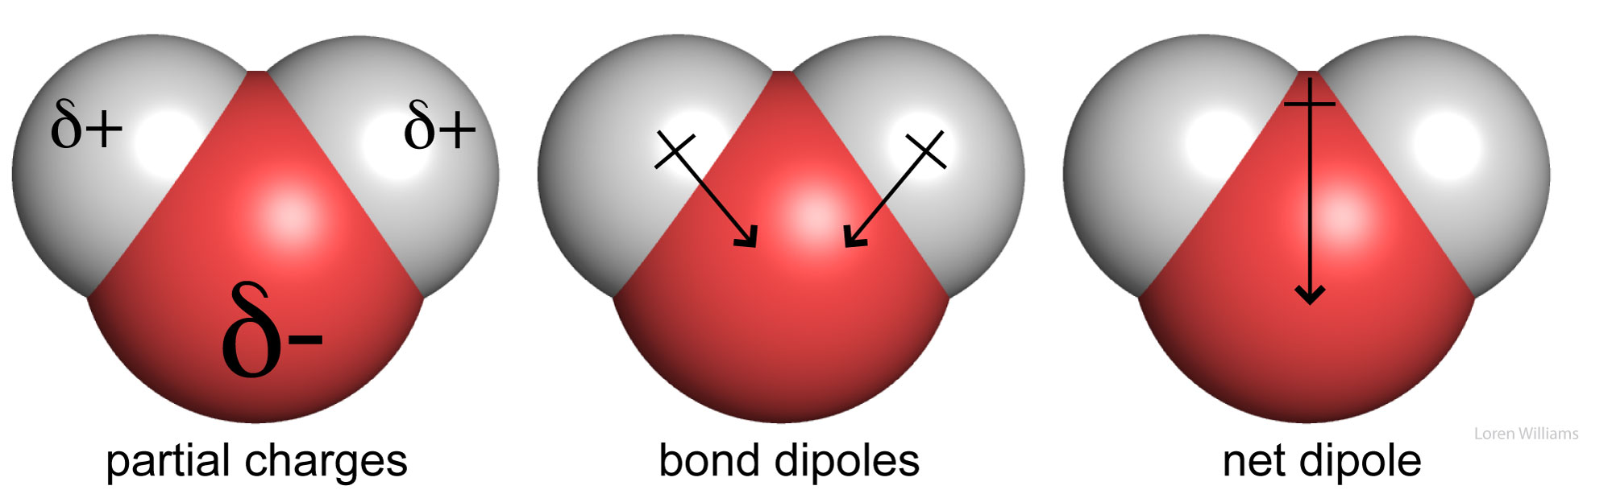
Water molecules are said to be polar because they
possess a permanent dipole moment.

Slide 4
What is the meaning of “ water has a dipole nature” ?
Answer : Dipole nature means that the overall polarity of the water molecule creates a region of positive charge and region of negative charge.
Oxygen is an extremely electronegative atom which means because of the big numbers of the electrons. So when electrons are shared between oxygen and hydrogen they are closer to the oxygen than the hydrogen.
The hydrogen which are not very electronegative will have a greater positive charge due to the lack of electron density.
Since both hydrogen are positively charged and
oxygen is negatively charged (two poles)
Meaning dipole molecule

Slide 5
Magnetic Properties of Water
It was found that the water chemistry mainly depends on :
- Shape of the molecule
- The asymmetry of the molecule
- The net dipole moment of the molecule
Recently, it was discovered that the near infrared spectrum and refractive index of water can be affected by a strong magnetic field. Some researchers have suggested that the magnetic field somehow strengthens hydrogen bonds, but the exact mechanism behind these results remains a mystery.

Slide 6

Our Idea
We thought about the effect of an external uniform magnetic field to be applied on the water stream and then use this water instead of normal drinking water in a very common medical process “chelation” of heavy metals from the blood by a famous chemical chelator to find out the enhancement chance by using magnetized water

Slide 7
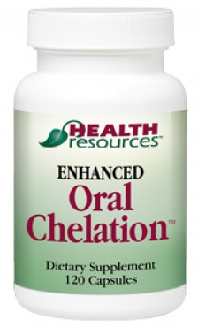
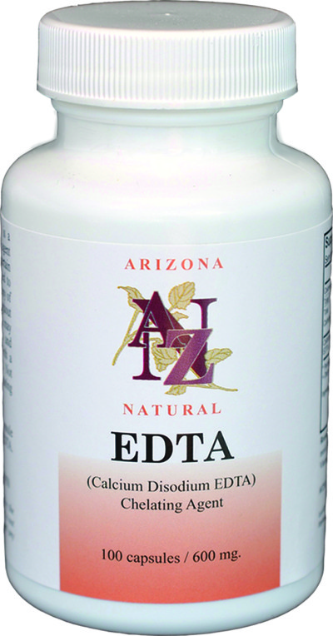
What is the chelation therapy ?
It is a medical procedure that involves the administration of chelating agents to remove heavy metals from the body. Chelation therapy has a long history of use in clinical toxicology
Common lead chelators :
DMSA
EDTA
Angelica Officinalis
Vit. C

Slide 8
Design
Experimental animals (rabbits)
N = 67
Control Group
Neither receive lead intoxication nor any treatment
Group 2
Animals received MTW instead of normal drinking water
Group 3
Animals received lead ions for 21 days with no treatment
Group 4
Animals received lead ions for 21 days with application of DMSA as a chelator with normal drinking water
Group 5
Animals received lead ions for 21 days with application of DMSA as a chelator with MT water

Slide 9
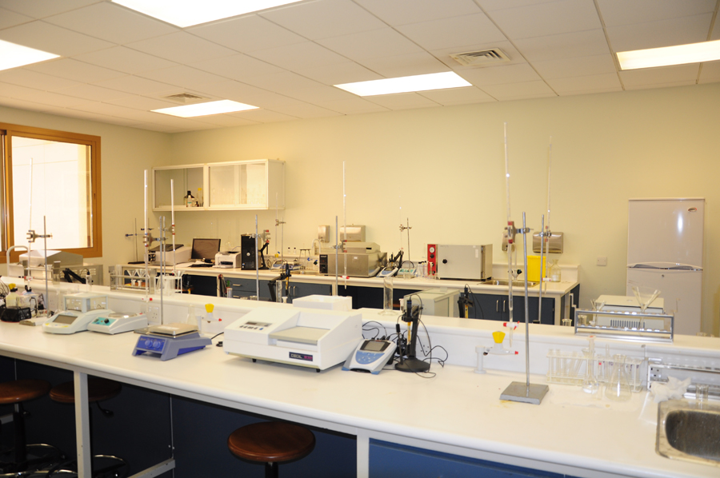

Experiment
After the incubation period, blood samples were collected from all animals in all groups and the following biochemical and biophysical assessments were carried out for each :
- Hemoglobin auto-oxidation rate
- Hemoglobin electrical conductivity
- Blood intrinsic viscosity
- Hemoglobin derivatives concentrations
- SOD and Glutathione peroxidase concentrations

Slide 10
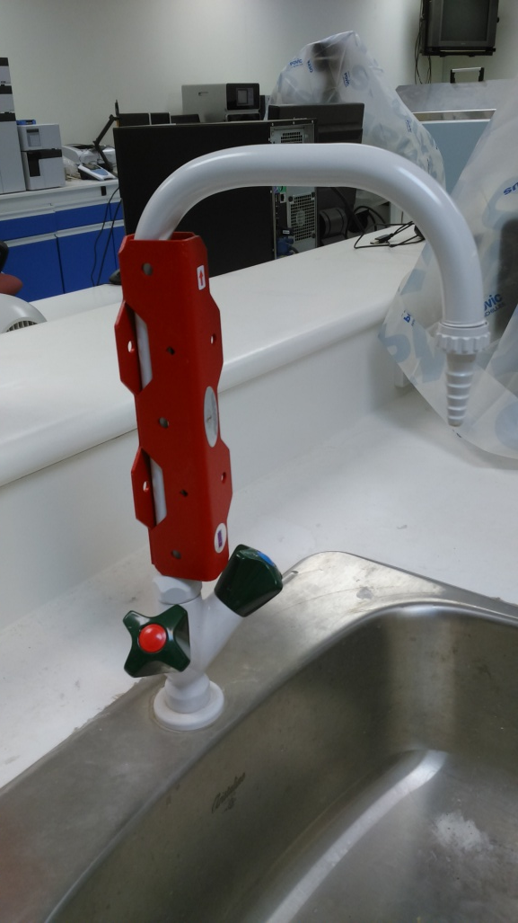

Water magnetization
Simply fix the magnet poles in the two sides of the water stream source, water will reserve its uniform magnetic properties for the next 12 hours

Slide 11
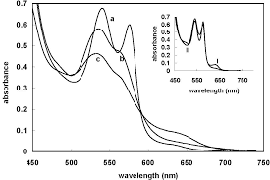
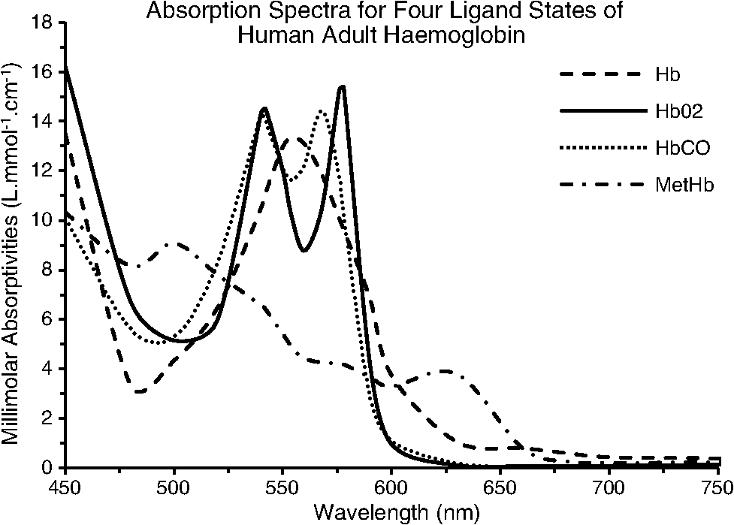
RESULTS
Hb Auto-oxidation rate
A_{630 nm}
_{Mm}⁻¹
Lead ions
Lead + DMSA + drinking water
Lead + DMSA + MTW
Control group
MTW only
Time hr
1
2
3
4
5
6
7

Slide 12
RESULTS
Hb Intrinsic viscosity
The extrapolation of the line represent the graph between concentration and the division of relative viscosity over the concentration fives the intrinsic viscosity of the hemoglobin. This is mean the viscosity when the effect of solvent is canceled.
_{♈︎/C}
C

Slide 13
RESULTS
Hb Intrinsic viscosity
The extrapolation of the line represent the graph between concentration and the division of relative viscosity over the concentration fives the intrinsic viscosity of the hemoglobin. This is mean the viscosity when the effect of solvent is canceled.
 | Control | G2 | G3 | G4 | G5
Intrinsic viscosity | 0.0311 ± 0.0031 | 0.0291 ± 0.0028 | 0.0398 ± 0.0032 | 0.0331 ± 0.0029 | 0.0324 ± 0.0031

Slide 14
RESULTS
Hb Electrical Conductivity
Hemoglobin molecules have hydrophobic groups in the their surface and these groups can act as electrical conductivity area, the speed by which the electricity run over the surface reflects a picture about the 3D dimensional structure of the molecules.
 | Control | G2 | G3 | G4 | G5
Electrical conductivity | 37.25 ± 3.25 | 36.88 ± 3.87 | 52.47 ± 4.98 | 45.68 ± 5.78 | 39.47 ± 4.58

Slide 15
RESULTS
Hb derivatives concentrations
Hemoglobin is found in the blood stream as conjugated derivatives, oxyhemoglobin, sulphohemoglobin, carboxy hemoglobin and Methemoglobin.

Slide 17
 | S-Hb |  | Met-Hb |  | Hb-CO |  | Hb-O₂
Control | gm/dl % |  | gm/dl % |  | gm/dl % |  | gm/dl %
 | 0.038 ± 0.0023 | 0.287 | 0.372 ± 0.034 | 2.81 | 0.285 ± 0.026 | 2.15 | 12.518 ± 1.35 | 94.74
G₁ | 0.031 ± 0.0021 | 0.255 | 0.212 ± 0.088 | 2.21 | 0.281 ± 0.020 | 2.05 | 12.812 ± 1.54 | 95.94
G₂ | 0.082 ± 0.0081 | 0.351 | 0.884 ± 0.077 | 2.81 | 0.351 ± 0.030 | 3.11 | 11.154 ± 1.08 | 88.02
G₃ | 0.035 ± 0.0081 | 0.031 | 0.521 ± 0.074 | 4.21 | 0.251 ± 0.049 | 2.88 | 12.747 ± 2.69 | 93.11
G₄ | 0.037 ± 0.0090 | 0.265 | 0.322 ± 0.018 | 2.41 | 0.274 ± 0.085 | 2.11 | 12.612 ± 2.66 | 94.45

Slide 18
RESULTS
Antioxidants concentrations
 | SOD activity U/mL | Glutathione peroxidase U/mL
Control | 148.28 ± 13.725 | 5754.14 ± 358.441
G₁ | 135.11 ± 11.258 | 5545.14 ± 344.441
G₂ | 258.78 ± 22.47 | 6987.18 ± 541.258
G₃ | 187.09 ± 15.698 | 5514.91 ± 486.147
G4 | 157.18 ± 14.697 | 5614.08 ± 387.459

Slide 19

In conclusion, it safe to say that magnetic treated water played a role in controlling the oxidative stress cam from the heavy metal ions and enhance the function hemoglobin derivatives as well as enhancing the biophysical performance of the hemoglobin molecule.

Slide 20



