Slide 1

Decision Tree for the Selection of Appropriate Ground Improvement Technique in the Arabian Gulf Region
Bashar Tarawneh, Ph.D., P.E
Associate Professor
Civil Engineering Department Chair
The University of Jordan
Amman, Jordan

Slide 2

Importance of Ground Improvement?
Deep foundations is typically more expensive than ground improvement.
Problematic soils should be treated before construction to avoid any future damage to structures.
Ground improvement is necessary to:
  Improve soil properties.
  Increase bearing capacity.
  Mitigate liquefaction.
  Reduce potential settlements.
Selection of appropriate ground improvement
technique is usually a challenge for designer and
contractor to meet project requirements.

Slide 3
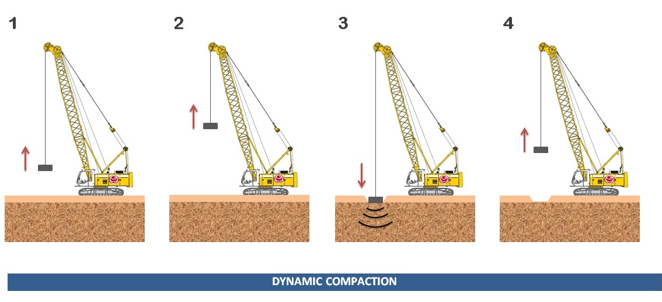
Most popular ground improvement techniques in the Arabian Gulf region
Dynamic Compaction (DC)
  Effective for sandy and granular soils.
  Can improve soil down to 6 to 9m below ground level.

Slide 4
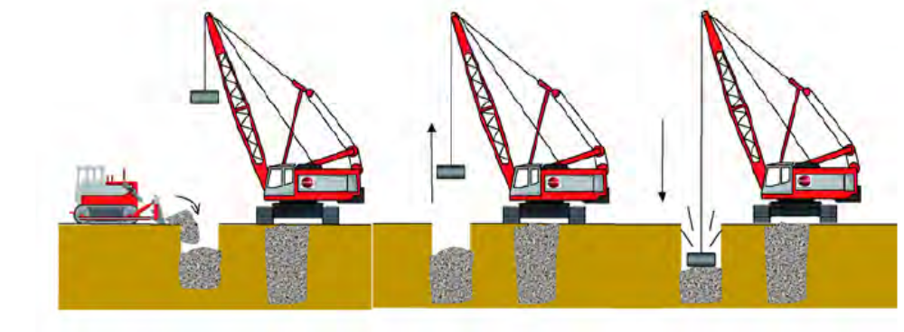
Most popular ground improvement techniques in the Arabian Gulf region
Dynamic Replacement (DR)
  Appropriate for soft saturated fine-grained soils with high fine content.
  Can reach to a depth of about 7m.

Slide 5
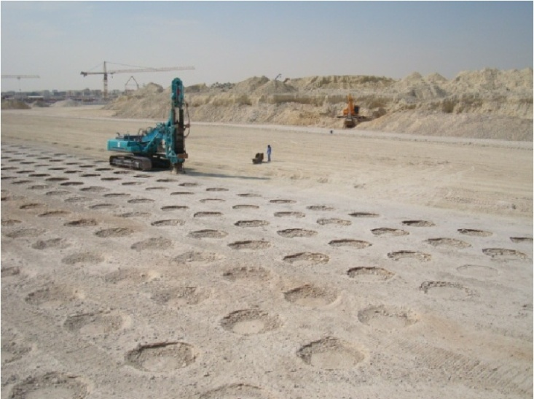
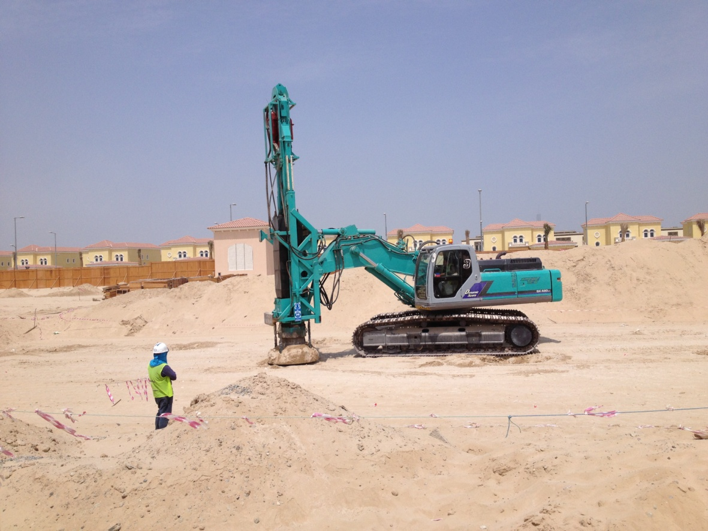
Most popular ground improvement techniques in the Arabian Gulf region
Rapid Impact Compaction (RIC)
  Middle-deep compaction method suitable to improve sandy soils where fine content is low.
  RIC can be employed to densify loose soils down to a depth of about 4 m to 6m.

Slide 6
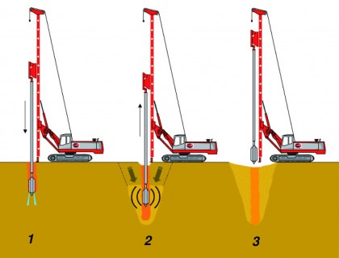
Most popular ground improvement techniques in the Arabian Gulf region
Vibro Compaction (VC)
  Effective for improving the relative density of granular soils with suitable gradations and limited fines contents (not more than 5%).

Slide 7
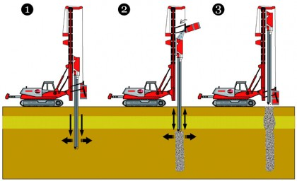
Most popular ground improvement techniques in the Arabian Gulf region
Stone Columns (SC)
  Used for soils with higher fine content.
  Can be performed near existing structures as it produces less vibration that other techniques.
  can be formed by inserting a vibratory probe to incorporate the granular soil into the ground and form vertical inclusions.

Slide 8
Decision Tree Development
Decision tree is considered:
  Simple but powerful form of multiple variable analysis.
  It is a graph that uses a branching method to choose between several events.
Geotechnical engineer must determine the most appropriate method under specific project conditions.
By eliminating incompatible techniques, a Geotechnical engineer can select the most appropriate one from the remaining compatible methods.
Data is obtained from 75 completed ground improvement projects in the Arabia Gulf region ( Saudi Arabia, Kuwait, United Arab Emirates, Oman, Qatar, and Bahrain).

Slide 9
Vibration Assessment
Technique | *PPV at 5 m away from the work (mm/s)
DC | 55
DR | 39
RIC | 20
VC and SC | 13
*Peak Particle Velocity

Slide 10
Analysis of the Collected Data
The statistical significance of the collected variables is verified using analysis of variance ( ANOVA).
All collected factors are significant for the selection process except the water table level (WTL).
This is because shallow WTL can be mitigated by using a filling platform to carry the equipment.
Ground Improvement Technique | Fine Content (%) | Depth of Improvement (m) | Distance to Nearby Structures (m) | Water Table Level (m)
DC | 7-21 | 4-9 | 17-75 | 1.5-6
DR | 25-70 | 2-7 | 25-100 | 1-8
SC | 20-80 | 4-19 | 4-36 | 0.5-7
RIC | 8-16 | 1-5 | 12-100 | 1-8
VC | 3-7 | 8-19 | 7-50 | 1-5

Slide 11
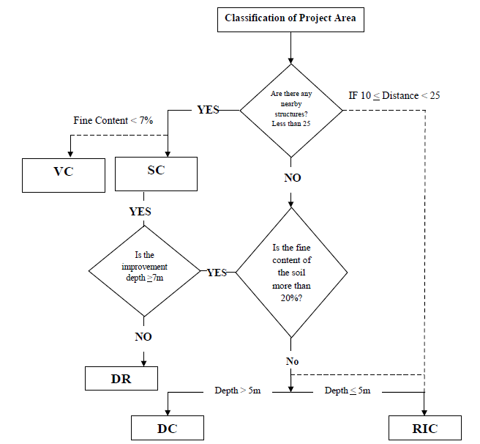
Decision Tree
If more than one technique is appropriate, cost effectiveness will be employed for the final selection.

Slide 12
Conclusions
The proposed decision tree can be used to select appropriate ground improvement method.
If two methods are appropriate, then cost-effectiveness must be employed for the final selection.
Distance to nearby structures is the most important factor because some of the techniques cannot be utilized due to the existence of nearby structures even though they are efficient and cost-effective.

Slide 13
Conclusions
All collected factors are significant for the selection process except the water table level (WTL).
This is because shallow WTL can be mitigated by using a filling platform to carry the equipment.
DC and DR can cause damage to nearby structures because they produce the highest PPV and must be used in rural areas.

Slide 14
Conclusions
SC and VC produce the least PPV and can be used in urban areas.
RIC produce PPV less than DC and DR but more than VC and SC. However, RIC can be used in urban areas with caution.

Slide 15
THANK YOU

