Slide 1


Slide 2
URINARY INCONTINENCE AWARENESS AMONG PREGNANT WOMEN
Basak POLAT, PT
Research Assistant, Istanbul Medipol University

Slide 3
Pelvic Floor Dysfunction,
particularly as manifested by genital prolapse and urinary or fecal incontinence and these are one of the most important issues in women’s health care today.
Kari Bo, Evidence Based Physical Therapy For the Pelvic Floor, 2007

Slide 4
Pelvic floor dysfunction may lead to the following conditions:
Urinary incontinence (stress, urge and mixed
incontinence)
Fecal incontinence
Pelvic organ prolapse
Sensory and emptying abnormalities of the
lower urinary tract
Defecatory dysfunction
Sexual dysfunction
Chronic pain syndromes
Urinary incontinence

Slide 5
Urinary incontinence is a common problem that can develop as a result of various factors.

Slide 6
Predisposing Factors
Gender
Genetic
Neurological
Anatomical
Collagen
Muscular
Cultural and environmental

Slide 7
İnciting Factors
Childbirth
Nerve damage
Muscle damage
Radiation
Tissue disruption
Radical surgery

Slide 8
Promoting Factors
Constipation
Occupation
Obesity
Smoking
Menstrual cycle
Infection
Medication
Menopause

Slide 9
Decompensating Factors
Ageing
Dementia
Disease
Medications

Slide 10
Increased age
Number of births
From young age and from the onset of pregnancy,
it is important to create urinary incontinence awareness.

Slide 11
For this purpose; we organized seminars to educate pregnant women every week in November 2015 at Istanbul Medipol University.
We both informed the participants about pregnancy and applied some questionnaires.

Slide 12
One of questionnaires was the “Questionnaire Awareness of Urinary Incontinence” that the researchers created was applied.
123 of 130 pregnant women participating in pregnancy education answered this questionnaire.

Slide 13
The aim of this study was to investigate urinary incontinence awareness of pregnant women.

Slide 14
The mean age = 27,9 ± 5,2

Slide 15
Our questionnaire consists of 23 questions.
We questioned
- The problem of urinary incontinence in
adults previously heard or not
- Causes of urinary incontinence
- Treatment of urinary incontinence
- Physical therapy and urinary incontinence

Slide 16
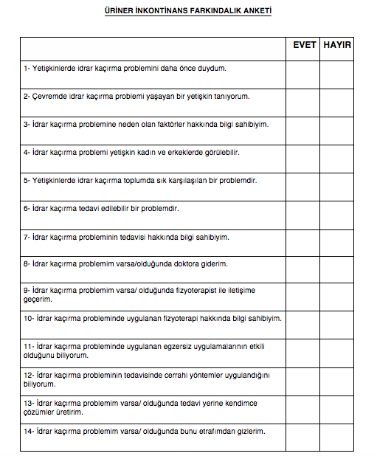

Slide 17
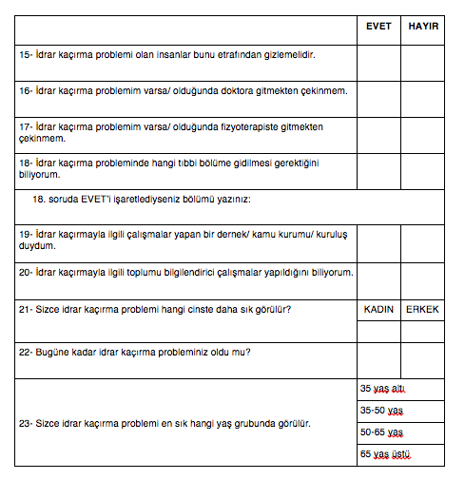

Slide 18
RESULTS
82,1 percent of participants stated that the problem of urinary incontinence in adults previously heard.
18,8 percent of them had knowledge of risk factors causing urinary incontinence.

Slide 19
While 111 pregnant women expressed that “urinary incontinence is treatable problem”,
only 22 pregnant women of them
had knowledge of treatment of urinary incontinence.

Slide 20
66 pregnant women expressed that
“I know the surgical operations applies in
treatment urinary incontinence”
37 pregnant women of participants said that the exercise applies are effective in treatment of urinary incontinence .

Slide 21
Only 10 women pregnant of 123 had knowledge of physiotherapy applies used in treatment urinary incontinence.

Slide 22
“Do you know which department you need to go in the presence of urinary incontinence” the question of 44 pregnant women yes replied and
11 of them expressed that the department must be urology or obstetrics and gynecologic.

Slide 23
CONCULUSION
Results showed us that more work should be done to inform women.
The importance of pelvic floor muscle training must be told.

Slide 24

Thank you…

