Slide 1
Opening the Doors to the Operating Room: Part II
A Longitudinal Study
Barbara Ann M. Messina, PhD, RN, ANP
Associate Professor
School of Health Professions & Nursing
Long Island University/Post
barbara.messina@liu.edu

Slide 2
Objectives
At the conclusion of this presentation the participant will be able to:
Describe the recruitment and retention strategy utilized
Develop recruitment and retention strategy for other nursing specialties'

Slide 3
Purpose of the Study
The purpose of this study was to:
Recruit graduating basic baccalaureate degree nursing students into the periOperative setting and
Decrease attrition of new nurse hires to the periOperative environment.

Slide 4
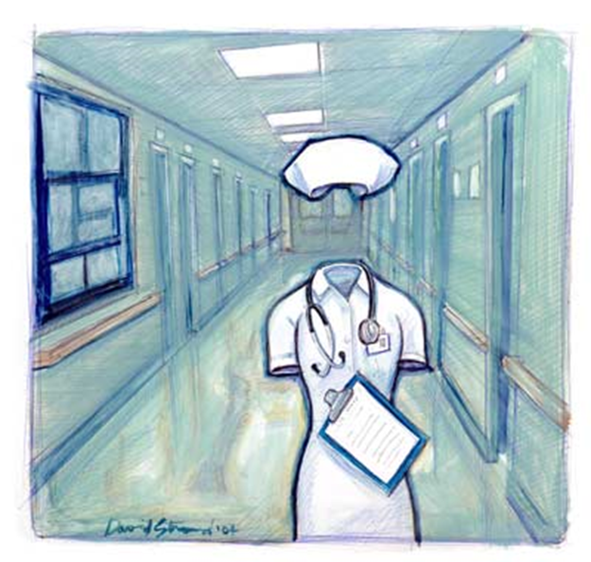
Nursing Shortage
A report issued by Buerhas, Staiger, & Auerbach (2009) estimated that the
shortage of nurses in the US could reach as high as 500,000 by the year 2025
while the demand for nurses is expected to continue to increase by 2% - 3%
per year during this same time period.

Slide 5
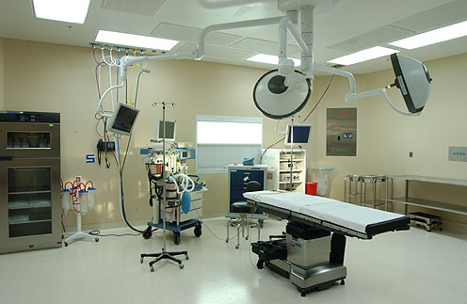
Operating Room Nurses
Approximately only about 4 percent of all RNs pursue a
career in periOperative nursing and within the next 5
years about 20 percent of all periOperative nurses are
expected to retire (Girard, 2004).

Slide 6
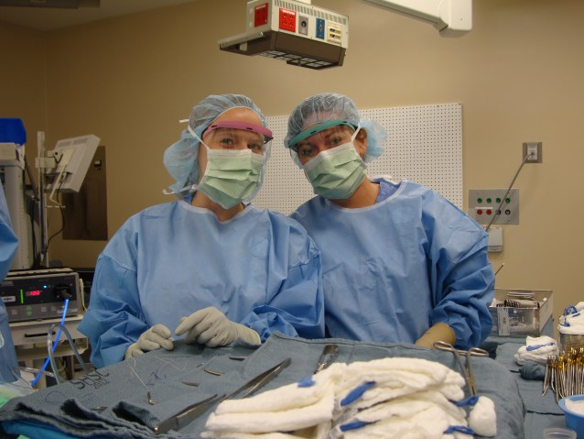
Recruitment & Retention
Utilizing Knowles theory (Knowles, 1968) a periOperative clinical experience was developed in accordance with the AORN guidelines for periOperative orientation for new nurses (AORN, 2007, 2012).

Slide 7
Program Development
The AORN (2007; 20102) guidelines for orientation to the periOperative clinical setting was utilized to develop the orientation program to the periOperative setting and provided the vertical threads for the curriculum.
Vertical threads permit the students to gain both breadth and depth as they progressed through the periOperative clinical practicum and capstone experience. As complexity of nursing interventions increased, new principles and theories were provided. Vertical threads included but were not limited to; introduction to periOperative setting, safety in the surgical suite, professionalism, critical thinking and positioning of the surgical patient

Slide 8
Program Development
The horizontal were derived from Knowles theory of adult learning (1968, 1980) and the expected outcomes of the periOperative senior clinical practicum and capstone experience.

Slide 9
Knowles (1968)
Adults have a need to know why they should learn something.
Adults have a need to be self-directing.
Adults have a greater volume and different quality of experience than youth.
Adults become ready to learn when they experience in their life situation a need to know or be able to perform more effectively and satisfyingly.
Adults enter into a learning experience with a task-centered (or problem centered or life-centered) orientation to learning.
Adults are motivated to learn by both extrinsic and intrinsic motivators.

Slide 10
Role of the Learner’s Experience
Pedagogy
Andragogy
To the experience learners bring to a learning situation is of little worth.
As people grow and develop, they accumulate an increasing reservoir of experience that becomes an increasing rich resource for learning – for themselves and others.

Slide 11
Readiness to Learn
Pedagogy
Andragogy
People are ready to learn whatever society (especially the school) says the ought to learn, provided the pressures on them (like fear or failure) are great enough.
People become ready to learn something when they experience the need to learn it in order to cope more satisfyingly with real-life tasks or problems.

Slide 12
Orientation to Learning
Pedagogy
Andragogy
Learners see education as a process of acquiring subject matter content , most of which they understand will be useful only at a later time in life.
Learners see education as a process of developing increased competence to achieve their full potential in life.

Slide 13
2007 - 2011
2007 -2011 | 24 students
2007 | 6 | 3
2008 | 6 | 1
2009 | 6 | 5
2010 | 6 | 5
2011 | 6 | 4
Total recruited to OR |  | 17

Slide 14
Data
2007 – 2011: 17 basic baccalaureate degree nursing students elected to participate in the periOperative senior clinical and capstone experience.
  SBU 7.5%
    National average 4% (Girard, 2004)
Nurses who did not elect the OR was 29% - did not elect to continue with capstone
  Qualitative findings:
  Two Common themes emerged:
    1. Too technical
    2. Desired more awake patient contact
SBU 2.5 % of students went into OR

Slide 15
Retention Data
Year | Retention | Rationale for Leaving
2 | 100%
3 year | 71% | Pursue full time graduate studies
4 years | 71% | Establish cardiothoracic surgical service *Hospital is satellite within the alliance
Note: National attrition rate of new nurses is 13% within the first year of hire (AACN, 2014)

Slide 16
Qualitative Data
Felt part of the team
Felt I was taking charge of my learning
Felt like my knowledge was finally being recognized

Slide 17
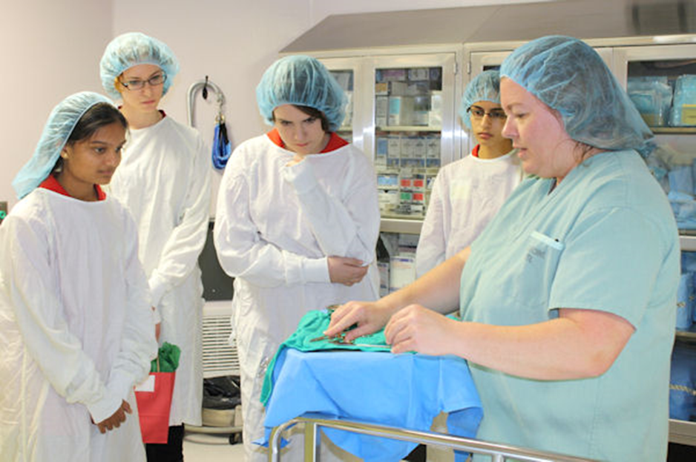
Key Strategies Employed
Pre-clinical senior placement interview (AORN,2007; 2012).
Student goals were reviewed.
The student responsibility as the program progressed.
Self-directed learning: required to select a topic, conduct literature review and provide presentation to periOperative team.
Provided with a clinical check list (AORN, 2007; 2012, Messina, 2008).
Met with periOperative nurse educator consistently throughout the program.

Slide 18
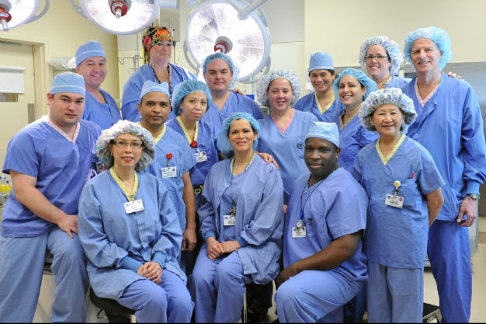
Immerse the Student in the Culture

Slide 19
References
Association of periOperative Registered Nurses. (2007, 2012). Perioperative Orientation Resources
Your Guide to Orientation, Recruitment and Retention. Retrieved from
http://www.aorn.org/Education/Curriculum/Periop101/Perioperative_Orientation_Resources.aspx
Buerhas PI, Staiger DO, Auerbach DI. (2009). The Future of the Nursing Workforce in
the United States: Data, Trends, and Implications. Boston, MA: Jones and Bartlett.
Girard N.J. (2004). Perioperative education: perspective from the think tank.
Association of periOperative Registered Nurses Journal, 80(5), 827-838.
Knowles, M. S. (1968). Andragogy, not pedagogy. Adult Leadership, 16(10),
350-352, 386.
Knowles, M. S. (1980). The modern practice of adult education: From pedagogy to
andragogy (2nd ed.). New York, NY: Cambridge Books.

