Slide 1

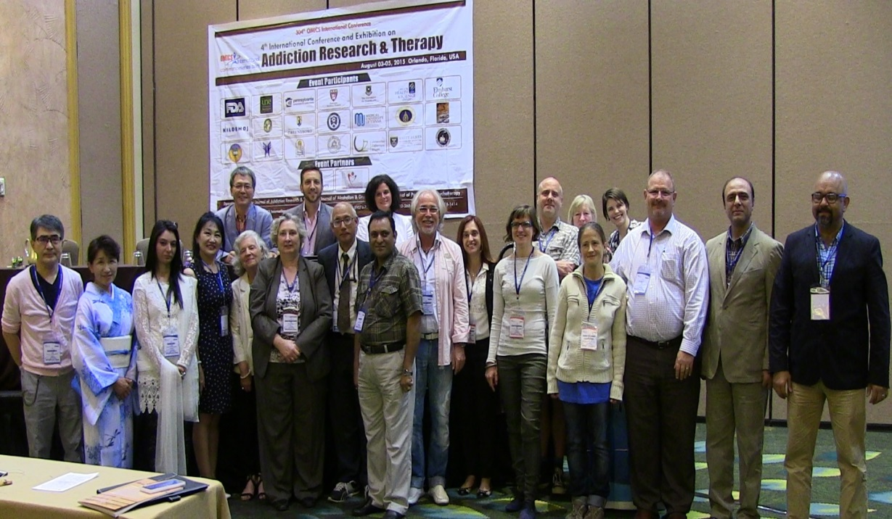
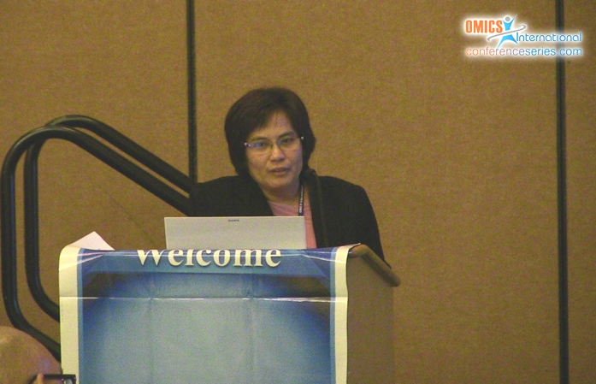
Addiction Therapy 2015
Florida, USA
August 03-08, 2015
Bang-on Thepthien

Slide 2

Chronic Care model and social protection
: experience in Thailand
Dr. Bang-on Thepthien
ASEAN Institute for Health Development,
Mahidol University
Thailand

Slide 3
Objective
To introduce health care system in Thailand.
To understand paradigm in health care in Thailand.
Chronic care model and implementation in Thailand.
Result.
to point out possible directions to meet the challenge of caring for a growing population with chronic conditions.

Slide 4
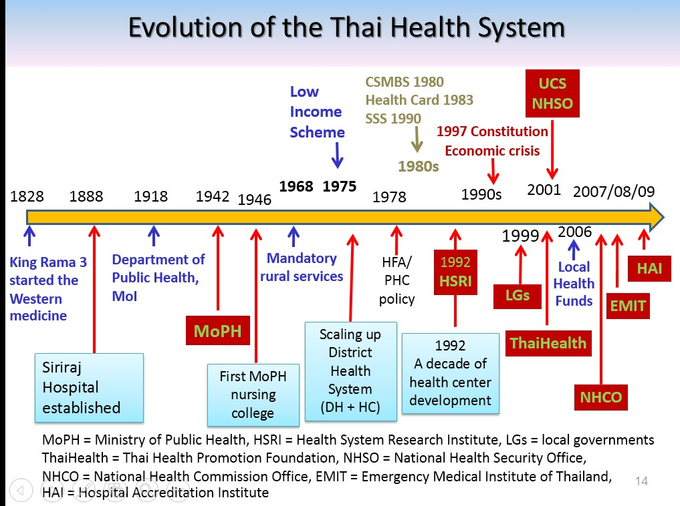
Characteristics of Acute Care and Chronic Care
Characteristics
_{of Care Type} Acute Chronic
Assistance and care: Maintain independent living, facilitate successful _{Goals of care} Cure: Restore to previous level of personal and social adjustment, minimize further deterioration of
functioning physical and mental health, and prevent acute exacerbations of chronic conditions
Specially trained health care and Multiple caregiver sources and settings, often includes a network of
Providers of human services professionals in
care institutions set up for acute care relatives, friends, and community of services along with hospital,
_{purposes} home health care, and social service professionals
Scope of care Primarily medical care Broad scope of social, community, and personal services, as well as
medical and rehabilitative care
Significant government investment
in outcome measures and quality of Relatively few measures to assess quality of care provided by home Quality of care care standards for most hospital- health agencies, community-based agencies, ambulatory clinics
based acute
conditions
Organizations Typically occurs within one Multiple organizations, requires organizational collaboration, may involved in care institution integrate primary care, acute care, and long-term care needs
Staff’s role Provide medical care Provide medical care and Prepare patients to self-manage
Patient’s role Comply with the treatment plan Self-manage treatments, diet, medications, etc.
When health problems are chronic, the acute care practice model doesn’t work.

Slide 5
Health Delivery system in Thailand
Department of Medical service
4 Hospitals under Ministry of Defense
5 Medical school hospitals
9
Hospitals BMA
83 community health care centers
19 Specialized hospitals and institutions
Bangkok
Heart, Skin, monk etc.
38 Specialized hospitals
Department of Mental Health
Department of Health
12 Mental Health Hospitals
12 Regional Health center
Regional Level
MCH
Cancer
Office of the Permanent Secretary
Drug Abuse
7 Medical school hospitals
52 Hospitals under Ministry of Defense
77 General hospitals)
15 Municipal health centers
Provincial Level
825 Community hospitals
365 Municipal health centers
District Level
Sub-district level
9,791 Health center
72,192 community PHC centers
Village Level
834,711 Village Health Volunteers

Slide 6
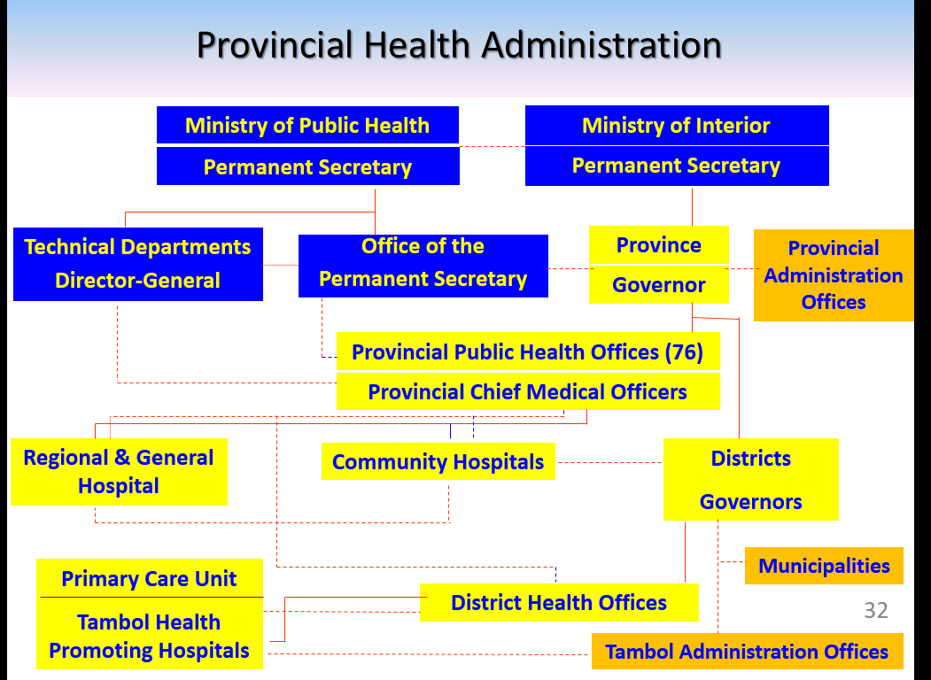

Slide 7
PARADIGM SHIFT IN HEALTH CARE
From | To
Chronic Disease | “Chronic conditions” describes all health problems that persist across time and require some degree of health care management. Diabetes, heart disease, depression, schizophrenia, HIV/AIDS, substance use and ongoing physical impairments
Hospital based | Population focus ; Health care systems for chronic conditions are most effective when they prioritize the health of a defined population rather than the single unit of a patient seeking care. Population management is a long-term, proactive strategy in which resources are organized to improve quality of care and health outcomes in populations with well known and well understood medical service needs. This approach reduces the need for high cost, high intensity resources. Community based
Cure | Prevention focus :to reduce health risks, they are more likely to reduce substance use, to stop using tobacco products, to practice safe sex, to eat healthy foods, and to engage in physical activity.
Quantity | Quality focus :accountable for providing effective and efficient care
Single | Integration, coordination, and continuity across all categories of chronic conditions, moving beyond traditional disease boundaries.
Routine | Flexibility/adaptability : surveillance, monitoring, and evaluation are key for systems to be able to adapt to changing contexts.
Biomedical approach | Bio-Psycho-Social approach
Medical Service | public health service

Slide 8
Characteristics of Acute Care and Chronic Care
Characteristics of Care Type | Acute | Chronic
Goals of care | Cure: Restore to previous level of functioning | Assistance and care: Maintain independent living, facilitate successful personal and social adjustment, minimize further deterioration of physical and mental health, and prevent acute exacerbations of chronic conditions
Providers of care | Specially trained health care and human services professionals in institutions set up for acute care purposes | Multiple caregiver sources and settings, often includes a network of relatives, friends, and community of services along with hospital, home health care, and social service professionals
Scope of care | Primarily medical care | Broad scope of social, community, and personal services, as well as medical and rehabilitative care
Quality of care | Significant government investment in outcome measures and quality of care standards for most hospital-based acute conditions | Relatively few measures to assess quality of care provided by home health agencies, community-based agencies, ambulatory clinics
Organizations involved in care | Typically occurs within one institution | Multiple organizations, requires organizational collaboration, may integrate primary care, acute care, and long-term care needs

Slide 9
Disease Centered vs Patient Centered Diagnosis
Anatomy
Idea, Expectation
Pathology
Disease
Function Illness
Illness
Physiology
Feeling, Concern
Family, Community
Environment
Income
Work place

Slide 10
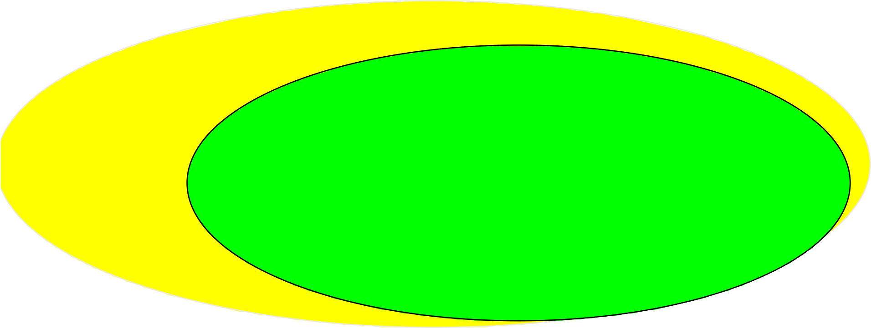
“Usual Care” Model:
Community:
No links w/community agencies or resources
Health System:
Leadership concerned primarily with “the Bottom Line”; incentives favor more frequent, shorter visits; no organized quality improvement processes
Patient problems in managing the condition not solicited or dealt with; counseling didactic only
Care delivery depends on MD only via short, unplanned visits and patient-
initiated follow up
Patient information limited to what is in chart; no population- based data available
No care protocols; specialist input via traditional
referrals only
Uninformed, passive patients
Frustrating, problem-centered interactions
Rushed, unpre- pared, reactive Practice Team
Sub-optimal functional and clinical outcomes

Slide 11
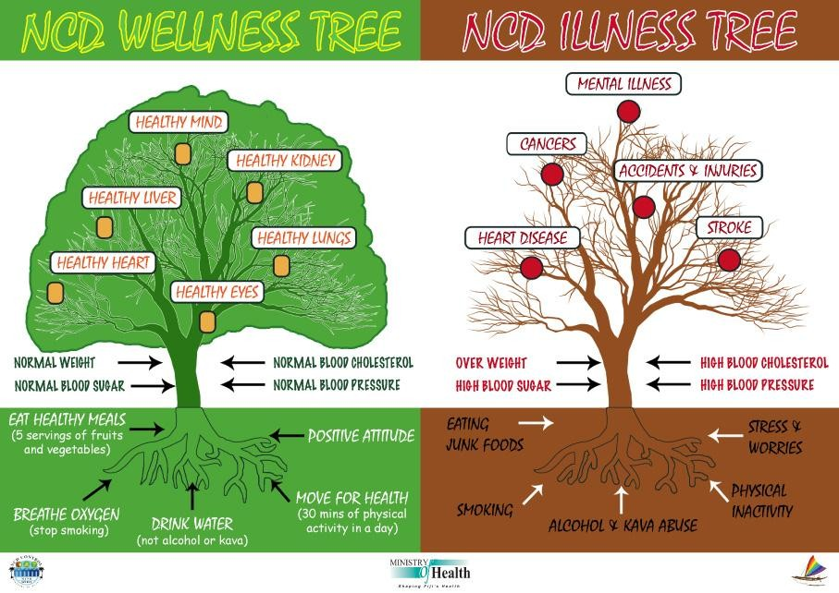

Slide 12



Achievement in 2025 of 9 global targets
Target 1 A 25% relative reduction in risk of premature mortality from CVDs,
cancer, diabetes, chronic respiratory diseases
Target 2 At least 10% relative reduction in the harmful use of alcohol, as appropriate, within the national context
Target 3 A 10% relative reduction in prevalence of insufficient physical activity Target 4 A 30% relative reduction in mean population intake of salt/sodium Target 5 A 30% relative reduction in prevalence of current tobacco use in persons
aged 15+ years
Target 6 A 25% relative reduction in the prevalence of raised blood pressure or contain the prevalence of raised blood pressure, according to national circumstances
Target 7 Halt the rise in diabetes and obesity
Target 8 At least 50% of eligible people receive drug therapy and counselling (including glycemic control) to prevent heart attacks and strokes
Target 9 An 80% availability of the affordable basic technologies and essential medicines, including generics, required to treat major NCDs in both public and private facilities

Slide 13
NCDs mortality, burden of disease and risks
RISK |  | M | F | Total | Data
Mortality
 | NCD mortality (thousand) | 161.3 | 143.4 | 304.7 | 2009
 | % NCD to total mortality | 68.6 | 79.4 | 73.3 | 2009
burden of disease
 | DALYs (million) | 3.7 | 3.4 | 7.1 | 2009
 | % NCD DALYS total | 67.7 | 80.4 | 73.3 | 2009
disability-adjusted-life-year (DALY). This time-based measure combines years of life lost due to premature mortality and years of life lost due to time lived in states of less than full health.
Prevalence of behavioral risks
 | daily smoker | 32.1 | 1.3 | 18.4 | 2010
 | physical inactivity | 17.1 | 21.4 | 19.2 | 2010
 | drinker | 51.0 | 8.8 | 30.0 | 2010
Prevalence of physiological risks
 | High bood pressure | 37.0 | 31.6 | 34.2 | 2010
 | Hyperglycemia | 7.3 | 7.1 | 7.2 | 2010
 | Overweight | 25.8 | 36.4 | 31.4 | 2009-10
 | Obesity | 4.9 | 11.8 | 8.5 | 2009-10
 | High cholesterol | 54.6 | 56.1 | 55.5 | 2010
Source: modified from National Health Exam Survey IV 2010, and National Statistic Office 2009

Slide 14
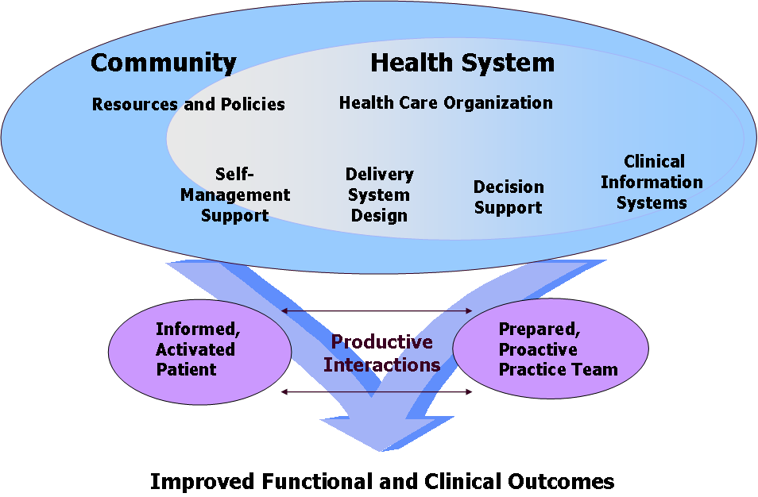
Wagner’s Chronic Care Model Demonstrates Best Practices in CDM

Slide 15


What characterizes an “informed, activated
patient”?
Informed, Activated Patient
They have the motivation, information, skills,
and confidence necessary to effectively make decisions about their health and manage it.

Slide 16


What characterizes a “prepared”
practice team?
Prepared Practice Team
At the time of the interaction they have the patient information, decision support, and resources necessary to deliver
high-quality care.

Slide 17







How would I recognize a
productive interaction?
Informed, Activated Patient
Productive Interactions
Prepared Practice Team
Improved Functional and Clinical Outcomes

Slide 18



Delivery system design
Clear point of access
Assessment & care pathways
Care plan /case management
Follow up and review
Cultural competency

Slide 19

Self-management support
Collaborative care planning
Self management support strategies
Self management integrated into
services
Capacity building of health professionals

Slide 20

Decision support
Embed evidence-based guidelines into assessment
Embed evidence-based guidelines
into care plans
Integrate specialist & care primary expertise

Slide 21

Clinical information system
Share information with providers to
coordinate care
Facilitate individual patient care planning
Monitor performance of practice team and care system
Organize patient and population data

Slide 22































Road Map
21
2010
2012
2014
2017
Source: National Health Security Office

Slide 23
Driven mechanism
22
Steering Committee
Network Professional Association/ Academic organization
Network Club or society Local health funds
Private funds and support
System Manager
Case Manager
Tools
NCD Board
Source: National Health Security Office

Slide 24





















Sharing/Utility
CDMIS
Networks
MedResNet : Clinical data
Transfer/Feedback Improvement Development
MoPH : Epi. Surv. data BRFSS. MoPH/NHSO : Indiv. PP OP IP
Academic : R2R, KM, NHES
Policy
Operation
Technocrat
MoPH.NHSO. NHCO.
Thaihealth. etc.
LGs./Health care delivery/PHO./Regional
Academic organization/ University
Policy direction
Strategic Plan
Resource support
Social mobilize
Advocacy
M&E
Health care service delivery
Quality improvement of care
Data registry
Self asses. & monitoring
Appropriate innovative tech.
R2R
Evidence-based guideline
Standard & Quality
Capacity building
Development Research
Innovative intervention
Health care service delivery
(P&P, Care, Rehabilitation)
Community ,Primary , Secondary , Tertiary
Health outcome , Quality of Life, Financial outcome, Evidence & Knowledge – based Management, Governance management

Slide 25
Administrative framework for DM/HT
1st prevention 2nd prevention
3rd Prevention & Care
1.HbA₁C
2.LDL
3.BP
4.Micro albumin
Eye exam
Foot exam
CKD
Clinic
RRT Center
Plan
P&P
Health exam and screening CVD
1.CAPD
2.HD
3.KT
CKD
Prevention Gr. 1 - 3
Screening
Retinopathy Rx. (LASER/op.)
Pre- DM
Pre- HT
Plan
DM/HT
Stroke Awareness Stroke
Alert
Stroke fast tract
Local health funds
Verbal screening
Reduced risk/behavior modification support
Self help group support (DM & HT)
Early detect & registry
ACS Alert
Prompt Rx.
Cardiac center
Improve Quality of Rx.
Behavior Modification
Source: National Health Security Office

Slide 26
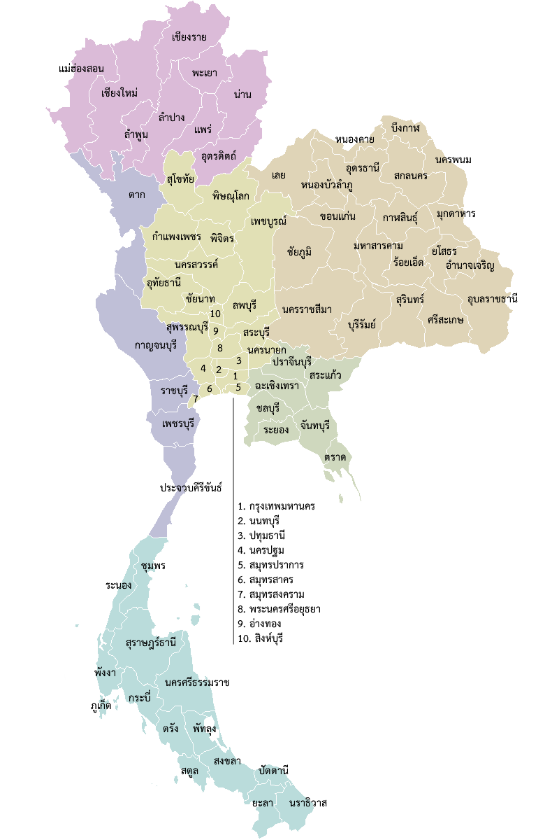


Capacity building of health personnel
cm20 , sm3
Cm 11,sm 4
Cm27,sm3
cm13 ,sm4
cm14,sm4
Cm 14,sm8
SM =
Provincial Health office, District health office, Specialist Medical doctor, Nurse
Cm 9 ,sm4
Cm 6
Cm 11 ,sm
4
Cm 14,sm3
Cm 6 ,sm4
Cm 14 ,sm 4
Cm 9,sm4
Cm 13,sm4 Cm 8,sm5
Cm 11
Cm 15 ,sm3
Cm 11,sm4
Cm 8 ,sm4
Cm 17,sm 4
Cm7,sm6
Cm 16,sm9
Cm13,sm4 Cm 13
Cm 14,sm4
Cm 15
Cm 8 ,sm6
Cm 8 ,sm4
Cm 14,sm6 Cm 8,sm4
Cm 12 ,sm4
Cm 20 ,sm4
Cm 19 ,sm3
Cm 15 ,sm4
Cm 8,sm4 _{Cm 7 ,sm4}
Cm 9,sm5
Cm 8,sm4
Cm13,sm3
Cm 17 ,sm4
Cm 11,sm4
Cm 20,sm4
Cm 8,sm4
Cm 11
Cm 6 ,sm4
Cm 9 ,sm4
Cm 7 ,sm4
Cm 15,sm5
Cm12,sm4
Cm 22 ,sm6
_{Cm 12 ,sm4}Cm15,sm4
Cm 8,sm4
1. Cm 47 ,sm4
CM=
Nurse and health personnel in heath center
2. C m 7 ,sm6
3. Cm 14 ,sm4
4. Cm 10 ,sm3
Cm 5,sm4
Cm 10 ,sm4
5.
Cm 8,sm4
Cm3 ,sm7
Cm3
6.
7.
Cm7,sm4
Cm 26 ,sm4
Cm 26 ,sm4
8. Cm 19,sm7
Ca1p.acNituy rbsueildCinagsfeormcharonnaicgcearre
1. Ca(sCe mMa)na1ge,0r (6C4M)1 ,0 64 p7e7rso n s (7 7 pr ovinces) 2.2.SySsytesmtemmanamgera(nSMa)g3e6m5 peernsotnste(7a7mprovinces)
(SM) 365 77
2557
9. Cm 10
Cm 9 ,sm4
Cm 9,sm3 Cm 15 ,sm4
10. C m 6,sm4
Cm4
Cm 6 ,sm3 ^{Cm 10 ,sm5} Cm 13 ,sm4
Cm 9 ,sm2 Cm 9 ,sm3
Source: National Health Security Office

Slide 27
























Health Voluntary well train
SCEENING RISK
SEX
Male female
Age
15 -34 year
35 – 60 year
61 -70 year
> 70 year
BMI (Height and Weight)
<=23
> 23 – 27.5
> 27.5
Waist measurement male<=90cm , female<=80cm male>90cm , female>80cm
Blood Pressure Yes
No
Alcohol drinking Yes
No Smoking Yes
No Genetic
Yes
No
No risk group
Public Health Policy
Population Based approach
Risk group
Clinic DPAC : Diet and Physical Activity Clinic
Fasting plasma glucose
AbA1c >7%
Healthy Food, Physical activity, smoking and alcohol reduction risk strategy
Patient without complication
ual Based approach
Patient with complication
NCD
Clinic
SYSTEM MANAGER
Individ
Case Manager
Building of healthy public policy
Creating supportive environments Strengthening community action Developing personal skills Reorientation of the health service
Health Center in
community
Mini Case Manager
Local government
Local health funds

Slide 28
AbA1c in diabetic patient during pass 4 years (2011 -2014)
100.0
90.0
Under control HbA1C<7%
Risk (HbA1C 7 - 8 %)
High Risk HbA1C>8%
80.0
77.8
70.0
73.3
73.3
60.0
66.7
63.2
57.0
60.3
50.0
52.1
43.7
45.3
40.0
39.1
37.6
29.3
32.2
32.7
32.7
30.0
26.3
27.0
31.6
20.0
212.31.6
20.9
19.6
21.3
29.7
20.0
14.8
17.8
17.1
18.3
24.1
22.0
10.0
7.0
7.4
8.9
6.7
0.0
2011
2012
2013
2014
2011
2012 2013
35 -60 year
2014
2011
2012
2013
2014
< 35 year
>60 year
Source : Huaiyot District N= 3,196 cases

Slide 29

Social Protection Intervention : Smoking bans and restrictions, Increasing the unit price for tobacco products, friendly clinic , Prevention second smoker etc.
20 18.9
18
16
14
12
10
8
6
4
2
0
Drinking and Smoking Behavior among age > 15 year
16.9
15.8
13.8
14.6
14.7
Percentage
2001
2007
2014
6.6
6.1
6.6
Drinking
Smoking Substance use
Drinking and smoking
Source : Health National survey, National statistic organization

Slide 30
Drinking and Smoking Behavior among age
by province in 2014
> 15 year
25
Drinking
Smoking
Drinking and Smoking
23.1
20.4
21.5
21.6
20.6
20
19.7
19
18.2
17.3
17.5
16.2
16.3
16.5
16.4
Percentage
15
15.2
_{14.9}15.2
14.9
15.1
13.9
13.0
13.5
12.4
11.0
10
9.4
8.4
9.2
7.2
7.3
6.1
7.2
5
3.1
3.7
4.1
4.2
2.1
0
1
2
3
4
5
6 7
Province of study
8
9
10
11
12
N= 450 cases in each province, National statistic organization

Slide 31
Number and % of quit smoking
⁸⁰ 74
70
Smoking Cessation Clinic quit %
61
60.0
60
54
48.4
51
48
43.8
50
42.9
44.1
46.4
Number
40
3534.3
34
33.3 ₃₁
29.6
31.1
28
31.4
30 26.2
23
21
21
20 16 16
15
15
9
15
15
13
16
9
12
10
5
0
1
2
3
4
5
6 7
DPAC and NCD Clinic
8
9
10
11
12

Slide 32
Number and % of Stop drinking
250
Alcihol
quit %
200
197
194
188
152
150
136
138
125
102
97
95
100
100
78
71
79
73
69
54
54
52
59
69.0
58
50
₄6₅5.2
45
49
52.9
53.6
51.3
48.2
52.9
46.4
39.7
45.0
42.0
30.4
0
1
2
3
4
5 6 7
DPAC and NCD Clinic
8
9
10
11
12

Slide 33

Substance dependence : Chronic Condition
Substance dependence is a common and costly chronic illness associated with medical and psychiatric comorbidity.
Treatment can be efficacious when it is actually received by patients. But the current system of care is fragmented, not coordinated, and does not always include proven efficacious treatments.
Patient motivation and coexisting health and social problems are barriers to receipt of effective treatment.
Integrated and coordinated care, which simultaneously addresses patient motivation and needs across health domains, provides efficacious addiction treatments and facilitates effective access to other treatment.
This integrated care may increase the likelihood that care is received and that addiction-related and other clinical outcomes improve.

Slide 34
Conclusion
Chronic Care Model (CCM) is a patient-centered model of care that involves longitudinal care delivery; integrated, and coordinated primary medical and specialty care; patient and clinician education; explicit evidence-based care plans; and expert care availability.
The model, incorporating mental health and specialty addiction care, holds promise for improving care for patients with substance dependence who often receive no care or fragmented ineffective care.
The CCM model goes beyond integrated case management by a professional, collocation of services, and integrated medical and addiction care—elements that individually can improve outcomes. Supporting evidence is presented that: 1) substance abuse is a chronic disease requiring longitudinal care, and 2) for other chronic diseases requiring longitudinal care (eg, diabetes, congestive heart failure), CCM has been proven effective.

Slide 35

Meet the eminent gathering once again at
Addiction Therapy 2016
Miami, USA
October 06-08, 2016
Addiction Therapy 2016
Website: addictiontherapy.conferenceseries.com

