Slide 1
Assessing Healthcare Liquid Waste Management of Hospitals in Kathmandu Valley, Nepal
Earth Science International Conference
San Francisco, USA July 28-30 2014
Bandana K Pradhan, PhD
Department of Community Medicine & Public Health
Institute of Medicine
and
Pushkar K Pradhan, PhD
Central Department of Geography
Tribhuvan University, Kathmandu, Nepal

Slide 2
Introduction
Nepal got EPA in 1996 and since then all industries and hospitals must have approvals of EIA/IEE
Hospitals being built before EPA 1996 required to comply with EIA/IEE within the stipulated time – 10 years
  About 95% water used in the hospitals being released as healthcare untreated liquid waste into the rivers, of which 20% hazardous

Slide 3
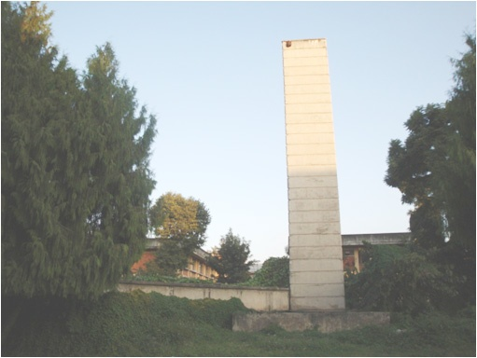
Low priority to HCLW- as only one hospital TUTH but not functioning
Ward/OT
Kitchen
Collection
Drainage
Treatment plant
OPD
Toilet/bathroom
Discharge
Laboratory
River –Samakhusi

Slide 4
  People residing nearby the rivers have to use the river water for different domestic activities
  Total waste water – HCLW contribution 1%; Industrial wastewater = (6+1)%

Slide 5
  MDR bacteria – 100% effluent samples from hospitals
  Resistance of antibiotics including penicillin, various generations of Cephalosporin, Cotrimoxazole, Gentamycin and Quinolones
  about one third of deaths of under-five children due to water borne diseases such as cholera, typhoid fever, dysentery and gastro-enteritis

Slide 6
Objectives
Analyze hospital liquid waste management practices and their possible impacts on the people, based in Kathmandu valley – the capital city

Slide 7
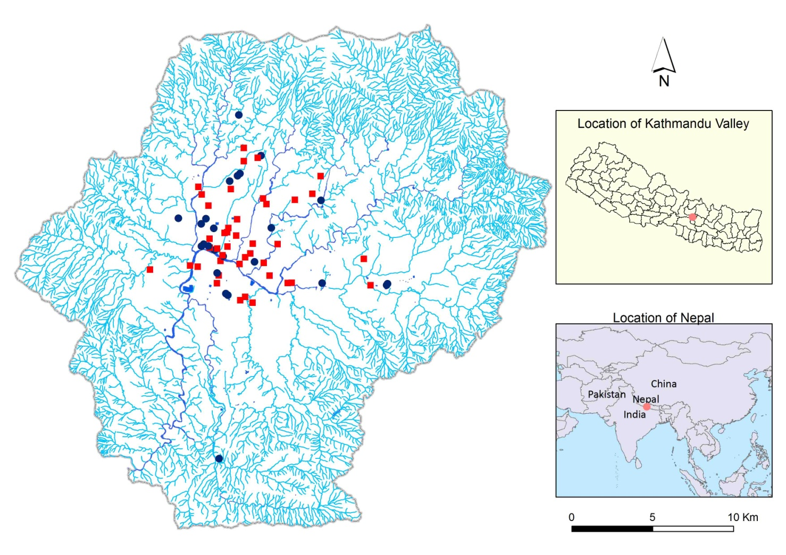
Research Design
Study area:
Kathmandu Valley area: 570 km² comprises rural parts of three districts and five municipalities
About 2 million population
Population density: >3500/ km²

Slide 8
  Data Acquired
Identified and located the hospitals (public and private) >50 beds within KTM and chosen 18 hospitals
Observed HCLWM practice through observation protocol
Laboratory analysis
    Collected effluent samples
    All chemical parameters including BOD and COD & bacteriological analysis, based on Standard Method (APHA 2000)

Slide 9
Findings
General characteristics of hospitals
H-type | H-bed (mean) | Total Staff (m) | Staff
 |  |  | WM (%) | LW
Private | 96 | 200 | 15 | No
Public | 364 | 692 | 21 | No
Note: H =hospital, WM – waste management, LW =liquid waste

Slide 10
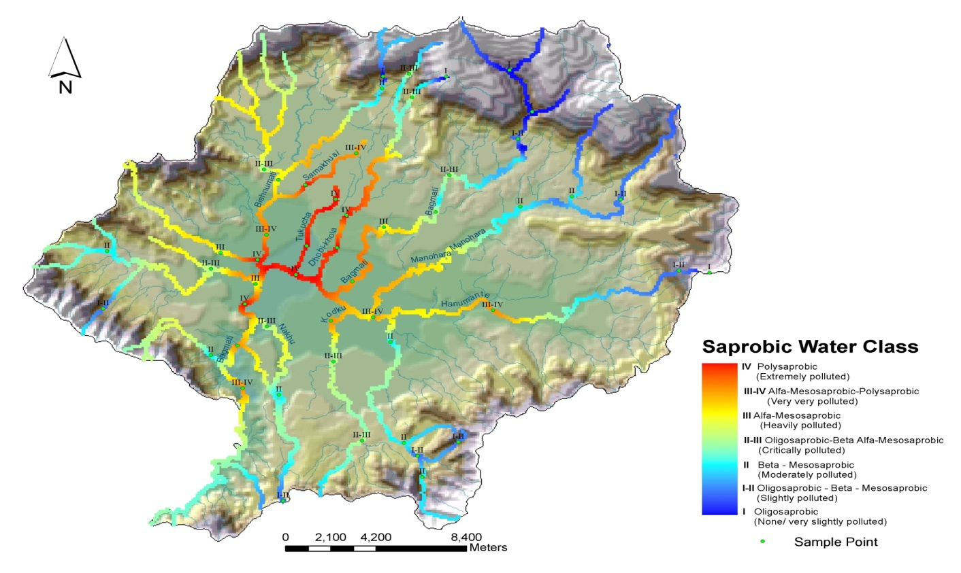
Findings (contd.)
Waste Management Status
Hospital type | WM policy/ guideline |  | EIA /I EE approval |  | Total
 | Yes | No | Yes | No | Number
Private | 3 (33) | 6 (66) | 3 | 3*+3 | 9
Public | 4 (44) | 5 (55) | 1 | 8 | 9
Note: *ToR approved for IEE study of the hospital

Slide 11
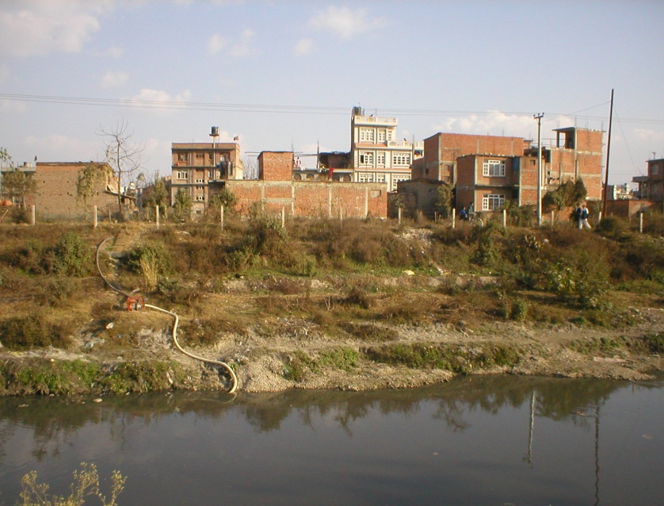
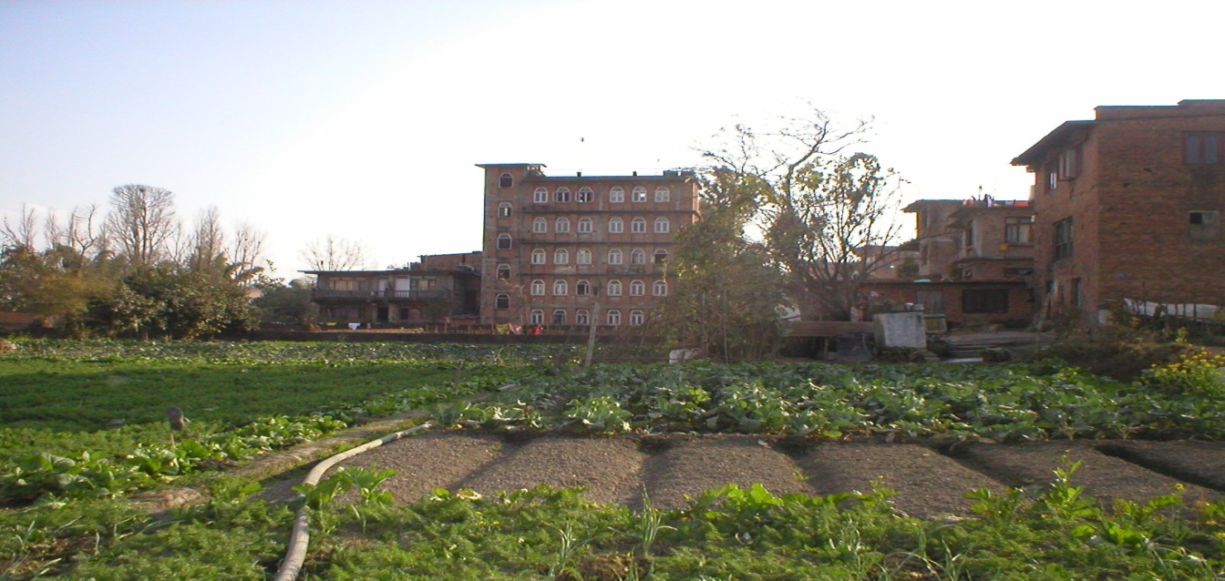
Water used and wastewater generated and treatment plants status by hospitals types
H type | Water used ( l/day m3) | HCLW /day (m3) | LWTP |  | Total
 |  |  | Yes | No
Private | 38.5 | 34.6 | 0 | 5*+4 | 9
Public | 112.1 | 100.9 | 1 | 2*+ 6 | 9
Total | 151.6 | 136.5 | 1 (6) | 17 (94) | 18
* Primary treatment

Slide 12
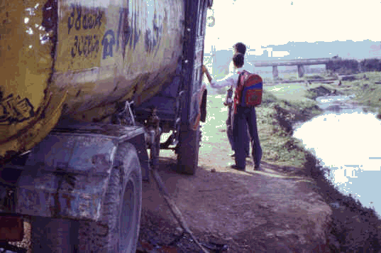
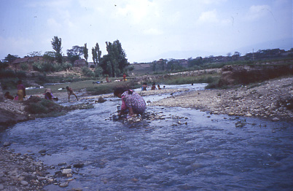
Parameter | p value
H count (cfu/ml) | 0.04

Slide 13
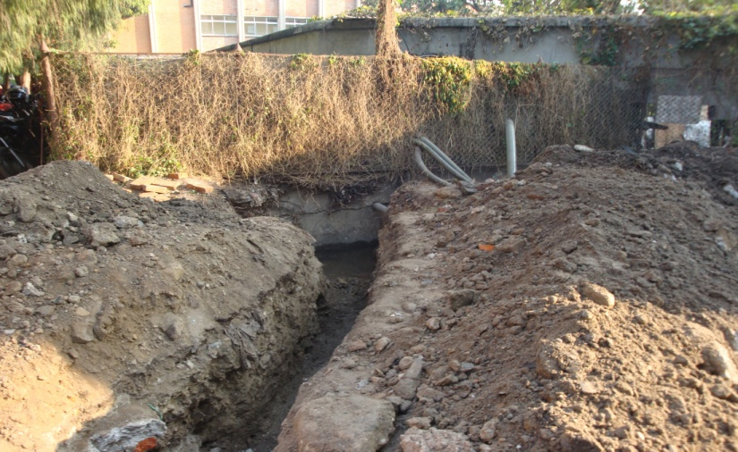
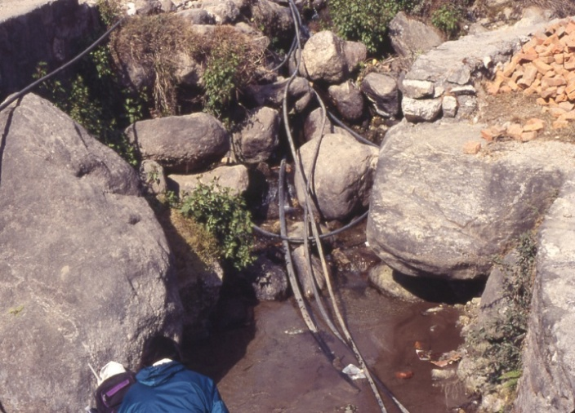
Water withdrawal for DW
Parameter | p value
COD (mg/l) | 0.2
COD/BOD | 0.5
Direct discharge of HCLWW

Slide 14
Parameter | p value
DO (mg/l) | 0.2
R-Cl (mg/l) | 0.02

Slide 15
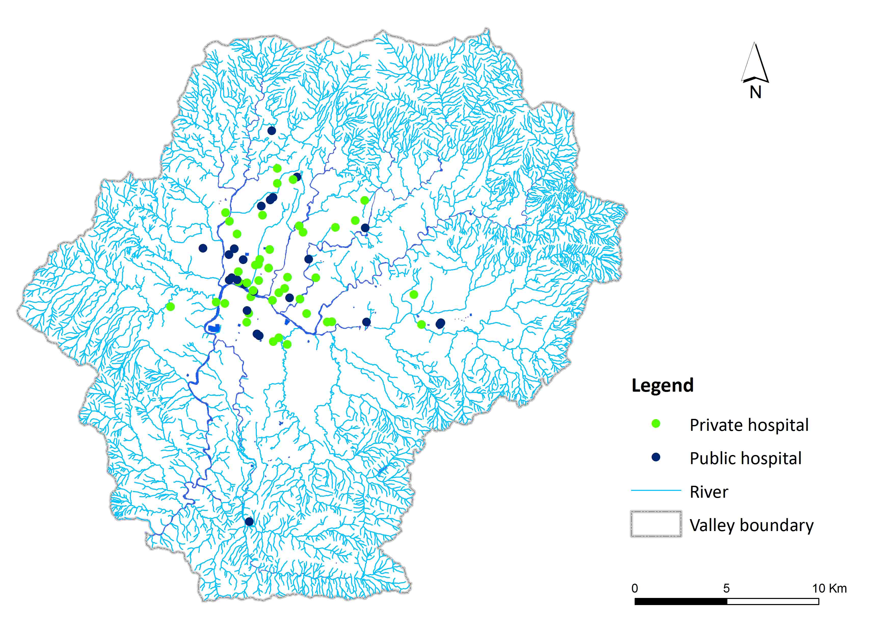
Potential health hazard

Slide 16
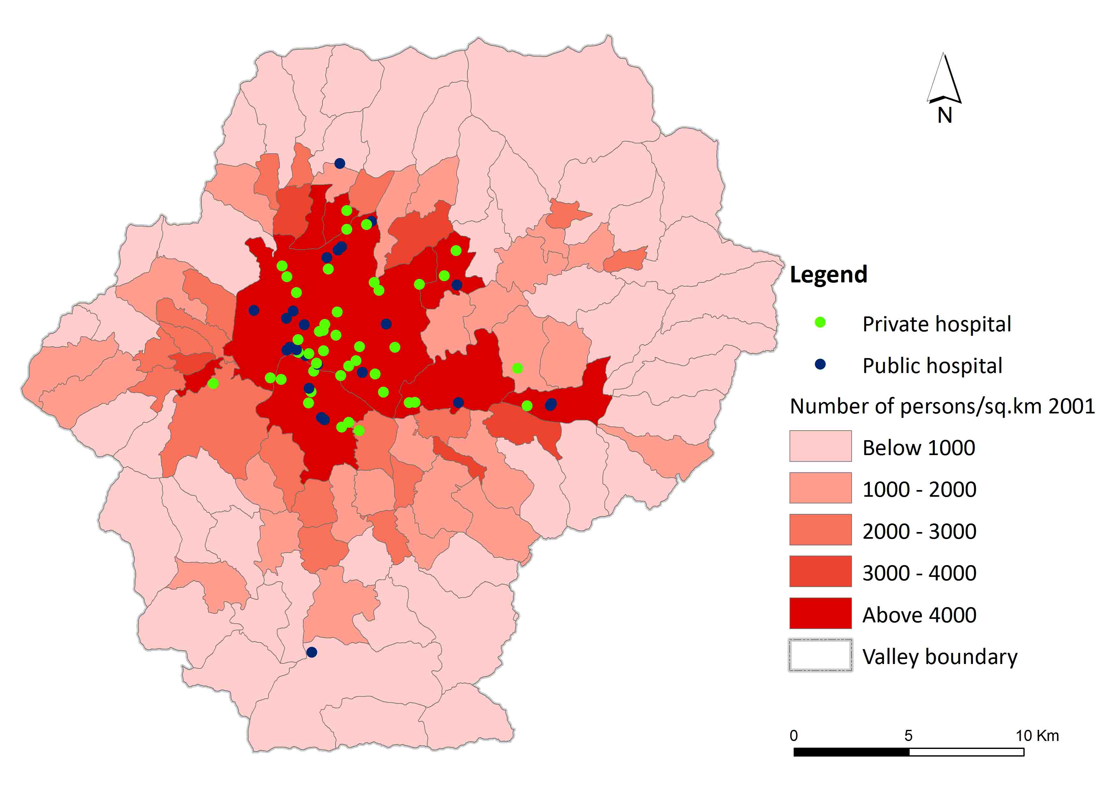
Potential health hazard spatial analysis

Slide 17
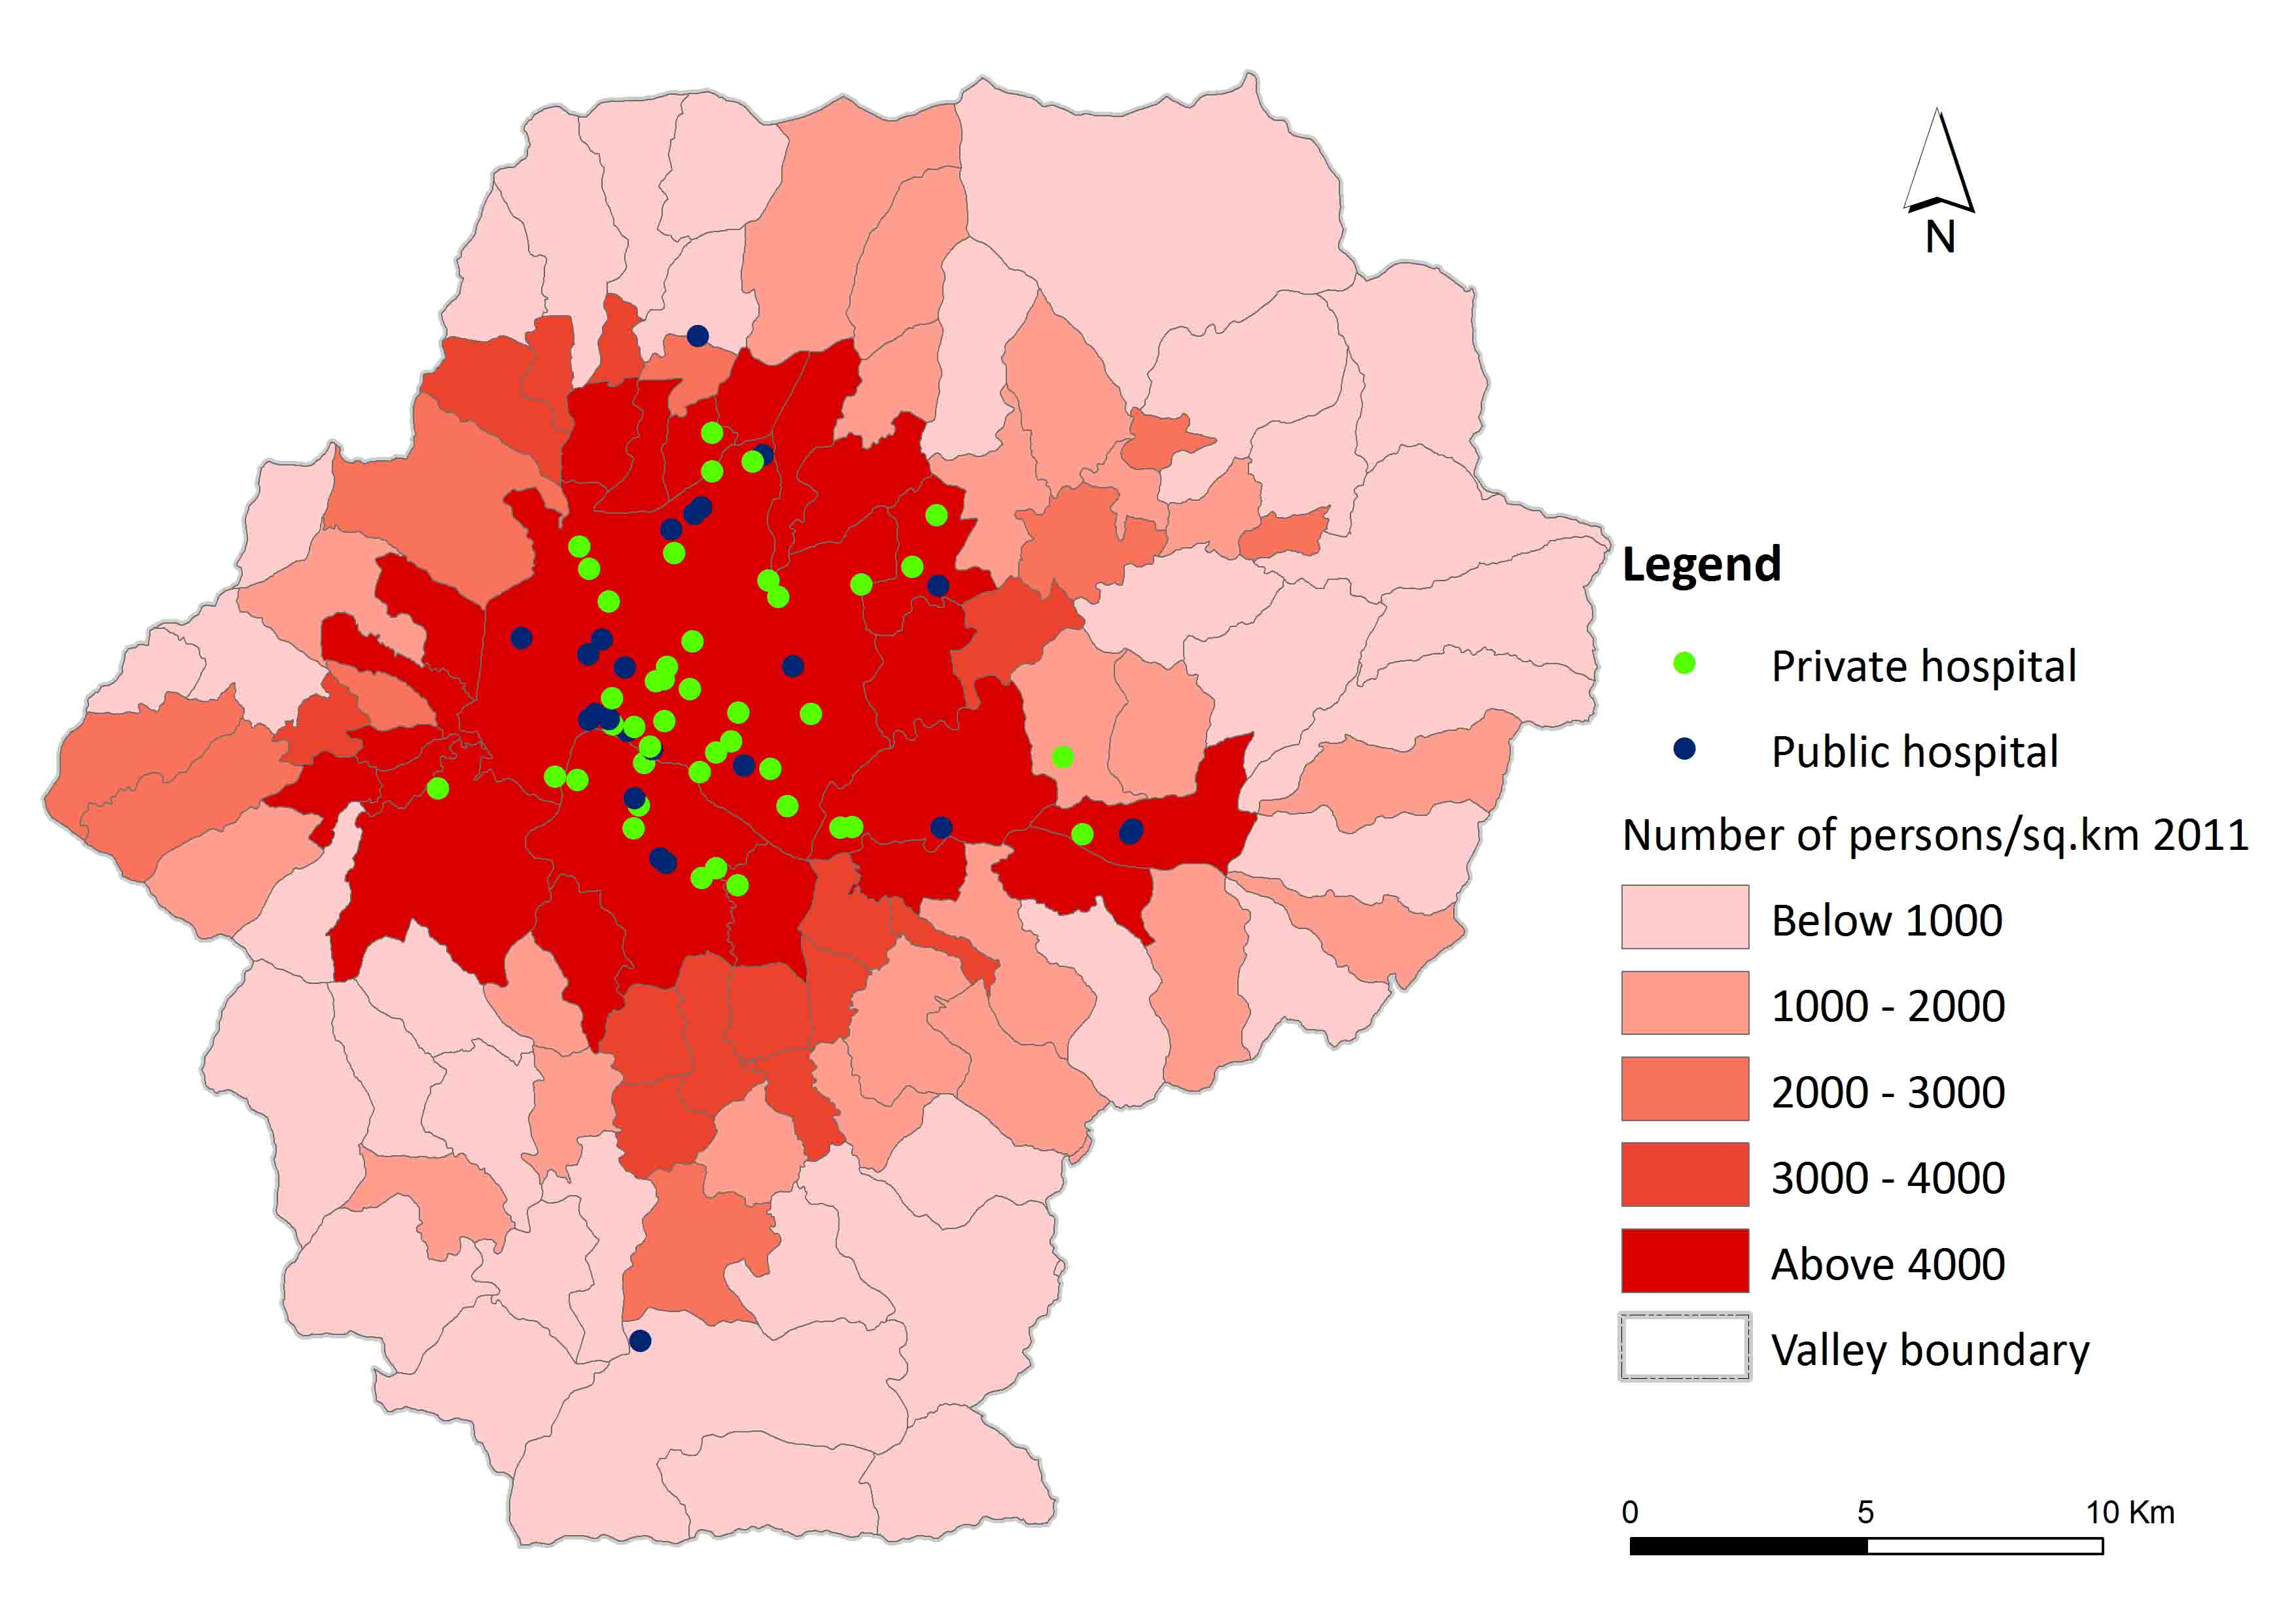

Slide 18
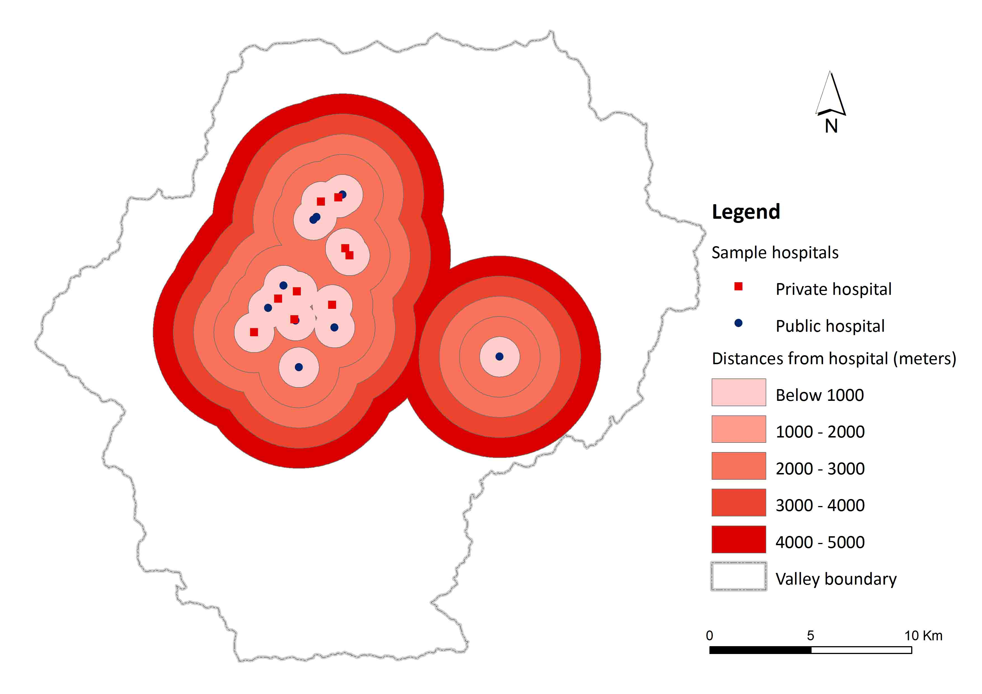
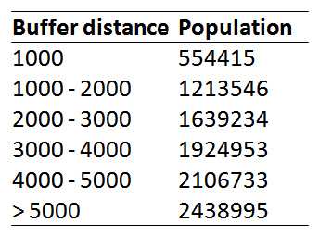

Slide 19
Conclusions
Direct discharge into nearby river
Bacteriological load in the HCLW higher in public hospitals than in private hospital
Weak monitoring of EIA /IEE of hospitals
Use of river water for different purposes – lack of awareness
Potential health impacts of hospital effluents to population living nearby hospitals/rivers
Yet to ascertain HCLW direct impacts between private and public hospitals on population

Slide 20
Recommendations
Healthcare without harm principle should be strictly followed by constructing reliable HCLW treatment plants
Monitoring – hospitals have followed EIA/IEE treatment of effluents
Awareness to both population and healthcare stakeholders about the health impacts of HCLW
Research/bench mark data generation on health impacts of HCLW

