Slide 1


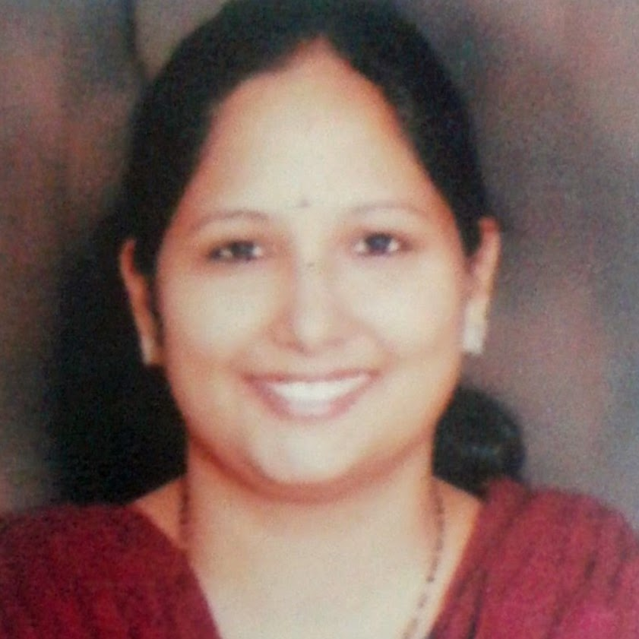
Bandana Bisht (BSN, MSN- Mental Health)
Vice Principal, Chitkara College of Nursing,
Chitkara University
India

Slide 2
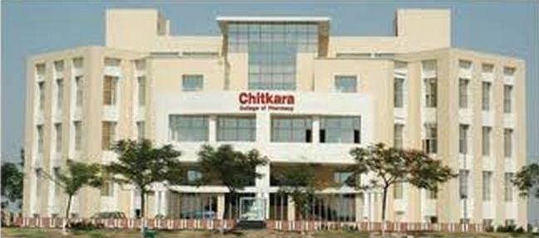
Chitkara University-leading non-profit private University
Committed to teaching excellence
Conduct research that makes a difference
100% placement record
Global Tie-ups with 50+ International Universities & Educational Institutes

Slide 3
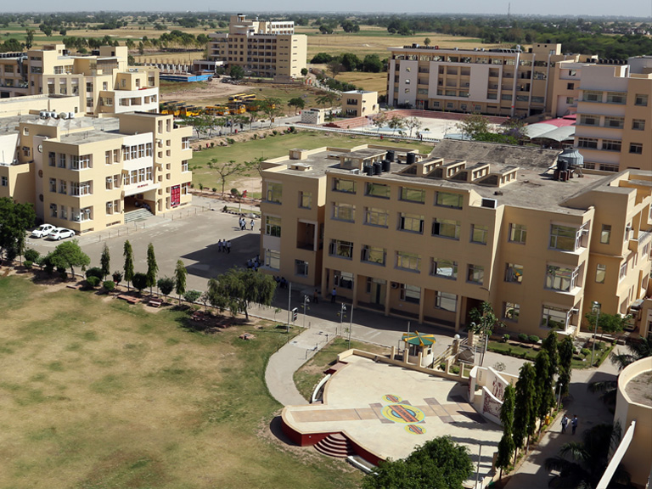
Ranks 1st in North India

Slide 4
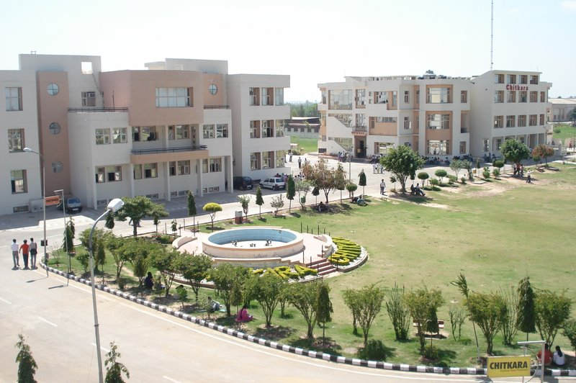
AMONG TOP 20 IN INDIA

Slide 5
Impact of multimedia approach to an awareness program on Knowledge and Attitude regarding Schizophrenia among students of University

Slide 6
Multimedia approach: Use of number of media devices or techniques in the teaching learning process. This includes text, graphics, audio, video, etc

Slide 7
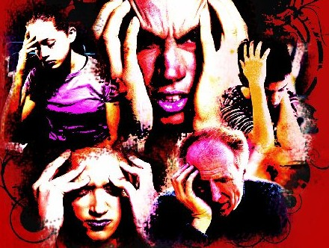
Schizophrenia is a psychotic disorder (or a group of disorders) marked by severely impaired thinking, emotions, and behaviors

Slide 8
RESEARCH HYPOTHESIS
H1: There will be a significant difference in pretest and posttest Knowledge scores of students regarding schizophrenia
H2: There will be a significant difference in pretest and posttest Attitude scores of students regarding schizophrenia

Slide 9
Research Design
One group Pretest- Posttest design
O₁ X O2
oO1- Pretest, X- Intervention , O2- Posttest

Slide 10

Population
All students of Chitkara University from various streams ( 12000 approx.)

Slide 11
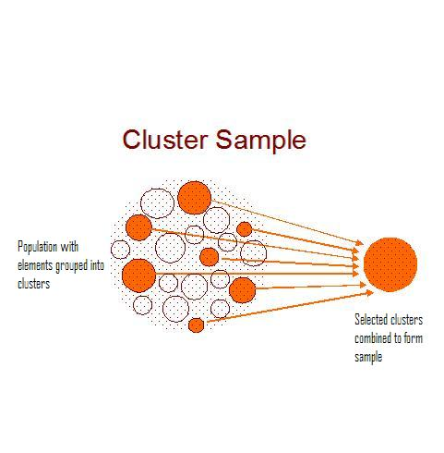
Two stage cluster sampling

Slide 12
Stage I (lottery method)
MJMC
Stage II
Year/ Semester
B.TECH (ECE)
B.SC. Nursing
B.Sc. Hospitality
167 partcipants

Slide 13
Development & Description of tool
Socio Demographic Data
Knowledge Questionnaire
Attitude Scale
*P<0.000

Slide 14
Demographic Variables | Frequency (n) | Percent
Age Group (in yrs)
15-18 | 50 | 29.9
19-21 | 93 | 55.7
22-24 | 24 | 14.4
Stream
B.Sc. Hospitality | 22 | 13.2
B.Sc. Nursing | 41 | 24.6
MJAMC | 33 | 19.8
B.Tech | 71 | 42.5
Gender
Male | 79 | 47.3
Female | 88 | 52.7

Slide 15

Knowledge Questionnaire- 40 items
14 items
( Risk Factors / etiology)
18 items (signs and symptoms in schizophrenia)
8 items
( definition , diagnosis)

Slide 16
Attitude Scale
Items | SA | A | N | DA | SDA
People who have schizophrenia never recover.
People with schizophrenia are dangerous.
People with schizophrenia have split or multiple personalities.
People get schizophrenia because they had bad weak character or personalities.
It is fearful to have a mental hospital near your vicinity
It is frightening to live next door to someone who has schizophrenia
One should not marry a person having schizophrenia
A schizophrenic person should be allowed to do job

Slide 17
Attitude Scale
Items | SA | A | N | DA | SDA
If I had schizophrenia, I would not tell it to others
People with schizophrenia can handle any household responsibility
People with schizophrenia should not be given any financial responsibility
People with schizophrenia are a burden on society
If any of my friend has schizophrenia, I would tell him/her not to tell anyone
People with schizophrenia, should always be kept in asylum
Anyone can have schizophrenia
Increased spending on mental health services is a waste of money

Slide 18
Attitude Scale
Items | SA | A | N | DA | SDA
People with schizophrenia are far less of a danger than most people suppose
Schizophrenic patients should be part of a normal society
Students with mental illness should not be in regular classes
Schizophrenic patients should not get married, it may spoil somebody's life
Women with schizophrenia will not be able to take care of small babies
Schizophrenia is an illness like any other illness
Divorce is the only way out if your partner develops schizophrenia
People with schizophrenia should be removed from your neighbourhood

Slide 19
Criterion Measure
Variable | Category | %age | Total Score Range | Score
Knowledge | Adequate Knowledge | Above 75% | 0-40 | 31-40
 | Moderate Knowledge | 51-75% |  | 21-30
 | Inadequate Knowledge | Up to 50% |  | <20
Attitude | Positive Attitude | 67- 100% | 30- 150 | 111-150
 | Neutral Attitude | 34-66% |  | 71-110
 | Negative Attitude | Upto 33% |  | 30-70

Slide 20


Intervention- Awareness Program
Video Instructional Module was shown to the participants by editing the movie, “ A Beautiful Mind” based on the life of Dr John Nash, a Nobel Laureate who also was a patient of paranoid schizophrenia. The editing of the movie was done with the help of one of computer science engineering student Mr Deep Sodhi.
It was followed by a Powerpoint presentation on schizophrenia, its signs and symptoms, etiology and treatment modalities used
Open Forum Discussion was done with the participants to discuss various myths regarding the illness

Slide 21

Spss 20

Slide 22
Mean Pretest & Posttest Knowledge scores among students regarding Schizophrenia
Knowledge regarding Schizophrenia | Mean | N | SD | ‘t’ value
Pre test Score | 17.43 | 167 | 6.733 | 19.382*
Post test Score | 30.17 | 167 | 5.175
*P<0.000

Slide 23
Mean Pretest & Posttest Attitude scores among students regarding Schizophrenia
Attitude regarding Schizophrenia | Mean | N | SD | ‘t’ value
Pre test Score | 99.68 | 167 | 14.31 | 12.682*
Post test Score | 115.79 | 167 | 15.29
*P<0.000

Slide 24
No. of students

Slide 25
No. of students

Slide 26
DISCUSSION
The image of people with mental illness in movies: effects on beliefs, attitudes and social distance, considering as example the movie "The white noise“.2003 [Article in German]Baumann A1, Zaeske H, Gaebel W.
OBJECTIVE: To examine the impact of the movie "The White Noise" on the audience's beliefs and attitudes towards schizophrenia.
RESULTS: Differences between the audience's knowledge about schizophrenia and expert opinion increased. Negative stereotypes reinforced and social distance increased.

Slide 27
Knowledge about schizophrenia and attitudes towards people with schizophrenia in Greece. Economou M1, Richardson C, Gramandani C, Stalikas A, Stefanis C
(nt J Soc Psychiatry. 2009 )
This study was the first national survey ever conducted in Greece aiming to monitor the level of stigma Greeks hold against people with schizophrenia (PWS).
RESULTS: Television was the main source of information (65.9%). Negative portrayals of PWS were recalled by 60.5%. Respondents believed that PWS are dangerous (74.6%), have split personalities (81.3%) and cannot work (83.2%). Regarding attitudes, a negative relationship between closeness and social distance was observed.
CONCLUSIONS: The Greek public has stigmatizing attitudes towards PWS. The role of television can be crucial in educating people

Slide 28
Conclusion

Slide 29
Media Portrayal
Dangerous
Unpredictable
Violent

Slide 30
A Beautiful Mind
The White Noise

Slide 31



Slide 32


