Slide 1
CHARACTERIZATION OF MAGNETIC ABRASIVES PREPARED BY SINTERING PROCESS
Dr. Balkar Singh
Director (College Development)
IKG,Punjab Technical University
Jalandhar, Punjab, India

Slide 2
ABSTRACT
Magnetic abrasives play essential role in Magnetic abrasive Finishing (MAF) process.
Most of the studies have been reported where simple mixing of ferromagnetic and abrasive particles is done.
The improved method suggested was sintering. But in the existing studies, the detail of sintering has not been mentioned.
In the present work the parametric studies have been undertaken to find the suitable combination of input process parameters of sintering so that good quality magnetic abrasive can be produced.
Three major parameters sintering time (min), compacting pressure (N/mm²), abrasive concentration (%age) have been chosen.
By adopting DOE technique Response Surface Methodology (RSM) a set of experiments have been conducted. The experimental data was analyzed by software and effect of input parameters on Percentage Improvement in Surface Finish (PISF) has been studied.
For brass specimen the results obtained 68.8 % PISF at sintering time 24 min, compacting pressure 8.3 N/mm² and abrasive concentration 18 % aluminum oxide with 82 % iron powder.
Keywords: MAF (Magnetic Abrasive Finishing), PISF (Percentage Improvement in Surface Finish), Sintering time, Compacting Pressure, Abrasive Concentration.

Slide 3
CONTENTS
Introduction
Objectives
Research Methodology
Experiment Setup
Characterization
Results and Discussion
Conclusions
References

Slide 4
INTRODUCTION
Machining Processes
Now days many products like airplanes bodies, rocket shell ,medical instruments, gun shells requires high surface finish. To achieve that high surface we have two type of machining process, conventional machining process and non-conventional machining process. Conventional machining process like turning, shaping, grinding etc, but conventional machining process do not give a high surface finish as much required to overcome that problem we have non- conventional machining process like
I. Abrasive Jet Machining (AJM)
II. Electro Chemical Machining (ECM)
III. Electro Discharge Machining (EDM)
IV. Laser Beam Machining (LBM)
V. Ultrasonic Machining (USM)

Slide 5
ABRASIVE MACHINING
The abrasives machining is done by the cutting action of abrasives as the abrasive have cutting edges that are used for material removal of given work piece. Abrasives are used as cutting tool in many non-traditional machining processes like AJM, USM and MAF etc.
As written above many finishing process are used in these days but magnetic abrasive finishing is very useful for finishing. Finishing by magnetic abrasives gives very good finishing surface. Magnetic abrasive finishing is very royal finishing process it used to finish heavy range of materials. MAF is used for finishing of internal or external as well as flat surface of magnetic as well as non-magnetic materials.

Slide 6
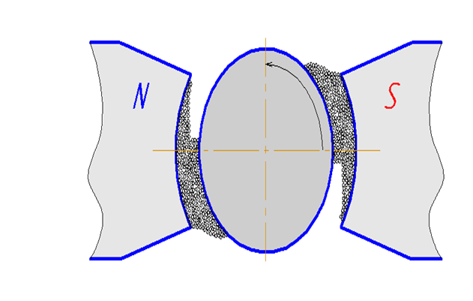
MAF (Magnetic Abrasive Finishing)-: Finishing process in which magnetic abrasives are used to finish the material under the effect of applied magnetic field.
It is of following three types-:
I. External finishing
II. Internal finishing
Plane finishing
External finishing
Figure 1: Schematic diagram of External MAF

Slide 7
MAGNETIC ABRASIVE PREPARATION IS DONE BY FOLLOWING METHODS
Mechanical alloying
Adhesive based
Plasma based magnetic abrasives
Loosely bonded magnetic abrasives
Sintered magnetic abrasives

Slide 8
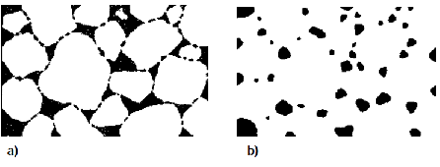
SINTERING PROCESS
Sintering is the process by which metal powder compacts are transformed into coherent solids at temperatures below their melting point. During sintering, the powder particles are bonded together by diffusion and other atomic transport mechanisms, and the resulting some what porous body acquires a certain mechanical strength.
Figure 2: Early (a) and late (b) stage of sintering
Figure reference: (Basic mechanisms of sintering)

Slide 9
GAPS IN EXISTING STUDY
Detail about preparation of magnetic abrasive is missing in the literature.
Properties of magnetic abrasives, like magnetic strength and cutting performance are not adequately available.
Comparison of various types of abrasives has not been undertaken for choosing a particular magnetic abrasive for a given work material.

Slide 10
OBJECTIVES
The main objectives of current research work which are outlined as follows:
To study the effect of following parameters on performance of magnetic abrasives by use of MAF(Magnetic Abrasive Finishing) process .
  Ratio of abrasive and ferromagnetic powder.
  Sintering time.
  Compacting pressure.
  To develop the empirical relation between input parameters and output parameters.

Slide 11
METHODOLOGY
The following steps are needed to evaluate this research.
Mixing of powders at different composition
Preparation of compacts
Sintered the prepared compacts
Check the surface finishing
Results and discussion
Conclusion

Slide 12
INPUT PARAMETERS FOR EXPERIMENTS
Selection of input parameters is governed by the findings from literature and pilot experimentation.
Abrasive Concentration
Abrasive concentration may alter the finishing capacity of magnetic abrasives. Minimum concentration of abrasive in iron powder was mixes in such a way that at least every abrasives particles can attached with iron particles. In this present study concentration of abrasive in iron powder varies in five different levels ranging from 10 to 50 %.

Slide 13
INPUT PARAMETERS FOR EXPERIMENTS
Sintering time
Heating of materials for longer time changes mechanical properties of materials. As green compact is heated during sintering process so mechanical properties of sintered compact may varies with different heating times. In this present work sintering time was selected in five different levels from 15 to 60 min.

Slide 14
INPUT PARAMETERS FOR EXPERIMENTS
Compacting pressure
As from pilot experimentation it has been clear that due to change in compacting pressure, height of green compact changes, which lead to change compact density known green density. So change in pressure may effect the performance of magnetic abrasives. In this present work pressure selected in five different levels ranged from 3.9 to 13.6 N/mm².

Slide 15
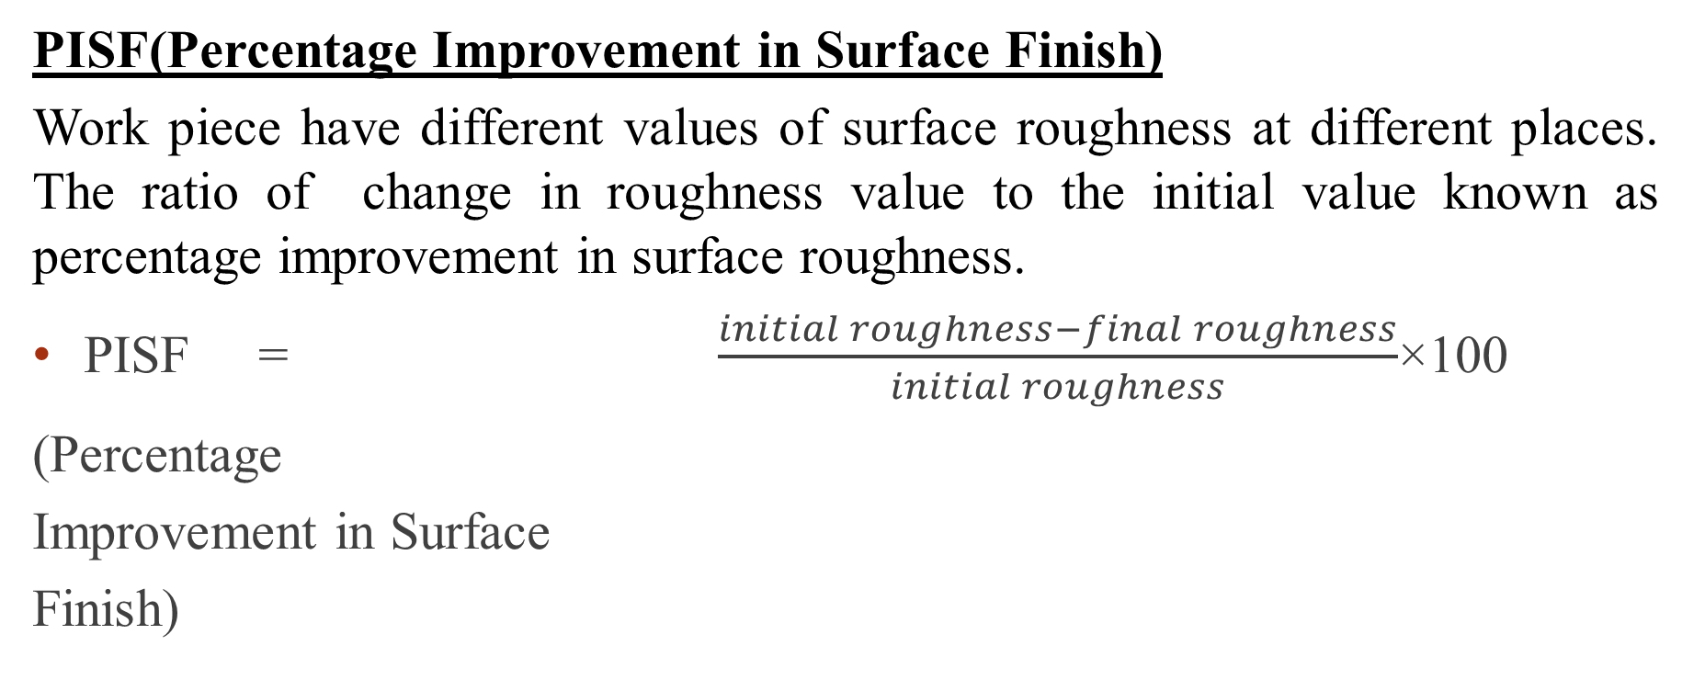
OUTPUT VARIABLES

Slide 16
PARAMETERS
factors levels | Concentration of abrasives in iron powder (%age) | Sintering time (min) | Compacting pressure(N/mm²)
1 | 10 | 15 | 6.9
2 | 18 | 24 | 8.3
3 | 30 | 37.5 | 10.3
4 | 42 | 51 | 12.4
5 | 50 | 60 | 13.6
Machining time 30 min, working gap 2 mm, Rotation of work piece 270 rpm,
Sintering temperature 1150ºC

Slide 17
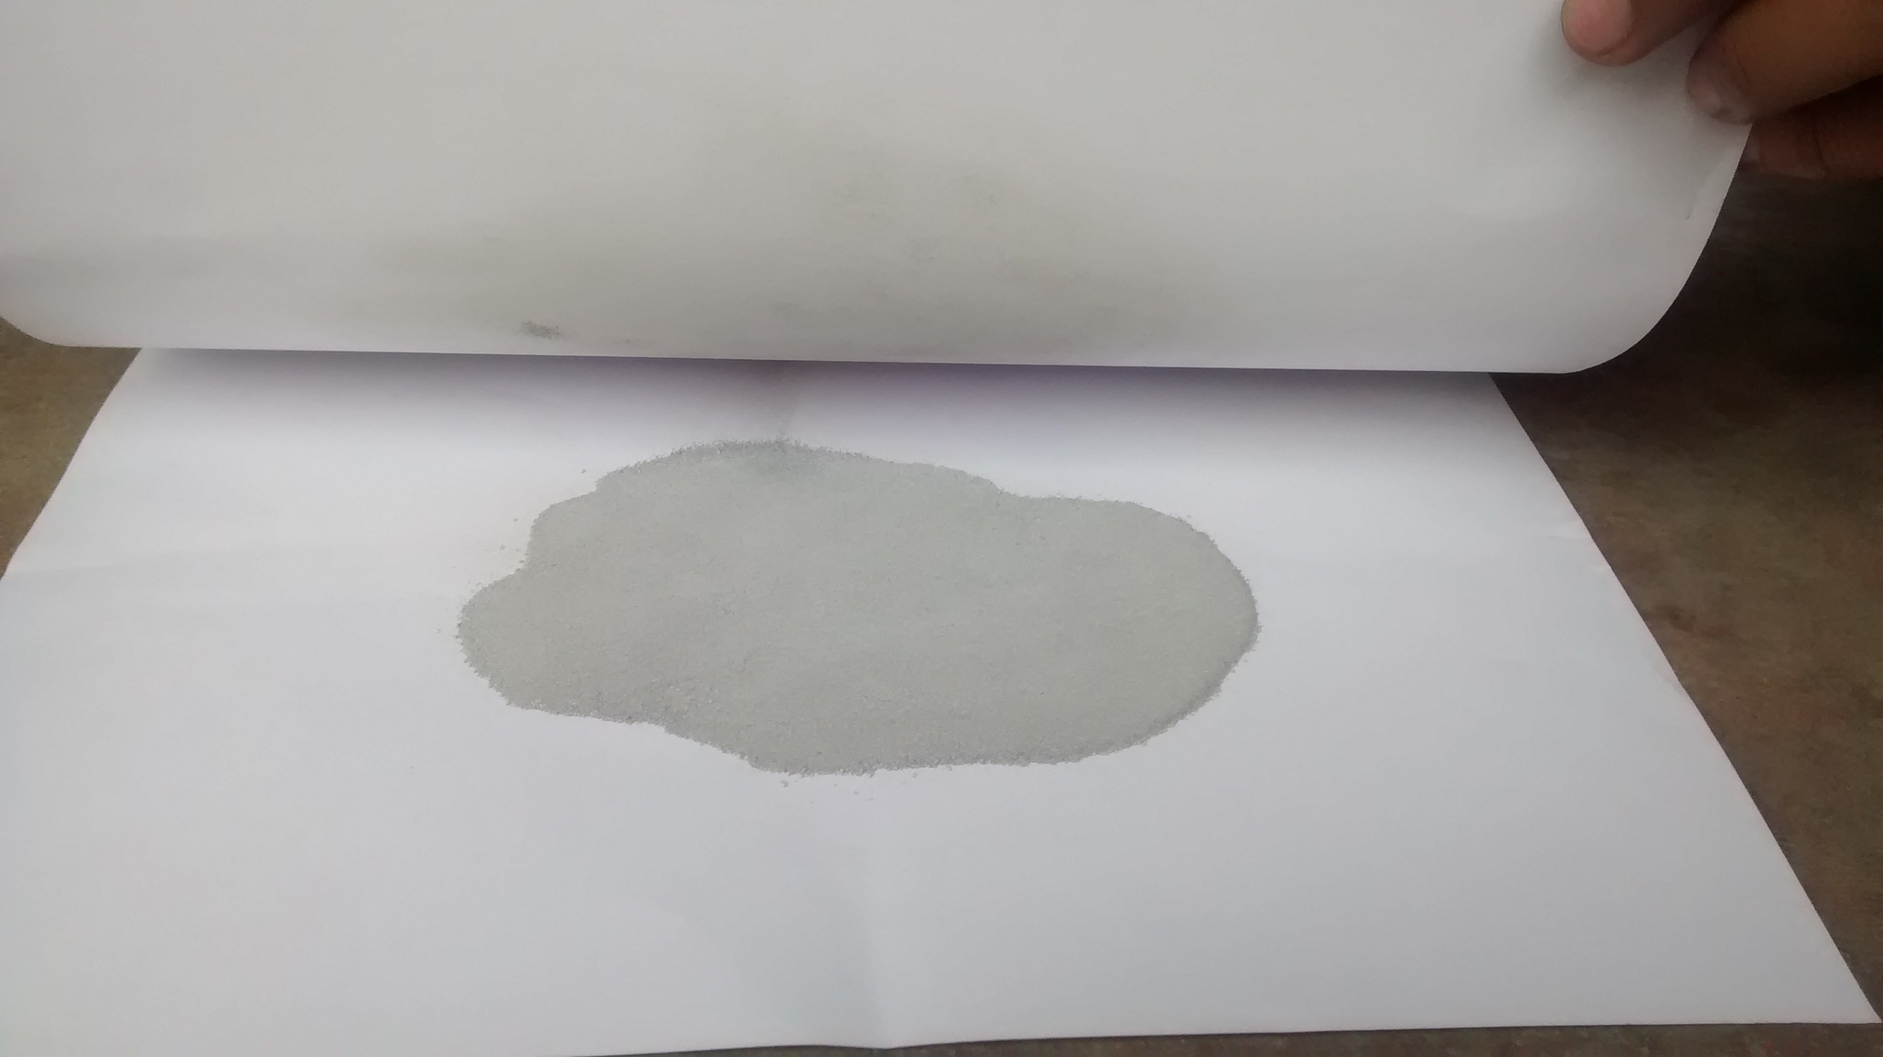
PREPARATION OF MAGNETIC ABRASIVES
Mixing of powders
  Iron powder
  Aluminum oxide
Figure 6: Powder mixing

Slide 18
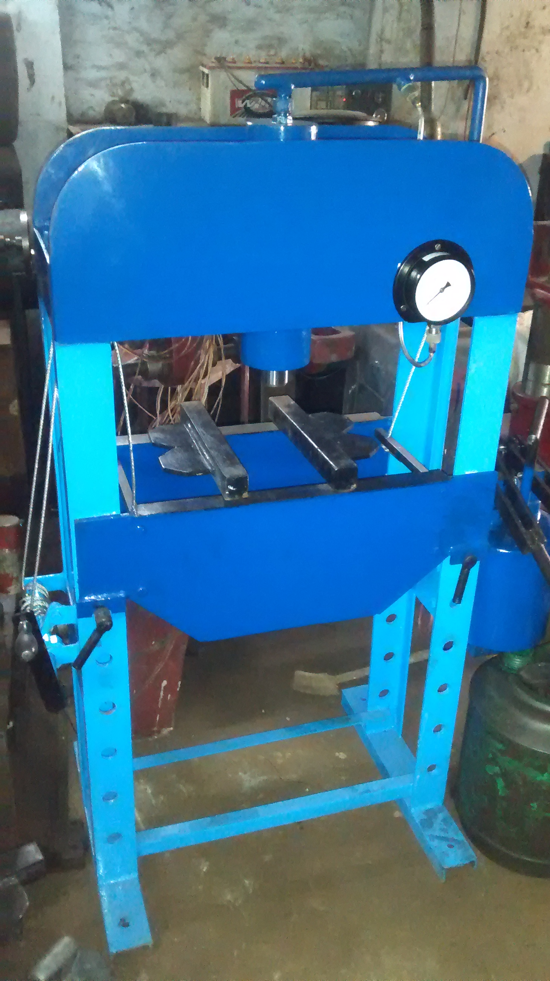
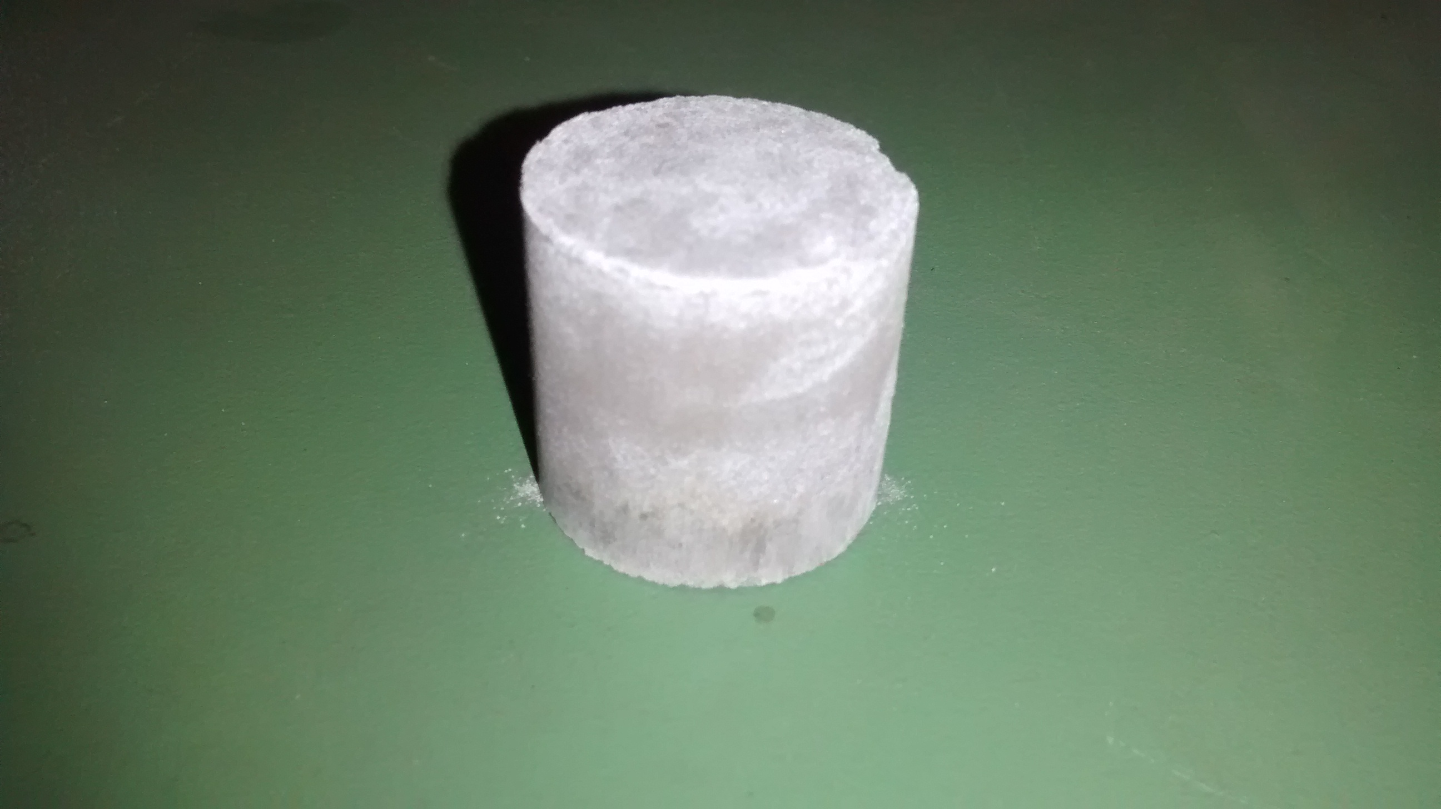
COMPACT FORMATION
Figure 7: Hydraulic press
Figure 8: Green Compact

Slide 19
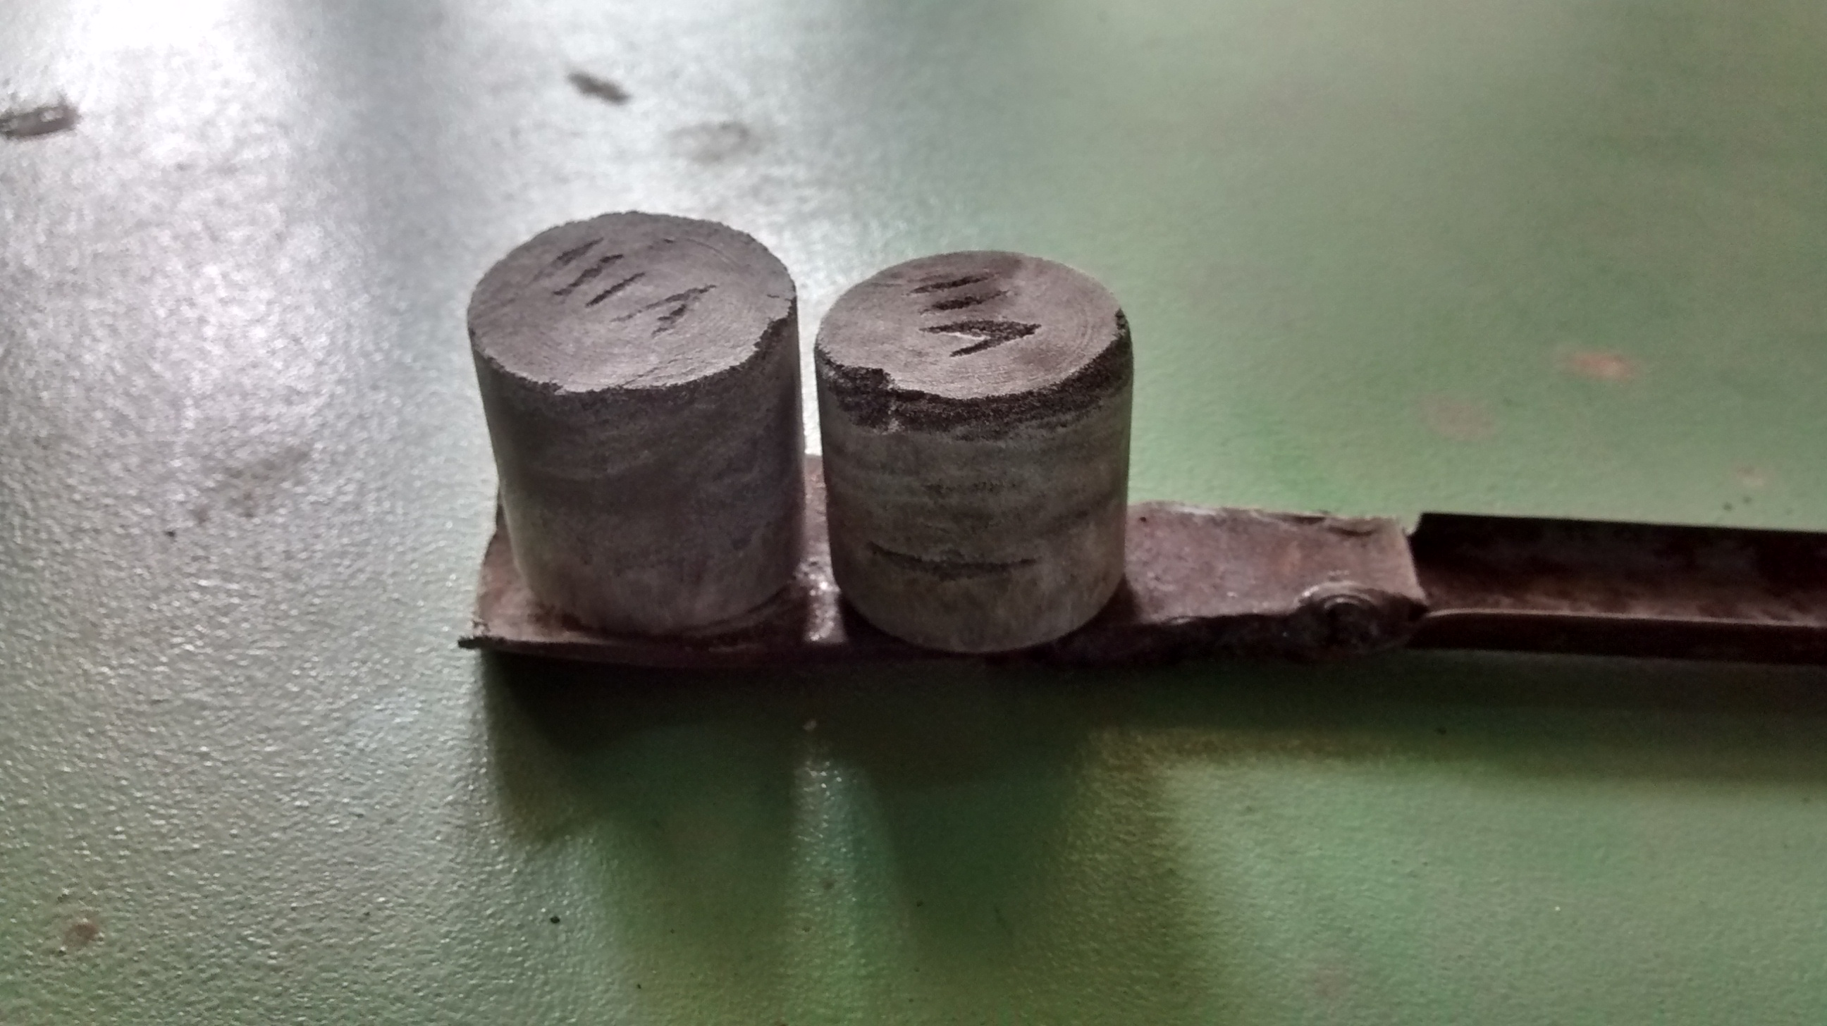
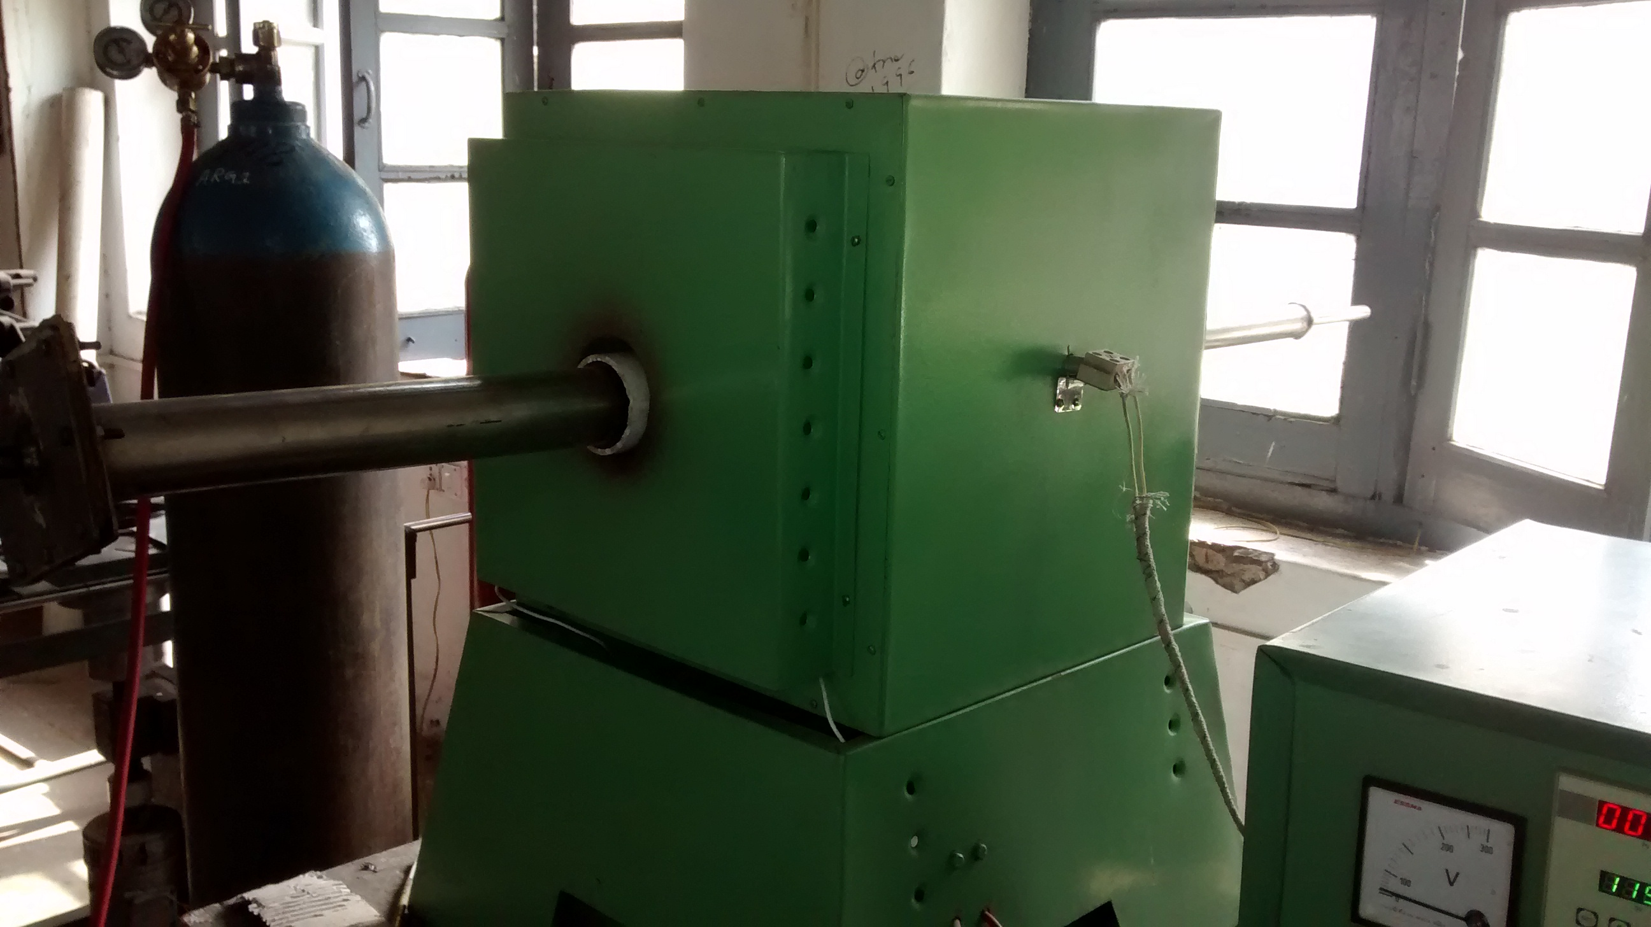
HEATING OF GREEN COMPACT
Figure 9: Placement of compact in furnace
Figure 10 : Ordinary furnace

Slide 20
RESULTS AND DISCUSSION
Run | Abrasive Concentration(%age) | Sintering Time(min) | Compacting Pressure(N/mm²) | PISF(%age)
1 | 30 | 37.5 | 10.3 | 49
2 | 42 | 51 | 12.4 | 3.7
3 | 30 | 37.5 | 13.8 | 49.6
4 | 30 | 37.5 | 10.3 | 50
5 | 30 | 37.5 | 10.3 | 49.2
6 | 50 | 37.5 | 10.3 | 22
7 | 18 | 51 | 8.3 | 21.9
8 | 18 | 24 | 8.3 | 68.8
9 | 18 | 24 | 12.4 | 30.8
10 | 30 | 60 | 10.3 | 15.5

Slide 21
RESULTS AND DISCUSSION
Run | Abrasive Concentration(%age) | Sintering Time(min) | Compacting Pressure(N/mm²) | PISF(%age)
11 | 10 | 37.5 | 10.3 | 18.0
12 | 30 | 37.5 | 10.3 | 49.0
13 | 42 | 24 | 12.4 | 20.0
14 | 30 | 37.5 | 10.3 | 49.4
15 | 42 | 51 | 8.3 | 4.30
16 | 30 | 37.5 | 10.3 | 49.2
17 | 18 | 51 | 12.4 | 46.1
18 | 30 | 37.5 | 6.9 | 27.0
19 | 42 | 24 | 8.3 | 17.2
20 | 30 | 15 | 10.3 | 40.0

Slide 22
RESPONSE 1 PISF(percentage improvement in surface finish)
Final Equation in Terms of Coded Factors:
PISF=+49.38-8.44* A-7.36* B+3.25* C+0.29* AB+3.06* AC+12.25* BC-10.48* A²-7.74* B²-11.38* C²

Slide 23
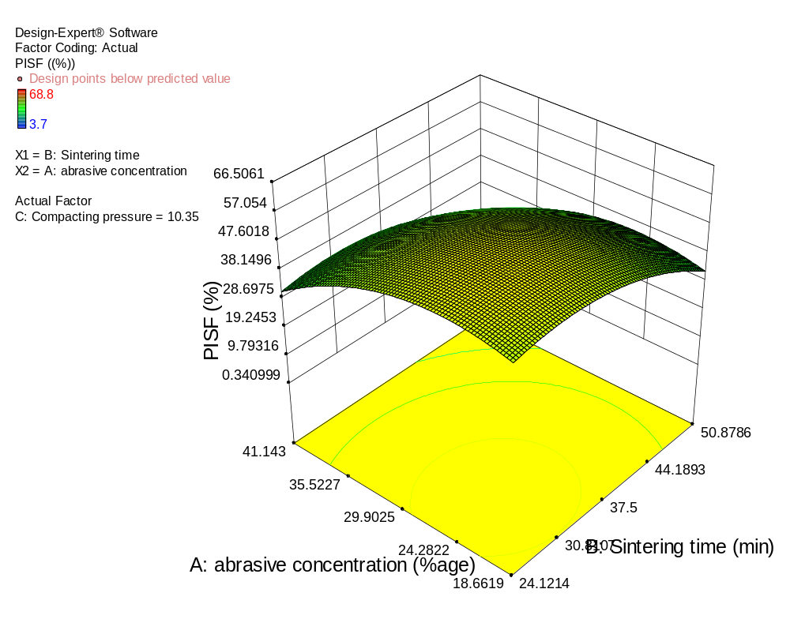
EFFECT ON PISF OF COMBINED PROCESS PARAMETERS
Combined effect of sintering time and abrasive concentration on PISF
Graph shows the relation between time and concentration. At low value of concentration PISF increase so in the case of time and then slight decrease near the higher value of time and concentration. At high value of time PISF increase with increase in concentration to half of the way and then slightly decreases. At low value of time PISF increases to half of the way along concentration then decreases.
Graph 1: Graph plot for interaction effects of Abrasive concentration (A) and Sintering time (B) on the PISF

Slide 24
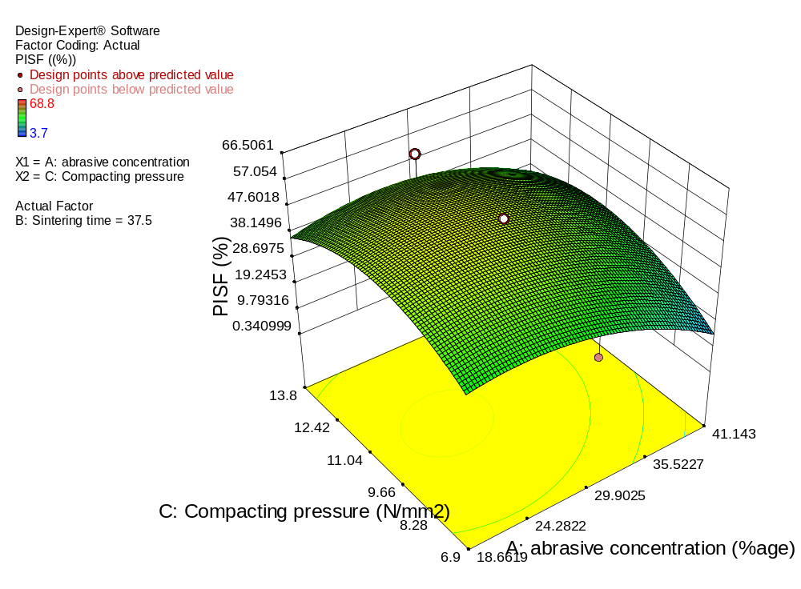
EFFECT ON PISF OF COMBINED PROCESS PARAMETERS
Combined effect of compacting pressure and abrasive concentration on PISF
Graph shows the relation between compacting pressure and abrasive concentration. At low value abrasive concentration slight increase in PISF with increase compacting pressure and near the end of abrasive concentration there negligible decrease in PISF. At higher value of abrasive concentration PISF increase slightly with increase of compacting pressure. At low value of compacting pressure PISF increases to half value of abrasive concentration then decreases for rest of the abrasive concentration value gradually.
Graph 2: Graph plot for interaction effects of Abrasive concentration (A) and Compacting pressure (C) on the PISF

Slide 25
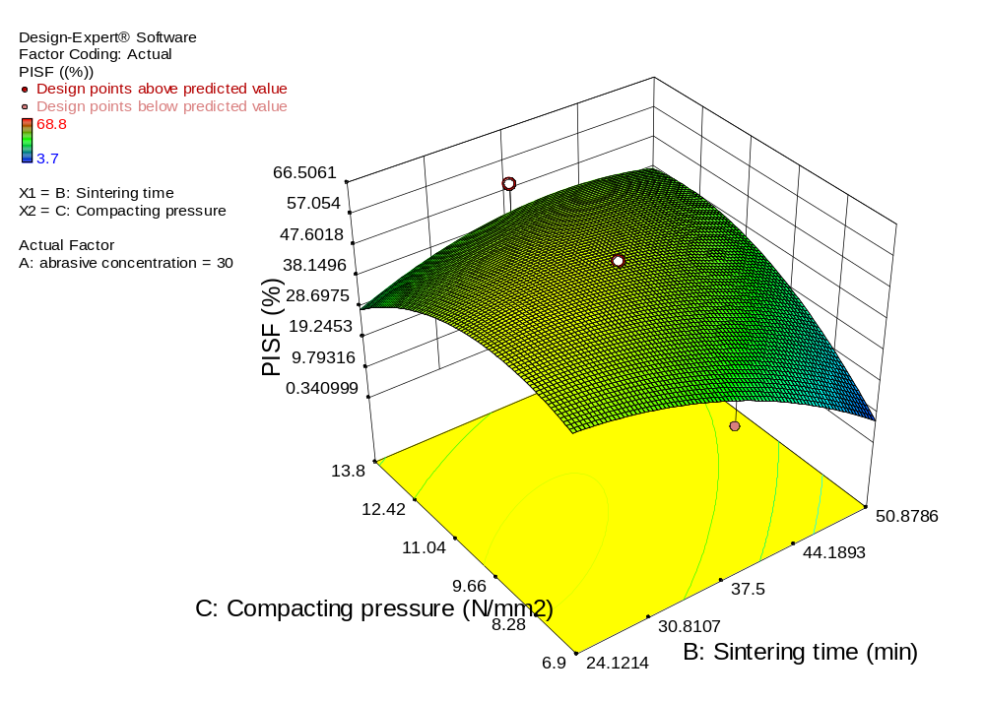
EFFECT ON PISF OF COMBINED PROCESS PARAMETERS
Combined effect of compacting
pressure and sintering time on PISF
Graph shows the relation between compacting pressure and sintering time. At low value of sintering time there was negligible change in PISF with increase of compacting pressure, but at the end of compacting pressure values significant decrease in the PISF was noted down. At high value of sintering time PISF gradually increases with increase in compacting pressure values. At low value of compacting pressure initially PISF was high value as sintering time low value of time and at the end of sintering time values PISF decrease.
Graph 3: Graph plot for interaction effects of Sintering time (B) and Compacting pressure (C) on the PISF

Slide 26
CONCLUSIONS
Following conclusions have been drawn from the present work-:
The maximum Percentage Improvement in Surface Finish (68.8 %) obtained by the magnetic abrasives prepared by parametric combination of concentration of abrasives 18 %, sintering time 24 min, and compacting pressure8.3 N/mm2.
Following mathematical model is proposed for calculation of parametric values for optimum PISF
PISF=+49.38-8.44*A-7.36*B+3.25*+0.29*ABC+3.06*AC+12.25*BC-10.48*A2-
7.74*B2 11.38* C2

Slide 27
REFERENCES
[1]Butkovic Samir, Oruc Mirsada, Saric Emir, Mehmedovic Muhamed (2012), “Effect of sintering parameters on the density, microstructure and mechanical properties of the niobium-modified heat-resistant stainless steel GX40CRNISI25-20 produced by MIM technology”, Materials and technology ,vol-46 ,pp: 185–190.
[2]Naif .M Nazar kias (2012), “Study on the parameter optimization in magnetic abrasive polishing for brass CUZN33plate using taguchi method”, The Iraqi Journal For Mechanical And Material Engineering, Vol.12, No.3,pp;596-615
[3]Rampal Rohit (2012) , “Comparing the Magnetic Abrasives by Investigating the Surface Finish”, Journal of Engineering, Computers & Applied Sciences (JEC&AS) ,vol-1,pp:20-24.
[4]Sharma Mithlesh , Singh Devinder pal (2013), “To study the effect of various parameters on magnetic abrasive finishing”, International Journal of Research in Mechanical Engineering & Technology,vol-3,pp:212-215.
[5]Singh and Singh (2014), “Effects of Different Variables on Magnetic Abrasive Powder in Mechanical Alloying Method”, International Journal of Engineering Research and Applications (IJERA) ,National Conference on Advances in Engineering and Technology, ISSN: 2248-9622,pp:66-70.

Slide 28
[6]Singh and Singh (2014), “Effect of magnetic abrasives in internal finishing of brass tubes using MAF”, Method Journal of Academia and Industrial Research (JAIR),vol-2,pp:689-692.
[7]Mulik .Rahul .S, Pandey .Pulik .M(2011), “ Ultrasonic assisted magnetic abrasive finishing of hardened AISI 52100 steel using unbonded SiC abrasives”, Intnational Journal of Refractory Metals and Hard Materials ,vol-29,pp: 68–77.
[8]Singh Baljinder , Kalra Charanjit Singh (2015), “Optimization of Magnetic Abrasive Finishing Parameters during finishing of Brass Tube” International Research Journal of Engineering and Technology ,vol-02,pp:1810-1817.
[9]Sharma Varun , Verma Girish Chandra ,M. Pandey (2015), “Magnetic Abrasive Finishing Process; State of the Art”, International Journal of Applied Engineering Research,Vol- 10,pp:27601-27607.
[10]Yamaguchi .H, Kang . J, Hashimoto.F(2011), “Metastable austenitic stainless steel tool for magnetic abrasive finishing” CIRP Annals - Manufacturing Technology ,vol-60,pp: 339–342.
[11]Wang .Q.B, Wang. Q.G, Wan .C.X (2010), “ Effect of Sintering Time on the Microstructure and Properties of Inorganic Polyphosphate Bio ceramics”, Science of Sintering, vol- 42,pp: 337-343.

