Slide 1


Atypical cells in the ascitic fluid of women with ovarian hyperstimulation syndrome: follow up and assessment of malignancy
Ioannis Hatzipetros, Peter M Gocze, Katalin Cziraky, Kalman Kovacs, Endre Kalman and Balint Farkas
University of Pecs Clinical Center, Department of Obstetrics and Gynecology

Slide 2
The current study was funded by:
1, SROP-4.2.2.A-11/1/KONV-2012-0053 Investigation of biomarkers
in culture medium for the success rate of in vitro fertilization.
University of Pécs, János Szentágothai Research Centre
Pécs, H-7624, Ifjúság str. 20., Hungary
2, MTA-PTE Human Reproduction Scientific Research Group.
Hungarian Academy of Sciences (MTA) and the University of Pecs (PTE),
Pécs, Hungary.

Slide 3
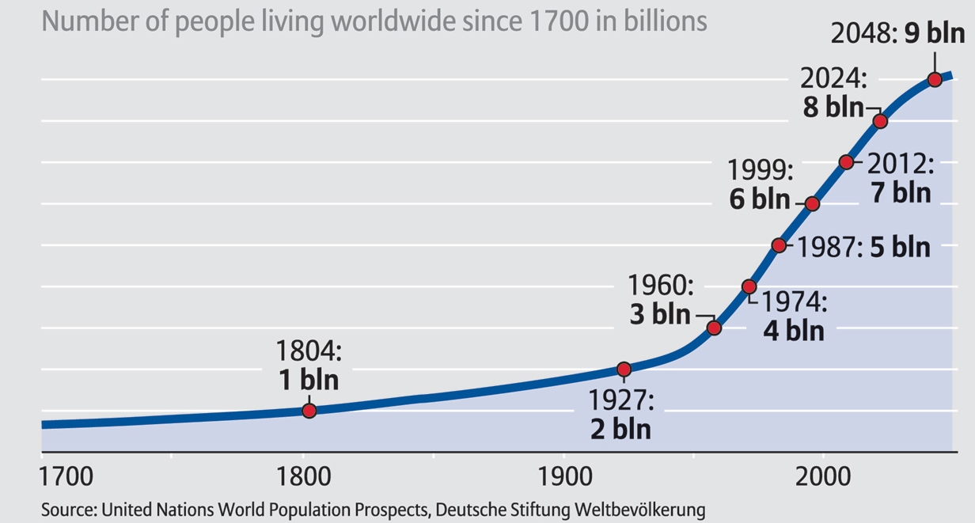
Population explosion; human race is leaving an „ecological footprint” on the planet in 2012.

Slide 4
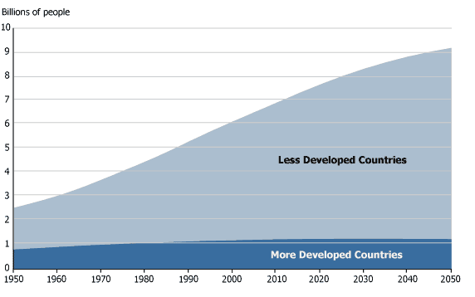
Less Developed Countries are responsible for this linear increase in the population in, while the population in the Developed Countries is constant or slightly decreasing.
Source: www. prb.org

Slide 5
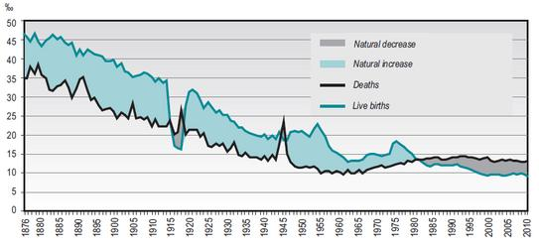
Hungarian population fall in the 20th century
Source: Hungarian Statistical Office, Demographic Yearbook, 2011.

Slide 6
Growing rate of infertility – growing need of ART
Based on data from the National Survey of Family Growth (NSFG), women aged 15–44 who had ever used infertility services increased from 9% in 1982 to 15% in 1995, then declined to 12% in 2002, and remained at that level in 2006–2010.
Etiology: - Male 25 %
          - Ovulatory 27 %
          - Tubal / uterine 22 %
          - Other 9 %
          - Unexplained 17 %

Slide 7
Is in vitro fertilization safe?
Egg-retrieval procedure complications
Miscarriage: about 15 - 20 %
Twin gestation: increased risk, if more than one embryo is implanted into the uterus.
Premature delivery and low birth weight: IVF slightly increases the risk.
Birth defect:
a, 8.3% vs. 5.8%, but IVF was not associated with greater odds, unlike ICSI, which was associated with a 57% increased risk. (Davies et al., NEJM, 2012)
b, 9 % vs 6.6 % increased risk for major birth defects for infants born after IVF compared to naturally conceived infants (Kelly-Quon et al., AAP, 2012)
Ovarian Hyperstimulation Syndrome (OHSS)
Ovarian cancer: ?

Slide 8
Ovarian Hyperstimulation Syndrome (OHSS)
Definition: Iatrogenic complication of ovarian induction therapy (OIT) resulting increased vascular permeability and subsequent fluid accumulation.
Symptoms: - abdominal pain and distension
- respiratory compromise (hydrothorax)
- ascites and GI problems
- oliguria
- thromboembolism

Slide 9
Ovarian Hyperstimulation Syndrome (OHSS)
Diagnosis:
1, antral follicule count ≥ 14 on a TVUS (82 % sensitivity, 89 % specificity – Kvee et al. 2007)
2, basal anti-Müllerian hormone level of ≥ 3.5 ng/ml (90.5 % sensitivity, 81.3 % specificity – Nardo et al. 2009)
Clinical forms:
a, Mild (Grade 1 - Whelan et al., 2010)
b, Moderate (Grade 2-3 - Whelan et al., 2010)
c, Severe (Grade 4-5 - Whelan et al., 2010)

Slide 10
Ovarian Hyperstimulation Syndrome (OHSS) and ovarian tumors
OHSS and struma ovarii (Balasch et al.,1993)
OHSS and folliculoma (Willemsen et al.,1993)
OHSS and serous papillary carcinoma (Komatsu et al.,1995)
OHSS and mucinous cystadenoma (Grimbizis et al.,1995)
OHSS and serous papillary cystadenoma (Grimbizis et al., 1995)
OHSS and granulosa-cell tumor (Willemsen at al.,1993)
OHSS and epithelial ovarian carcinoma (Goldberg et al.,1992)
Shushan et al. In 1993 concluded that OIT with human menopausal gonadotropin might increase the risk of epithelial ovarian malignancies, specifically borderline ovarian tumours.

Slide 11
Aim of the study
To determine whether women undergoing OIT at our IVF clinic, especially those with severe OHSS and suspicious cytologic findings, were at risk for developing malignant ovarian tumours after treatment, or not.

Slide 12
Methods
Prospective study design.
Clinical Centre of the University of Pecs Department of Obstetrics and Gynaecology/Reproductive Centre between January 2006 and December 2012.
Severe OHSS patients were investigated, which cases US guided culdocentesis obtained ascitic fluid.
Out of the collected cells smear was made, GIEMSA stained and evaluated by Papanicolau method under light microscopy.
Peripheral blood was drawn for tumor marker level assessment (CA-125 and HE4).

Slide 13
Results
1587 women underwent OIT in 4892 cycles
23 patients (1.4 %) got hospitalized with severe OHSS
None developed malignant ovarian tumour during the study period
9 / 23 underwent culdocentesis for severe OHSS

Slide 14
Case No. | Age (y) | Douglas puncture | OIT | Ascites cytologyφ | Control histology | Remarks
1 | 28 | 05/2006 | CC + hMG + hCG | P IV | 06/2006, neg.# | Tumor-free
2 | 23 | 03/2007 | FSH + hMG + hCG | P IV | 05/2007, neg.# | Tumor-free
3 | 24 | 10/2007 | CC + FSH | P IV | 12/2007, neg.# | Tumor-free
4 | 23 | 10/2007 | CC + hCG | P IV | 12/2007, neg.# | Tumor-free
5 | 26 | 11/2007 | CC + FSH + hCG | P III | 02/2008, neg.# | Tumor-free§
6 | 30 | 02/2008 | hMG + hCG | P III | 04/2008, neg.# | Tumor-free
7 | 26 | 11/2008 | FSH + hCG | P III | 01/2009, neg.# | Tumor-free
8 | 30 | 11/2009 | GnRH-a + hMG + hCG | P III | 01/2010, neg.# | Tumor-free
9 | 34 | 10/2012 | GnRH-a + FSH + hCG | P III-IV | 12/2012, neg.# | Tumor-free$
Dates are shown for Douglas puncture and control histology tests.
OIT, Ovarian induction therapy; CC, Clomiphen citrate;
hMG, Human menopausal gonadotropin;
hCG, Human chorial gonadotropin; GnRH-a,
Gonadotropin-releasing hormone analog; FSH, Follicle-stimulating hormone.

Slide 15
Laparoscopic examination was performed at 8 to 12 weeks after the
culdocentesis.
Inspection of the abdominal cavity, eluents from the Douglas pouch were
sampled and histological samples were obtained from the ovaries.

Slide 16
Case No. | Age (y) | CA-125 (U/mL) | HE4 (pM) | ROMA (%)
1 | 28 | 45.2 | 40.1 | 4.9
2 | 23 | 27.1 | 47.9 | 7.0
3 | 24 | 505.8 | 38.2 | 5.0
4 | 23 | 40.5 | 39.9 | 4.8
5 | 26 | 19.2 | 51.6 | 8.1
6 | 30 | 9.8 | 45.6 | 5.2
7 | 26 | 38.1 | 45.2 | 6.2
8 | 30 | 56.3 | 37.4 | 4.2
9 | 34 | 210.3 | 40.1 | 5.3
The mean (± SD) value of CA- 125 was increased (105.81 ± 161.55 U/mL) compared to the reference range of 0 to 39 U/mL. However, the mean serum level of HE4 (42.89 ± 4.88 pM) was within the normal range of 0 to 150 pM.

Slide 17
Conclusions
Even if OHSS indicates abnormality and possible malignancy, radical surgical intervention is not clinically indicated, instead these patients should be closely followed and monitored.
If the ovarian size remains abnormal, then the aetiology of the enlargement should be determined by histological sampling via laparoscopy, and the histologist should be informed of the previous OIT.
Large population-based studies will be required to determine if ovarian induction is associated with tumourigenesis over the long-term.

Slide 18

Thank you for your attention!

