Slide 1
Study of crystallization kinetics of polypropylene/acrylonitrile butadiene styrene blends
Presented by: Dr. Bader Albusairi
Work Done by: Dr. Bader Albusairi
Eng. Reem Alkhaldey
Chemical Engineering Department
College of Engineering and Petroleum
Kuwait University

Slide 2
Highlights
Three different types of blends containing polypropylene (PP), and acrylonitrile-butadiene styrene (ABS) have been developed.
Uncompatilized blends and compatilized ones using maleic anhydride (MAH) as a compatibilizer with different compositions have been developed using twin screw extruder.
The detailed non isothermal crystallization kinetics of these blends were evaluated using Avrami, Tobin and Malkin models.
Polymath was used to estimate the crystallization kinetic parameters obtained from these three models.
The best model that represents wide range of compositions is …

Slide 3
Introduction
PP is a semi crystalline thermoplastic.
Pros:
  Chemical, heat resistance,
  Elongation and
  Heat distortion temperature.
Cons:
  High mold shrinkage
  Low impact strength.

Slide 4
Introduction
ABS is an amorphous thermoplastic polymer
Pros:
  Chemical resistance and
  High impact strength
Cons:
  Poor elongation.

Slide 5
Introduction
In this work, PP is blended with ABS to:
  Get better impact properties without losing the valuable properties of each polymer.
  Widen the range of applications of both the polymers.

Slide 6
Experimental
PP and commercial grade ABS (moldable grade) were used to develop the below blends blends.
  Blend 1: 30 PP / 70 ABS,
  Blend 2: 50 PP / 50 ABS,
  Blend 3: 70 PP / 30 ABS
For compatibilized samples, 5wt% PP-g-MAH compatibilizer is used.

Slide 7
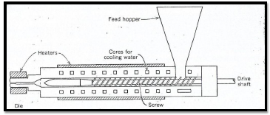
Experimental
Figure 1: Diagram of Plastics Extruder

Slide 8
Experimental
Perkin Elmer Diamond DSC is used to determine the thermal properties of PP/ABS blends and their crystallization behavior .
Four predefined heating and cooling rates were used between ambient and 250 ºC.
  Heating and cooling rates: 5, 10, 15, and 20 ºC/min.
  Sample held at 250 ºC for 5 minutes before cooling to remove thermal history.

Slide 9
Experimental
The percentage crystalline content was estimated.
The exothermic peaks obtained on cooling were evaluated as a function of temperature.
The crystallization kinetic parameters were determined using non isothermal kinetic models (Avrami, Tobin, and Malkin)

Slide 10
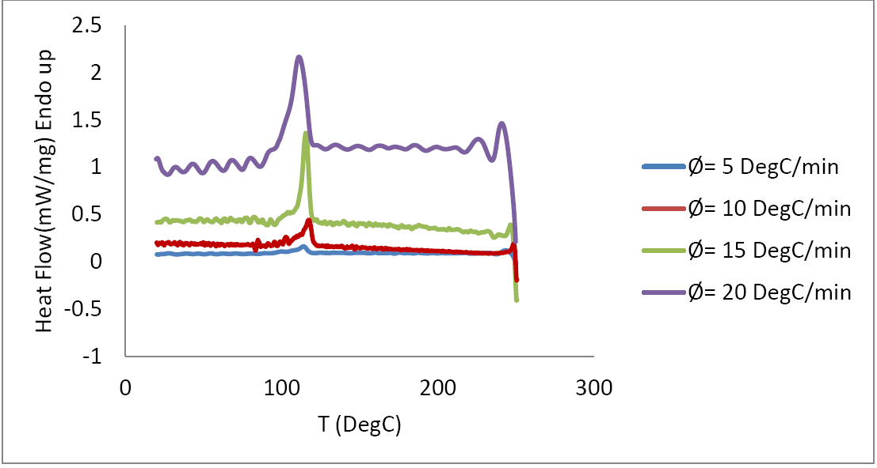
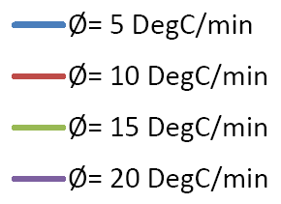
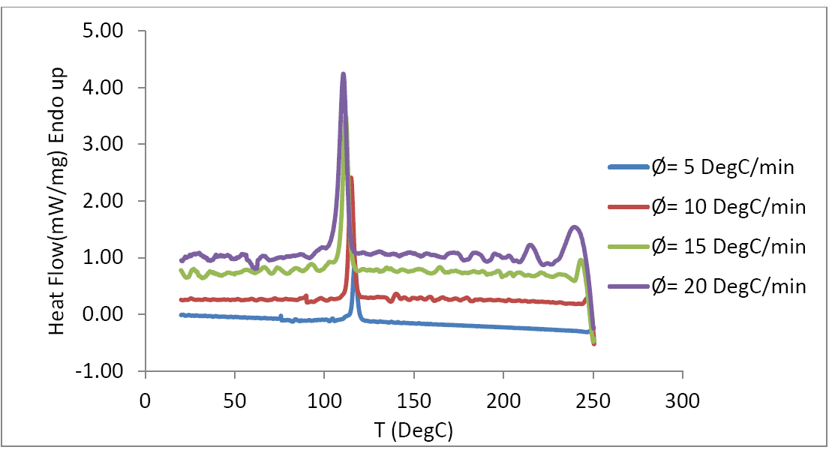
Results and Discussion
DSC Results Different Cooling Rate
Un-compatiblize 30 PP / 70 ABS
Compatiblize 30 PP / 70 ABS

Slide 11
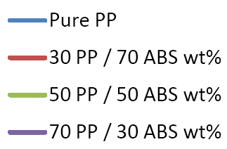
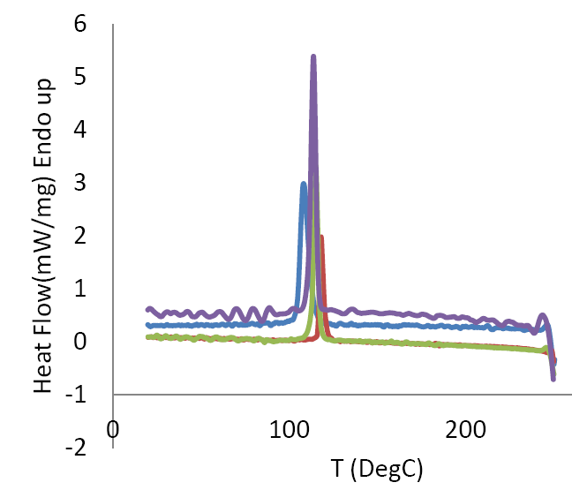
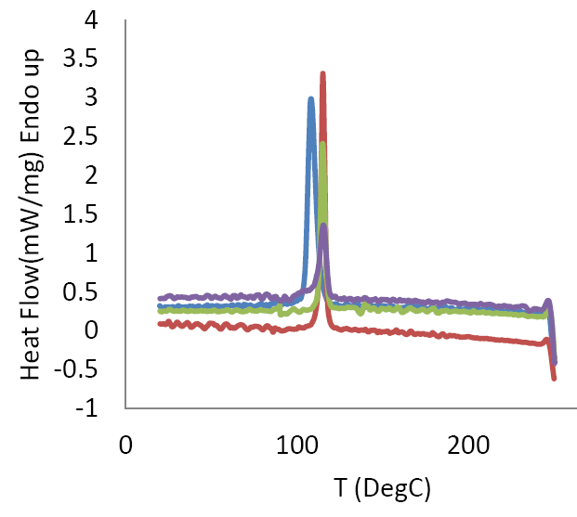
Results and Discussion
DSC Results Different Composition
Un-compatiblize 10 DegC/min
Compatiblize 10 DegC/min

Slide 12
Results and Discussion
Cristalinity (θ)
The energy released in non-isothermal crystallization process is a function of temperature. The relative crystallinity, θ, can be given as:
T_{o} an T = onset and an arbitrary point of temperature.
H_{c} is amount of heat released during crystallization at the defined temperature.

Slide 13
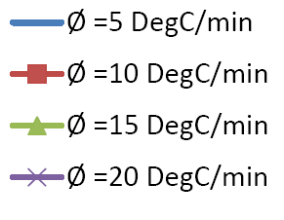
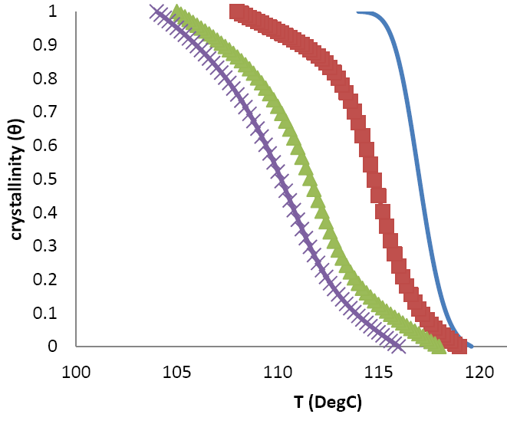
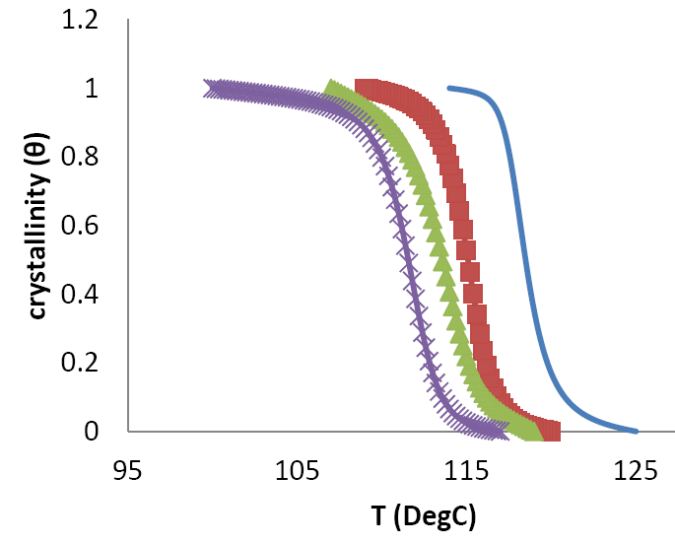
Results and Discussion
Crystalinity and Temp. 50 PP / 50 ABS
Un-Compatiblize
Compatiblize

Slide 14
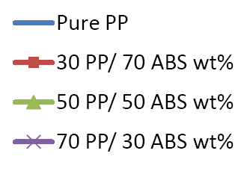
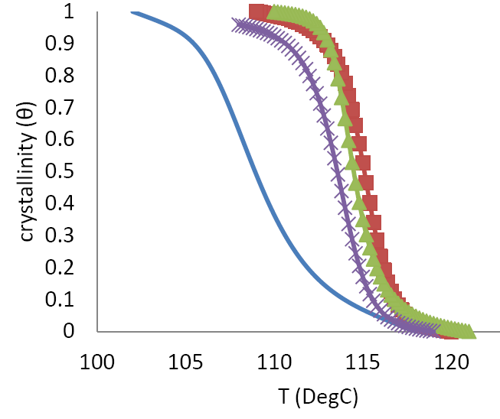
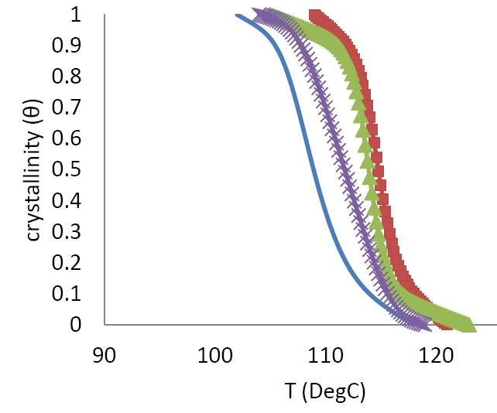
Results and Discussion
Crystalinity and Temp. 10 DegC/min
Un-Compatiblize
Compatiblize

Slide 15
Results and Discussion
Crystallization Time (t)
The time (t) and temperature (T) can be related as:
φ is the cooling rate.

Slide 16
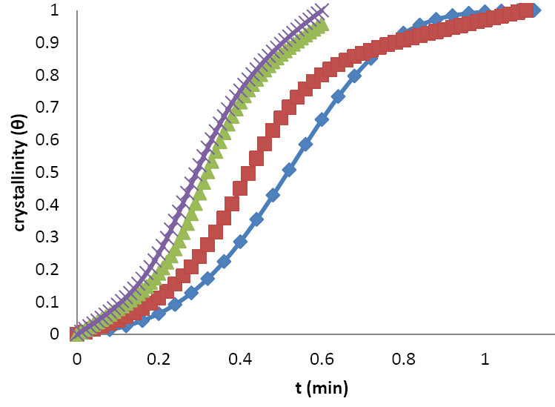
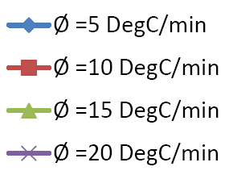
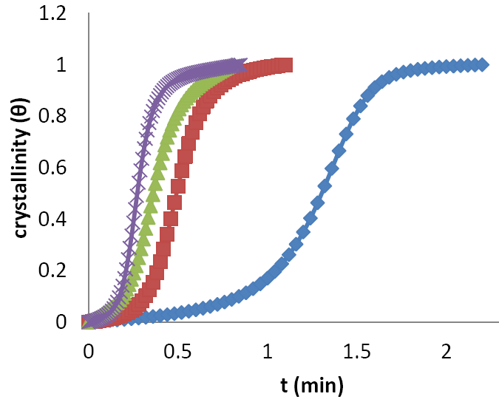
Results and Discussion
Crystalinity Time 50 PP / 50 ABS
Un-Compatiblize
Compatiblize

Slide 17
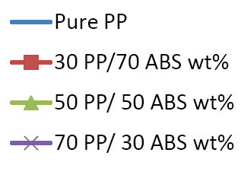
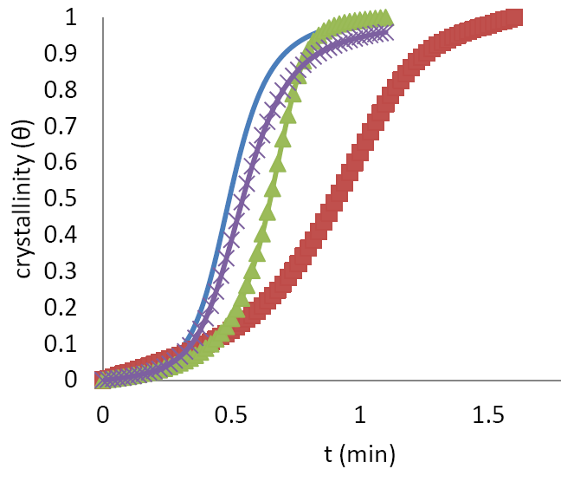
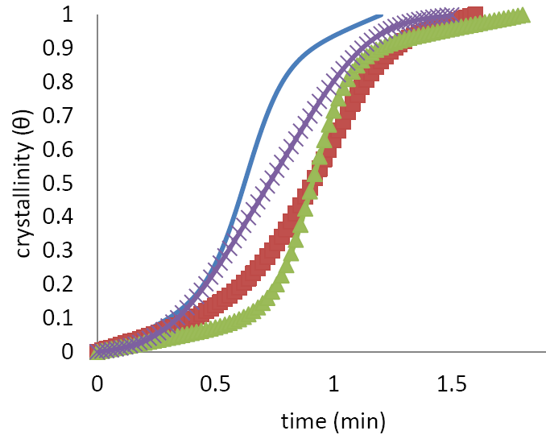
Results and Discussion
Crystalinity Time 10 DegC / min
Un-Compatiblize
Compatiblize

Slide 18
Kinetic Models (Avrami)
Avrami model is the most commonly used approach:
K_{a} = Avrami Crystalization Constant.
n_{a} = Avrami Crystalization Exponent.

Slide 19
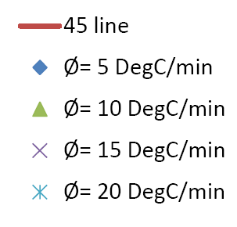
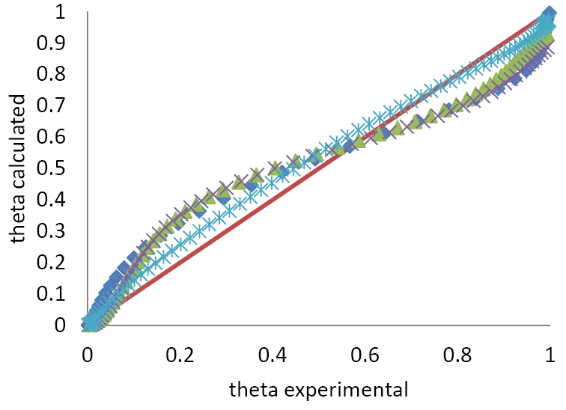
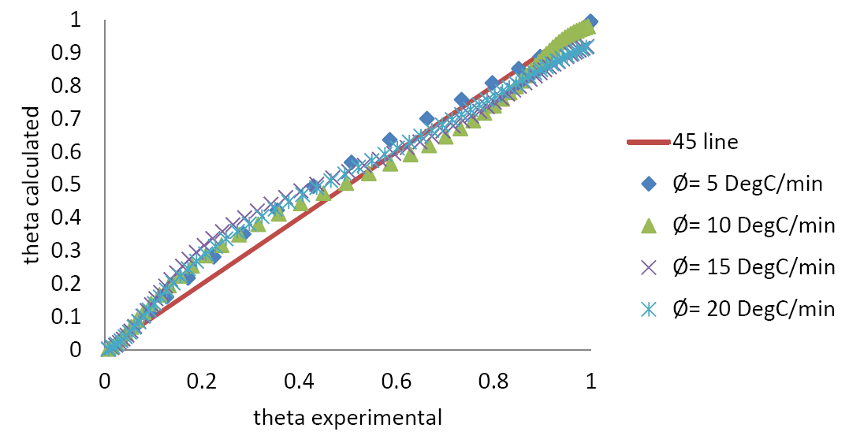
Kinetic Models (Avrami)
Un-Compatiblize
Compatiblize

Slide 20
Kinetic Models (Tobin)
Tobin model account for secondary crystallization process:
K_{t} = Tobin Crystalization Constant.
n_{t} = Tobin Crystalization Exponent.

Slide 21
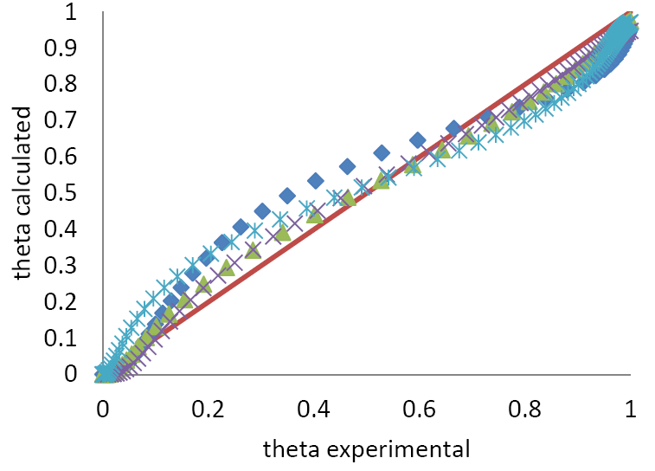
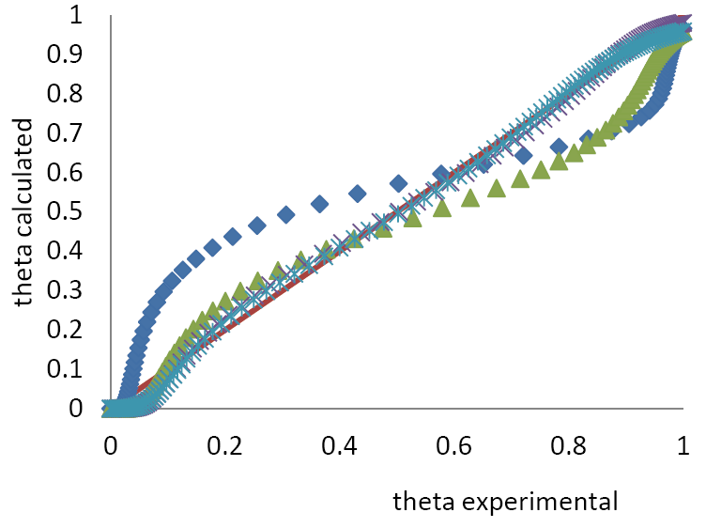
Kinetic Models (Tobin)
Un-Compatiblize
Compatiblize

Slide 22
Kinetic Models (Malkin)
Malkin model is based on the approach that the rate of crystallization is equal to the summation of the rate at which the primary nucleus emerges and crystal growth rate.

Slide 23
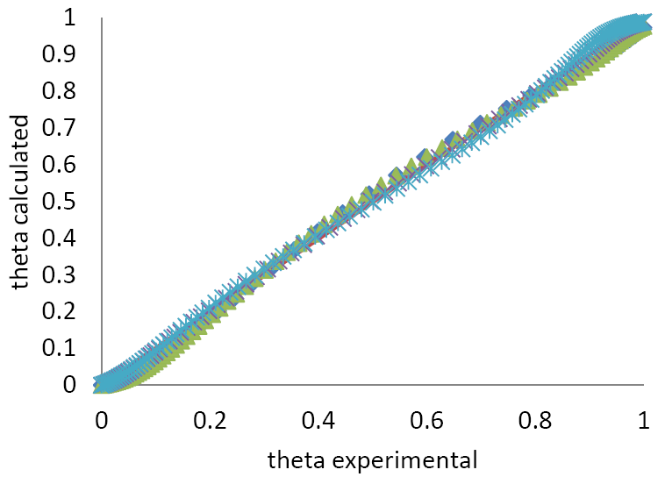
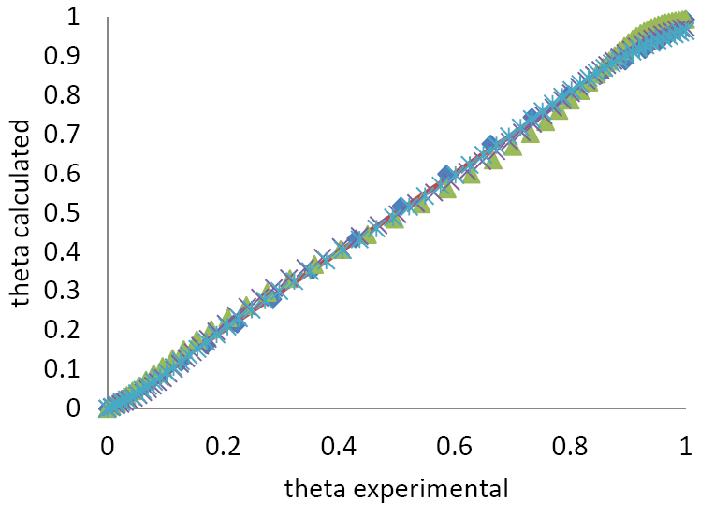
Kinetic Models (Malkin)
Un-Compatiblize
Compatiblize

Slide 24
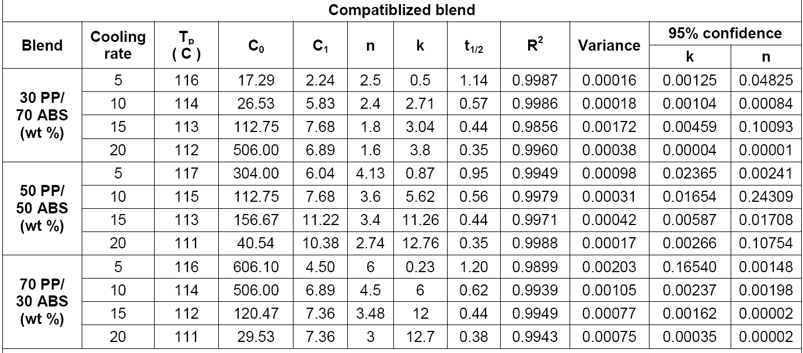
Kinetic Models (Malkin)

Slide 25
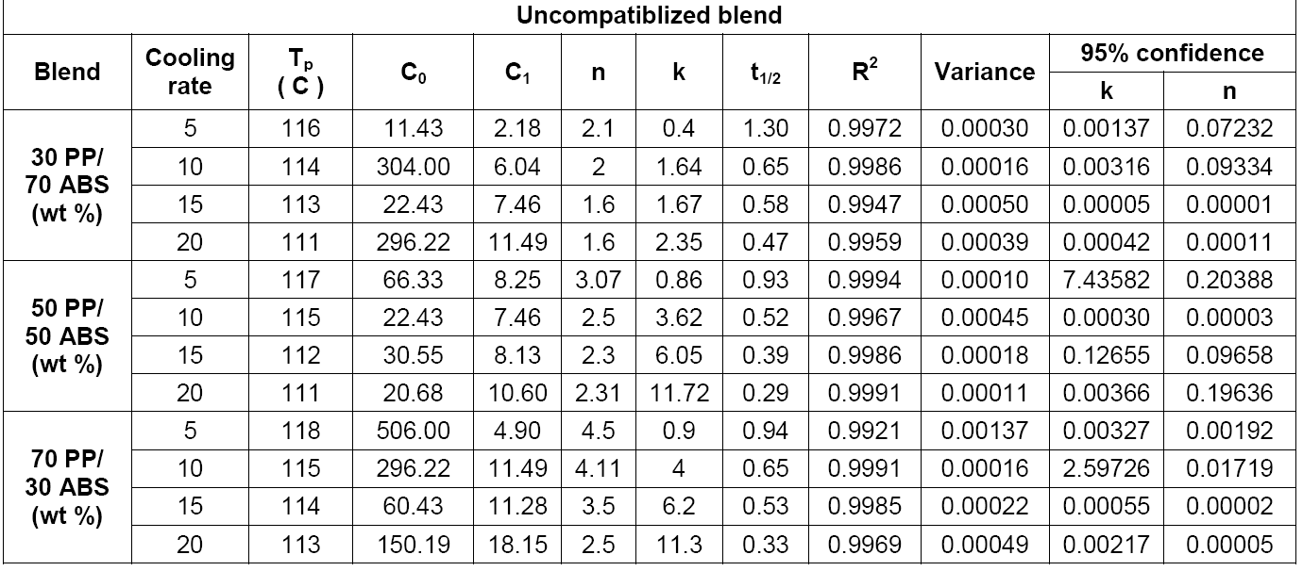
Kinetic Models (Malkin)

Slide 26
Kinetic Models (Malkin)
Crystalization Activation Energy (ΔE)
The energy of activation (ΔE) for the non-isothermal crystallization process was determined using Kissinger model:
T_{P} = Peak Crystallization Temperature

Slide 27
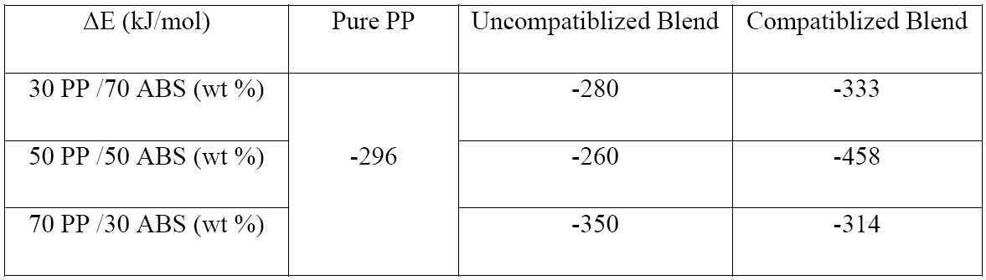
Kinetic Models (Malkin)
Crystalization Activation Energy (ΔE)

Slide 28
Final Observations and Conclusion
The peak crystallization values are shifted to lower temperatures with increasing amount of PP concentration.
Crystallization begins faster at slow cooling rates.
Compatiblized blends have higher crystallization temperature due to formation of large molecular chains, and better dispersion of each component in each other.
The ΔE values for the compatiblized reaction are comparatively greater than the uncompatiblized process indicating release of more energy due to more ordering of the molecular chains in presence of maleic anhydride as a compatibilizer.
Malkin model was the best to fit the kinetic data for blends crystallization, which indicate the importance of both rate of nucleation and rate of crystal growth.

