Slide 1
Effect of BMP-2 peptide conjugated TiO₂ nanoparticle on osteogenic expression through biomimetic Zein PDA nanofibrous scaffold
Babitha Sekar
CSIR - Central Leather Research Institute Chennai ,Tamil Nadu, India

Slide 2
Introduction
Bone
Heal & remodel without leaving a scar
Composite material of polymer ceramic matrix
Current treatment methods
Autologous bone graft , Allograft
Alternative – Metals & Ceramics
Tissue engineering
Cells, ECM, Intercellular communication, Cell – Matrix interaction, Growth factors, 3D configuration
Well co-ordinated spatial & time dependent

Slide 3
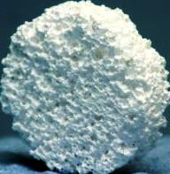
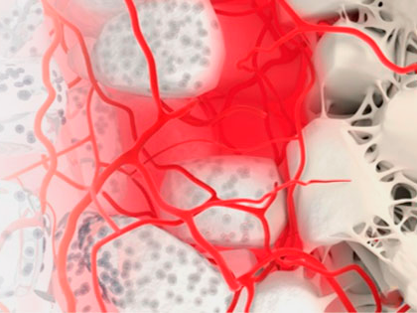
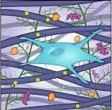

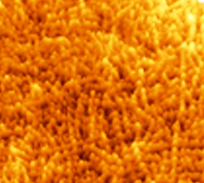
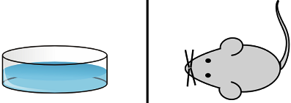
Biomimetic scaffold

Slide 4
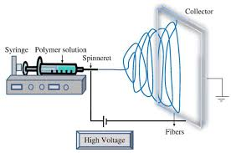
Electrospinning
Versatile
Low start up cost
Control over size & morphology
Ease of fiber functionalization
Ease of material combination
Variety of polymers

Slide 5
Nanofiber
    Large specific surface area
    Support & Strength
    Encapsulation
    Structure - porosity, diameter
    (50-1000nm)

Slide 6
Natural biodegradable polymer
  Favors cell attachment, Less immunogenic & Promotes chemotactic response, Weak mechanical property
  Zein – Amphiphilic, Tensile strength, Elastic property, Ectopic bone formation
  Polydopamine - Versatile, Secondary surface-mediated reaction
  Metal oxide nanoparticles - TiO₂ NPs
  Chemically reactive
  Synergistic effect
  Growth factors
  BMPs- Signaling molecules
  Recruit MSCs, Differentiate, Proliferate & Promote collagen production

Slide 7

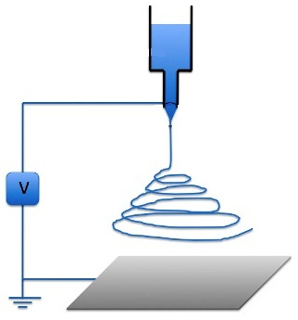
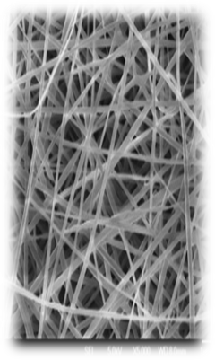
Preparation of composite nanofibrous scaffold
ZeinPDA
TiO₂BMP-2 peptide
Solution
16 kV
0.4 mL/Hr
15 cm
Composite nanofiber

Slide 8
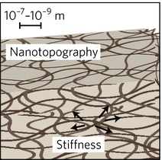
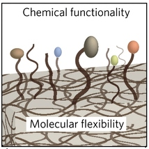
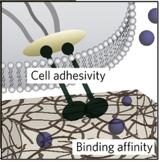
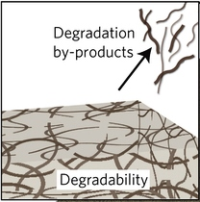
Composite polymeric
matrix

Slide 9
In-vitro analysis
Release profile
Compatibility studies
  Cell viability
  Haemocompatibility
  Cell biomaterial interaction
Osteogenic potential
  Alkaline phosphatase activity
  Mineralization assay
  Immunofluorescent staining
  ELISA

Slide 10
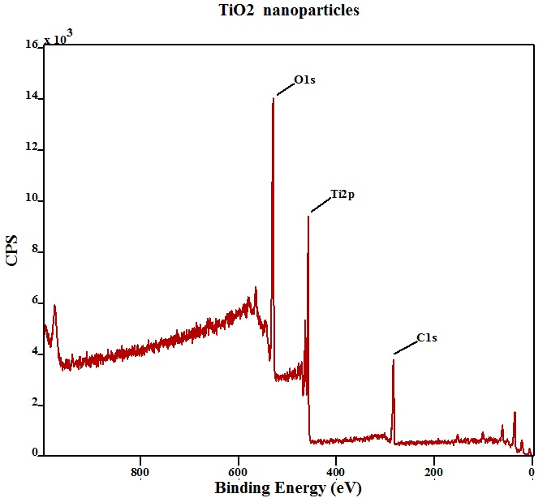
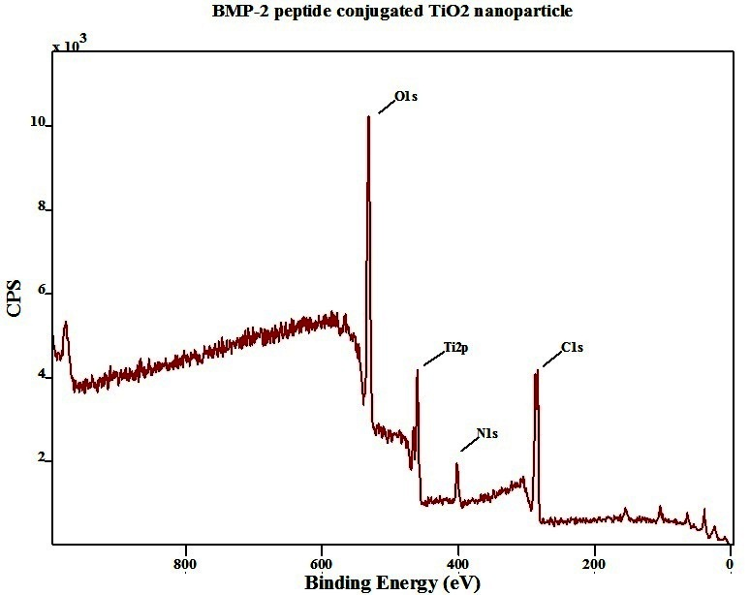
Results
X-ray photoelectron spectroscopy

Slide 11
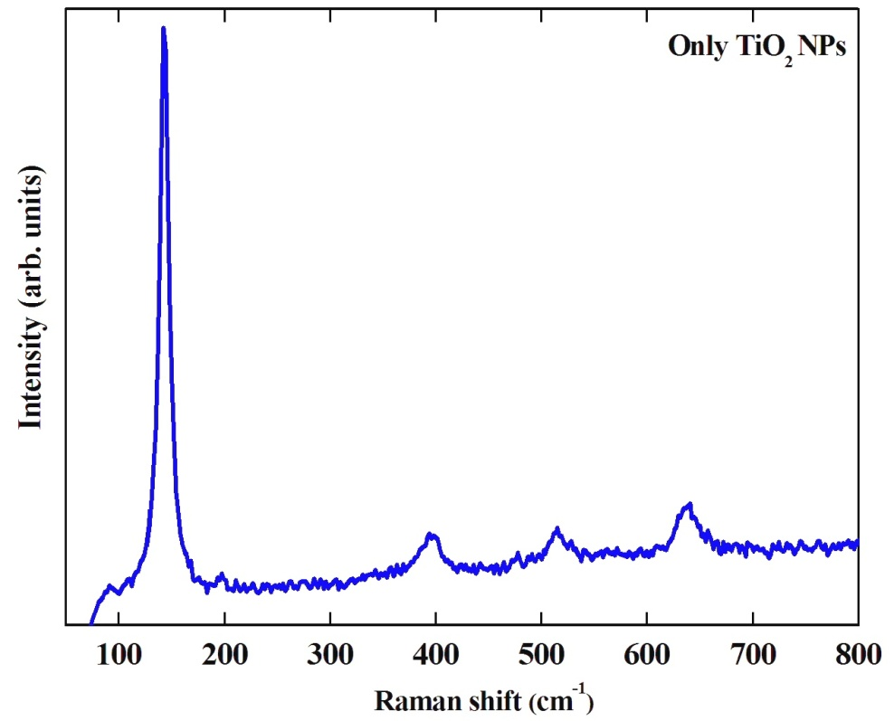
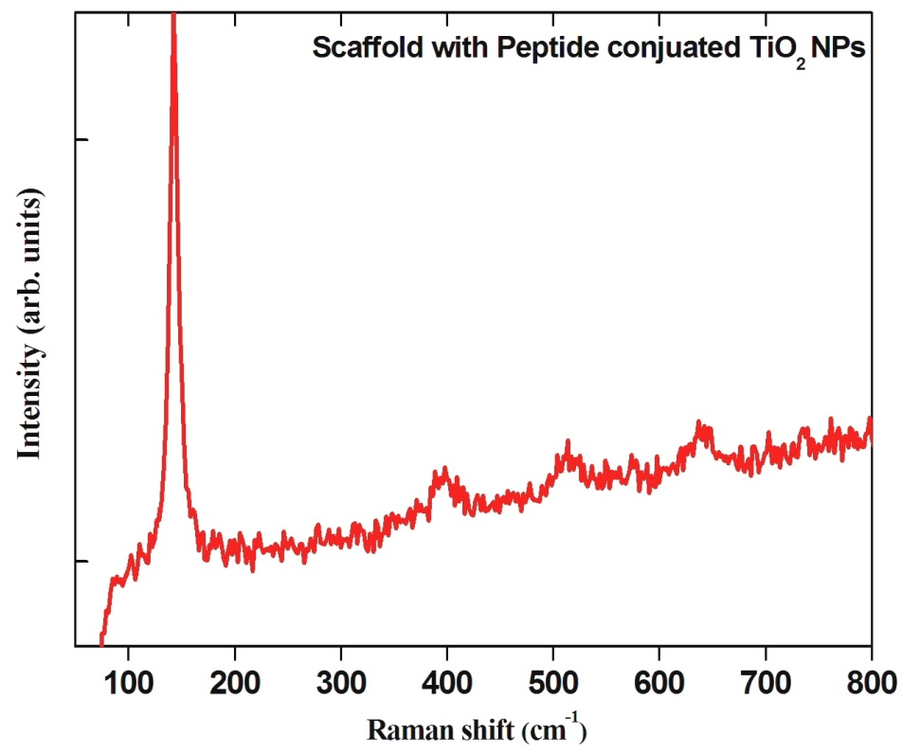
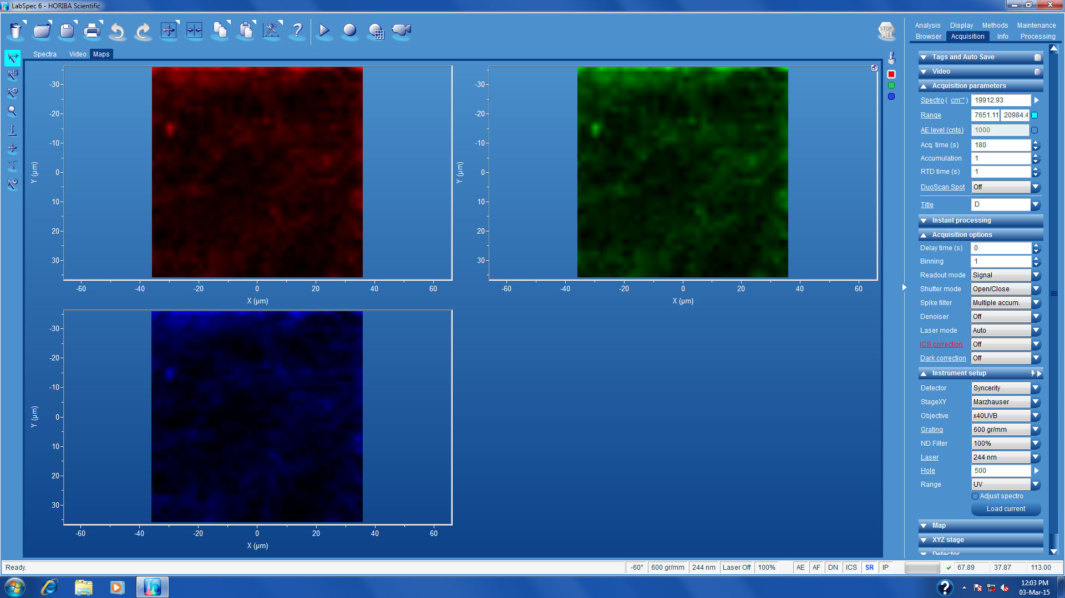
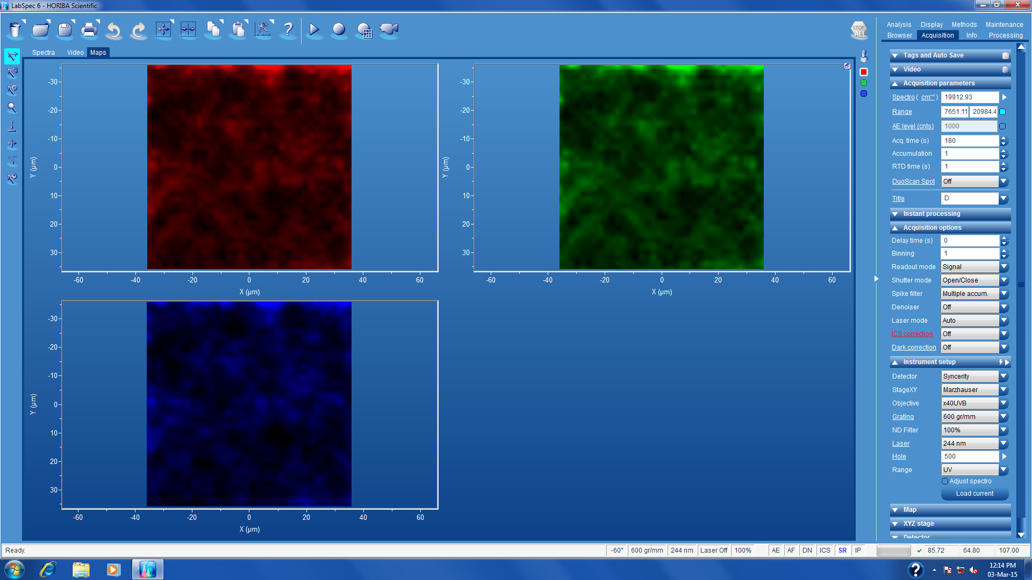
Raman Spectroscopy
a
b
a – Only TiO₂ NPs, b – BMP-2 peptide conjugated TiO₂ NPs

Slide 12
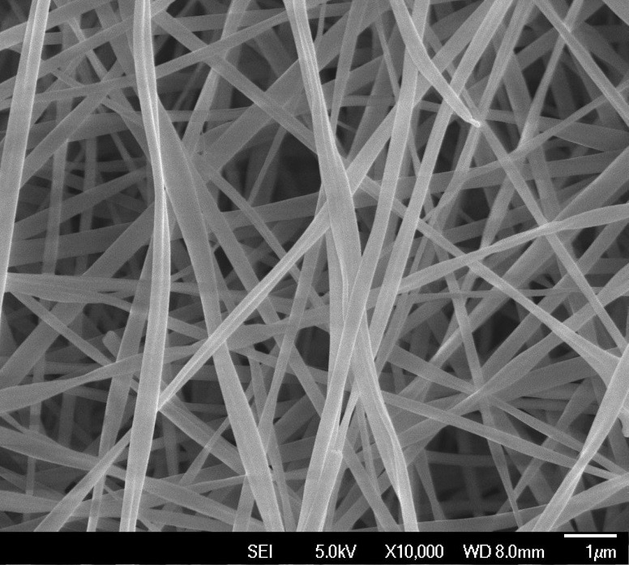
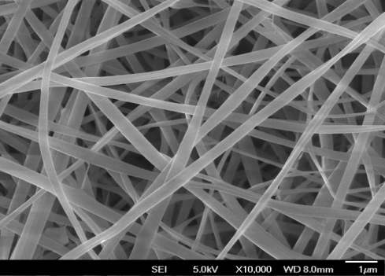
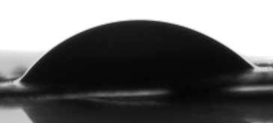

Morphology & Surface Wettability
a
b
a1
b1
a, a1 – Zein nanofiber
b, b1 – BMP-2 peptide conjugate TiO₂ NPs incorporated ZeinPDA nanofibrous Scaffold
Scale bar - 1μm

Slide 13
HR-TEM & Fluorescence microscopic images
a – Only Zein nanofibers (Scale - 0.5 μm)
b – BMP-2 peptide conjugated TiO₂ nanoparticles on ZeinP DA nanofiber (Scale - 50 nm)
c – FITC tagged BMP-2 peptide conjugated TiO₂ nanoparticles (Scale - 10 μm)

Slide 14
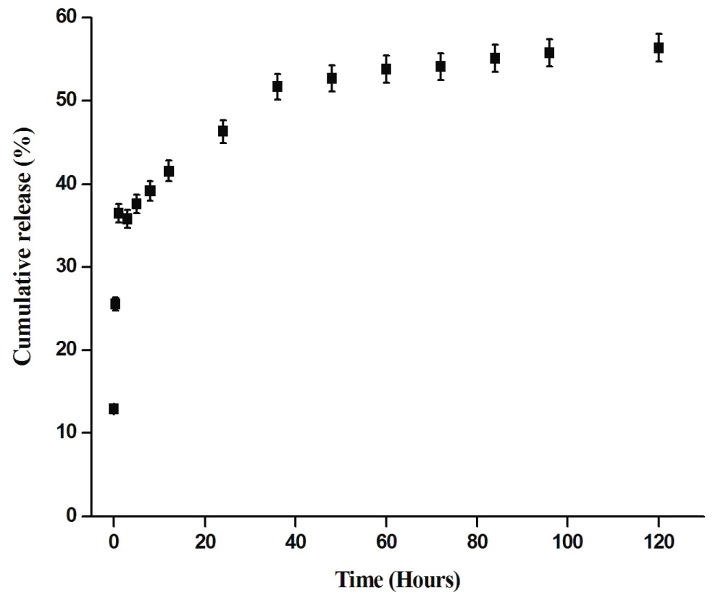
Release Profile

Slide 15
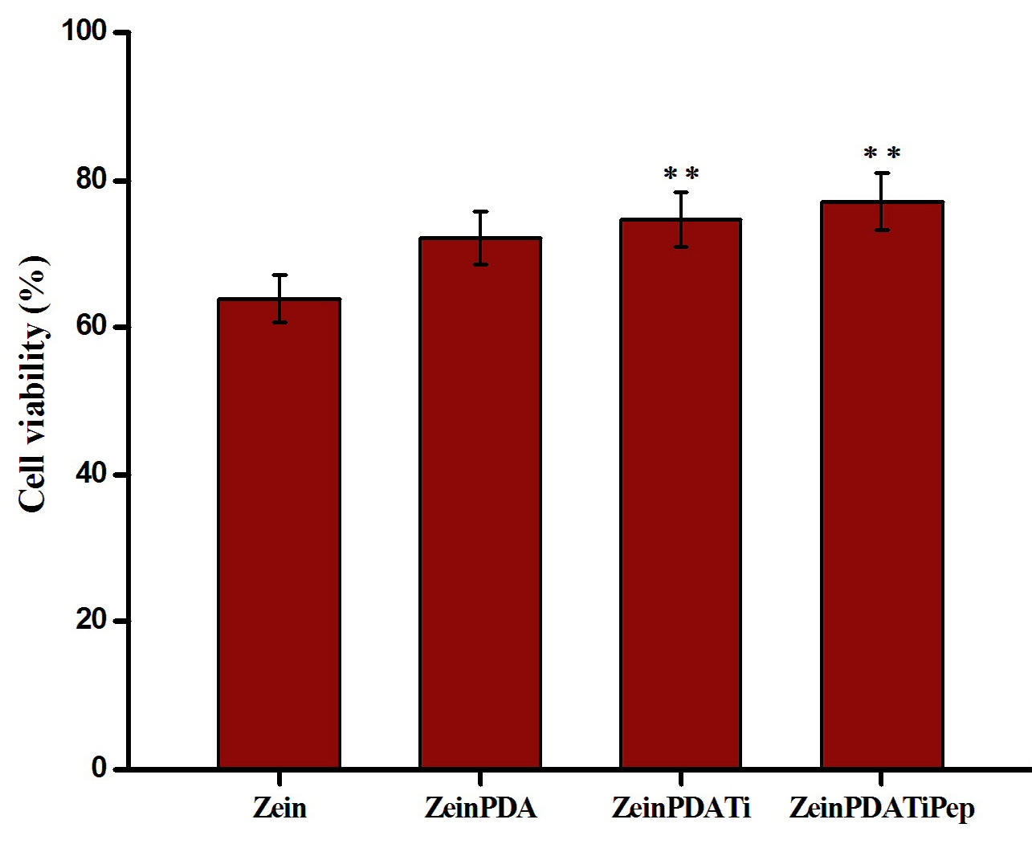
Cell Viability – MTT assay
** p value < 0.022

Slide 16
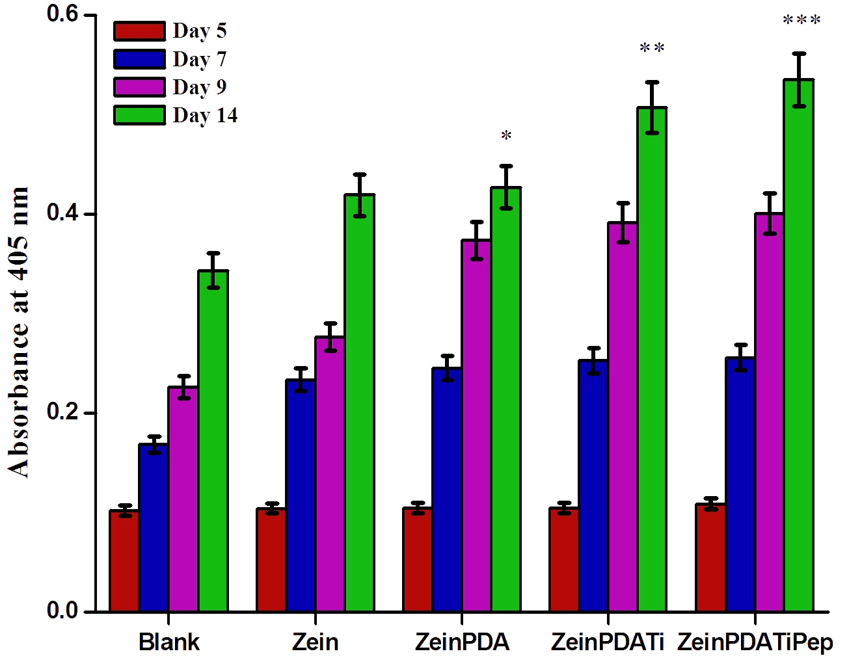
Alkaline phosphatase activity
*
*
*
* p value less than 0.05

Slide 17
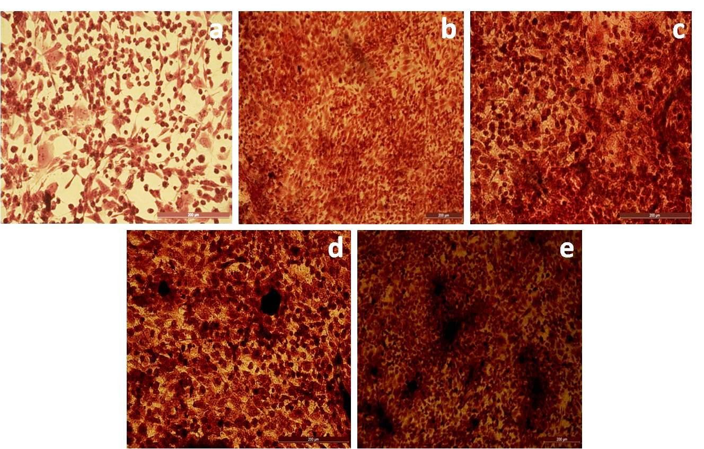
Mineralization content assay – ARS
a – TCP, b – Zein NF, c – ZeinPDA NF, d – ZeinPDATi NF, e – ZeinPDATiBMP-2 NF

Slide 18
Cell – Biomaterial Interaction
Control
Zein NF
ZeinPDA NF
ZeinPDATi NF
ZeinPATiBMP-2 NF
Scale bar - 1μm

Slide 19
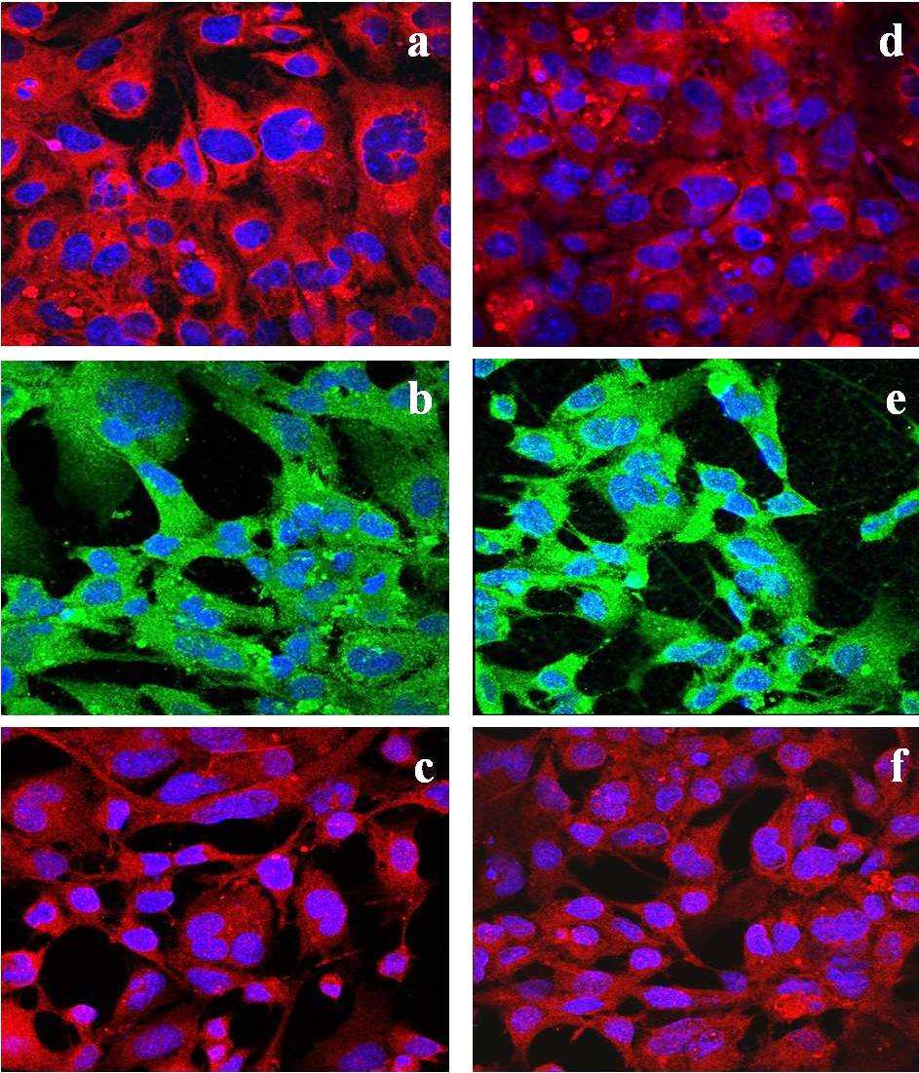
Immunofluorescent staining of Osteogenic markers
a,d – Osteocalcin; b,e – BMP-2; c,f - Osteopontin

Slide 20
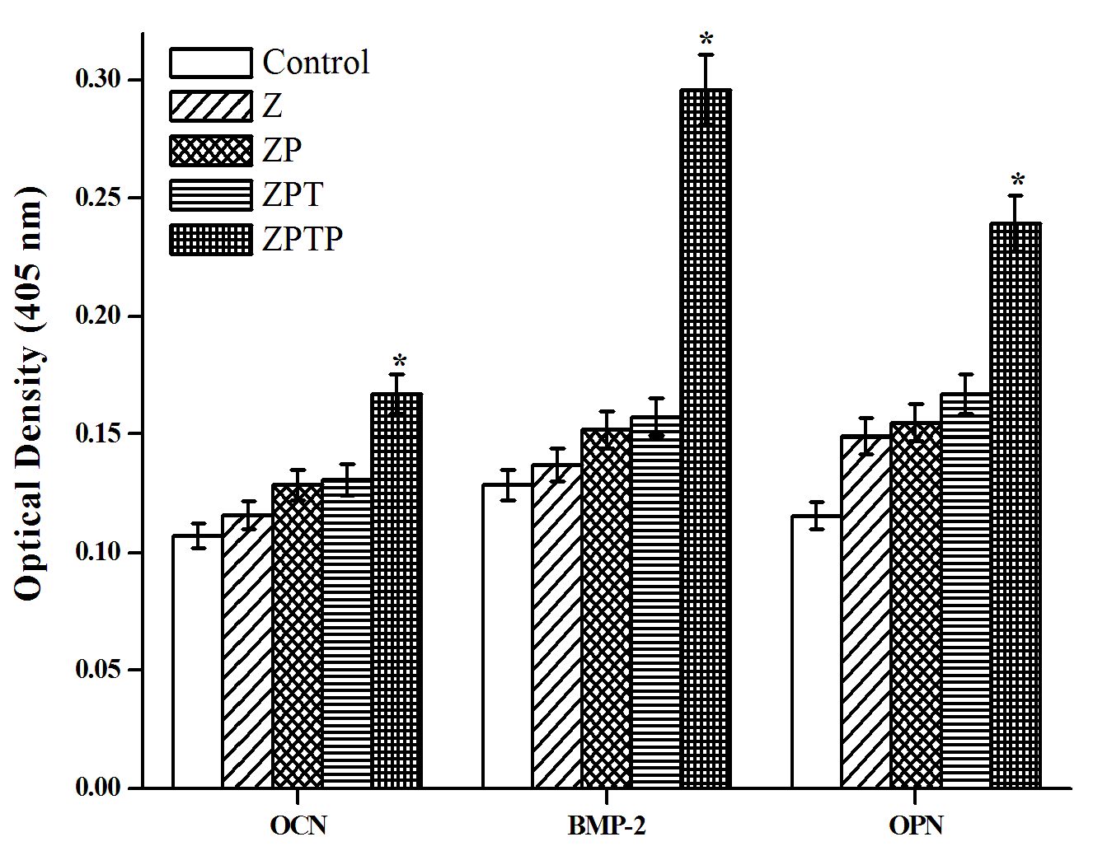
Protein Expression Analysis - ELISA
* P value less than 0.05

Slide 21
Conclusion
Better biocompatibility, Increased mineralization content and enhanced expression of osteogenic markers
Act as an effective matrix for bone tissue engineering

Slide 22
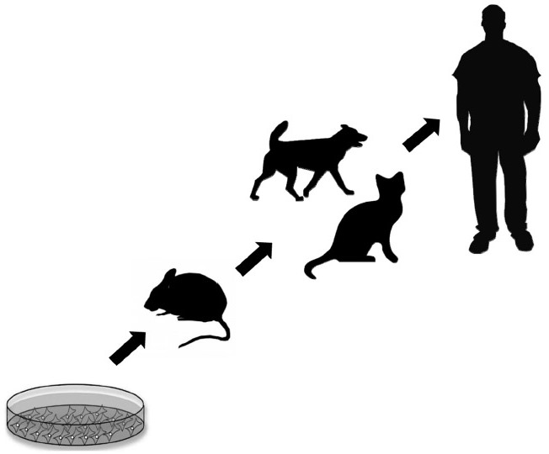
Future perspectives
Evaluate the performance of nanofibrous scaffold in-vivo
Ethical committee approval

Slide 23
Thank you

