Slide 1
Development of a Batch Fabrication Process for Chemical Nanosensors: Recent Advancements at NASA Glenn Research Center
Dr. Azlin M. Biaggi-Labiosa
NASA Glenn Research Center
Email: azlin.m.biaggi-labiosa@nasa.gov
http://www.grc.nasa.gov/WWW/sensors/

Slide 2
OUTLINE
Background
Previous Work
Experimental
Results and Discussion
Summary
Acknowledgements

Slide 3
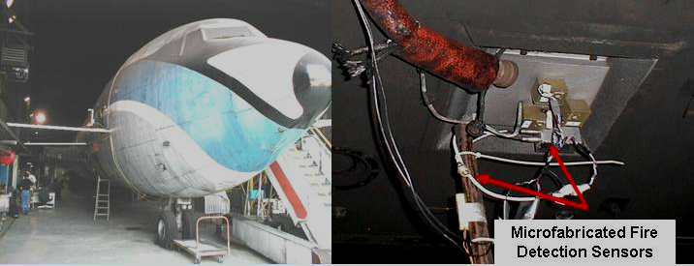
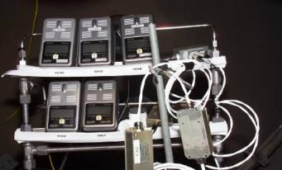
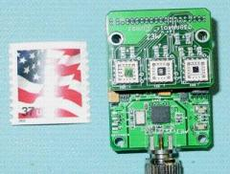
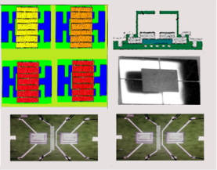
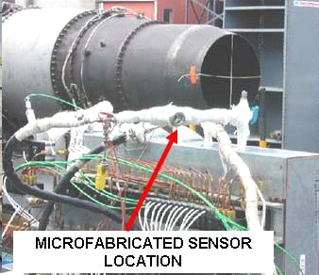
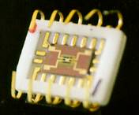
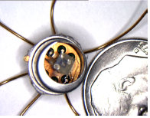

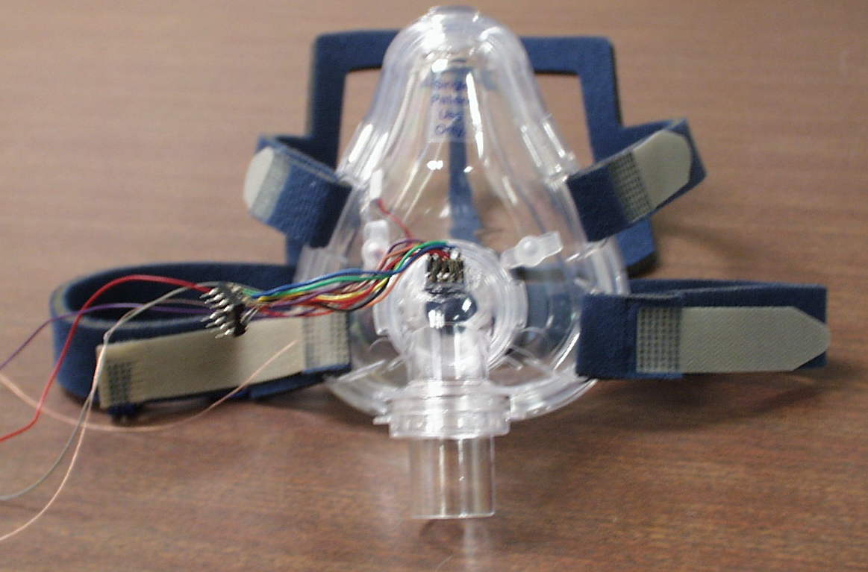
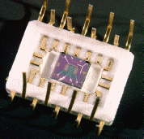
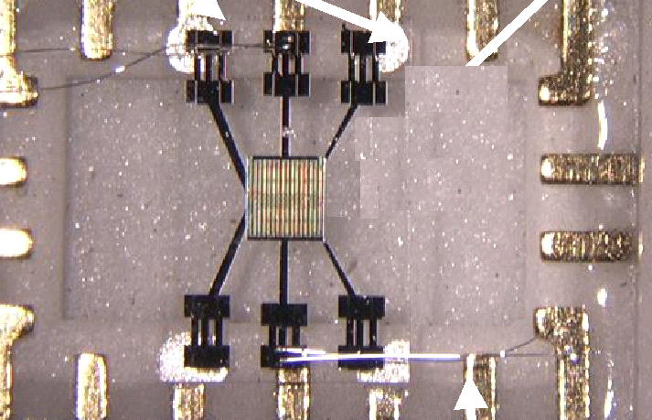



Integration of Micro Sensor Combinations into Small, Rugged Sensor Suites
Example Applications: AEROSPACE VEHICLE FIRE, FUEL LEAKS, EMISSIONS, ENVIRONMENTAL MONITORING, CREW HEALTH, SECURITY
  Multi Species Fire Sensors for Aircraft Cargo Bays and Space Applications
  Environmental monitoring
  (ISS Whitesand Testing)
  “Lick and Stick” Space Launch Vehicle Leak Sensors with Power and Telemetry
  Aircraft Propulsion Exhaust High Temperature Electronic Nose
Oxygen Sensor
SiC Hydrocarbon
Sensor
  Sensor Equipped
  Prototype Medical Pulmonary Monitor
Nanocrystalline Tin Oxide NOx and CO Sensor
  Hydrazine EVA Sensors (ppb Level Detection)
H2 Sensor

Slide 4
BACKGROUND
Fabrication of operational sensors from nanostructures is less mature than MEMS sensors.
No matter how good the sensor, if you cannot make contact with the sensor, then the device will be ineffective.
Micro-nano integration/contacts
  Major question for nanostructured based sensors: how are the nanostructured materials integrated into a micro/macro structure
    Cost effectiveness, time-efficient, controlled electrical contact
Typical standard method of deposition of nanostructures onto a sensor platform
  Disperse in suspension and deposit on a substrate
    Simple but difficult to reproduce
    Inability to mass produce sensors in a controllable way.

Slide 5
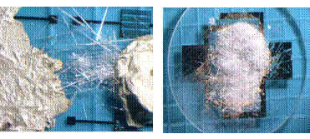
BACKGROUND
Manual methods generally involve repeatability issues e.g.
  Density of the nanorod or nanowire materials
  Quality of the contact
  Limited alignment
  Device contacts are random and uncontrolled, rather than reproducible and uniform.
a)
b)
nanorods contacted with the substrate via a silver epoxy
nanorods precipitated onto substrate between two electrodes

Slide 6
BACKGROUND
Attempts to control orientation and alignment of nanostructures on microdevices:
  AFM or laser tweezers
    Labor-intensive
    Not viable for mass production
  e-beam lithography
    High-end processing
    Limited to nanodimensional linewidths (standard microfabrication techniques require larger linewidth resolutions)
  Langmuir-Blodgett method
    Slow compression of dispersed nanostructures in organic solution on substrate until desired structure is achieved.
    Range of materials is limited
  Superlattice nanowire pattern transfer (SNAP)
    Range of materials is limited.
Notes:
Langmuir-Blodgett method - The nanoparticles are dispersed in organic solvents such as toluene, and this solution is spread dropwise onto the subphase surface. The nanoparticles form a monolayer on the water-air interface, which is slowly compressed. Depending on the particle size, the length of the capping ligand, and the surface pressure, various microscopic structure of islands, wires, and rings composed of the nanoparticles can be formed. As the monolayer is compressed, they start to form a condensed phase, usually a hexagonally close-packed structure due to the isotropic interparticle interactions. At this stage, the interparticle separation distance decreases with increased compression. This raises the possibility of obtaining a range of controllable properties that can be finely tuned without extreme conditions such as high temperature and pressure.

Slide 7
PREVIOUS WORK
Integration of standard microfabrication techniques with the alignment of nanostructures
Deposit opposing sawtooth patterns on a substrate using standard photolithographic techniques.
2) Coat the electrodes with a photoresist mixture containing nanostructures.
3-4) Use the sawtooth electrodes and dielectrophoresis to align the nanostructures.
5) Expose the electrodes while the nanostructures are held in place with photoresist.
6) Deposit the top metallic layer over the bottom sawtooth electrode pattern leaving nanostructures buried in the electrodes and complete photoresist removal. The dotted line is an alternate pattern for the top metallic layer that broadly covers the bottom electrodes in a rectangle, rather than the sawtooth electrode pattern.
Fabrication steps of the alignment and deposition process. a) Top view and b) side view.
G.W. Hunter, et.al. Nanostructured Material Sensor Processing Using Microfabrication Techniques, Sensor Review 32/2 (2012) 106-117. *Patent

Slide 8
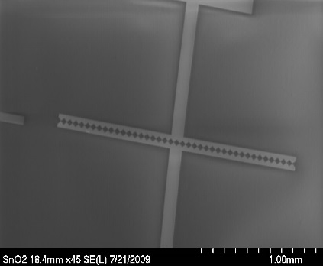
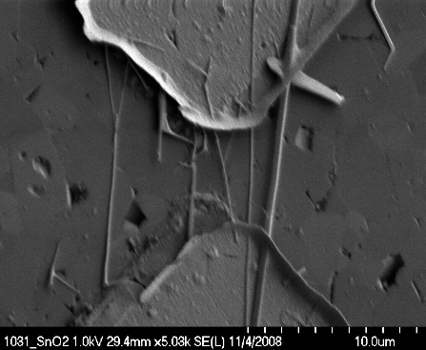
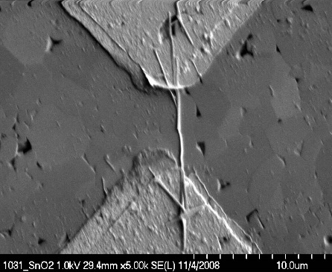
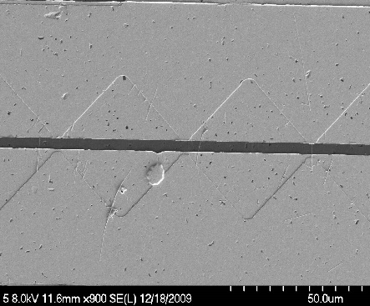
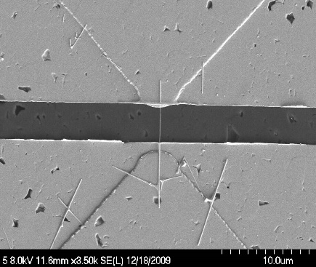
PREVIOUS WORK
Advantages of this approach
  Through control of photoresist density and nanostructure concentration/dispersion, different densities of nanostructures can be obtained
  Length of nanostructures are affected by AC frequency used for alignment
  Improved electrical contacts
    Nanostructures are buried in a metallic contact “sandwich”
  Incorporation of nanomaterials into standard photolithographic processing procedures
Pt contact pads
Pt sawtooth electrodes
1.0 mm
Alumina substrate (4 mm x 5 mm)
G.W. Hunter, et.al. Nanostructured Material Sensor Processing Using Microfabrication Techniques, Sensor Review 32/2 (2012) 106-117. *Patent

Slide 9
PREVIOUS WORK
Motivation:
  Build a SnO₂-based sensor for H₂ and hydrocarbons that can operate at room temperature as well as high temperatures.
  SnO₂ is an n-type wide band gap (~3.6 eV) semiconductor.
  Sensors usually operate above 200°C due to their reaction mechanism.
Schematic representation of the reactions occurring at the surface of an n-type semiconductor metal oxide
Adsorption of oxygen at the surface creates surface-acceptor sites that immobilize conduction band electrons from the near surface region, creating a depletion layer.
Reducing gases, such as CO, remove surface bound oxygen atoms, releasing the immobilized electrons, reducing the thickness of the depletion layer.

Slide 10
PREVIOUS WORK
Three mechanisms of conductance in metal-oxide gas sensitive materials:
The shaded part shows the core region and the unshaded part shows the depletion layer and GB = grain boundary.
a) D >> 2L, the conductance, which is higher in the non-depleted core region, is controlled by grain boundaries.
b) D ≈ 2L, where necks between coalesced primary grains control the conductance.
c) D < 2L, when the grains are small enough to be fully depleted the conductance is grain controlled [4]
When the SnO₂ crystallite size is comparable with or less than 2L (~ 6 nm), where L is the depth of the space-charge layer, the sensitivity can be greatly increased.
A. Rothschild and Y. Komen. The effect of grain size on the sensitivity of nanocrystalline metal-oxide gas sensors, J. App. Phys. 95, 6374 (2004).

Slide 11
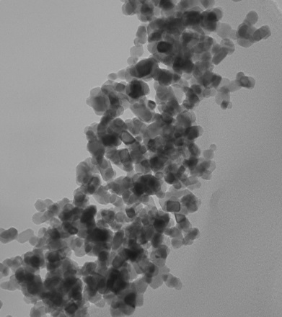
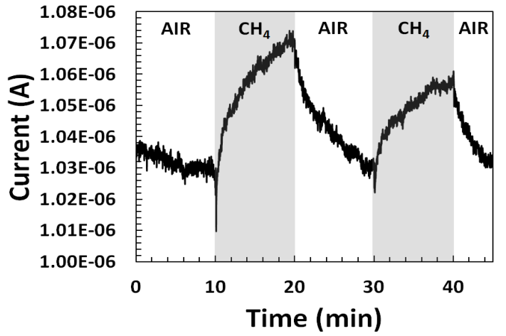
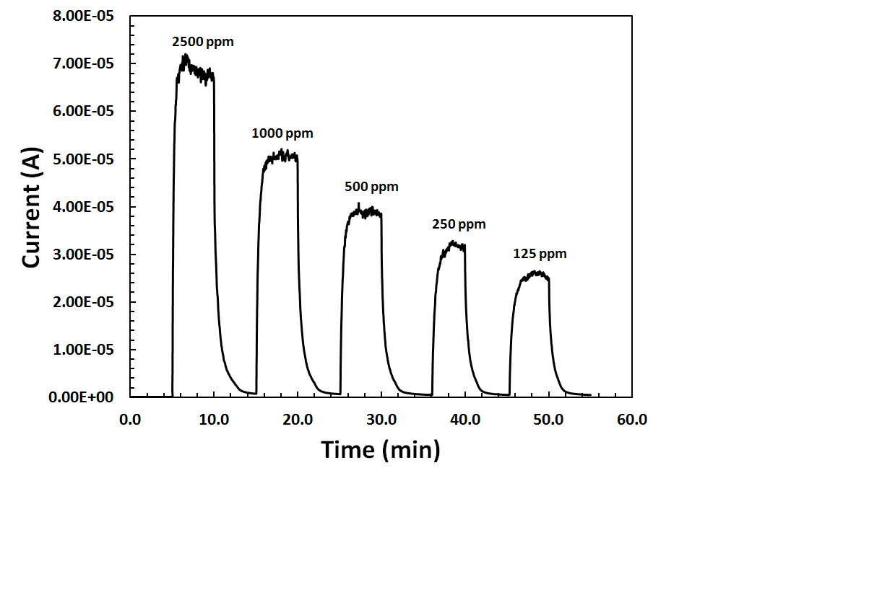
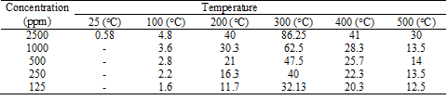
PREVIOUS WORK
Dielectrophoretic alignment approach extended for use with other nanomaterials.
  Porous SnO₂ nanorods via templated approach
    Room temperature methane detection
    High temperature methane detection (up to 500°C)
T = 300°C
100 nm
A. Biaggi-Labiosa, et.al. A Novel Methane Sensor Based on Porous SnO2 Nanorods: Room Temperature to High Temperature Detection, Nanotechnology 23 (2012) 455501. *Patent pending

Slide 12
EXPERIMENTAL
Goal: Mass production of sensors with uniformly controlled properties.
  Broader applications
Commercial MWCNTs (NanoLab) were used for the proof-of-concept.
  Diameter 15±5 nm
  Length 5-20 µm
  S1805 photoresist solution concentration 2 mg/mL
Array of paired patterned Pt electrodes on a 2” alumina wafer.
  Electrical connection in such a way that a field applied to one set of electrodes is simultaneously applied to the full array on the wafer.
  Distance between opposing sawtooth electrodes ~1-2 µm
  20 MHz, 10 V_{p-p}, 0 V_{offset} for 20 min

Slide 13
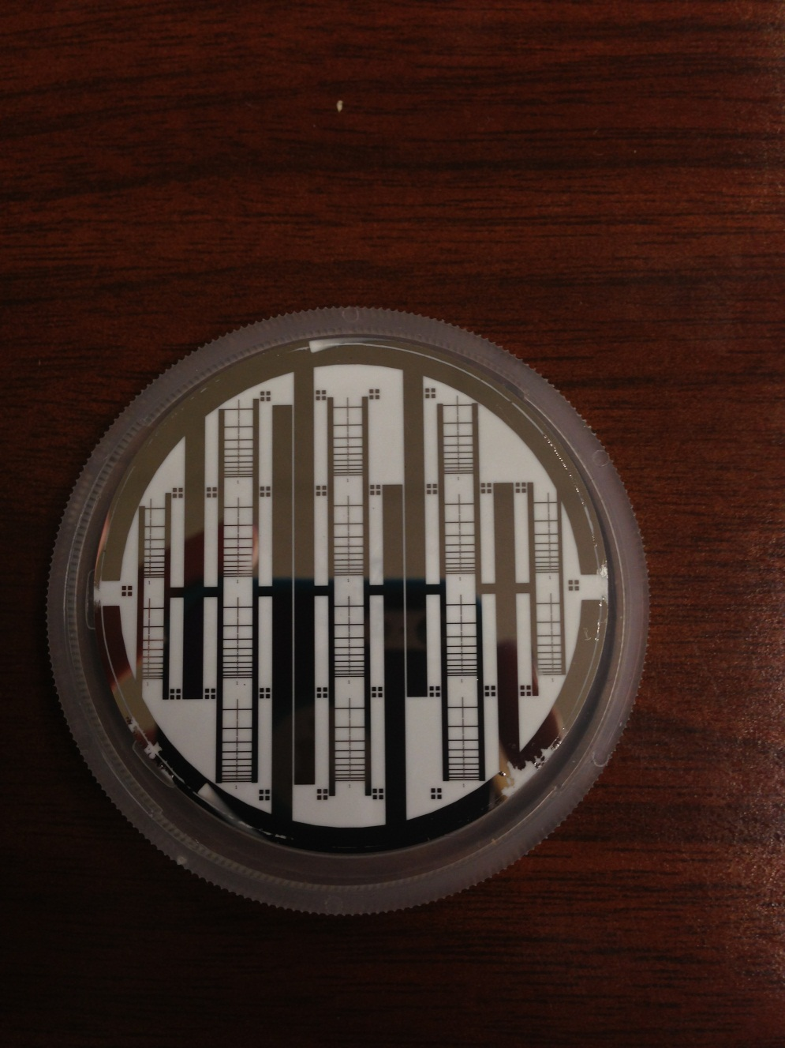
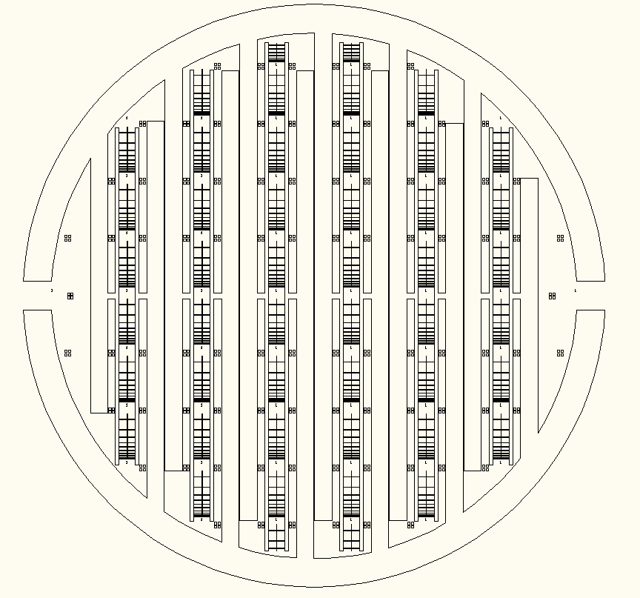
RESULTS AND DISCUSSION
Design
  There are 16 patterns, each with 146 opposing sawtooth electrodes for a total of 2336 electrodes.
  Can be separated into individual sensors.
Probe contact
40
30
20
14
12
10
8
6
4
2
Probe contact

Slide 14
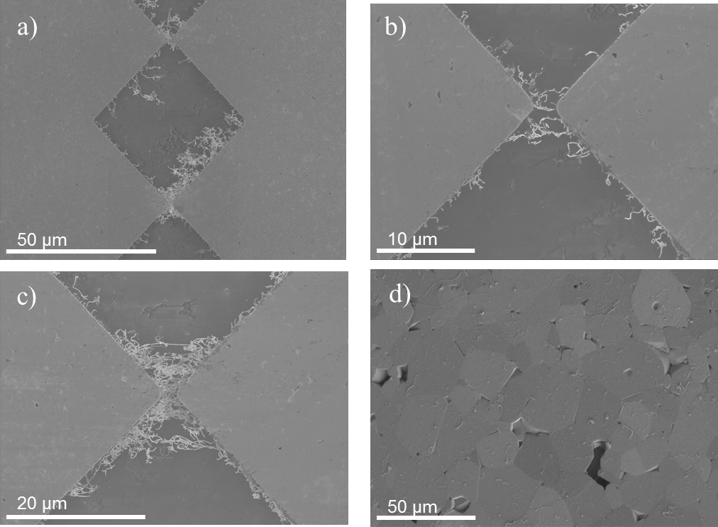
RESULTS AND DISCUSSION
Proof-of-concept
  SEM images of aligned MWCNTs on the whole wafer
Lower magnification to show alignment on more than one sawtooth electrode.
Alignment of a few nanotubes between opposing electrodes.
Alignment of more nanotubes between opposing electrodes.
Image of alumina substrate showing that there are no nanotubes (or a little amount) demonstrating that the nanotubes are found between opposing electrodes.
Managed to obtain alignment on 2313 of the 2336 electrodes for a 99% yield.

Slide 15
SUMMARY
Standardized approach to chemical sensors processing using nanostructures.
  Integration and alignment of nanostructures with microfabrication methods.
Mass production of sensors with uniformly controlled properties.
Approach addresses significant barriers in integrating nanotechnology with microsensors, such as
  Deposition control
  Contact robustness
  Simplified processing

Slide 16
SUMMARY
Resulting sensors can be used in applications where presently microsensors are used.
Further refinement of the DEP and photoresist suspension are planned to increase and to better control the yield for each paired contact pattern.
Current work in applying mass production approach with metal oxide nanostructures.

Slide 17
ACKNOWLEDGEMNTS
Dr. Gary Hunter, Laura Evans, Gordon Berger and Dr. Jennifer Xu
Technical Support:
  José M. González
  Michelle Mrdenovich
  Christopher Hampton
Dr. Lawrence G. Matus and Dr. Mary V. Zeller for helpful discussions.
Research supported by the Vehicle Systems Safety Technologies (VSST) Project.

Slide 18

QUESTIONS

