Slide 1

Towards Effective Public Participation in Water Resources Management: Issues and Approaches in Turkey
PROF. DR. AYSEGUL TANIK
Istanbul Technical University, Dpt. of Environmental Engineering, Maslak-Istanbul
3rd International Conference on Biodiversity & Sustainable Energy Development
June 24-26, 2014
Valencia Conference Centre, Spain

Slide 2
SUSTAINABLE WATER USE
Rapid Population Increase
Urbanization
Increase in Water Demand
Water Pollution
Drought/Flooding
Desertification
Deforestation
Pollution Sources (point, diffuse, natural, etc.)
Degradation of Ecosystems
Climate Change
Encouraging the sustainable use of available water and land resources
Rehabilitation and prevention of further deterioration of water and water related ecosystems

Slide 3
HISTORY
Till 1980’s
After 1980’s
Focusing on water supply
Quantity of Water was the priority issue
Planning with limited scale for specific purposes
Producing single solutions to specific/unit problems
Integration
Finding solutions in large scale to numerous problems
International Principles
New Concepts
  Sustainability
  Participation of Stakeholders
  Integrated Understanding and Transition to management

Slide 4
Sustainability & Integration
Meeting the current targets and needs, without interrupting the demand and needs of future generations, in an integrated manner
Integration of Environmental Media (Air, Water, Soil, Surface Waters, Groundwater, Land-Use, Erosion, Wetlands, Coastal Zones, etc. and interaction among them)
Integration of environmental factors with social, economic, administrative and legal components (SUSTAINABILITY)
Integration of various disciplines
Integration of actors (COORDINATION)
Integration of Financial Sources
Integration of Management Tools (Decision- support Systems, data bases, models, GIS, expert systems)
Climate change and potential risks

Slide 5
European Union Water Framework Directive
“Integrated River Basin Management Approach” has been assimilated as a tool in the application of the Directive.
  WHAT IS EXPECTED?
    I. Determining the watershed regions
    II. Forming expert organizations
    III. Performing watershed plans

Slide 6
Integrated River Basin Management Approach
Determining the watershed regions
Combining one or more river basins
II. Forming Expert Organizations
At watershed basis (for each of the watershed region)
At National scale,
If exists at international basis for transboundary waters.
Method;
    By an already existing expert organization and through revising its duties,
    By means of a commission design that includes the related ministries,
    By defining a new structure that is independent from the existing organization and institutions,
III. Preparation of River Basin Management Plans (RBMP)

Slide 7
Fundamental Steps of RBMPs
Important pressures and impacts of human-induced activities;
Determining and mapping of Protection Areas;
Mapping of monitoring network;
Listing the environmental goals;
Economical Analyses;
Forming the Preventive Measures Program;
Preparing detailed plans that covers an abstract;
Informing public and summarizing the preventive measures;
Listing the authorities responsible from watershed management;
Determining the communication points and related communication procedures formed to gain information and evaluations from public.
Characterization of the River Basin;

Slide 8
Informing Public, Summary of Consultation Results
Forming the Participation Plan.
(All the state offices and organizations, private sector, chambers of various disciplines, chamber of industry, active NGOs at the watershed scale need to be encouraged for participation)
Preparing the criteria for consulting and public informing.
Reporting, Presenting and Discussion of the results.

Slide 9
What is the Public Participation?
Public participation is a planned effort to involve citizens in the decision-making process and to present and resolve citizen conflict through mutual two-way communications.
Planning of Public Participation Process
Identification of the objectives
Identification of the selected actors
Choice of the methods of the public participation
Preparation of the implementing plan

Slide 10
Pyramid of the members of the public participation process
Decision-making bodies
Agencies responsible for the implementation of the pp plan
Competent professionals on the examined topic
NGOs
Stakeholders, layers

Slide 11
Orbits of involvement
Unsurprised apathetics
Observers
Commenters
Technical reviewers
Active participants
Co-decisionmakers

Slide 12
Why public participation?
to comply with the Directive and to achieve environmental goals and other benefits
Key potential benefits:
    increasing public awareness of environmental issues
    making use of knowledge, experience and initiatives of the different stakeholders
    public acceptance, commitment and support with regard to decision taking processes;
    more transparent and more creative decision making;
    less litigation, misunderstandings, fewer delays and more effective implementation;
    social learning and experience–if participation results in constructive dialogue with all relevant parties involved then the various publics, government and experts can learn from each others “water awareness”.

Slide 13
Disadvantages of the Public Participation
Costs
include the potential for confusion of the issues many new perspectives may be introduced
it is possible to receive erroneous information
include uncertainty of the results of the process
Main Objectives of the Public Participation
Establish and maintain the legitimacy of the agency
Establish and maintain the legitimacy of the project
Establish and maintain the legitimacy of all major assumptions and earlier decisions
Get to know all the potentially affected interests
Identify problems
Generate solutions
Articulate and clarify the key issues
To develop informal acceptance of options

Slide 14
What is PP NOT about? (source: Public Participation Guidance)
everybody joining: be selective with actors, they should reflect the right interest
everybody deciding: make clear what the responsibilities are, and for whom
losing control: do organise it well, clear and strategically
consensus at all expenses: be prepared that the outcome of public participation will be compromise between the wishes of several actors and that extend of the process is often limited.

Slide 15
Models of national PP processes
General requirements to the models
  To allow active interaction between the proponent and participants
  Are expected to be used in any number of stages of a participatory process
  Need to be sufficiently flexible to accommodate a range of possibilities

Slide 16
4 models of Public Participation
Social Learning
Consent/ Consensus
Commentary
Joint Planning
Proponent-centred
Intermediary - centred
Participant - centred

Slide 17
Relationships in the Commentary model
Stakeholder
B
Stakeholder
C
Stakeholder
A
Stakeholder
D
Proponent

Slide 18
Relationships in the Social Learning Model
Individual
B
Individual
C
Individual
A
Individual
D
Intermediary
Proponent

Slide 19
The Joint Planning Model
Intermediary
Proponent
Stakeholder
A
Stakeholder
D
Stakeholder
B
Stakeholder
C

Slide 20
Relationships in the Consent / Consensus Model
Proponent
Stakeholder
A
Stakeholder
D
Mediator
Stakeholder
B
Stakeholder
C

Slide 21
PP Activities
Site visits/
surveys
Meetings
Volunteering monitoring groups
Cleaning/
rehabilitation days
Training programs
(schools, city groups, local org.)
Media/ internet
Public surveys
Various activities heading focal points

Slide 22

Activities for participation in EU Member State Countries
EU countries has started application of RBMPs
Information on the status of applications covering years 2009-2015 are given on the website of European Commission.

Slide 23
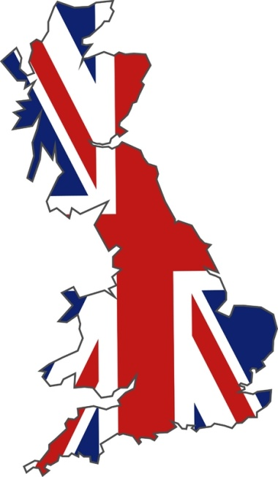

UK & Wales
Public Participation is realized through
  media,
  internet,
  printed materials
  invitations sent to various related groups.
  Workshops and panels are organized at the basins with various related groups.
  Face-to-face contact is preferred; however, messages are also sent via internet.

Slide 24

UK & Wales
Stakeholders are,
  water companies,
  farmers,
  Harbour corporations,
  fishermen,
  Industries,
  protection associations,
  Local and local planning authorities,
  NGOs,
  Consumer groups and general public.

Slide 25
UK & Wales
Recently, some plan changes have occurred as a result of public consultation in some basins.
At the web page of Scotland, a summary file is present that covers the anxieties of public. During the consultation period, researches on these concerns increased.
Various amendments will take place in the plans as a result of new measurements and by the addition of new information.
Scotland has also initiated some consultancy groups under Water Environment Services for better RBMPs.

Slide 26

Denmark
An agreement is signed at April 2010 at the Parliament named as “Green Growth" after the development of RBMPs.
www.vandognatur.dk, a special website for informing public on water plans is formed.
Consultation with public on the draft plans are separated into two steps;
  Initially; municipalities, regions and public offices are being consulted on the plans.
  Afterwards, public consultation started.

Slide 27

Denmark
Written notices were delivered by
  individuals,
  commercial sites,
  environmental organizations,
  agricultural consultancy centres, and
  public enterprices.
The initial meetings are realized by the municipalities, regions and public offices.
Through the public consultation, more than 4200 feedback is received from public for the water and nature plans.
During the additional period, 1700 additional survey results were achieved.

Slide 28
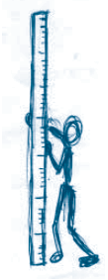
Denmark
In the final plans, one can easily recognize the effects of public participation, the related comments and corresponding amendments realized are observed.
The participations are summarized in the web site of Nature Agency (www.naturstyrelsen.dk).
Importance of public participation is clearly defined; as the amendments done on the plans (RBMPs) relied on realistic measurements.
Consultations were mainly focusing on,
  discharges,
  conditions of water masses,
  recommended activities

Slide 29

Denmark
All the feedback received from public are considered and reflected in the plans.
No information is present on whether such consultation periods will continue or not in the future; however, a water and nature association is formed consisting of members from
  Municipalities,
  Nature protection agencies,
  NGOs,
  Regional authorities.

Slide 30
STATUS OF TURKEY
ISSUES & APPROACHES IN RBMPs

Slide 31
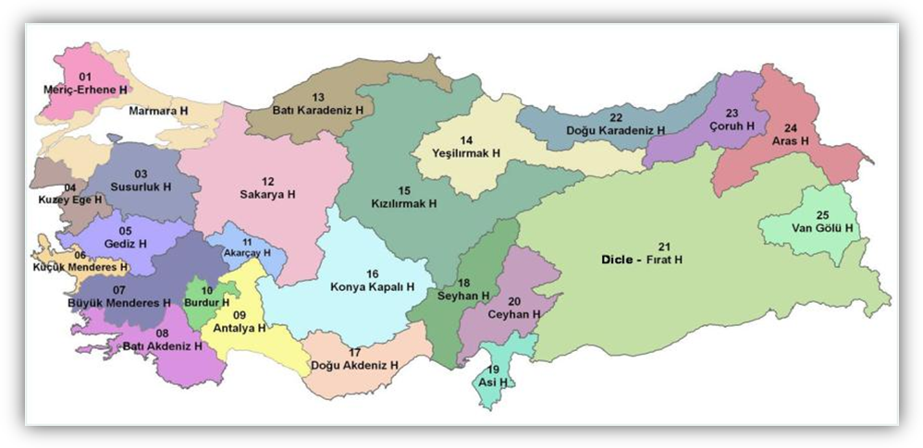
25 River Basins of Turkey

Slide 32
Main Challenges of Water Sector in Turkey
1- WATER QUANTITY PROBLEMS
2- WATER QUALITY PROBLEMS
3- IRRIGATION MANAGEMENT
4- AGRICULTURAL PRACTICES
5-LACK OF RELATIONSHIP BETWEEN WATER RESOURCES MANAGEMENT AND LAND USE PLANNING
6- DEFICIENCES OF MONITORING SYSTEM AND INCOMPLETE DATA
7- LEGAL ISSUES
8- ORGANIZATIONAL STRUCTURE
9- CHALLENGE OF TRANSPOSING AND IMPLEMENTING ALL ELEMENTS OF THE EU WFD

Slide 33
Main Challenges of Water Sector in Turkey
Water issues that Turkey faces today are largely derived due to lack of good and efficient governance.
Organizational structure for water resources management is highly centralized.
Stakeholder participation in decision-making process is at a low level.
The lack of a comprehensive water law,
fragmentation of the institutional framework,
complexity of coordination mechanisms are the other major challenges in the Turkish water sector.

Slide 34
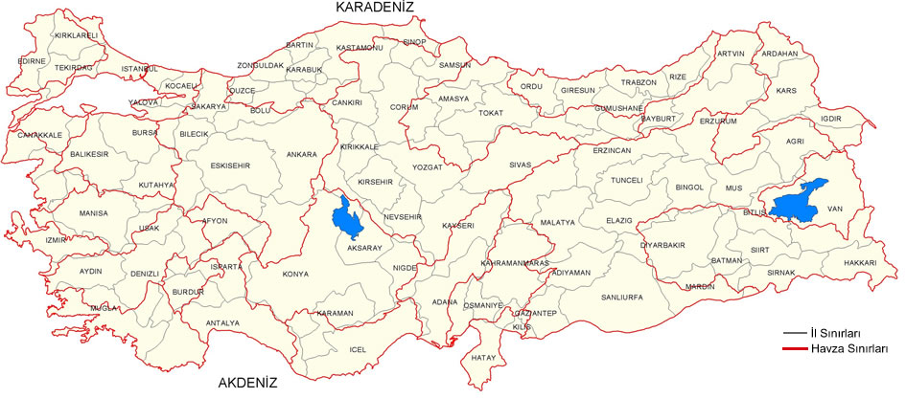
Administrative boundaries matched with watershed boundaries

Slide 35
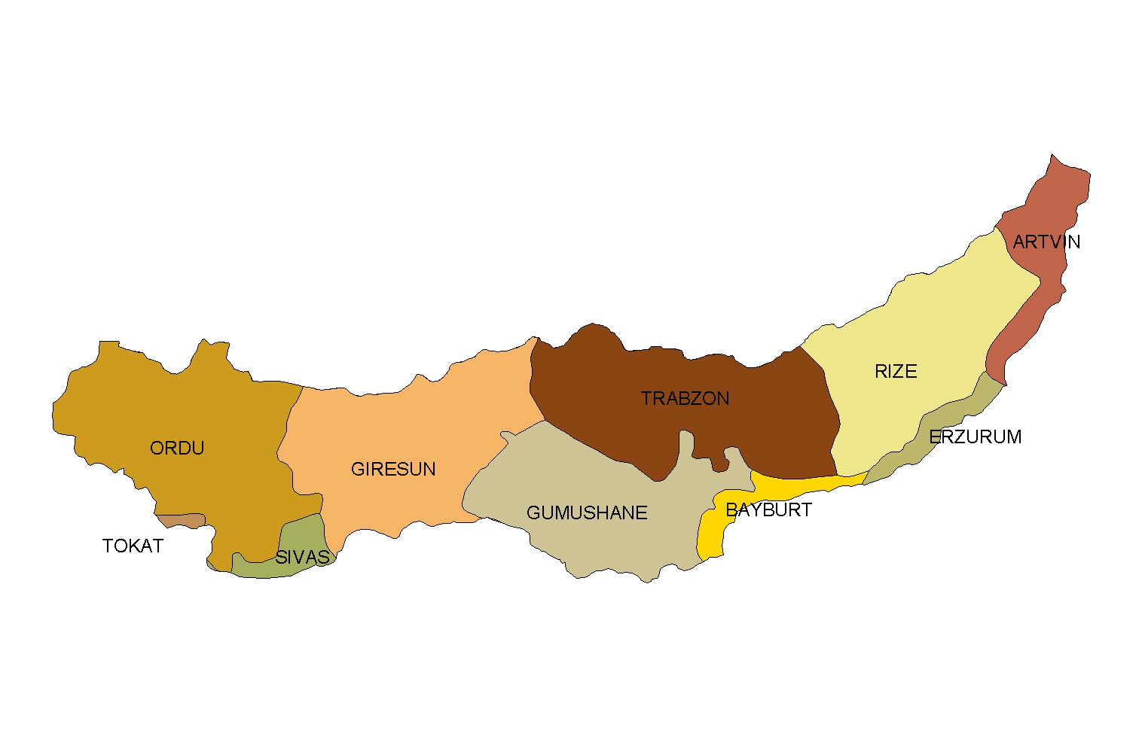
Eastern Black Sea Watershed

Slide 36
Determination of the Actors and the Management Purposes
Identification of Watershed system
Forming databases
Watershed Information System
Improvement of monitoring network
Data reliability
Data analyses
Online data transfer
Watershed Modeling
Scenarios
Evaluation of decisions taken and their impact
Decision Models
Decision Support System
Determination of Management Decisions
Application and Monitoring
Querrying actors, purposes of management and the proposed Management Plan

Slide 37
Improvement of Monitoring Network
GENERAL DIRECTORATE OF STATE WATER WORKS
1310 stations conduct seasonal analyses (4 times a year; 59% for drinking purposes and 41% for general use)
Additionally heavy metal (6 times) and biological analyses in drinking water
35 parameters are analyzed in groundwater's (2 times a year)
Former General Directorate of Electrical Power Resources Survey and Development Administration
General Directorate of Renewable Energy
140 STATIONS, 20 parameters
UNIVERSITIES
TÜBİTAK
Sampling stations are lacking
Measurement frequencies are different.
Measurement terms are different.
Stations are at various locations.
Data obtained are stored in different organizations.
NATIONAL WATER DATABASE (under preparation)

Slide 38
Public Institutions related with Water Management
Ministry of Forestry and Water Affairs
General Directorate of Water Management | General Directorate of State Water Works (DSİ ) General Directorate of Meteorological Works (DMİ) General Dir. of Forestation and Erosion Control
Ministry of Environment and Urbanization
General Dir. of Environmental Management |  | General Dir. of EIA and Planning Bank of Provinces
Ministry of Energy and Natural Resources
General Directorate of Renewable Energy Resources
Ministry of Food, Agriculture and Livestock
Ministry of Health
Ministry of Interior Works
Ministry of Culture and Tourism
Ministry of Development
Water and Sewage Administrations in Greater Municipalities
Special Provincial Administration Fund
Various bureaucratic institutions are responsible from the management of watersheds
Facing serious problems during the management and planning of resources as each organization bear self specific approaches

Slide 39
Improvement coordination and co-operation process among the institutions responsible for water resources, environmental management, agriculture, etc.
Identification of River Basin Authorities and Capacity Building
Including STAKEHOLDERS in the water management
Public Participation and Awareness
ENACTING THE NATIONAL WATER FRAMEWORK ACT

Slide 40
TRANSPOSITION OF THE EU WFD IN NATIONAL LEGISLATION
ENACTING THE NATIONAL WATER FRAMEWORK ACT
TRANSBOUNDARY WATERS
Turkey will be obliged to ratify Aarhus, Espoo and Helsinki Conventions that the EU is a party.

Slide 41
Recent Improvements
At 09.04.2012 National Basin Management Strategy (Draft) is pre-published to take the opinions of the related groups. It acts as an initial guide on how the public participation be managed in the water and basin –related affairs. All the stakeholders are referred in the document.
The regulation on “Protection of Basins and Preparation of their Management Plans” is put into force on17.10.2012 .
Item 5 of this regulation emphasises on “Participatory Management Approach “.
Item 6 mentions that during the preparation of the RBMPs active participation of all related institutions will be maintained and comments will be taken from all the related parties.
It also bears some points for the encouragement of effective public participation during the preparation, reviewing and updating stages of RBMPs. Moreover, it underlines the importance of informing public .

Slide 42
Recent Improvements
The statement on “Establishing Basin Management Commission, its duties, working methodology and principles” is put into force on 18.06.2013.
This statement defines the duties and responsibilities of Basin Steering Committee as well lists the members of Basin Management Commissions (representatives of the provincial directorates of the related ministries, local authorities, local universities, NGOs, chambers of industry and commerce, farmers, etc.).
Information is provided by this statement on the meetings to be realized and the outline of these meetings, working methodology and applications.
Thus; the publication of these legislative notices act as initial movements towards the realization of public in the preparation of RBMPs.

Slide 43
Recent Improvements
Coordinator provinces of the 25 basins are stated. The governorship of the coordinator provinces will be the head of the Basin Management Commissions.
These commissions will take common decisions by majority votes.
It is observed that all the recent developments take into consideration of ‘holistic management approach’, public participation from all the water and basin related groups.
During the harmonization stage with EU, these recent legislative improvements need to be realized to comply with EU Water Framework Directive.
Participation of NGOs are of utmost important at this stage.
In the recent years, they have taken a step further by realizing programs and applications on the rehabilitation of spoilt areas, deforestation, soil protection and protection of biological diversity.

Slide 44
THANKS FOR YOUR ATTENTION…

