Slide 1


Influence of Grey water on Properties of Mortar and Concrete Mixes
Dr. Ayoup M. Ghrair¹,
Dr. Othman Al-Mashaqbeh¹, Dr. Mohamd Sarairah², Eng. Nidal Alkoz¹, Eng. Muath Kronz³
¹ Royal Scientific Society, Knowledge, Scientific Research Center, Amman, Jordan;
²Tafila Technical University, ³Kingdom Concrete Company
“2nd World Congress and Expo on Recycling“, SHERATON BERLIN GRAND HOTEL ESPLANADE, Luetzowufer 15, Berlin, Germany
July 25-27, 2016

Slide 2
Table of Content
General Introduction
- Water situation in Jordan
- Research problem
- Project objectives
Development and installation of a Grey Water filtration-system Using Jordanian Natural Resources
Materials and Methodology
Results
Conclusion

Slide 3
Introduction and Background:
Water situation
Jordan is located in an arid to semi arid area (50 mm to 600 mm), Approximately 92.2% of the rainfall evaporates and considered as one of the top water scarce countries in the world. Therefore, water reuse is a high priority.
Recently, the problem of water shortage in Jordan has been become worse as a result of high natural population growth, influxes of refugees, rural to urban migration and increased standards of living.

Slide 4
Research problem
Currently, Construction activities world-wide are expected to expand over the coming years and will consume more fresh water “annually one billion tons of mixing water”
In Jordan, around 4 Mm³/y of fresh water is needed to prepare ready mix concrete. In addition, another 4 Mm³/y for washing activities and wet curing.
According to JS it is a must to use fresh water for concrete production
The treated wastewater is estimated to be around 117 MCM/year in 2020 [1]. Between 50% and 80% of the domestic household wastewater is grey water.
Therefore, grey water treatment and reuse for concrete industry is a high priority and rational action. Such research type is important in order to change people attitude and the legislations.

Slide 5
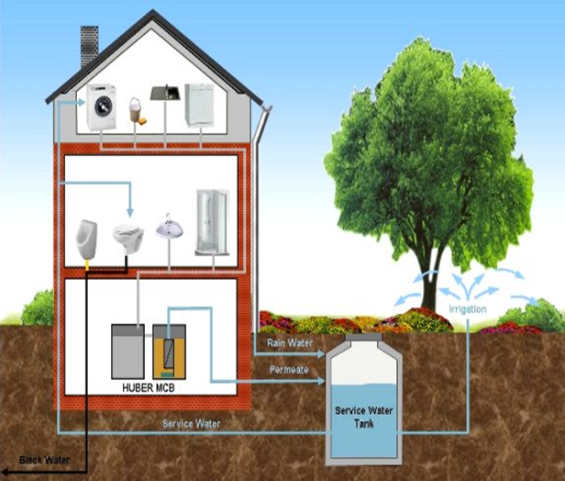
Grey water
Definition
is all types of wastewater collected from household activities except toilet wastewater
Project objectives
This study aimed to
Provide a new water resource to sustain the construction activities in Jordan.
evaluate the potential of reused grey water in concrete and mortar in order to save the fresh water for drinking purposes.

Slide 6
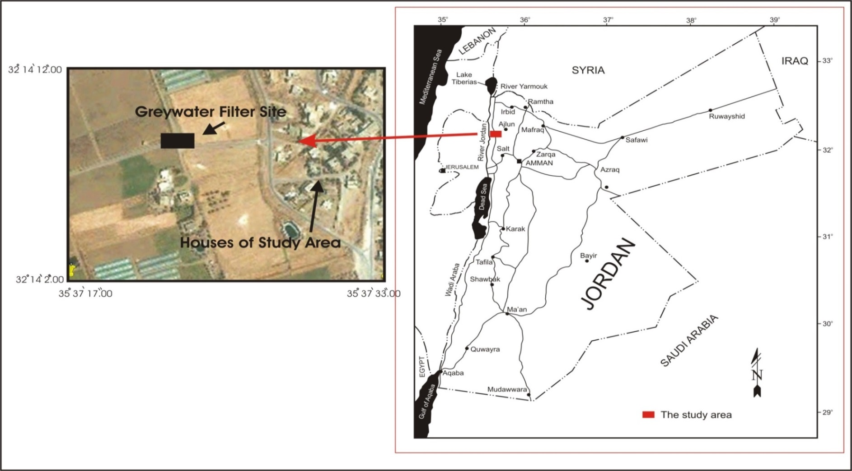
Development of a Grey Water filtration-system Using Jordanian Natural Resources
Study area \ Deir Alla (Um-Ayyaash area) which is located in the Middle Ghor,
(rainfall 100 to 150 mm) and (temperature varying from 19 to 36.5°C)

Slide 7

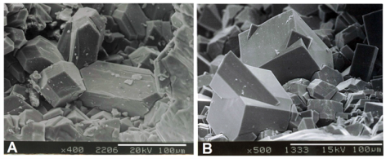
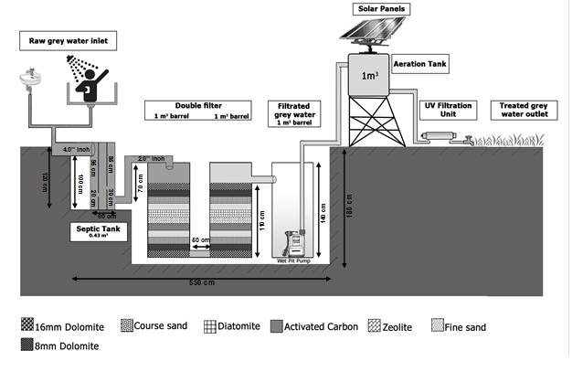
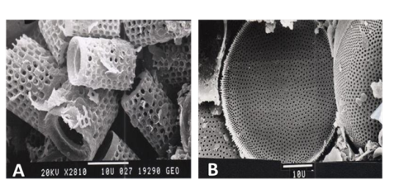
Installation of multi layer filter in Field
The pilot plant is running automatically
The system running cost is zero
There is no rejected water (Filtration efficiency is 100%)

Slide 8
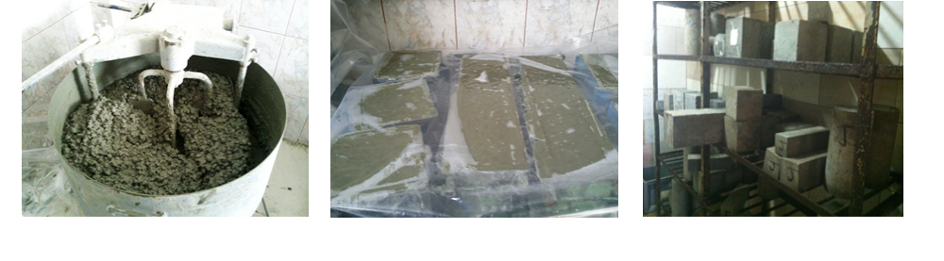
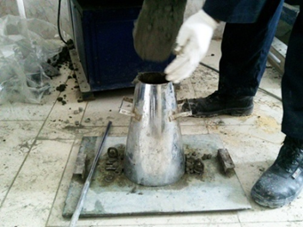
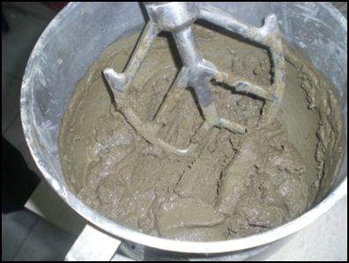
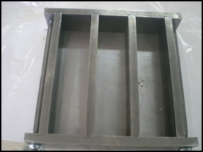
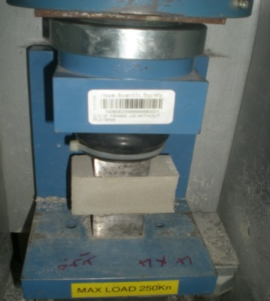
Materials and Methodology
Two types of Grey water samples were collected from the pilot plant (RGW and TGW) and analyzed .
- Coarse and fine aggregates and cement were collected and characterized
- Concrete and mortar mixes using RGW and TGW as well as Distilled Water (DW) were prepared and casted in cubic and prisms moulds .
- Fresh properties of mortar and concrete were tested directly.
Other properties were tested after various curing ages (7, 28, 120, and 200 days).
Mixing, Casting, and Curing, testing for Concrete

Slide 9
Mortar and Concrete Mix Design
Table (1). Proportions of mortar mixes.
Mix Designation | Fine Aggregate(g) | Cement (g) | Water (g)
RGW | 1350 | 550 | 280
TGW | 1350 | 550 | 280
DW | 1350 | 550 | 280
Table 2. Concrete Mix designation contents.
Mix Contents | Median Particle size (mm) | Quantity (kg/m3)
Coarse Aggregate (Hemseyeh) | 9.5 | 514.728 kg
Coarse Aggregate (Adaseyeh) | 4.7 | 370.3 Kg
Coarse Aggregate (Semsmeyeh) | 2.4 | 252.1 Kg
Fine Aggregate (Swealeh Sand) | 0.3 | 502.7 Kg
Cement |  | 418.18 kg
Water (RGW, TGW, or DW) |  | 233 kg

Slide 10
Results
Table 2 Grey water quality and the mixing water permissible limits for concrete
Parameter | Unit | RGW | TGW | *Maximum concentration
TSS | mg/L | 436 | 2 | 2000
TDS | mg/L | 980 | 803 | 2000
COD | mg/L | 900 | 6.97 | 500
BOD5 | mg/L | 536 | 2.98 | -
Cl | mg/L | 243 | 208 | 500
SO₄ | mg/L | 222 | 137 | 2000
NH₃ | mg/L | 24 | 4.5˃ | No specific limit
pH | - | 7.5 | 7.9 | 6-8
E-Coli | MPN/100ml | 1.70E+05 | ˂1 | **˂200
*Mixing water permissible limits according to ASTM C94 [30] or EN 1008 [34], [31], and [29]. **The maximum limits for an open system application of wastewater [15].
Although the initial raw grey water has high bacteria and organic content, the filtration system was capable to remove all of it

Slide 11
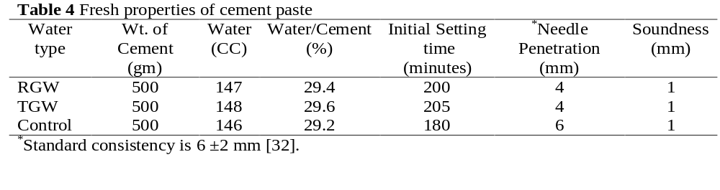
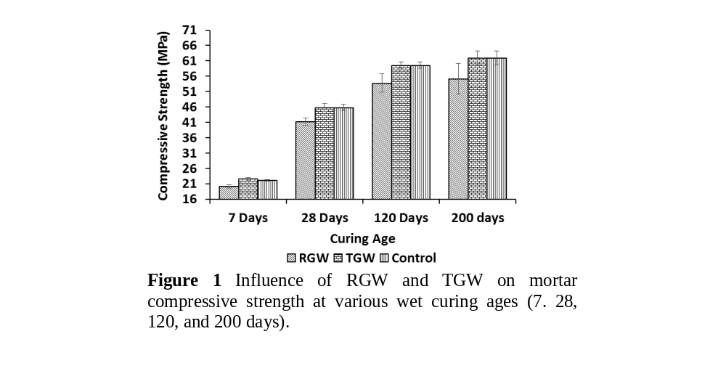
Mortar properties
-11%
ASTM C109: water is suitable for concrete if mortar made with it have comp. strength at 7 days equal or less than 10 % reduction than of control sample made with distilled water.
-9%

Slide 12
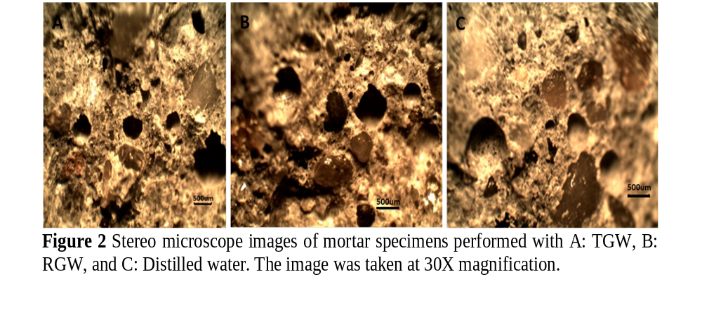
Mortar Stereomicroscope images

Slide 13
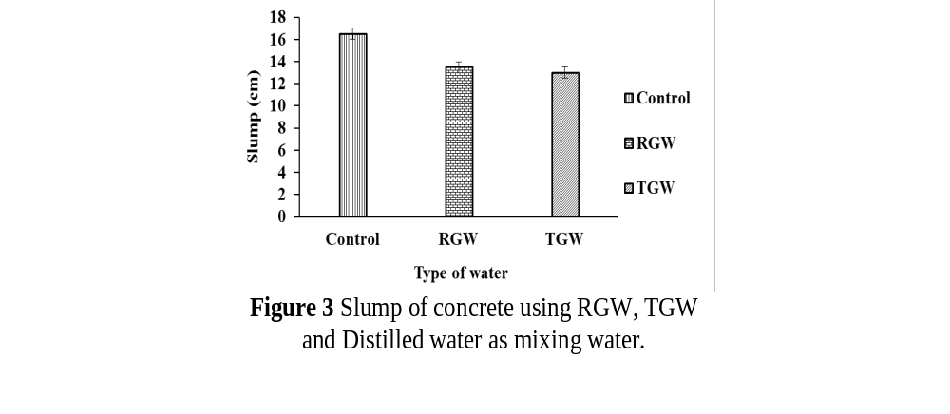
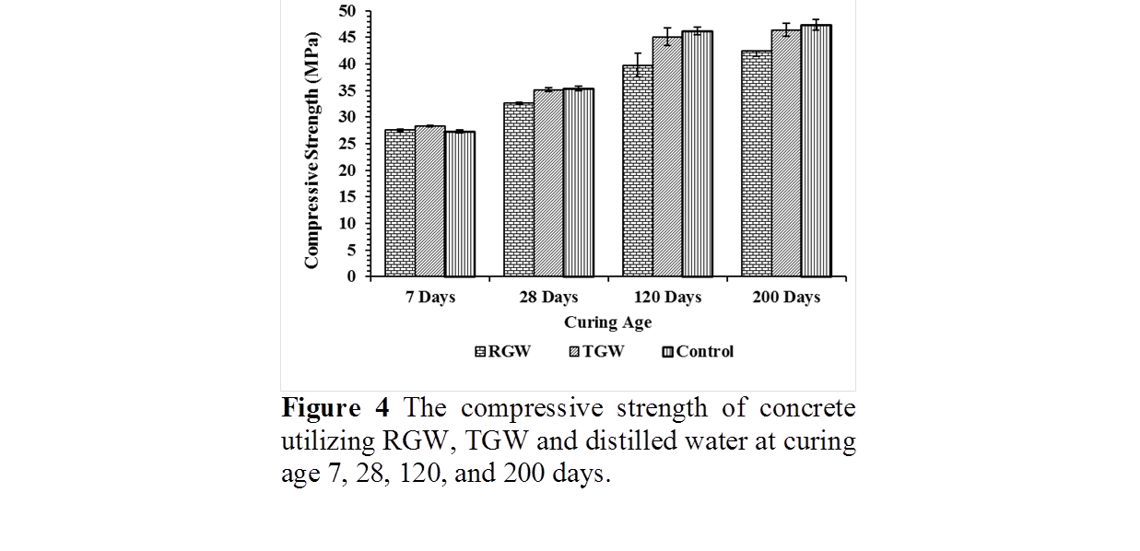
Concrete Results

Slide 14
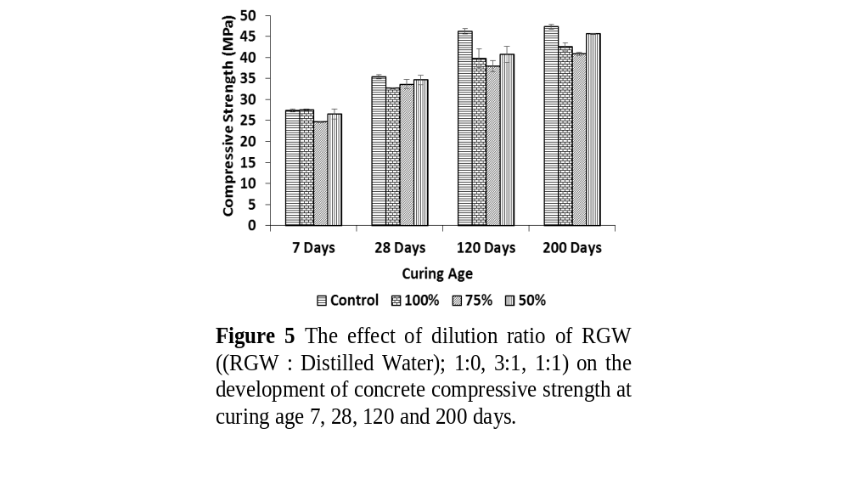
Dilution effect of RGW on concrete compressive strength

Slide 15
Conclusion
Based on of grey water quality and the Mixing water permissible limits for concrete, the TGW is suitable for concrete production. However, the RGW should be pretreated to reduce the microorganism content before the water can be in direct contact with humans.
According to ASTM C94, ASTM C109 requirements and the IS 456, TGW and RGW are suitable for concrete production.
In conclusion, TGW and RGW are a potential alternative for fresh water in concrete industry.

Slide 16
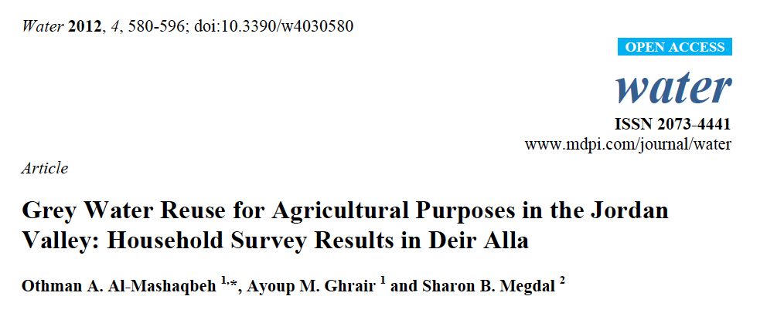
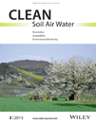
Four Scientific Papers and one Patent
1-
http://www.mdpi.com/2073-4441/4/3/580
2-
Performance of grey water pilot plant using a multi-layer filter of natural materials for agricultural purposes in the Jordan valley. Clean-Soil, Air, Water – Wiley-VCH, 43 (3), 351-359. DOI: 10.1002/clen.201300488.
Ghrair, A.M, Almashaqbeh, O., Megdal S. (2015).
http://onlinelibrary.wiley.com/doi/10.1002/clen.201300488/abstract
3-
A portable device for converting grey water to potable water | Jordan/Ministry of industry and trade/Directorate of industrial property | Patent No. 2924 | Year 2015
4-Influence of Grey water on Physical and Mechanical Properties of Mortar and Concrete Mixes. Ain shams Engineering Journal (Submitted )
5-Domestic Wastewater Reuse in Concrete Using Bench-Scale Testing and Full-Scale Implementation. Water Journal(Submitted)

Slide 17
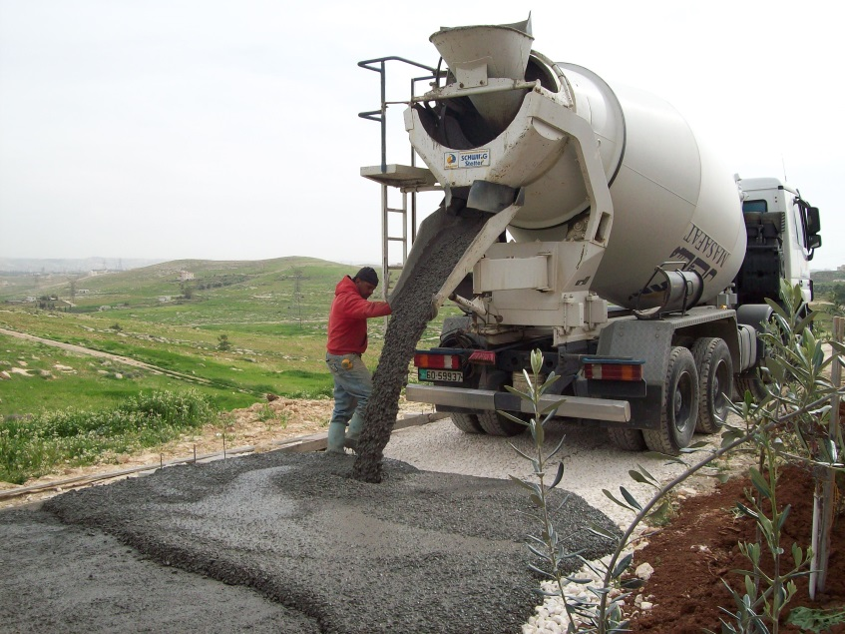

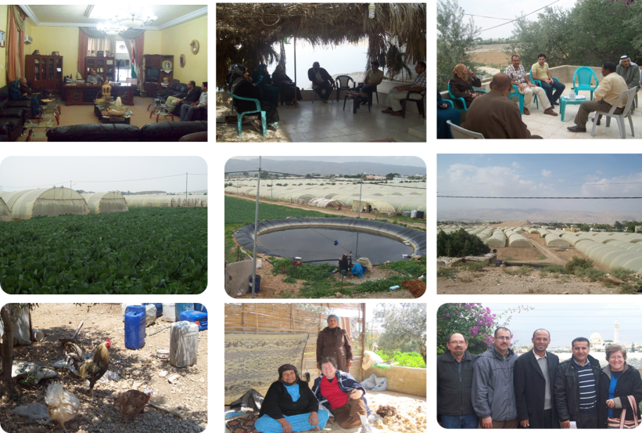
Thank you!
Acknowledgments
This study is funded by an EU funded project titled ‘Support to Research, Technological Development & Innovation in Jordan’ (SRTD – II), managed by the Higher Council for Science & Technology.

