Slide 1




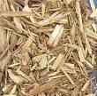

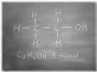
Acetic Acid Removal from Pretreated Wood Extract
University of Jeddah, Department of Chemical Engineering, Jeddah, Saudi Arabia
University of Maine, Department of Chemical and Biological Engineering, Orono, Maine 04469 USA
Dr. Aymn Abdulrahman
Monday, September 12th, 2016

Slide 2
Outline
Introduction
Motivation
Objectives
Material and Method
Procedure
Results and Conclusion
Future Work
Acknowledgment

Slide 3


INTEGRATED FOREST BIOREFINERY
Maine is a Forest state ( covers 90 % of the state)
STRATEGIC GOAL : Evolve existing pulp mills into forest biorefineries.
  Pulp, paper, and wood products
  Renewable energy
  Chemical products

Slide 4
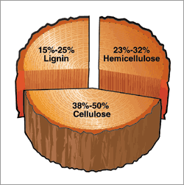
Deriving optimal value from wood components
Hemicellulose:
low strength
low energy density
Most soluble
Fermentation feedstock?
Lignin: highest energy density
Cellulose: strong fibers

Slide 5
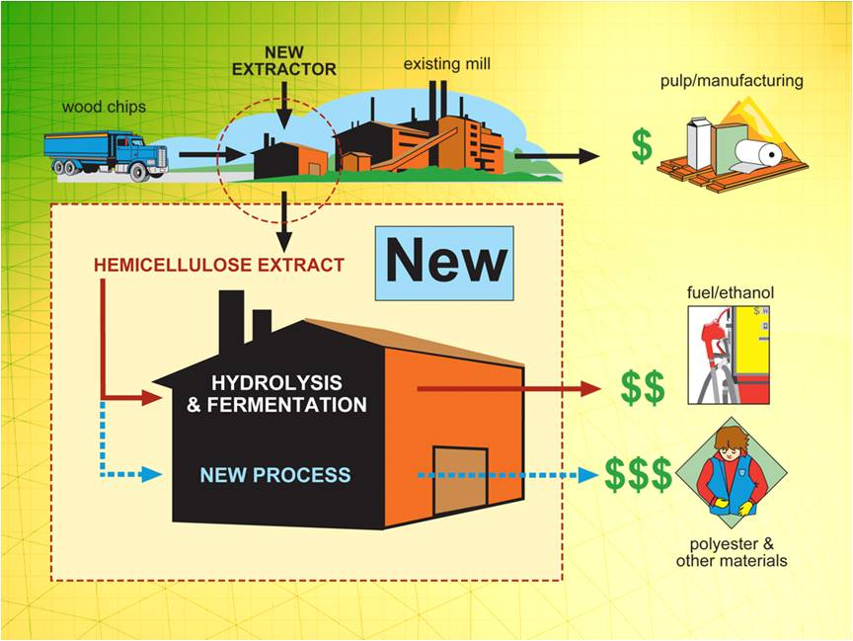
Van Heiningen Process: From Lab to Mill Floor – Success of DOE FC36-04GO14306 (2004-08)
Forest Products Industry of the Future ,Drew Ronneberg, DOE Headquarters
Notes:
5

Slide 6
Overall Pulp and Biorefinery
Wood Chips
Green Liquor
Kraft pulping process
Pulp and paper
Hot Water
Extractor
HAc
Wood chips
Sugar Concentration
water
Solvent+ HAc
Distillation
Sulfuric Acid
Acid Hydrolysis
Solvent
HAc Removal
Lignin Removal
Fermentation
Ethanol

Slide 7
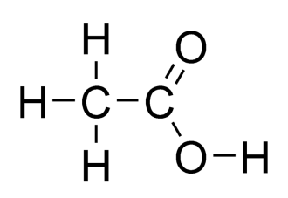
Motivation
Acetic acid is a valuable product
Acetic acid can inhibit ethanol fermentation
Acetic acid presents in extract:
GL extract : 8-9 g/L
HW extract :1-3 g/L
Acetic acid structure

Slide 8
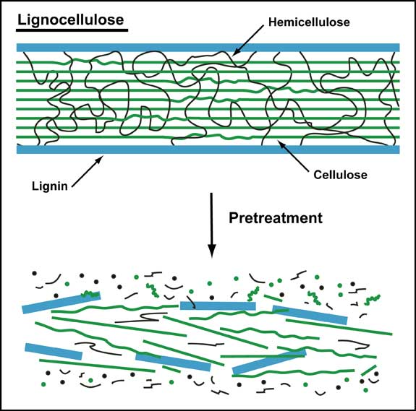
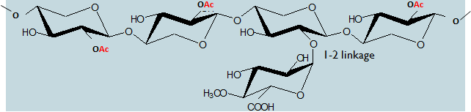


Lignocellulose Extraction
7 acetyl groups per every 10 xyloses
USDA Agricultural Research Service
http://www.biomassmagazine.com/article-print.jsp?article_id=1533

Slide 9
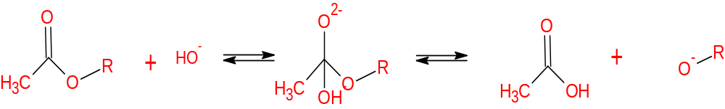
Alkaline Hydrolysis
Saponification
Apply under alkaline condition
-
Ref. (Sjostrom, 1993)

Slide 10
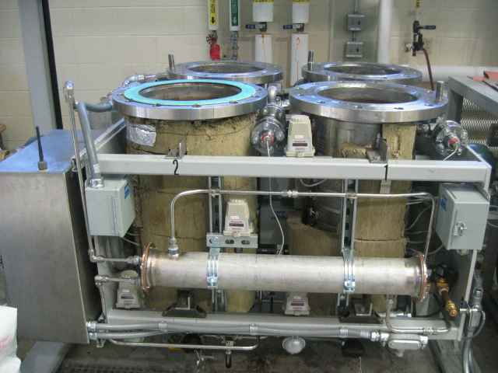
Hemicellulose Extract
Extraction :
  Using a 60 L rotating digester
  7 kg ( dry weight) of fresh chips (16mm× 22.6mm ×3mm)
  Mixing with green liquor (1.4 % of Na₂O)
  Ratio of Liquid : Wood chip=4:1
  Rotating speed (2 rpm) at 160 ◦C for 110 minutes
  Collecting the free-draining extract
Secondary Hydrolysis of Extract:
  with 4 % (w/v) H₂SO₄ for 60 min at 121°C

Slide 11
Composition of 3 % Na2O Green Liquor (GL) Extracted Northern Hardwood
Composition of Extract | GL Extract² [g/L] | GL Extract³ [g/L]
Glucose | 0.09 | 0.36
XMG¹ | 0.11 | 1.62
Arabinose | 0.02 | 0.24
Acetic Acid | 8.32 | 9.40
Total Sugars | 0.22 | 2.22
a ¹ xylose, mannose, and galactose, ³ secondary hydrolyzed with 72 % sulfuric acid, ² analyzed without secondary hydrolysis. ( By Dr. Um)

Slide 12
Objectives
Recovery of acetic acid from hemicellulose extract
Optimization of Liquid-Liquid Extraction (pH, ratio of org: aq. )
Recycling of solvent by distillation
Select between two solvents
Determine the most efficient configuration of the extraction system

Slide 13
Methods
Liquid-Liquid Extraction
  Clean System (Acetic acid in DI-water) (10 g/L)
  Hemicellulose Extract (GL extract)
Separations
  Centrifuge
  Distillation

Slide 14
Extraction Flow Diagram
Hemicellulose Extract
Volatile solvent
Solvent
HAc
Centrifuge
Liquid-Liquid Extraction
Centrifuge
Solvent
Solvent + HAc
Distillation
Pure Acetic Acid Recovery
Aqueous Phase
Solvent Recycle
Fermentation

Slide 15
Materials
Solvent
  Trioctylphosphine oxide (TOPO)
  ( [CH₃(CH₂)₇]₃PO mol wt. 386.64 )
  Undecane ( C₁₁H₂₄, mol. wt. 156.3 )
  Trioctylamine (TOA) ( [CH₃(CH₂)₇]₃N mol wt. 353.67 )
  Octanol ( CH₃(CH₂)₇OH mol wt. 130.23 )
Acetic Acid ( CH₃COOH )
Sulfuric acid ( H₂SO₄ )
Sodium Hydroxide ( 0.05 M NaOH )
( using phenolphthalein as indicator )

Slide 16
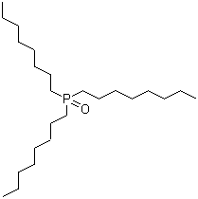
TOPO
Strong solvating extractant
Strong hydrogen bonding acceptors, induces the carboxylic acid to transfer to the extract phase
CH₃COOH + TOPO(org)↔ CH₃COOH(TOPO)org
High boiling point
Excellent chemical stability
Low solubility in water
Expensive component (dilute with undecane + recycle)
Trioctylphosphine oxide
Molecular Formula: [CH₃(CH₂)₇]₃PO
Molecular Wight : 386.64
Melting Point: 50-55 ºC
Boiling Point: 201-202 ºC

Slide 17
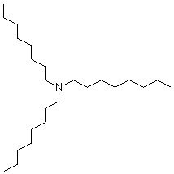
TOA
Strong solvating extractant
CH₃COOH + TOA(org)↔ CH₃COOH(TOA)org
High boiling point
Low solubility in water
Less expensive component
Trioctyl amine
Molecular Formula: [CH₃(CH₂)₇]₃N
Molecular Wight : 353.67
Melting Point: -40 ºC
Boiling Point: 365 – 367 ºC

Slide 18
Analysis
Aqueous phase
  High Performance Liquid Chromatography (HPLC) (Bio-Rad Aminex HPX-87H Column)
Organic phase
  Gas Chromatography (GC) with He as carrier gas and FID
  Titration with standardized 0.05 M NaOH solution
pH meter

Slide 19
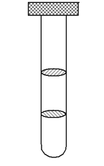
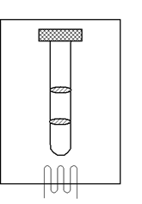
L-L Extraction Procedure
For Small Scale
Water Bath
Load
Sample:
C11 +TOPO (10mL:10mL)
Analysis
vigorous shaking for 30 seconds
70 ° C
Centrifuge
(9000 rpm, 20 minutes)
Residence time is 60 minutes

Slide 20
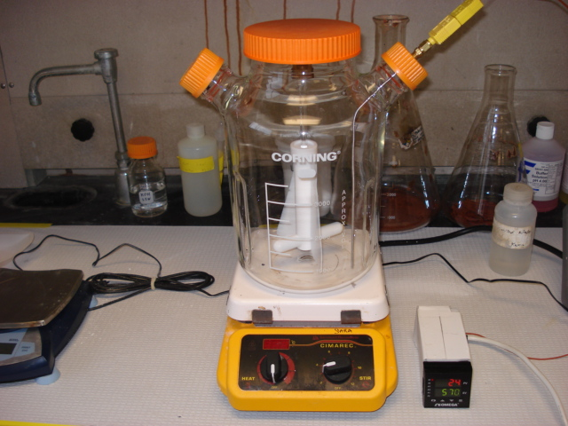
For 2 L Working Volume (1L org: 1L aqu)
Load
Sample:
C11 +TOPO (1 L:1 L)
Centrifuge
Analysis
For 60 min
Mixing and heating at 70 °C for 60 min

Slide 21
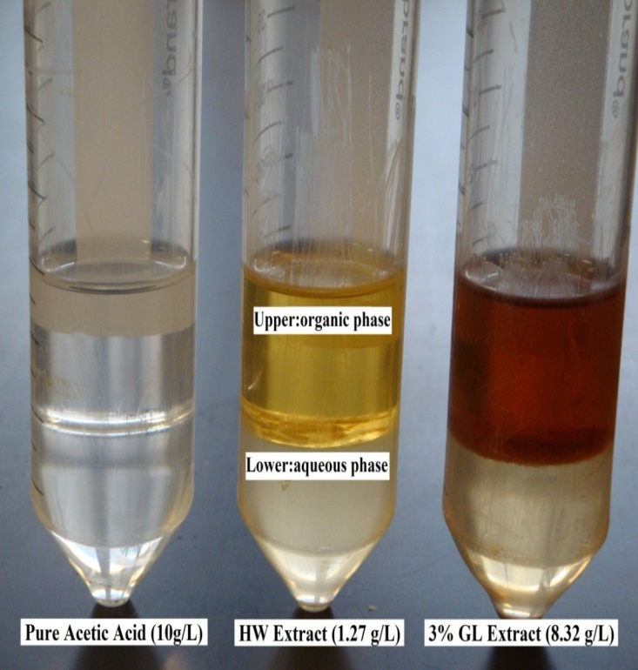
Two Phases Separation
* Phase separation after TOPO-undecane extraction at 70 ° C and pH=1
* (Byung-Hwan Um, 2008)

Slide 22
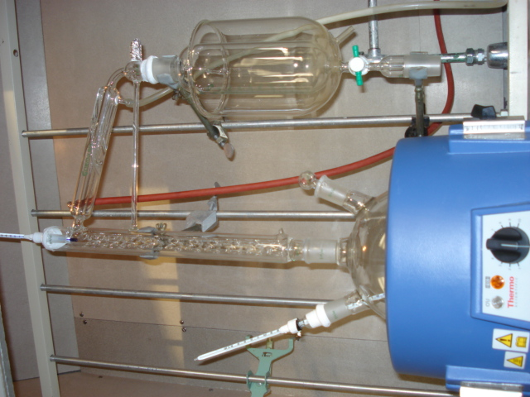
Distillation
Separate acetic acid from TOPO/C11
C11 returned to boiling flask
HAC determined by GC and Titration

Slide 23
Results
Comparing two solvents:
Extraction conditions + efficiency
Compatibility with green liquor Extract
Recyclability
Washing Solvent

Slide 24
TOA
Note: For Clean System
Initial concentration of pure acetic acid solution= 10 g/L, at 70 °C, Ratio [1:1]

Slide 25
Note: - This is for clean system
- Initial concentration of pure acetic acid solution= 10 g/L , at 70 °C

Slide 26
Note: - This is for clean system
- Initial concentration of pure acetic acid solution= 10 g/L , at 70 °C , Ratio [1:1]

Slide 27
Note: Extraction for Clean system, initial concentration of pure acetic acid solution= 10 g/L, 370 g/L for TOPO, 200 g/L for TOA, volume ratio of organic:aqueous phases[1:1]

Slide 28
Note: Initial aqueous acetic acid concentration is 10 g/L for clean system and 8.7 g/L for green liquor, 370 g/L TOPO/undecane, 70 °C , 1:1 ratio and pH is 1

Slide 30
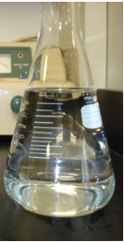
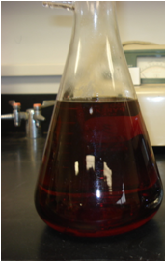
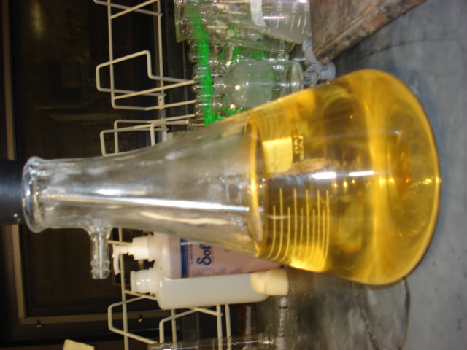
Organic Washing by NaOH
Org. before extraction
Org. after extraction
Org. after washing by 1 M NaOH

Slide 31
Note: This is for green liquor extract system with 8.7 g/L initial acetic acid concentration, using 370 g/L of TOPO/Undecane, 1 pH, volume ratio organic:aqueous: 1

Slide 32
Note: CS; clean system
GL; green liquor extract system
Initial aqueous acetic acid concentration is 10 g/L for clean system and 8.7 g/L for green liquor
The extraction conditions were 1 pH, 1 ratio and at 70 °C
Using 370 g/L TOPO/undecane, 200 g/L TOA/Octanol

Slide 33
Comparison between TOPO & TOA
 | TOPO | TOA
Solvent concentration in organic | 370 g/L | 200 g/L
pH | 3 or lower | 2-4
Ratio | 1:1 | 1.5:1
Clean system | 64% | 91%
Green liquor | 62% | 41%
Handling | Hard at room temp. | Easy at room temp.
Cost | Expensive | Less expensive
Recyclability | Stable | Deteriorates

Slide 34
Conclusions
Liquid-liquid extraction recovered acetic acid from two systems:
  Clean system ( acetic acid in D-water )
  Hemicellulose extract ( green liquor extract )
Compared two solvents:
  TOPO in Undecane
  TOA in Octanol
Best extraction conditions have been determined for TOPO and TOA extraction system (extractant concentration, Ratio. pH)
TOPO shows better recyclability than TOA
Acetic acid may be a viable co-product for a kraft pulp mill

Slide 35
Future Work
TOA separation by distillation
Analysis of organics in aqueous phase
Scale up to pilot scale

Slide 36
Acknowledgment
University of Jeddah
Dr. G. Peter van Walsum
Thesis Committee members (Dr. van Heiningen and Dr. Wheeler)
Dr. Byung-Hwan Um & Audrey Polifka
Dr. Martin Lawoko & Dr. Sara Walton

